Slide 1
Des Moines Area MPO UPdates
Iowa DOT Commission
June 2025

Slide 2
Future 435

Slide 3
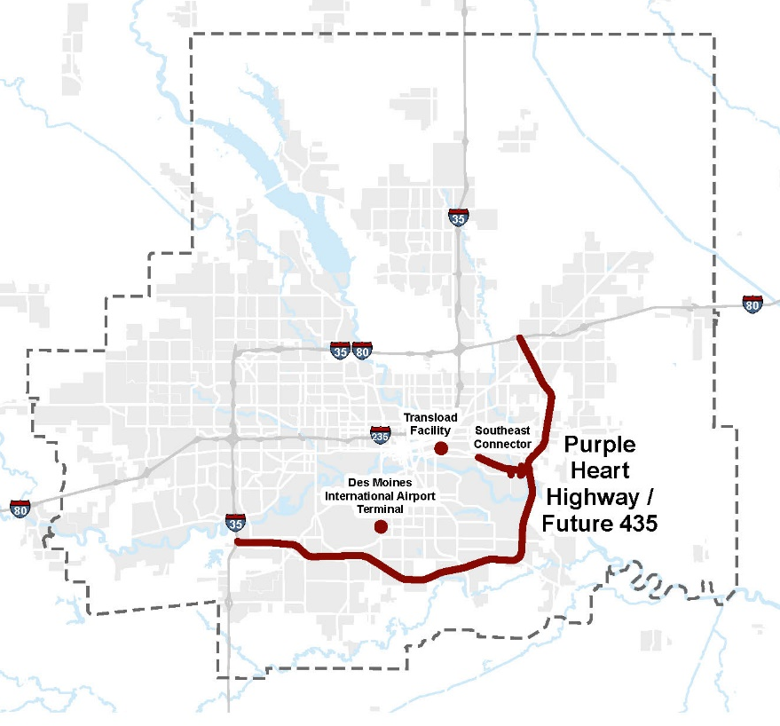
Thank you!
The Iowa DOT has played a critical role in the effort to designate the Highway 5/65 bypass as an interstate.
However, a “standard” interstate designation would trigger two laws.
  STATE: Minimum speed (40 mph)
  FEDERAL: Maximum weight (80,000 lbs.)
These limits would be problematic to existing user groups, both in ag sector.
  Farmers moving equipment across river (slow moving vehicles)
  Use corridor to haul product for processing (96,000 lbs. on seven axles)

Slide 4
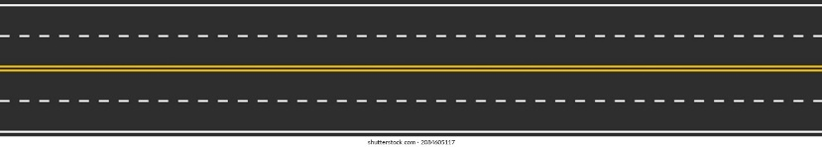
Recap of Future 435 Effort
2002
Bypass opens
2013
Previous designation attempt fails
2020
Iowa DOT starts listening tour
2022
Iowa DOT releases Action Plan for MPO / Partnership to execute
2023
MPO proposes Alternatives Analysis
2024
First bill falls short in state legislature
2025
Bill passes state legislature
Iowa DOT Action Plan
1. State Exemption for Speed…………………………2024-2025
2. Federal Exemption for Weight……………………………………2025-2026?
3. Technical Analysis………………………………………………………………………………….…???
4. Designation Application……………………………………………………………………………………….????

Slide 5
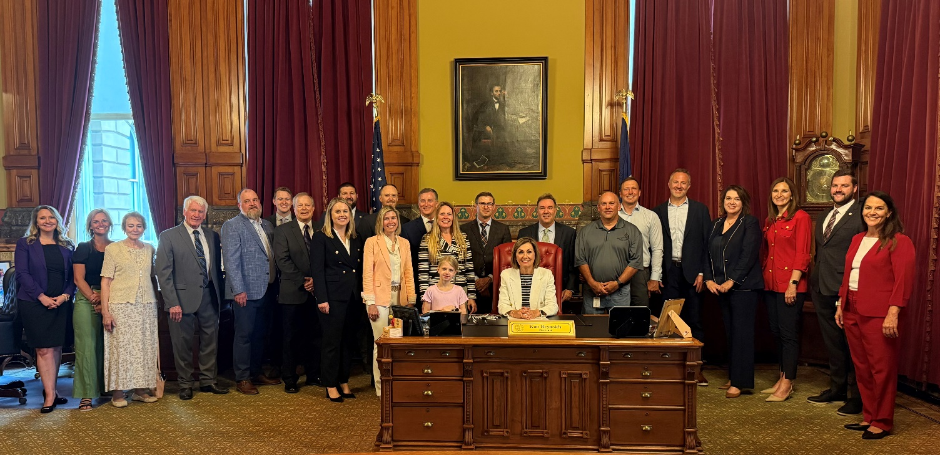
2025 IOWA LEGISLATURE: Bill Passed
Bill passed House 90-2 and the Senate 50-0.
Signed by Governor Reynolds on May 27

Slide 6
FEDERAL WEIGHT EXEMTION
Thanks to Iowa DOT for drafting proposed federal exemption language and submitting to congressional delegation for proposed including in the surface transportation reauthorization bill.
Proposed language:
(u) Operation of Vehicles on Certain Iowa Highways.—If any segment of Iowa State Route 5 in Iowa from the interchange with Interstate Route 35 to the interchange with United States Route 65, or United States Route 65 in Iowa from the interchange with Iowa State Route 5 and United States Route 69 to the interchange with Interstate Route 80, is designated as part of the Interstate System, no limit established under this section may apply to that segment with respect to the operation of any vehicle that could have legally operated on that segment before such designation.

Slide 7
Safe streets for all grant application development

Slide 8
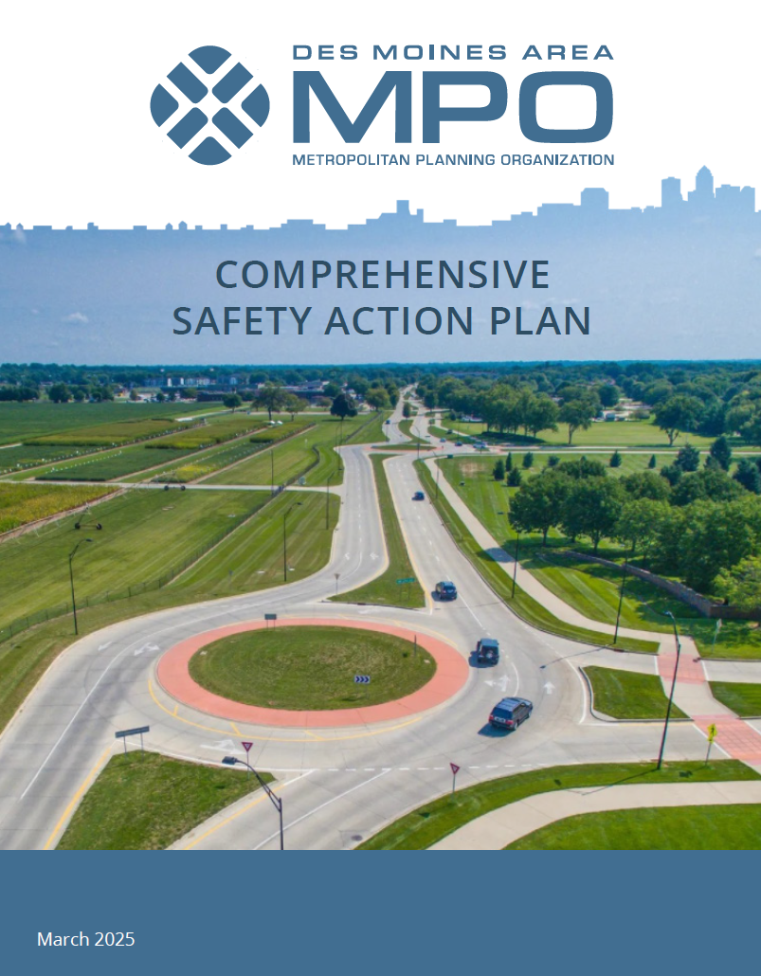
Comprehensive Safety Action Plan
REGIONAL PLAN
Developed with SS4A Grant funding
Adopted in March 2025
Goal: Zero fatalities or series injuries by 2045
REGIONAL GRANT APPLICATION
Due June 26th
Up to $580M available
$2.5M to $25M awards
40 to 70 implementation grants
1 to 5 years period of performance

Slide 9
Overview of Regional Application
Project Type | Count | Total Cost | Federal Share | Match | Percent of Project
Construction | 10 | $24,500,000 | $19,600,000 | $4,900,000 | 79%
Study | 4 | $6,000,000 | $4,800,000 | $1,200,000 | 19%
Education | 2 | $350,000 | $280,000 | $70,000 | 1%
Total | 17 | $30,350,000 | $24,280,000 | $6,070,000
Construction Projects: Communities would be subrecipients
Communities would be responsible for design, construction, and assist MPO with reporting needs.
Studies & Education: MPO would lead
MPO would lead procurement of consultants to complete components work with communities to select firms.
Thank You: Iowa DOT involvement
Several of the proposed projects are on Iowa DOT facilities inside MPO member jurisdictions.

Slide 10
Member Community Projects
Member Community | Project | Project Description | Type | Total Cost | Fed Share | Match
Altoona | Hubbell Ave & Adventureland Dr | Intersection Safety Feasibility Study | Study | $500,000 | $400,000 | $100,000
Ankeny | Oralabor Rd & Ankeny Blvd | Trail Underpass | Construction | $2,000,000 | $1,600,000 | $400,000
Clive/Urbandale | 86th Street | Pedestrian Enhancements | Construction | $1,000,000 | $800,000 | $200,000
Des Moines | SW 9th St | Intersection Enhancements | Construction | $3,000,000 | $2,400,000 | $600,000
Grimes | IA 44 | Roundabout | Construction | $3,000,000 | $2,400,000 | $600,000
Johnston | Pedestrian Crossings | 2 HAWK, I Intersection Enhancement | Construction | $1,000,000 | $800,000 | $200,000
Norwalk | Sunset Dr | Pedestrian Enhancements | Construction | $2,000,000 | $1,600,000 | $400,000
Waukee | NW 10th St | Trail Underpass | Construction | $3,000,000 | $2,400,000 | $600,000
West Des Moines/Clive | University Ave | Corridor Safety Feasibility Study | Study | $500,000 | $400,000 | $100,000
West Des Moines | Ashworth Rd | Corridor Safety Improvements | Construction | $3,000,000 | $2,400,000 | $600,000
Windsor Heights | 73rd Street | Pedestrian Enhancements | Construction | $500,000 | $400,000 | $100,000

Slide 11
Regional Components
Member Community | Project | Type | Total Cost | Fed Share | Match
Regional | Low-Cost Countermeasures Projects | Construction | $6,000,000 | $4,800,000 | $1,200,000
Regional | Roadway Safety Audits | Study | $4,000,000 | $3,200,000 | $800,000
Regional | Speed Study | Study | $500,000 | $400,000 | $100,000
Regional | TIM Training | Education | $100,000 | $80,000 | $20,000
Regional | Education & Policy Enhancements | Education | $250,000 | $200,000 | $50,000
MPO will identify one subrecipient to lead design and construction of Regional Low-Cost Countermeasures Projects.
MPO will procure on-call consultants to complete Roadway Safety Audits.
MPO will procure one consultant to complete a Speed Study.
MPO will lead TIM Training and Education & Policy Enhancement efforts.

Slide 12



THANK YOU
Dylan Mullenix, AICP
Executive Director
dmullenix@dmampo.org
Altoona • Ankeny • Bondurant • Carlisle • Clive • Dallas County • Des Moines • DART • Grimes
^{Johnston • Mitchellville} Norwalk • Pleasant Hill • Polk City • Polk County • Urbandale •
Warren County • Waukee • West Des Moines • Windsor Heights

