Slide 1
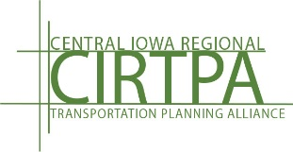
Iowa Transportation Commission
Central Iowa Regional Transportation Planning Alliance (CIRTPA)/RPA-11
June 10, 2025

Slide 2
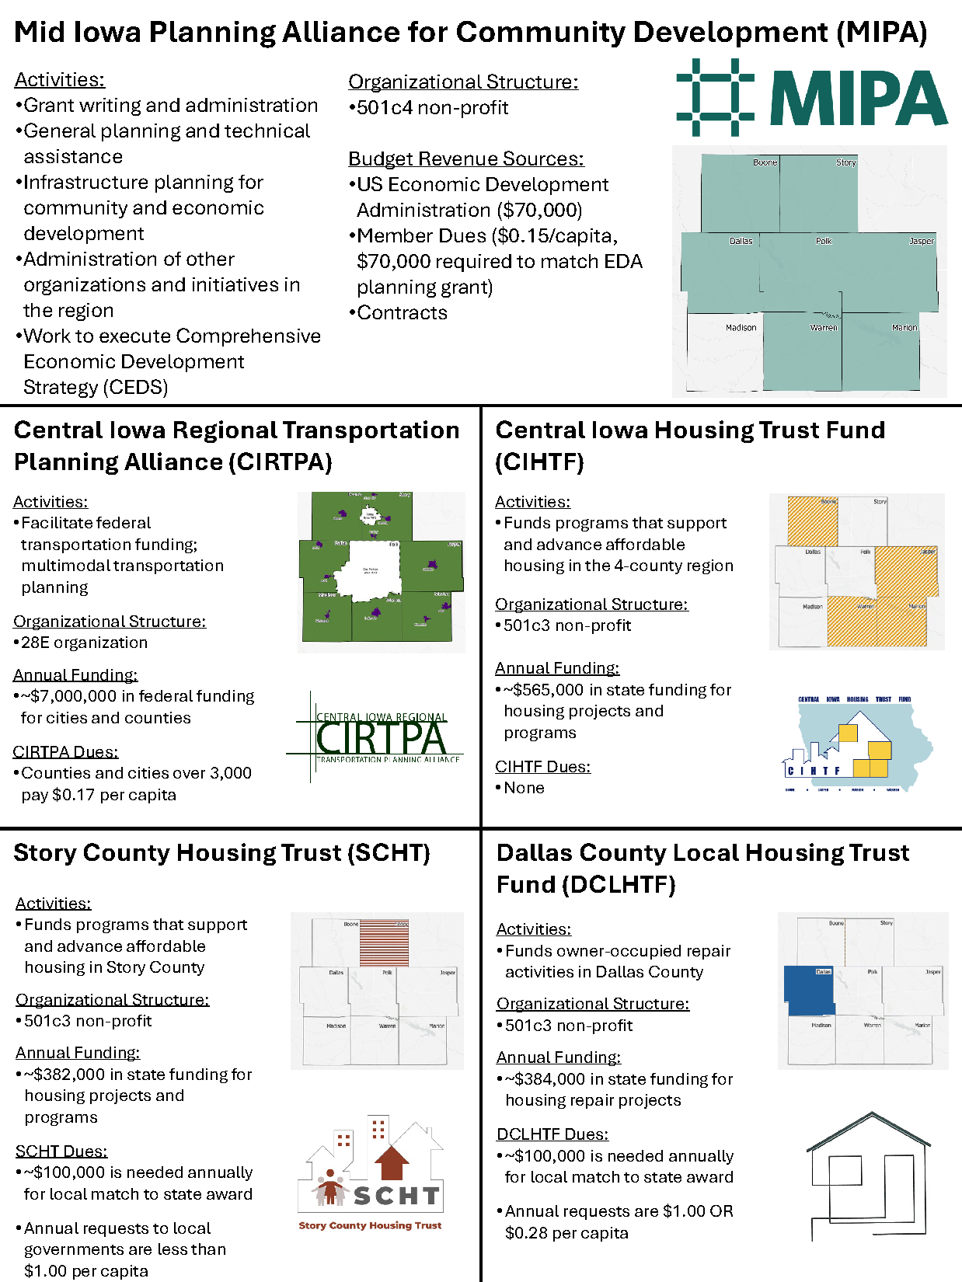
Mid-Iowa Planning Alliance for Community Development
MIPA is the designated Economic Development District (EDD) and serves as the Council of Governments (COG) for Central Iowa
MIPA works on behalf of and coordinates with its member governments (cities and counties) to implement infrastructure projects (vertical and horizontal) by facilitating federal, state, and local funding
MIPA is the administrator of several stand-along organizations (see right) to ensure community development, transportation, and housing funding and activities are available to communities

Slide 3
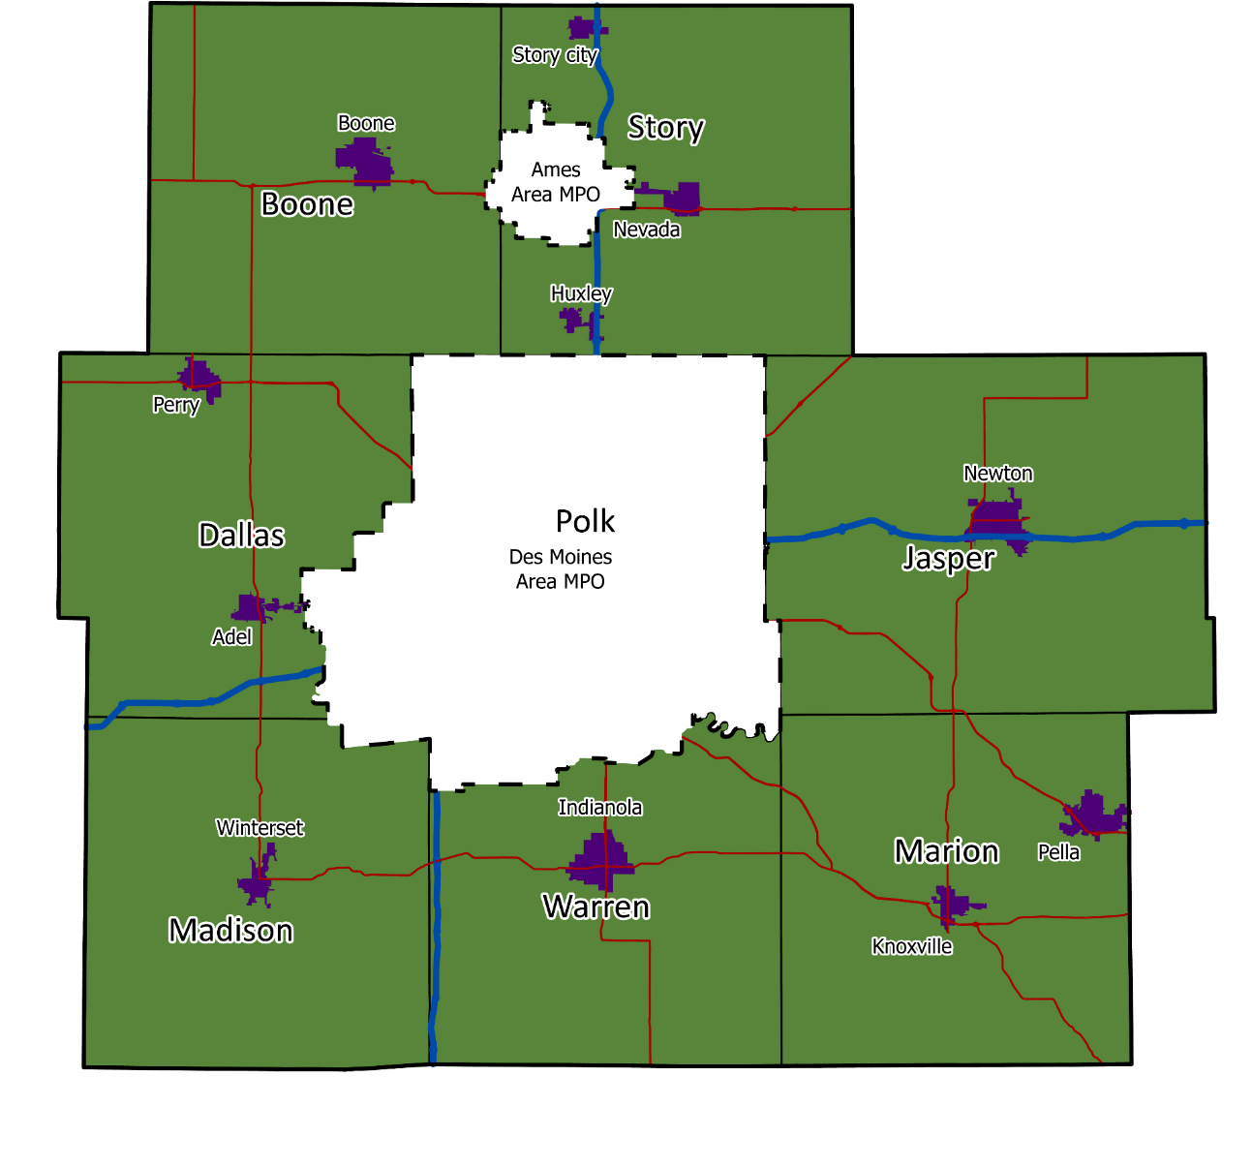










Central Iowa Regional Transportation Planning Alliance (RPA-11) - Overview
The Central Iowa Regional Transportation Planning Alliance is the Regional Planning Affiliation (RPA-11) for the 7 counties surrounding Polk County
RPAs must follow the same regulations and have the same functions as MPOs, but for less populated rural areas
CIRTPA coordinates with communities, other MPOs, the Iowa DOT, and other stakeholders on a variety of transportation activities and projects

Slide 4
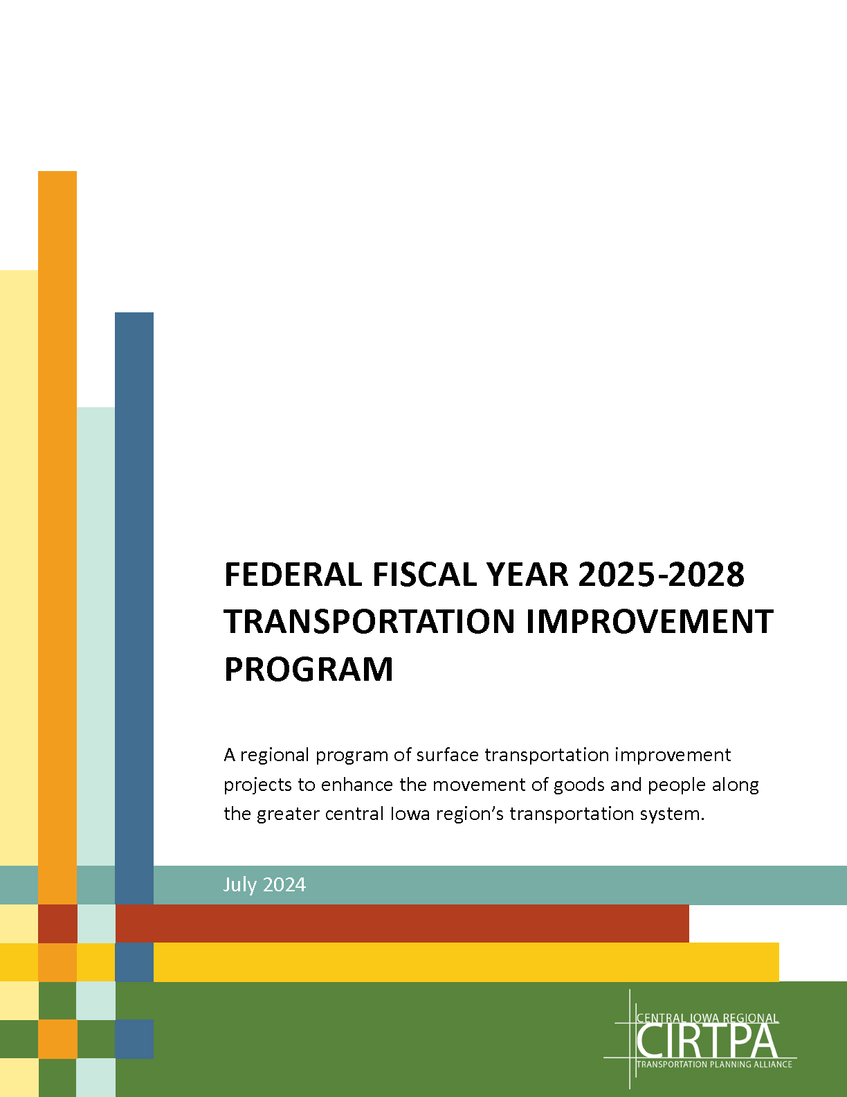
Central Iowa Regional Transportation Planning Alliance (RPA-11) – FFY 2020-2024 Funding Expenditures
FFY 2020-2024 - STBG $5.9 Million average annual allocation
  $29,000,918 in road, bridge, and capital expenditures
  32 projects
  Average of $5.8 Million in spending per year
FFY 2020-2024 - TAP $417k average annual allocation
  $2,737,461 in trail and other non-motorized transportation expenditures
  13 projects
  Average of $548k in spending per year

Slide 5
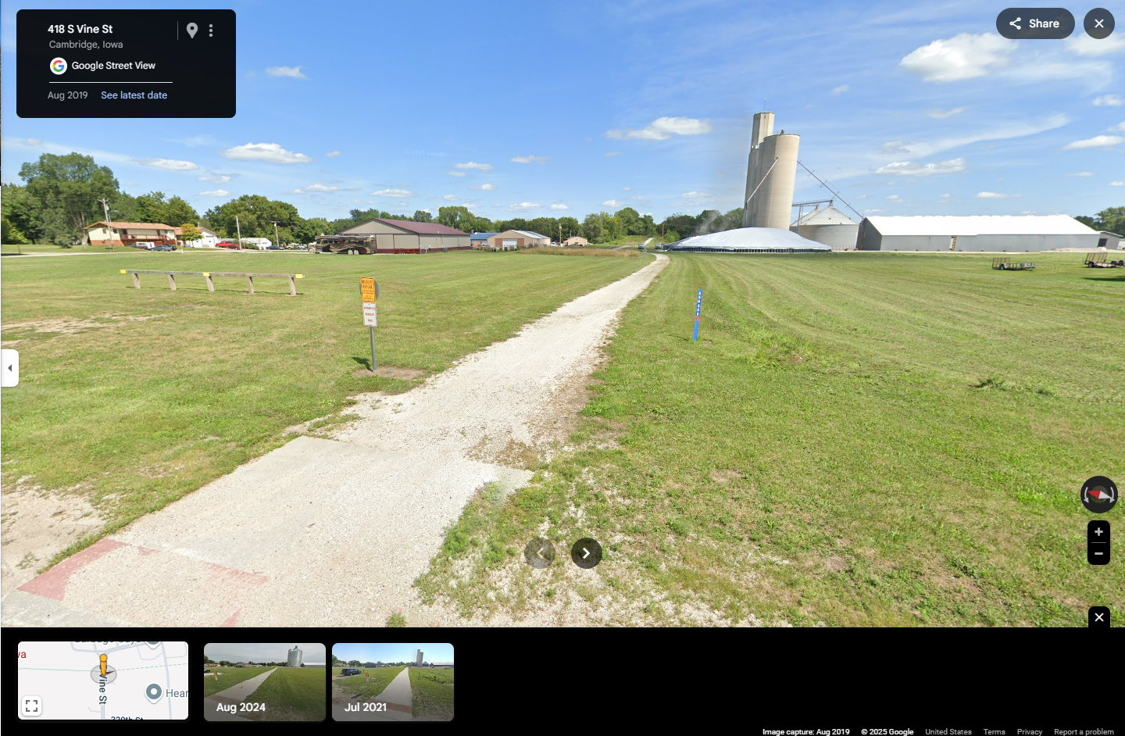
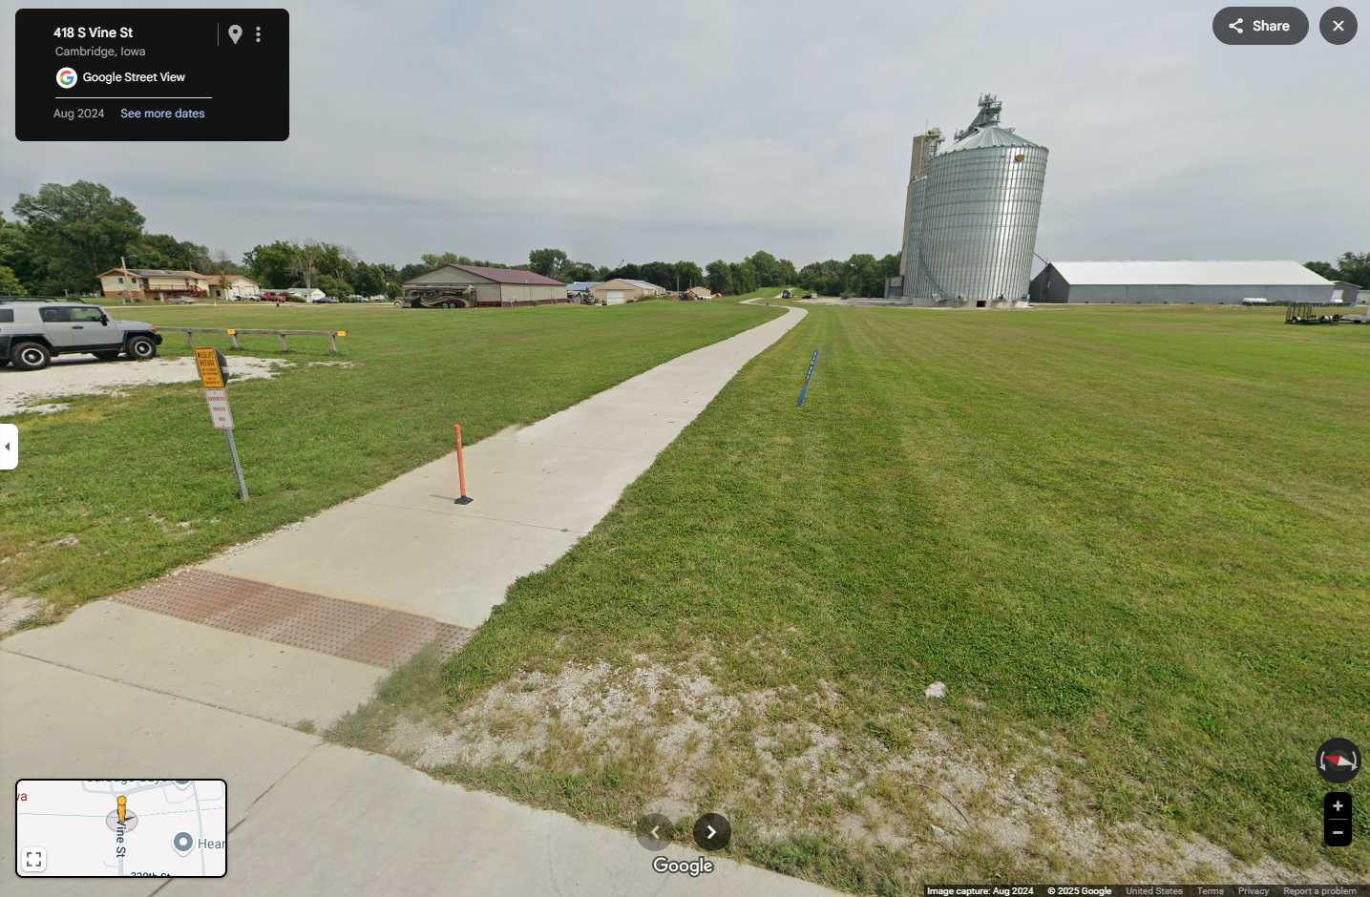
Central Iowa Regional Transportation Planning Alliance (RPA-11) – Funded Projects
FFY 2020 Story County Conservation – Heart of Iowa Nature Trail Paving
  $1,077,000 Total Funding
  $200,000 TAP
After
Before

Slide 6
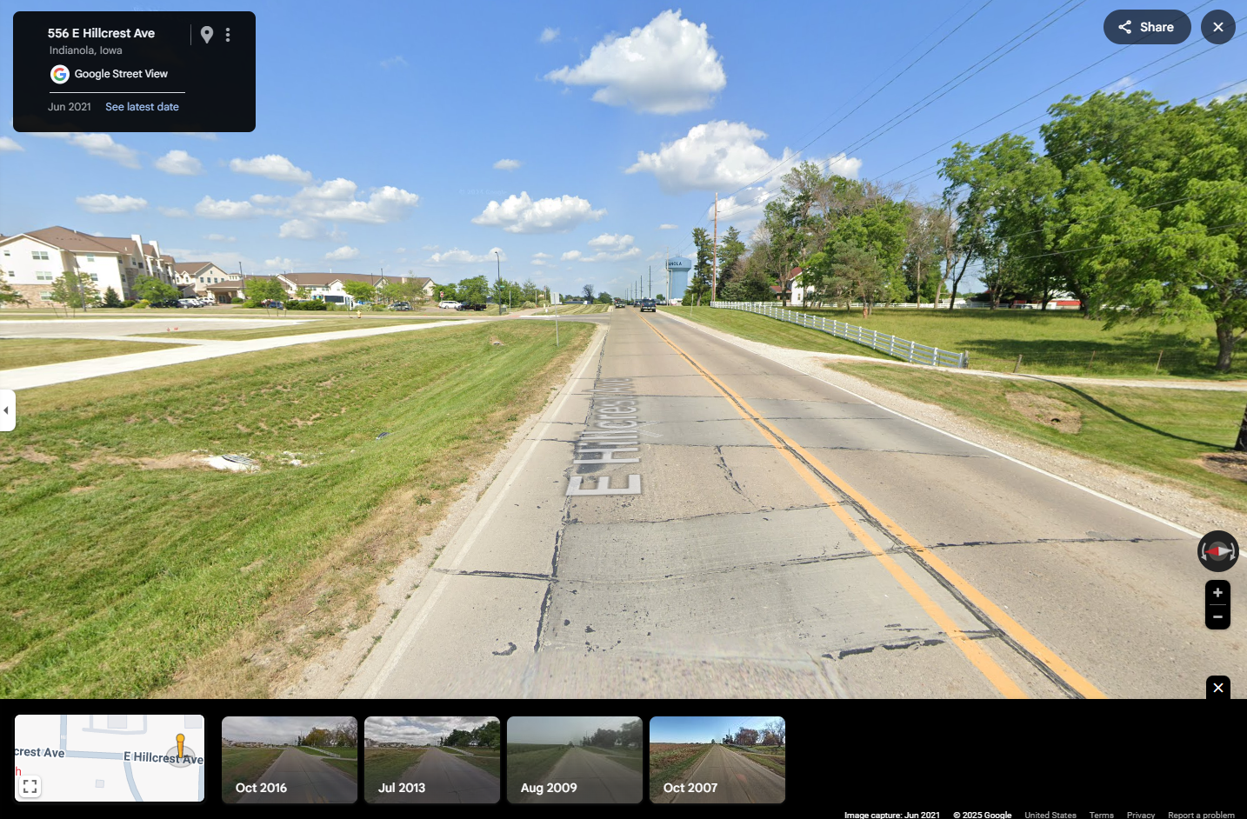
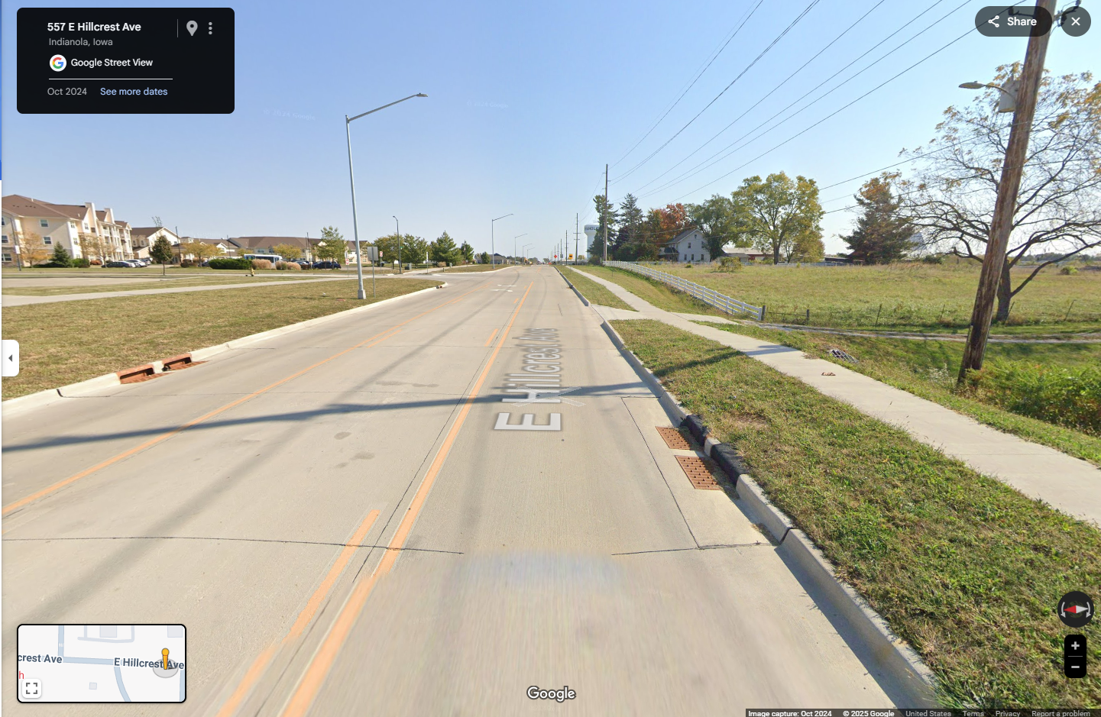
Central Iowa Regional Transportation Planning Alliance (RPA-11) – Funded Projects
FFY 2023 City of Indianola – East Hillcrest Avenue Reconstruction
  $6,180,000 Total Funding
  $3,800,000 SWAP-STBG
After
Before

Slide 7
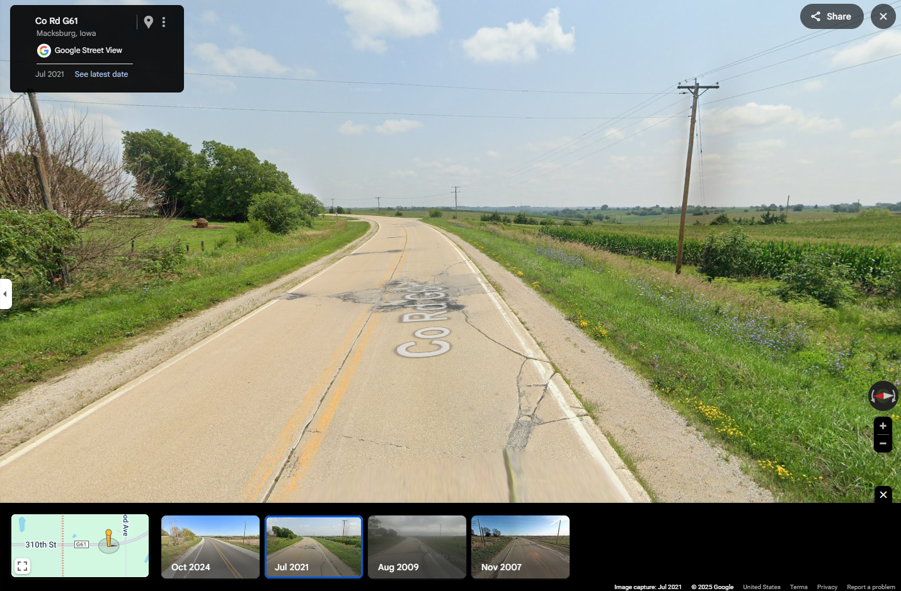
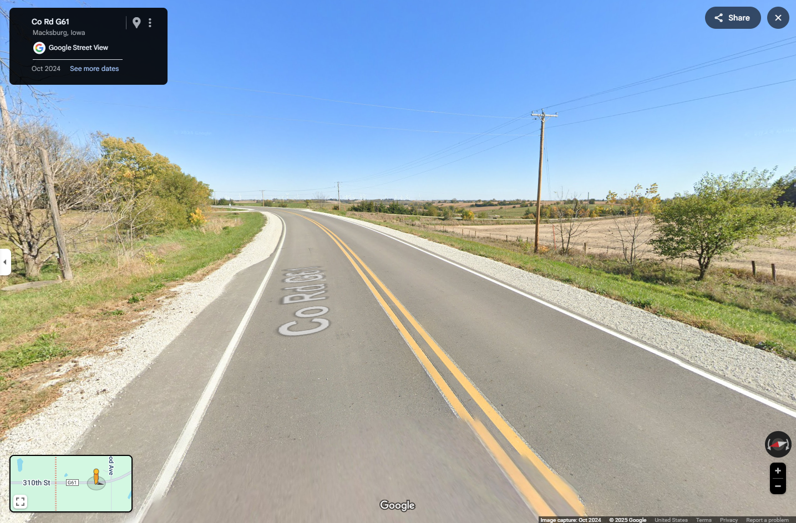
Central Iowa Regional Transportation Planning Alliance (RPA-11) – Funded Projects
FFY 2023 Madison County – G61 Pavement Rehabilitation
  $2,500,000 Total Funding
  $2,000,000 STBG
After
Before

Slide 8
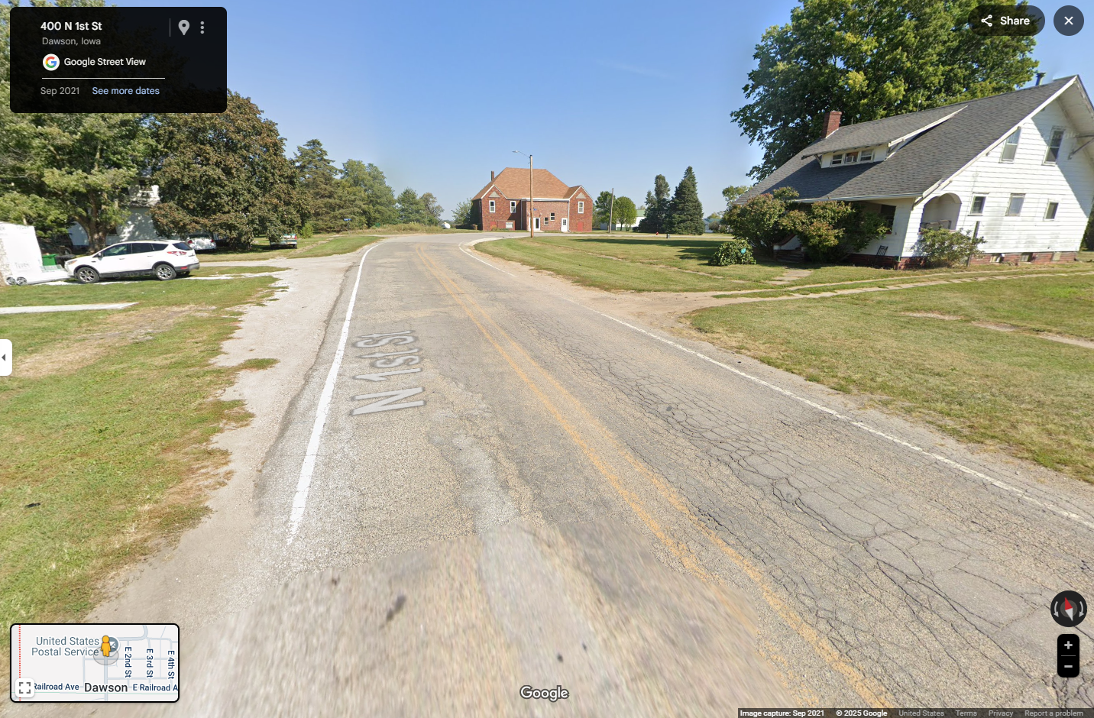
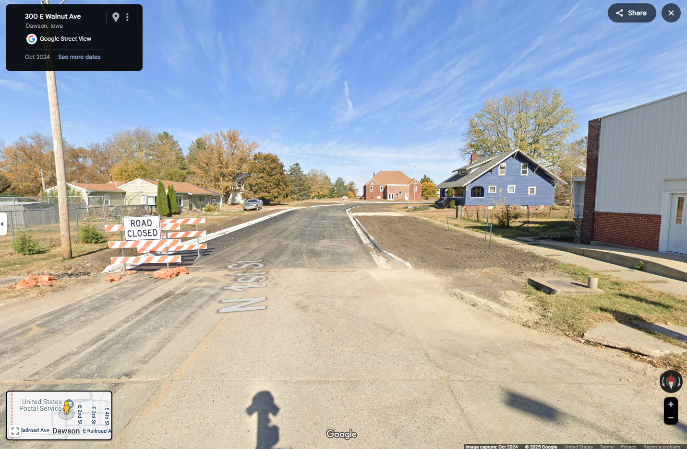
Central Iowa Regional Transportation Planning Alliance (RPA-11) – Funded Projects
FFY 2024 City of Dawson/Dallas County – P46 Pavement Rehabilitation and Widening Project
  $2,000,000 Total Funding
  $240,000 SWAP-STBG
After
Before

Slide 9
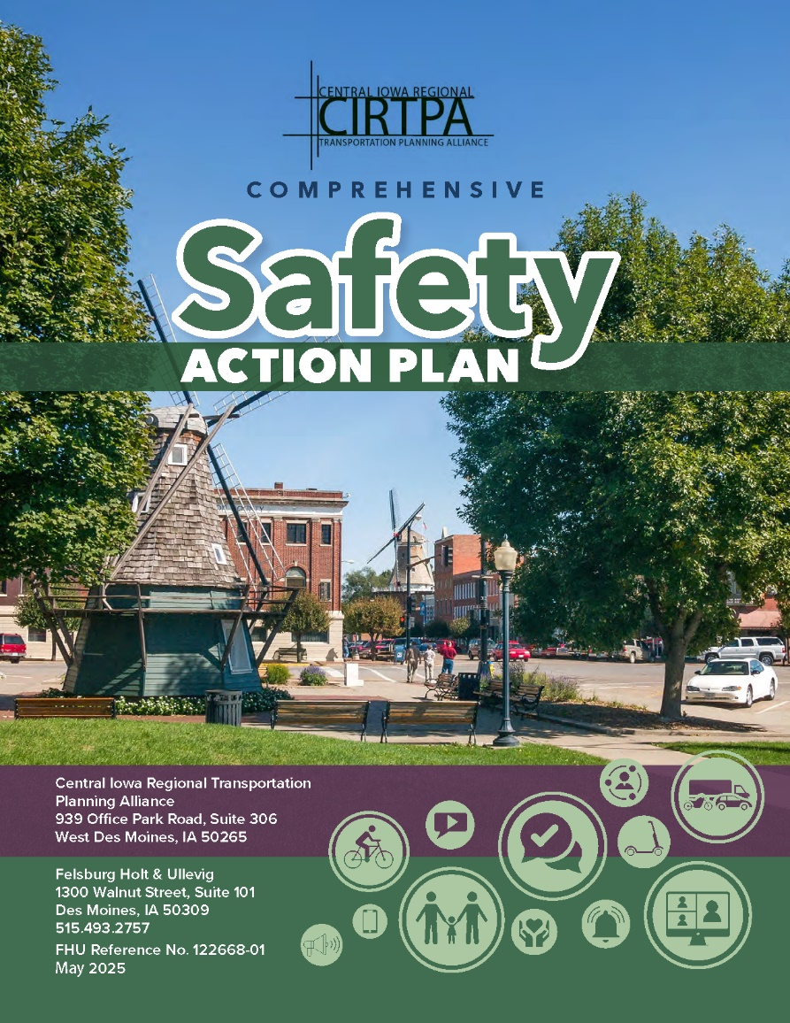
Central Iowa Regional Transportation Planning Alliance (RPA-11) – Comprehensive Safety Action Plan
CIRTPA received a $200k Safe Streets for All (SS4A) Planning Grant in 2023 to create a Safety Action Plan for the cities of CIRTPA
  Plan was adopted in May
Preparing for an estimated $20 Million application for an SS4A Implementation Grant due in June
  City of Adel – Center Turn Lane on IA 92
  City of Nevada – Two to Three Lane Conversion on Washington St
  City of Newton – E 8th Street Reconstruction
  City of Pella – Two to Three Lane Conversions on Washington St

Slide 10
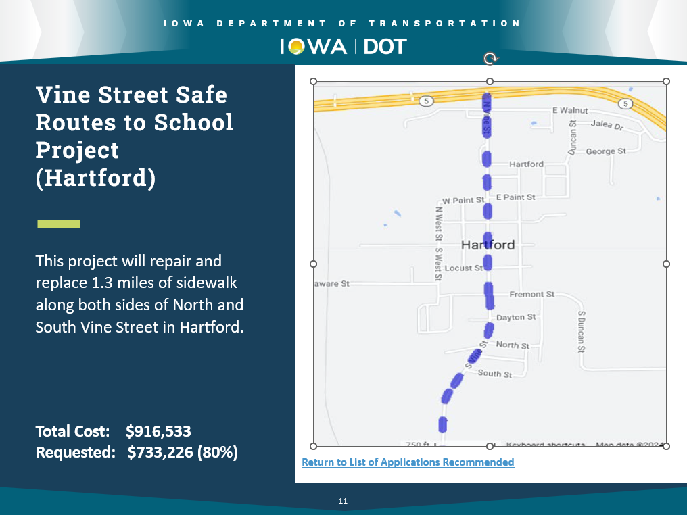
Central Iowa Regional Transportation Planning Alliance (RPA-11) – Other Projects
CIRTPA pays for InTrans pavement data collection every 4 years to support communities’ use of Pavement Management Programming. Staff also prepares Pavement Management Plans for requesting communities
Supports grant applications for CIRTPA communities
  Safe Routes to School application for the City of Hartford – Approved for FFY 2026 funding
Other transportation related projects as requested

Slide 11
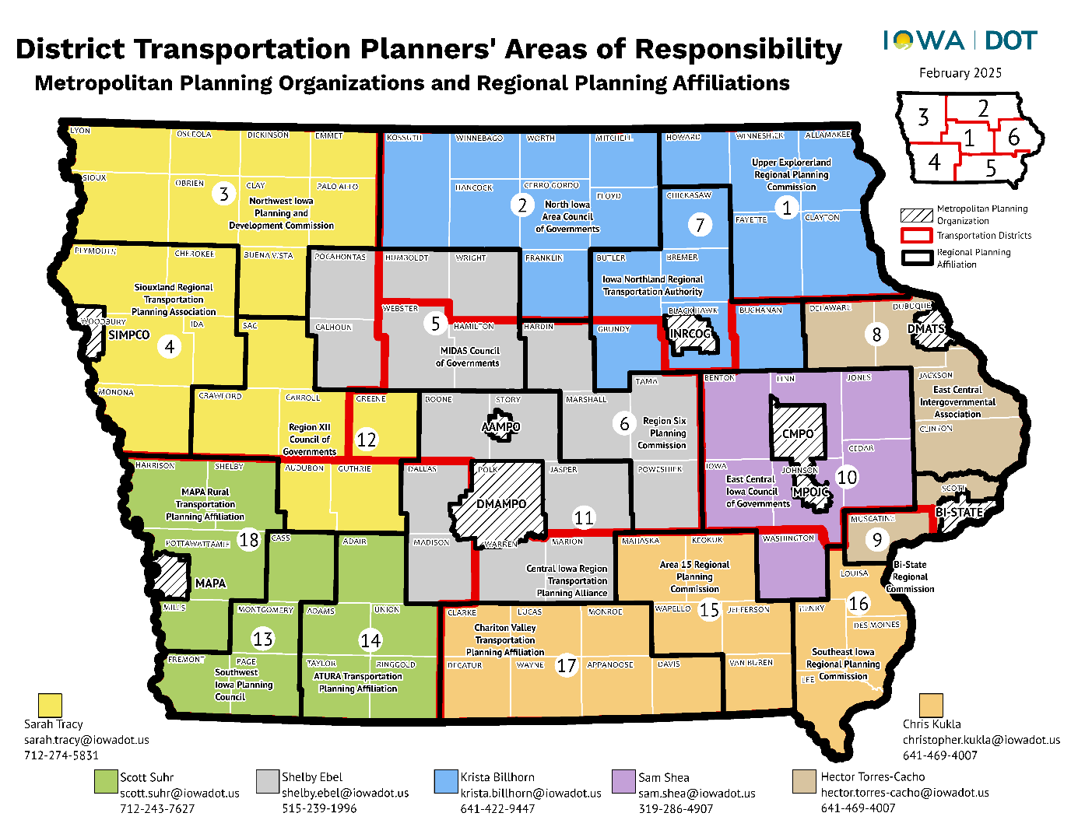
Thank You!
Thank you for the support of MPOs and RPAs across the State
Local communities making local decisions on how funding is allocated to best improve the performance of the surface transportation system
CIRTPA serves over 200,000 rural Iowans and looks forward to continuing to serve as a conduit for transportation coordination, funding, and advocacy

Slide 12
Thank You!
Andrew Collings – Executive Director
Mid-Iowa Planning Alliance/Central Iowa Regional Transportation Planning Alliance
P: 515-304-3524
E: acollings@midiowaplanning.org

