Slide 1
Ankeny Regional Airport
Polk County Aviation Authority
Paul Moritz, PE
Airport Board Manager

Slide 2
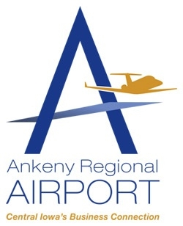
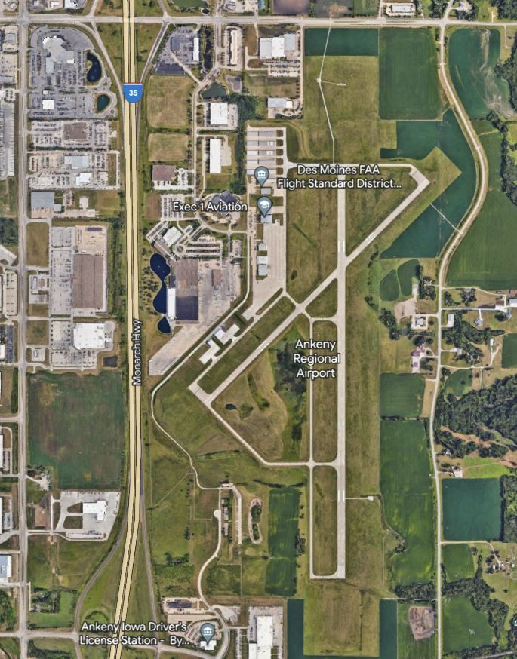
Polk County Aviation Authority – 5 Board Members from Polk County and Ankeny
Within Ankeny City Limits, adjacent to Interstate 35 and SE Oralabor Road
Initial Construction in early 1990’s, numerous expansion projects
Designated Reliever Airport for Des Moines International
Ankeny: Current Population = 74,600, 18th Best City Nationwide
Busiest General Aviation Airport in Iowa
Administration by City of Ankeny Staff
On-Site Management – Exec 1 Aviation

Slide 3
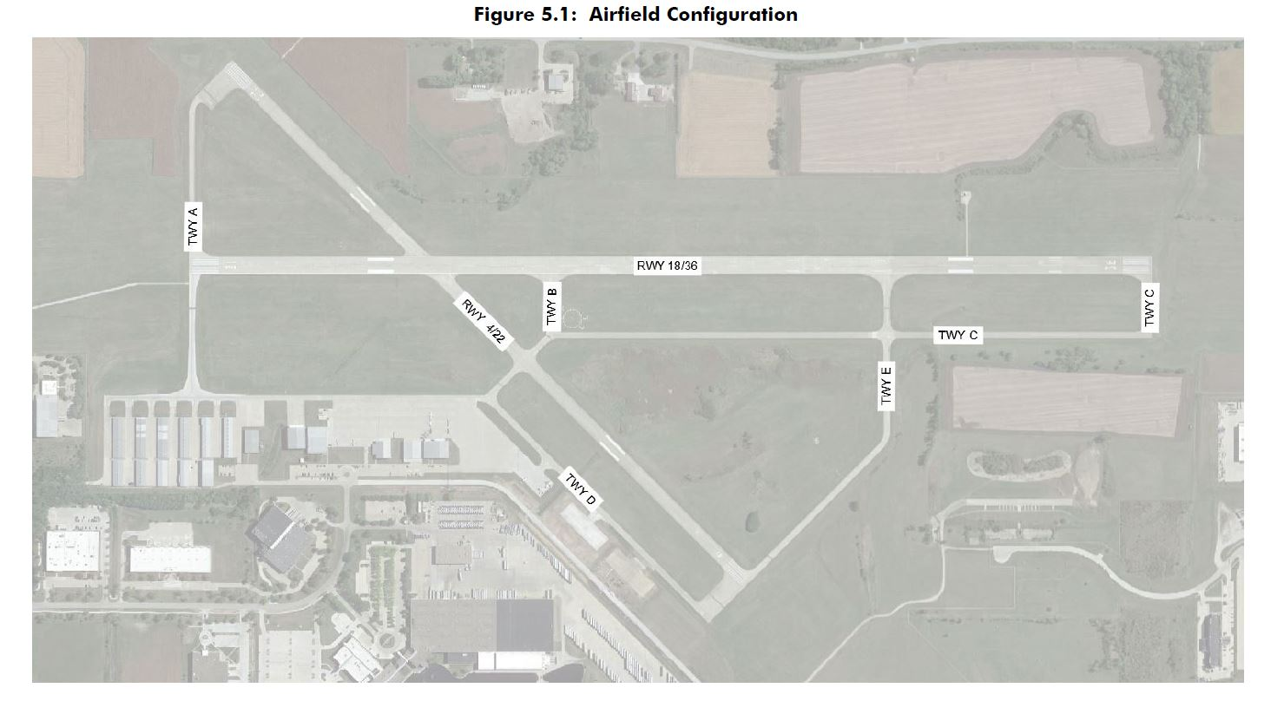
5,500-foot Main Runway
4,200-foot Secondary Runway
Taxiways and Aprons
Lighting System
Main Terminal Building
84 Tee Hangars and 2 New Box Hangars
2 FBO-owned Large Box Hangars
8 Privately Owned Box Hangars (6 New)
FAA – FSDO Building
Aircraft Maintenance Shop
Fueling Facility
Museum

Slide 4

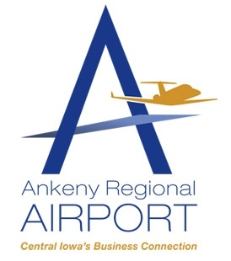
Exec 1 Aviation – Long-term Airport FBO Operator
Aircraft Maintenance
Hangar Leases and Short-term Indoor Storage
Vegetation, Runway and Lighting Maintenance
Snow and Ice Control
Fuel Sales
Courtesy Cars
Flight Lessons
Nationwide Flight Chartering – 10 Jets
General Aviation: No Commercial Flights, No Tower
105 Based Aircraft
Heavy Business/Commuter Flights
3,000 Business Class Itinerant Operations Annually
Tee Hangar Waiting List – 80+

Slide 5
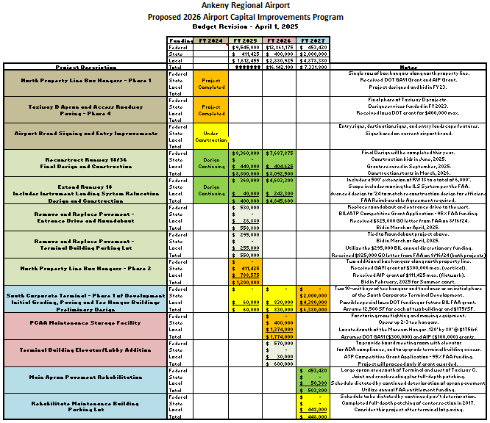
Development Strategy – ACIP Program
Current three-prong strategy for addressing growth and development:
Replace our Deteriorated Main Runway.
Address Need for Additional Hangar Space.
Develop South Terminal Area.

Slide 6
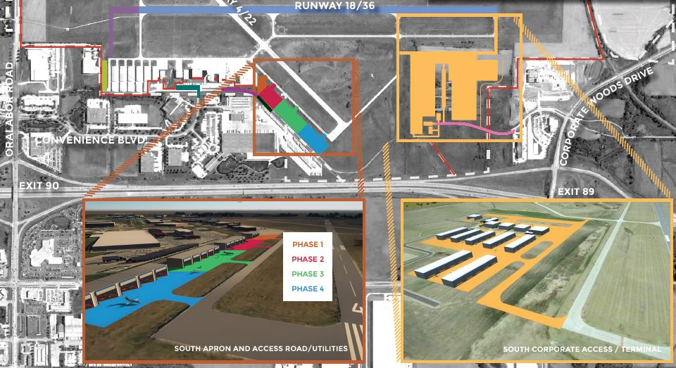

Slide 7
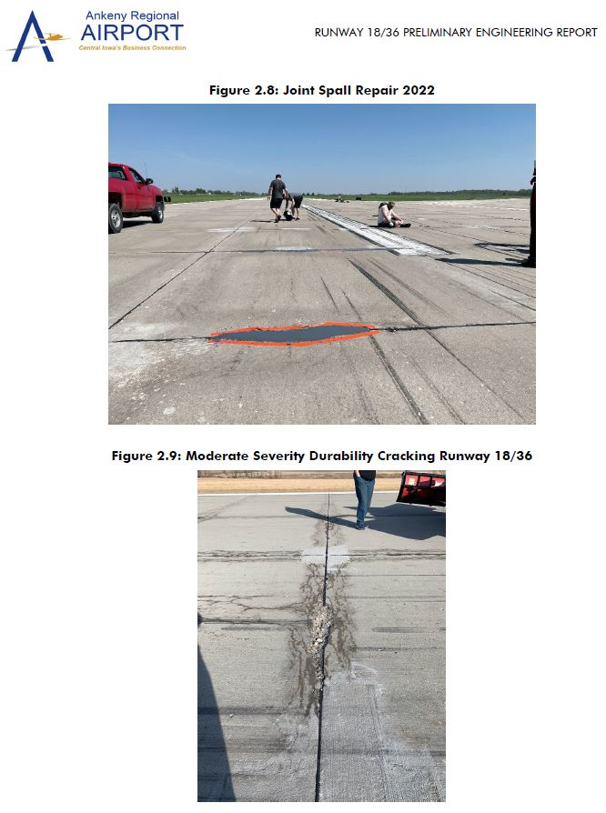
Runway 18/36 – Main Runway
5,500 feet long, 100 feet wide
Deteriorated Conditions – Joint Spalls
Emergency Patching and Repairs needed regularly
Full Reconstruction: Final Design in 2024, Construction in 2026
500-foot Extension: Attempting Same Schedule

Slide 8
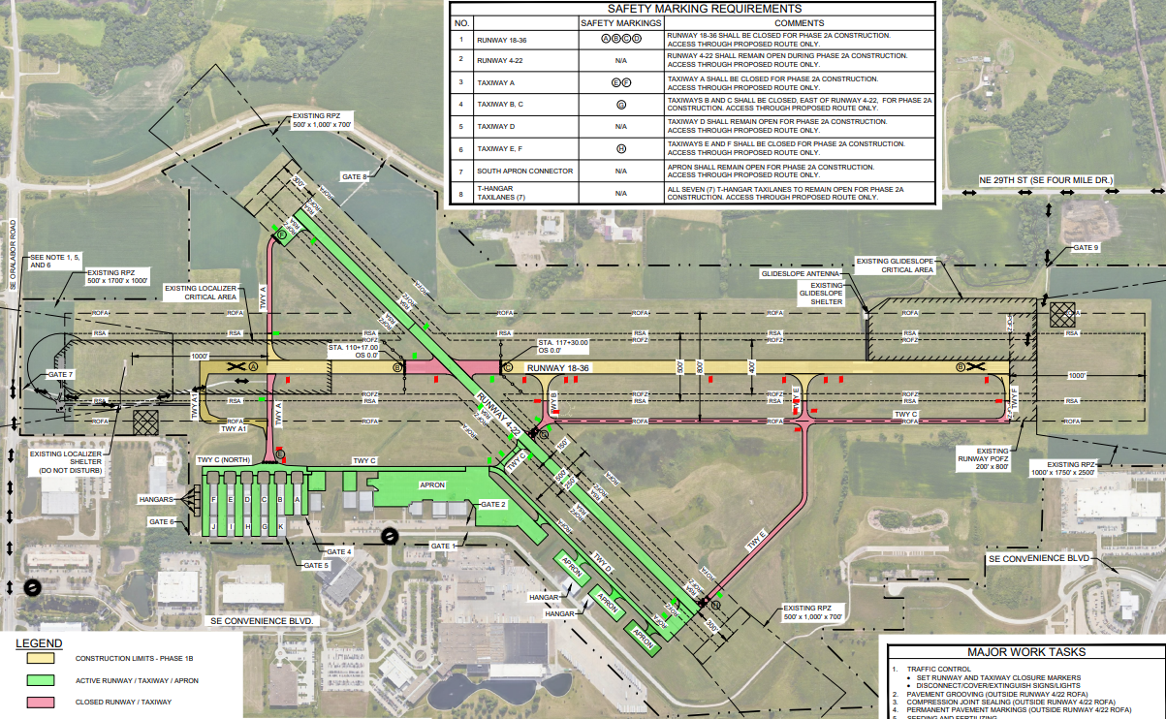

Slide 9
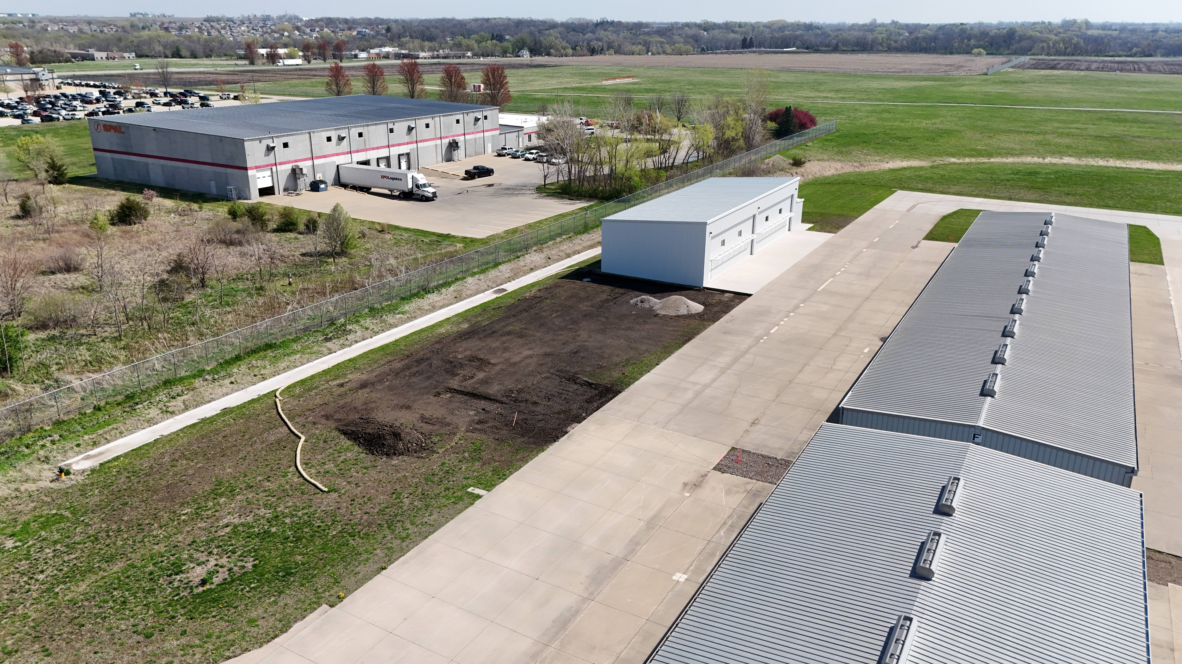
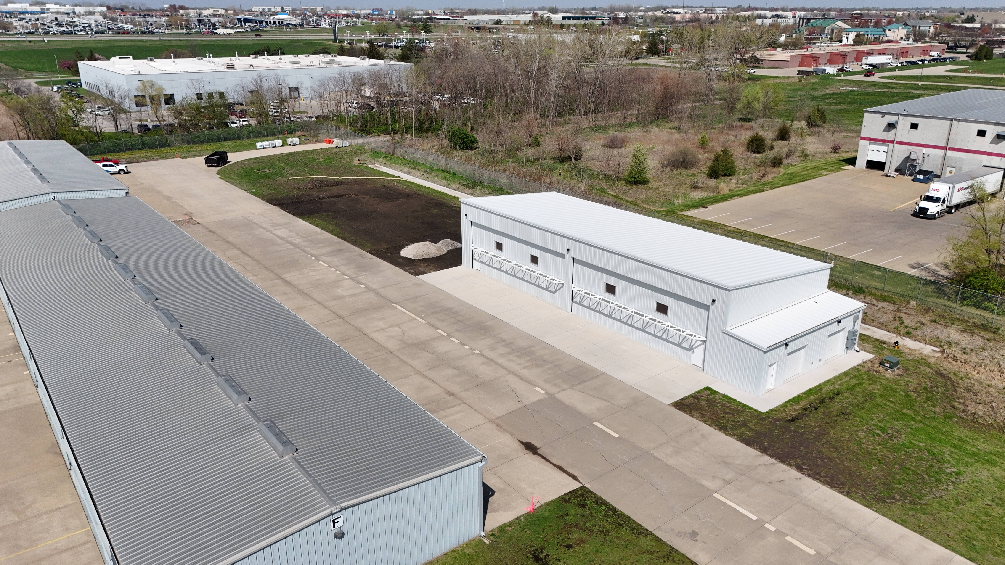
North Row Box Hangar Development
(PCAA ownership)
Phase 1 completed in 2024 – Both 64’ by 50’ hangars now leased.
Phase 2 construction underway – two more hangars.
Utilized AIP and GAVI grants.
Phase 3 scheduled for after proposed maintenance hangar.

Slide 10
Taxiway D Private Box Hangar Development
Aprons, access roadway and utilities completed in four phases.
1,170’ of hangar frontage, 80’ deep – offered for private hangar development (50-year land leases).
All leased except 73’. All built or building now.

Slide 11
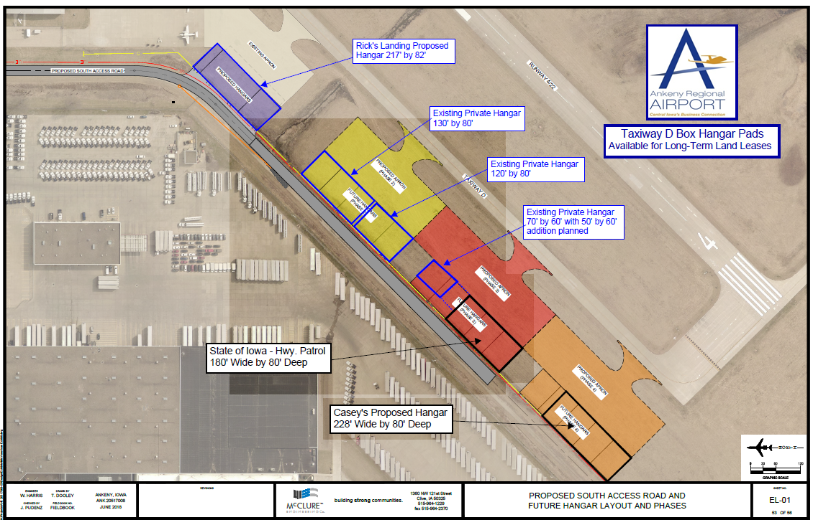

Slide 12
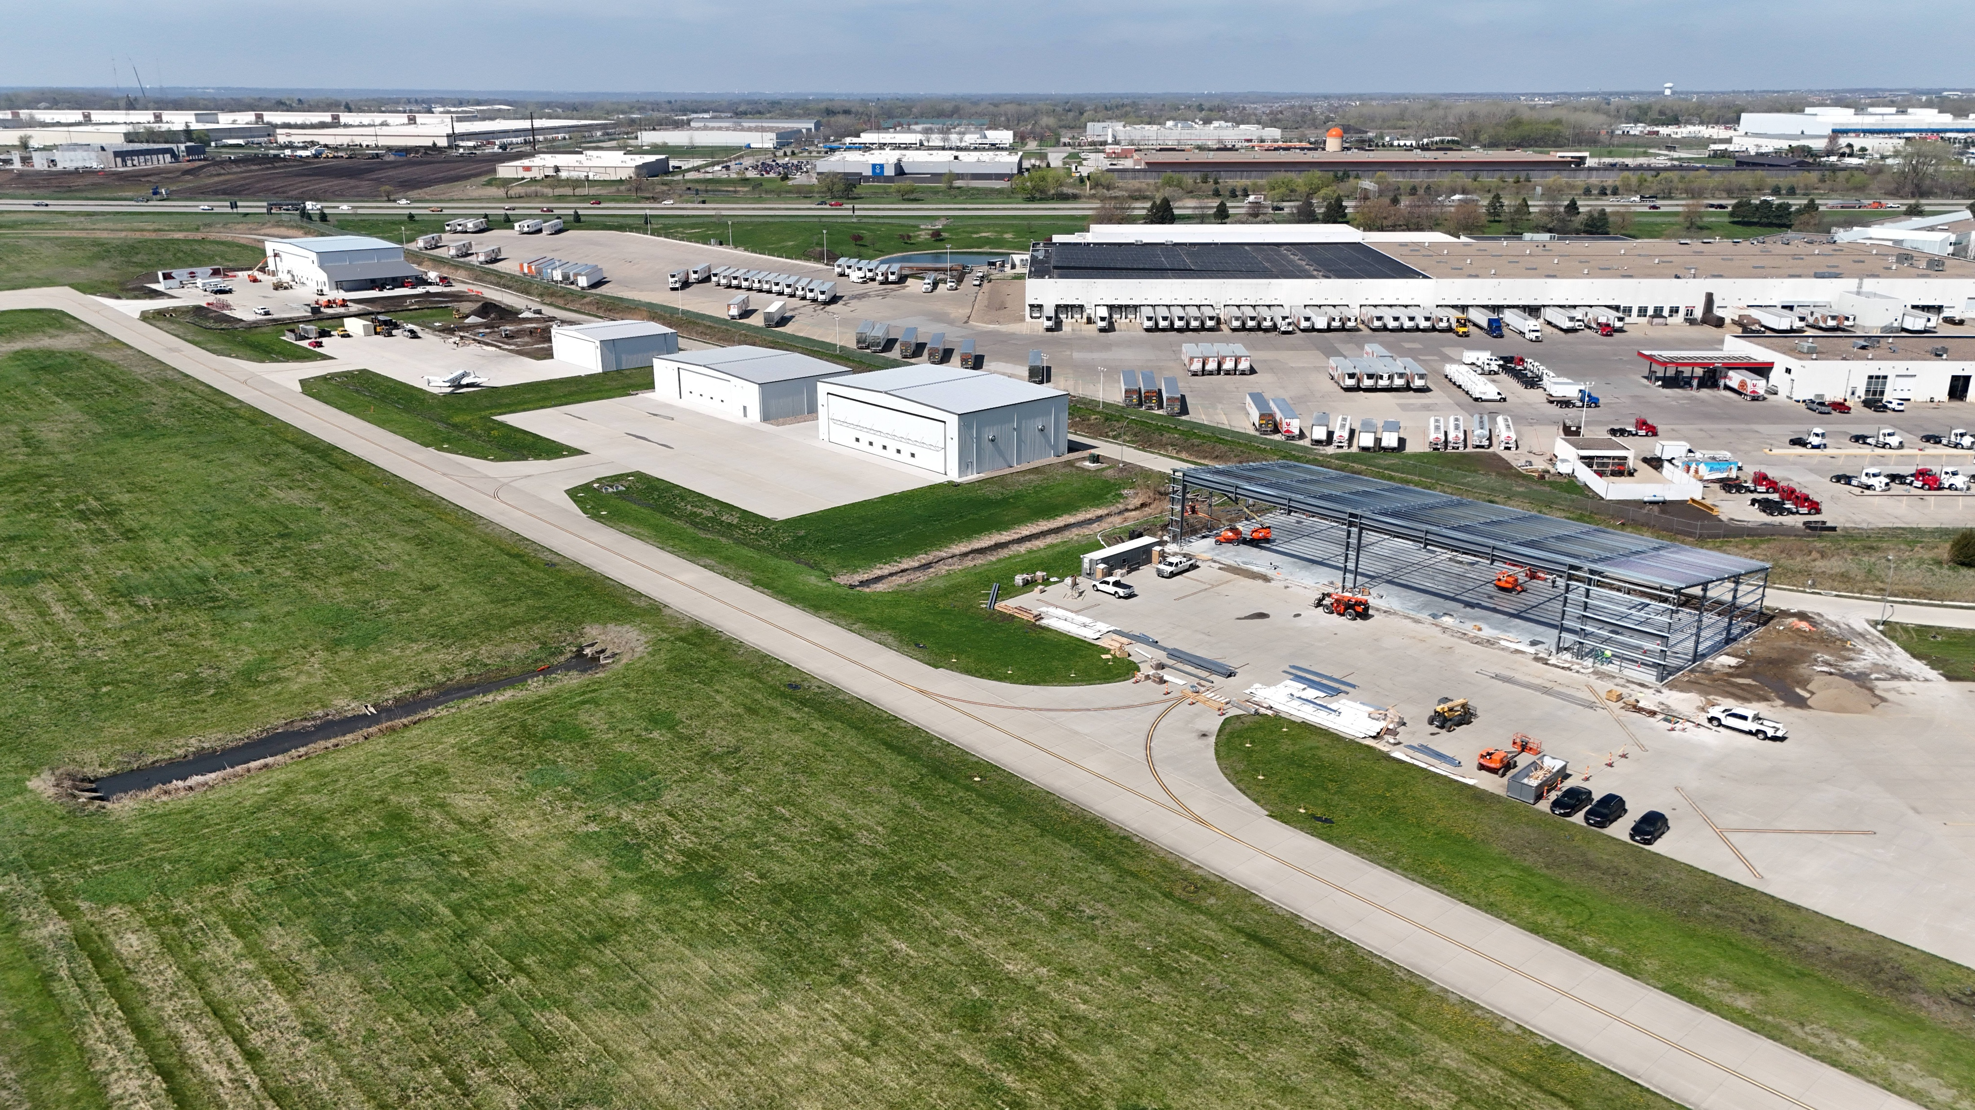
North Row Box Hangar Development

Slide 13
South Corporate Terminal Area Development Concept
South Corporate Terminal
Proposed Development
SE Convenience Boulevard constructed using RISE Funding.
Access from SE Corporate Woods/I-35 Interchange.
First phase: Earthwork, paving and two T-hangar buildings.

Slide 14
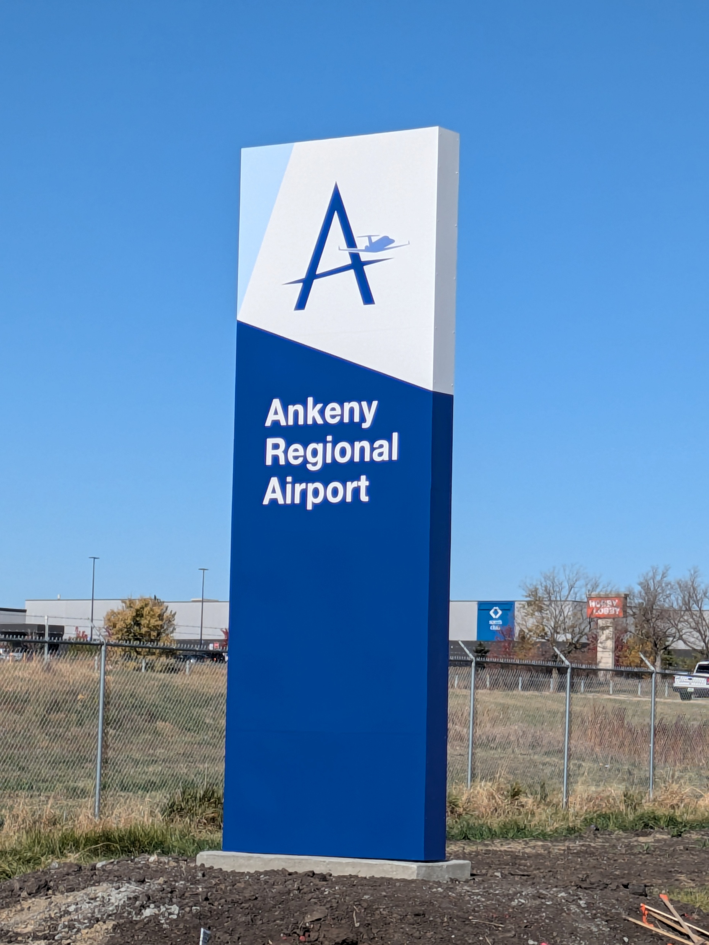
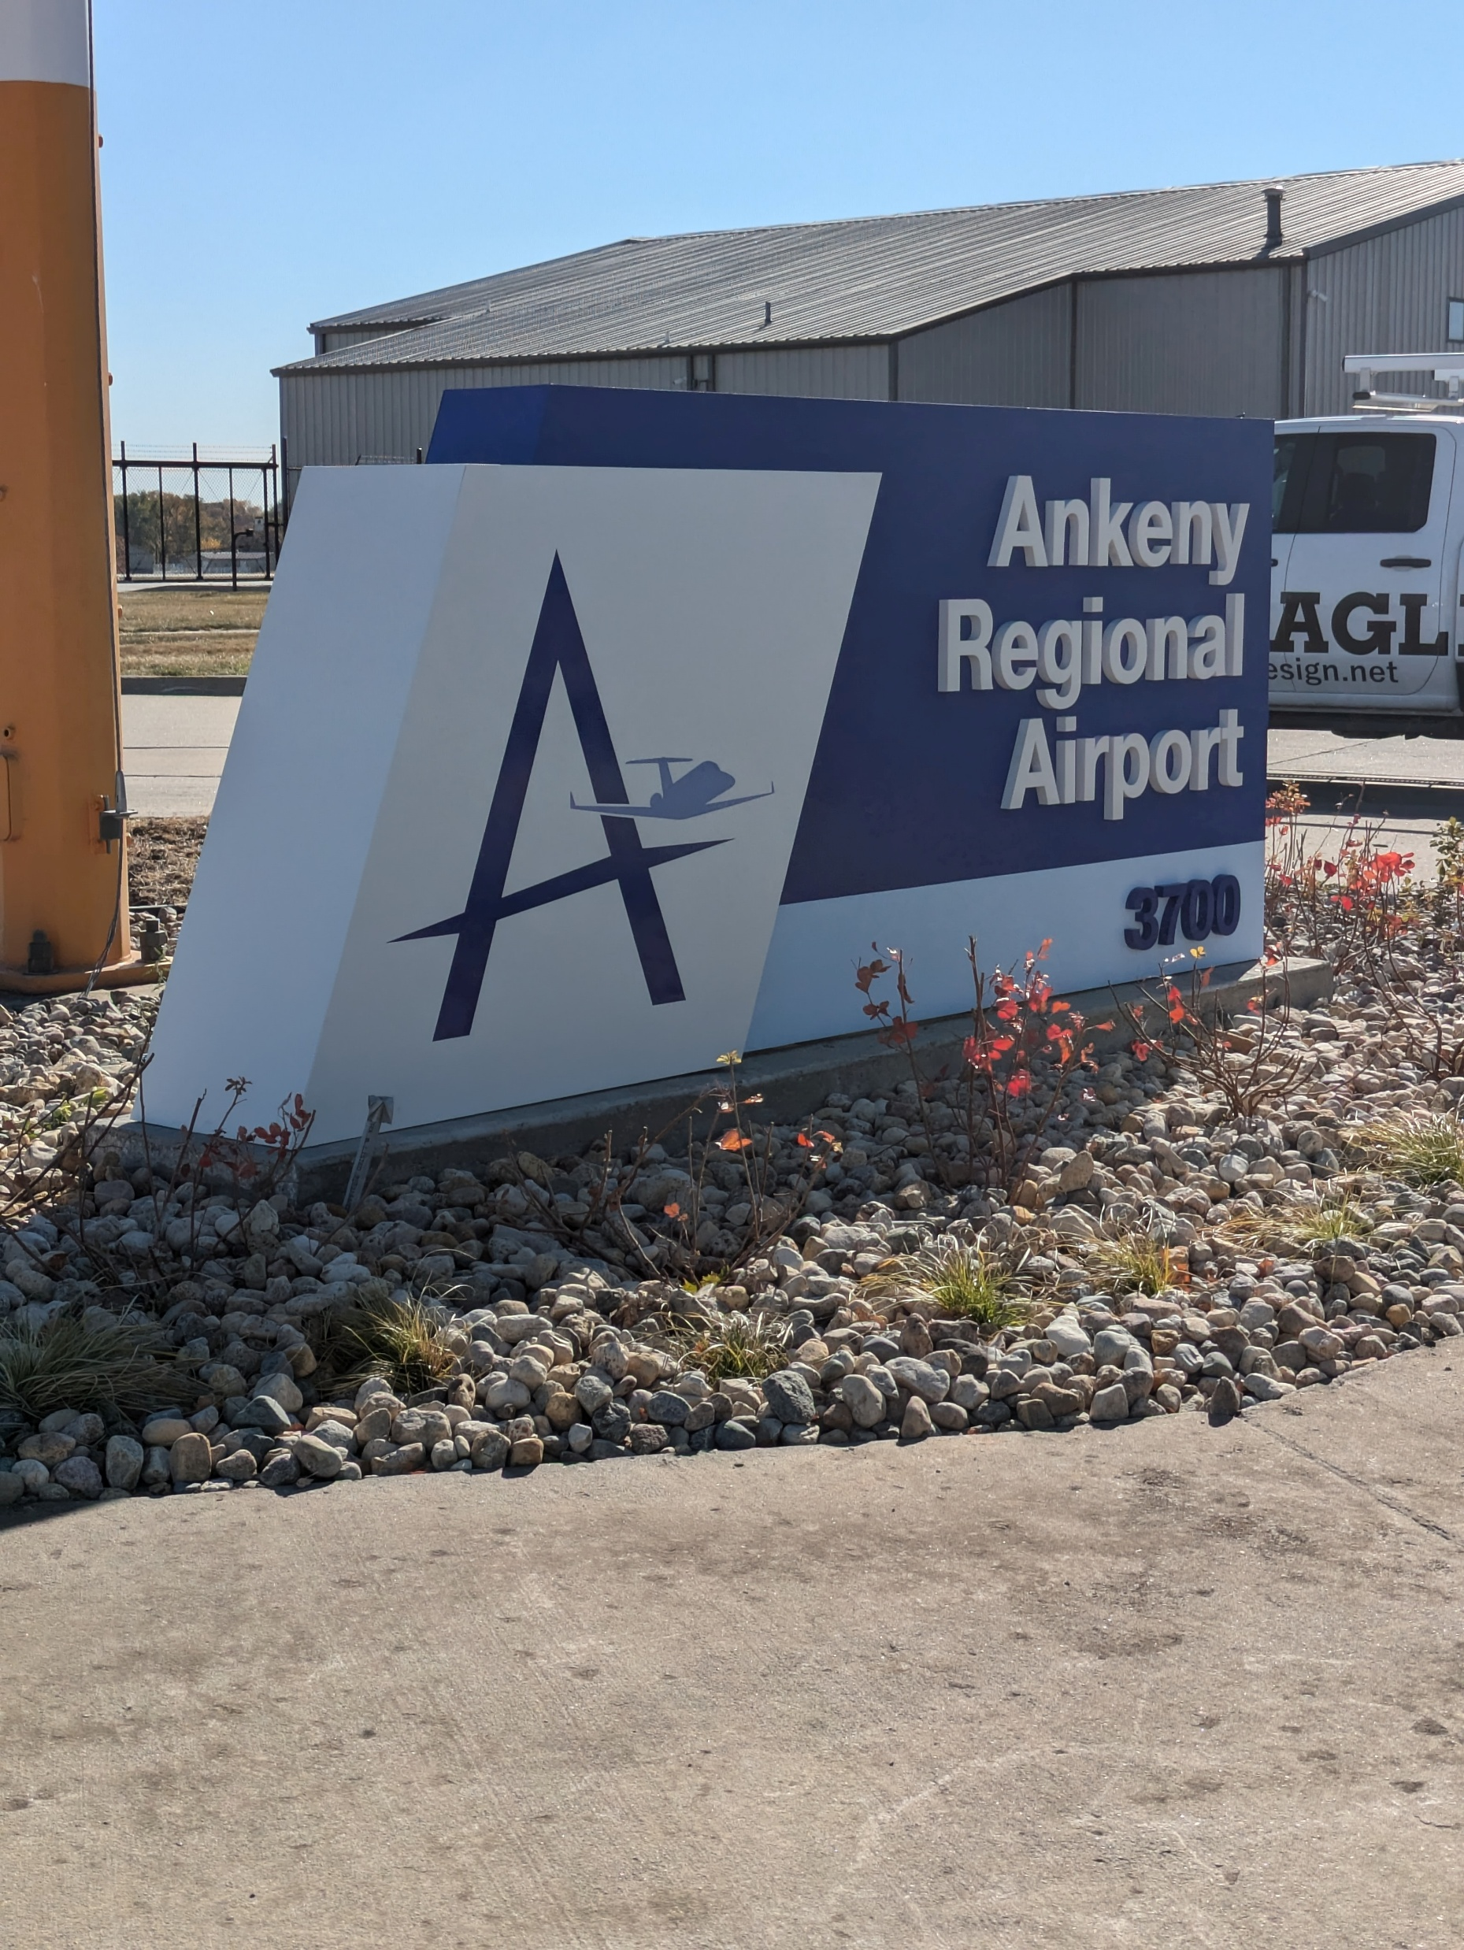
Iowa DOT Funding Utilization
Airport Improvement Program (AIP)
General Aviation Vertical Infrastructure (GAVI)
Taxiway D – Phase 1 (2019)
Total Cost = $ 970,000
AIP Grant = $ 225,000
Taxiway D – Phase 2 (2020)
Total Cost = $ 826,000
AIP Grant = $ 357,000
Taxiway D – Phase 3 (2022)
Total Cost = $ 699,000
AIP Grant = $ 313,000
Taxiway D – Phase 4 (2024)
Total Cost = $ 659,000
AIP Grant = $ 297,000
North Box Hangars – Phase 1 (2023)
Total Cost = $ 1,518,000
AIP and GAVI Grants = $ 465,000
North Box Hangars – Phase 2 (2025)
Total Cost = $ 884,000
AIP and GAVI Grants = $ 300,000
Funding Summary:
Total Investment = $ 5,556,000
DOT Participation = $ 1,957,000 (35%)

Slide 15
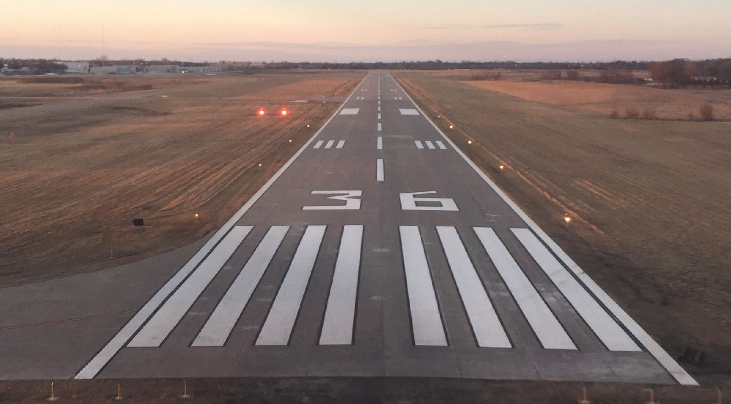
Questions?
Thank You

