Slide 1
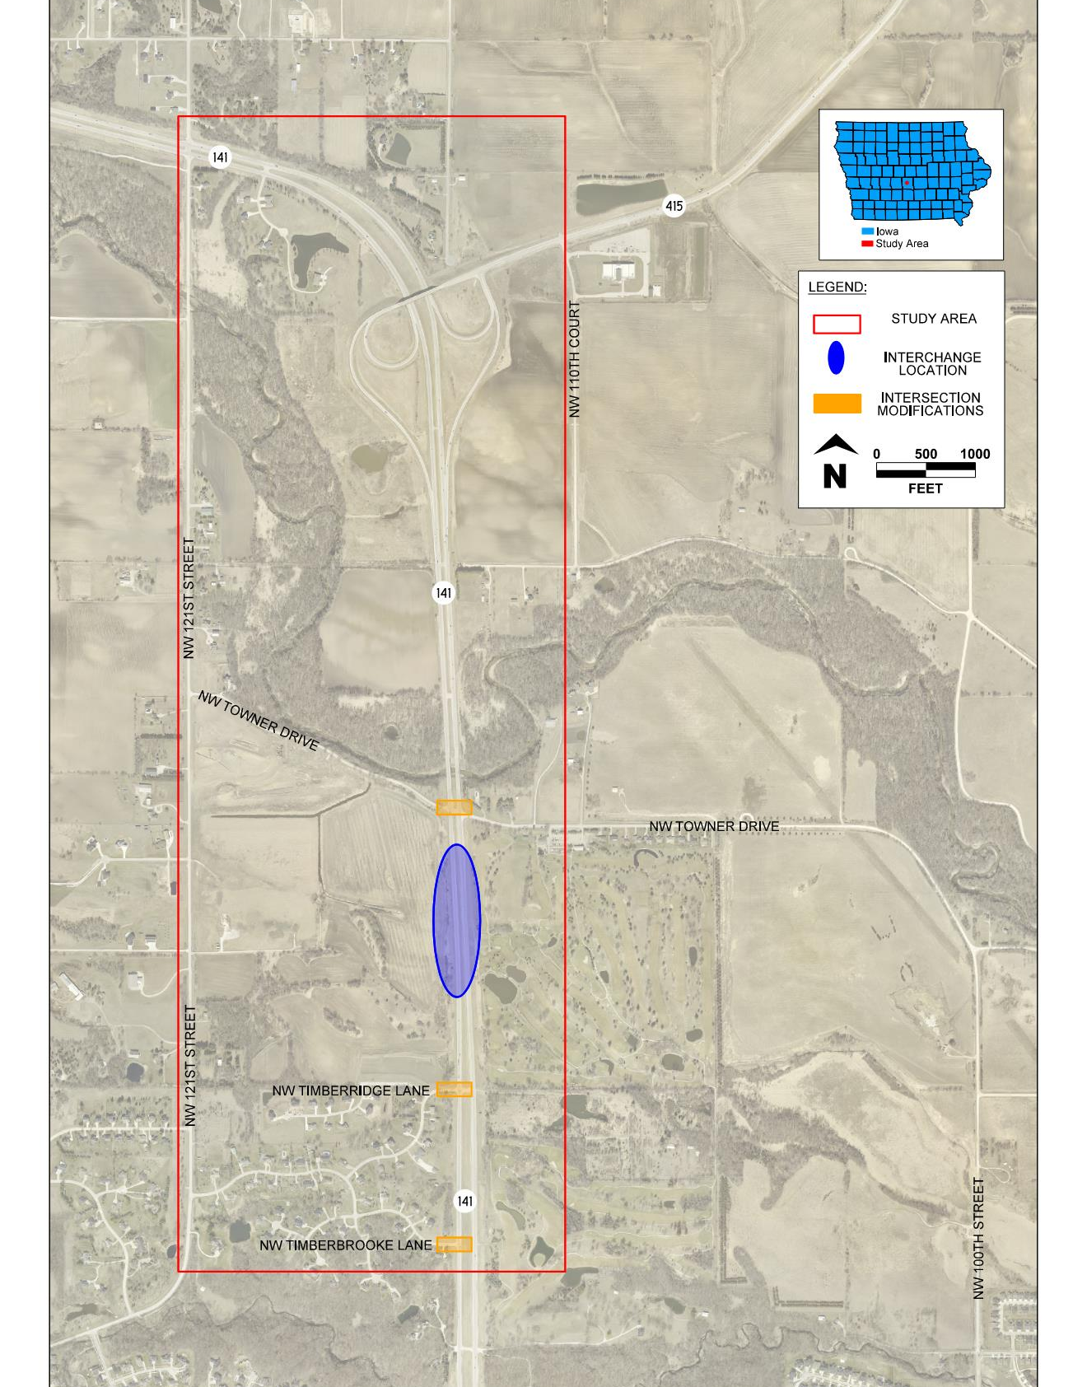
IA 141 / NW Towner Drive Interchange Update
Iowa DOT Commission
June 10, 2025
Paula Dierenfeld, Mayor
David Wilwerding, Assistant City Administrator
Mark Perington, PE, Snyder and Associates

Slide 2
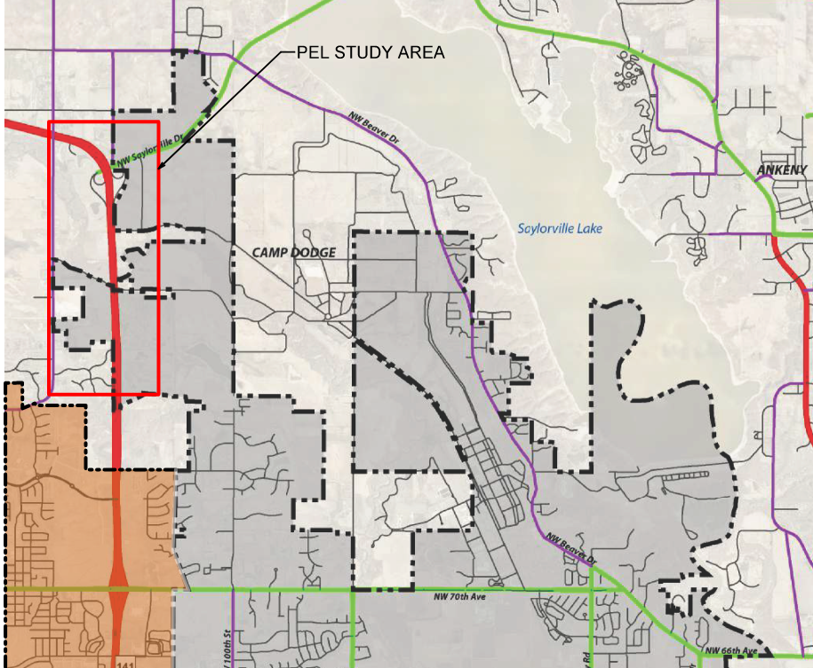
PROJECT HISTORY – STUDIES
STUDIES AND COMP PLANS
2018 Corridor Study – Polk County & Iowa DOT
2020 Corridor Study – Johnston, Grimes, Polk County & Iowa DOT
Grimes Comp Plan – 2019
Johnston Comp Plan – Thrive 2040
PROJECT LOCATION MAP

Slide 3
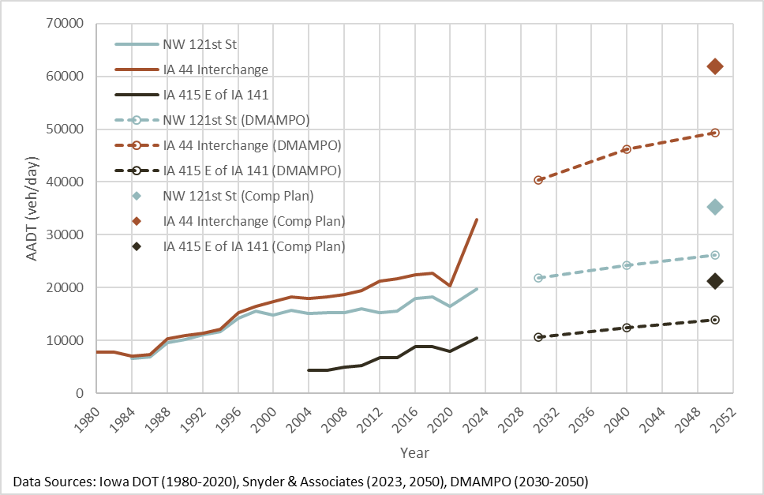
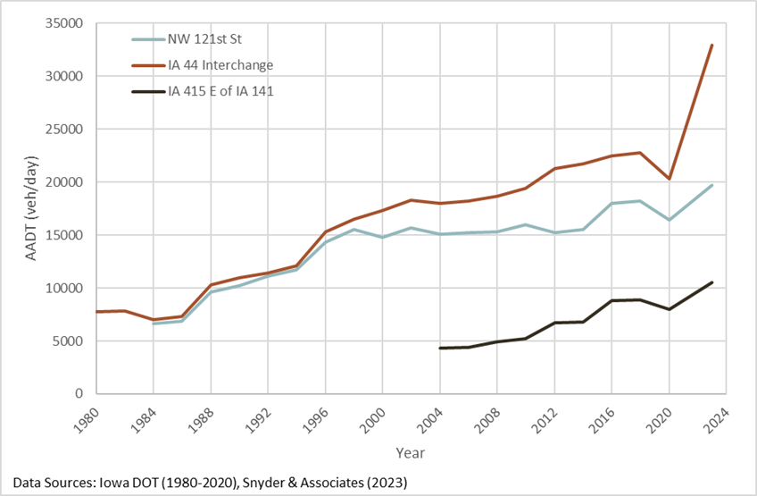
PROJECT HISTORY – TRAFFIC VOLUMES
IA 141 West of NW 121st Street
~ 17,000 AADT in 2016
~ 19,710 AADT in 2023
~ 35,200 AADT in 2050
IA 141 North of IA 44 Interchange
~ 25,000 AADT in 2016
~ 32,910 AADT in 2023
~ 61,900 AADT in 2050
IA 415 East of IA 141
~ 8,000 AADT in 2016
~ 10,500 AADT in 2023
~ 21,200 AADT in 2050
2050 Assumes full build out
Historic Traffic Volume Estimates (Annual Average Daily Traffic)
Historic, Existing, and Forecasted AADT Estimates

Slide 4
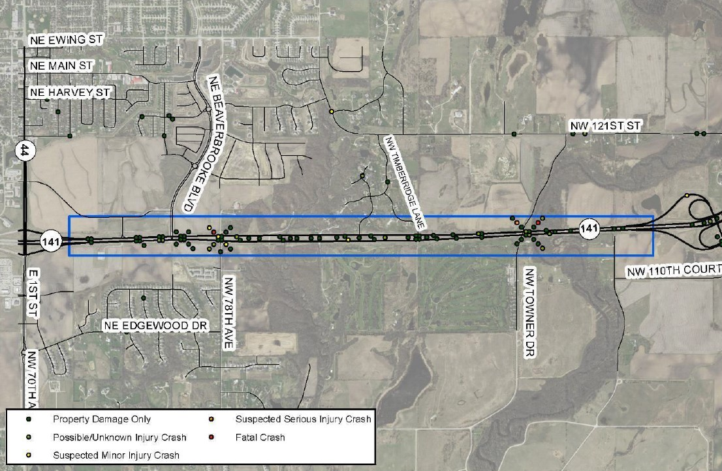
PROJECT HISTORY – 2019-2023 CRASH HISTORY
Intersections (side road STOP conditions)
47 crashes with 20 injuries.
IA 141/NW 121st saw 20 crashes.
Timberbrooke and Timberridge saw 8 crashes with 3 major injuries.
At-grade intersections saw 12 broadside, 15 rear-end, and 8 non-collision crashes.
IA 141 Roadway Segments (non-intersection)
42 crashes resulting in 13 injuries.
1 fatality.
Geometry upgrades needed

Slide 5
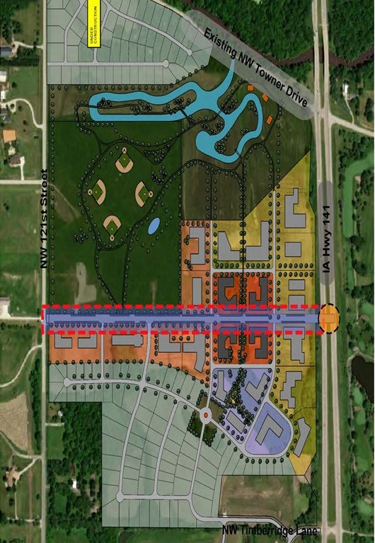
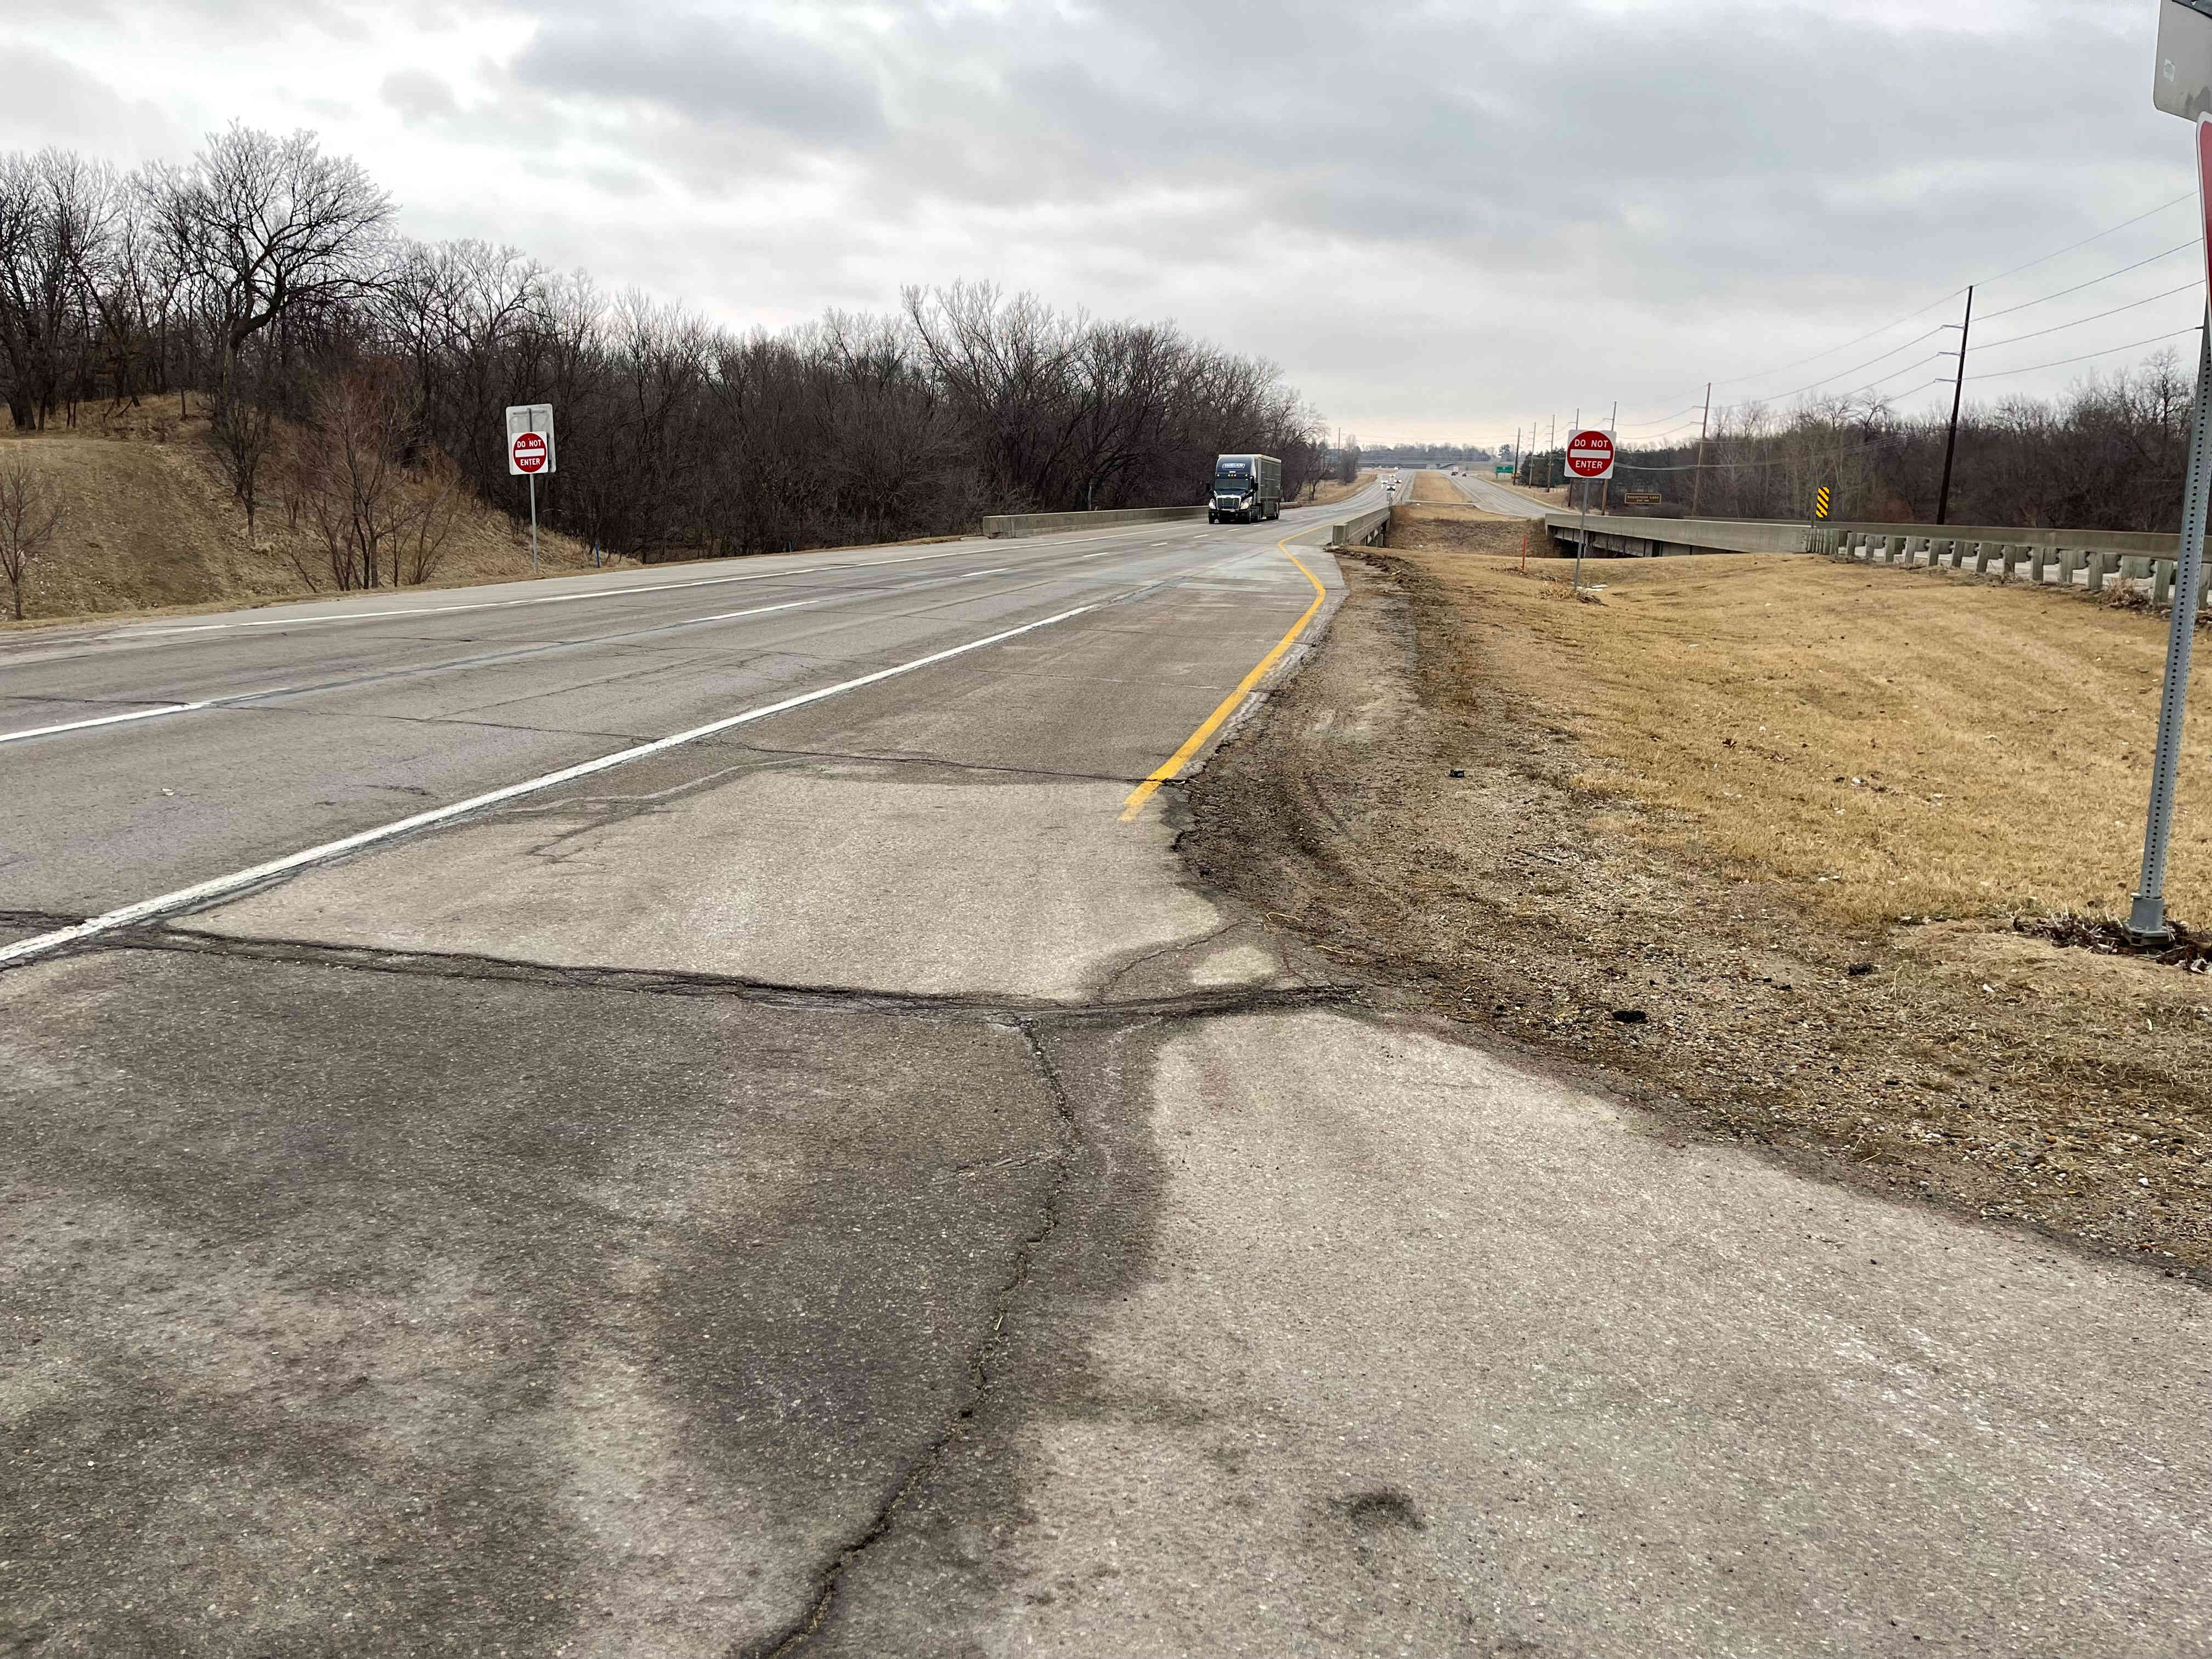
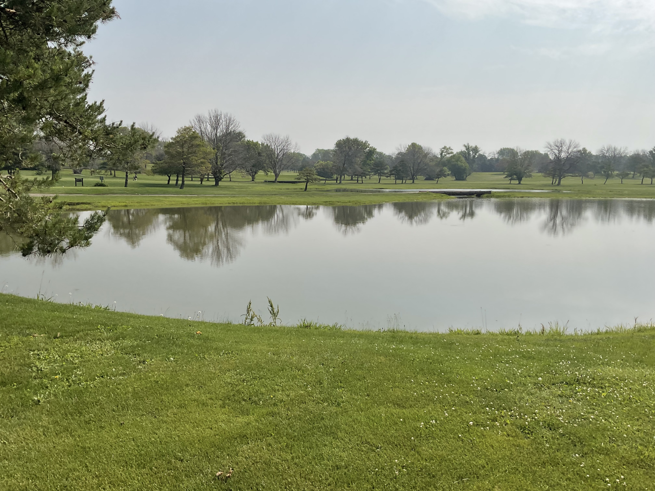
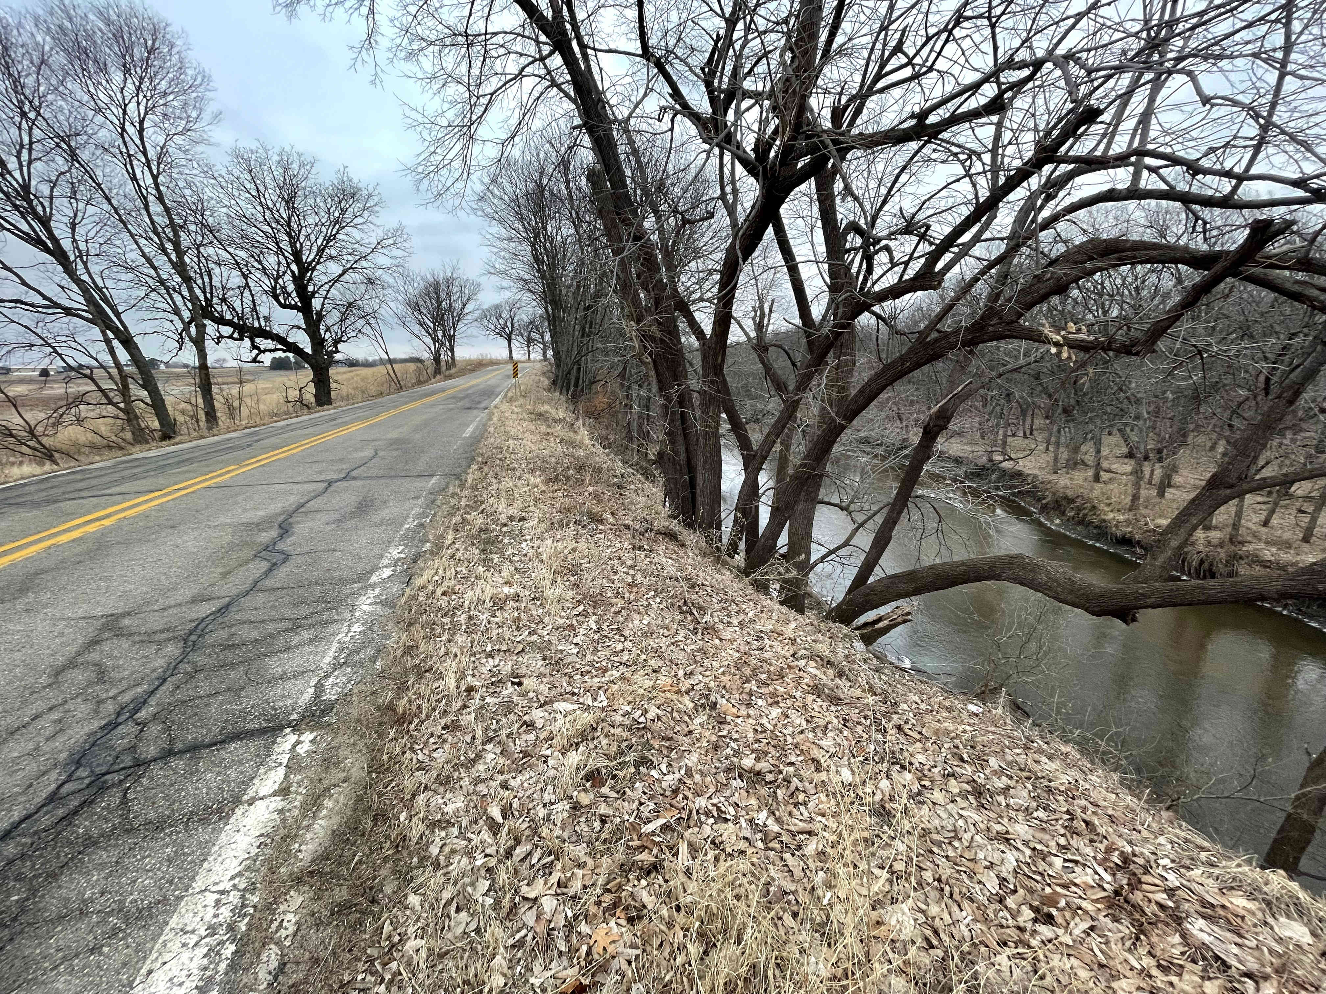

PROJECT PURPOSE & NEEDS
Enhance Safety for the Traveling Public Within the Study Area
Support Current and Planned Area Economic Growth and Development

Slide 6
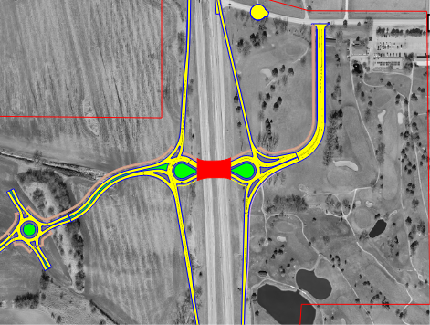
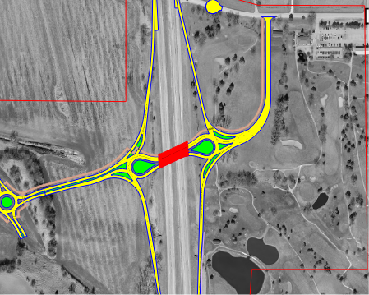
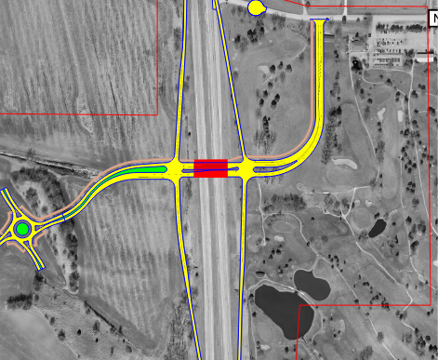
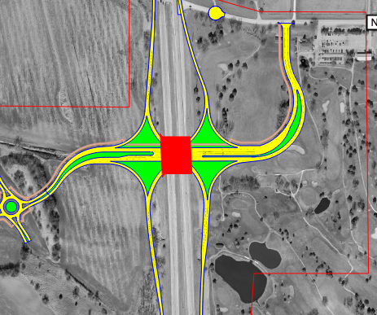
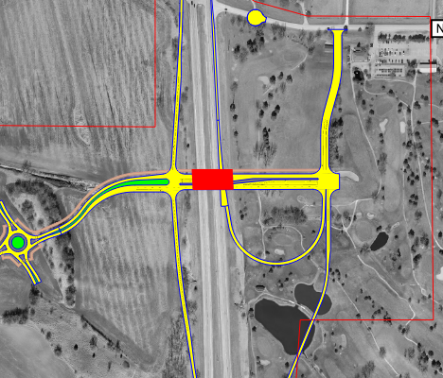

ALTERNATIVES ANALYSIS
Five Alternatives Developed
Roundabout
Skewed Roundabout
Diamond
Single Point Urban
Folded Diamond

Slide 7
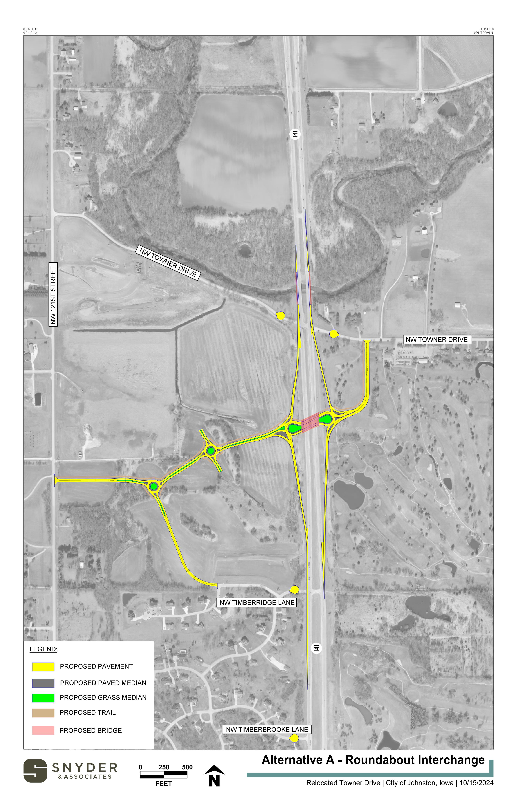
Preferred Alternative
Skewed Roundabout
Supports improved safety
Closure of existing NW Towner Drive, NW Timberridge Lane, and NW Timberbrooke Lane
Reduces traffic conflict points at ramp termini
Slows traffic at intersection points
Pedestrian/bike crossings
Supports improved operations
Reduces delays along IA 141
Reduces delays at ramp termini
Supports adjacent development with skew
Minimizes impacts to golf course
Provides best alignment for developing west side

Slide 8
PROJECT SCHEDULE
 | Spring of 2023 | Summer of 2023 | Fall of 2023 | Winter of 2023 | Spring of 2024 | Summer of 2024 | Fall of 2024 | Winter of 2024 | Spring of 2025 | Summer of 2025 | Fall of 2025 | Winter of 2025 | Spring of 2026 | Summer of 2026 | Fall of 2026 | Winter of 2026 | Spring of 2027 | Summer of 2027 | Fall of 2027 | Winter of 2027 | Spring of 2028 | Summer of 2028 | Fall of 2028 | Winter of 2028 | Spring of 2029 | Summer of 2029 | Fall of 2029 | Winter of 2029 | Spring of 2030
Iowa DOT Pre-Design Agreement
Public Engagement
Stakeholder Meetings
PEL Study
NEPA Study
Preliminary Design
Right of Way Acquisition
Final Design
Construction

Slide 9
COSTS & FUNDING
PROJECT ELEMENTS | COSTS
Construction | $26,390,000
Preliminary Engineering & Studies | $2,508,000
Land Acquisition | $1,505,000
Construction Engineering | $1,452,000
TOTAL COSTS | $31,855,000
FUNDING SECURED | AMOUNTS
STBG | $2,400,000
Carbon Reduction Program, CRP | $1,133,000
City of Johnston – Pre-design Agreement | $1,205,000
Iowa DOT – Pre-design Agreement | $3,200,000
Subtotal | $7,938,000
POTENTIAL FUNDING | AMOUNTS
Community Project Funding, CPF (application submitted) | $2,000,000
BUILD Grant (application submitted) | $15,492,000
RISE Grant (no application made yet) | $518,000
Developer Agreement / City of Johnston / Iowa DOT (TBD) | $5,907,000
Subtotal | $22,917,000
TOTAL FUNDING | $31,855,000
Note:
Costs shown in the table are from the January 2025 BUILD Grant application. The Cost opinion was updated recently due to observed bid pricing on similar projects dropping slightly. Current estimate for the project is approximately $28M.

Slide 10
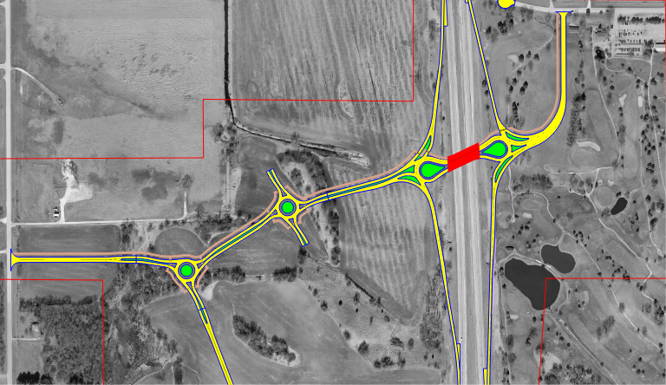
THANK YOU

