Slide 1


City of West Des Moines
Transportation Update
June 10, 2025
Mayor Russ Trimble

Slide 2
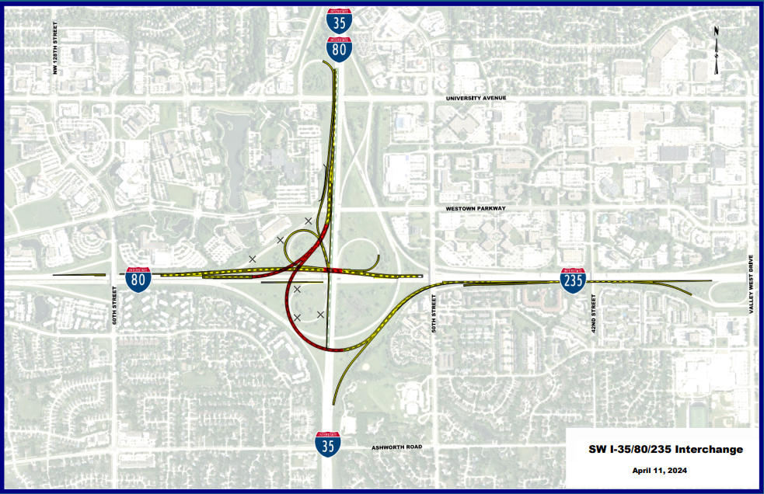
Southwest Mixmaster
Thank You

Slide 3
Success Story
Grand Avenue Widening
1st Street to 4th Street

Slide 4
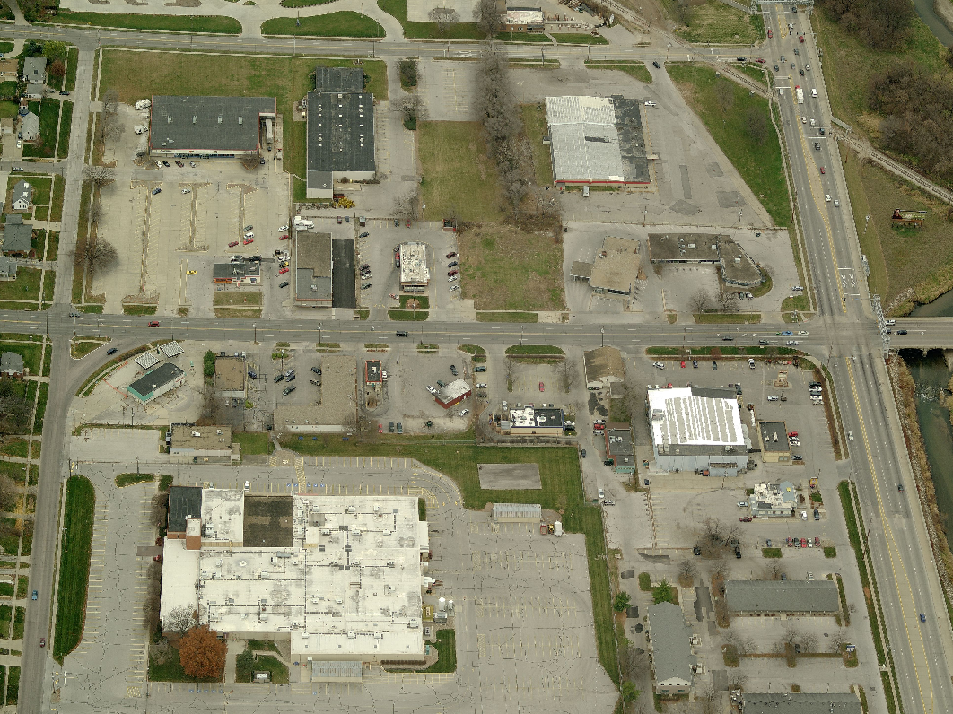
15 years ago
Ashworth Rd
Grand Ave
4th St
1st St / 63rd St
22 access points
4-lane undivided street
No left-turn lane

Slide 5
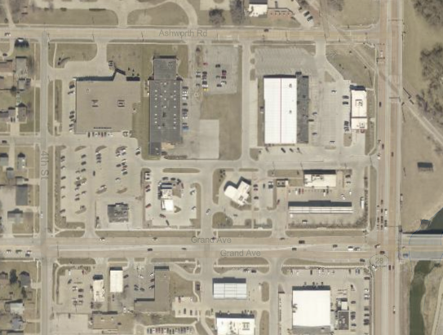
TODAY
8 access points
5-lane divided street
Dedicated left-turn lane
Dual Lefts at 1st St
Right Turn Lane at 1st St
Ashworth Rd
4th St
1st St / 63rd St
Grand Ave

Slide 6
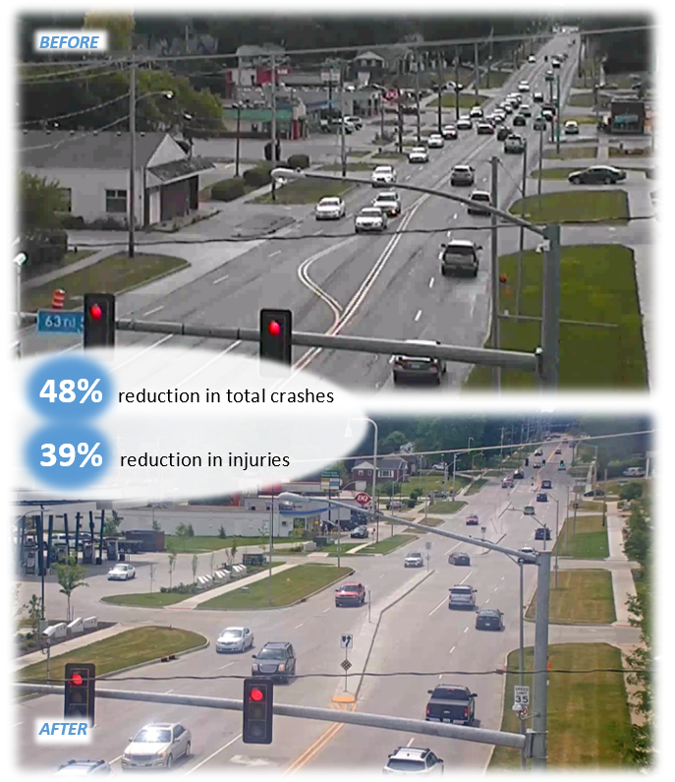
Improved traffic flow
Fewer conflict points and crashes
Added left and right turn lanes
80/20 STBG and TSIP funded
Won ICPA Award
Won MOVITE Award

Slide 7
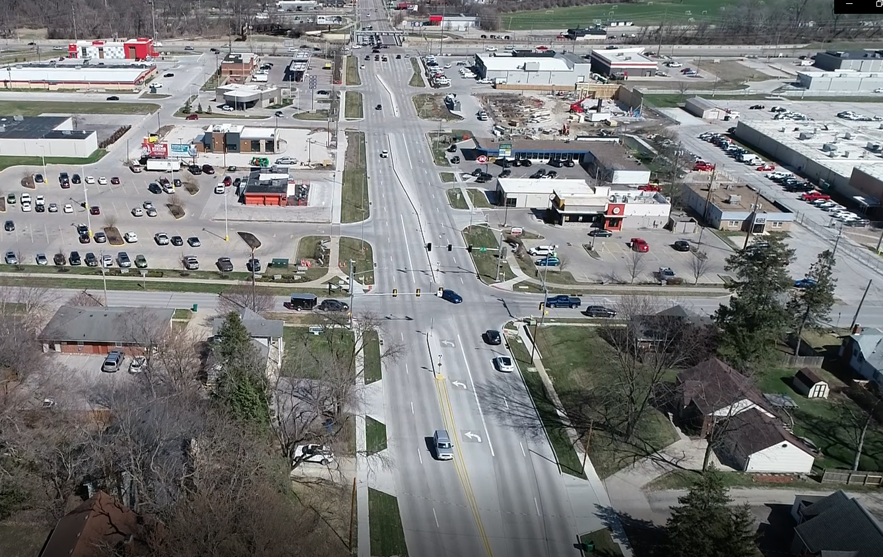

Slide 8
Completed Projects of Note
8th Street Widening
Southwest Loop

Slide 9
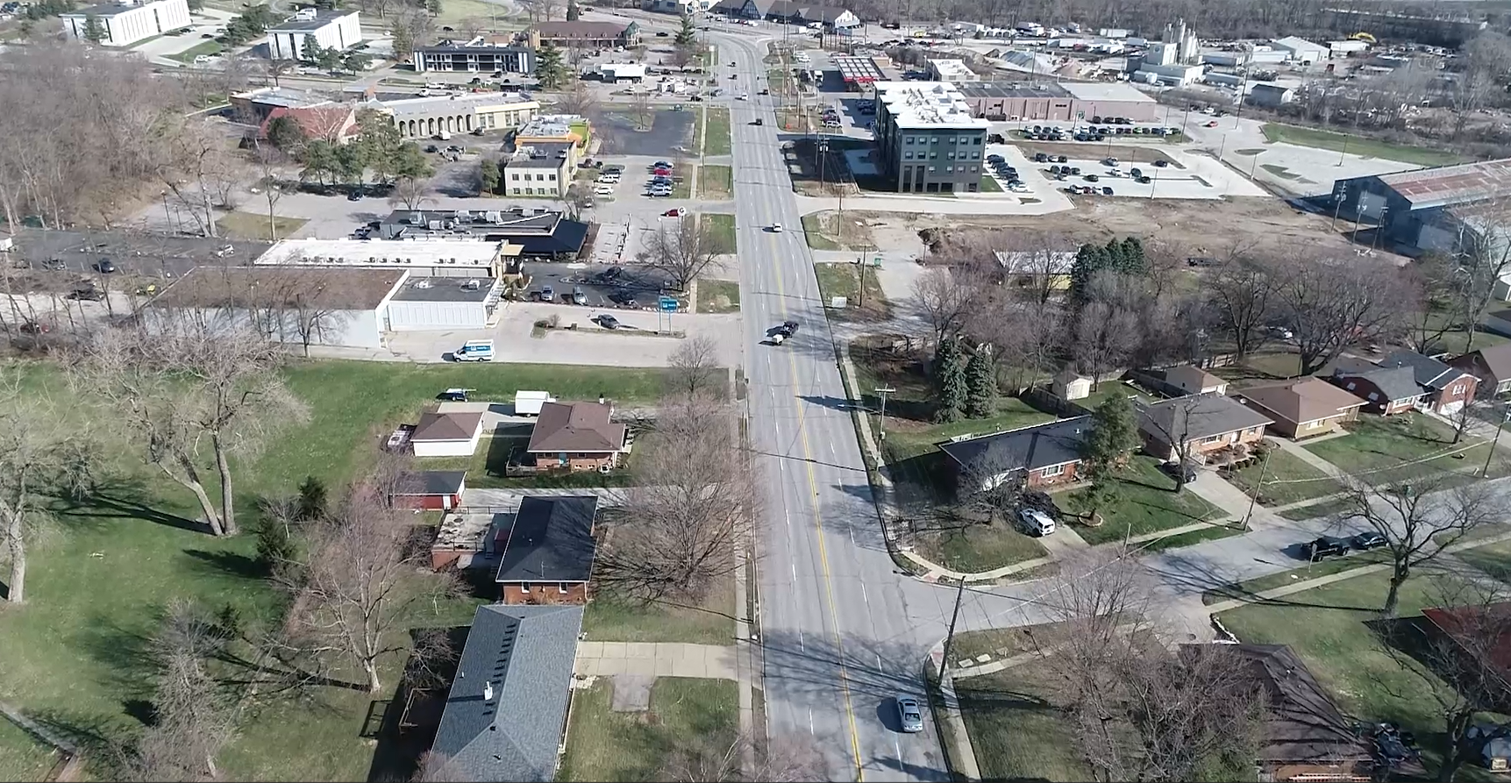
8th Street Reconstruction - BEFORE

Slide 10
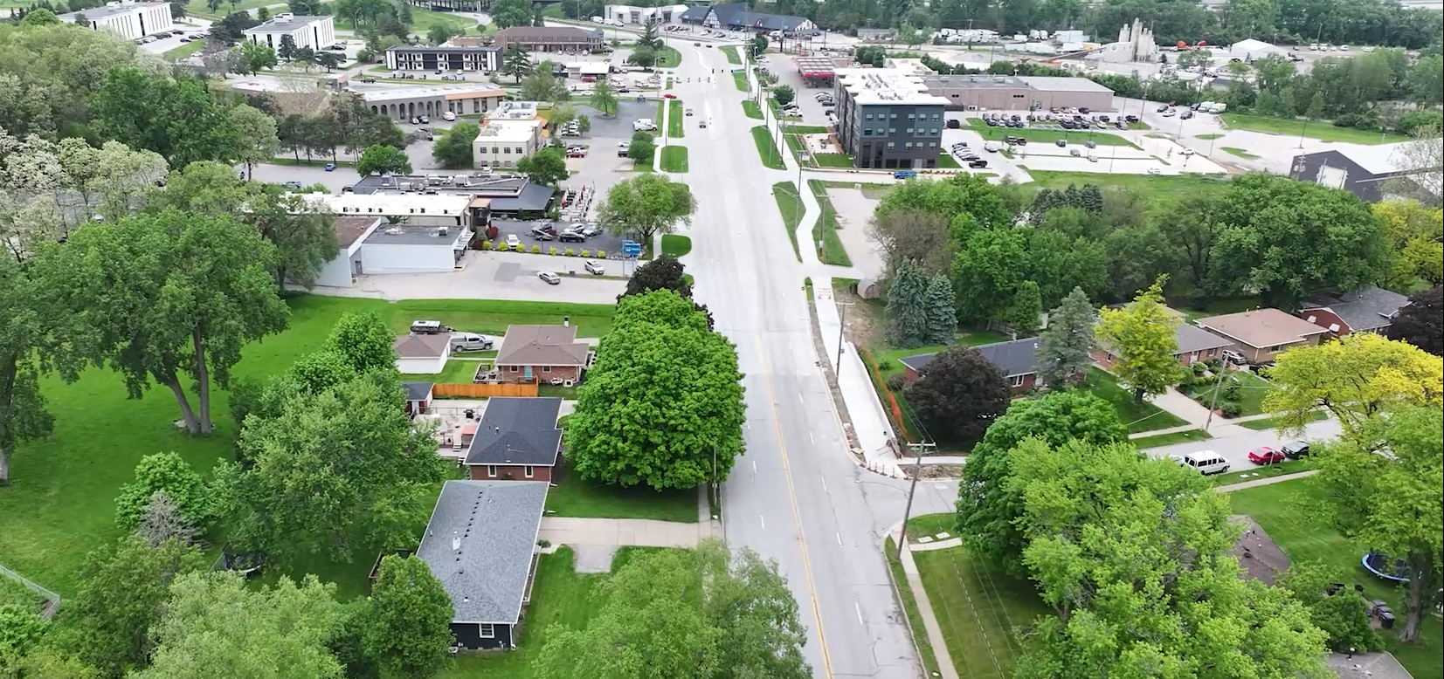
8th Street Reconstruction - COMPLETED
Added a median
Decreased conflict points
Added left turn lanes
Added a shared use path
Improved Storm Water Drainage
80/20 STBG funded
Reduced crashes by ??%
Decreased crash-related injuries by ??%

Slide 11
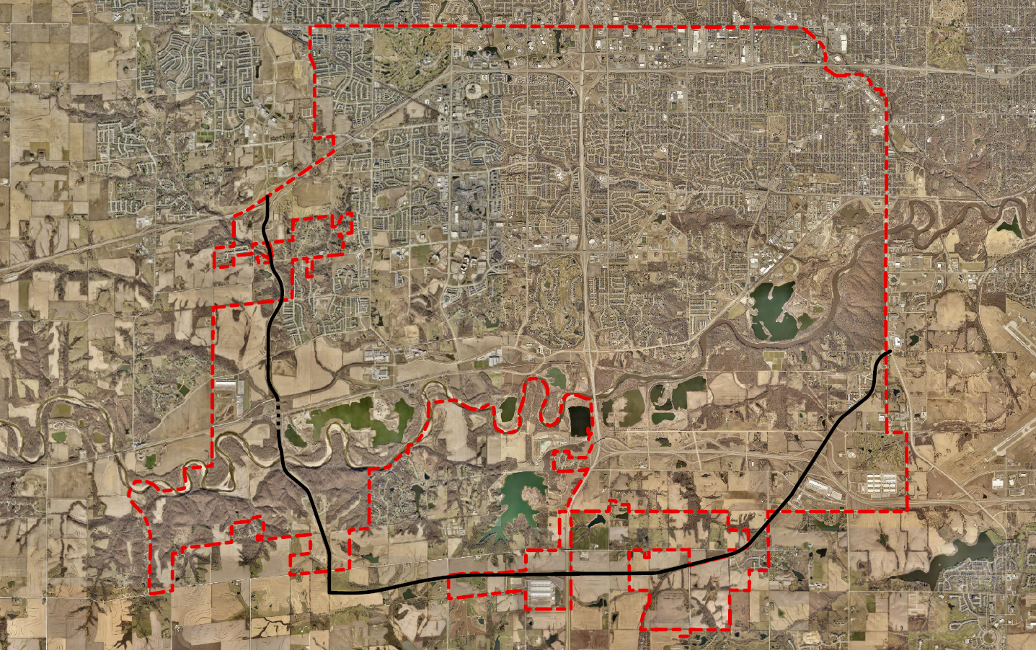
Southwest Loop
South Grand Prairie Parkway
Veterans Parkway
Missing Link
NOW OPEN

Slide 12
Upcoming Projects of Note
Ashworth Road
EP True Parkway & Bridgewood Blvd
Mills Civic Parkway
Grand Avenue

Slide 13
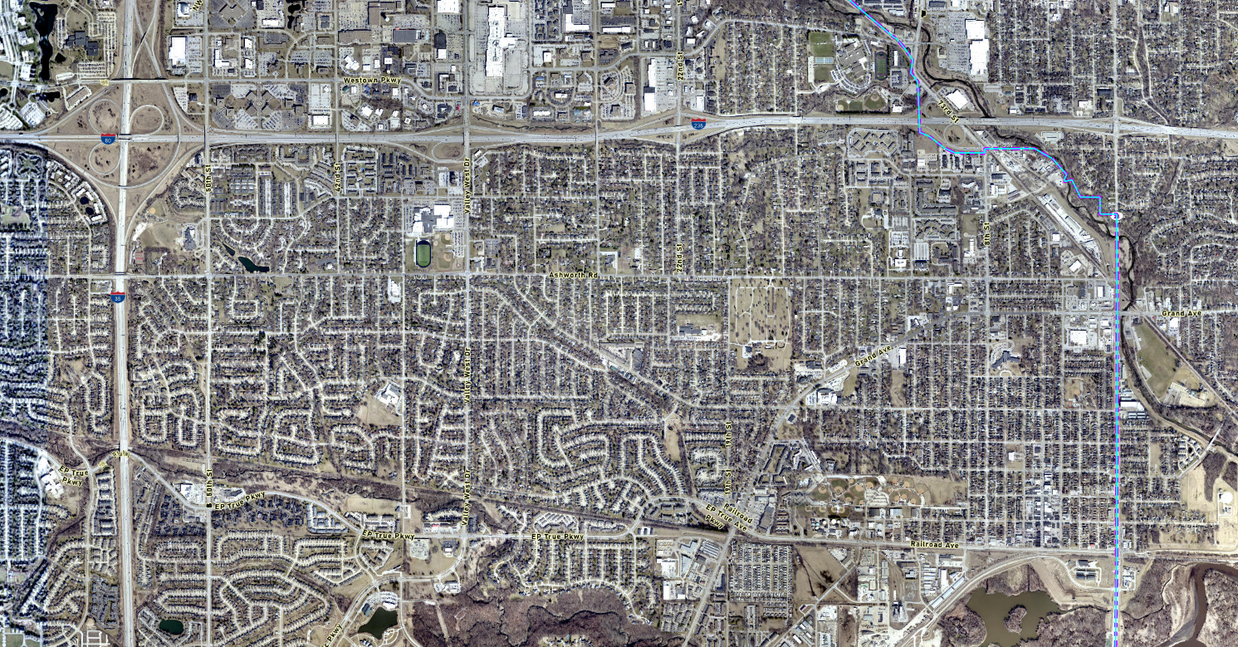
Ashworth Road – 1st Street to 50th Street
Reconstruction Necessary
10+ Year Project
Four to Three Lane Conversion
Successful Pilot from 1st to 19th
  Positive Public Comment
  Crashes and Speeds are both down
Design of 19th to 23rd
  Starting Now
  Construction Planned for 2026
$4.5M in STBG secured

Slide 14
EP True & Bridgewood
EP True Parkway
  Design Fall 2024-Spring 2025
  Construction Spring 2025-Summer 2026
Bridgewood Boulevard
  Design Fall 2024-Spring 2025
  Permitting 2025
  Construction ?

Slide 15
Mills Civic Parkway - Reconstruction
Mills Civic Parkway Sugar Creek and Fox Creek Crossings
  Construction Complete Fall 2025
Mills Widening – SGPP to S 91st
  Design Complete
  Right of Way Spring 2025
  Construction Fall 2025- End 2026

Slide 16
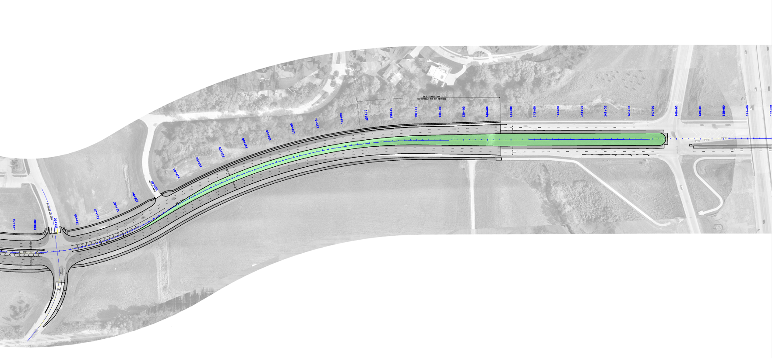
Grand Avenue Widening – I-35 to 60th Street
Grand Avenue Widening
  Design and ROW Complete
  Bidding Nov 2024
  Construction Spring 2025-Summer 2026

