Slide 1
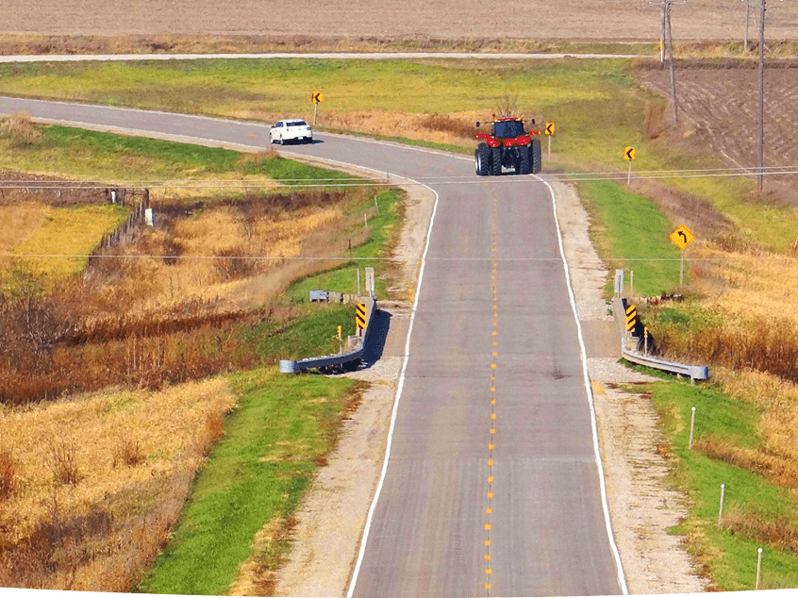

Secondary Road Fund Distribution Committee Update – FY 2026 Distribution Factors
Iowa Transportation Commission – July 8, 2025
Stuart Anderson
Brian Moore

Slide 2


Agenda
State Road Fund Distribution
Secondary Road Fund Distribution Committee
Past Administrative Rule Process
Boards and Commissions Changes
Commission Action
FY 2026 Distribution Factors
2

Slide 3
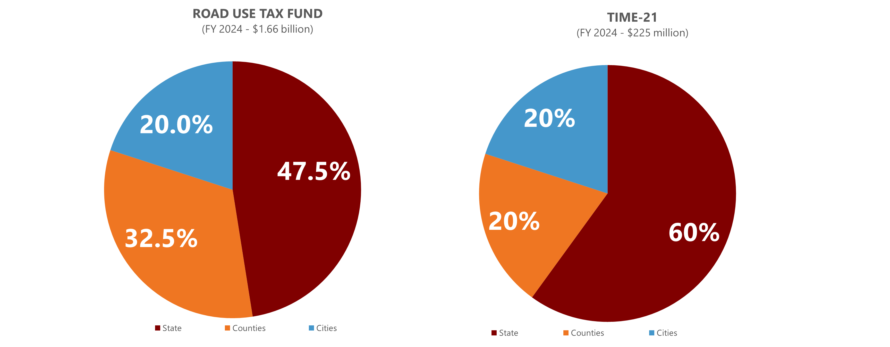
State Road Fund Distribution

Slide 4
Road Use Tax Fund Distribution
DOT: Primary Road Fund (47.5 percent)
Cities: Street Construction Fund (20 percent)
  Allocated to individual cities based on each city’s share of total state municipal population.
Counties (32.5 percent):
  Secondary Road Fund (24.5 percent)
    Allocated to individual counties based on a formula
  Farm-to-Market Fund (8 percent)
    Allocated to individual counties based on a formula

Slide 5
County Road Fund Distribution
Legislature established a Secondary Road Fund Distribution Advisory Committee (SRFDAC) in 2002 to consider new methodologies for fund distribution among counties and make recommendations to the general assembly
Committee met extensively from 2002 through 2004
  Assessed options to improve the need study process
  Reviewed past studies
  Reviewed other state methodologies
SRFDAC Recommendation submitted to the general assembly in January 2005
Legislature passed House File 674 in the 2005 Session
  Renamed the Secondary Road Fund Distribution Advisory Committee to the Secondary Road Fund Distribution Committee (SRFDC)
  Empowered SRFDC to determine the formula for distributing county road funds
  Directed SRFDC to adopt rules to govern the determination and modification of the formula for distribution of county road funds.
  Directed new methodology be phased-in over five-years beginning July 1, 2006 (FY 2007)

Slide 6
Past Administrative Rule Process
Iowa County Engineers Association Service Bureau annually calculates Secondary Road Fund and Farm-to-Market Fund distribution allocations using data from Iowa DOT.
Factor | Secondary Road Fund Weighting | Farm-to-Market Road Fund Weighting | Factor explanation
Area | 30% | 30% | Total area of each county, including urban areas – serves as measure of system size and extent
Pop | 10% | 15% | Rural population living outside incorporated areas
VMT | 12.5% | 10% | "Vehicle Miles of Travel per day" -- a measure of total traffic
Dirt | 0.5% | 0% | Miles of un-surfaced roads
Granular | 20% | 9% | Miles of granular surfaced roads
Paved | 13% | 23% | Miles of paved, seal-coated or otherwise weatherproofed roads
-LFBD- | 14% | 13% | Total lineal feet of bridge deck of all structures included in National Bridge Inventory [Span >= 20 ft]
 | 100% | 100%

Slide 7
Past Administrative Rule Process
Secondary Road Fund Distribution Committee
  Membership (twelve members)
    Six county engineers appointed by Iowa County Engineers Association
    Six county supervisors appointed by the Iowa State Association of County Supervisors
    Equal distribution of members from large, medium, and small counties with geographic diversity and no county having more than one member.
    Six-year staggered terms
  Meetings - at least once a year
  Resolution to propose a new or modified formula requires 10 affirmative votes
  Resolution to adopt, amend, or rescind administrative rules requires 10 affirmative votes

Slide 8
Past Administrative Rule Process
Changes to the distribution formula
  Can be proposed by committee or executive board of Iowa County Engineers Association or Iowa State Association of County Supervisors
  With a new proposal, committee will establish a work plan and schedule to complete a report within 18 months of request
  Report provided to all county engineers and supervisors for comment.
  After receipt of comment, the committee may adopt a resolution that formally proposes a distribution formula (10 affirmative votes)
  Both executive boards shall consider a request to endorse.
  With executive boards endorsement, each county considers and adopts a resolution in favor or in opposition.
  If at least 66 counties adopt resolutions in support, the new distribution formula is adopted.

Slide 9
Boards and Commissions Changes
Senate File 2385 – Passed in the 2024 Session
Eliminates SRFDC from Iowa Code
Requires Transportation Commission to adopt county road fund distribution formulas through administrative rules
Transportation Commission empowered to establish and utilize ad hoc advisory committees

Slide 10
Commission Action
Rescinded Chapter 102 – Secondary Road Fund Distribution Committee
Adopted new Chapter 103 – Secondary Road Fund Distribution Methodology
  Establish and utilize SRFDC as an ad hoc advisory committee to the Transportation Commission
  Retain current distribution formula
  Retain current process for considering changes to the formula and requirements for executive boards and counties to approve, with final consideration and approval by the Transportation Commission.

Slide 11
SRFDC Meetings
SRFDC meets 2 Times per Year, March and August
  March 2024 - Discussed Review of Proposed changes to IAC 102, SRFDC Formula Factor Updates, and Update on Road Use Tax Fund Projections.
  August 2024 – Review of Draft IAC Chapter 103 and report on new FY25 SRFDC Factors.
  March 2025 – No meeting
  No concerns with existing formula and no requests for consideration of changes to formula

Slide 12
SRFDC Factor Schedules
New Fiscal Year Factors
  Iowa DOT provides updated data by last week of June
  ICEASB calculates updated factors
  ICEASB distributes NEW FY SRFDC factors by July 1st (Secondary Road Fund Factors and Farm-to-Market Factors)
    Iowa County Engineers
    SRFDC Committee
    State of Iowa Treasurer
    Iowa DOT
Updated FY Factors for Budgeting
  Updated RUTF Revenue projections provided by Iowa DOT mid October
  ICEASB applies current FY factors to updated revenue for next FY budgets
  ICEASB distributes updated budget projections by late October
    Iowa County Engineers
No Action required by the Commission

Slide 13
FY 2026 SRFDC Factors
Secondary Road Fund Factors
  Range -0.746% (Mills County) to 2.179% (Polk County)
  Changes result of Traffic Count up/down and increase in bridge area
Farm to Market Fund Factors
  Range -1.351% (Lee County) to 2.928% (Dallas County)
  Changes result of Traffic Count up/down and decrease of bridge area

Slide 14
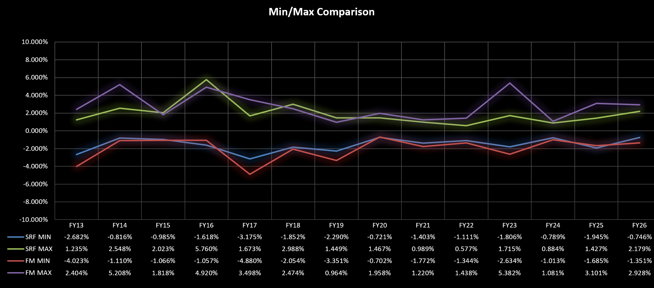
SRFDC Factor History - Stability

Slide 15
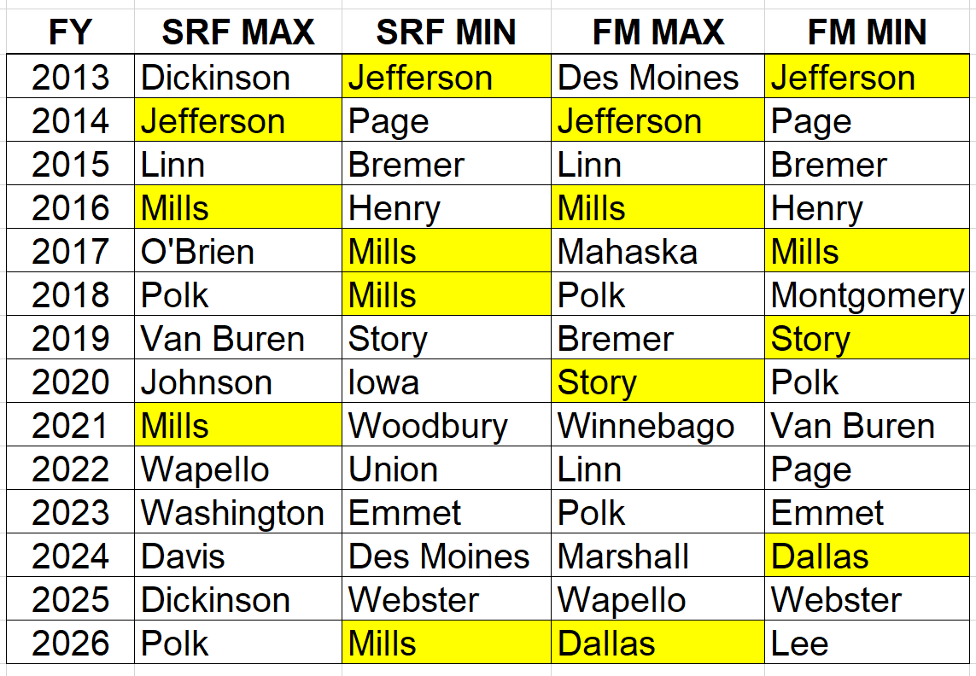
SRFDC Factor History - Stability

Slide 16



Questions?
stuart.anderson@iowadot.us
515-239-1661

