Slide 1



Transportation Trends Update
July 8, 2025
3/2/2023

Slide 2
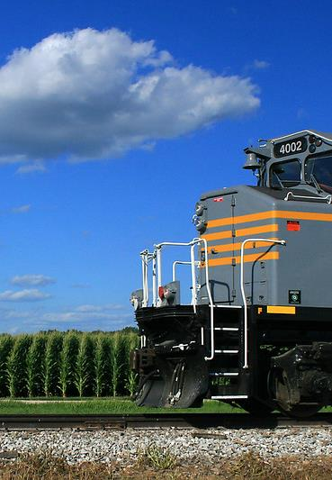

Agenda
US total rail carloads
Commercial air service passenger counts
Public transit ridership
Vehicular traffic

Slide 4
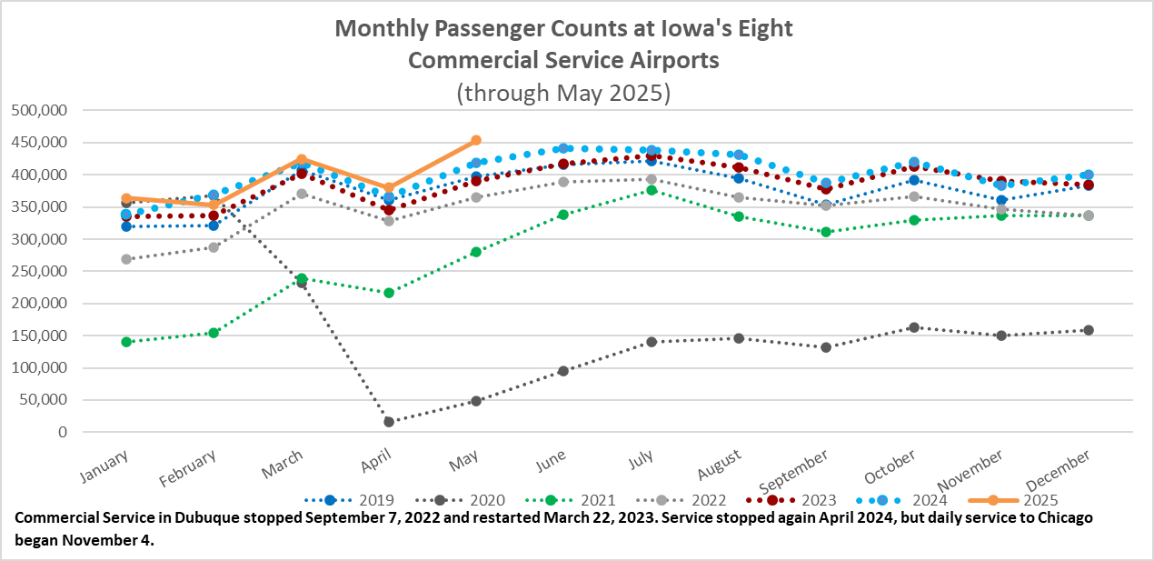

Slide 5
Monthly State Vehicle Miles of Travel
(through May 2025)
Vehicle Miles of Travel (in millions)

Slide 6
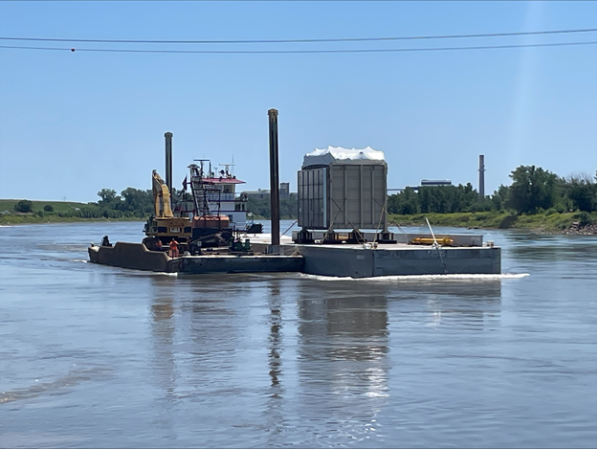
Missouri River Barge – June 20, 2025

Slide 7
Questions?

