Slide 1
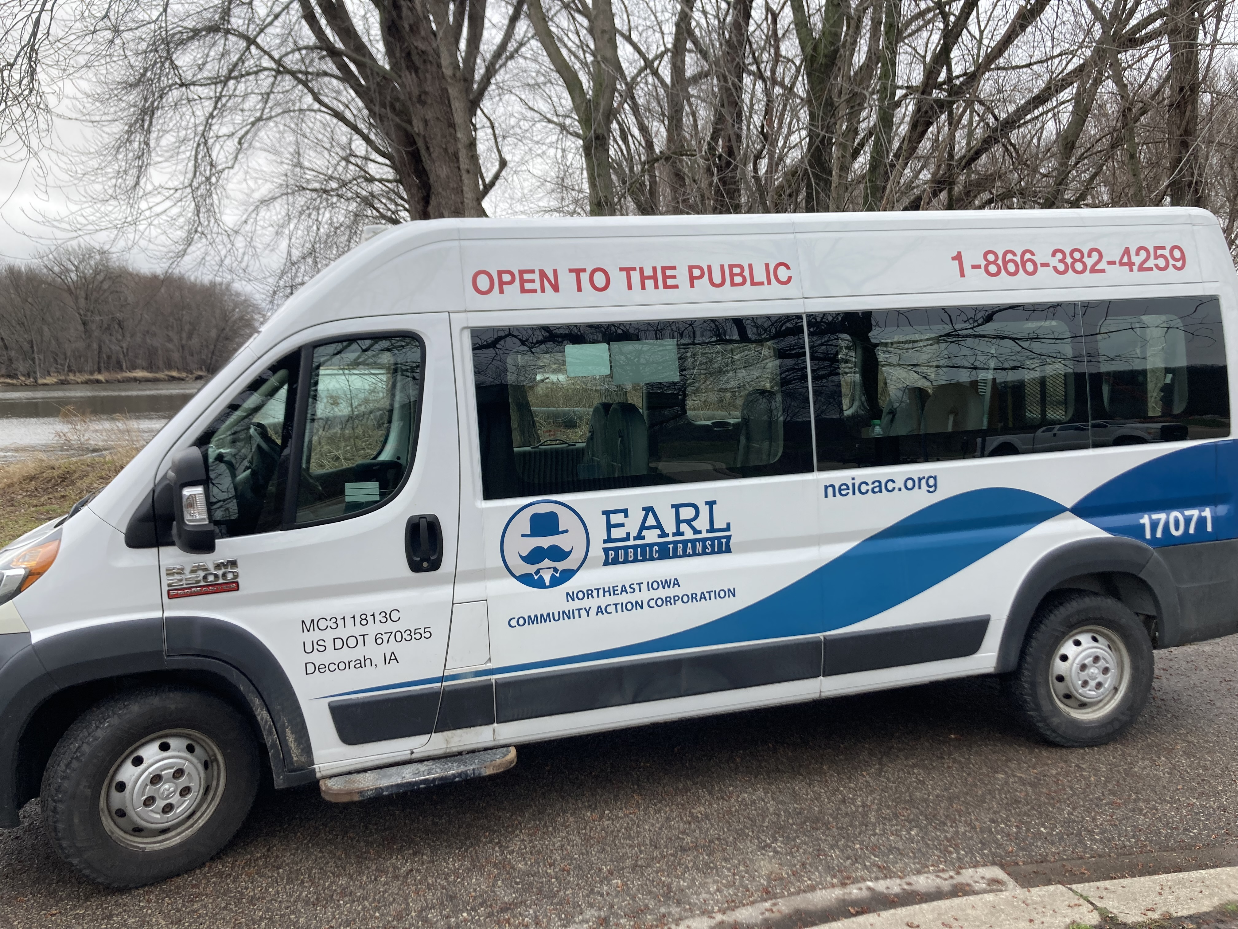
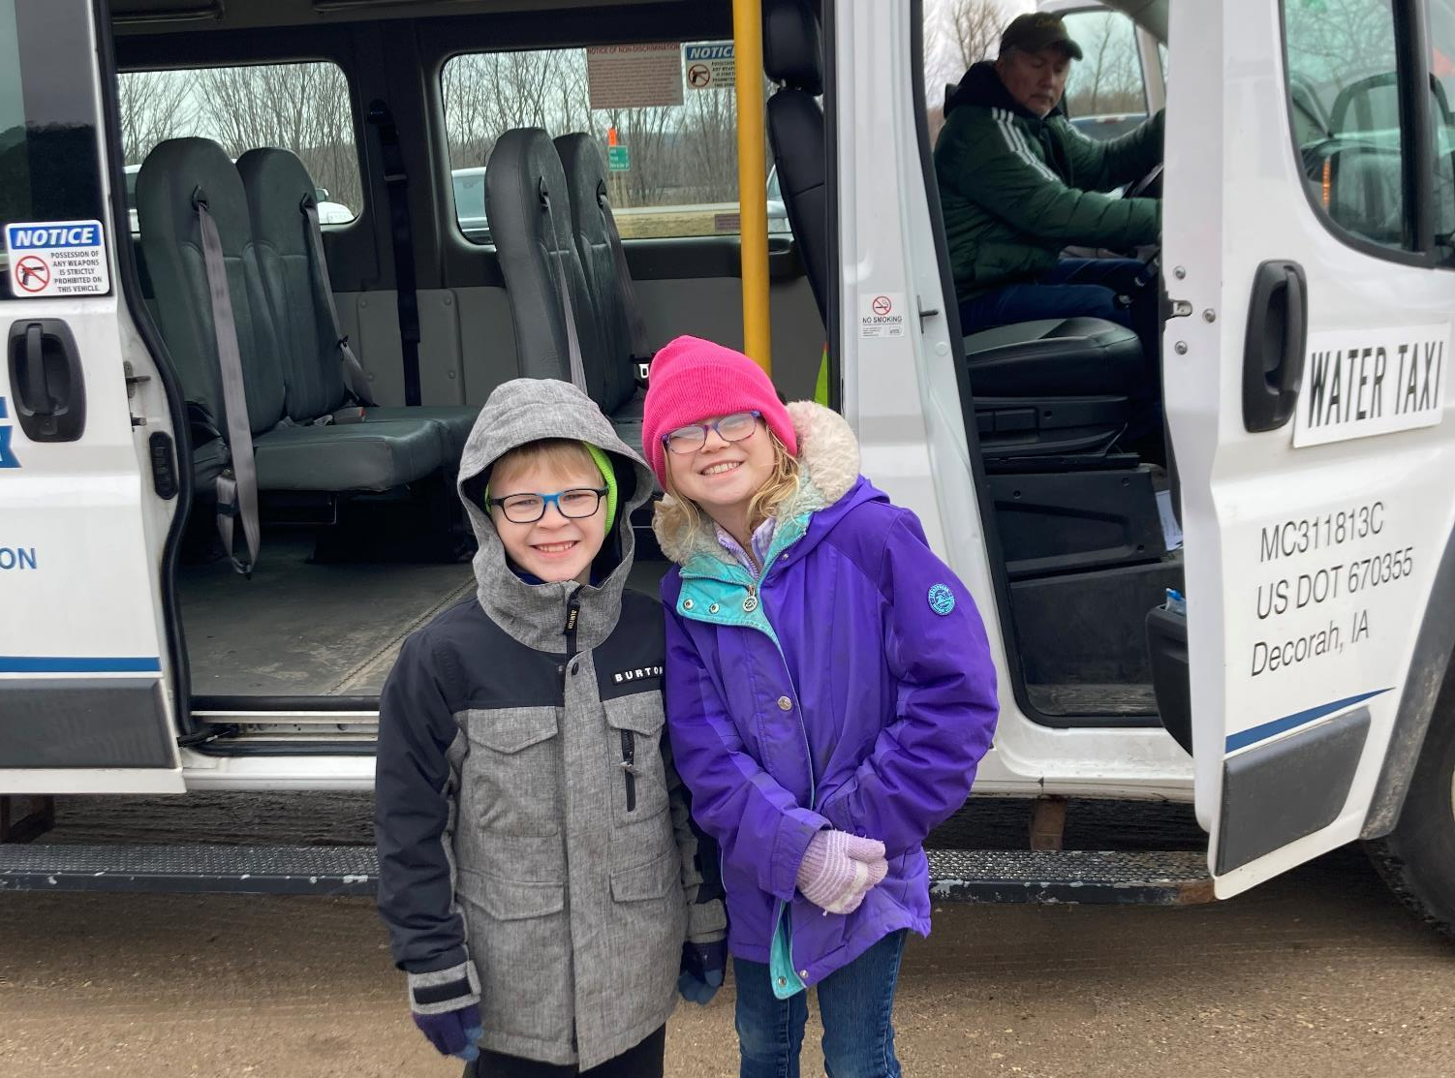


FY 2026 Public Transit Infrastructure
Grant Program
3/2/2023
Brent Paulsen
Transit Programs Manager
Commission Workshop July 8, 2025

Slide 2
Public Transit Infrastructure Grant Program
Program created by 2006 General Assembly
Funds vertical infrastructure projects for public transit
All 35 public transit systems are eligible
Notes:
The Public Transit Infrastructure Grant Program (PTIG) was created in 2006 by the General Assembly. This program funds vertical infrastructure projects for public transit. All 35 transit systems are eligible. Projects can involve new construction, reconstruction or remodeling.

Slide 3
Project Evaluation Criteria
No more than 40-percent of the funds available can be awarded to an individual transit system
Structural integrity of existing facilities
Safety enhancements to existing facilities
New facilities that enhance the life of the transit fleet or optimize transit service
Projects should be “shovel ready” and capable of completion in 18 months
Notes:
For this program, no more than 40-percent of the appropriation can be awarded to an individual transit system. The PTIG share is up to 80 percent of the project cost. The structural integrity of existing facilities, potential safety enhancements to existing facilities, as well as new facilities that will enhance the life of the transit fleet or optimize service are project considerations. Projects should be “shovel ready” and capable of completion within 18 months. Projects may include but are not limited to facilities for the administration of public transit operations, facilities for servicing, maintenance or storage of public transit vehicles, transit vehicle fueling facilities, bus wash bays, passenger waiting facilities.

Slide 4
Available Funding and Application Summary
Annual appropriation: $1,200,000
Underrun/withdrawals: $215,240
Funds available: $1,415,240
Total number of projects: 4
Total project costs: $13,271,183
Total PTIG requested: $1,560,000
Notes:
The PTIG annual appropriation for FY26 is $1.2 million. There is $215,240 in underrun/withdrawal funds to add to the annual appropriation totaling $1,415,240 in available funding. Four projects were submitted totaling $13,271,183 in federal, state, and local project costs. The total amount of PTIG requested is $1,560,000.

Slide 5
Table of Projects Recommended For Award
Project Name | Sponsor | Total Project Cost | Requested Amount (% of Total Project Cost) | Recommended Amount (% of Total Project Cost)
Maintenance Facility Expansion and Modernization | University of Iowa, Cambus | $12,067,590 | $600,000 (4.97%) | $566,096 (4.69%)
In-Ground Hoist Replacement | Ames Transit Agency, Cyride | $750,000 | $600,000 (80.00%) | $566,096 (75.48%)
Revolving Door Replacement | Des Moines Area Regional Transit Authority | $153,593 | $120,000 (78.13%) | $120,000 (78.13%)
Passenger Elevator Replacement | Sioux City Transit | $300,000 | $240,000 (80.00%) | $163,048 (54.35%)
Jump to Projects Not Recommended For Award
Notes:
Four projects are recommended for award. The first project is Maintenance Facility Expansion and Modernization at the University of Iowa Cambus. It has a total project cost of $12,067,590, with a requested amount of $600,000 and recommended funding amount of $566,096. The second project is In-Ground Hoist Replacement for Ames Transit Agency, Cyride. The total project cost is $750,000, with a requested amount of $600,000 and recommended funding amount of $566,096. The third project is Revolving Door Replacement for Des Moines Area Regional Transit Authority. The total project cost is $153,593 with a requested and recommended amount of $120,000. The fourth project is Passenger Elevator Replacement for Sioux City Transit. The total project costs is $300,000 with a requested amount of $240,000 and recommended amount of $163,048.

Slide 6
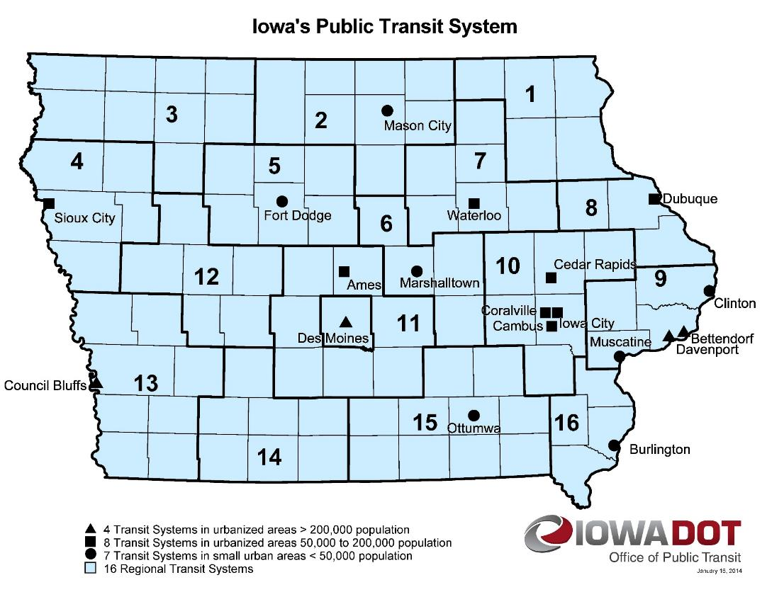
Questions?
CONTACT NAME
###-###-####
email@iowadot.gov​
iowadot.gov

Slide 7
Questions?
Brent Paulsen
515-239-1132
Brent.Paulsen@iowadot.gov​
iowadot.gov
For more information on Iowa’s public transit and intercity bus programs, visit
www.iowadot.gov/transit

Slide 8
Project Recommended
for Award
University of Iowa Cambus
Maintenance Facility Expansion and Modernization
Construct a 25,000 square foot expansion and modernization of the CAMBUS Maintenance Facility
Funding Request: $600,000
Recommended: $566,096 (80%)
Return to Table of Projects Recommended for Award
Notes:
Cambus will construct a 25,000 sqft expansion and modernization of the CAMBUS Maintenance Facility, located at 517 S. Madison Street in Iowa City. The expansion will create new dedicated maintenance bays to replace maintenance bays that have several safety deficiencies and return the existing maintenance bays to bus storage. The new maintenance bays will also support alternatively fueled buses, including battery-electric buses, hybrid, and fuel cell. CAMBUS plans to purchase its first six battery-electric buses in fall 2025. The modernization and rehabilitation portion of the project will include new maintenance offices, and adding operations offices, meeting rooms, and classrooms to the facility. The support spaces will improve operational efficiency of the transit system.
Cambus was awarded $16,376,765 in FTA FY24 Low/No Emissions Program funding for the transit portion of the facility project and battery electric bus procurement. The project was based on cost estimates from April 2024. The total project cost of the transit portion (53%) and non-transit portion (47%) of the facility submitted in the Low/No application was $18,855,206, and as of April 2025 was $22,769,038, an increase of 21%. The transit use only cost estimate of the building increased from $9,993,259 to $12,067,590 ($2,074,331 additional). The PTIG funds will offset a portion of the increased local match for the FTA Low/No Emission project.

Slide 9
Project Recommended
for Award
Ames Transit Agency, CyRide
In-Ground Hoist Replacement
Replace in-ground bus hoist with two new in-ground hoists capable of lifting two 40-foot buses independently or operating in sync to lift one 60-foot articulated bus.
Funding Request: $600,000
Recommended: $566,096 (80%)
Return to Table of Projects Recommended for Award
Notes:
Cyride will replace the current in-ground bus hoist in Steam Clean Bay with two new in-ground hoists capable of lifting two 40-foot buses independently or operating in sync to lift one 60-foot articulated bus. The existing hoist, installed in 2010, is past its useful life and cannot accommodate lifting an articulated bus which CyRide began purchasing in 2012 to accommodate increased passenger demand. These new hoists will allow CyRide to remove sand, oil and debris from bus engines and transmissions of its entire fleet prior to working on the vehicle to keep them in a state of good repair.

Slide 10
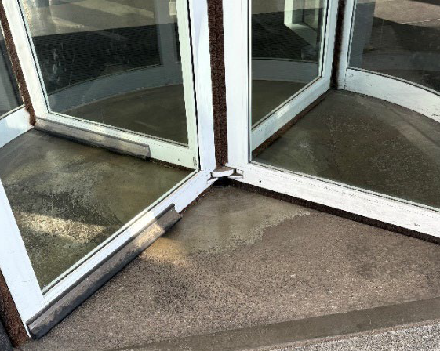
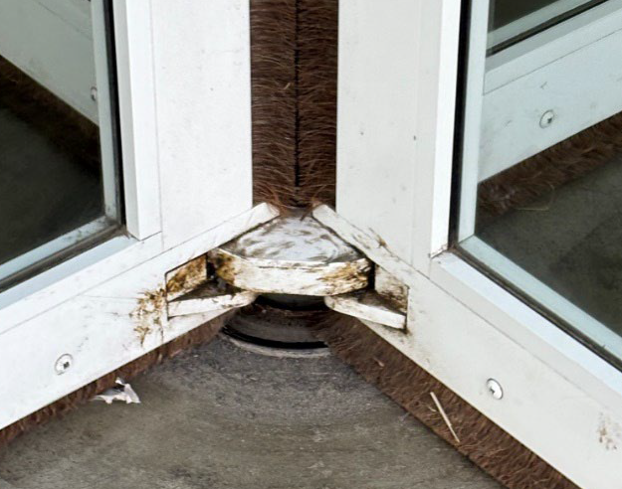
Project Recommended
for Award
Des Moines Area Regional Transit Authority
Revolving Door Replacement
Replacement of two revolving door systems and surrounding flooring at primary customer facility, DART Central Station.
Funding Request: $153,593
Recommended: $120,000 (80%)
Return to Table of Projects Recommended for Award
Notes:
DART will replace the original automated revolving doors, installed when the building was constructed in 2012. These doors are costly to maintain and have frequent issues:
• Temperature control challenges due to inadequate door sealing and constant
rotation
• Mechanical failures, including axle damage
• Extended periods of non-operation, especially during extreme cold
• Physical abuse and misuse from pedestrians pushing or forcing the doors
• Foreign objects and debris becoming lodged under the doors, causing damage to both the doors and flooring

Slide 11
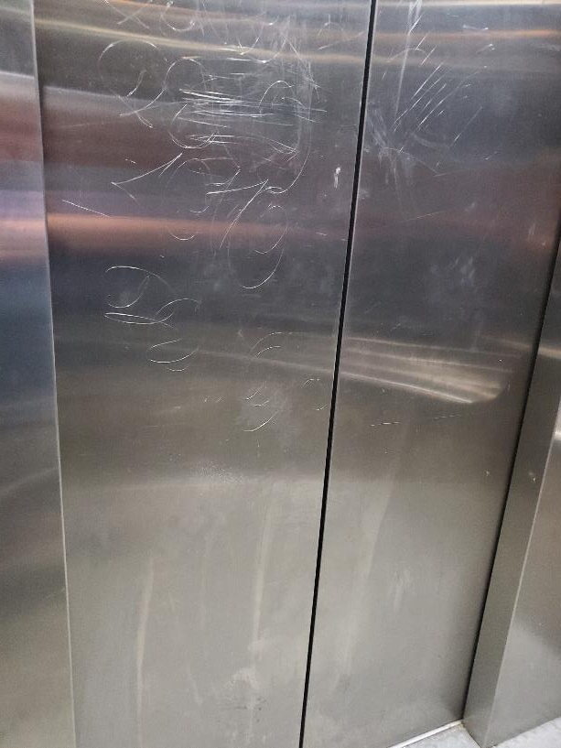
Project Recommended
for Award
Sioux City Transit
Passenger Elevator Replacement
This project will provide replacement and upgrade for two elevators in the Martin Luther King Jr. Transportation Center
Funding Request: $240,000
Recommended: $163,048 (80%)
Return to Table of Projects Recommended for Award
Notes:
Sioux City will replace and upgrade the elevator controller, door operator, traveling cable, hoist way wiring, and other items to both elevators in Martin Luther King Jr. Transportation Center, which provides transit and parking facilities with skywalk accessibility to downtown buildings in the skywalk system.

