Slide 1
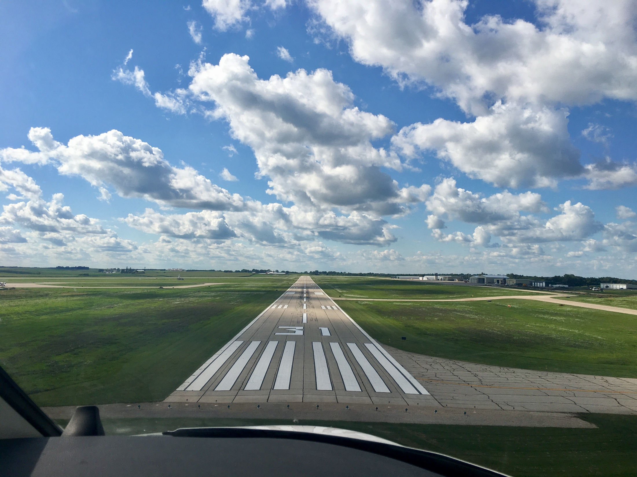

FY2026 State Aviation Program
Funding Recommendation
Shane Wright
Aviation Program Manager
7/8/2025

Slide 2
State Aviation Programs - Overview
Three state programs for review
Airport Improvement Program (AIP)
Funded through Aviation Fuel Taxes and Aircraft Registration fees deposited into the State Aviation Fund
General Aviation Vertical Infrastructure (GAVI)
Funded through Rebuild Iowa Infrastructure (RIIF) appropriation
Commercial Service Vertical Infrastructure (CSVI)
Funded through Rebuild Iowa Infrastructure (RIIF) appropriation
Commission Role
The commission is responsible for approving the projects to be funded in all three of these programs
Process
Projects are presented for review at the July meeting and commission action will be requested at the August meeting

Slide 3
State Aviation Program - AIP
Includes Airport Improvement Program (AIP)
Public-owned airport sponsors may apply for grants to assist in the preservation and development of the airfield and related infrastructure.
Eligible projects are funded up to 85% and generally include planning and improvements related to enhancing airport safety, capacity, security and environmental concerns.

Slide 4
Project Evaluation Criteria
Airport Role (5-20 Points)
Local participation (5-30 Points)
Multi-jurisdictional support (0-10 Points)
Type of project (5-30 Points)
Justification (5-20 Points)

Slide 5
Available Funding and Application Summary
Available Funding:
FY26 Funds Available: $ 6,730,423
Aviation Safety Programs: $ (370,000)
Aviation Development Programs: $ (473,000)
Funds available for projects: $ 5,887,423
Application Summary:
Total number of applications: 45
Total project costs: $19,810,582
Total amount requested: $12,703,722

Slide 6
List of Applications Recommended
PROJECT NAME | SPONSOR | SCORE | TOTAL PROJECT COST | REQUESTED AMOUNT (% of Total Project Cost) | RECOMMENDED AMOUNT (% of Total Project Cost)
Snow Removal Equipment Building Site Improvements and Paving | The Eastern Iowa Airport | 85 | 3,081,193 | 400,000 (13%) | 400,000 (13%)
Fuel Farm Improvements - Jet A | Ames Municipal Airport | 80 | 725,000 | 412,500 (57%) | 400,000 (55%)
Construct Hangar Apron | Council Bluffs Municipal Airport | 80 | 165,000 | 82,500 (50%) | 82,500 (50%)
North GA Apron Entrance Taxilane | Des Moines International Airport | 80 | 874,751 | 396,638 (45%) | 396,638 (45%)
Reconstruct GA Apron | Dubuque Regional Airport | 80 | 670,000 | 400,000 (60%) | 400,000 (60%)
Replace Runway 15/33 Edge Lighting and REIL | Boone Municipal Airport | 75 | 550,000 | 401,500 (67%) | 400,000 (67%)
Construct Taxilane | Muscatine Municipal Airport | 75 | 550,000 | 400,000 (73%) | 400,000 (72%)
Apron Expansion | Pella Municipal Airport | 75 | 609,500 | 365,700 (73%) | 365,700 (73%)
South Apron Reconstruction - Phase II | Sioux Gateway Airport | 75 | 600,000 | 400,000 (60%) | 400,000 (60%)
Site Work to Construct Maintenance Facility | Ankeny Regional Airport | 75 | 150,000 | 100,000 (75%) | 100,000 (75%)
South Apron Expansion - Phase II | Sioux County Regional Airport | 75 | 376,412 | 282,309 (67%) | 282,309 (67%)
East Taxilane Extension | Atlantic Municipal Airport | 70 | 130,000 | 91,000 (70%) | 91,000 (70%)
Reconstruct Taxiway C and Apron Entrance | Davenport Municipal Airport | 70 | 500,000 | 400,000 (80%) | 400,000 (80%)
Parallel Taxiway - Turf | Estherville Municipal Airport | 70 | 570,000 | 399,000 (70%) | 399,000 (70%)
Reconstruct Parking Apron | Grinnell Regional Airport | 70 | 375,000 | 300,000 (80%) | 300,000 (80%)
Construct Taxiway and Reconstruct Apron | Le Mars Municipal Airport | 70 | 550,000 | 401,500 (73%) | 320,420 (58%)
Zoning Ordinance Development | Sheldon Regional Airport | 70 | 20,000 | 17,000 (85%) | 17,000 (85%)
Runway Pavement Repairs | Sibley Municipal Airport | 70 | 60,000 | 48,000 (80%) | 48,000 (80%)
Construct Hangar Approaches | Spencer Municipal Airport | 70 | 207,410 | 165,928 (80%) | 165,928 (80%)
Remove and Trim Trees | Milford Municipal Airport | 65 | 55,660 | 44,528 (80%) | 44,528 (80%)
Develop ALP | Waukon Municipal Airport | 65 | 37,500 | 30,000 (80%) | 30,000 (80%)
Obstruction Mitigation | Spirit Lake Municipal Airport | 65 | 61,000 | 48,800 (80%) | 48,800 (80%)
New GA Terminal Site Improvements | Creston Municipal Airport | 60 | 186,000 | 158,100 (85%) | 158,100 (85%)
Construct Taxilane | Mount Pleasant Municipal Airport | 60 | 485,000 | 412,250 (85%) | 225,000 (46%)
Replace Airport Entrance Sign | Algona Municipal Airport | 55 | 25,000 | 12,500 (50%) | 12,500 (50%)
Jump to applications not recommended for funding

Slide 7
State Aviation Program - GAVI
General Aviation Vertical Infrastructure(GAVI)
Public owned general aviation airport sponsors may apply for projects that include landside development and renovation of airport terminals, hangars, maintenance buildings, and fuel facilities.
Eligible projects are funded up to 85%
Funds are subject to annual appropriation

Slide 8
Project Evaluation Criteria
Airport Role (5-20 Points)
Local participation (5-30 Points)
Multi-jurisdictional support (0-10 Points)
Type of project (10-30 Points)
Justification (5-20 Points)

Slide 9
Available Funding and Application Summary
Available Funding:
FY26 Funds Appropriated: $1,000,000
Project Cancellations and Underrun: $35,720
Funds available for projects $1,035,720
Application Summary:
Total number of applications: 10
Total project costs: $4,563,043
Total amount requested: $1,844,709

Slide 10
List of GAVI Applications Recommended
PROJECT NAME | SPONSOR | SCORE | TOTAL PROJECT COST | REQUESTED AMOUNT (% of Total Project Cost) | RECOMMENDED AMOUNT (% of Total Project Cost)
Construct Box Hangar | Council Bluffs Municipal Airport | 95 | 1,000,000 | 300,000 (30%) | 300,000 (30%)
Construct Maintenance Storage Facility | Ankeny Regional Airport | 80 | 1,661,000 | 300,000 (18%) | 300,000 (18%)
Construct Hangars | Mount Pleasant Municipal Airport | 80 | 526,400 | 300,000 (57%) | 300,000 (57%)
New GA Terminal Building | Creston Municipal Airport | 75 | 226,200 | 135,720 (60%) | 135,720 (60%)
Jump to applications not recommended for funding

Slide 11
State Aviation Program - CSVI
The Commercial Service Vertical Infrastructure (CSVI) program provides funding for landside development and renovation of terminals, hangars, maintenance buildings, and fuel facilities at commercial service airports.
Appropriated funds are distributed to the commercial service airports formula with no local match required.
50% evenly split between the airports
40% based on enplanements
10% based on cargo activity

Slide 12
Available Funding and Application Summary
Available Funding:
FY26 Funds Appropriated: $1,900,000
Funds available for projects: $1,900,000
Application Summary:
Total number of projects: 8
Total project costs: $33,993,307
Total amount requested: $1,900,000
Unused funds will be carried forward to current approved projects

Slide 13
List of CSVI Applications Recommended
PROJECT NAME | SPONSOR | SCORE | TOTAL PROJECT COST | REQUESTED AMOUNT (% of Total Project Cost) | RECOMMENDED AMOUNT (% of Total Project Cost)
Maintenance Facility Expansion | Des Moines International Airport | N/A | $1,314,000 | $718,040 | $718,040
Snow Removal Building, Exitlane, Hangar Improvements, Fuel Farm Improvements | Dubuque Regional Airport | N/A | $300,000 | $124,238 | $124,238
Snow Removal Equipment Building | Eastern Iowa Airport | N/A | $31,513,261 | $445,250 | $445,250
Terminal and Hangar Renovations | Fort Dodge Regional Airport | N/A | $125,000 | $120,812 | $120,812
Construct Utility Building | Mason City Municipal Airport | N/A | $360,650 | $120,674 | $120,674
Terminal Improvements - Roof, Boilers, Doors | Sioux Gateway Airport | N/A | $127,776 | $127,776 | $127,776
Hangar Improvements, Expand Hold Area, Covered Walkway | Southeast Iowa Regional Airport | N/A | $125,000 | $120,107 | $120,107
Terminal Renovations | Waterloo Regional Airport | N/A | $127,620 | $123,103 | $123,103

Slide 15


Questions?
shane.wright@iowadot.us
515-239-1048

Slide 16
List of AIP Applications Not Recommended
PROJECT NAME | SPONSOR | SCORE | TOTAL PROJECT COST | REQUESTED AMOUNT (% of Total Project Cost) | RECOMMENDED AMOUNT (% of Total Project Cost)
SRE Building Site Improvements | Muscatine Municipal Airport | 75 | 350,000 | 262,500 | 0
Fuel System Site Work and Facilities | Cherokee County Regional Airport | 70 | 395,643 | 276,950 | 0
Hangar Building Site Improvements | Perry Municipal Airport | 70 | 405,000 | 283,500 | 0
Reconstruct Taxilane Row B/C | Clinton Municipal Airport | 70 | 357,143 | 300,000 | 0
Reconstruct Apron Pavement | Southeast Iowa Regional Airport | 70 | 476,190 | 400,000 | 0
Fuel System Improvements - AVGAS | Belle Plaine Municipal Airport | 65 | 350,000 | 262,500 | 0
Upgrade Airport Water Service | Greenfield Municipal Airport | 65 | 60,000 | 30,000 | 0
Update Fuel System | Harlan Municipal Airport | 65 | 520,000 | 400,000 | 0
Terminal Building Flooding Mitigation | Iowa Falls Municipal Airport | 65 | 120,750 | 84,525 | 0
Fuel Farm Paving Reconstruction | Jefferson Municipal Airport | 65 | 320,000 | 240,000 | 0
Reconstruct Hangar Area paving | Newton Municipal Airport | 65 | 276,250 | 234,812 | 0
Taxilane Rehabilitation | Ottumwa Regional Airport | 65 | 468,350 | 398,097 | 0
Construct Taxilanes | Iowa City Municipal Airport | 65 | 472,730 | 401,820 | 0
Drainage Improvements | Washington Municipal Airport | 65 | 500,000 | 375,000 | 0
Hangar Approach and Parking Lot Paving | Forest City Municipal Airport | 55 | 314,600 | 251,680 | 0
Runway Reconstruction | Osage Municipal Airport | 55 | 1,700,000 | 1,445,000 | 0
Runway Lighting Replacement | Osage Municipal Airport | 55 | 300,000 | 255,000 | 0
Security Fence Improvements | Sheldon Regional Airport | 55 | 110,300 | 93,755
Rehabilitate Parking Lot and Entrance Road | Iowa Falls Municipal Airport | 50 | 554,500 | 415,875
Pave Existing Gravel Surfaces | Osceola Municipal Airport | 40 | 144,700 | 122,955
Jump to applications recommended for funding

Slide 17
List of GAVI Applications Not Recommended
PROJECT NAME | SPONSOR | SCORE | TOTAL PROJECT COST | REQUESTED AMOUNT (% of Total Project Cost) | RECOMMENDED AMOUNT (% of Total Project Cost)
Terminal Rehab and Building Removal | Webster City Municipal Airport | 75 | 30,000 | 15,000 | 0
Construct Hangars | Perry Municipal Airport | 75 | 214,263 | 149,984 | 0
Construct Hangars | Iowa City Municipal Airport | 75 | 364,880 | 300,000 | 0
Construct Snow Removal Equipment Building | Muscatine Municipal Airport | 70 | 365,000 | 200,750 | 0
Replace Hangar Door Components | Estherville Municipal Airport | 70 | 115,000 | 92,000 | 0
Terminal Exterior and Septic Rehabilitation | Mathews Memorial Airport | 50 | 60,300 | 51,255 | 0
Jump to applications recommended for funding

