Slide 1
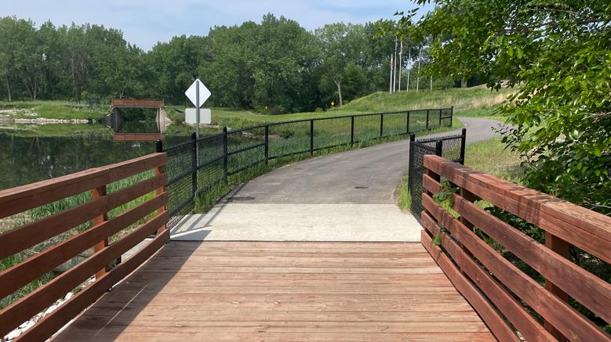

Statewide Transportation Alternatives
Set-aside Program
Funding Recommendation
Debra Arp
Local Systems Bureau, Grant Team Leader
7/08/25

Slide 2
Statewide Transportation Alternatives Set-Aside Program
Current version of program in existence since 1991
Majority of funding is distributed to Iowa’s MPOs and RPAs, but $5 million reserved for statewide projects annually with 20% target for Safe Routes to School projects
Available to a variety of project sponsors but most applicants are cities and counties
2
2

Slide 3
Eligible Activities
On-road and off-road non-motorized trail facilities, safe routes for non-drivers, conversion of abandoned rail corridors for trails, preservation/rehabilitation of historic transportation facilities among others
Federal Recreational Trails Program eligible activities
Infrastructure-related or non-infrastructure related Safe Routes to School Projects
Scenic Byways
3
3

Slide 4
Project Evaluation Criteria
Criteria | Points
Statewide or multi-regional impact of the project | 25
Connectivity and Completion of Trail Linkages | 15
Alignment with Local, Regional, or Statewide Planning Documents | 15
Federal-aid Project Development Process, Understanding & Capacity | 10
Contribution Toward Safety for All Transportation Modes | 10
Enhancement of Statewide Tourism Benefits | 10
Leverage of other funding sources | 10
Need for the proposed project | 10
Addresses high-need areas | 10
Improve accessibility | 5
Long-term maintenance plan | 5
Project readiness | 5
MAXIMUM POINTS | 130
4
4

Slide 5
Available Funding and Application Summary
Available Funding: | Column 2
FY2026 Funding Remaining | $9,000,000 | $4,976,134
Underruns from closed projects | $1,800,000 (20%) | $1,537,059
Total Funding Available | $8,000,000 | $6,513,193
Application Summary:
Total number of projects: | 16
Total project costs | $29,506,036
Total amount requested | $18,603,430
5
5

Slide 6
Applications Recommended
PROJECT NAME | SPONSOR | SCORE | TOTAL PROJECT COST | REQUESTED AMOUNT (% of Total Project Cost) | RECOMMENDED AMOUNT (% of Total Project Cost)
Iowa River’s Edge Trail Bridges & Great American Rail Trail Connector | Marshalltown | 113 | $3,353,000 | $2,000,000 (60%) | $2,000,000 (60%)
Waukee Regional Trail Connection and Safety Improvements Project | Waukee | 112 | $5,588,000 | $2,000,000 (36%) | $2,000,000 (36%)
Emmons Street Pedestrian Bridge over I-380 | Hiawatha | 111 | $1,056,000 | $792,000 (75%) | $792,000 (75%)
6
Jump to Applications Not Recommended for Funding
6

Slide 7
Applications Recommended
PROJECT NAME | SPONSOR | SCORE | TOTAL PROJECT COST | REQUESTED AMOUNT (% of Total Project Cost) | RECOMMENDED AMOUNT (% of Total Project Cost)
Duck Creek Trail Underpass at Division Street | Davenport | 107 | $256,500 | $205,200 (80%) | $205,200 (80%)
Iowa River’s Edge Trail Paving from Gifford to Union | Hardin County | 103 | $1,482,000 | $1,185,600 (80%) | $1,185,600 (80%)
7
Jump to Applications Not Recommended for Funding
7

Slide 8
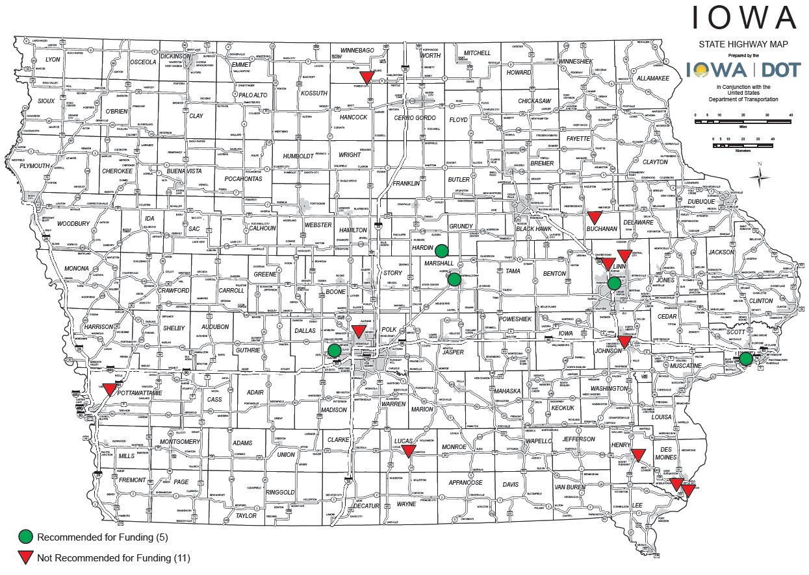
Applications Received & Recommended
8

Slide 9



Questions?
susan.hollenkamp@iowadot.us
515-239-1810

Slide 10
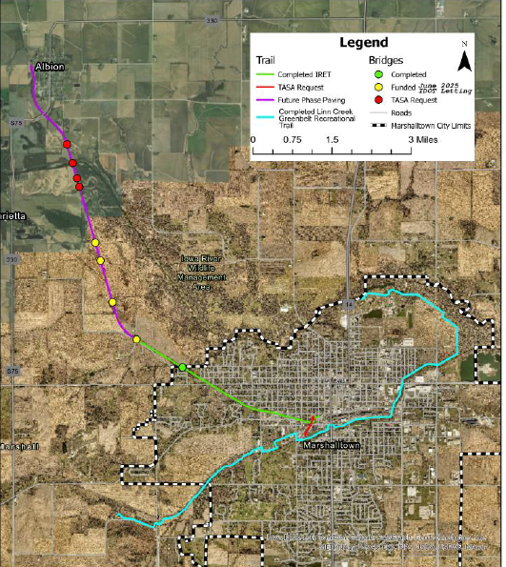
Iowa River’s Edge Trail Bridges & Great American Rail Trail Connector
(Marshalltown)
This project rehabilitates three and replaces one existing rail bridge providing a safe 2.7 mile unimproved segment of the Iowa River's Edge Trail north to Albion & constructs a 0.3-mile trail connection to the Linn Creek Greenbelt Trail in Marshalltown.
Total Cost: $3,353,000
Requested: $2,000,000 (60%)
Return to List of Applications Recommended
10

Slide 11
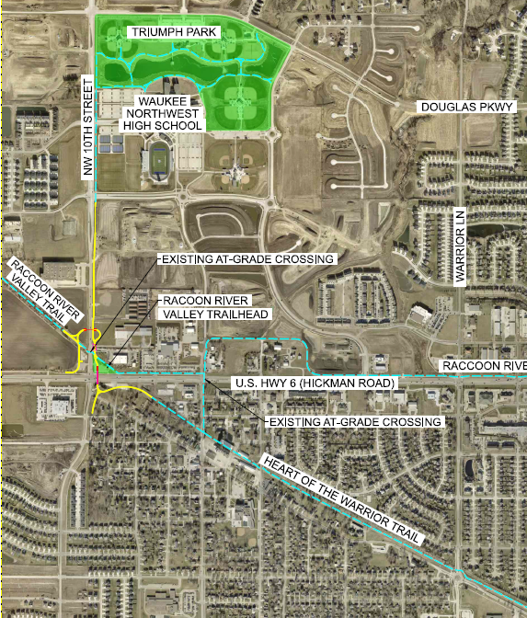
Waukee Regional Trail Connection & Safety Improvements Project
(Waukee)
This project will construct 0.84 mile of trail between the Raccoon River Valley Trail and the Heart of the Warrior Trail including trail underpasses at U.S. 6 and NW 10th Street in Waukee.
Total Cost: $5,588,000
Requested: $2,000,000 (36%)
Return to List of Applications Recommended
11

Slide 12
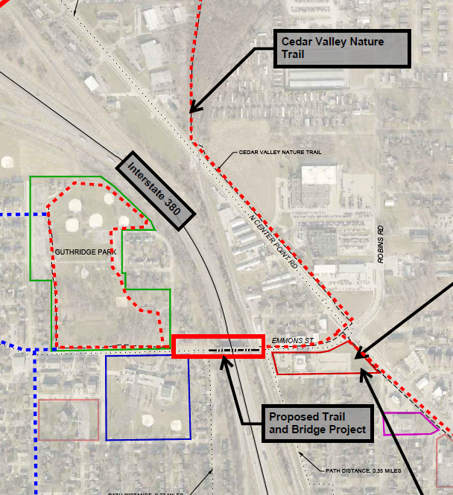
Emmons Street Pedestrian Bridge over I-380
(Hiawatha)
The project will construct 400-foot of trail and a pedestrian trail bridge over I-380 connecting the Emmons Street Trail and Guthridge Park and providing a route for west Hiawatha to access the 52-mile Cedar Valley Nature Trail.
Total Cost: $1,056,000
Requested: $792,000 (75%)
Return to List of Applications Recommended
12

Slide 13
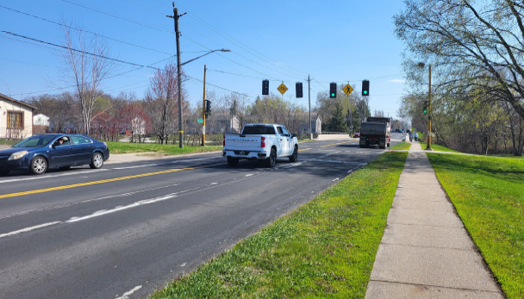
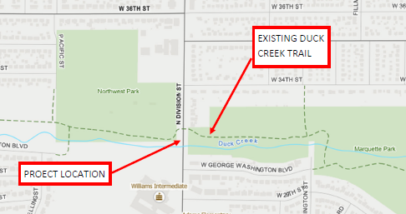
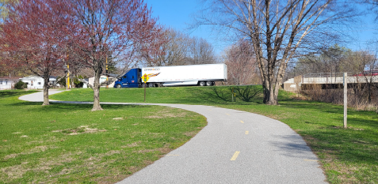
Duck Creek Trail Underpass at Division Street
(Davenport)
This project will replace an at-grade crossing on a four-lane arterial roadway with a 425-foot trail underpass of Duck Creek Trail at Division Street.
Total Cost: $256,500
Requested: $205,200 (80%)
Return to List of Applications Recommended
13

Slide 14
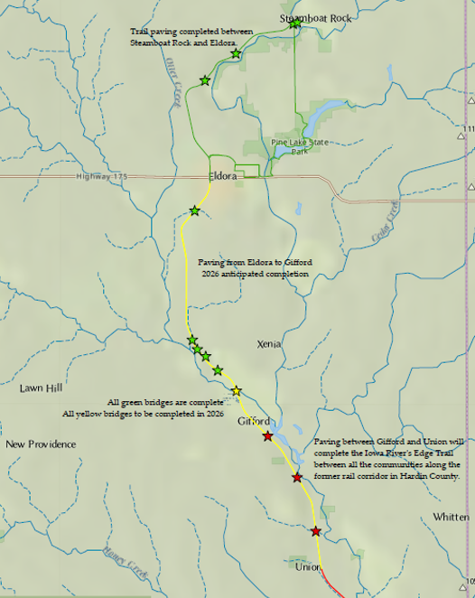
Iowa River’s Edge Trail Paving from Gifford to Union
(Hardin County)
This project will pave 3.6 miles of the Iowa River’s Edge Trail from Gifford to Union to create a nearly 14-mile continuous paved trail south from Steamboat Rock.
Total Cost: $1,482,000
Requested: $1,185,600 (80%)
Return to List of Applications Recommended
14

Slide 15
List of Applications Not Recommended for Award
PROJECT NAME | SPONSOR | SCORE | TOTAL PROJECT COST | REQUESTED AMOUNT (% of Total Project Cost) | RECOMMENDED AMOUNT (% of Total Project Cost)
NW 94thAvenue Trail Connection to the Neal Smith Trail | Polk County Conservation Board | 102 | $831,000 | $664,800 (80%) | $0 (0%)
Great American Rail Trail - Weston to Underwood | Pottawattamie County Conservation Board | 100 | $4,224,000 | $2,000,000 (47%) | $0 (0%)
Summer Street-Dankwardt Park Connector Trail | Burlington | 99 | $942,000 | $750,000 (80%) | $0 (0%)
Wapsi Bluff Trail – Central City, Iowa | Linn County Conservation Board | 96 | $782,623 | $375,000 (48%) | $0 (0%)
15
Return to List of Applications Recommended
15

Slide 16
List of Applications Not Recommended for Award
PROJECT NAME | SPONSOR | SCORE | TOTAL PROJECT COST | REQUESTED AMOUNT (% of Total Project Cost) | RECOMMENDED AMOUNT (% of Total Project Cost)
Washington-Grand Connector Trail | Mount Pleasant | 92 | $1,647,100 | $1,317,000 (80%) | $0 (0%)
Iowa River Trail – West Bank Project | Iowa City | 91 | $3,600,000 | $2,880,000 (80%) | $0 (0%)
Tim Coffey Trail – Phase 2C | Forest City | 90 | $500,000 | $400,000 (80%) | $0 (0%)
16
Return to List of Applications Recommended
16

Slide 17
List of Applications Not Recommended for Award
PROJECT NAME | SPONSOR | SCORE | TOTAL PROJECT COST | REQUESTED AMOUNT (% of Total Project Cost) | RECOMMENDED AMOUNT (% of Total Project Cost)
Taylors Ford Bridge Rehabilitation | Buchanan County Secondary Roads | 85 | $2,244,275 | $1,795,000 (80%) | $0 (0%)
Agency Road Trail | West Burlington | 84 | $2,351,000 | $1,800,000 (77%) | $0 (0%)
ADA Compliant Sidewalk Project – City Segment | Chariton | 77 | $48,538 | $38,830 (80%) | $0 (0%)
17
Return to List of Applications Recommended
17

Slide 18
List of Applications Not Recommended for Award
PROJECT NAME | SPONSOR | SCORE | TOTAL PROJECT COST | REQUESTED AMOUNT (% of Total Project Cost) | RECOMMENDED AMOUNT (% of Total Project Cost)
Morgan Creek Trail, Cedar River Bridge Plans | Linn County Conservation Board | 55 | $600,000 | $400,000 (67%) | $0 (0%)
18
Return to List of Applications Recommended
18

