Slide 1
Doc Express®
July 15, 2025, Improvements

Slide 2
Webinar Review
All Participants are muted
As our presentation unfolds, please drop your questions in the Q/A
We will have people monitoring the Q/A during the Webinar
Will have time for Q/A at the end of the presentation

Slide 3
Introductions
Cedric Wilkinson, CMB, E-Construction Program Administrator
Jen Strunk, CMB, AASHTOWare/Doc Express Support Lead
Derek Peck, Local Systems, E-Construction Program Administrator
Doug Heeren, Local Systems, Agreements Specialist

Slide 4
Scott Nixon, District 1, District Construction Engineer
Kevin Merryman, CMB, Contract Administration Engineer
Melissa Serio, CMB, Earthwork Field Engineer
Curtis Carter, CMB, Structure Specialist Engineer
Jen Strunk, CMB, AASHTOWare/Doc Express Support Lead
Cedric Wilkinson, CMB, E-Construction Program Administrator
Derek Peck, Local Systems, E-Construction Program Administrator
Troy Schroeder, Local Systems, Federal Grants Manager
Doug Heeren, Local Systems, Agreements Specialist
Dennis Whittle, Local Systems, Field Technician

Slide 5
Support
Primary System (Interstate/State Highway)
Jen Strunk
Jennifer.Strunk@iowadot.us
Local Systems (City/County Projects)
Derek Peck
Derek.Peck@iowadot.us
515-239-1391
641-344-0044 - Cell

Slide 6
WHY?
Conversations started at an AGC/Iowa DOT meeting
Consistency between Local Systems and Primary System
Contractors work both Systems
Better Documentation for ALL
Better Audits/Better Finalizing Process
WHEN?
Starting with July 15, 2025, Letting

Slide 7
Current
New
Primary

Slide 8
Current
New
Local systems

Slide 9
Contract Modification is now
Change Order

Slide 10
Contract Documentation
Addendum
Agreement - Local Public Agency
Agreements for Private Property Used by Contractor
Correspondence - Misc.
DBE Commercially Useful Function Checklist (Form 517014)
DBE Commitment Report
DBE Truck Tracking Sheet
Developmental Specifications
EEO Project Site Inspection / Wage Rate Report (Form 650170)
Final Highway Funding Sources
Haul Road Designation
Meeting Minutes
Preconstruction Meeting Information
Project Schedule
Proposal
Railroad Agreement
Special Provisions
Subcontractor Request and Approval
Supplemental Specifications
Primary Only
Estimate Payment
Right of Way Certificate
Utility Bid Attachments
Local Systems Only
Appia Project Setup File (.json)
Contractor's Liability Insurance
Detailed Damage Inspection Report
Field Review Reports
FMIS Document
Funding Agreements
Notice to Bidders
Project Development Certificate
Resolutions
Sales Tax Exempt Certificate(s) and AA/EEO Poster

Slide 11
No Change to Contract Signing or process

Slide 12
Environmental
Amended PPP Site Map
Asbestos Abatement Report
Clean Water Act Section 404 Permit
Environmental Clearances, Permits, and Documents
Environmental Review Certification Form (Form 536003)
Erosion Control Certifications (ESC Basics-ECT)
Erosion Control Implementation Plan (ECIP)
Iowa DNR Abandoned Water Well Plugging Form (DNR Form 542-1226)
Iowa DNR Floodplain Permit
Notice of Demolition
Registration of Minor, Nonrecurring Use of Water (542-3112)
Storm Water Co-Permittee Certification Statement (Form 830215)
Storm Water Inspection Reports (Form 830124) (Signatures Required)
Storm Water Notice of Discontinuation (NOD)
Storm Water Permit
All Environmental Documentation in one location

Slide 13
Items & Material Documentation
Central Materials Input
District Materials Input
Materials Acceptance Report
Source of Materials List
PCC Paving – Contractor Quality Control Plan
PCC Paving – Plant Monitor Gradations
PCC Paving / Structure – PCC Plant Report
PCC Paving / Structure – Air & Slump Test Results
PCC Paving / Structure – Beam Break Results
PCC Paving / Structure – Maturity (Curves & Verification)
PCC Paving / Structure - Time Temperature Factor Readings
PCC – Mix Design
HMA - Mix Design
Structures - Plant Monitor Gradation
Structures Weekly Grade Report (Form 830242)
HMA - Plant Report
HMA - Charts

Slide 14
No Change to Payrolls Drawer

Slide 15
Project Closeout
Audit of Final Pay Estimate (Form 830301)
Certificate of Completion and Final Acceptance of Agreement Work (Form 640003)
Certification of DBE Accomplishment (Form 102116)
Certification of Subcontractor Payment (Form 518002)
Contract Quantity Agreement (Form 830230)
Contractor Evaluations
Final Payment (Form 830436)
Final Voucher
Interest Payment Information (Form 830235)
Non-Compliance Notice (Form 830245)
Noncomplying Test or Measurements of Materials Incorporated into the Project
Pre-Audit Agreement/Estimate Payment
Request for Early Release of Retained Funds
Statement of Completion and Final Acceptance of Work (Form 830435)
Primary Only
Certificate of Completion and Acknowledgement of Utility Work (Form 517112)
Cost Sharing Memorandum
Statement of Salvaged Materials
Local Systems Only
Checklist and Certification for the Utilization of Targeted Small Businesses
Required Local Public Agency Project Documentation & Pre-Audit Checklist
Final Forms Checklist (6.110 Attachment F)
One location to close out a Project

Slide 16
Shop & Working Drawings
No Change to Drawer Types just Name currently.
December 2024 started putting Project #, Iowa DOT Design # and FHWA Bridge # as one tag.

Slide 17
Traffic Control
Contractor's Daily Traffic Control Diary
Night Work Plan
Traffic Control Monitor (Form E126)
Traffic Control Technician Training Certificate
One location for Traffic Control Items
This does not include Material Certifications

Slide 18
Weekly Reports
Weekly Report of Working Days
Notice to Proceed (Form 830237)
Notice of Suspension or Resumption of Work (Form 810036)
Local Systems Only
Weekly Report of Working Days (for Incentive/Disincentive Clause) (Form 830241)

Slide 19
No Change to Working Drawer

Slide 20
Estimate Payments
(Local Systems Only)
*Estimate Payment for Primary will be in Contract Documentation Drawer
Other Estimate Payments Documentation types will be in Project Closeout Drawer
Pre-Audit Agreement/Estimate Payment
Final Voucher

Slide 21
July 2025 Letting
Doc Express® Drawers
New Look | Old Primary | Old Local Systems
Change Order | Contract Documents | Agreement and Resolutions
Contract Documentation | Contract Modifications | Change Order
Contract Signing | Contract Signing | Contract Documents
Environmental | Pay Items | Contract Signing
Items and Materials Documentation | Payrolls | Diaries
Payrolls | Plans | Environmental
Plans | Signature | Estimate and Vouchers
Project Closeout | Shop Drawings | Items and Materials
Shop & Working Drawings | Working | Meetings
Traffic Control |  | Payrolls
Weekly Reports |  | Plans
Working |  | Project Closeout
Local Systems only |  | Right of Way Acquisition
Estimate Payments |  | Shop Drawings
 |  | Traffic Control
 |  | Weekly Reports
 |  | Working
 | Green = Same Name
 | Yellow = Deleted
 | Blue = New Name

Slide 22
New Notifications will need to be set after you are awarded a contract
Do not delete existing notifications
Only add any new ones
Example Contract Modification is now Change Order
Types have moved from one Drawer to another new Drawer
Do not need to set up a new notification if the type is still named the same
Naming Convention document will have all the new Types and the location

Slide 23
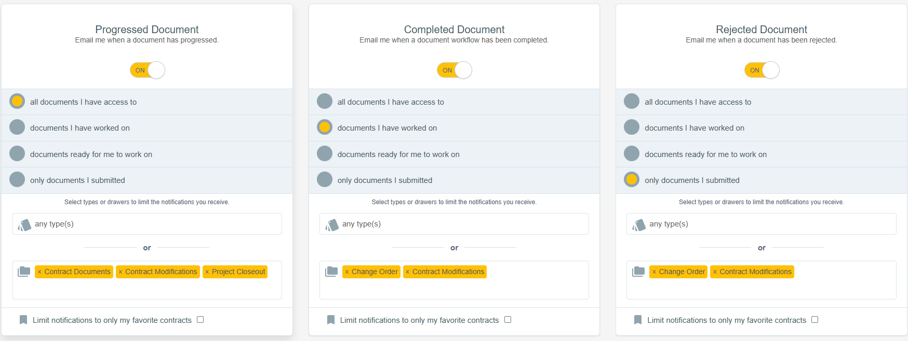

Slide 24
Naming Convention?
July 15, 2025, Letting for the new Drawer/Type set up
Only for new projects
No change for existing contracts
No change to Contract Signing drawer or process
Local Systems, Yes
Primary, No
Primary will highly suggest the use of Local Systems Naming Convention

Slide 25
Training Documentation has been updated for everyone
Naming Convention with all the Drawers and Types
List of all Drawer and Types
Old vs New Drawer and Type comparison

Slide 26
Training Documentation
Construction and Materials Website Location
https://iowadot.gov/consultants-contractors/construction-materials/inspection-tools#guides-references
Local Systems Website Location
https://iowadot.gov/transportation-development/local-systems/resources-tools/doc-express-appia

Slide 27
Support
Primary System (Interstate/State Highway)
Jen Strunk
Jennifer.Strunk@iowadot.us
Local Systems (City/County Projects)
Derek Peck
Derek.Peck@iowadot.us
515-239-1391
641-344-0044 - Cell

Slide 28
Q&A
Please add your questions in the Q&A
THANK YOU

