Slide 1



Transportation Trends Update
August 11, 2025
3/2/2023

Slide 2
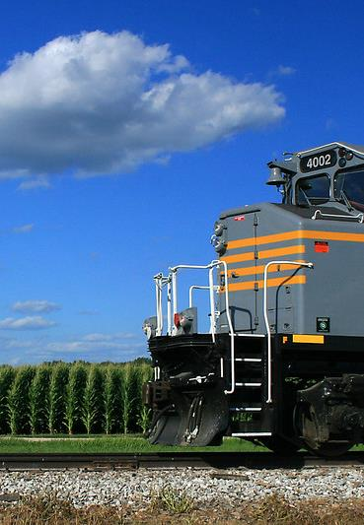

Agenda
US total rail carloads
Commercial air service passenger counts
Public transit ridership
Vehicular traffic
Safety

Slide 4
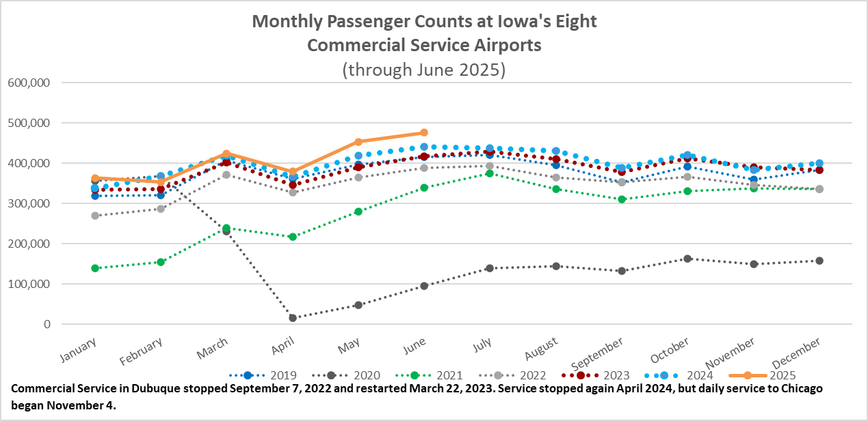

Slide 5
Monthly State Vehicle Miles of Travel
(through June 2025)
Vehicle Miles of Travel (in millions)

Slide 6
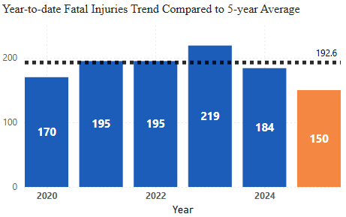
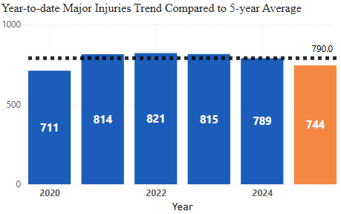


Statewide Fatalities & Major Injuries Year-to-Date
(through August 4, 2025)

Slide 7
Questions?

