Slide 1
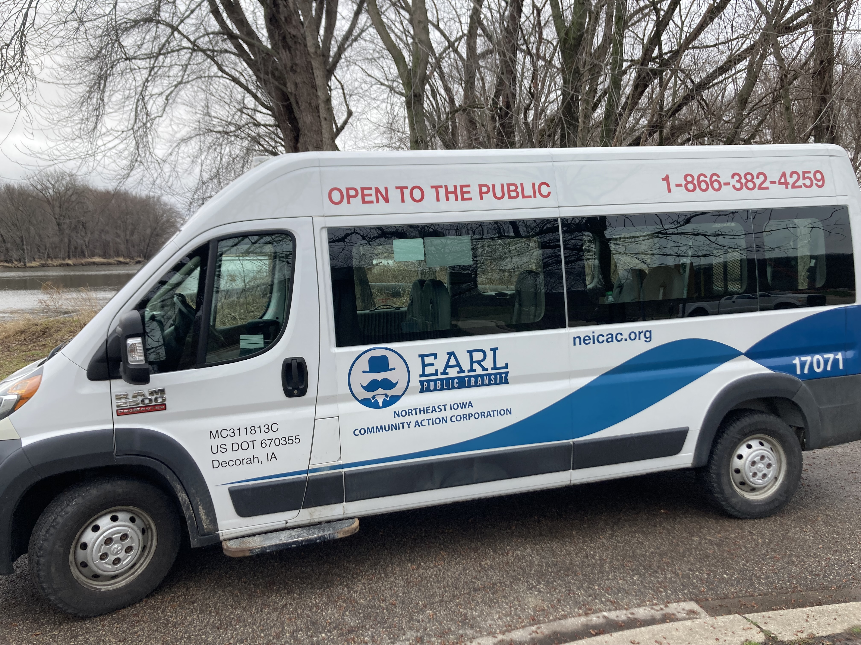
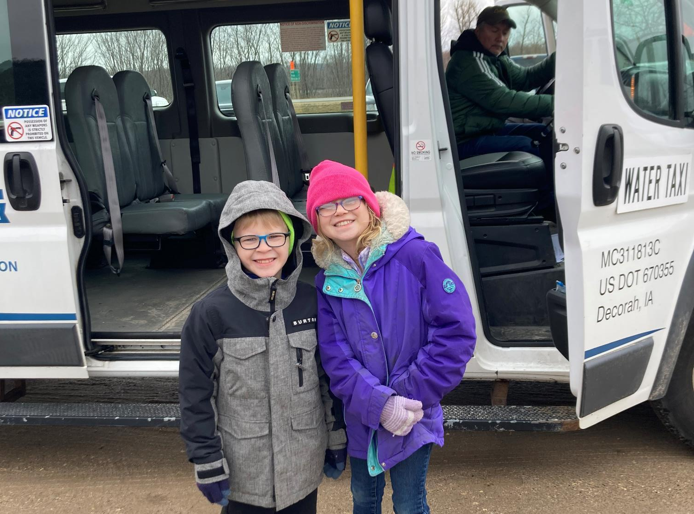


Federal Fiscal Year (FFY) 2025
Transit Program (Vehicle Replacement)
3/2/2023
Brent Paulsen
Transit Programs Manager
Commission Workshop August 11, 2025

Slide 2
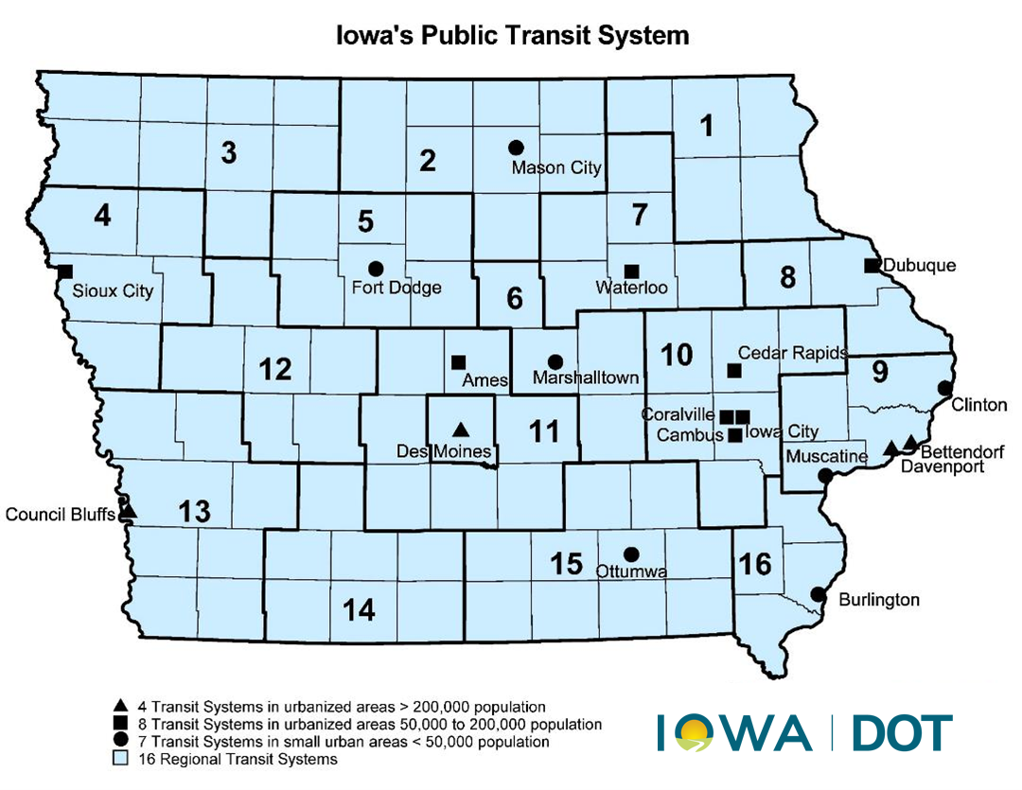
Questions?
CONTACT NAME
###-###-####
email@iowadot.gov​
iowadot.gov
Notes:
Iowa has 35 designated public transit systems. Sixteen of these systems are regional and nineteen are urban. In FY24, 19.2 million trips and 25.5 million revenue miles were provided in Iowa. Vehicle replacement is need for public transit providers. There are 1,617 public transit vehicles in the combined statewide fleet, of which 915 of (57%) have met the useful life standard and are eligible for replacement.

Slide 3
Federal Funds for Transit Vehicle Replacement
Grants for Bus and Bus Facilities Formula Program – 5339(a) Provides funding to states and transit agencies through a statutory formula to replace, rehabilitate and purchase buses and related equipment and to construct bus-related facilities.
Buses and Bus Facilities Competitive Program – 5339(b) Same as above but distributed through a competitive solicitation.
Low or No Emission Grant Program – 5339(c) Provides funding to state and local governmental authorities through a competitive solicitation for the purchase or lease of zero-emission and low-emission transit buses as well as acquisition, construction, and leasing of required supporting facilities.
Carbon Reduction Program – Provides funding for projects designed to reduce transportation carbon dioxide emissions, including traffic management, public transportation, pedestrian facilities, alternative fuels.

Slide 4
Summary of Available Funding for FFY 2025
5339(a) State Apportionments + CRP + Underruns:
– 5339(a) Urban (50-200K population) – $1,227,451
– 5339(a) Statewide Non-urban – $4,000,000
– Carbon Reduction Program – $3,000,000
– Underruns in closed contracts – $503,352
– Total Available – $8,730,803
Notes:
5339(a) - 33 vehicles at 12 public transit systems. CRP - 7 vehicles at 4 public transit systems

Slide 5
Project Distribution Criteria
Funds are distributed for bus replacement based on the Public Transit Management System (PTMS) process and the availability of local match
Prioritizes vehicle replacements based on the degree to which each vehicle exceeds the useful life for that particular vehicle type in terms of both age and accumulated mileage
The age, vehicle type, and mileage are maintained for all vehicles within the PTMS database

Slide 6
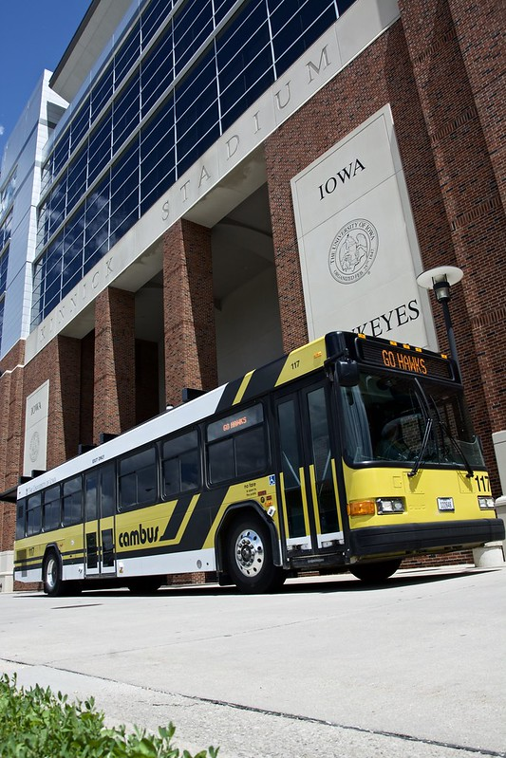
Recommendation
Total capital funds available and recommended for reprogramming: $8,730,803
Sixteen public transit systems will be able to purchase 40 vehicles
A list of vehicles is included in the Federal Fiscal Year (FFY) 2025 Transit Program (Vehicle Replacements) Handout

Slide 7
Questions?

Slide 8
Questions?
Brent Paulsen
515-239-1132
Brent.Paulsen@iowadot.gov​
iowadot.gov
For more information on Iowa’s public transit and intercity bus programs, visit www.iowadot.gov/modes-travel/transit

