Slide 1

RPA-14 / ATURA

Slide 2
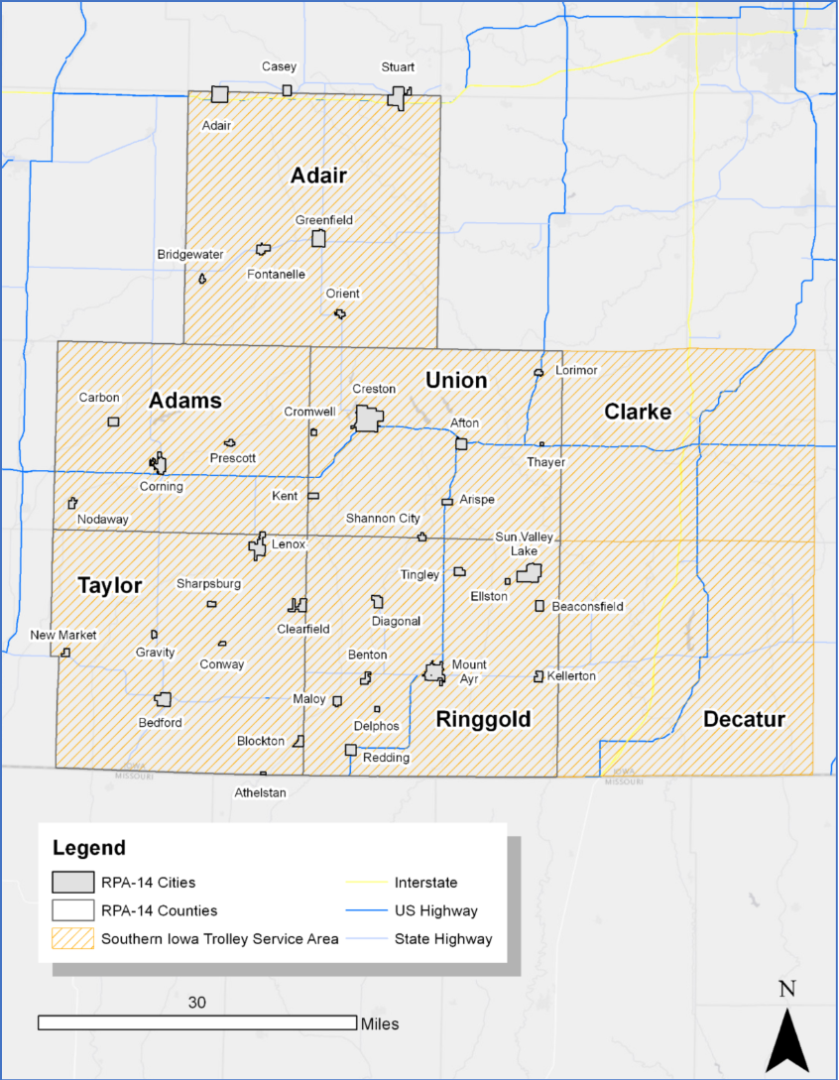
Background
The region is comprised of five counties: Adair, Adams, Ringgold, Taylor, and Union
Creston is the only city in the region with a population over 5,000
The total regional population is 33,842
Southern Iowa Trolley serves as the sole public transit provider

Slide 3
Current Issues
Transportation System
Aging infrastructure across roads and bridges
Persistent county engineer vacancies
Funding shortfall for maintenance and expansion
Limited and fragmented pedestrian infrastructure
Public Transit
Ongoing driver shortages affecting service
Ongoing decline in ridership
Reduced funding affecting operations
Discontinuation of child transportation

Slide 4
Current Needs
Transportation System
Rehabilitate and improve aging roads and bridges
Increase funding for all modes of transportation
Expand and connect pedestrian and bicycle infrastructure
Public Transit
Expand public transit service area and hours
Increase transit ridership
Restore child transportation services to traditional levels

Slide 5
Thank you
Paul Johnston
Johnston@sicog.com
www.sicog.com
641-782-8491

