Slide 1
Southwest Iowa Planning Council
And
Southwest Iowa Transit Agency

Slide 2
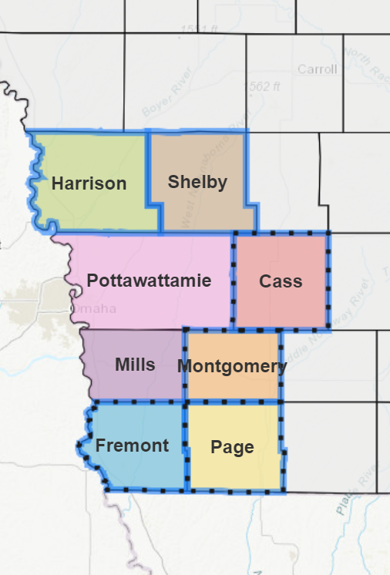
Southwest Iowa Planning Council (SWIPCO) was formed in 1975 with the goal to promote regional cooperation.
We aim to serve the counties and cities within our region with community and economic development activities to improve the quality of life for all of Southwest Iowa.
SWIPCO serves eight counties in Southwest Iowa and their municipalities: Cass, Fremont, Harrison, Mills, Montgomery, Page, Pottawattamie, and Shelby. Mills and Pottawattamie counties are also members of the Metropolitan Area Planning Agency (MAPA), based in Omaha.
SWIPCO also manages Regional Planning Affiliate (RPA) 13 which includes Cass, Fremont, Montgomery, and Page counties. RPA’s are designated through the Iowa Department of Transportation to provide transportation planning services.

Slide 3

Regional Planning Affiliate 13
SWIPCO manages Regional Planning Affiliate 13 (RPA 13), which is the transportation planning region designated through the Iowa Department of Transportation. Counties within RPA 13 include Cass, Fremont, Montgomery, and Page counties. Planning activities for RPA include:
Transportation Improvement Plan (TIP)*
Passenger Transportation Plan (PTP)*
Long-Range Transportation Plan (LRTP)*
Transportation Planning Work Program (TPWP)*
Manage Regional Transportation Alternatives Program applications and projects.
RPA 13 also can assist communities through other transportation planning activities including trail plans and grant applications such as State Recreational Trails, TAP, etc

Slide 4
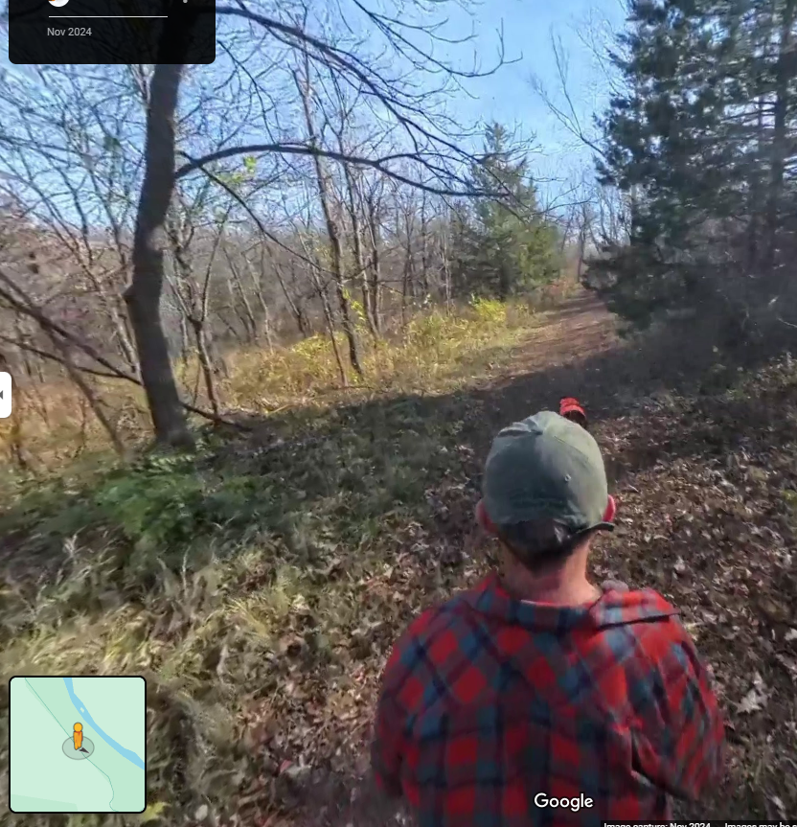
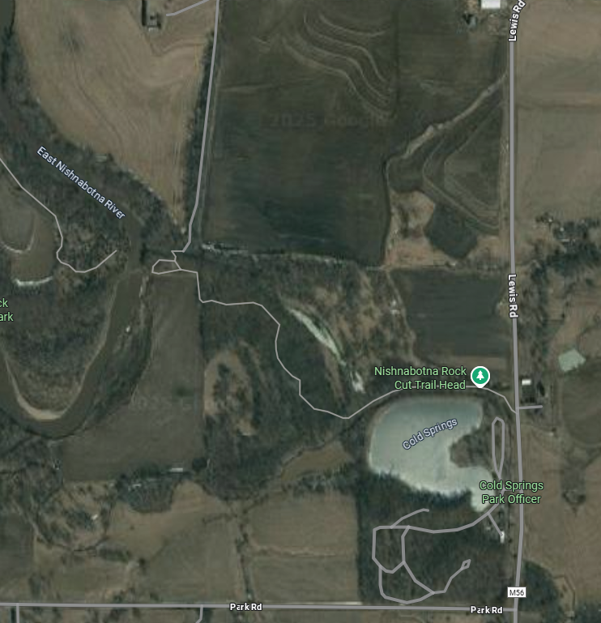

Slide 5
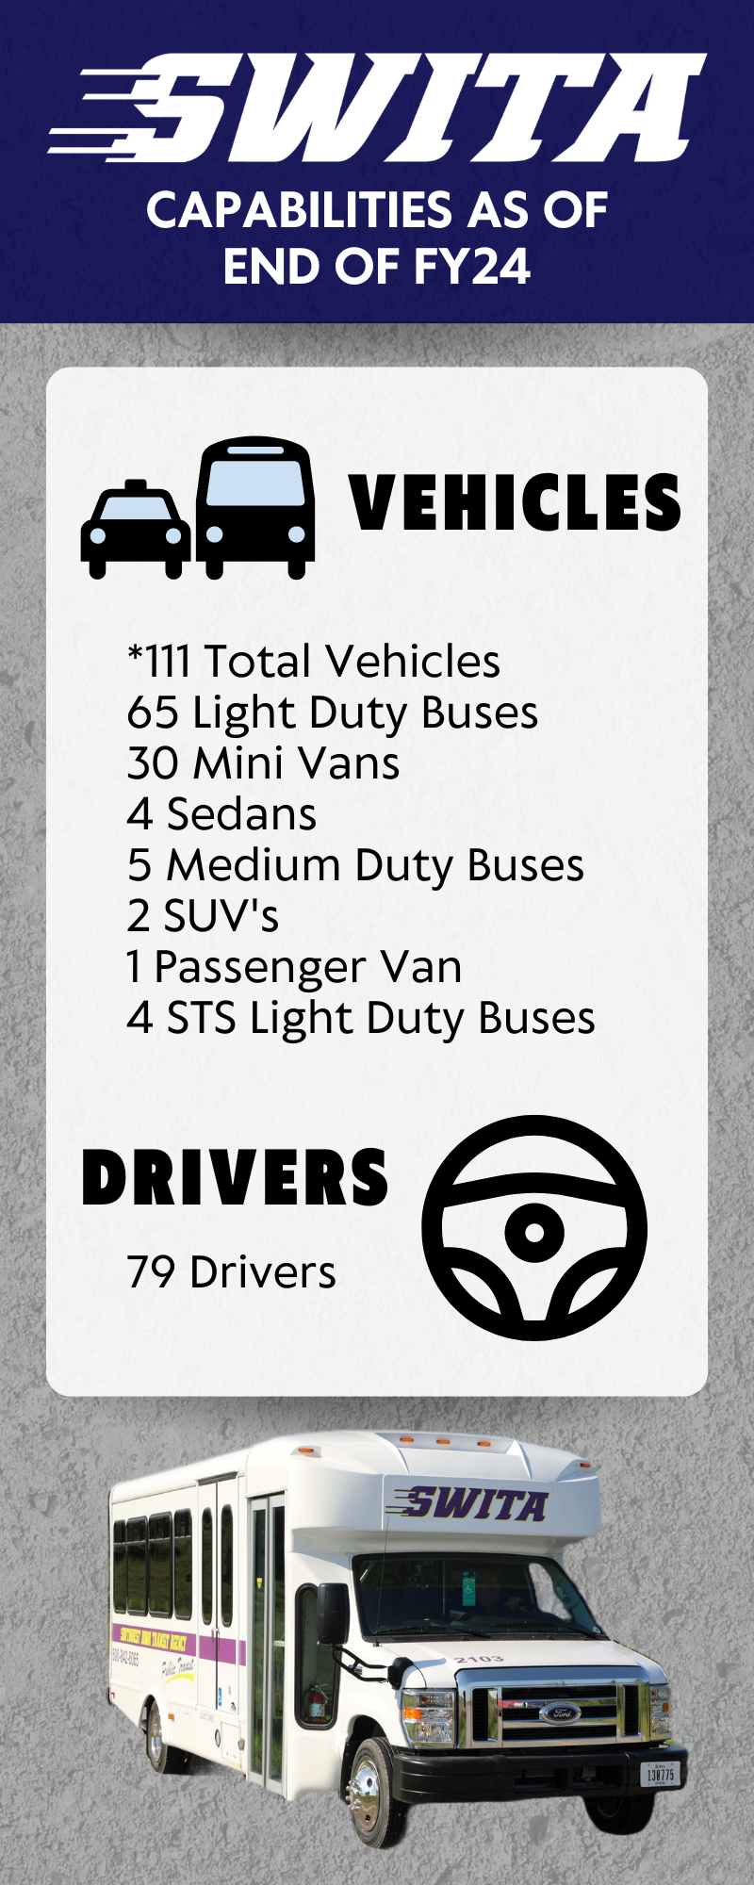

Student Transportation- Rides to and from preschool or school is available to students who live in town and are not served by their school bus system in Atlantic, Glenwood, Harlan, and Red Oak. $1.75 per ride per child and all rides are open to the public.
Work Routes- SWITA provides round trip transportation to employees of OSI from Omaha, Council Bluffs, and Atlantic to Oakland seven days a week. Round trip transportation for employees of Monogram Foods in Harlan is available from Omaha, Council Bluffs, and Atlantic. Round trip transportation for employees of Carry-On Trailer is available from Council Bluffs to Missouri Valley. SWITA has also partnered with Commute with Enterprise to support vanpool options in the region as well.
Taxi- SWITA offers taxi services in Atlantic, Glenwood, Harlan, Missouri Valley, Red Oak, and Shenandoah. This offers residents of those communities a quick, affordable option to get where they need to go within the community.

Slide 6
Medical Transportation- SWITA offers medical transportation services for seniors, dependents, clients, or anyone else who needs a medical related ride. People with disabilities and mobility issues are welcome and accommodated. Medical trips can sometimes be funded through support services or insurance, otherwise can be billed at an hourly rate of $35 per hour.
Special Trips- Subject to driver and bus availability special trips can be booked through SWITA to get wherever you need to go in the region. Cost is $45 per hour for non-medical transportation.
Summer Fun Bus- Each year during the summer break for area school districts SWITA offers a service to get kids to their summer activities in Atlantic, Glenwood, Harlan, Red Oak, and Shenandoah. Youth 18 and under can get rides anywhere within two miles of city limits for $1 each way or $40 for an unlimited summer pass. This helps busy kids get to sports, lessons, swimming pool, grandma’s house, or wherever they need to go. Parents and Caregivers may also ride along with the students for free. A number of special excursion trips are set up in various communities for anyone to sign up for each year (ex: zoo, splash pad, etc.)

Slide 7
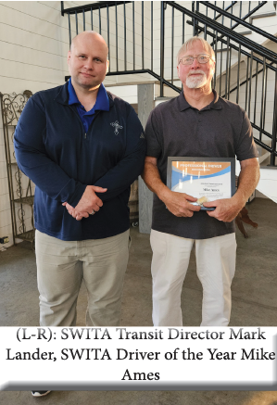
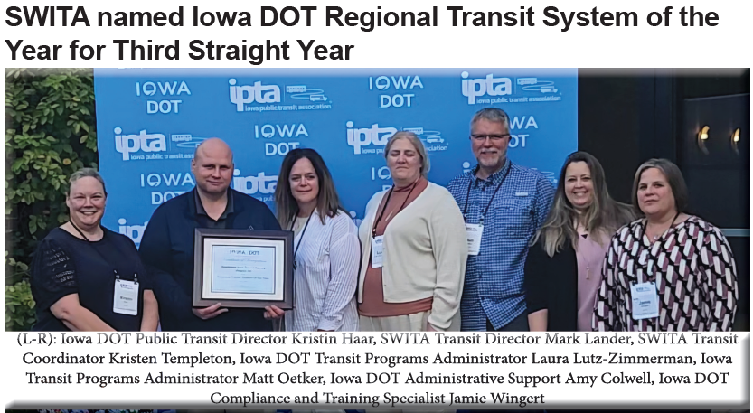

Slide 8
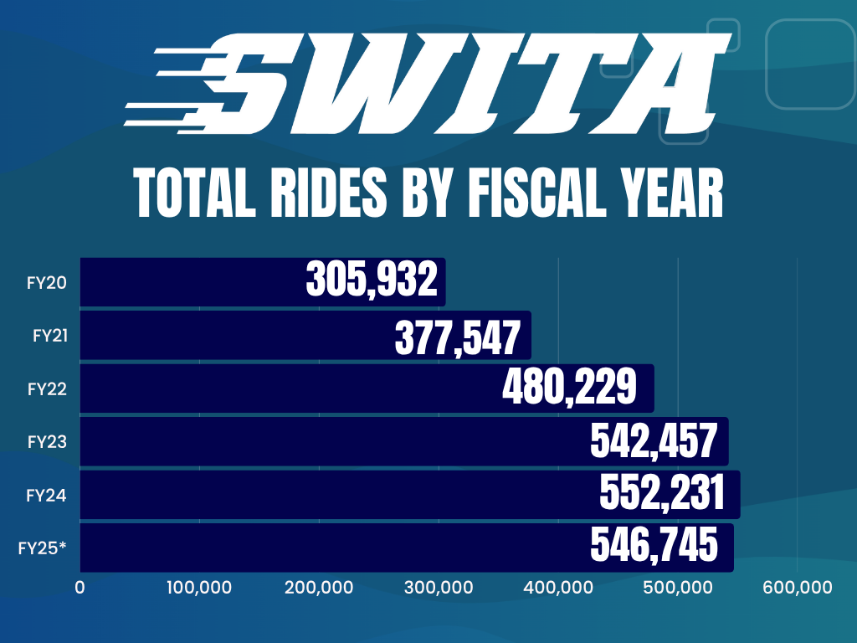

Slide 9
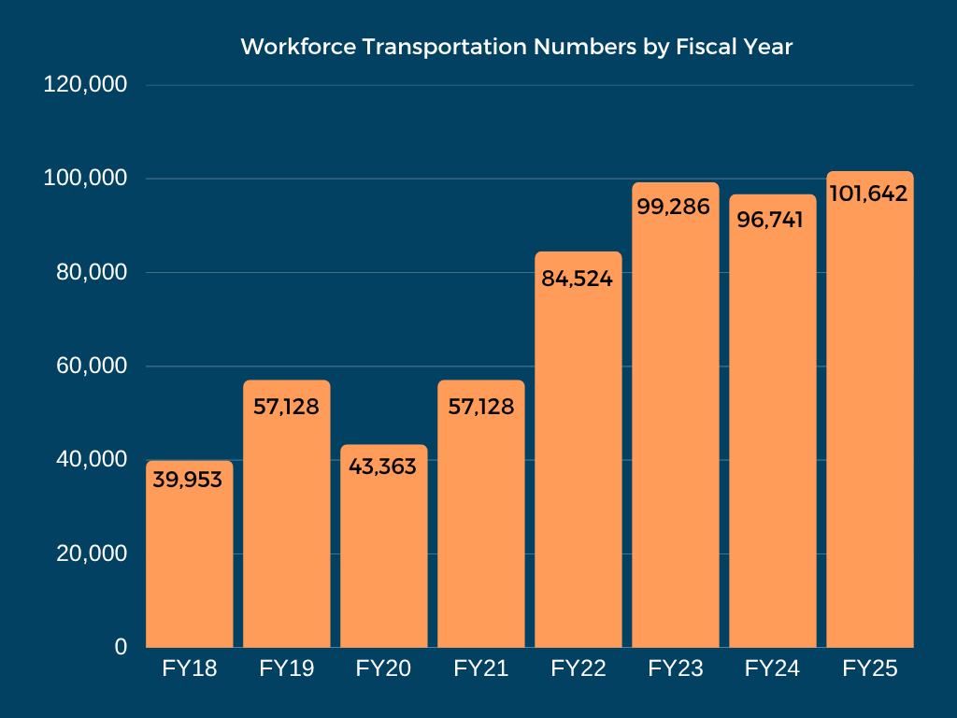
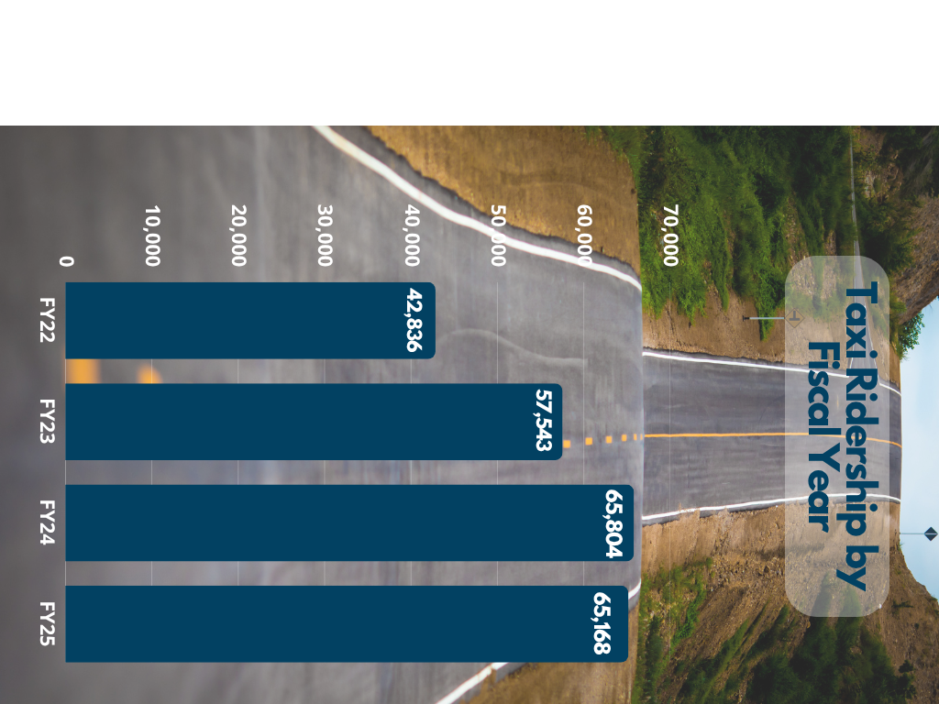

Slide 10

SWITA is Cost Effective
Average cost per SWITA ride is $9.12
Statewide average is $20.87
Highest cost by system is $53.85

Slide 11

SWITA’s Big Opportunities
We have a diverse mix of services.
Are already 24/7 capable.
Technology is starting to catch up to our outstanding people.

Slide 12
SWITA’s Big Challenges
Hard to get buses.
Limited driver pool.
Increasingly frail riders.

Slide 13


