Slide 1
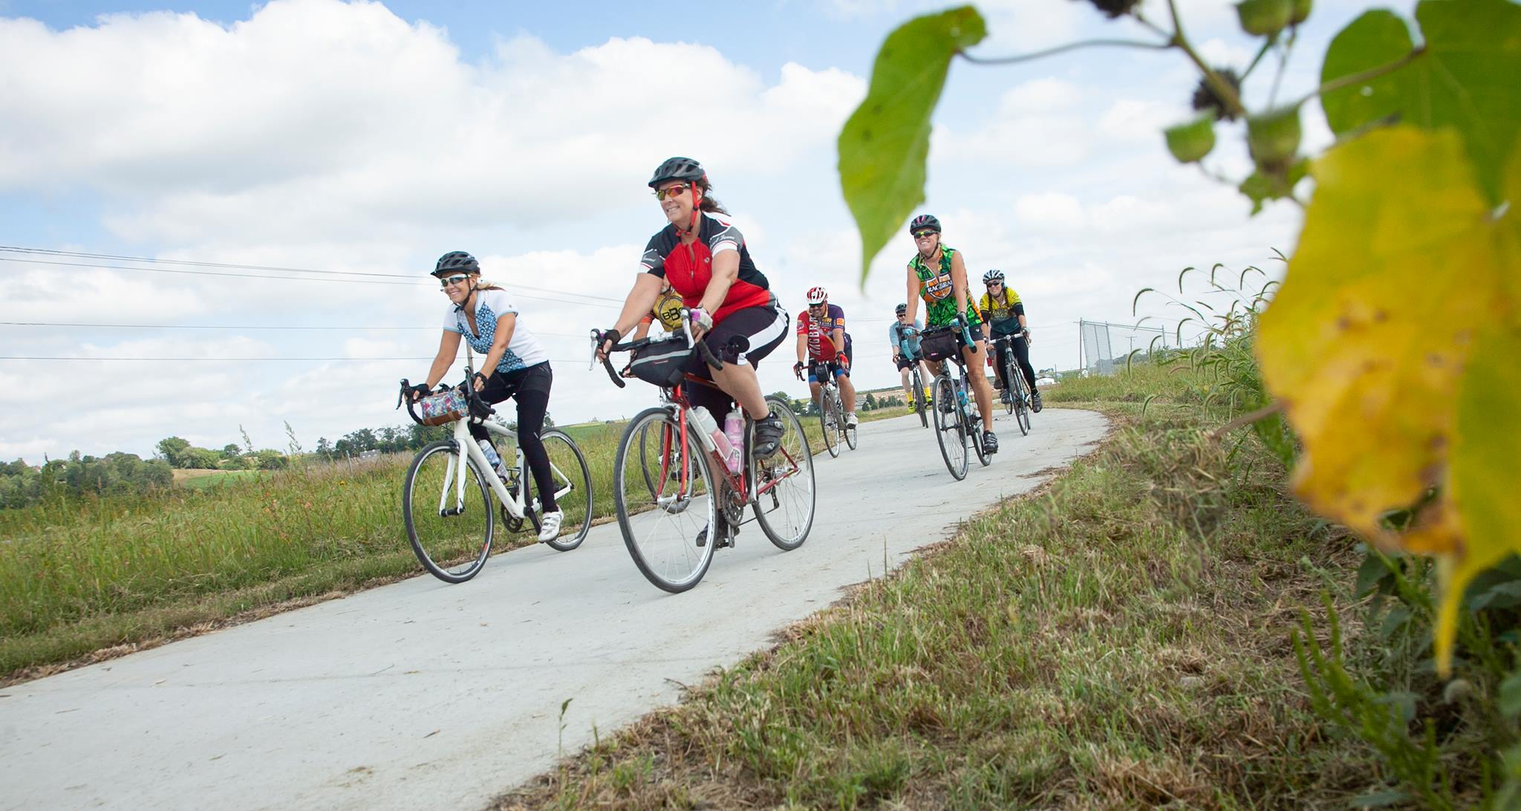
Pottawattamie County Trails: Untapped Potential
DOT Commission Meeting | August 2025

Slide 2
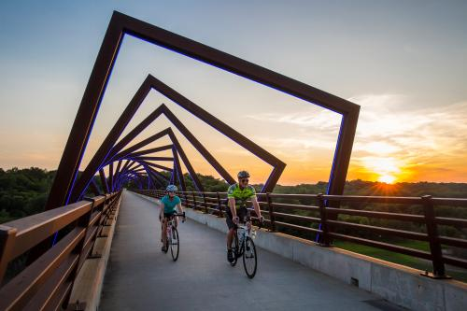

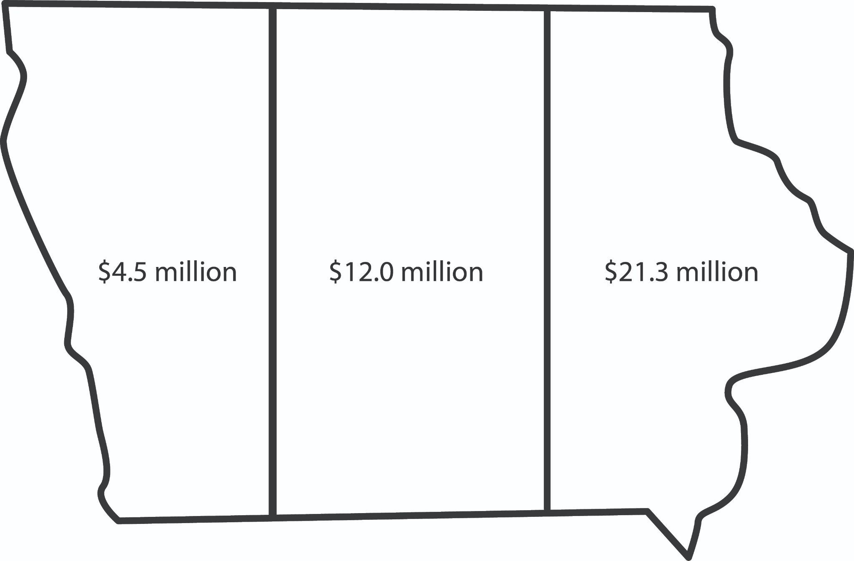
State Trail Funding: Impacts
State funding for trails in other areas has had a tremendous impact on local tourism and economies *source Scioto Analysis
Ex: *Cedar Rapids/Iowa City - $210M trails impact
Ex: *Des Moines/Ames - $420M trails impact

Slide 3
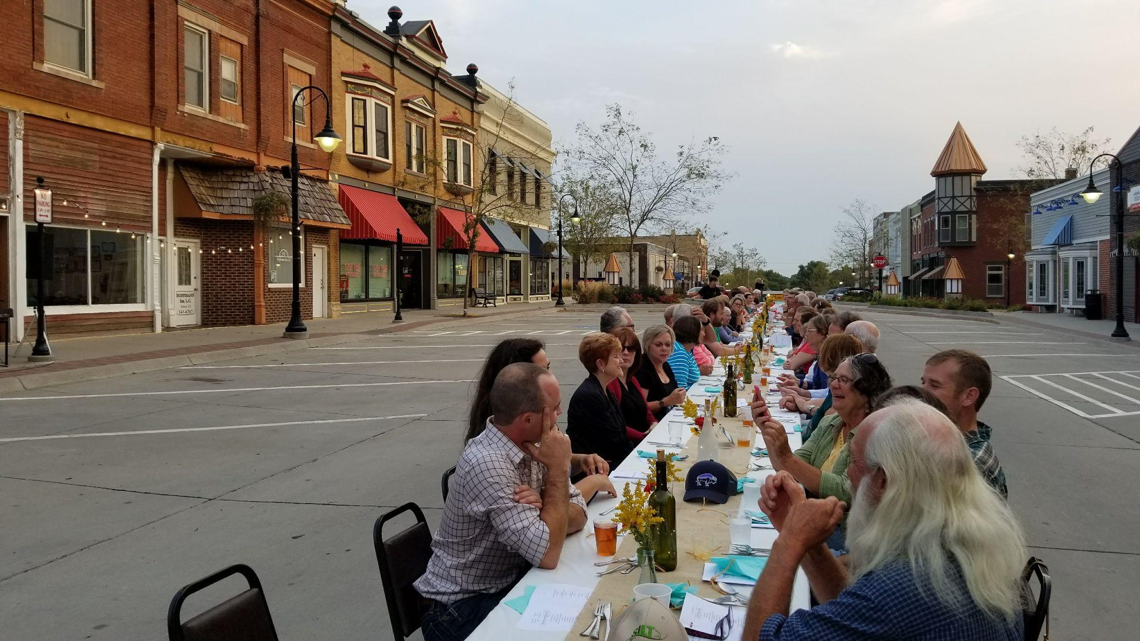
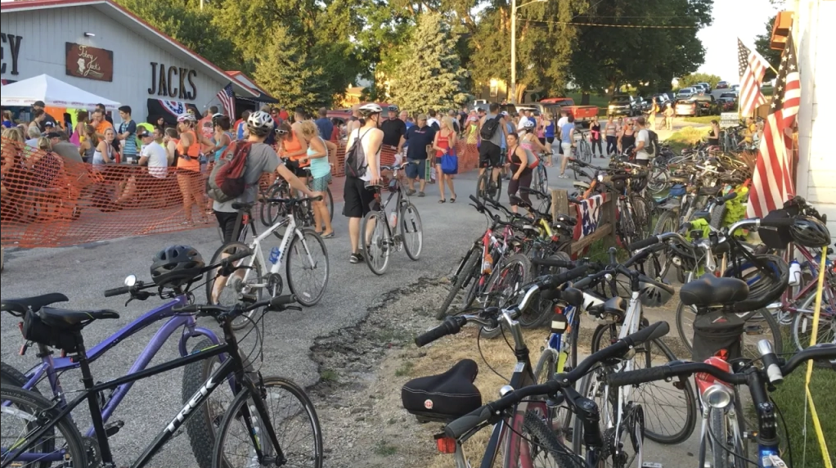
Current Economic Impact
Per the 2025 Economic and Health Impacts of Bicycling and Trails in Iowa study, Pottawattamie County:
  Is already home to 28,000 cyclists
  Sees a $34 million annual impact from cyclists
  Home to 360 jobs thanks to cyclists; generating $11 million in annual earnings
  Limited trail development strongly indicates untapped potential exists

Slide 4
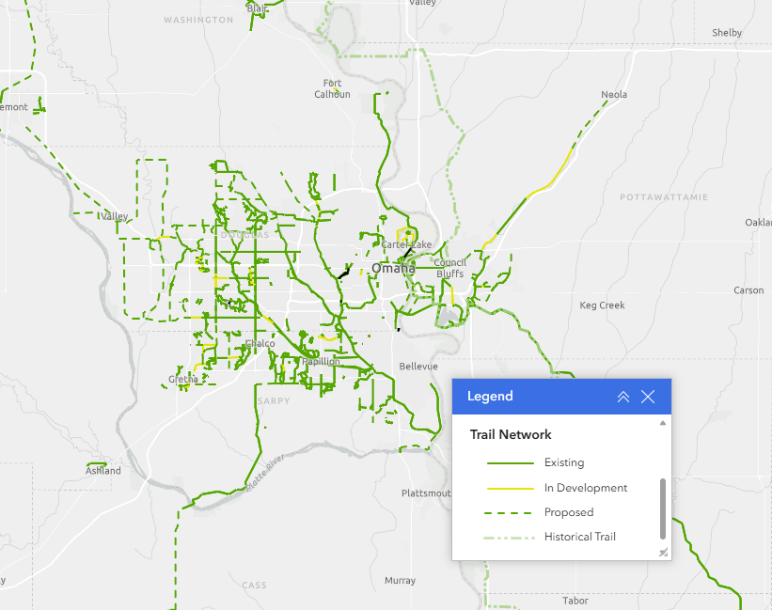
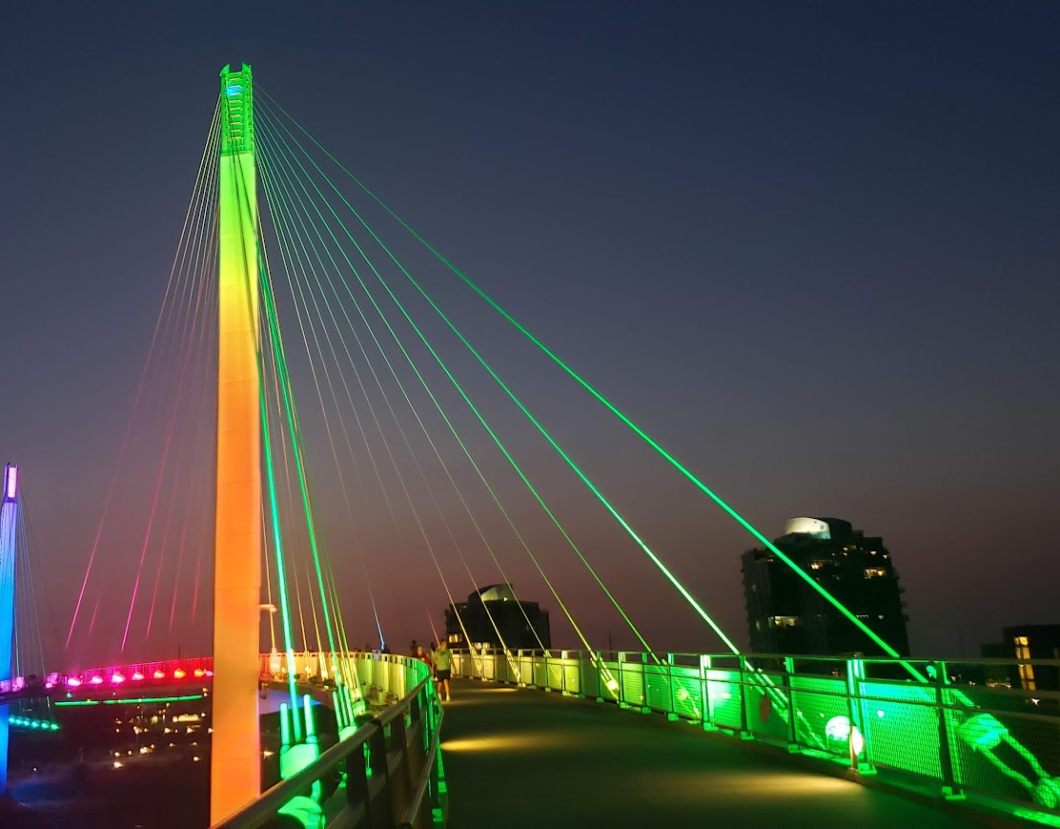
Untapped Potential for Economic Growth?
Serving the largest metro in state ~1M people
Nebraska residents regularly seek outdoor opportunities in Pottawattamie County
    Hitchcock Nature Center - 80% NE visitation
    Crescent Hill (formerly Mt. Crescent) - 80% NE visitation
    Lake Manawa - busiest Iowa State Park, 3.2 M visits in 2021, predominantly NE visitors
50K+ active trail users in the Omaha area;
Additional trails are one of the most requested amenities from local residents – Iowa West Foundation surveys
Wabash Trace Trail home to most popular informal trail ride in the state

Slide 5
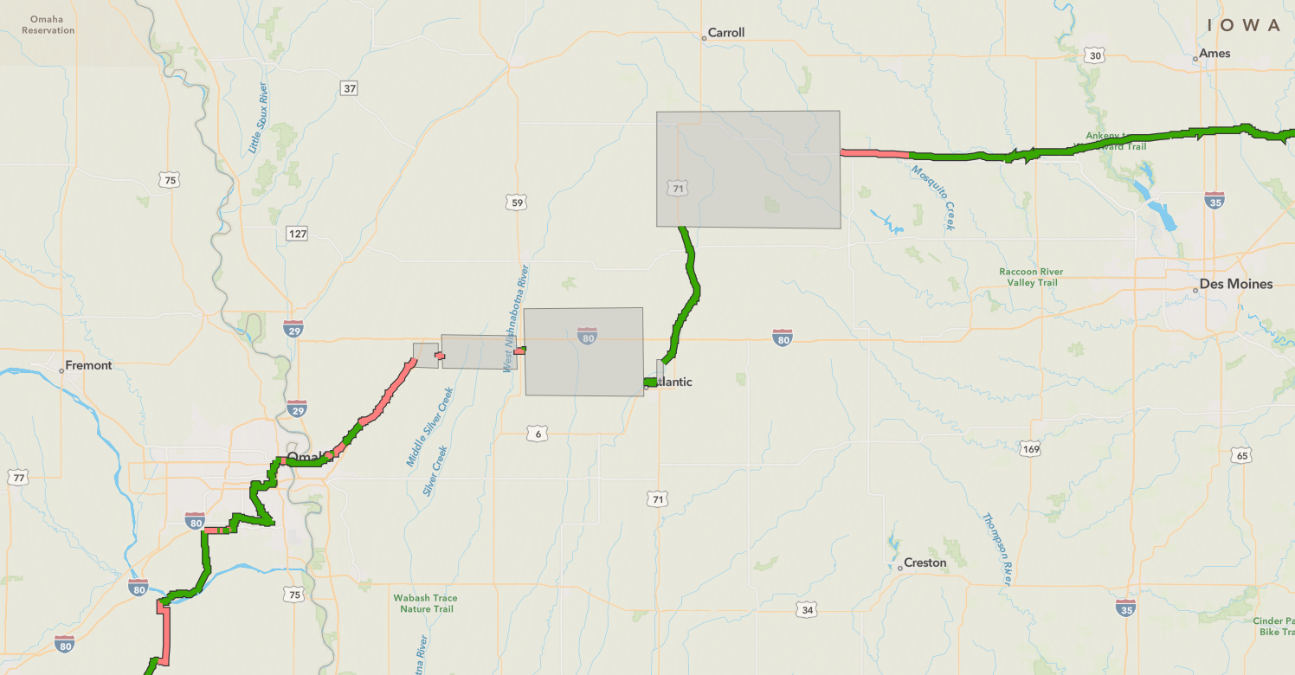
Great American Rail Trail

Slide 6
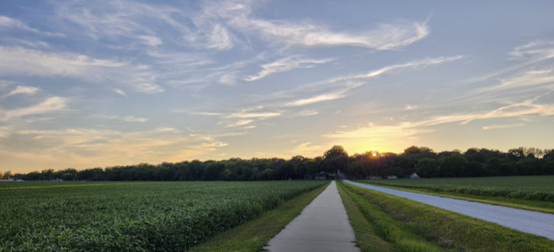
Strong Local, Regional, and National Support for Pottawattamie County Trails
Great American Rail Trail/Rails to Trail (National)
Iowa Natural Heritage Foundation (Regional)
Iowa Bicycle Coalition (Regional)
Iowa West Foundation (Regional)
Golden Hills RC&D (Regional)
Metropolitan Area Planning Agency (Regional, Omaha-based)
Pottawattamie County (Local)
Pottawattamie County Trails Association (Local)

Slide 7
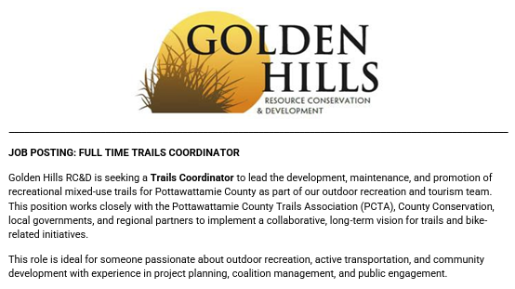
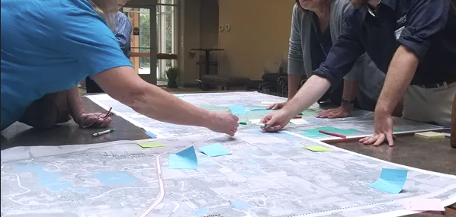
A Full-Time Commitment
Pottawattamie County has developed and manages
~5-miles of trails
Four-way partnership to fund and support a Trails Coordinator for Pottawattamie County
Oversight and Direction
High-level oversight and planning provided by a 5-person steering committee representing local and regional stakeholders
Day-day oversight provided by Golden Hills RC&D

Slide 8
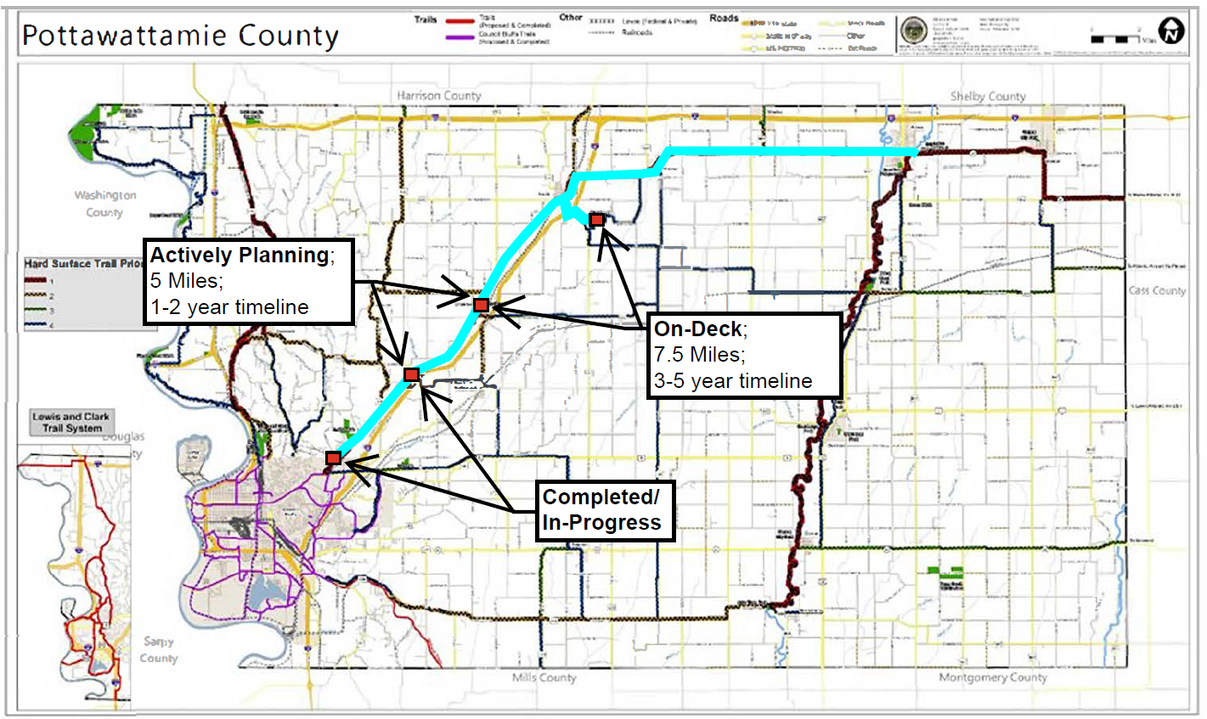
5-Year Plan: Pottawattamie County
Actively Planning
Weston – Underwood
5 miles
~$5M in needs
SRT and TAP requests summer/fall 2025
On-Deck
Underwood – Neola
7.5 miles
$7.5M in needs

Slide 9
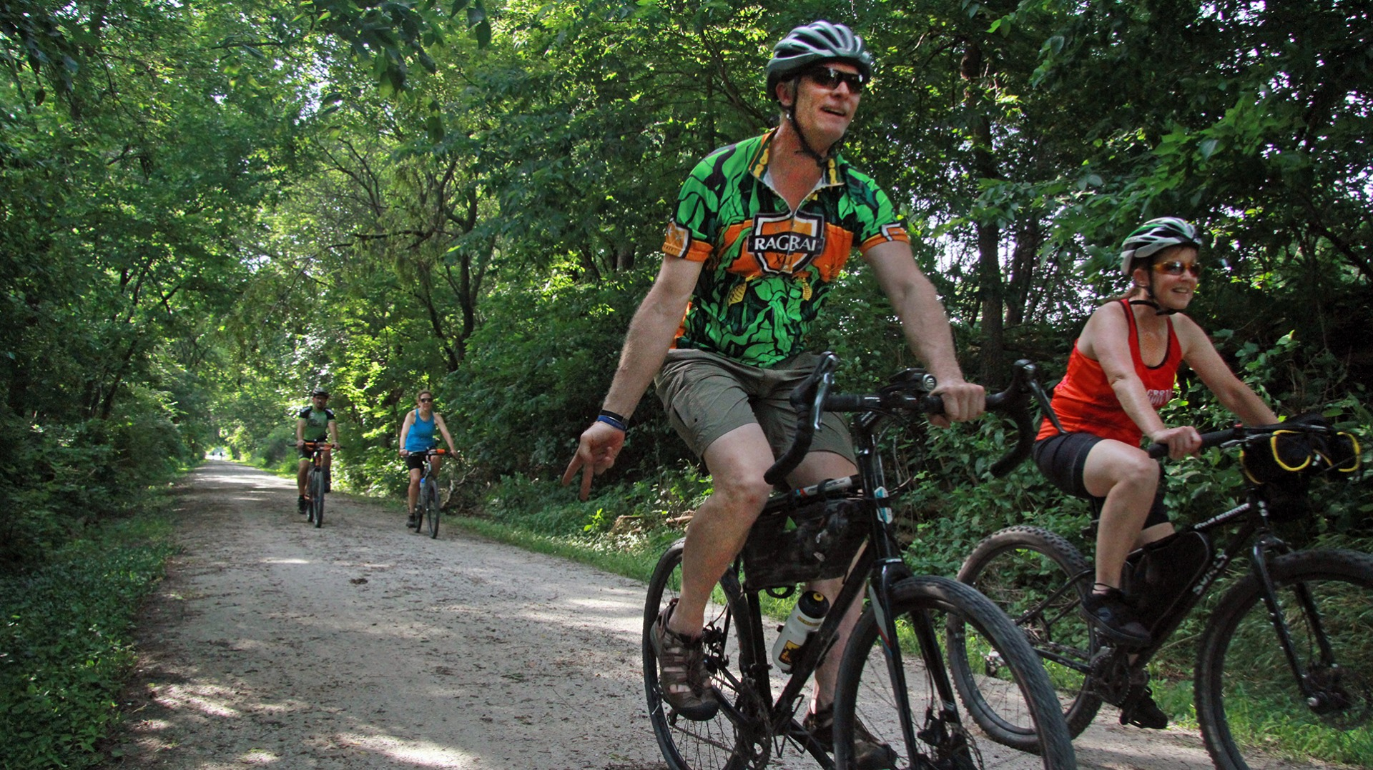
Thank you for your time.
Questions?

