Slide 1


MAPA & RPA-18 Updates
Iowa DOT Transportation Commission
Carlos Morales
Transportation and Data Manager
August 2025

Slide 2
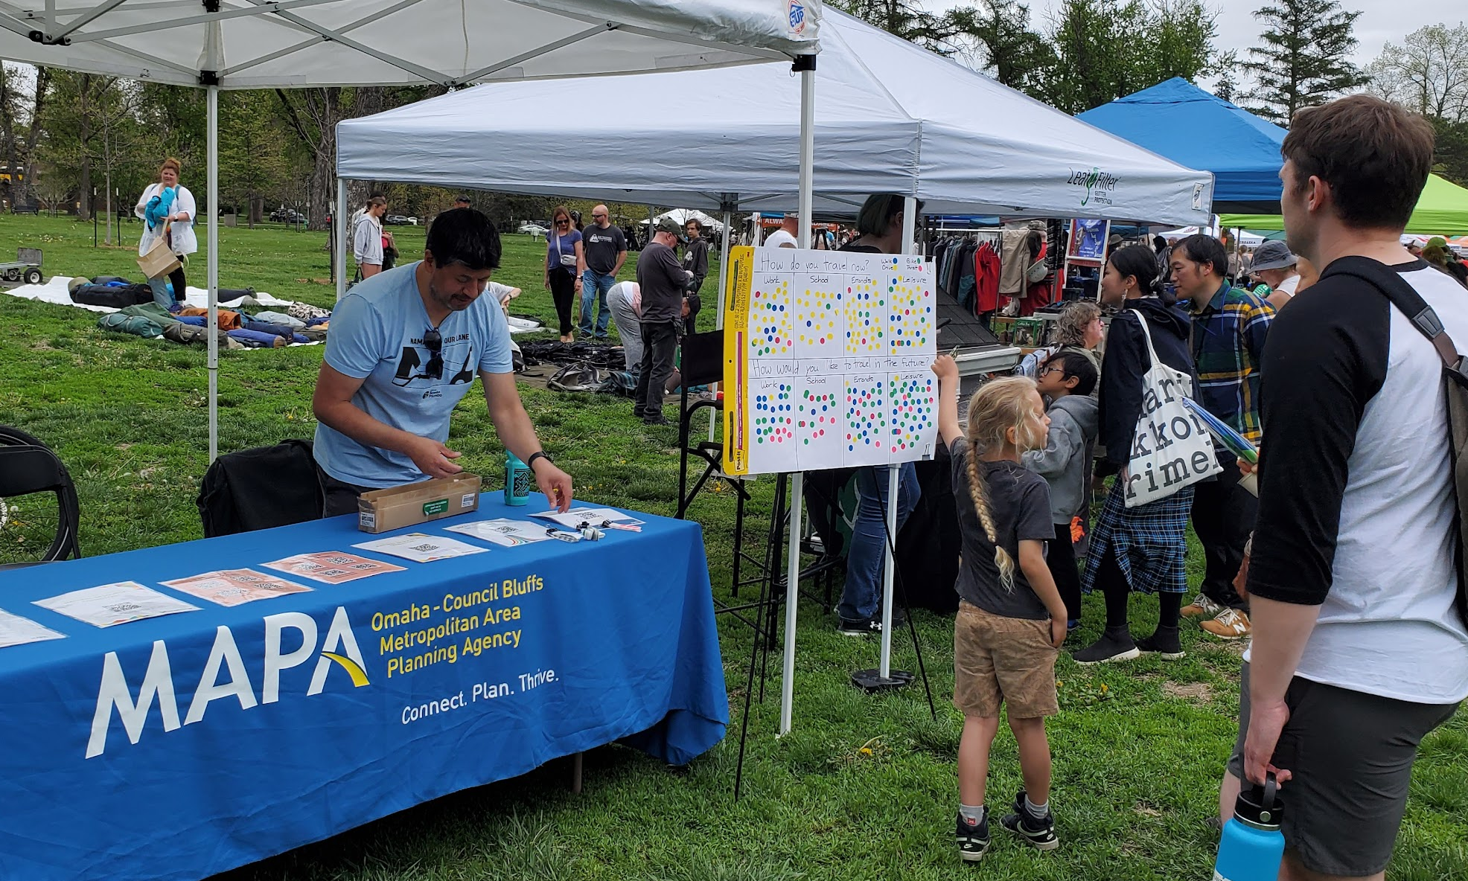
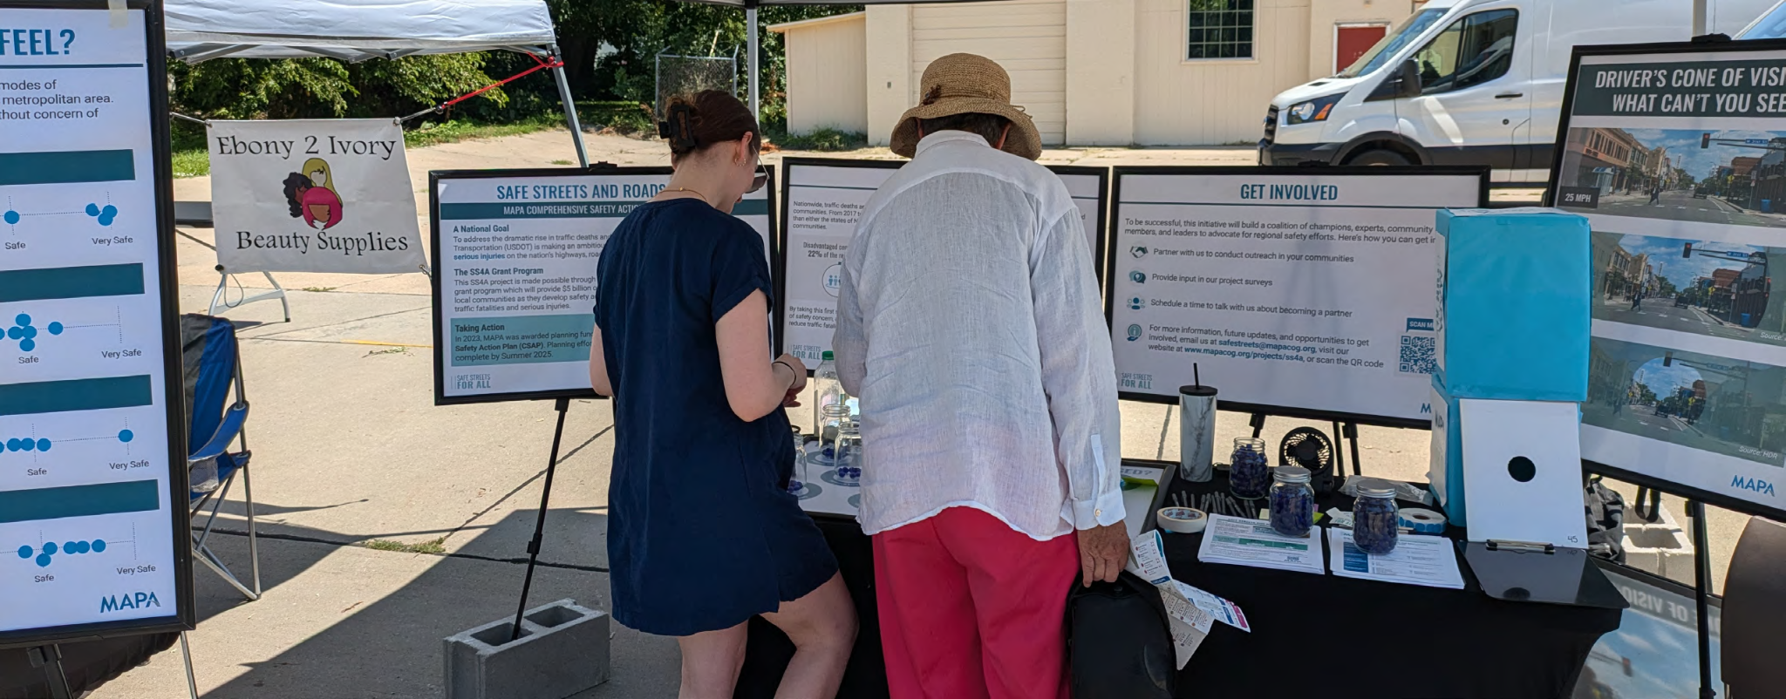
2050 MTP Update
New name! MTP instead of LRTP
Utilizing current and recent plans by MAPA and others
Updating the Model base year from 2015 to 2022
Collecting information about future regionally significant transportation projects

Slide 3
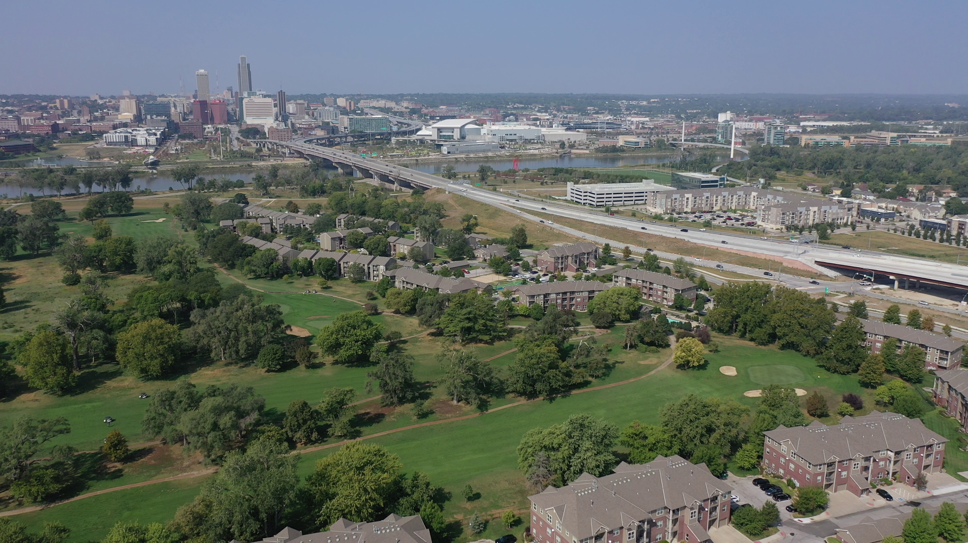
Project Purpose & Need
Reasonable Alternatives
Operations & Financial Plans
Final Report & Questionnaire
Missouri River Multimodal Bridge
Planning & Environmental Linkages Study

Slide 4
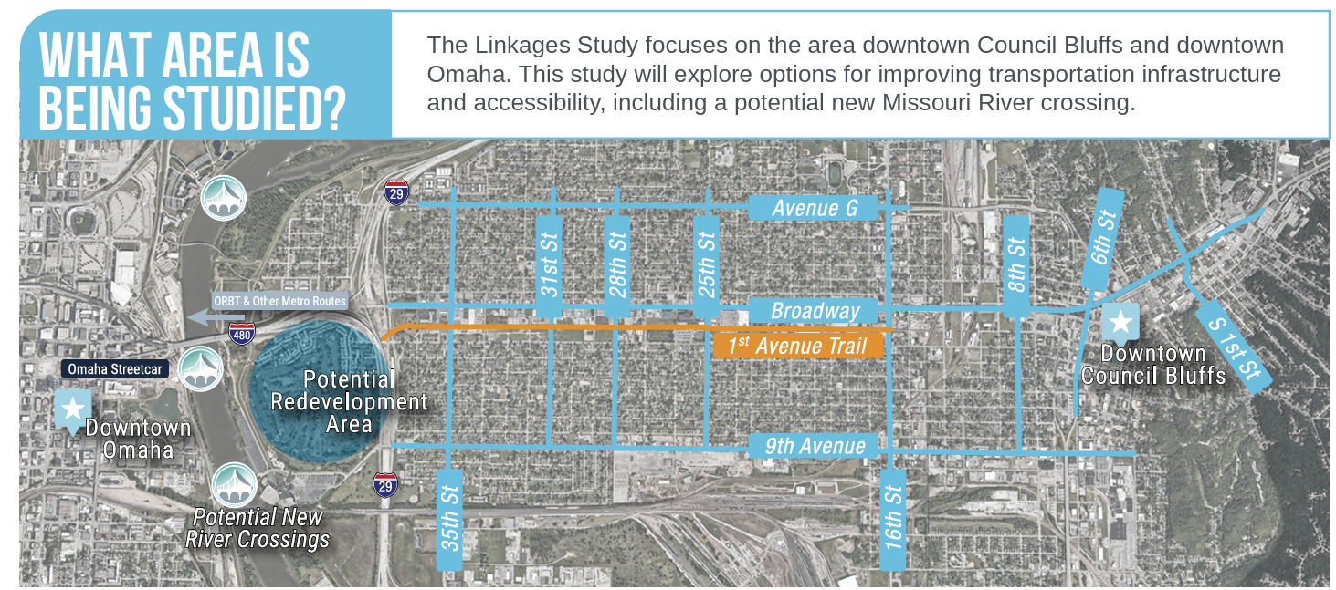
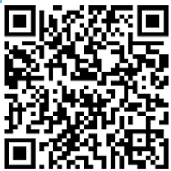

Slide 5
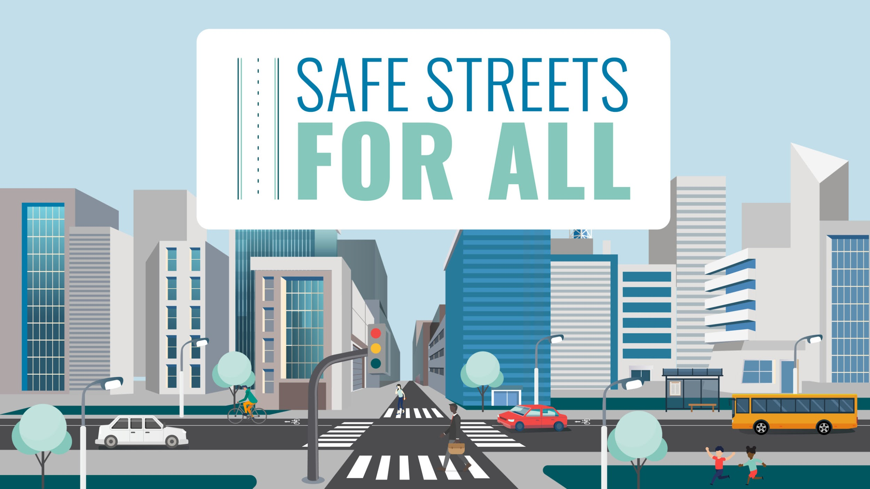


Slide 6

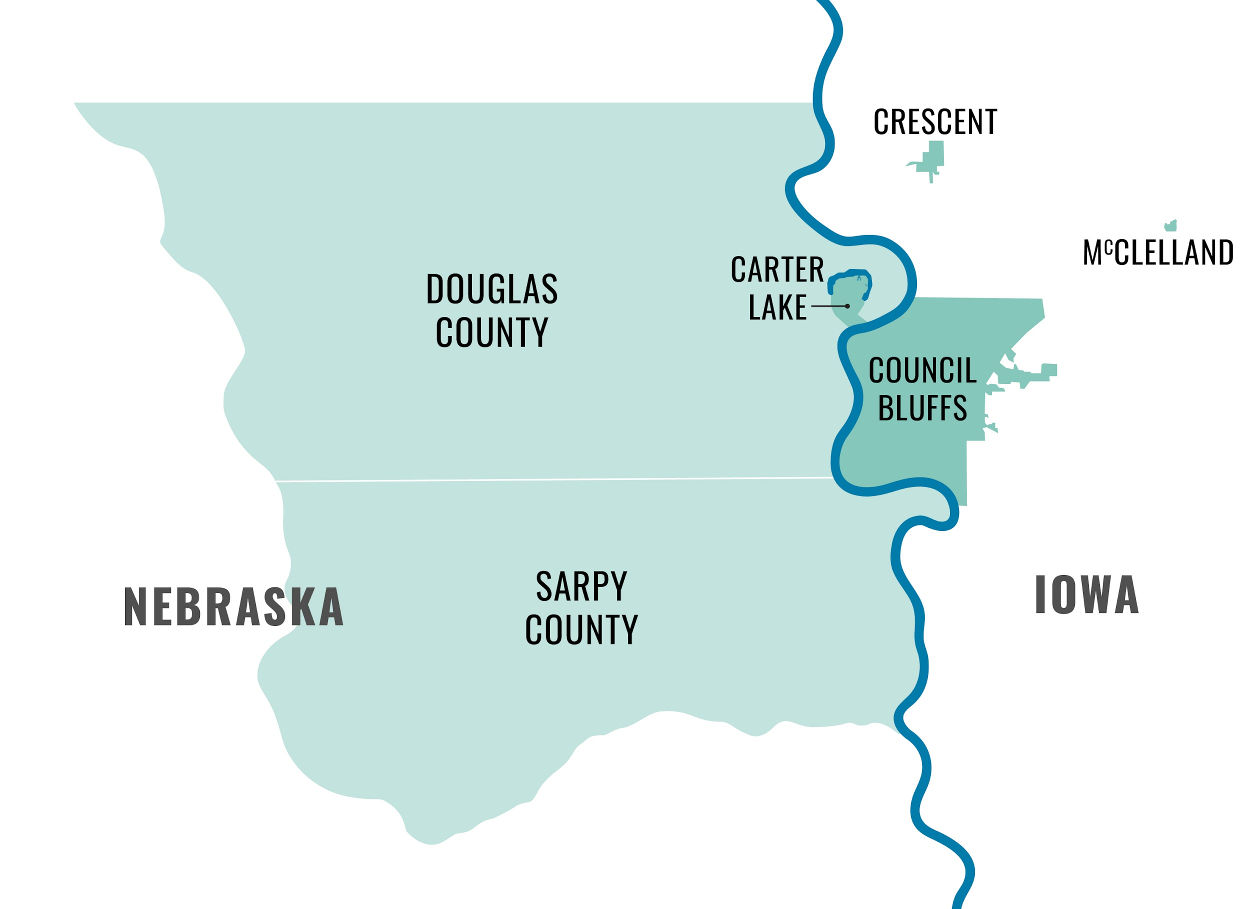

MAPA SS4A Project Overview
The MAPA SS4A project will develop a regional Comprehensive Safety Action Plan (CSAP). Our priorities are:
Enhancing Safety
Increasing Accessibility
Ensuring the well-being of all community members
… regardless of ability or mode of transportation

Slide 7
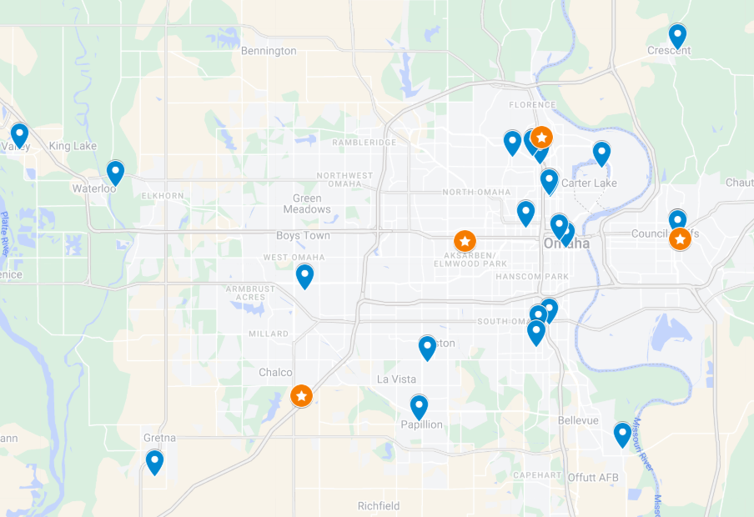
Public & Stakeholder Engagement
Public Engagement
50+ hours at community events
6 Community Presentations*
4 Public Meetings
Stakeholder Engagement
8 Focus Group Meetings
20 One-on-One Meetings*
24 Meetings with local jurisdictions
Legend
Complete
Events held throughout the SS4A project area.
Notes:
Presenter – Tim or Jon

Slide 8
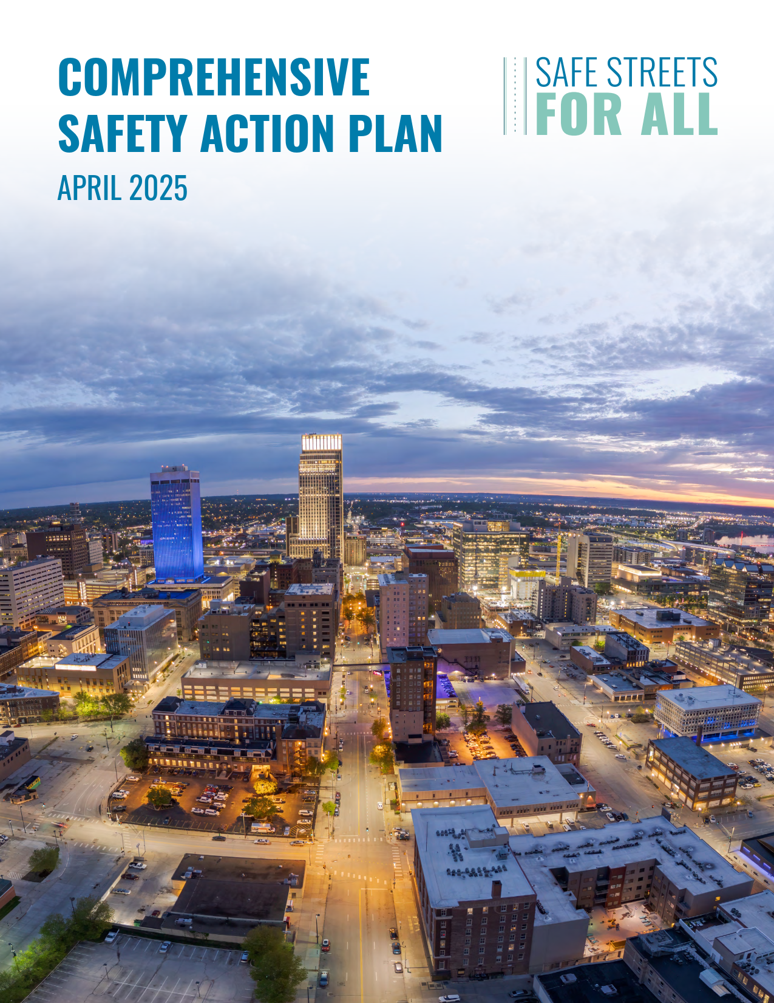
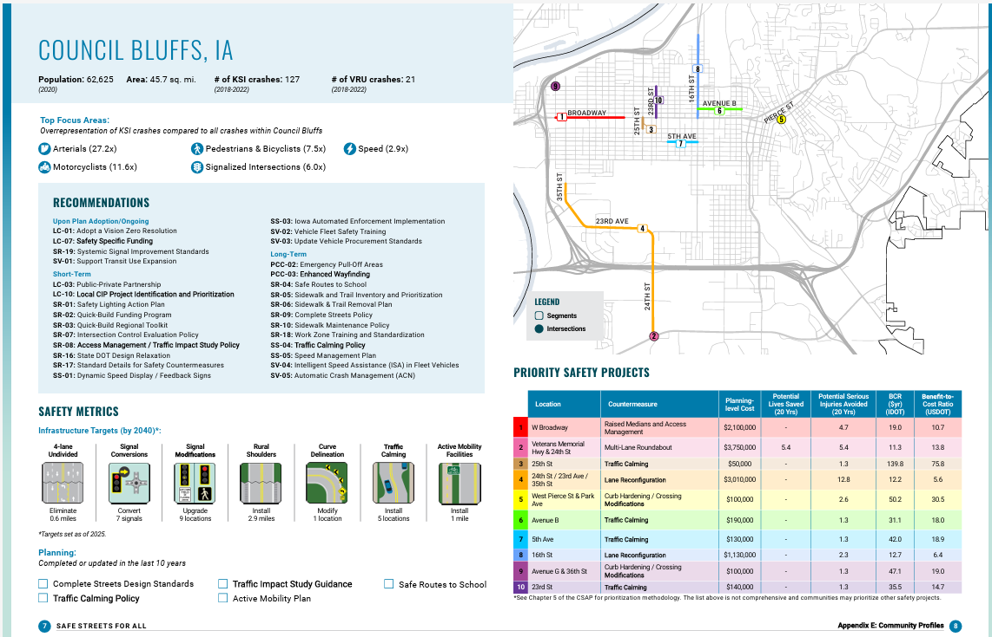

Slide 9
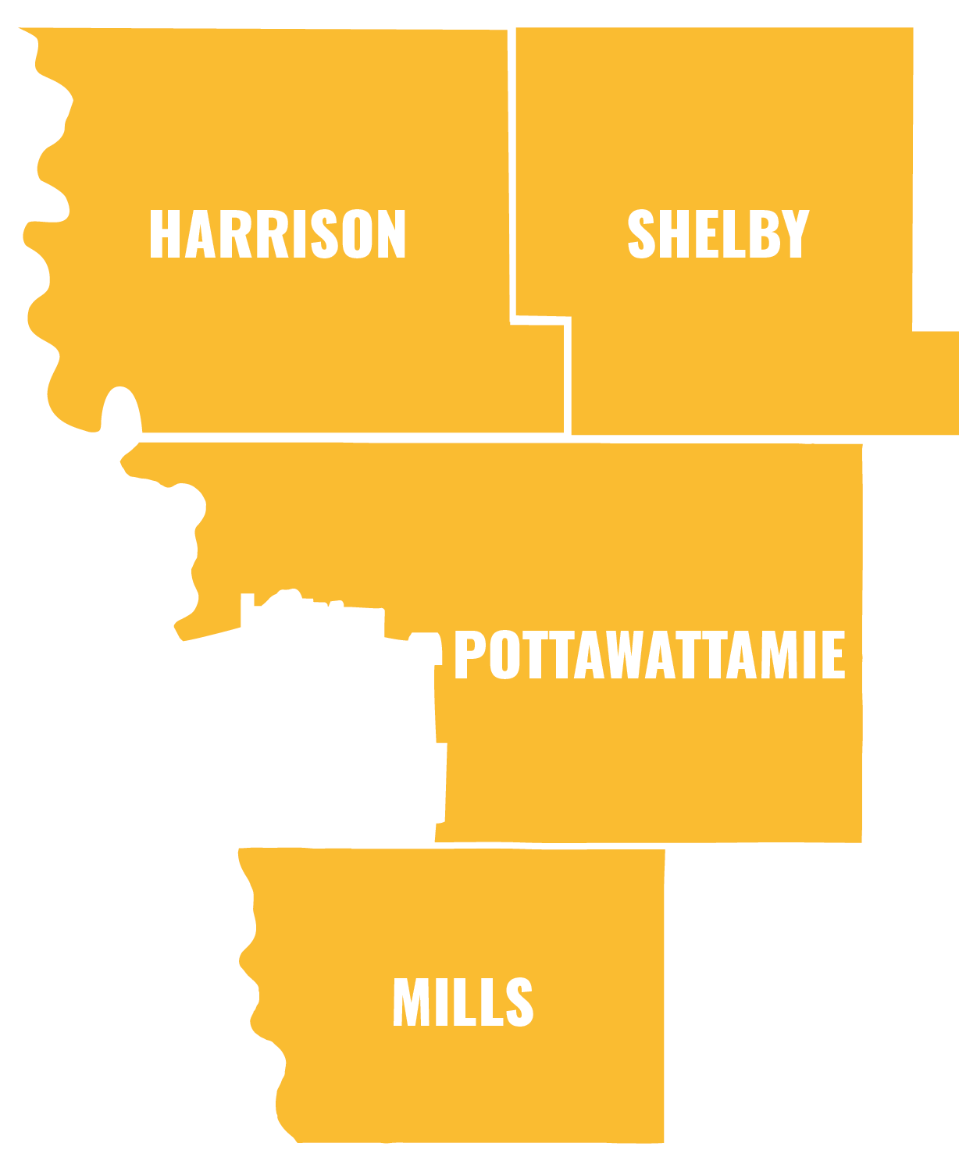
REGIONAL PLANNING AFFILIATION (RPA) 18
LONG RANGE TRANSPORTATION PLAN

Slide 10
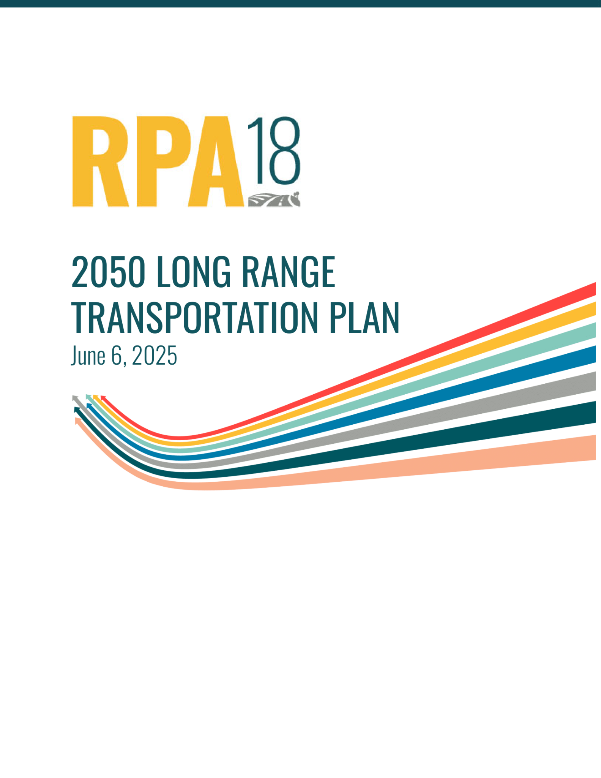
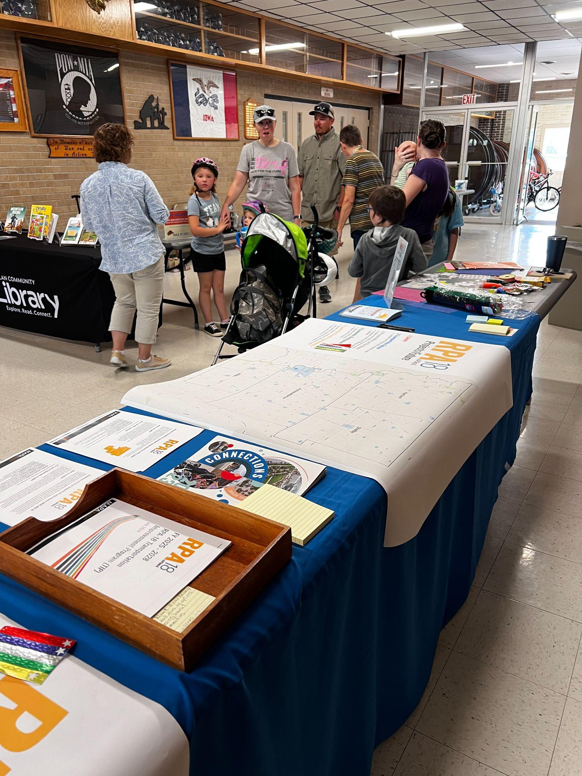

Long Range Transportation Plan
Outlines current status and future needs of region’s transportation system
Helps direct planning efforts & programming investments for the region
Examines any shifts in travel patterns or funding priorities
Prioritizes stakeholder involvement and public input to help formulate and prioritize goals

Slide 11






2045 LRTP Goals | Updated Goals for 2050 LRTP
Safety: Invest in enhancing safety of transportation system | Safety & Security: Increase the safety and security of the transportation system for motorized and non motorized users
Transportation Options: Invest in enhancing safety of transportation system | Transportation Options: Enhance accessibility, mobility, and connectivity between modes & choices available to residents in the region
Preservation: Maintain existing assets | Preservation & Resilience: Maintenance, reliability, ability to recover from natural disasters, e.g., flooding
Economic: Invest in enhancing safety of transportation system | Economic Vitality: Transportation facilities that promote economic development & enhance travel and tourism
Environment: Invest in enhancing safety of transportation system | Land Use and Growth & Sustainability: Consistency between transportation improvements and planned growth & economic development patterns, energy conservation
Land Use and Growth: Support coordinated, compact development

Slide 12
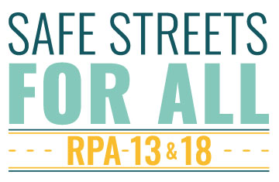
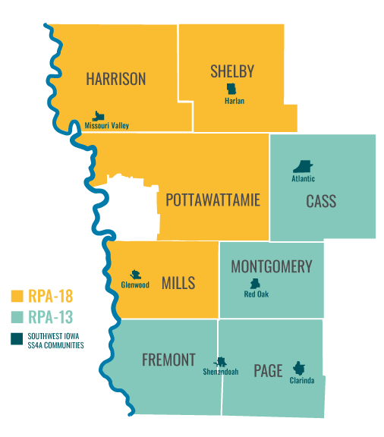
Project currently underway to create a Comprehensive Safety Action Plan
Conducting public outreach
Final plan anticipated October 2026
https://rpa-safestreets.mapacog.org/

Slide 13
Thank You!
Carlos Morales
Transportation & Data Manager
cmorales@mapacog.org
402-444-6866 x 3220

