Slide 1
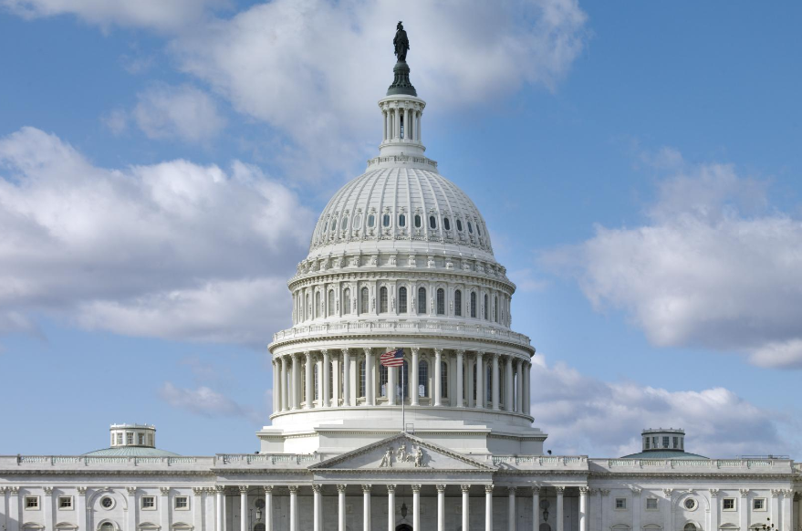


Washington, D.C. Trip
August 11, 2025
3/2/2023

Slide 2
Purpose
Meet with Iowa’s Congressional Delegation, US DOT officials, and US Army Corps of Engineers officials
Discuss Iowa’s use of federal transportation funds
Provide Iowa perspectives of future transportation authorization priorities

Slide 3
Schedule
Monday, September 15 – Fly to D.C.
Tuesday, September 16
  Morning: House meetings
  Afternoon:
    TBD: US DOT officials meeting
    2:00 pm: US Army Corps of Engineers
Wednesday, September 17
  Morning: Senate meetings
  Afternoon/Evening: Fly back

Slide 4
Focus Areas – Congressional Delegation
Iowa’s Strengths
  Efficient/quick use of federal funds
  Partnerships with jurisdictions and stakeholders
Transportation Challenges
  Inflationary impacts
  Discretionary programs and awards
Reauthorization Priorities
  Increase funding levels
  Focus on core formula programs
  Reduce regulations and streamline processes
  Support state’s ability to harness innovation and technology

Slide 5
Focus Areas – US DOT
Iowa’s Strengths
Transportation Challenges
Reauthorization Priorities
Support for US DOT priorities
Discretionary grants

Slide 6
Focus Areas – US Army Corps of Engineers
Iowa’s interest and support of navigation on both the Missouri River and Mississippi River
Support for Upper Mississippi Lock and Dam investment
Major river bridge project coordination
Project delivery streamlining and acceleration

Slide 7
Questions/Comments

