Slide 1
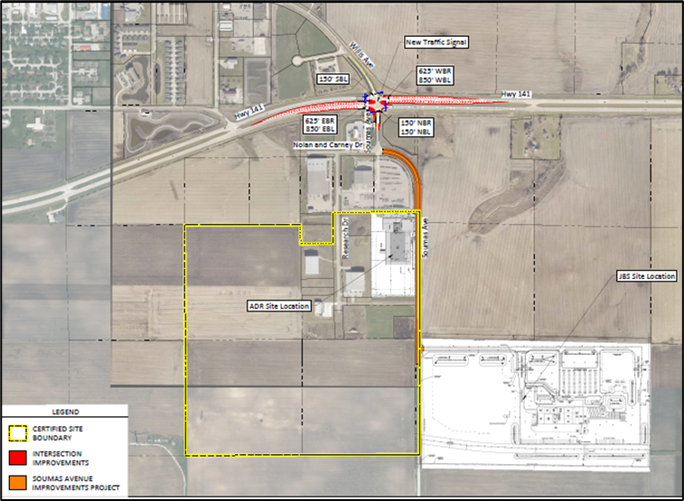
Immediate Opportunity/Local Development Hybrid Recommendation
PROJECT | SPONSOR | JOBS/ SCORE | TOTAL PROJECT COST | PERCENT PARTICIPATION | RECOMMENDED AMOUNT
Reconstruction of approximately 2,700 feet of Soumas Avenue located on the southeast side of town | Perry | 207 Jobs | $3,618,275 | 80% | $2,894,620
Turn lanes and a traffic signal at the intersection of Iowa 141 and Soumas Avenue located on the southeast side of town | Perry | Score 67 | $3,217,744 | 60% | $1,930,646
1
1

Slide 2
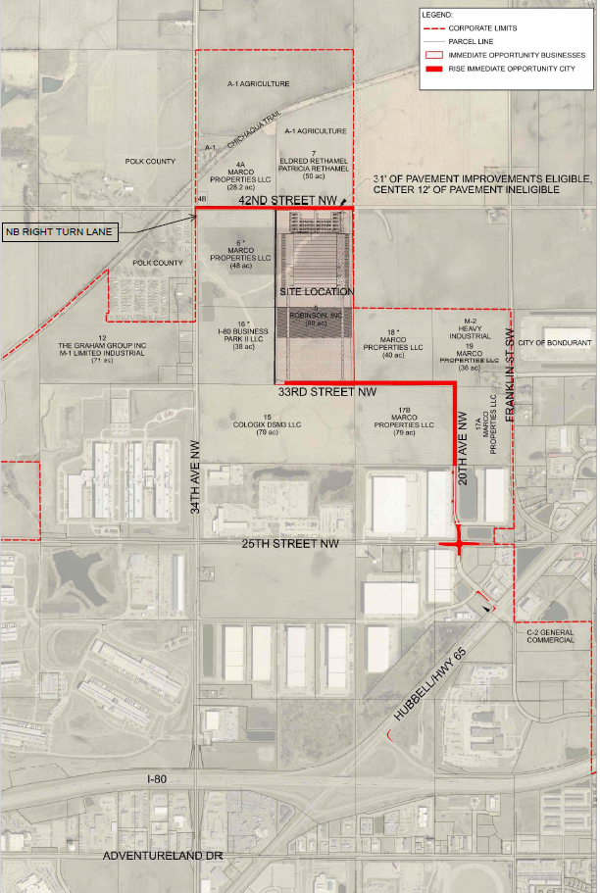
Local Development Recommendation
PROJECT NAME | SPONSOR | SCORE | TOTAL PROJECT COST | PERCENT PARTICIPATION | RECOMMENDED AMOUNT
Widening of 975 feet of 20th Avenue NW and I-80 ramp return; construction of 1,375 feet of 20th Avenue NW and 2,960 feet of 33rd Street NW; paving of 2,620 feet of 42nd Street, intersection improvements at 20th Avenue NW and 25th Street NW and also 20th Avenue NW and Hubbell Avenue; and a turn lane at 34th Avenue NW and 42nd Street NW located on the northwest side of town (all lengths approximate) | Altoona | 69 | $11,930,281 | 50% | $5,965,141
2
2

Slide 3
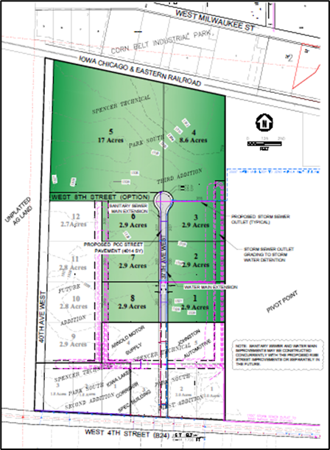
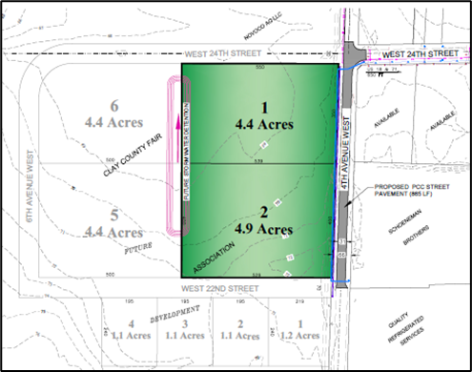
Local Development Recommendation
PROJECT NAME | SPONSOR | SCORE | TOTAL PROJECT COST | PERCENT PARTICIPATION | RECOMMENDED AMOUNT
Construction of approximately 865 feet of 4th Avenue West located on the north side of town and approximately 955 feet of 37th Avenue West located on the west side of town (Business Relocation & Job Retention) | Spencer | 55 | $1,190,179 | 70% | $833,125
3
3

Slide 4
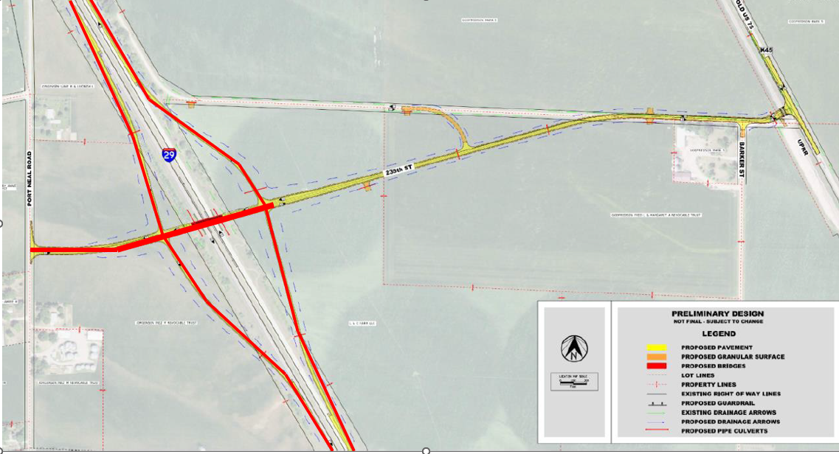
Local Development Recommendation
PROJECT NAME | SPONSOR | SCORE | TOTAL PROJECT COST | PERCENT PARTICIPATION | RECOMMENDED AMOUNT
Construction of a new interchange on Interstate 29 located south of Sioux City | Woodbury County | 59 | $22,789,824 | 21% | $4,796,168
4
4

