Slide 1
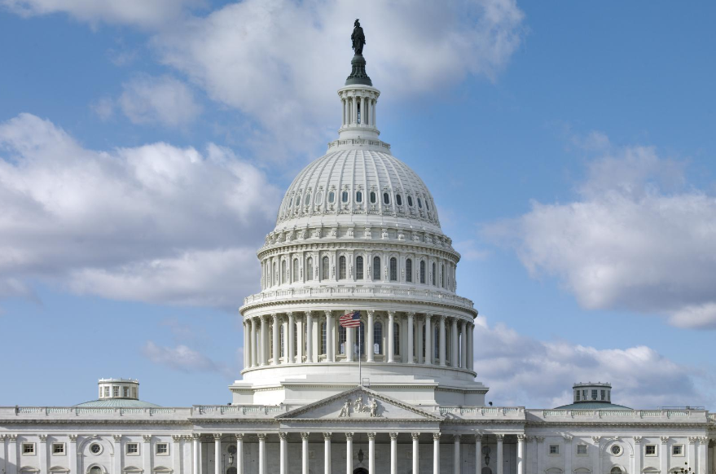


Washington, D.C. Trip
September 9, 2025
3/2/2023

Slide 2
Purpose
Meet with Iowa’s Congressional Delegation, Federal Highway Administration officials, and US Army Corps of Engineers officials
Discuss Iowa’s use of federal transportation funds
Provide Iowa perspectives of future transportation authorization priorities

Slide 3
Schedule
Monday, September 15 – Fly to D.C.
Tuesday, September 16
TBD: Representatives Miller-Meeks, Hinson, and Nunn
11:30 am: FHWA officials meeting
2:00 pm: US Army Corps of Engineers
4:15 pm: Senator Grassley
Wednesday, September 17
10:00 am: Senator Ernst
11:00 am: Representative Feenstra
Afternoon/Evening: Fly back

Slide 4
Questions/Comments

