Slide 1



Transportation Trends Update
September 9, 2025
3/2/2023

Slide 2
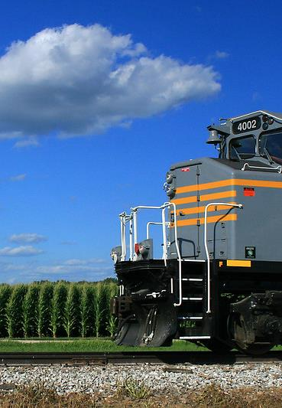

Agenda
US total rail carloads
Commercial air service passenger counts
Public transit ridership
Vehicular traffic
Safety
Mississippi River

Slide 4
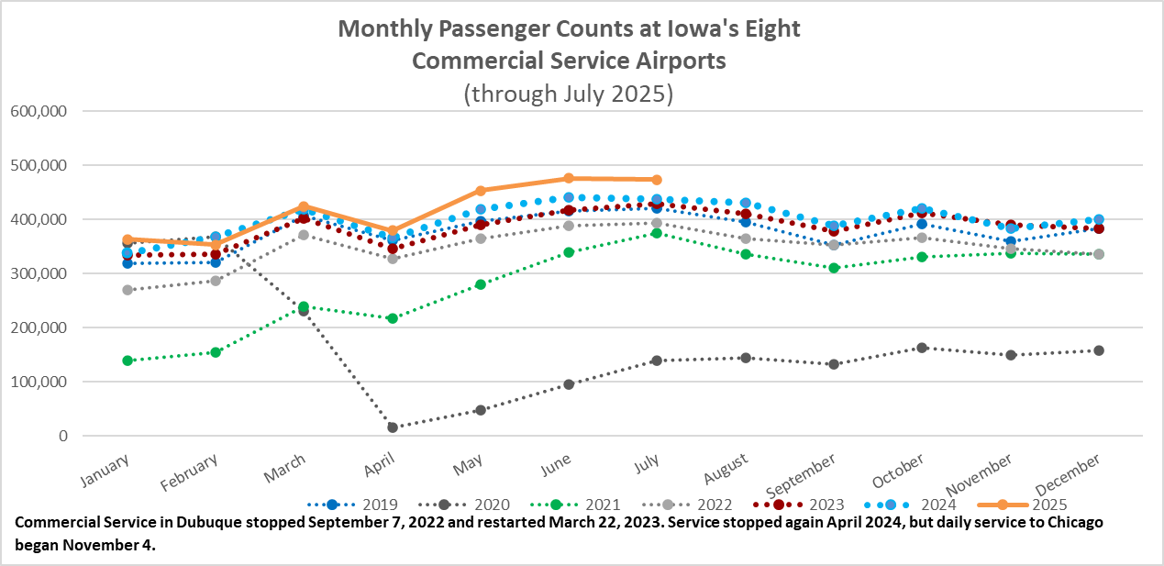

Slide 5
Monthly State Vehicle Miles of Travel
(through July 2025)
Vehicle Miles of Travel (in millions)

Slide 6
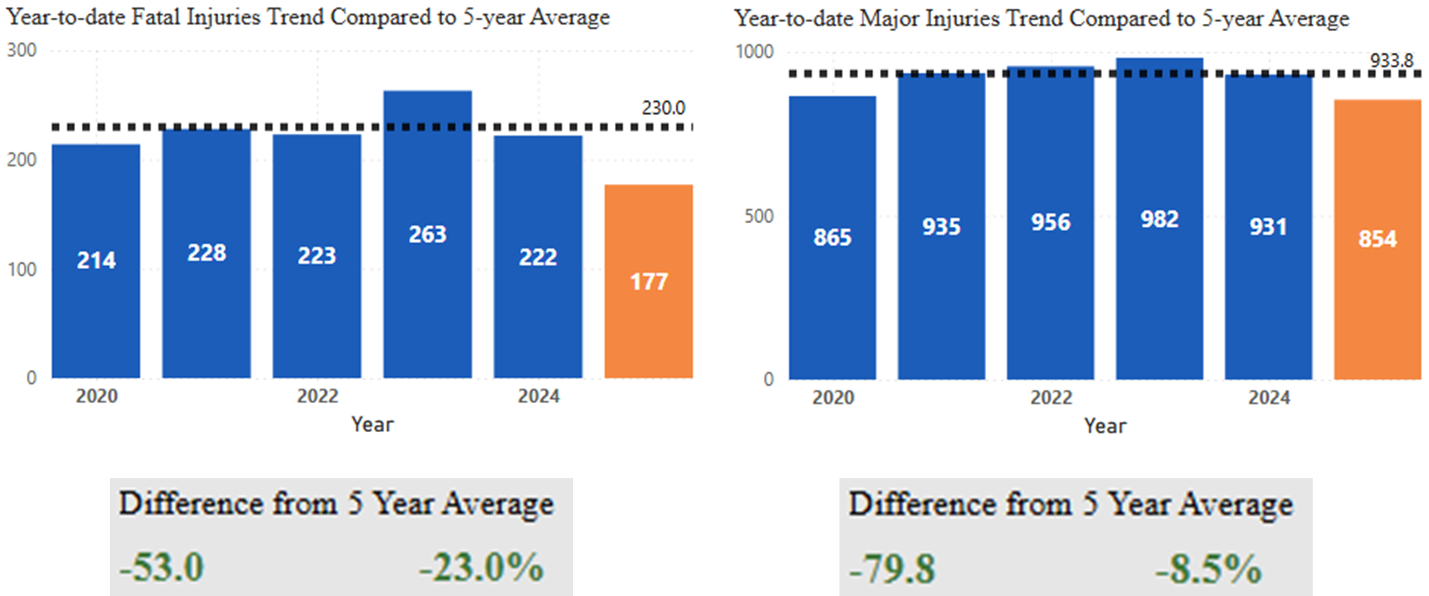
Statewide Fatalities & Major Injuries Year-to-Date
(As of September 2, 2025)

Slide 7
Mississippi River Water Levels
Low water levels could be experienced in the lower Mississippi River in the next few weeks.
Current water levels are higher than last year but there is limited rain in the forecast.
Could result in draft limits on barges.

Slide 8
Questions?

