Slide 1
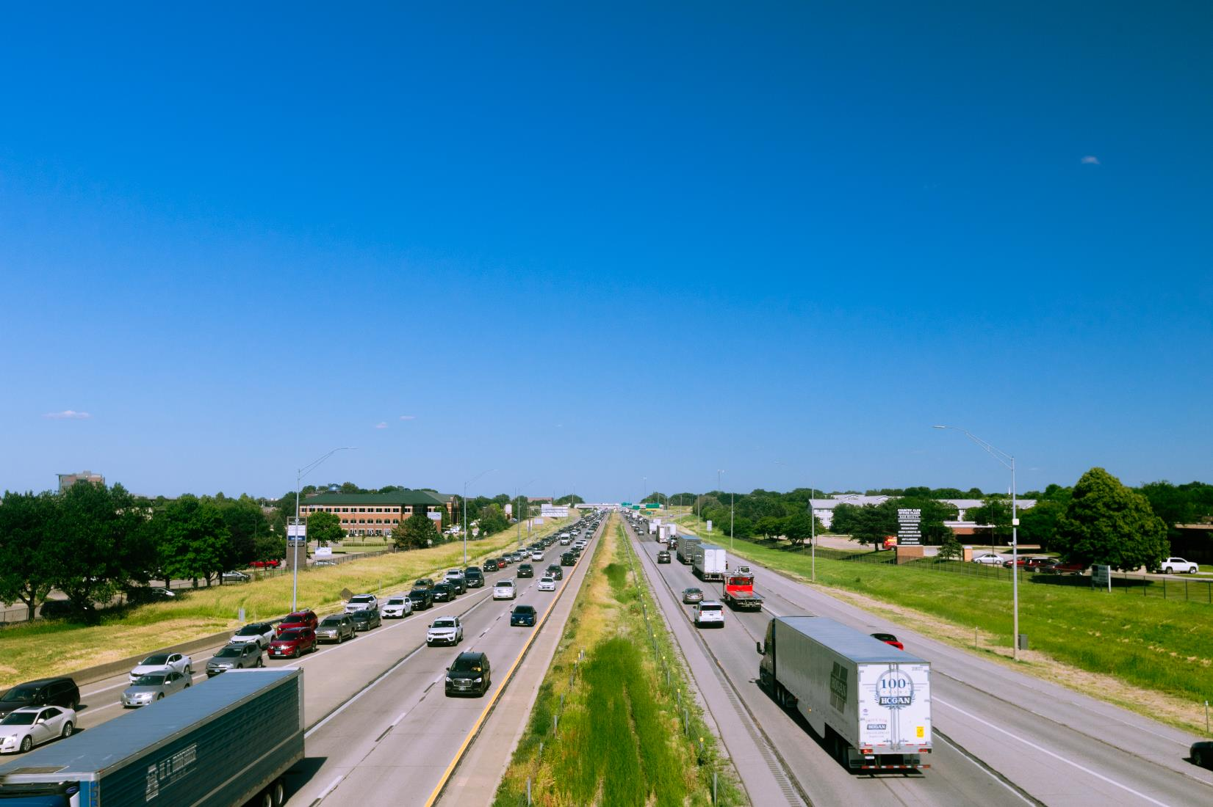


FY 2026 Highway Program Balance Report
September 9, 2025
3/2/2023

Slide 2
Receipts / Costs
Revenue
Forecast PRF Receipts (July) $76.8m
Actual PRF Receipts (July) $77.8m
Lettings
Programmed Amounts (August) $167.2m
Project Costs (August) $147.9m

Slide 3
Balance
FY 2026 Program Balance (June 2025) ($32.3m)
July PRF Receipts Difference $1.0m
August Project Letting Difference $19.3m
Program Balance (August 2025) ($11.9m)
Previous Balance Reported: ($22.2m)
FY 2026 Highway Program Balance Overview

Slide 4






Fiscal Year 2026 Overview
Revenue: Expect monthly revenue fluctuations.
Lettings:
Nineteen percent of the FY 2026 Program has been awarded.
The August letting was approximately $62 million.
Next letting scheduled for September 16, 2025.

Slide 5
Questions?

