Slide 1
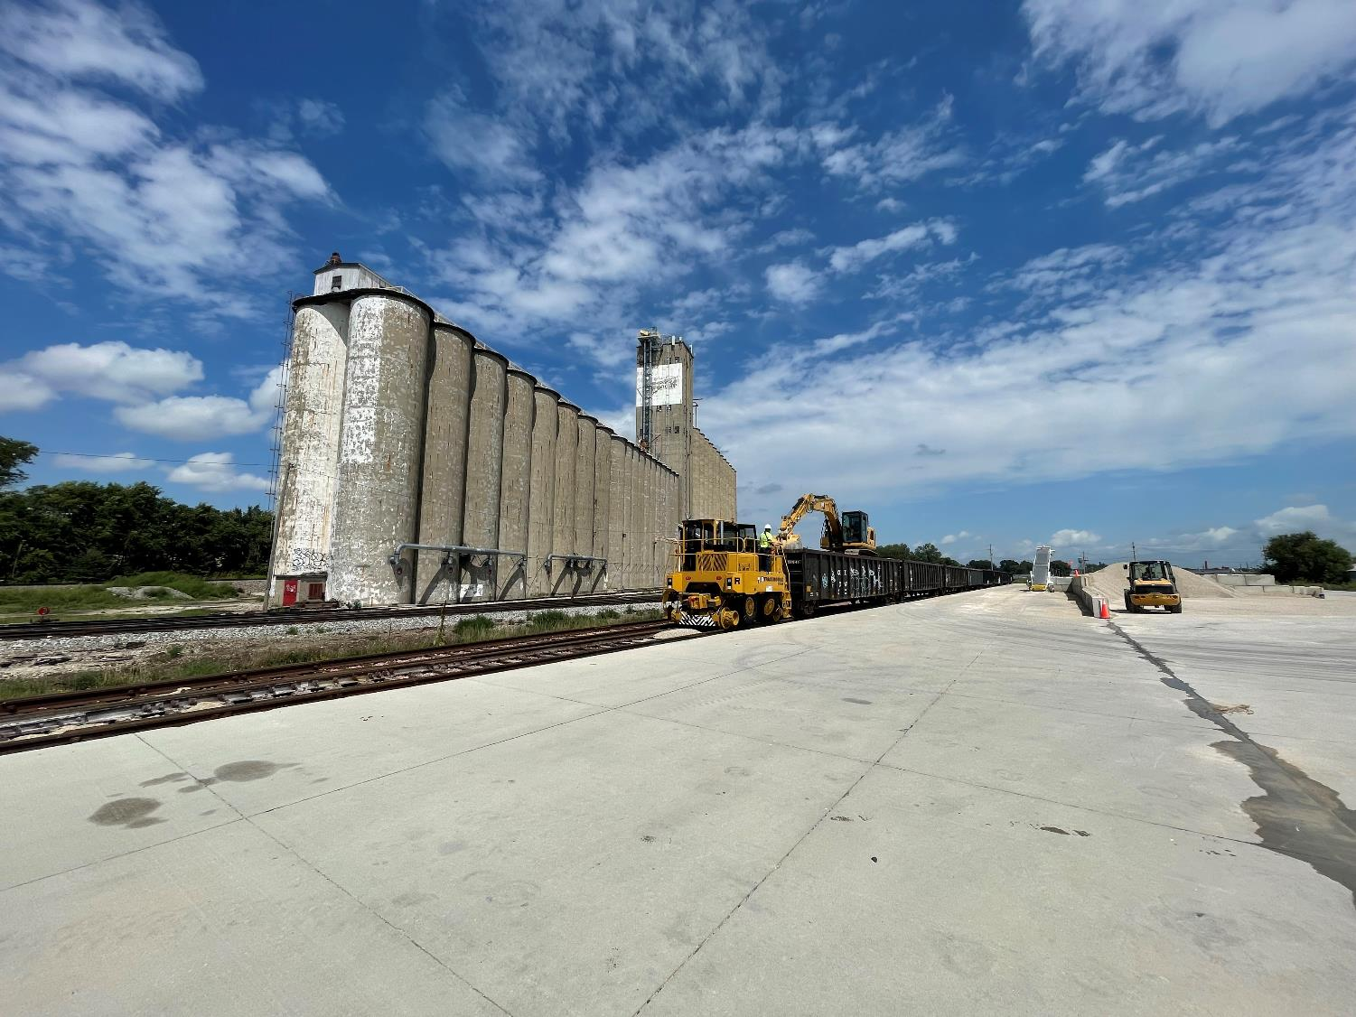


FY 2026
Rail Revolving Loan and Grant Program Applications and Funding Recommendations
3/2/2023
James (Jim) Glaspie
Rail Development Manager
September 9, 2025 Transportation Commission
Notes:
Good morning, members of the Transportation Commission, and thank you for the opportunity to present the fiscal year 2026 Rail Revolving Loan and Grant program funding recommendation. I am Jim Glaspie. I serve as the Rail Development Manager.

Slide 2
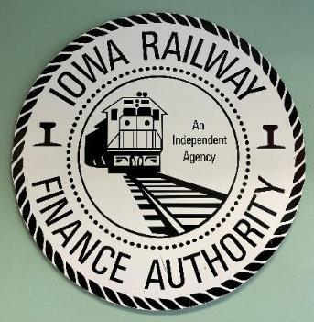
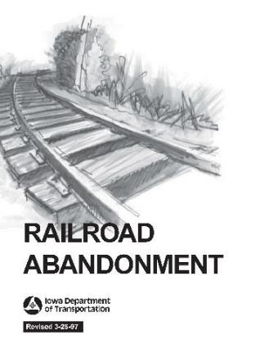
HISTORY
Created within what was Iowa Railway Finance Authority (IRFA).
The IRFA was created in 1980 and was active until 2009.
Created in 2005 by an amendment to Iowa Code 327H.20 and follows Administrative Rule 761, Chapter 822.
Notes:
The Rail Revolving Loan and Grant (RRLG) program comes from what was the Iowa Railway Finance Authority (IRFA). The IRFA was created in 1980 in response to gaps in rail service cause by rail line abandonments during this time. The RRLG program of today was created in 2005 by an amendment to Iowa code and follows administrative rules set by the Department of Transportation.

Slide 3
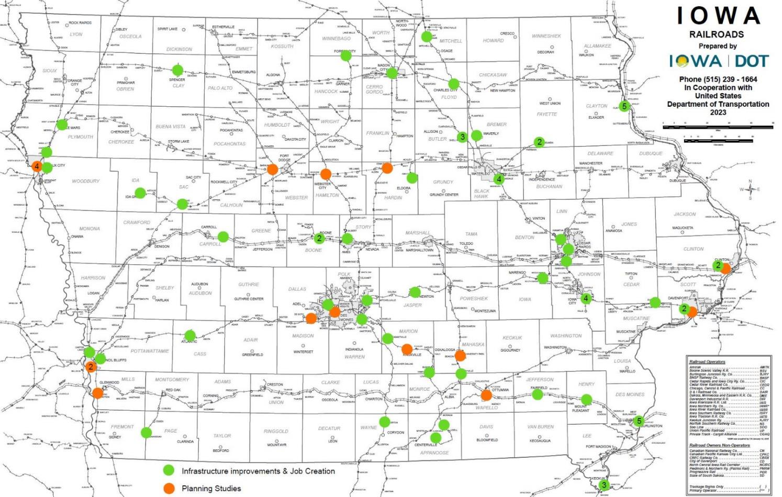
Rail Revolving Loan & Grant program FY2006 to FY2025
Notes:
Between 2006 and 2025, the Rail Revolving Loan and Grant program has worked to fund projects a crossed the state using the three parts of the program. This map shows ongoing and completed projects, between 2006 and 2025. The green dots show infrastructure and jobs creation or retention projects, and the orange dots show planning studies.

Slide 4
Parts of the RRLG program
(1) Targeted Job Creation & Retention - Grant
(2) Infrastructure Creation or Improvement - Loan
(3) Rail Port Planning Study - Grant
Notes:
Remember from the last slide I talked about three parts of the program, but I only had two different colored dots on the map. That’s because parts 1 and 2 can be used together. Part 1 is a GRANT for Jobs creation or retention. Part 2 is a LOAN for infrastructure creation or improvement with no immediate connection to jobs. And part 3 is a GRANT for planning studies.

Slide 5
Notes:
This program’s Notice of Funding Availability, (NOFA), is formulated using the yearly appropriation from the Rebuilding Iowa’s Infrastructure Fund (RIIF) and from anticipated loan repayments. It also recaptures unused funds. This usually happens if a project is completed below the award amount but may also reflect forfeitures of funding. Forfeitures occur when a project is unable to move forward. This chart shows the relationship between appropriations, (green line), the funding available, (blue line), and the funding requests, (orange line).

Slide 6
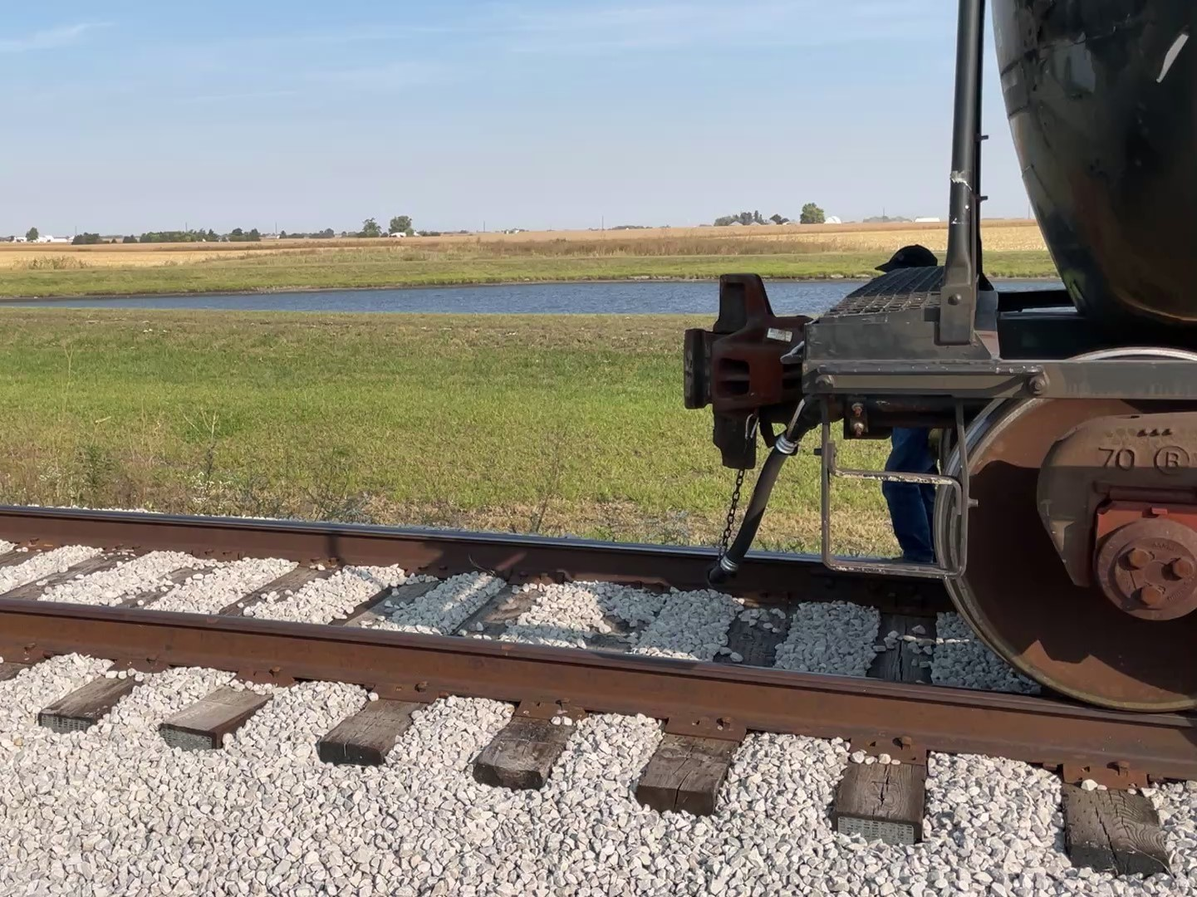
FY2026 RRLG funding break down
Appropriations $ 2,000,000
Loan repayments $ 1,346,847
Funding total $ 3,346,847
Applications 5
Notes:
READ SLIDE

Slide 7
Applications recommended for funding
PROJECT NAME | SPONSOR | TOTAL PROJECT COST | REQUESTED AMOUNT (% of Total Project Cost) | RECOMMENDED AMOUNT (% of Total Project Cost)
Floyd Valley Transload 1321 Lewis Blvd | Floyd Valley Transload | $1,500,752 | Loan $1,200,602 (80%) | Loan $830,000 (55.3%)
Floyd Valley Transload Rustin Street Spur Addition | Floyd Valley Transload | $320,000 | Loan $256,000 (80%) | Loan $256,000 (80%)
BJRY Le Mars Transload Expansion | Burlington Junction Railway | $1,131,330 | Loan $792,000 (70%) | Loan $792,000 (70%)
Black Hawk – New Box Manufacturing Facility | International Paper | $299,543,000 | Grant $2,125,000 (0.7%) | Grant $1,469,000 (0.5%)
Notes:
In Sioux City, this project will upgrade a grain storage facility to accommodate heavier rail cars and improve usability of the existing facility.
In Sioux City, this project is an addition to a FY2023 RRLG project completed at the end of 2024. It adds more capacity to the transload site.
In Le Mars, this project will add an additional transload location South of the FY17 RRLG project. The city of Le Mars has acquired 60 acres south of the existing industrial park and will extend their industrial rail access link allowing BJRY to build and operate the new transload that they will construct.
In Waterloo, this facility will be built in the Midport Industrial Park at the Waterloo Regional Airport. International Paper is unable to expand at their current location. The new location will keep the current 129 jobs in the area and allow for the creation of 72 new jobs.

Slide 8
Applications not recommended for funding
PROJECT NAME | SPONSOR | TOTAL PROJECT COST | REQUESTED AMOUNT (% of Total Project Cost) | RECOMMENDED AMOUNT (% of Total Project Cost)
Cedar Rapids North UPRR Track Reconstruction | City of Cedar Rapids | $3,250,000 | Grant $1,625,000 (50%) | Grant $0 (0%)
Notes:
Due to funding limits this year, our recommendation is to NOT fund this application.

Slide 9
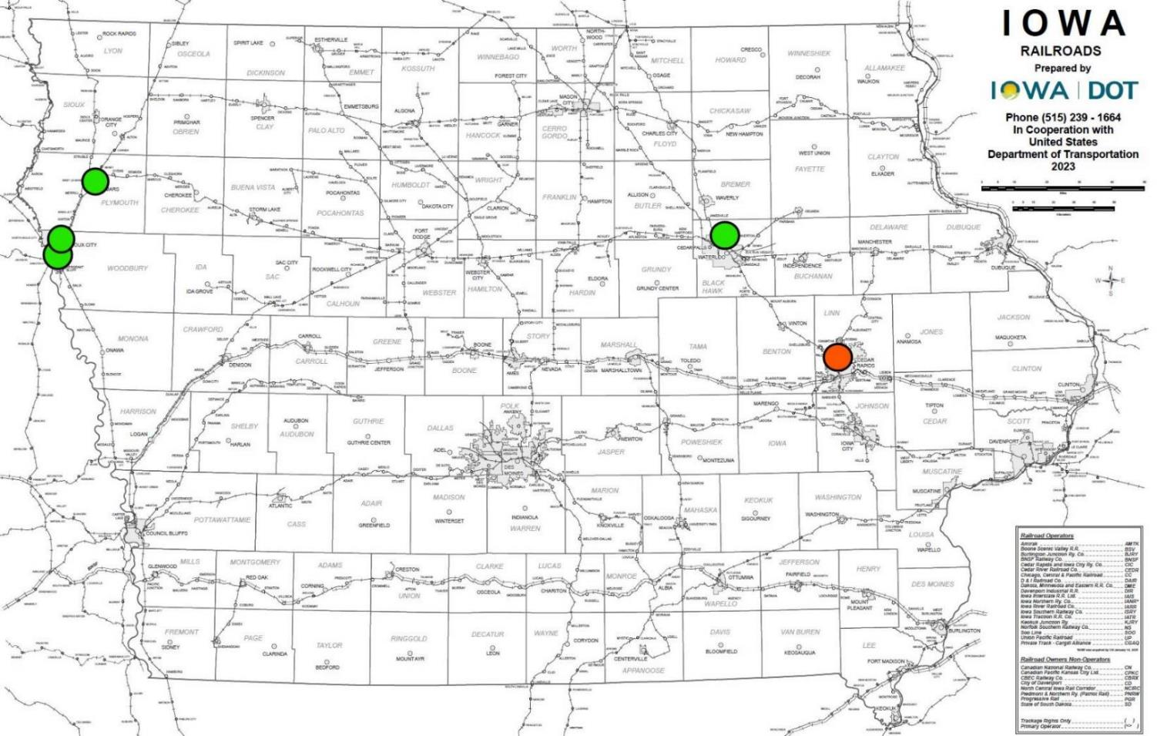
FY2026 RRLG funding recommendation by location
Notes:
This map shows the locations and the recommendation for FY2026 RRLG funding.

Slide 10

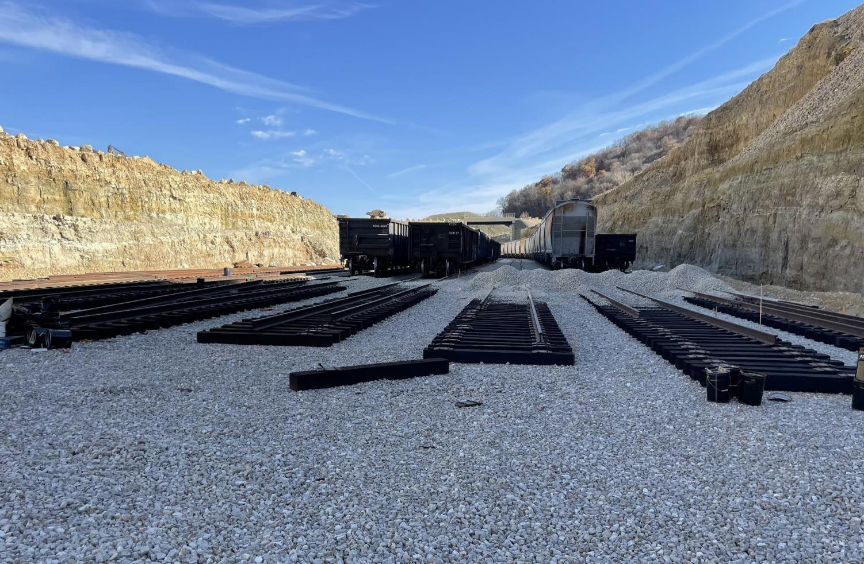

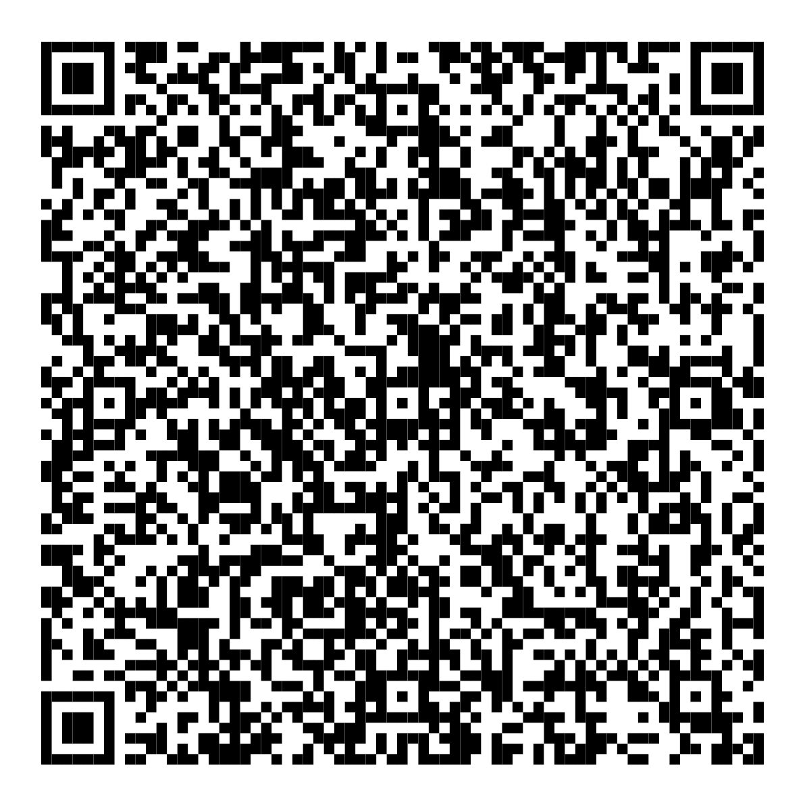
james.glaspie@iowadot.us
515-567-0715
Notes:
Thank you for your time today. Do you have any questions?

Slide 11
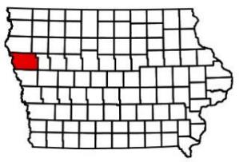
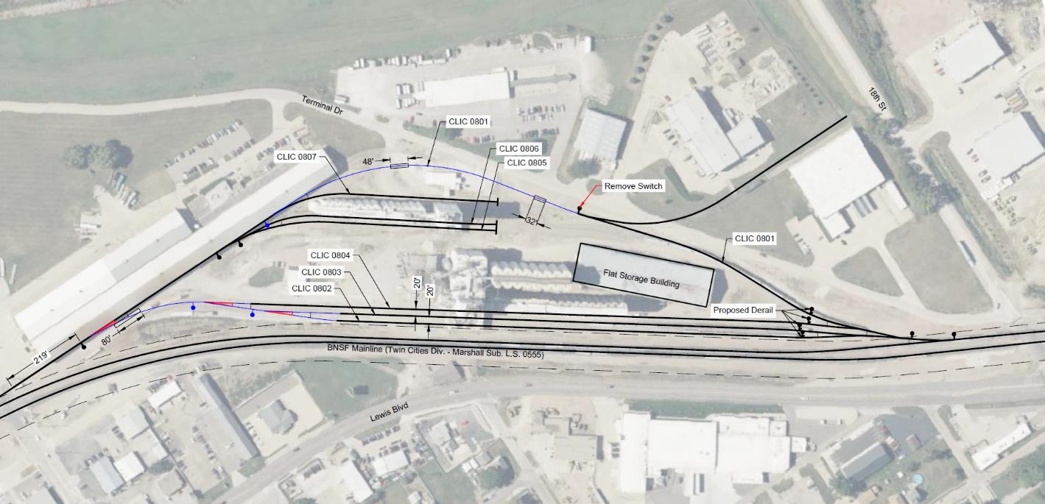
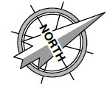
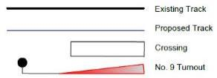
Floyd Valley Transload – 1321 Lewis Blvd, Sioux City
Floyd Valley Transload plans to upgrade 1397’ of rail and rail infrastructure at the Lewis Blvd site. Upgrades will allow for 3 additional businesses to access this under-utilized site and facilitate local rail car handling on site. Total rail cost $1,500,752.
Loan Request $1,200,602 Recommendation $830,000

Slide 12

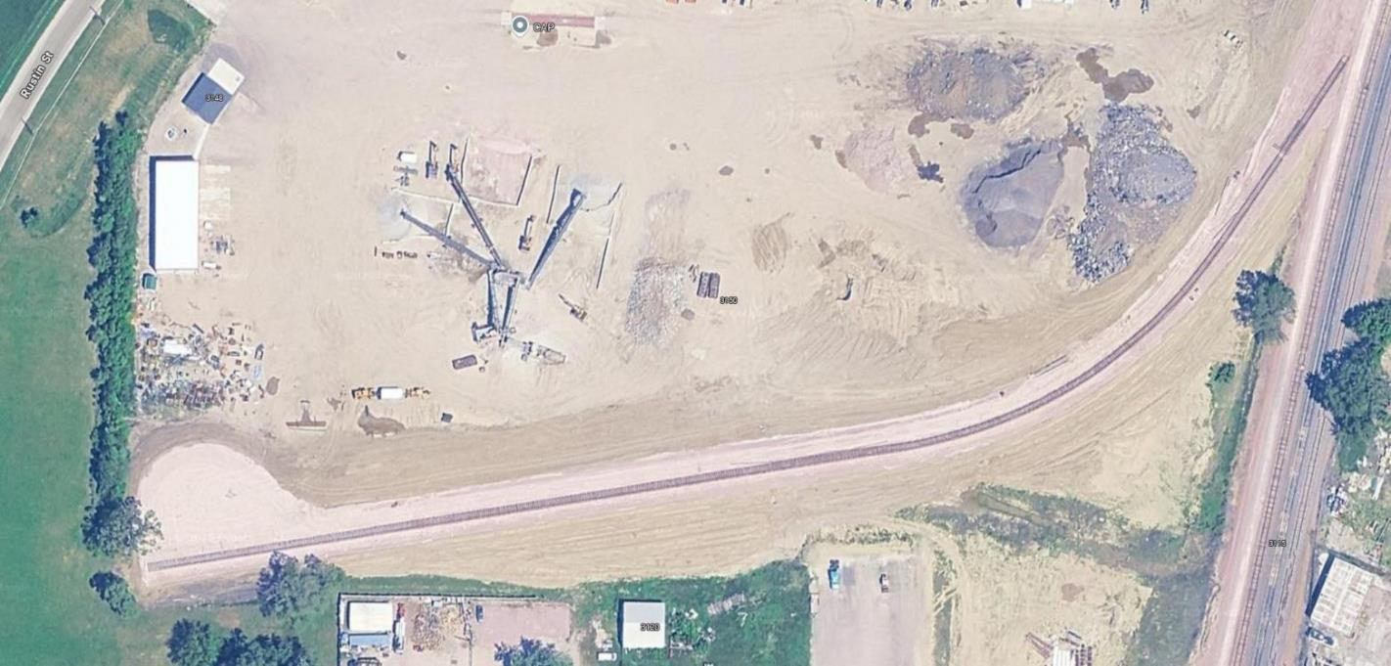
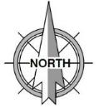
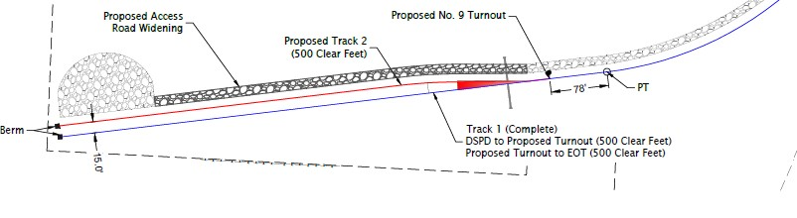
Floyd Valley Transload – Rustin Street, Sioux City
Floyd Valley Transload plans to add 558’ of rail to the recently
completed RRLG project awarded FY2023. This project will add
tank car capacity to the transload facility that handles liquid by
products from a local meat processing. Total rail cost $320,000.
Loan request $256 ,000 Recommendation $256,000

Slide 13
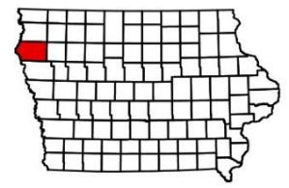
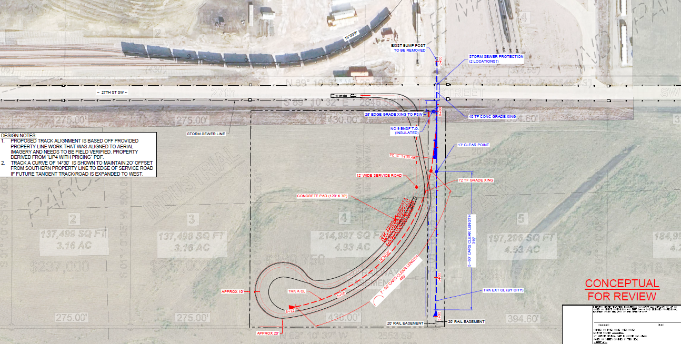
Burlington Junction Railway (BJRY) – Transload expansion, Le Mars
BJRY plans to expand the transload site at the industrial park in
Le Mars. This project will add 670’ of rail and additional transload
area to the 4.9-acre site in conjunction with the city of Le Mars
rail expansion. Total rail cost $1,131,330.
Loan request $792,000 Recommendation $792,000
City of Le Mars expansion
BJRY expansion

Slide 14
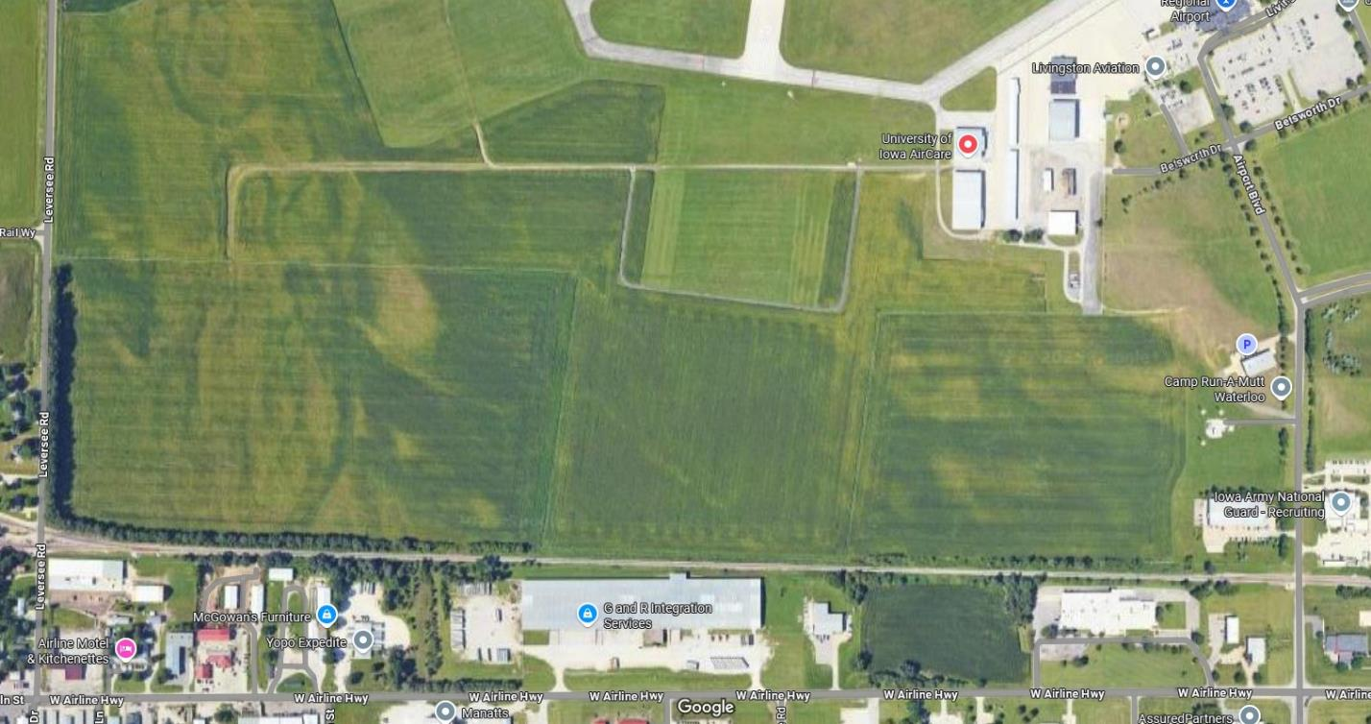

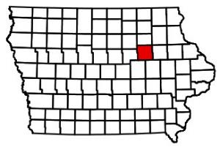
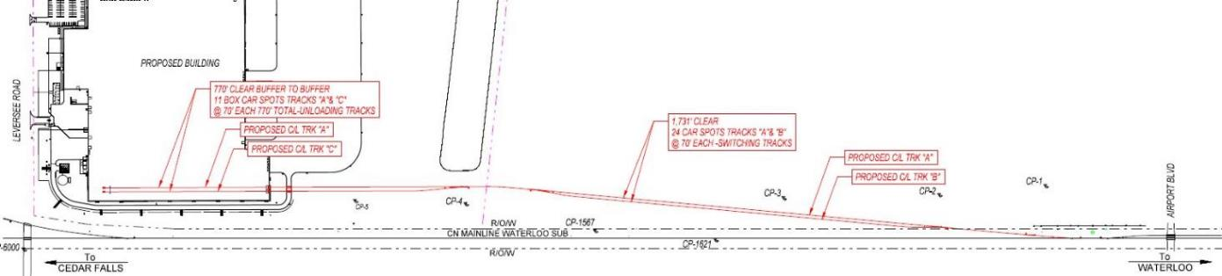
Blackhawk – New Box Manufacturing Facility, Waterloo
International Paper is planning a new facility at the MidPort America Business Park at the Waterloo Airport. This facility will replace the current one, in Waterloo and will add 7823’ of new rail. Jobs – 129 retained, 72 created. Total rail cost $4,250,000.
Grant request $2,125,000 Recommendation $1,469,000

Slide 15
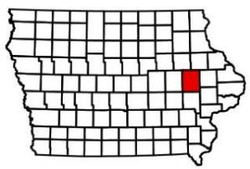
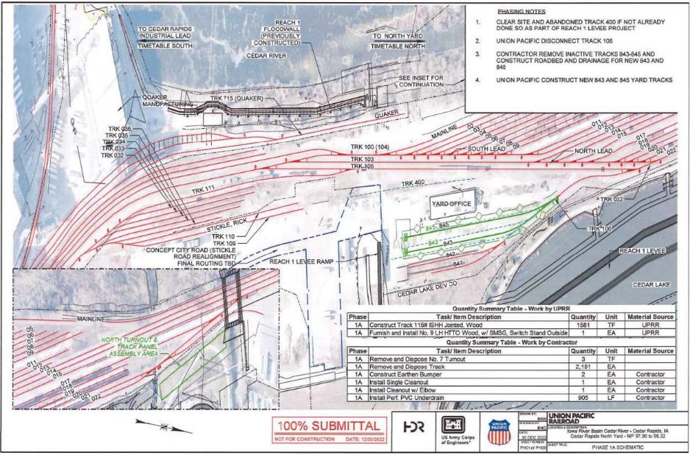
Cedar Rapids North Yard UPRR Track Reconstruction, Cedar Rapids
The city of Cedar Rapids is planning to remove and reconstruct
derelict rail infrastructure in the North Union Pacific Railroad
(UPRR) yard. Jobs – 940 retained. Total rail cost $3,250,000.
Grant request $2,125,000 Not recommended for funding.

