Slide 1
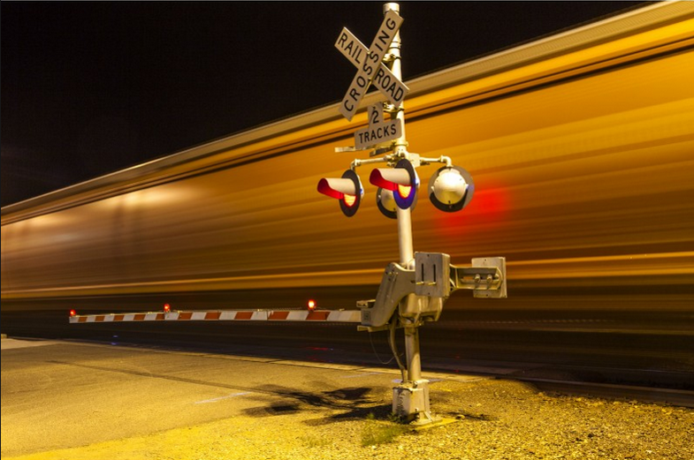

FY 2027
Highway-Railroad Crossing Safety Program
Funding Recommendation
Kristopher Klop
Railroad Crossing Safety Programs Manager
September 9, 2025

Slide 2
Program
FHWA Funding available for states to improve warning devices at railroad crossings.(23 USC Section 130) as part of the Highway Safety Improvement Program (HSIP).
Amount of appropriation funded by FHWA is determined by the number of public railroad crossings in the state.
Iowa currently has 4,832 public railroad crossings, (4,042 at-grade).
2
2

Slide 3
Available Funding and Application Summary
Available Funding from Section 130 Appropriation: | Column 2
Annual appropriation | $5,178,586
Cancelled projects (6) + | $1,251,000
Application Summary:
Total number of projects | 14 & 3 railroad crossing closures
Total project costs | $6,484,000
Total amount requested | $6,484,000
Total Funding balance:
$6,429,586
Remaining balance: ($54,414)
3
3

Slide 4
Project Requests
PROJECT NAME | SPONSOR | SCORE | TOTAL PROJECT COST | REQUESTED AMOUNT (% of Total Project Cost) | RECOMMENDED AMOUNT (% of Total Project Cost)
Moscow Avenue, 606835P | IAIS Railroad Muscatine County | 30.07 | $357,000 | $357,000 (100%) | $357,000 (100%)
W Canal Shore Drive, 865616N | DME Railroad City of LeClaire | 26.06 | $600,000 | $600,000 (100%) | $600,000 (100%)
Lost Grove Road, 865579N | DME Railroad City of Princeton | 18.09 | $375,000 | $375,000 (100%) | $375,000 (100%)
West 11th Street, 607576J | IANR Railroad City of Waterloo | 17.32 | $500,000 | $500,000 (100%) | $500,000 (100%)
Eldorado Avenue, 909175U | IAIS Railroad Dallas County | 15.88 | $200,000 | $200,000 (100%) | $200,000 (100%)
4
4

Slide 5
Project Requests
PROJECT NAME | SPONSOR | SCORE | TOTAL PROJECT COST | REQUESTED AMOUNT (% of Total Project Cost) | RECOMMENDED AMOUNT (% of Total Project Cost)
Dubuque Street, 606878H | IAIS Railroad City of Iowa City | 14.03 | $600,000 | $600,000 (100%) | $600,000 (100%)
510th Street, 603130N | IAIS Railroad Pottawattamie County | 13.93 | $357,000 | $357,000 (100%) | $357,000 (100%)
North Sunset Road, 079190C | BNSF Railroad City of West Burlington | 6.67 | $350,000 | $350,000 (100%) | $350,000 (100%)
Main Street, 376176A | DME Railroad City of McGregor | * | $600,000 | $600,000 (100%) | $600,000 (100%)
* AADT component of the benefit-cost formula not representative of the number of vehicles accessing the boat ramp and restaurant during tourist season.
5
5

Slide 6
Project Requests
PROJECT NAME | SPONSOR | SCORE | TOTAL PROJECT COST | REQUESTED AMOUNT (% of Total Project Cost) | RECOMMENDED AMOUNT (% of Total Project Cost)
172nd Avenue, 697147B | DME Railroad Wapello County | ** | $345,000 | $345,000 (100%) | $345,000 (100%)
** This crossing is relocated from the east through a rail yard, thus alleviating a blocked crossing situation at one of the worst / most frequently blocked crossings in the state (375761J / 163rd Avenue). The county and railroad are also closing three additional crossings as part of this project.
12th Avenue SE, 190495A | UP Railroad City of Cedar Rapids | 0.75 *** | $500,000 | $500,000 (100%) | $500,000 (100%)
*** Previously funded FY 2018 project required roadway geometry changes. UP Railroad failed to review and approve the city’s roadway plans in before the federal funding was set to expire. Project had to be cancelled, and a new application was submitted.
6
6

Slide 7
Project Requests
PROJECT NAME | SPONSOR | SCORE | TOTAL PROJECT COST | REQUESTED AMOUNT (% of Total Project Cost) | RECOMMENDED AMOUNT (% of Total Project Cost)
Waconia Avenue, 840199K | CIC Railroad City of Cedar Rapids | 0.74 **** | $650,000 | $650,000 (100%) | $650,000 (100%)
**** At onsite review for FY26 funded Highway-Railroad Crossing Surface Repair project, it was noted that additional changes to the roadway were necessary to accommodate recent increased truck traffic. This is project is to fund the placement of the new railroad crossing signals based upon the modified roadway geometry.
NE Broadway, 876012P | Polk County | ***** | $500,000 | $500,000 (100%) | $500,000 (100%)
***** $500,000 lump-sum to Polk County Grade Separation project, (over UP Railroad) as part of $26M overall roadway / bridge project.
7
7

Slide 8
Project Requests
PROJECT NAME | SPONSOR | SCORE | TOTAL PROJECT COST | REQUESTED AMOUNT (% of Total Project Cost) | RECOMMENDED AMOUNT (% of Total Project Cost)
Fairbanks Avenue, 307404X | Webster County | ****** | $250,000 | $250,000 (100%) | $250,000 (100%)
****** $250,000 lump-sum to Webster County for one-lane wooden bridge (over CCP Railroad) replacement project. This allows truck access to nearby ethanol plant. Additionally, the County is closing one railroad crossing.
3 projected closure incentive payments at various locations ($100,000 per location) | TBD | N/A | $300,000 | $300,000 (100%) | $300,000 (100%)
8
8

Slide 9
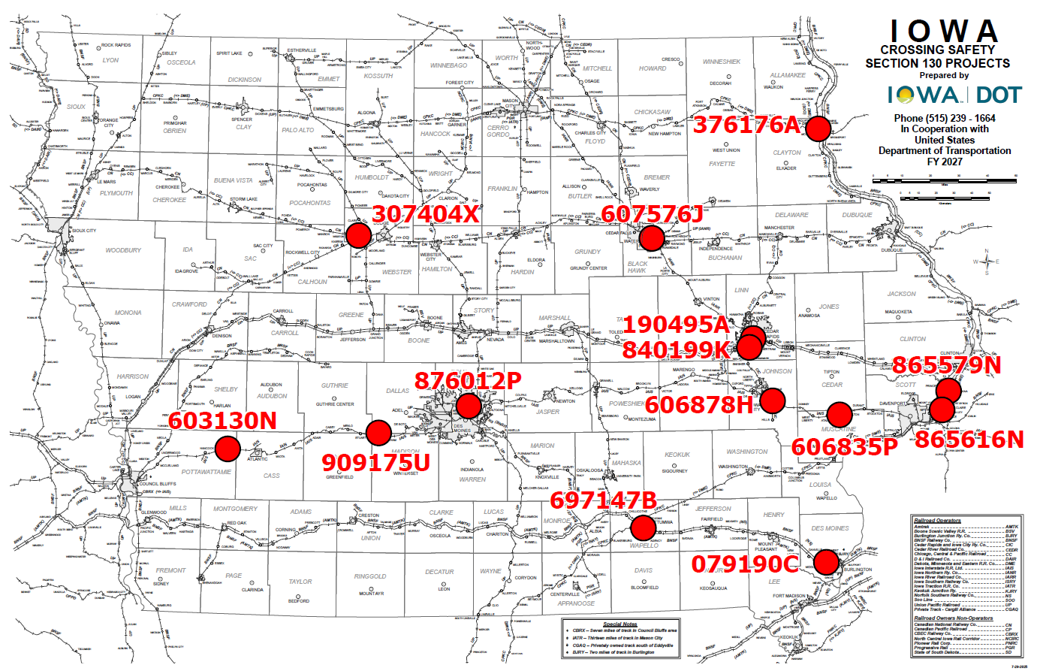
Map of Applications Received
9

Slide 10



Questions?
Kristopher.klop@iowadot.us
515-203-1646

