Slide 1
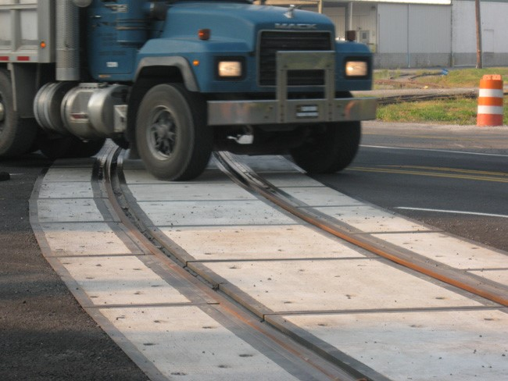

FY 2027 Highway-Railroad Crossing
Surface Repair Program
Funding Recommendation
Kristopher Klop
Railroad Crossing Safety Programs Manager
September 9, 2025

Slide 2
Program
Highway-Railroad crossing surface repair program incentivizes railroads and roadway authorities to participate in the cooperative repair of crossing surfaces.
- Project funding breakdown:
60% State
20% Roadway authority
20% Railroad
- Responsibilities:
Railroad: Replacement of rock (ballast), ties, track, underlayment, and crossing surface, flagging
Roadway Authority: Replacement of crossing roadway approaches and existing sidewalks (ADA compliant), road closures and detours
2
2

Slide 3
Project Evaluation Criteria
Projects are funded in the order the applications are received, except that up to 50% of the program allocation can be used in a discretionary manner.
All 35 crossing applications currently in the program queue were scored according to the following criteria:
Type of route the crossing is on, (crude oil, ethanol, passenger)
Average daily vehicle traffic / train traffic
Exposure index, (number of trains x number of cars)
Predicted Accidents, (train speed, roadway speed, number of traffic lanes, number of tracks)
Planned concurrent roadway projects
On-site inspection
Maximum score possible: 35 points
Final Projects
The three highest scored crossings were brought forward to be funded in addition to those already scheduled to be funded for FY 2027 for a total of 12 projects.
Associated railroads and roadway authorities were contacted and confirmed they were able to participate with funding and repairs.
3
3

Slide 4
Available Funding and Application Summary
Available Funding: | Column 2
Annual appropriation | $900,000
Cancelled Projects (5) | $547,800
Application Summary:
Total number of projects | 9-order received $833,973 / 55% 3-scoring $677,559 / 45% 12 Total
Total project costs | $2,519,220 (100% amount)
Total amount requested | $1,511,532 (Program 60% amount)
Available funds $1,447,800
4
4
Difference ($63,732)

Slide 5
Requested Projects
PROJECT NAME | SPONSOR | SCORE | TOTAL PROJECT COST | REQUESTED AMOUNT (% of Total Project Cost) | RECOMMENDED AMOUNT (% of Total Project Cost)
210th Avenue, 385590M | DME Railroad Kossuth County | N/A Order Received | $101,520 | $60,912 (60%) | $60,912 (60%)
40th Avenue, 385623X | DME Railroad Kossuth County | N/A Order Received | $130,000 | $78,000 (60%) | $78,000 (60%)
Greene Street, 271479R | BSV Railroad City of Boone | N/A Order Received | $120,000 | $72,000 (60%) | $72,000 (60%)
Tama Street, 271483F | BSV Railroad City of Boone | N/A Order Received | $100,000 | $60,000 (60%) | $60,000 (60%)
Sixth Avenue, 095312V | BNSF Railroad Adams County | N/A Order Received | $280,000 | $168,000 (60%) | $168,000 (60%)
5
5

Slide 6
Requested Projects
PROJECT NAME | SPONSOR | SCORE | TOTAL PROJECT COST | REQUESTED AMOUNT (% of Total Project Cost) | RECOMMENDED AMOUNT (% of Total Project Cost)
West 18th Street, 607572G | IANR/ CN Railroad City of Waterloo | N/A Order Received | $159,535 | $95,721 (60%) | $95,721 (60%)
Hawthorne Avenue, 607571A | IANR/ CN Railroad City of Waterloo | N/A Order Received | $118,700 | $71,220 (60%) | $71,220 (60%)
C-16, 097429K | BNSF Railroad Plymouth County | N/A Order Received | $65,000 | $39,000 (60%) | $39,000 (60%)
Bellingham Road, 865635T | DME Railroad City of Riverdale | N/A Order Received | $315,200 | $189,120 (60%) | $189,120 (60%)
6
6

Slide 7
Requested Projects
PROJECT NAME | SPONSOR | SCORE | TOTAL PROJECT COST | REQUESTED AMOUNT (% of Total Project Cost) | RECOMMENDED AMOUNT (% of Total Project Cost)
Vanderbilt Street, 190538R | UP Railroad City of Fairfax | 26 | $374,350 | $224,610 (60%) | $224,610 (60%)
8th Avenue SE, 190501B | UP Railroad City of Cedar Rapids | 25 | $472,308 | $283,385 (60%) | $283,385 (60%)
8th Avenue SE, 376707U | CIC Railroad City of Cedar Rapids | 24 | $282,607 | $169,564 (60%) | $169,564 (60%)
7
7

Slide 8
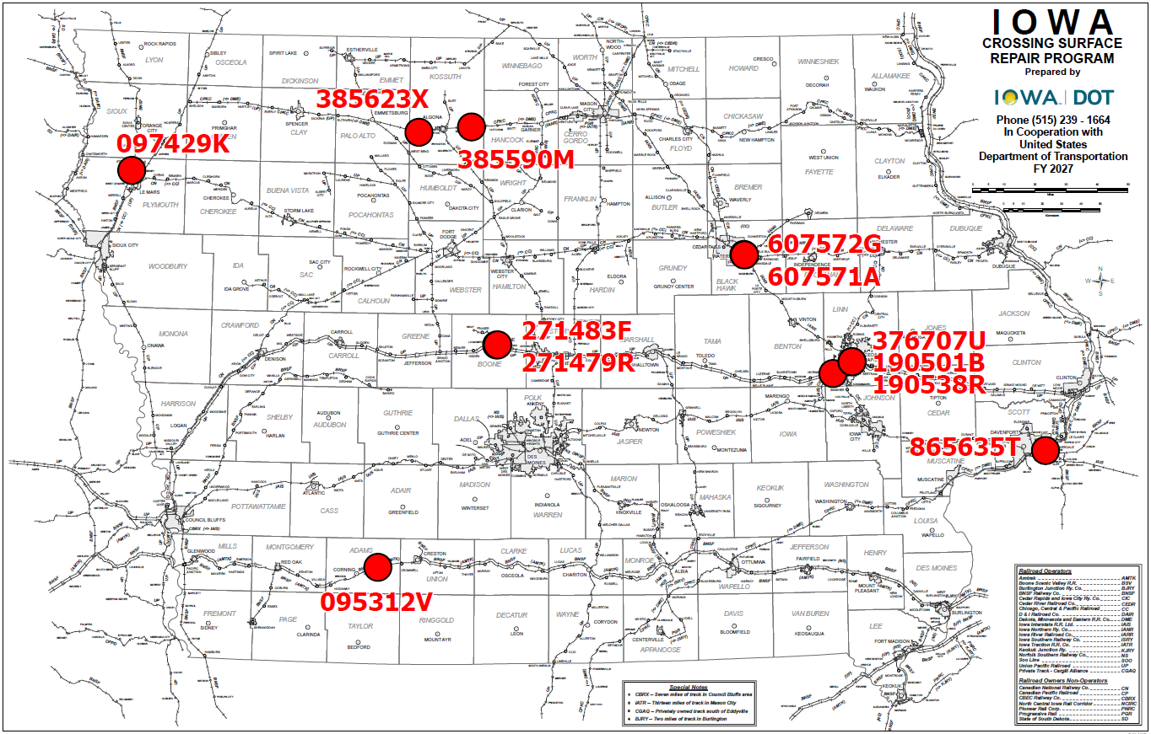
Map of Applications Recommended Awards
8

Slide 9



Questions?
Kristopher.klop@iowadot.us
515-203-1646

