Slide 1
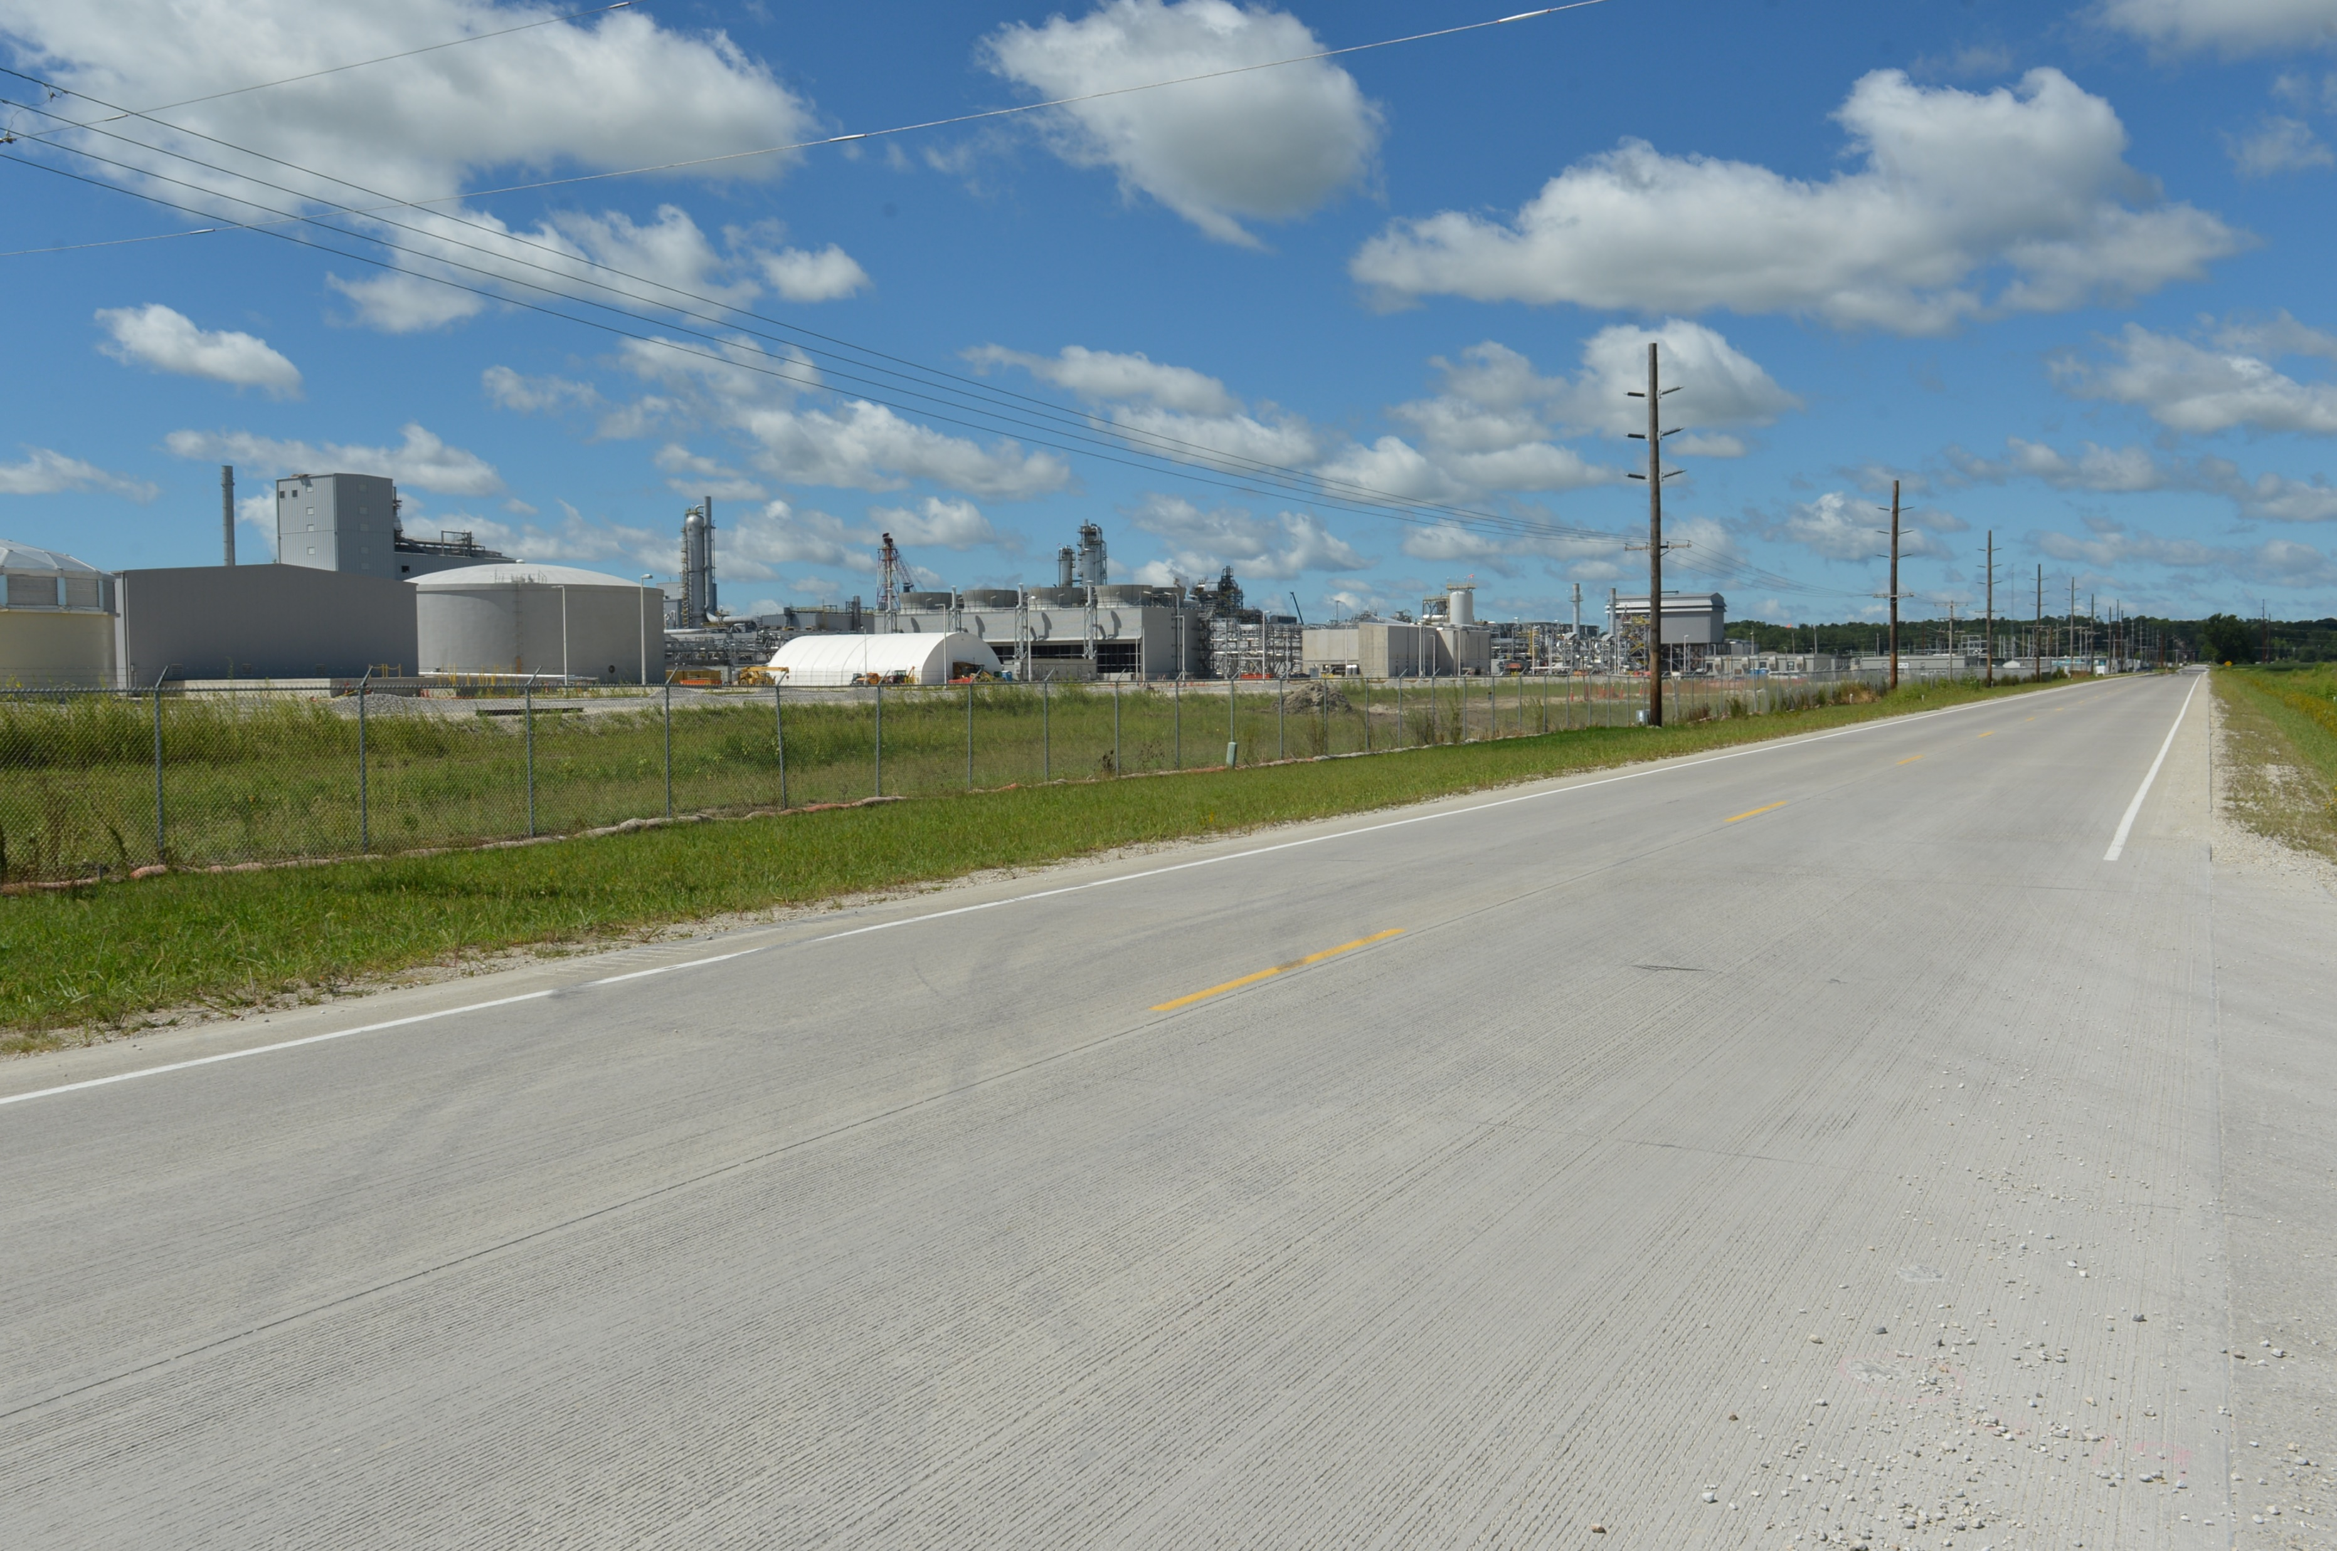

Revitalize Iowa’s Sound Economy Program
Funding Recommendation
Debra Arp
Local Systems Bureau, Grant Team Leader
9/9/2025

Slide 2
Revitalize Iowa’s Sound Economy Program
Created in 1985
Purpose: To promote economic development through roadway improvements
Eligible development shall have value-adding activities that feed new dollars into the economy
Available to cities and counties through an application program
2
2

Slide 3
Monthly Program Financial Report
Funded annually with dedicated state motor fuel and special fuel tax revenues
 | City RISE Fund | County RISE Fund
FY2026 Projected Total RISE Road Use Tax Fund (RUTF) Revenue ¹ | $12,017,805 | $6,008,902
Actual RISE Revenue Received as of 7/31/2025 ² (% of FY2025 Projected Revenue) | $967,089 (8.0%) | $483,545 (8.0%)
FY2026 RISE Funds Awarded as of 7/31/2025 (% of Projected Total RUTF committed) | $0 (0%) | $0 (0%)
Fund Balance as of 7/31/2025 | $59,088,046 | $23,792,196
Outstanding Commitments as of 7/31/2025 | ($42,784,594) | ($14,661,568)
Uncommitted Balance as of 7/31/2025 | $16,303,452 | $483,545
¹ Calculation based on FY2025 average monthly RISE RUTF revenue of $1,001,484 to the city RISE fund and $500,742 to the county RISE fund. As of 7/31/2025, FY2026 is 8.3% complete.
² Actual RISE revenue includes RUTF revenue, loan repayments, and project settlements. These revenue sources are variable and are not included in projections.
3
3

Slide 4
Immediate Opportunity Project Evaluation
Job Creation and/or Retention | Economic Development Assisted
Quality of jobs | Diversifies Iowa’s economy
Potential for future job growth | Few in-state competitors
Hiring Iowa residents | Higher proportion of in-state suppliers
Average wages 100% of laborshed rate | Higher proportion of out-of-state sales
 | Import substitution
 | No pattern of violations
4
4

Slide 5
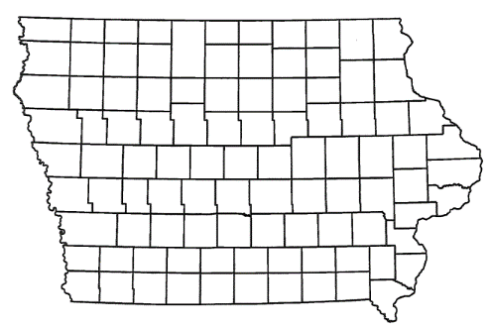
Immediate Opportunity/Local Development Hybrid Recommendation
PROJECT | SPONSOR | JOBS/ SCORE | TOTAL PROJECT COST | PERCENT PARTICIPATION | RECOMMENDED AMOUNT
Reconstruction of approximately 2,700 feet of Soumas Avenue located on the southeast side of town | Perry | 207 Jobs | $3,618,275 | 80% | $2,894,620
Turn lanes and a traffic signal at the intersection of Iowa 141 and Soumas Avenue located on the southeast side of town | Perry | Score 67 | $3,217,744 | 60% | $1,930,646
5
5

Slide 6
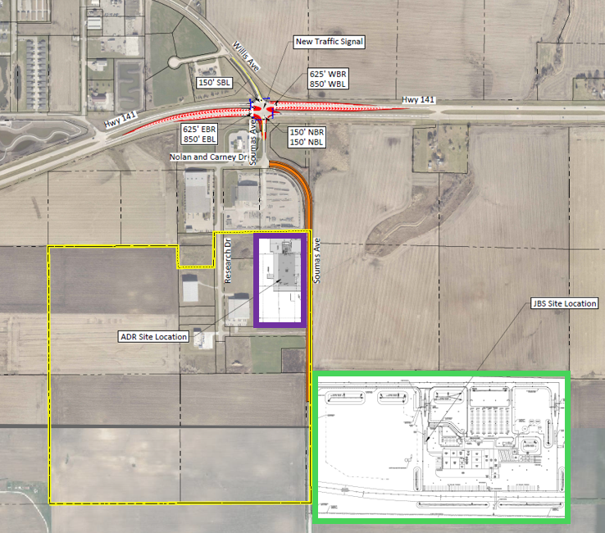
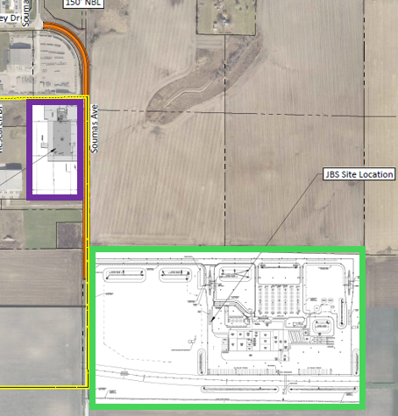
Perry Immediate Opportunity Component
Reconstruction of approximately 2,700 feet of Soumas Avenue located on the southeast side of town. These improvements are necessary to provide improved access to the proposed Swift Pork Company (JBS) and ADR Group sites.
Component Cost: $3,618,275
Requested: $2,894,620 (80%)
Jobs Committed: 207
RISE Cost/Job Assisted: $13,984
Capital Investment: $152 million
Capital Investment/RISE: $52.64
Ave Wage of Committed Jobs: $28.36
Percent of Laborshed Wage: 105%
6

Slide 7
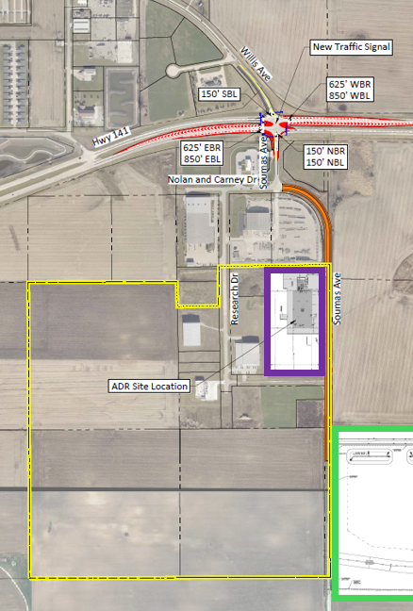
Perry Local Development Component
Turn lanes and a traffic signal at the intersection of Soumas Avenue and Iowa 141 located on the southeast side of town. These improvements provide access to support development at the proposed JBS and ADR as well as to the Perry Industrial Park, an Iowa Economic Development Authority certified site area of more than 156 acres.
Component Cost: $3,217,744
Requested: $1,930,646 (60%)
TOTAL Project Cost: $6,836,019
TOTAL RISE: $4,825,266 (71% combined)
7

Slide 8
Local Development Project Evaluation Criteria
Criteria | Points
Development Potential | 35
Economic Impact and Cost Effectiveness | 20
Local Commitment and Initiative | 33
Transportation Need and Justification | 4
Local Economic Need | 6
8
8

Slide 9
Local Development Recommendations
PROJECT NAME | SPONSOR | SCORE | TOTAL PROJECT COST | PERCENT PARTICIPATION | RECOMMENDED AMOUNT
Widening of 975 feet of 20th Avenue NW and I-80 ramp return; construction of 1,375 feet of 20th Avenue NW and 2,960 feet of 33rd Street NW; paving of 2,620 feet of 42nd Street, intersection improvements at 20th Avenue NW and 25th Street NW and also 20th Avenue NW and Hubbell Avenue; and a turn lane at 34th Avenue NW and 42nd Street NW located on the northwest side of town (all lengths approximate) | Altoona | 69 | $11,930,281 | 50% | $5,965,141
9
9

Slide 10
Local Development Recommendations
PROJECT NAME | SPONSOR | SCORE | TOTAL PROJECT COST | PERCENT PARTICIPATION | RECOMMENDED AMOUNT
Construction of approximately 865 feet of 4th Avenue West located on the north side of town and approximately 955 feet of 37th Avenue West located on the west side of town (Business Relocation & Job Retention) | Spencer | 55 | $1,190,179 | 70% | $833,125
Construction of a new interchange on Interstate 29 located south of Sioux City | Woodbury County | 59 | $22,789,824 | 21% | $4,796,168
10
10

Slide 11
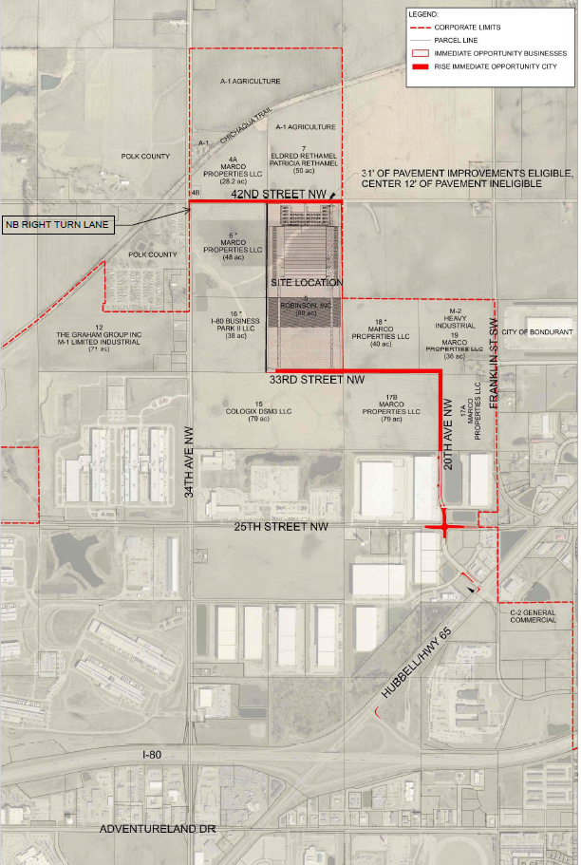
Altoona
Local Development
Widening of approximately 975 feet of 20th Avenue NW and I-80 ramp return; construction of 1,375 feet of 20th Avenue NW and 2,960 feet of 33rd Street NW; paving of 2,620 feet of 42nd Street, intersection improvements at 20th Avenue NW and 25th Street NW and also 20th Avenue NW and Hubbell Avenue; and a turn lane at 34th Avenue NW and 42nd Street NW located on the northwest side of town. This project is necessary to provide access to more than 89 acres for industrial purposes.
Total Cost: $11,930,281
Requested: $5,965,141 (50%)
11

Slide 12
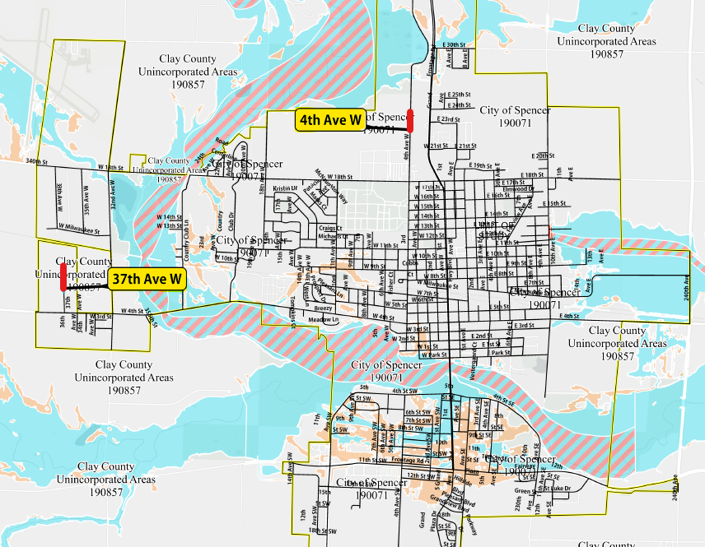
Spencer Local Development
Business Relocation & Job Retention
12

Slide 13
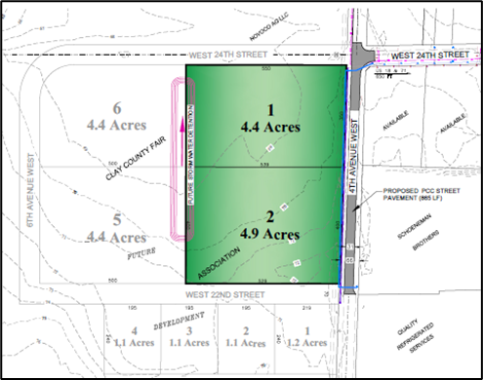
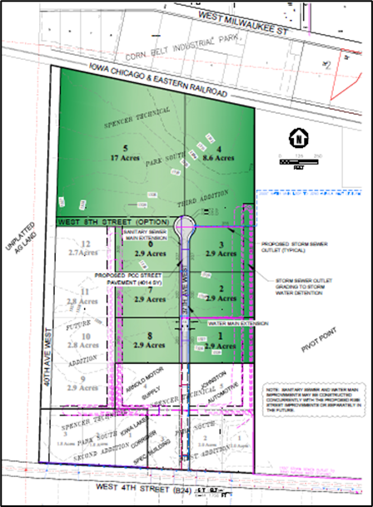
Spencer
Local Development (Business Relocation & Job Retention)
Construction of approximately 865 feet of 4th Avenue West located on the north side of town and 955 feet of 37th Avenue West located on the west side of town. This project is necessary to provide access to 10 lots totaling approximately 52 acres.
Total Cost: $1,190,179
Requested: $833,125 (70%)
13

Slide 14
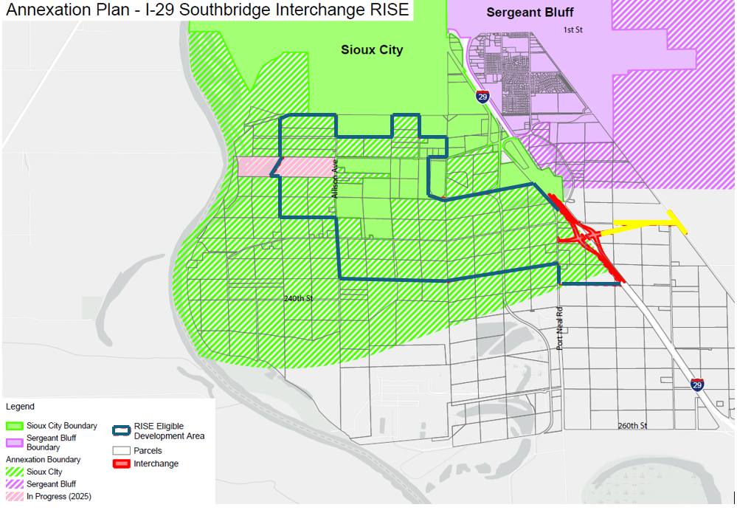
Woodbury County Local Development
(RISE Eligible)
Other Improvements
(Not eligible for RISE)
14

Slide 15
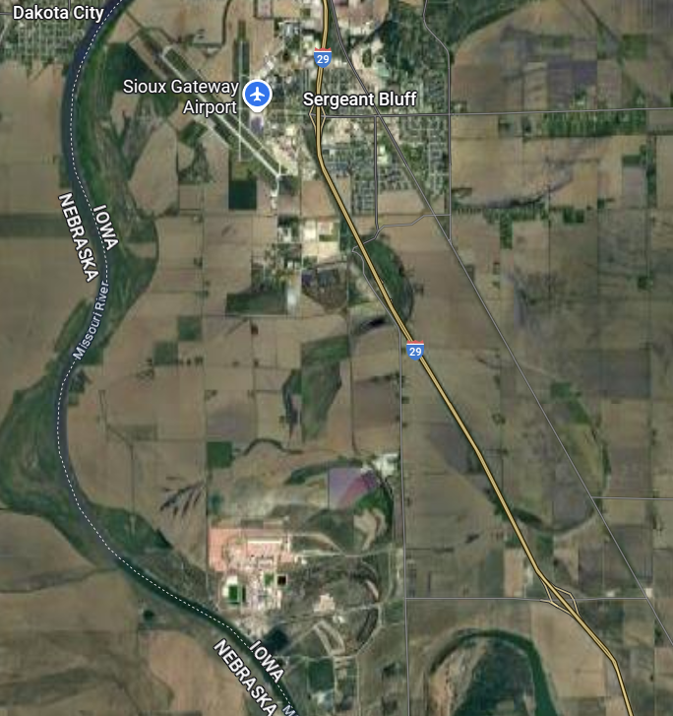
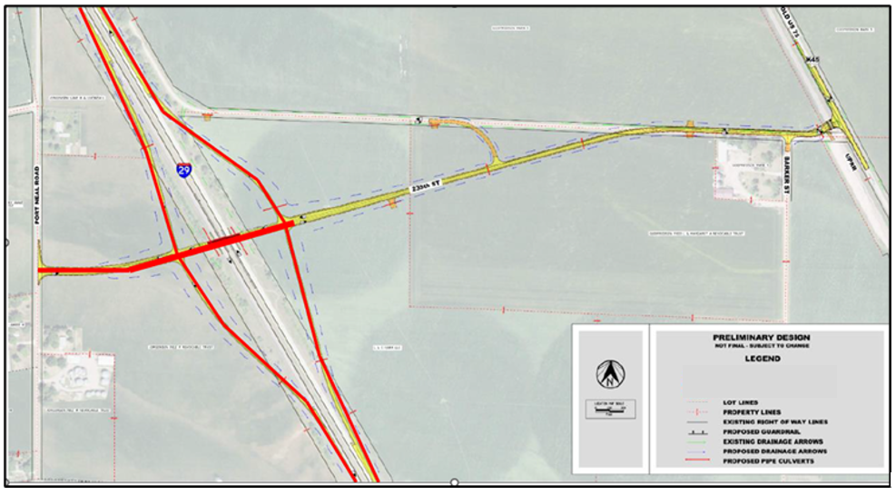
Woodbury County
Local Development
Construction of a new interchange on I-29 south of Sioux City. This project is necessary to provide improved access to more than 2,000 acres for industrial purposes.
Total Cost: $22,789,824
Requested: $4,796,168 (21%)
15

Slide 16



Questions?
jennifer.kolacia@iowadot.us
515-239-1738

