Slide 1
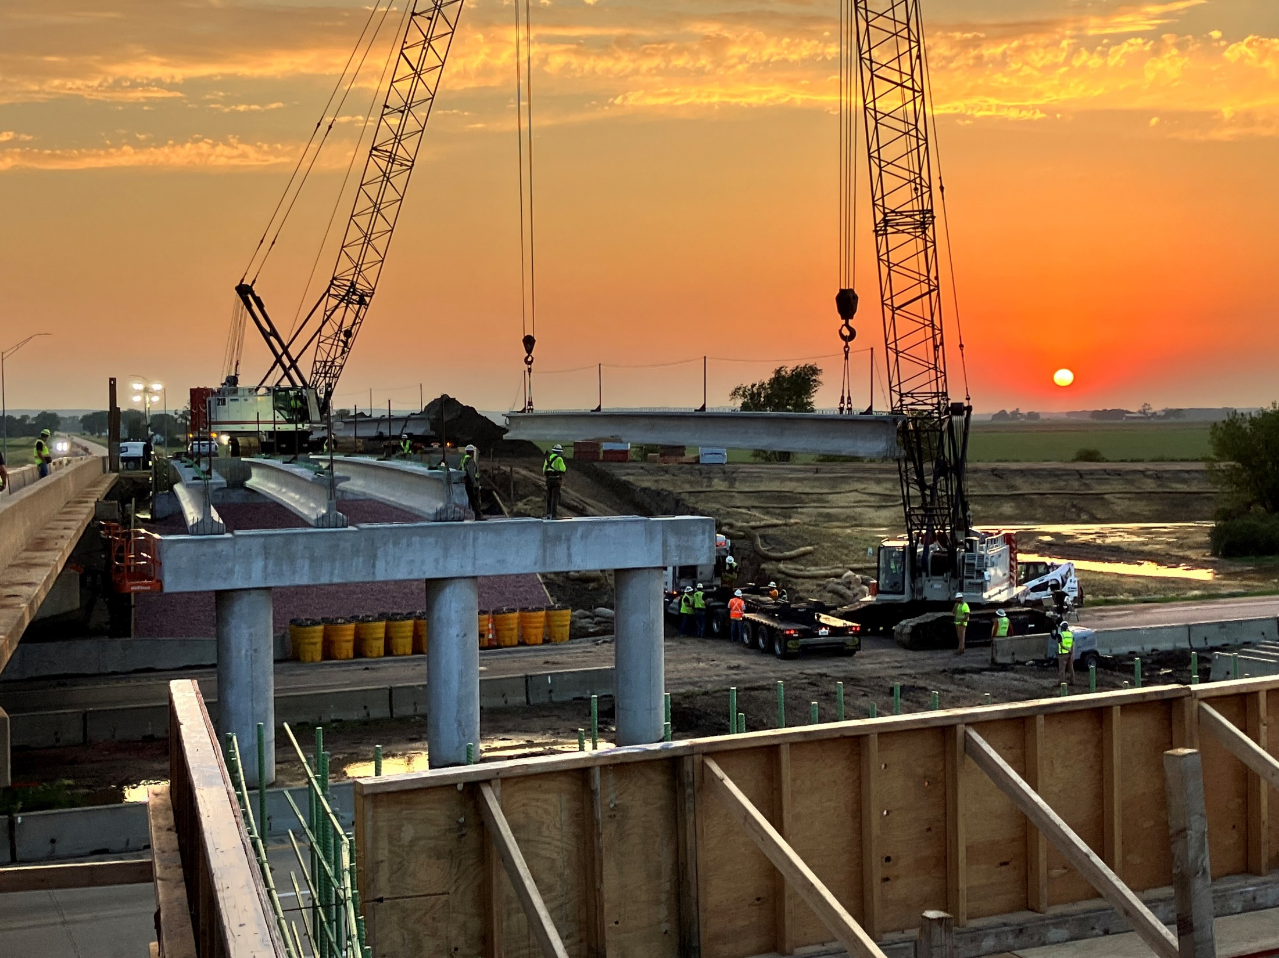


Highway System Overview
Iowa Transportation Commission Workshop
3/2/2023
Garrett Pedersen Systems Planning Bureau Director
September 9, 2025

Slide 2
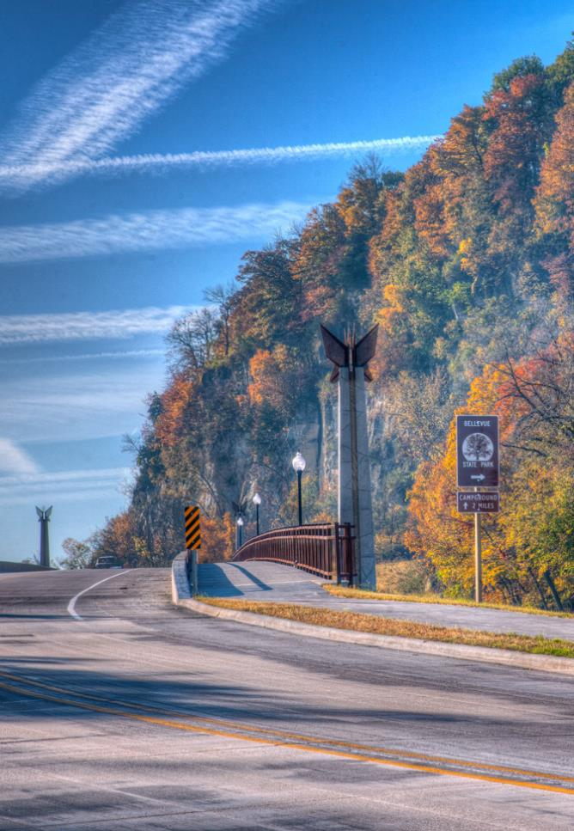

Agenda
Iowa’s Public Roadway System
Highway Networks
State Highway System Usage
Highway Planning and Programming

Slide 3
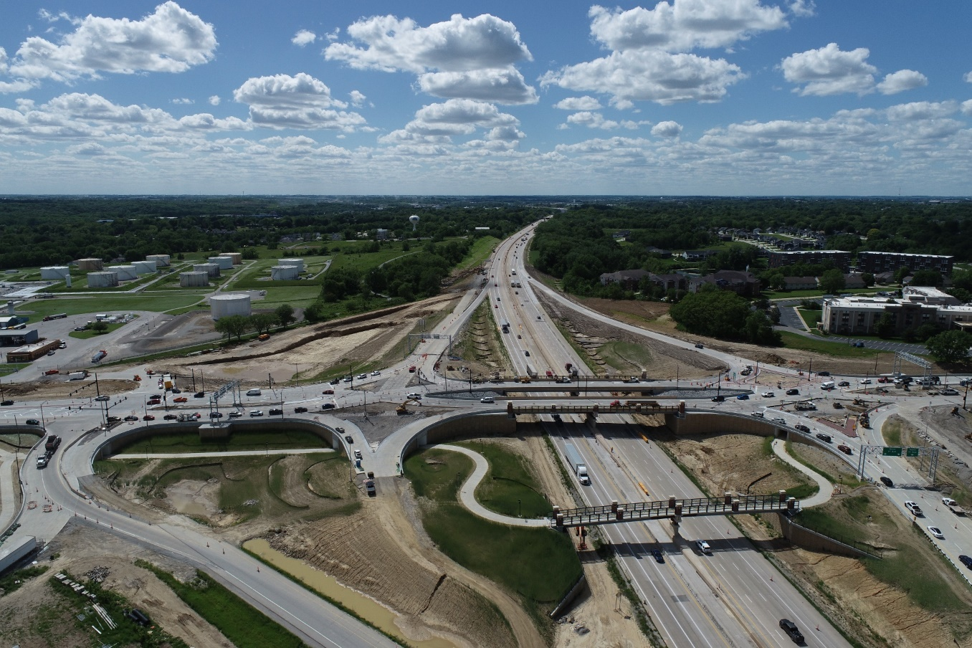
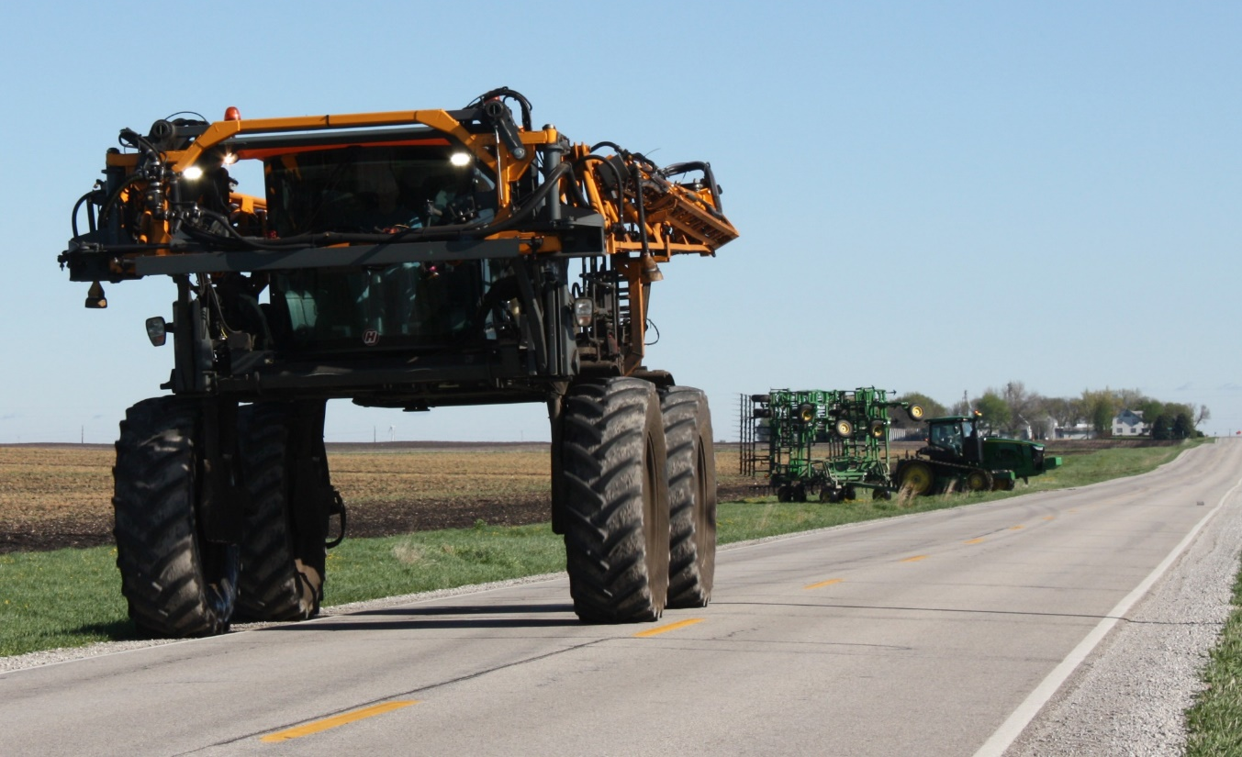
Iowa’s Public Roadway System

Slide 4
Iowa Public Road System Mileage by Ownership and Surface Type, 2024
Primary: 9,626 miles (8.3%)
(100% Paved)
Total Miles:
115,785
(38% Paved)
City: 15,847 miles (13.7%)
(93% Paved)
County: 89,569 miles (77.4%)
(21% Paved)
Parks & Institutional: 743 miles (0.6%)
(65% Paved)
Notes:
These are center-line miles with ramps included.
Over, 38% of highways are paved (asphalt, concrete, or bituminous treatment) and 62% is not paved (gravel or not surfaced).
Percentages of system:
Primary: 8.3%
City: 13.7%
County: 77.4%
Parks & Institutional: 0.6%

Slide 5
Iowa Public Bridge System by Ownership, 2024
Total Bridges:
23,685
Primary: 4,214 bridges (17.8%)
City: 1,275 bridges (5.4%)
County: 18,196 bridges (76.8%)

Slide 6
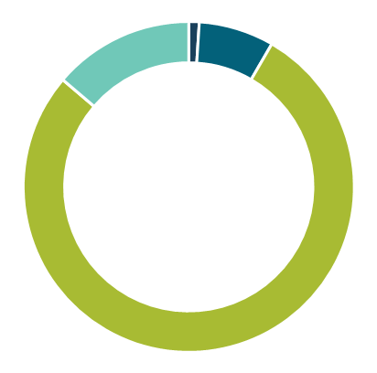
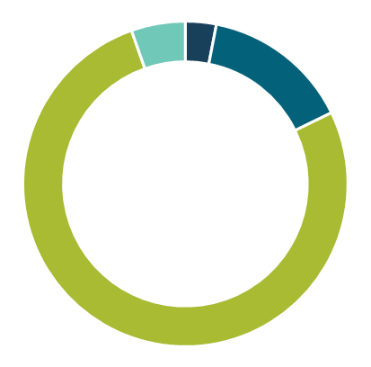
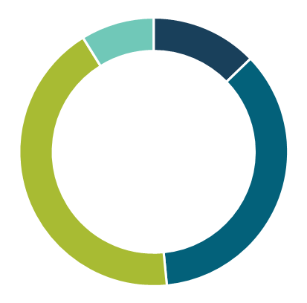



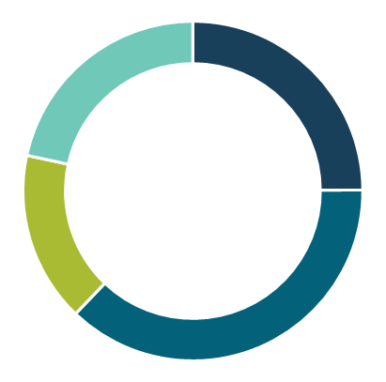
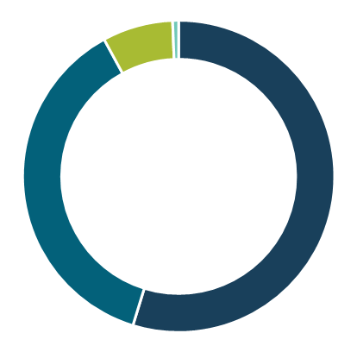



Iowa Public Road System – 2024
14%
7%
5%
15%
9%
13%
1%
3%
ft²
Miles of roads
Number of bridges
Deck area
of bridges
36%
43%
78%
77%
22%
25%
7%
Interstate
<1%
Other Primary
55%
County
16%
All traffic
37%
Large truck traffic
City
37%
Does not include Park & Institutional Roads
Notes:
*Bridge percentages look a bit different than last year – last year’s presentation used NBI data pulled from FHWA’s website. This year’s data comes directly from B&S’s annual report and Jerry Gong. It appears the FHWA download was missing a chunk of primary bridges.
Interstate is split out from the remainder of the Primary System to show what a large percentage of traffic it carries for only being 1% of the overall public road system’s mileage. Also, the Primary System only accounts for 18% of the state’s bridges by numbers, but 49% by deck area.
Note: the mileage in cities as increased by almost 2,000 miles since 2001 – reflective of overall Iowa trend of urbanization.

Slide 7
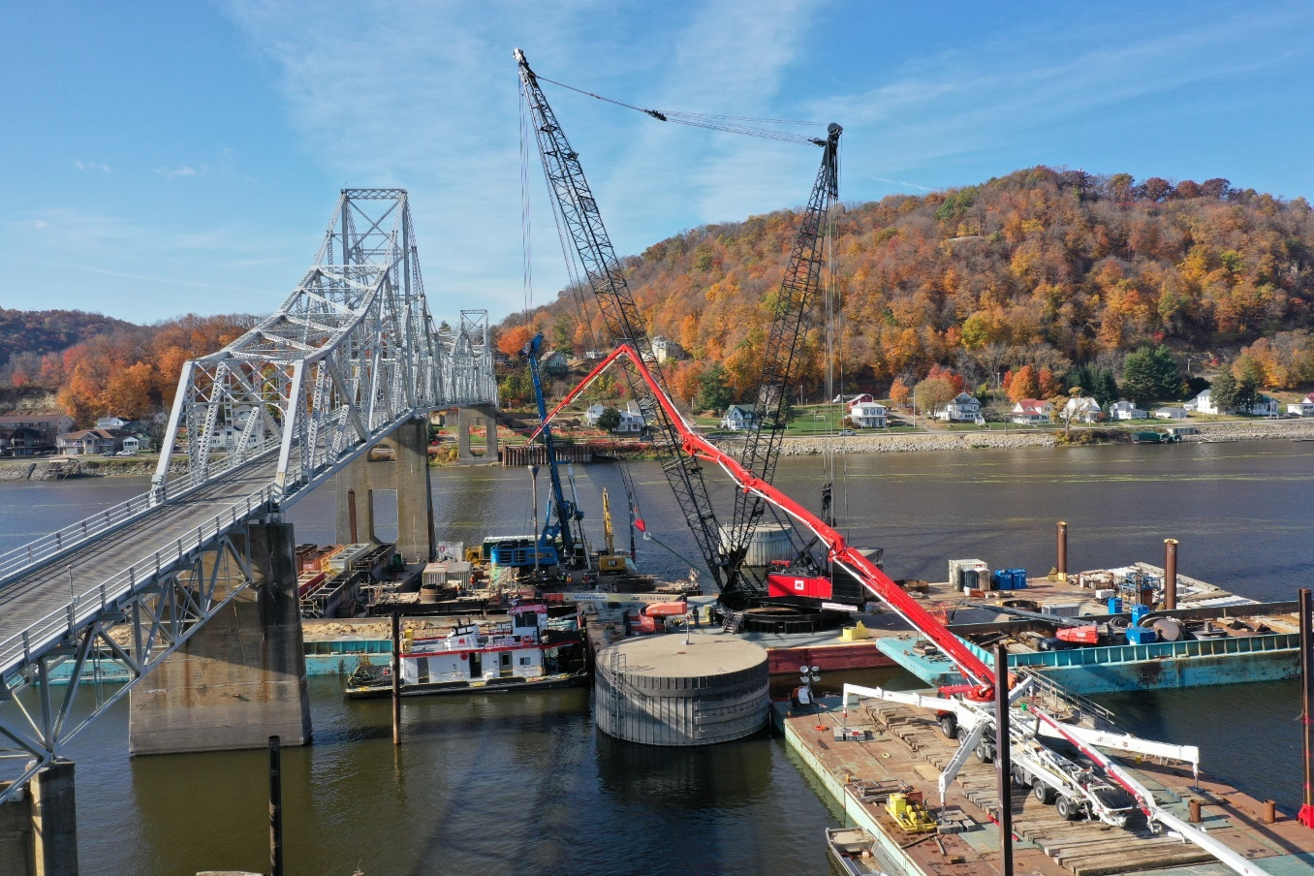
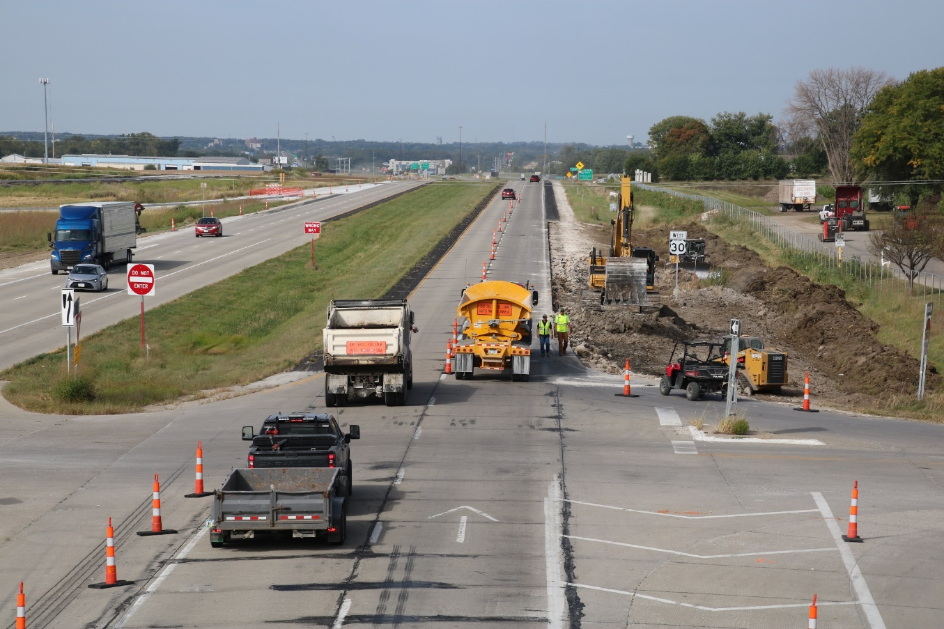
Highway
Networks

Slide 8
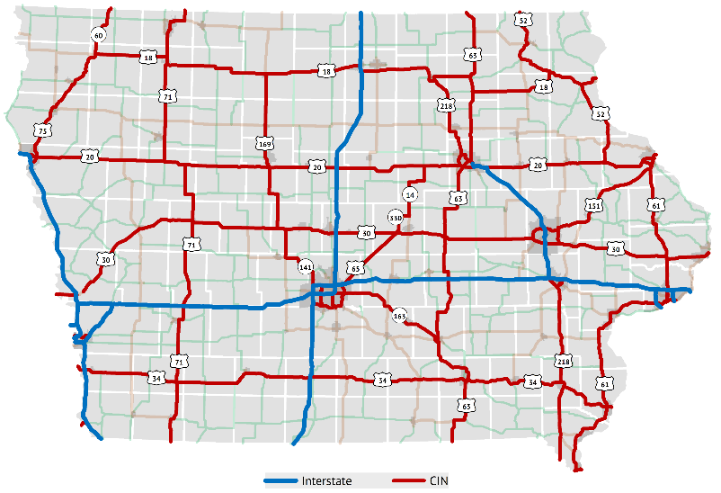
Commercial and Industrial Network
State legislature directed Commission to designate a network of commercial and industrial highways
Purpose:
Improve the flow of commerce
Make travel more convenient, safe, and efficient
Better connect Iowa with regional, national, and international markets
Enhance opportunities for the development and diversification of the state’s economy
Notes:
1988: Legislature directed the designation
Required the Commission to concentrate a major portion of its annual construction budget on this network
Aligns well with the Commission’s recent emphasis on Super-2 improvements on several of these corridors.
Per Mike, there are 2543 miles of open, public, cardinal direction mainline routes on the CIN

Slide 9
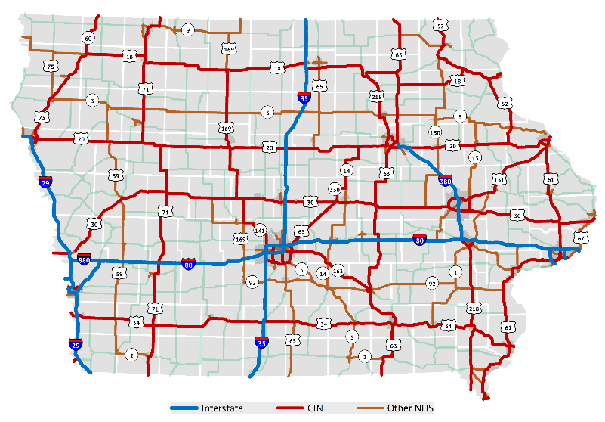
Federally-designated system
Includes Interstate System and other “Principal Arterial” routes
Includes full CIN
Small portion is locally-owned
Purpose:
“National Highway System consists of roadways important to the nation's economy, defense, and mobility”
Eligible for federal National Highway Performance Program (NHPP) funding
Performance management reporting
National Highway System (NHS)

Slide 10
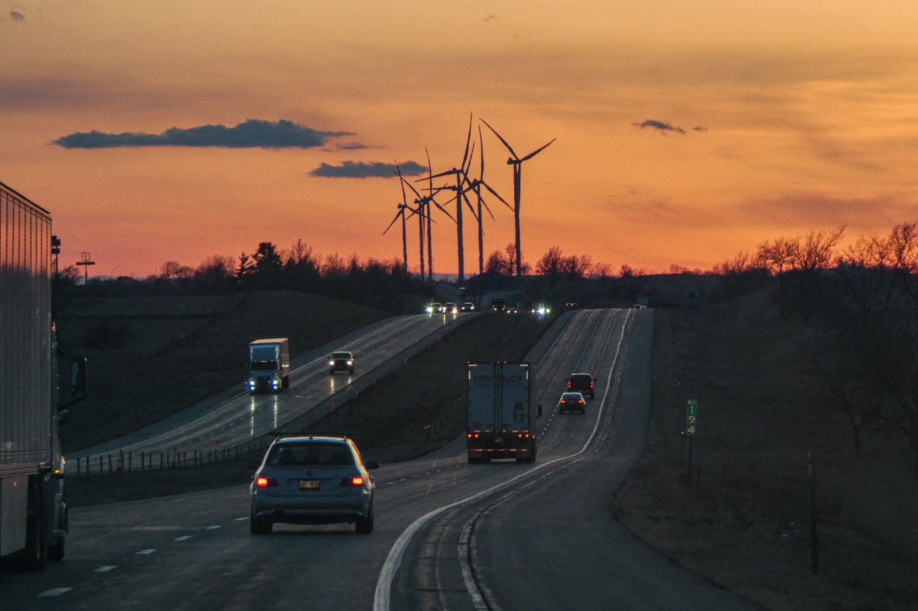
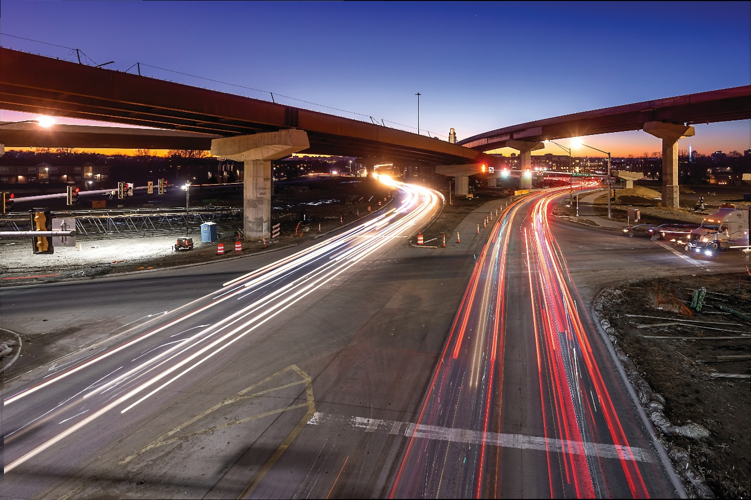
State Highway
System Usage

Slide 11
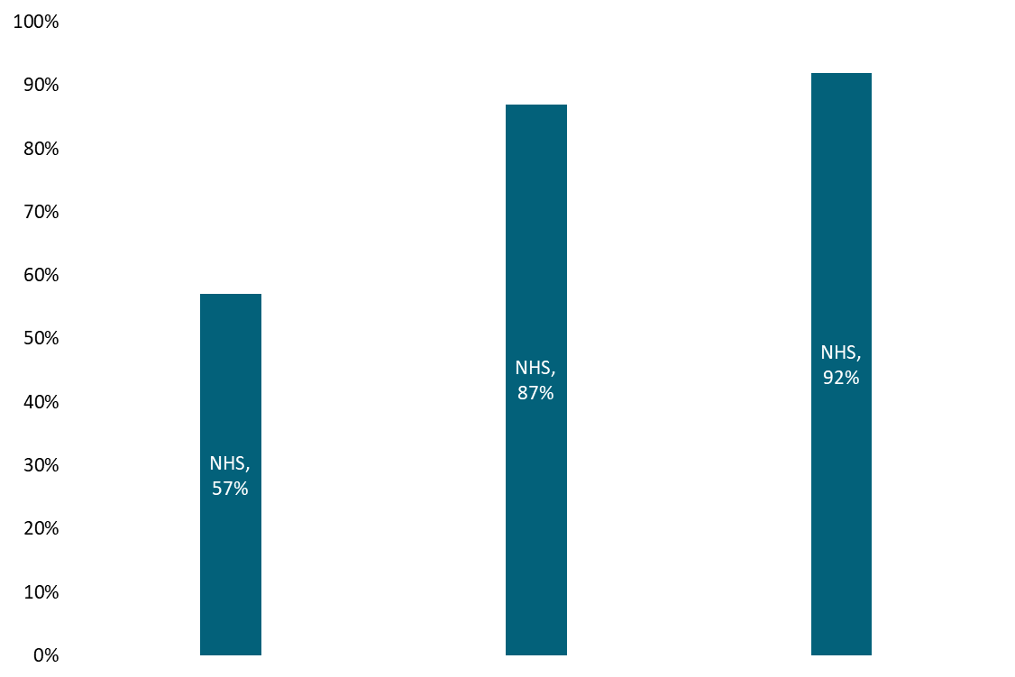
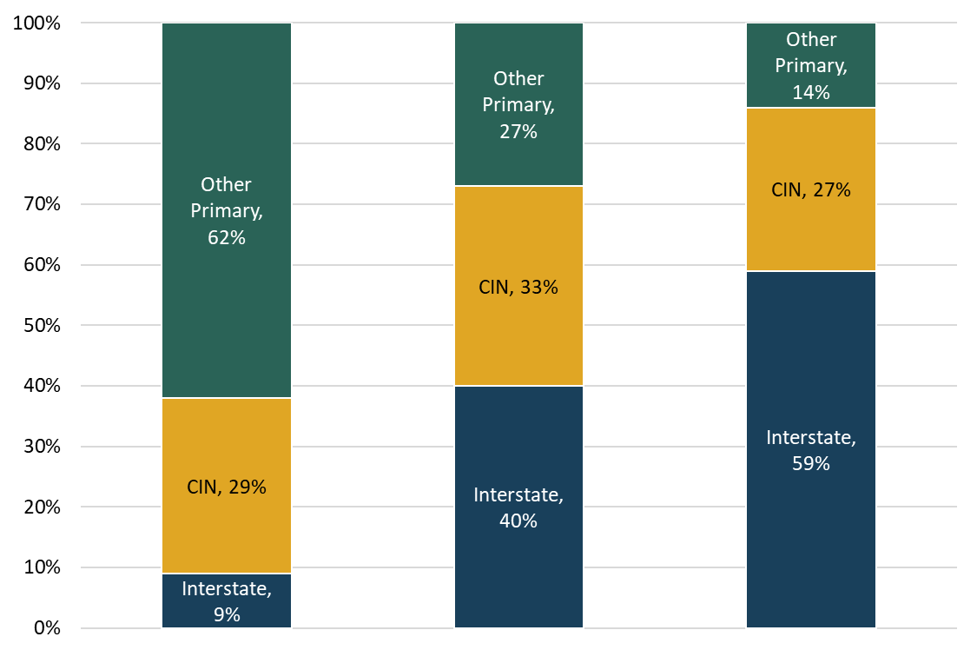



State Highway System Mileage and Traffic
Miles of
roads
All Traffic
Large Truck
Traffic

Slide 12
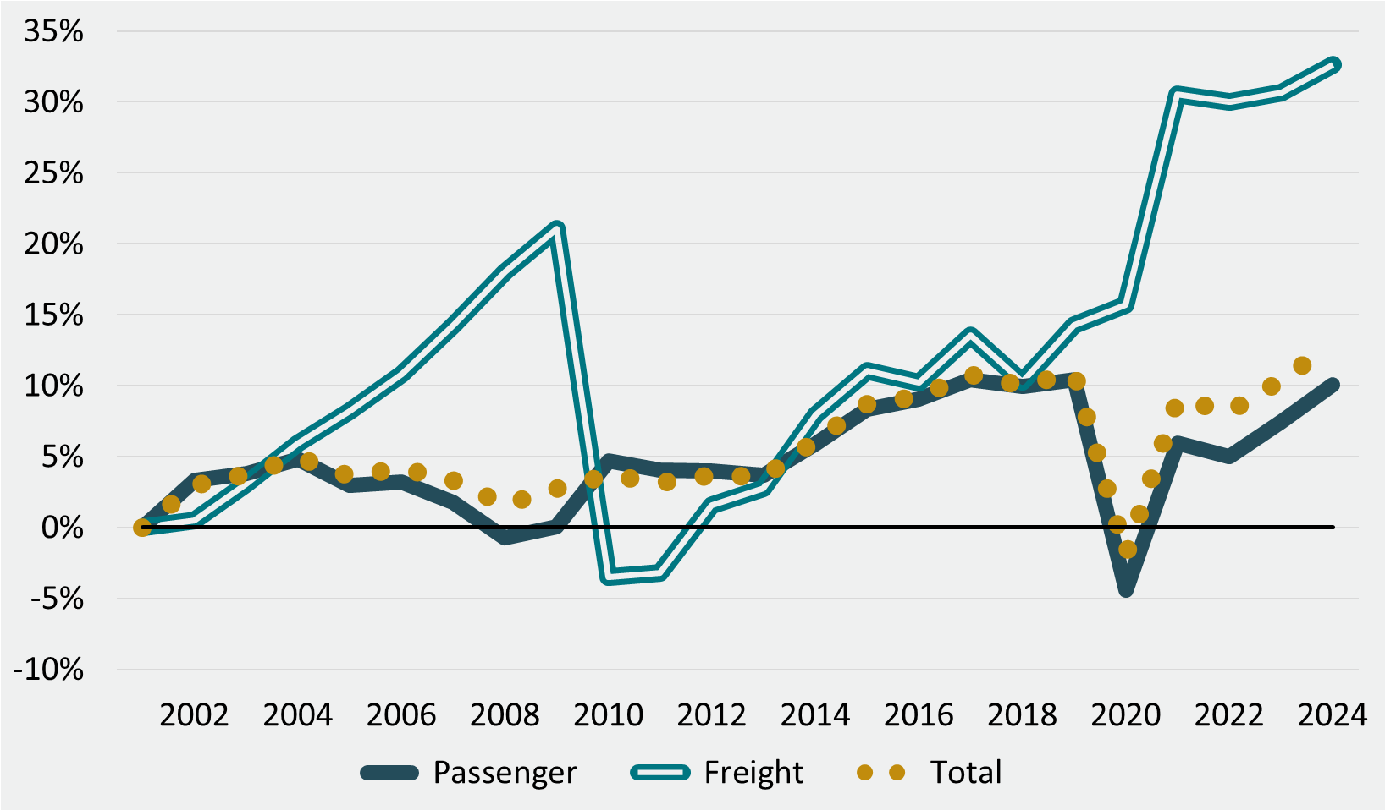
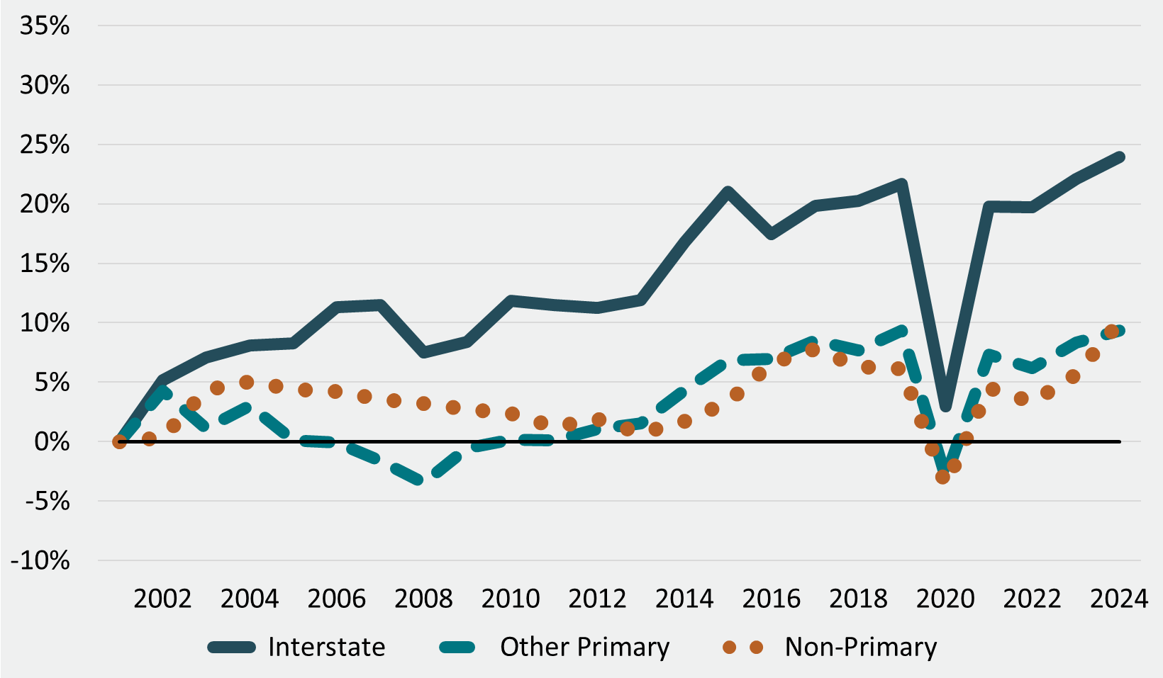
Traffic – Percent Change since 2001
Passenger and Freight
Primary and non-Primary
Notes:
VMT growth was more rapid during the 1990s. Since 2000, have seen slower growth over time. Forecasting about 0.05% growth per year over time. On the top, it’s interesting to see different impacts of Great Recession (freight drop, passenger slight increase) vs. COVID (passenger drop, freight large increase). On the bottom, Interstate traffic growth has been much higher than the rest of the system.

Slide 13
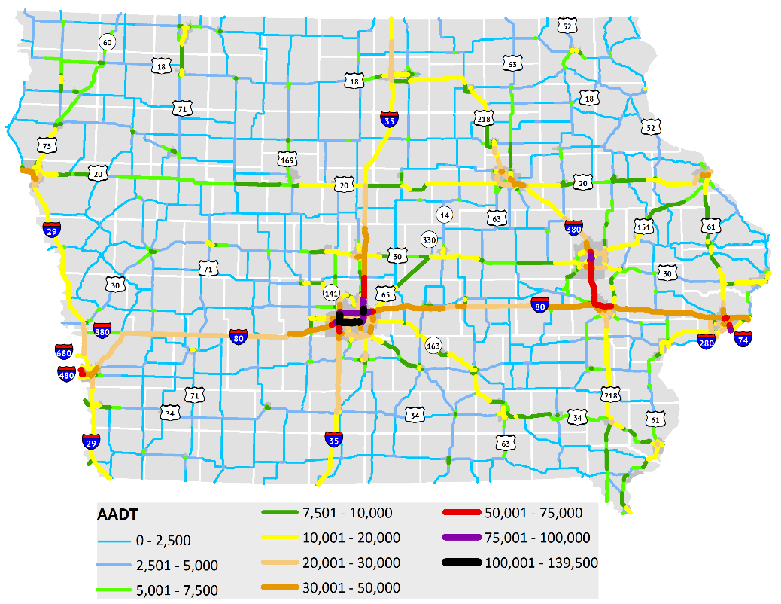
Traffic Volume
Notes:
Shows expected pattern of concentration in metro areas and on interstates; commuter corridors on 35 and 380 stand out.

Slide 14
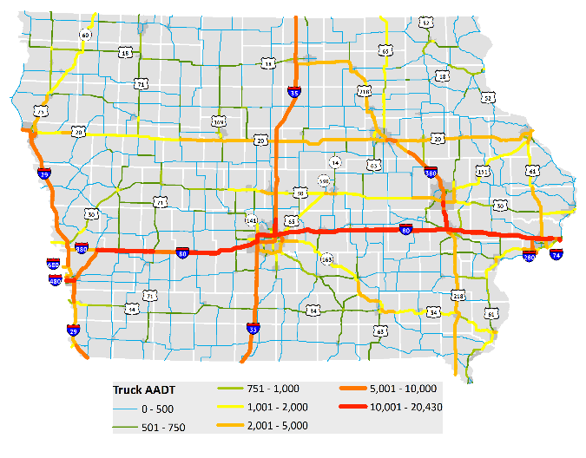
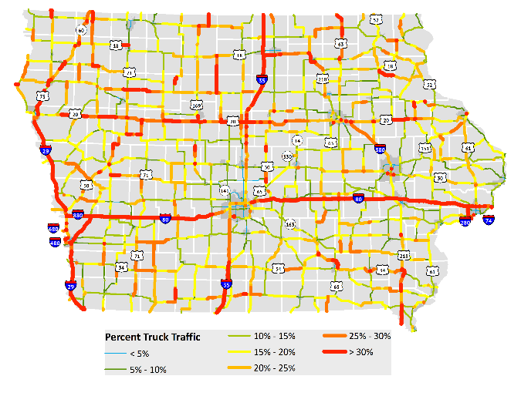
Truck Traffic Volume
Notes:
Truck Traffic Volume – Interstates and CIN stand out significantly compared to other highways.
Only about 2 miles of highways that are not on the Interstate or CIN have more than 2,000 trucks per day.
Percent Truck Traffic – notice low numbers in metro areas and cities due to much heavier passenger traffic. NW Iowa doesn’t have high truck traffic overall, but has high percent trucks (most productive ag area of state in terms of crops and hogs)

Slide 15
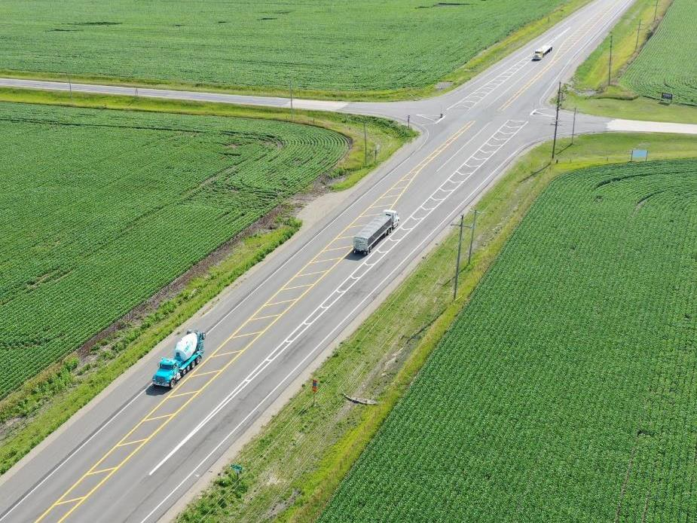
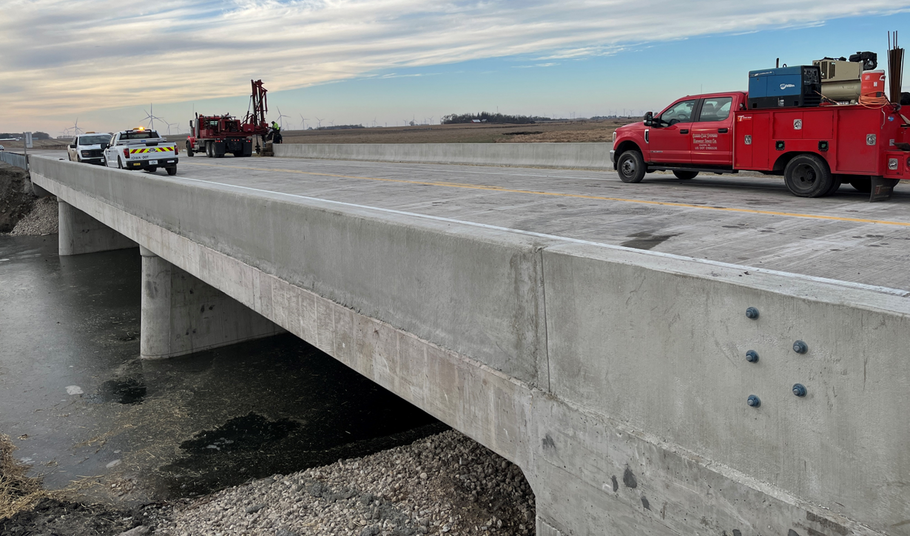
Highway Planning & Programming

Slide 16
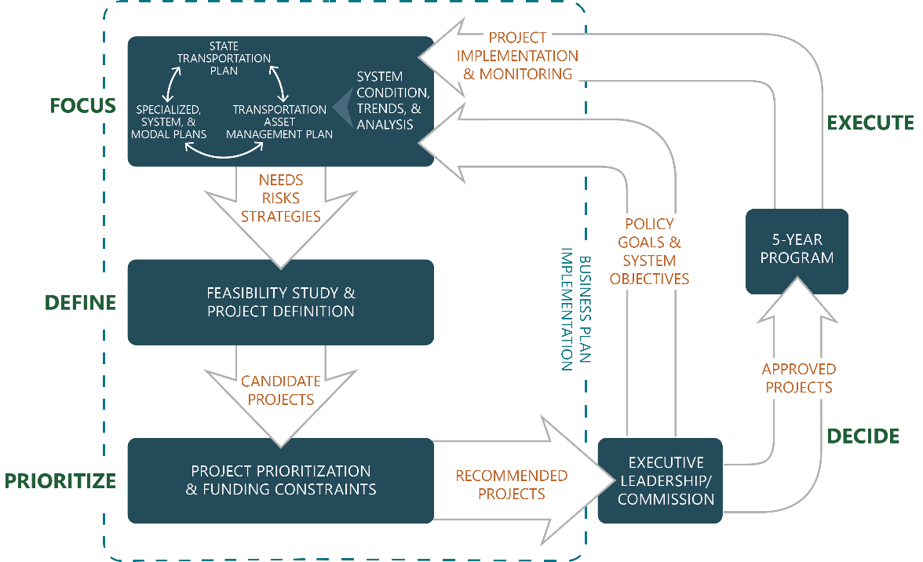
Planning and Programming Process
Notes:
The emphasis here is to provide an overview of the overall process. For each of the next four slides, a specific section of the diagram is highlighted, and the discussion could include the planning efforts or process steps that occur during it.

Slide 17

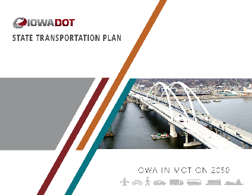
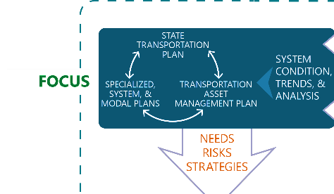



Planning and Programming Process: Focus
Notes:
Slide focus: Policy goals & system objectives set through ELT/Commission, Business plan helps describe the operationalization of this. Plans like the SLRTP, SFP, TAMP provide the highest level view of the highway system, its needs and risks, and what we need to be focusing on from a policy and system perspective.

Slide 18
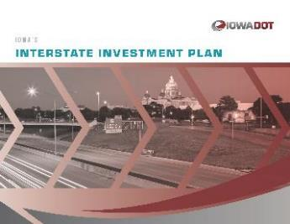
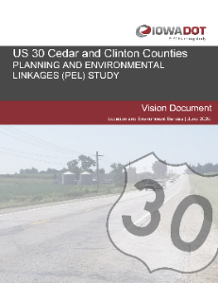
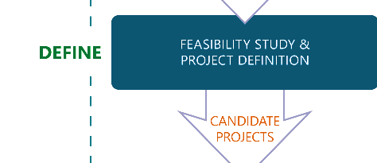
Planning and Programming Process: Define
Notes:
Slide focus: More specific plans and studies are developed based on the policies/strategies/needs identified in higher level plans. Corridor level plans provide a more detailed look at needs in a specific corridor and lead to project definition.

Slide 19
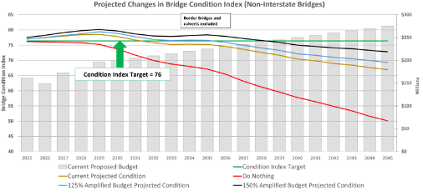
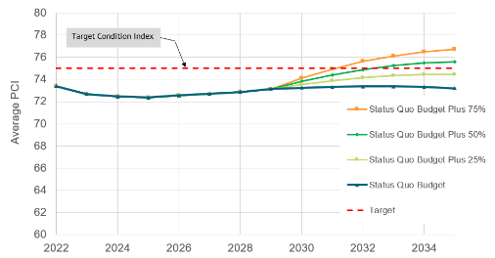
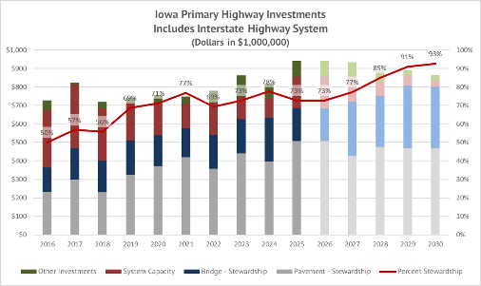
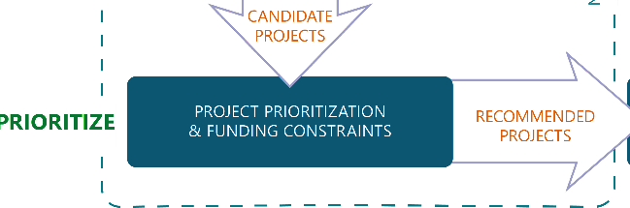
Planning and Programming Process: Prioritize
Notes:
Slide focus: Projects have to be weighed against each other and the overall funding available to determine what to program for funding.

Slide 20
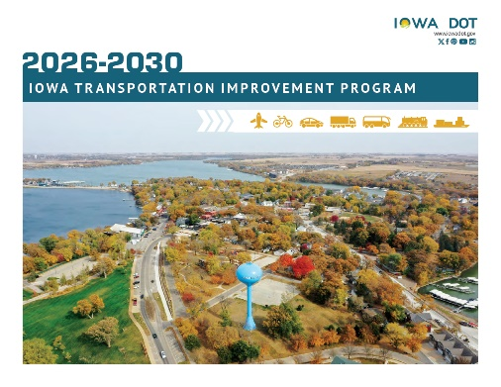

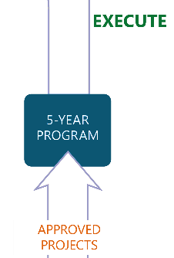
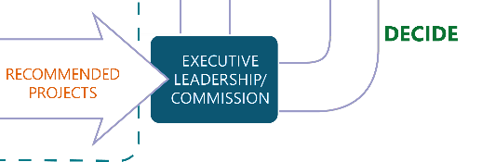
Planning and Programming Process: Decide & Execute
Notes:
Slide focus: Planning process has led to a recommended program of projects that is ultimately included in the 5YP upon Commission approval, then integrated into the STIP. After projects are completed, data/performance monitoring help track future condition and needs and feed back into the planning process.

Slide 21
Questions?
GARRETT PEDERSEN
515-239-1027
Garrett.Pedersen@iowadot.us​
iowadot.gov

