Slide 1
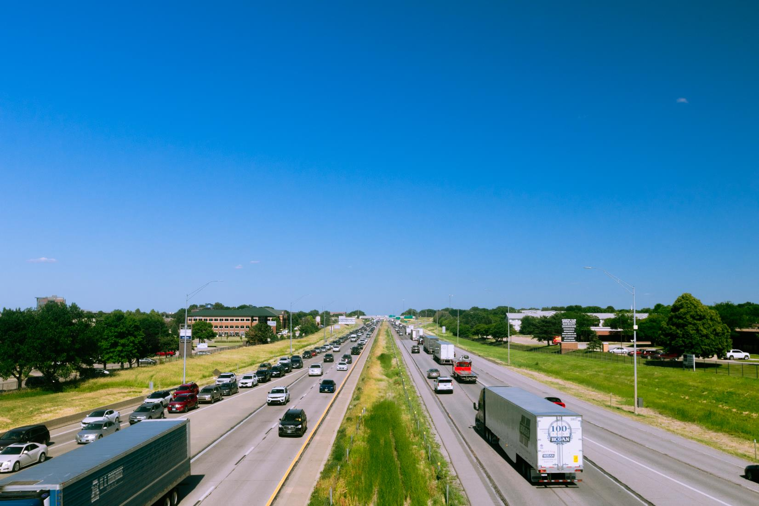


FY 2026 Highway Program Balance Report
October 13, 2025
3/2/2023

Slide 2
Receipts / Costs
Revenue
Forecast PRF Receipts (August) $176.7m
Actual PRF Receipts (August) $178.1m
Lettings
Programmed Amounts (September) $176.1m
Project Costs (September) $157.0m

Slide 3
Balance
FY 2026 Program Balance (June 2025) ($32.3m)
August PRF Receipts Difference $1.4m
September Project Letting Difference $19.1m
Program Balance (September 2025) ($11.8m)
Previous Balance Reported: ($11.9m)
FY 2026 Highway Program Balance Overview

Slide 4






Fiscal Year 2026 Overview
Revenue: Expect monthly revenue fluctuations.
Lettings:
Twenty percent of the FY 2026 Program has been awarded.
The September letting was approximately $9 million.
Next letting scheduled for October 21, 2025.

Slide 5
Questions?

