Slide 1



Transportation Trends Update
October 13, 2025
3/2/2023

Slide 2
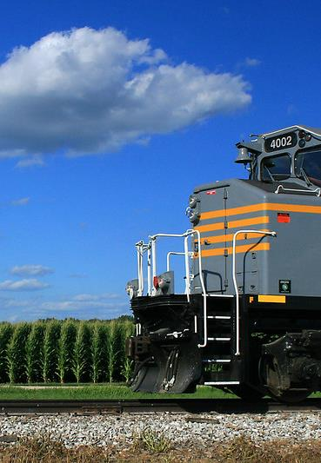

Agenda
US total rail carloads
Commercial air service passenger counts
Public transit ridership
Vehicular traffic
Safety
Mississippi River

Slide 4
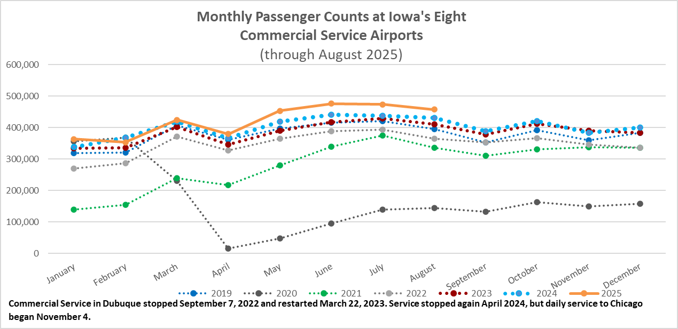

Slide 5
Monthly State Vehicle Miles of Travel
(through August 2025)
Vehicle Miles of Travel (in millions)

Slide 6
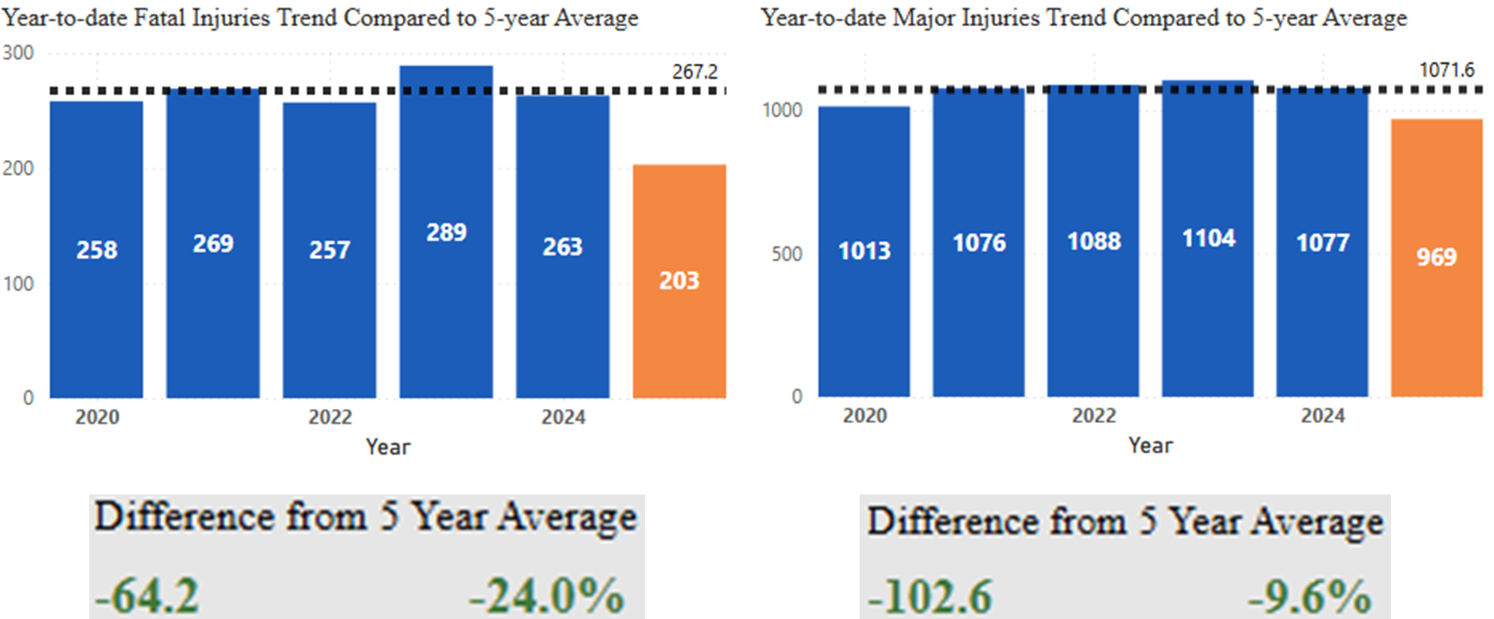
Statewide Fatalities & Major Injuries Year-to-Date
(As of October 2, 2025)

Slide 7
Mississippi River Water Levels
Low water levels have been reached in some locations on the Lower Mississippi River.
Since September 19, there have been restrictions on barges on both weight and number of barges in a tow.
Low water levels expected to continue throughout October.

Slide 8
Questions?

