Slide 1
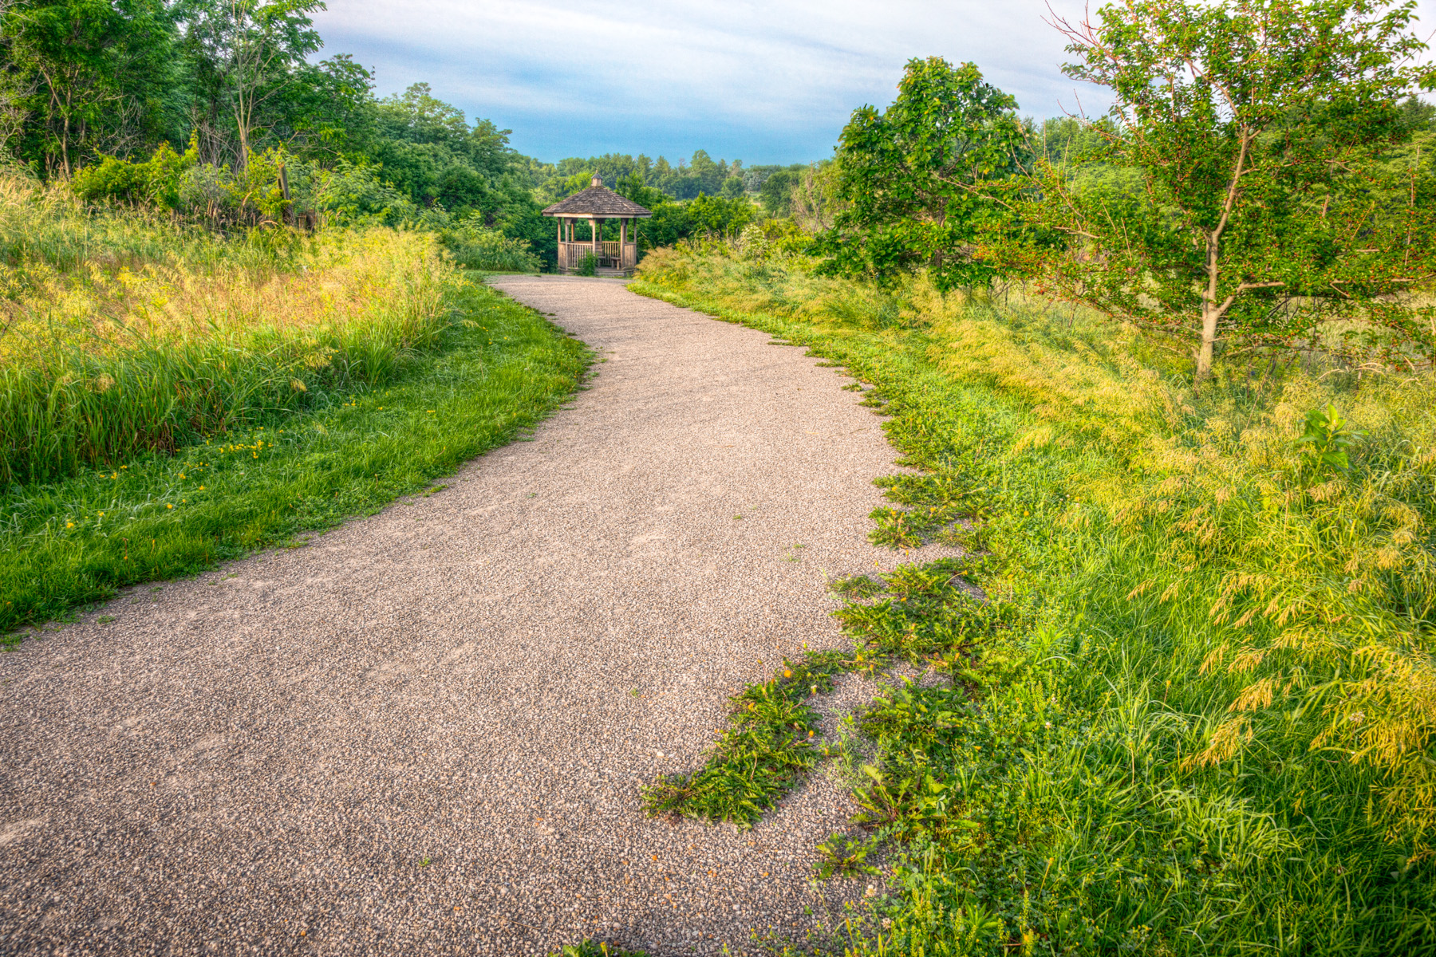

State Recreational Trails Program
Funding Recommendation
Debra Arp
Local Systems Bureau, Grant Team Leader
10/13/2025

Slide 2
State Recreational Trail Program
Created in 1988
Available to cities, counties, state agencies, local governments, or non-profit organizations through an application program
Purpose is to establish recreational trails in Iowa for the use, enjoyment and participation of the public.
2
2

Slide 3
Project Evaluation Criteria
Criteria | Points
Need in terms of population to be served and existing trails in the area | 16
Benefits of multiple uses and recreational opportunities | 16
Project Readiness-project will be completed by 6/30/2027 | 12
Leverage of other funding sources-secured funding | 12
Enhancement of economic and tourism benefits | 10
Connectivity and completion of trail linkages | 10
Alignment with local, regional or statewide plans | 8
Improvements to accessibility | 8
Long-term maintenance plan | 8
MAXIMUM POINTS | 100
3
3

Slide 4
Available Funding and Application Summary
Available Funding: | Column 2
FY26 Legislative appropriation | $2,500,000
Underruns from closed projects | $130,585
Cancelled projects | $600,082
Total available funding | $3,230,667
Application Summary:
Total number of projects | 22
Total project costs | $47,475,493
Total amount requested | $11,618,130
4
4

Slide 5
List of Applications Recommended
PROJECT NAME | SPONSOR | SCORE | TOTAL PROJECT COST | REQUESTED AMOUNT (% of Total Project Cost) | RECOMMENDED AMOUNT (% of Total Project Cost)
Clay County Connection Phase 3 | Dickinson County | 75 | $736,550 | $295,000 (40%) | $295,000 (40%)
Neal Smith Trail Reconstruction and Birdland Park Connection | Des Moines | 74 | $1,155,000 | $200,000 (17%) | $200,000 (17%)
Wabash Trace Rapp Park Connector Trail | Page County | 73 | $1,937,350 | $285,000 (15%) | $285,000 (15%)
Waukee Regional Trail Connection & Safety Improvements Project | Waukee | 67 | $5,588,000 | $500,000 (9%) | $500,000 (9%)
Heritage Trail Bridge 30 Replacement | Dubuque County Conservation Board | 62 | $227,000 | $170,250 (75%) | $170,250 (75%)
5
Jump to Applications Not Recommended for Funding
5

Slide 6
List of Applications Recommended
PROJECT NAME | SPONSOR | SCORE | TOTAL PROJECT COST | REQUESTED AMOUNT (% of Total Project Cost) | RECOMMENDED AMOUNT (% of Total Project Cost)
Grant Wood Trail Connection to Cedar Valley Nature Trail | Cedar Rapids | 60 | $1,993,000 | $200,000 (10%) | $200,000 (10%)
Great American Rail Trail: Weston to Underwood | Pottawattamie County Conservation Board | 58 | $4,224,000 | $500,000 (12%) | $500,000 (12%)
Great Western Trail Rehabilitation Phase 2 | Warren County Conservation Board | 57 | $826,000 | $543,200 (66%) | $543,200 (66%)
Prairie Restoration Trail | Laurens | 56 | $578,570 | $433,927 (75%) | $433,927 (75%)
6
Jump to Applications Not Recommended for Funding
6

Slide 7
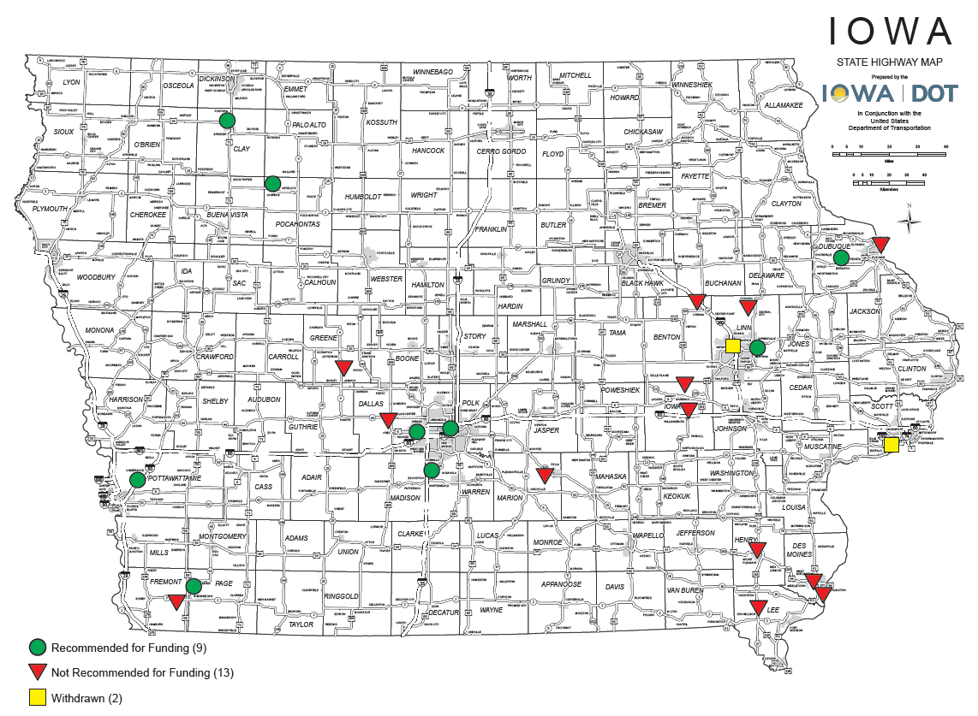
Map of Applications Received
7

Slide 8



Questions?
scott.flagg@iowadot.us
515-239-1252

Slide 9
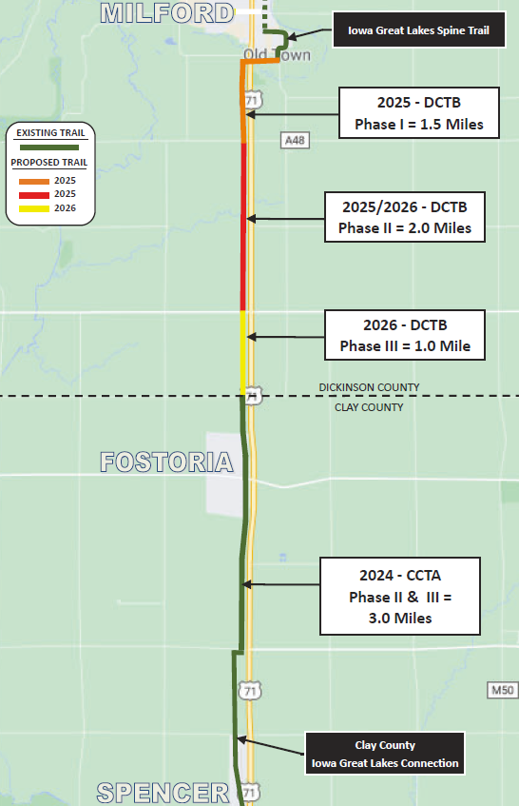
Clay County Connection Ph. 3
(Dickinson County)
Construction of a 1-mile paved trail from 270th Street to 260th Street making the connection between 20 miles of trail in Clay County and the larger Iowa Great Lakes Trails system resulting
in over 75 miles of adjoining trails in northwest Iowa.
Total Cost: $736,550
Requested: $295,000 (40%)
Return to List of Applications Recommended
9

Slide 10
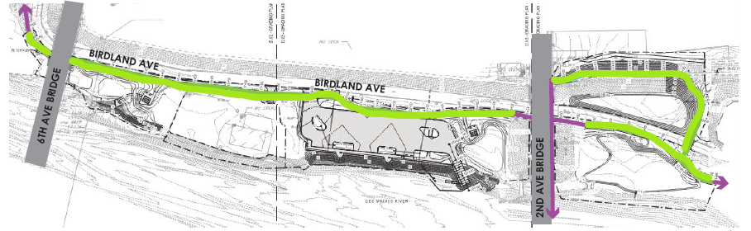
Neal Smith Trail Reconstruction and Birdland Park Connection
(Des Moines)
Reconstruction of 0.41 mile of the Neal Smith Trail, part of the American Discovery Trail, from 6th Avenue through Birdland Park. This project raises the existing trail to reduce future flood events and trail closures and is part of a larger Birdland Park redevelopment plan.
Total Cost: $1,155,000
Requested: $200,000 (17%)
Return to List of Applications Recommended
10

Slide 11
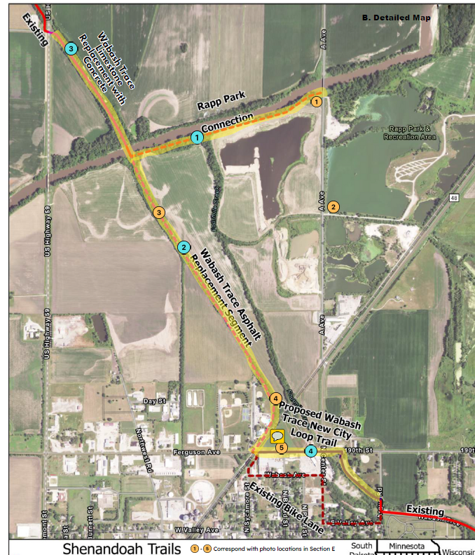
Wabash Trace Rapp Park Connector Trail
(Page County)
Construction of 0.75 mile of paved trail from A Avenue to Rapp Park and 0.35 mile east of the Wabash Trace Depot Trailhead as well as resurfacing 2 miles of trail from U.S. 59 and Cemetery Trailhead improving connections between the 63-mile Wabash Trace Nature Trail and Shenandoah.
Total Cost: $1,937,350
Requested: $285,000 (15%)
Return to List of Applications Recommended
11

Slide 12
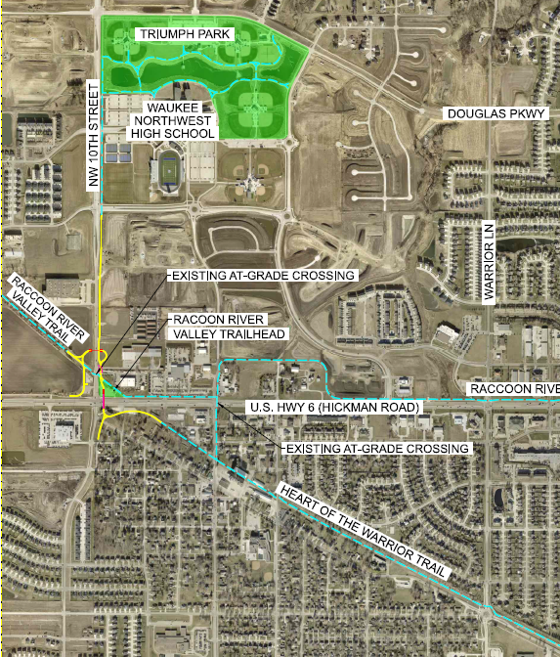
Waukee Regional Trail Connection & Safety Improvements Project
(Waukee)
This project will construct 0.84 mile of trail between the Raccoon River Valley Trail and the Heart of the Warrior Trail including trail underpasses at U.S. 6 and NW 10th Street in Waukee.
Total Cost: $5,588,000
Requested: $500,000 (9%)
Return to List of Applications Recommended
12

Slide 13
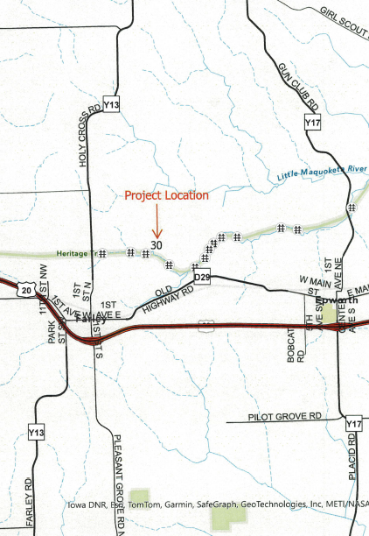
Heritage Trail Bridge 30 Replacement
(Dubuque County Conservation Board)
Replaces a 100-year-old 30-foot timber bridge northeast of Farley with a modern concrete bridge. The 29-mile Heritage Trail is located in the former Chicago Great Western Railroad corridor between Dubuque and Dyersville.
Total Cost: $227,000
Requested: $170,250 (75%)
Return to List of Applications Recommended
13

Slide 14
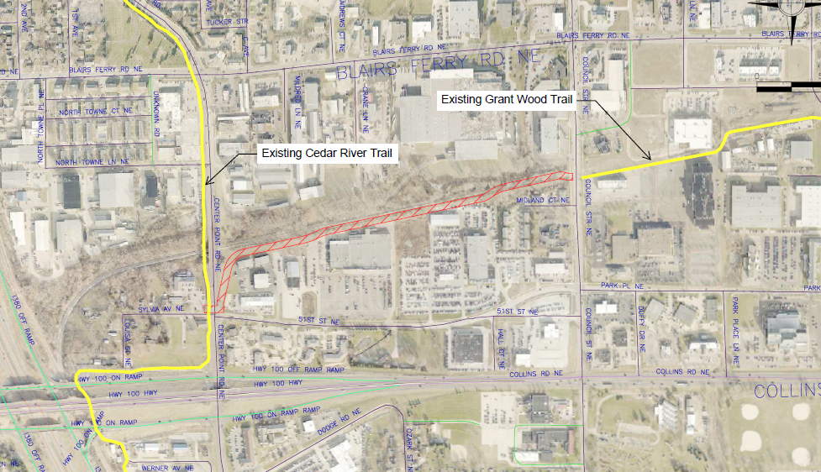
Grant Wood Trail Connection to Cedar Valley Nature Trail
(Cedar Rapids)
Extends the Grant Wood Trail 0.5 mile from Council Street NE to the 69-mile Cedar Valley Nature Trail at Sylvia Avenue NE and Center Point Road NE.
Total Cost: $1,993,000
Requested: $200,000 (10%)
Return to List of Applications Recommended
14

Slide 15
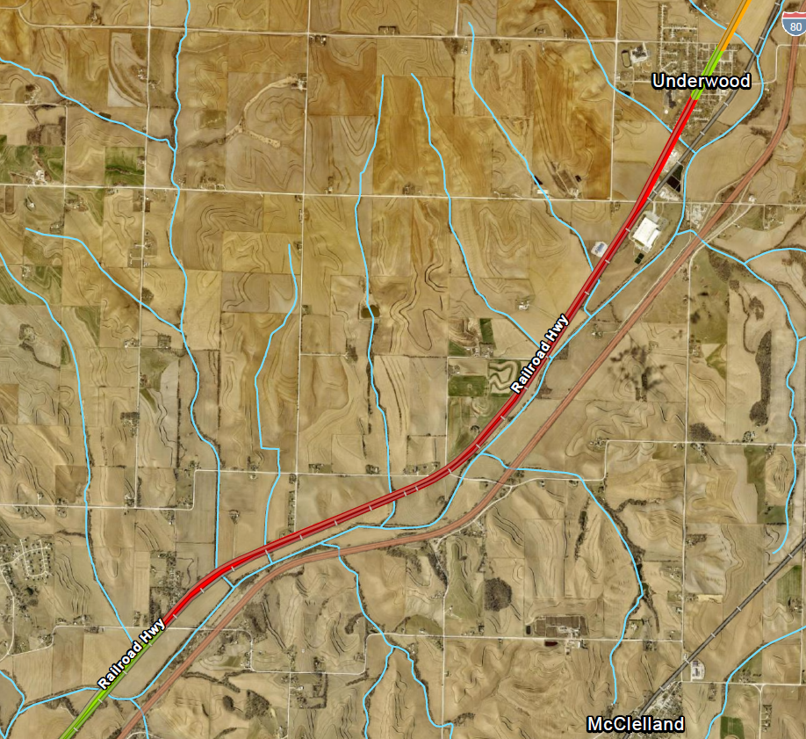
Great American Rail Trail: Weston to Underwood
(Pottawattamie County Conservation Board)
Constructs a 4.9-mile paved extension from Weston to Underwood of the 5-mile Railway Highway Trail. This project is part of the Great American Rail Trail, a planned 3,700-mile coast-to-coast trail from Washington, D.C., to Washington state.
Total Cost: $4,224,000
Requested: $500,000 (12%)
Return to List of Applications Recommended
15

Slide 16
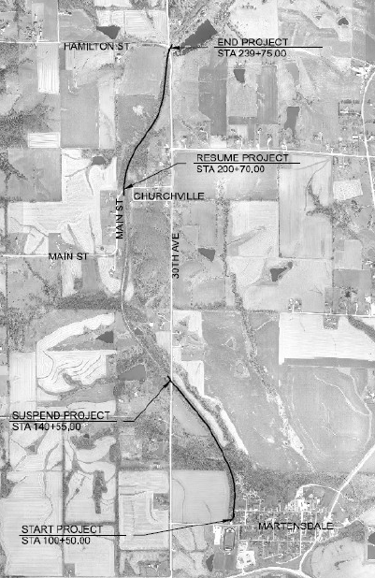
Great Western Trail Rehabilitation Ph. 2 (Warren County Conservation Board)
Reconstruction of two segments of the Great Western Trail totaling 1.4 miles of paved trail from Iowa Avenue in Martensdale to 30th Avenue and from Main Street in Churchville to Hamilton Street. The 19-mile Great Western Trail connects to the Bill Riley Trail and the larger Central Iowa Trail network.
Total Cost: $826,000
Requested: $543,200 (66%)
Return to List of Applications Recommended
16

Slide 17
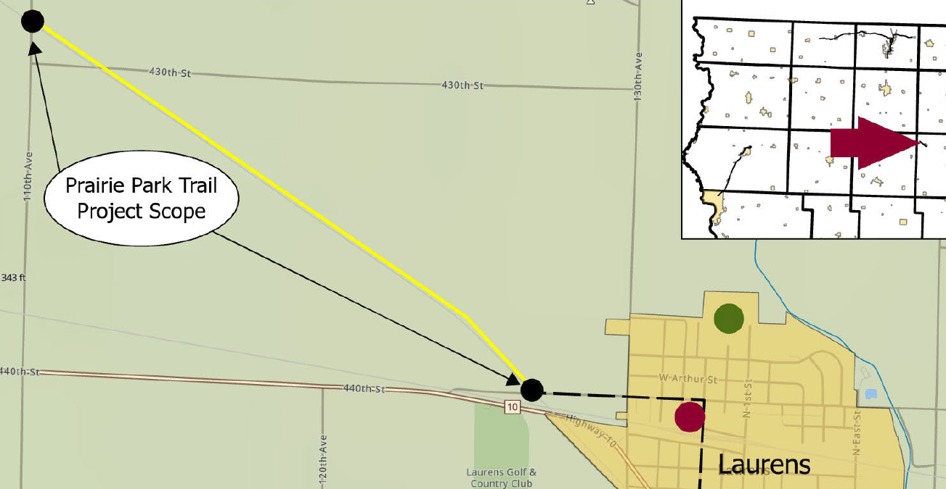
Prairie Restoration Trail
(Laurens)
Construction of 2.2 miles of granular trail from 440th Street to 110th Avenue along the former Union Pacific railroad corridor. The Prairie Restoration Trail will join 1.9 miles of existing bicycle and pedestrian routes through Laurens to create a 4.1-mile trail system.
Total Cost: $578,570
Requested: $433,927 (75%)
Return to List of Applications Recommended
17

Slide 18
List of Applications Not Recommended for Award
PROJECT NAME | SPONSOR | SCORE | TOTAL PROJECT COST | REQUESTED AMOUNT (% of Total Project Cost) | RECOMMENDED AMOUNT (% of Total Project Cost)
Volksweg Trail Extension at Red Rock Dam | Marion County | 55 | $14,520,000 | $500,000 (3%) | $0
Raccoon River Valley Trail Phase V: South 18th Street to South 5th Street | Dallas County Conservation Board | 54 | $790,000 | $197,500 (25%) | $0
Gateway Preserve Trail Expansion | Marengo Trails Foundation | 54 | $329,500 | $242,928 (74%) | $0
Old Man’s Creek Trail Phase 2 | Williamsburg | 53 | $733,700 | $220,000 (30%) | $0
Summer Street- Dankwardt Park Connector Trail | Burlington | 52 | $942,000 | $706,500 (75%) | $0
18
Return to List of Applications Recommended
18

Slide 19
List of Applications Not Recommended for Award
PROJECT NAME | SPONSOR | SCORE | TOTAL PROJECT COST | REQUESTED AMOUNT (% of Total Project Cost) | RECOMMENDED AMOUNT (% of Total Project Cost)
Washington Grand Connector Trail | Mount Pleasant | 51 | $1,647,100 | $1,235,325 (75%) | $0
Waspi Bluff Trail | Linn County Conservation Board | 47 | $460,913 | $345,000 (75%) | $0
Westview Park Trail Phase 2 | Donnellson | 47 | $421,000 | $315,750 (75%) | $0
Agency Road Trail | West Burlington | 47 | $2,351,000 | $1,763,250 (75%) | $0
Dubuque Area Mountain Biking Venue | Tristate Mountain Bike Riders | 45 | $652,410 | $450,000 (69%) | $0
19
Return to List of Applications Recommended
19

Slide 20
List of Applications Not Recommended for Award
PROJECT NAME | SPONSOR | SCORE | TOTAL PROJECT COST | REQUESTED AMOUNT (% of Total Project Cost) | RECOMMENDED AMOUNT (% of Total Project Cost)
Admiral Trail Phase 3: 390th Avenue to Iowa 2 | Farragut | 43 | $600,000 | $450,000 (75%) | $0
55th Street Trail: Meadow View Drive to Richland Avenue | Urbana | 42 | $1,886,000 | $1,414,500 (75%) | $0
Raccoon River Valley Trail Resurfacing | Greene County Conservation Board | 34 | $4,876,400 | $650,000 (13%) | $0
20
Return to List of Applications Recommended
20

