Slide 1


Transportation Asset Management Overview
October 13, 2025
Charlie Purcell, P.E.
Deputy Director, Transportation Development Division
3/2/2023

Slide 2
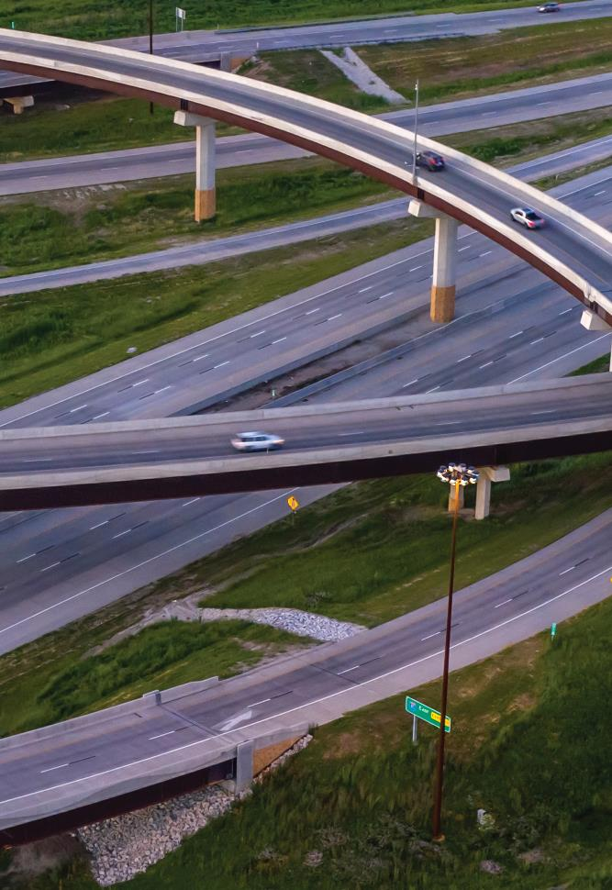

Agenda
What is asset management?
Why is asset management important?
What are we doing to implement asset management?
Preview of upcoming asset management presentations

Slide 3
Making the right investments at the right time to maximize the benefits to the transportation system while minimizing the costs.
It’s both an art and a science.
What is asset management?

Slide 4
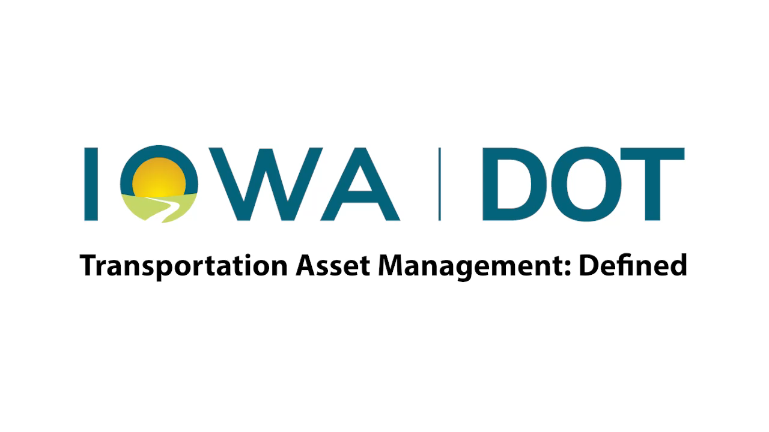

Slide 5
It helps us:
Build, preserve, operate, maintain, upgrade, and expand the transportation system more cost-effectively throughout its whole life.
Improve performance of the transportation system.
Deliver to Iowa DOT’s customers the best value for every dollar spent
Demonstrate the Commission’s sustained efforts to be good stewards of our transportation assets
Why is asset management important?
Notes:
Total asset value of pavement / bridges is about $51B. Even a 1% increase in efficiency yields $510M in savings over the entire asset lifecycle
Right investments at the right time allow us to stretch our limited dollars as far as they will go
This in turn leads to a better performing system because it helps us keep the system in the best possible condition
Delivering the best value while maximizing performance builds credibility
Credibility is important because we serve as stewards of a tremendously valuable transportation system
Current replacement value of all primary roads and bridges is about $36 billion
When considering the value of the goods and services that depend on this system, the value is even more

Slide 6
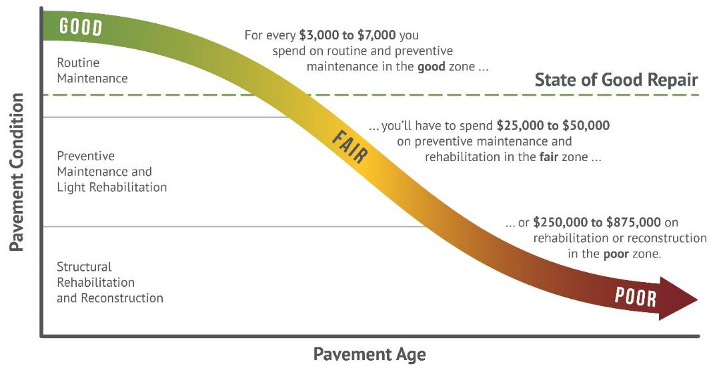
Good roads cost less
Notes:
Targets are set to maintain a state of good repair
Maintaining assets in a state of good repair minimizes overall lifecycle costs (good roads cost less)

Slide 7
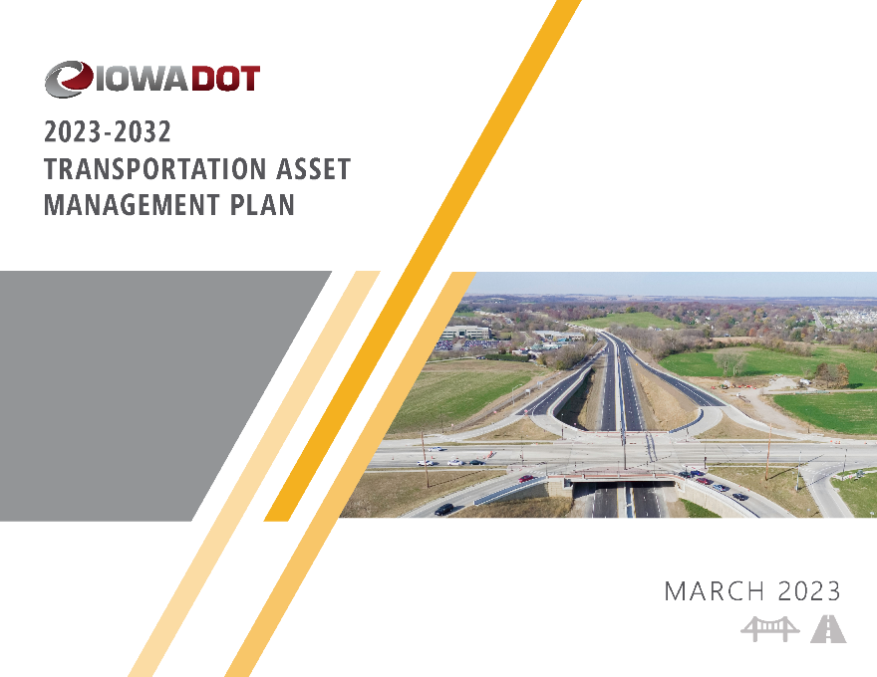
We have a plan
What are we doing to implement asset management?
(we call it our TAMP)
Notes:
Update process will kick-off later this Fall
Next update due in Mar 2027

Slide 8
TAMP Objectives
Defines clear links among agency goals, objectives, and decisions.
Defines the relationship between proposed funding levels and expected results.
Develops a long-term outlook for asset performance.
Documents how decisions are supported by sound information.
Develops a feedback loop from observed performance to subsequent planning and programming decisions.
Improves accountability for decision making.
Unifies existing data, business practices, and divisions to achieve Iowa DOT’s asset management goals

Slide 9
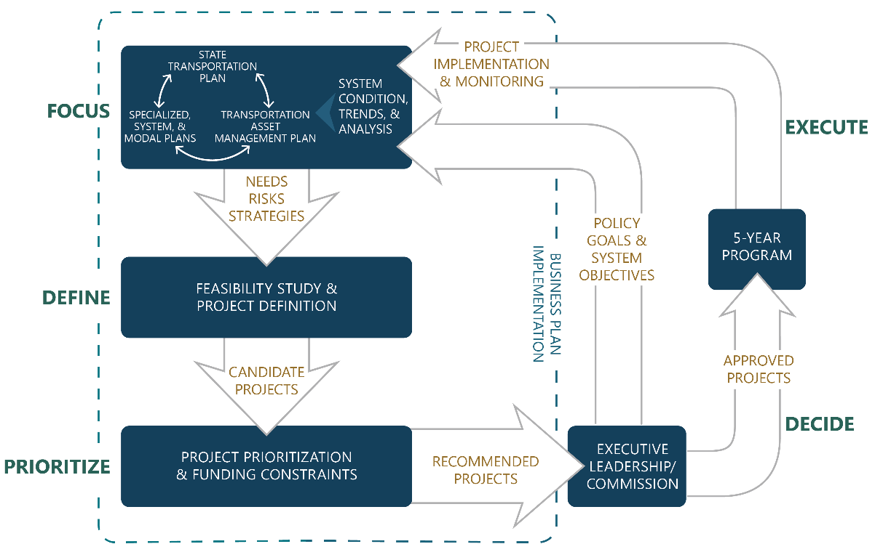
How does our TAMP fit in the planning and programming process?
Notes:
Diagram illustrates how the TAMP is connected to our long-range plan, various system and modal plans, and our 5-year program

Slide 10

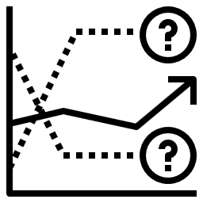
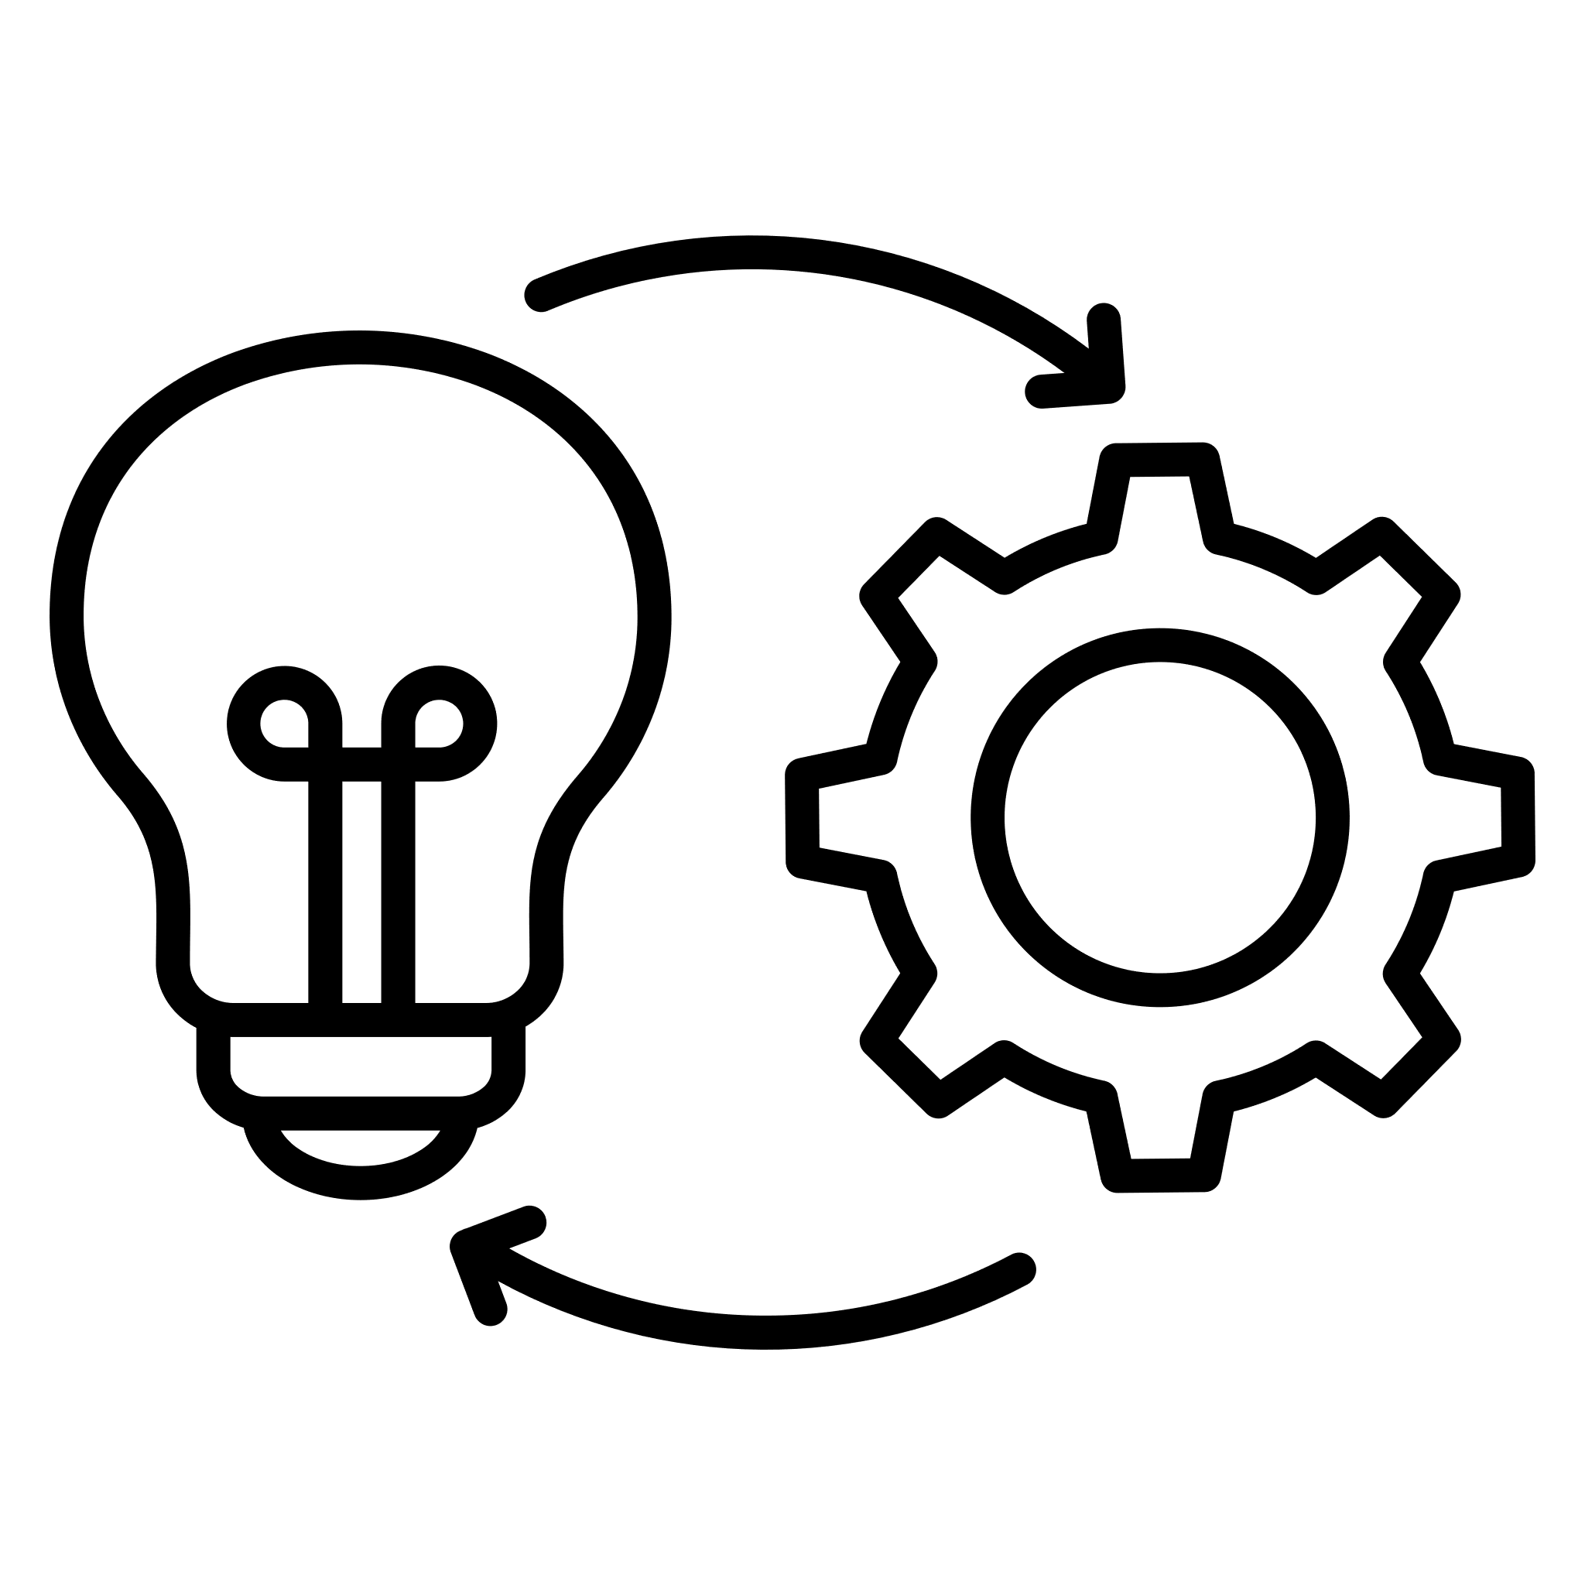



TAM Governance Structure
Technical Teams & SMEs
TAM Implementation Team (TAMIT)
Executive Leadership Team & Iowa Transportation Commission
Analysis
Forecasting
Recommendations
Coordination
Implementation
Governance
Policy
Resource Allocation
Decision Making
Notes:
Technical Teams and subject matter experts for pavements, bridges, and other assets form the foundation of asset management. They are responsible for collecting asset data, forecasting future performance, recommending strategies for the optimal mix of treatments and projects, and assessing asset performance.
The TAM Implementation Team, or TAMIT, serves as the cornerstone of TAM governance at Iowa DOT. TAMIT helps develop and implement the TAMP and serves as a conduit between technical staff and the Executive Leadership Team and Commission. TAMIT provides coordination, guidance, and support for TAM efforts within the department and pursues new, proactive ways to further integrate asset management into department processes and the lifecycle of infrastructure.
The Executive Leadership Team and the Iowa Transportation Commission guide overall TAM efforts by providing policy direction, allocating resources, and making decisions. Direction for asset management is provided through the policy established through the State Long-Range Transportation Plan as well as the investment decisions documented in the Five-Year Program.

Slide 11
Preview of upcoming presentations
Nov 2025 – Project Prioritization Update
Dec 2025 – Interstate Plan Update
Jan 2026
  Pavement Asset Management
  Statewide Traffic Operations and ITS Overview
Feb 2026 – Bridge Asset Management
Mar 2026 – Asset Management Summary
Notes:
Nov 2025 – Project Prioritization Update
Update on proposed changes to our project prioritization scoring method and process
Dec 2025 – Interstate Plan Update
Present updated recommendations for timing and location of future capacity and stewardship investments
Receive Commission input on proposed schedule and funding level
Jan 2026
Pavement Asset Management
Review of current conditions
Present different investment scenarios and resulting conditions
Statewide Traffic Operations and ITS Overview
Highlight asset management needs for ITS infrastructure
Overview of needs and uses for the Statewide Operations line item
Feb 2026 – Bridge Asset Management
Review of current conditions
Present different investment scenarios and resulting conditions
Border bridge needs
Mar 2026 – Asset Management Summary
Summarize recommendations from previous presentations
Review past growth in stewardship investments and recommend continued increases to stewardship

Slide 12
Questions?

