Slide 1

City of Clinton
Transportation Initiatives
October 14, 2025

Slide 2
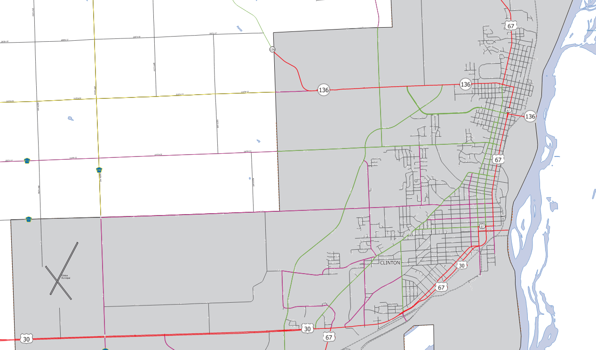
City of Clinton - Federal Aid Routes

Slide 3
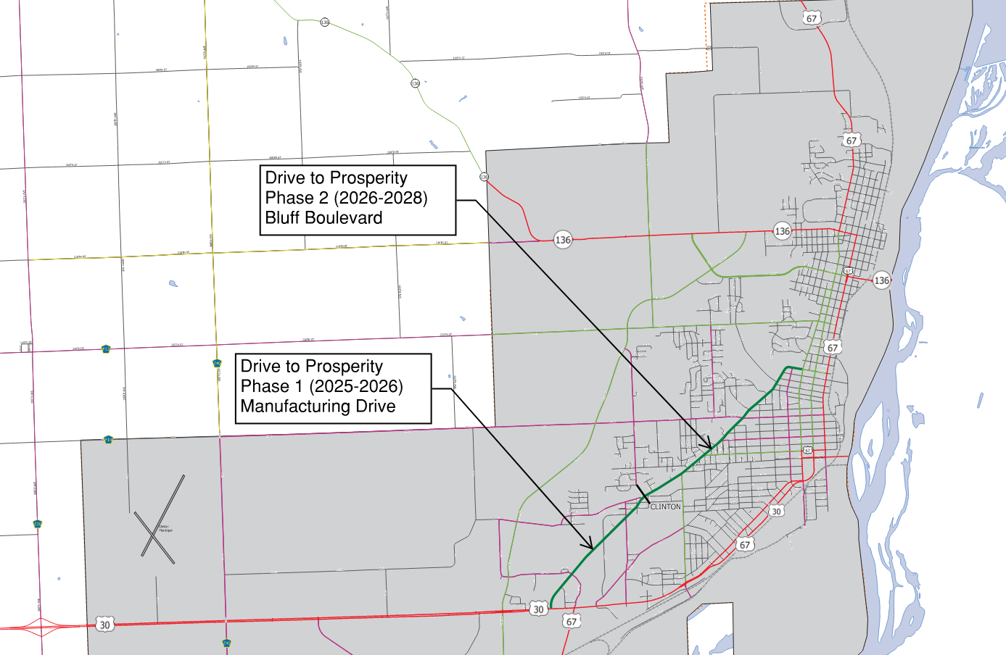
Drive to Prosperity RAISE Project
FUNDING
$15 Million RAISE Grant
$8 Million SWAP Funds
$1 Million TSIP Grants
$16 Local Funding

Slide 4
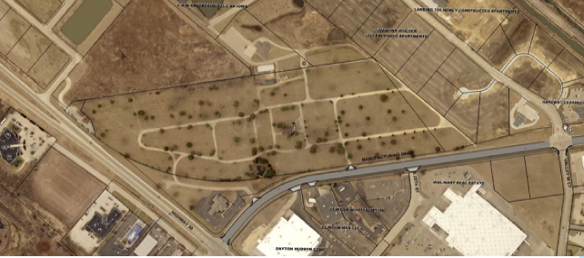
Manufacturing Drive – Phase 1
Drive to Prosperity RAISE Project

Slide 5
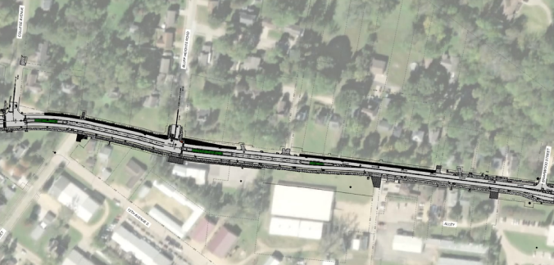
Drive to Prosperity RAISE Project
Bluff Blvd – Phase 2 - South

Slide 6
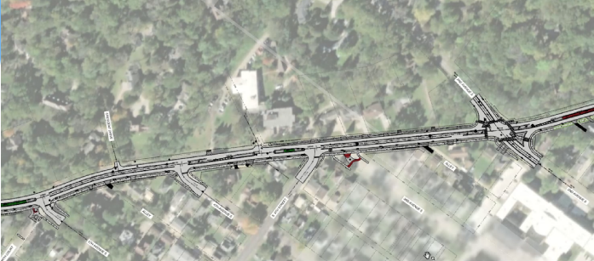
Drive to Prosperity RAISE Project
Bluff Blvd – Phase 2 - North

Slide 7
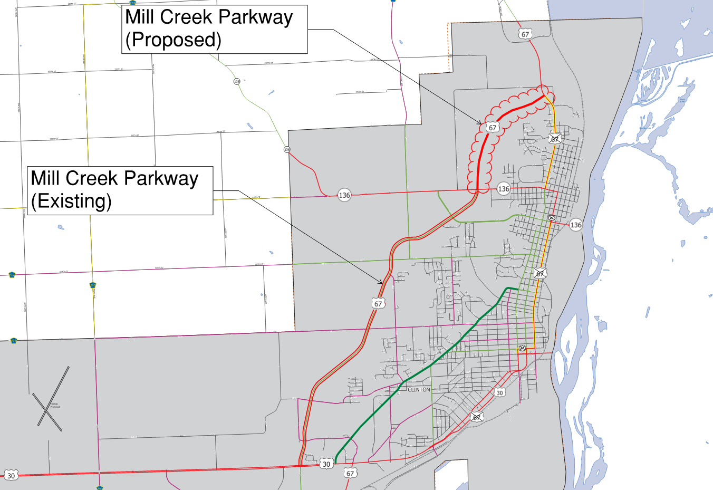
Highway 67 – Jurisdictional Transfer

Slide 8
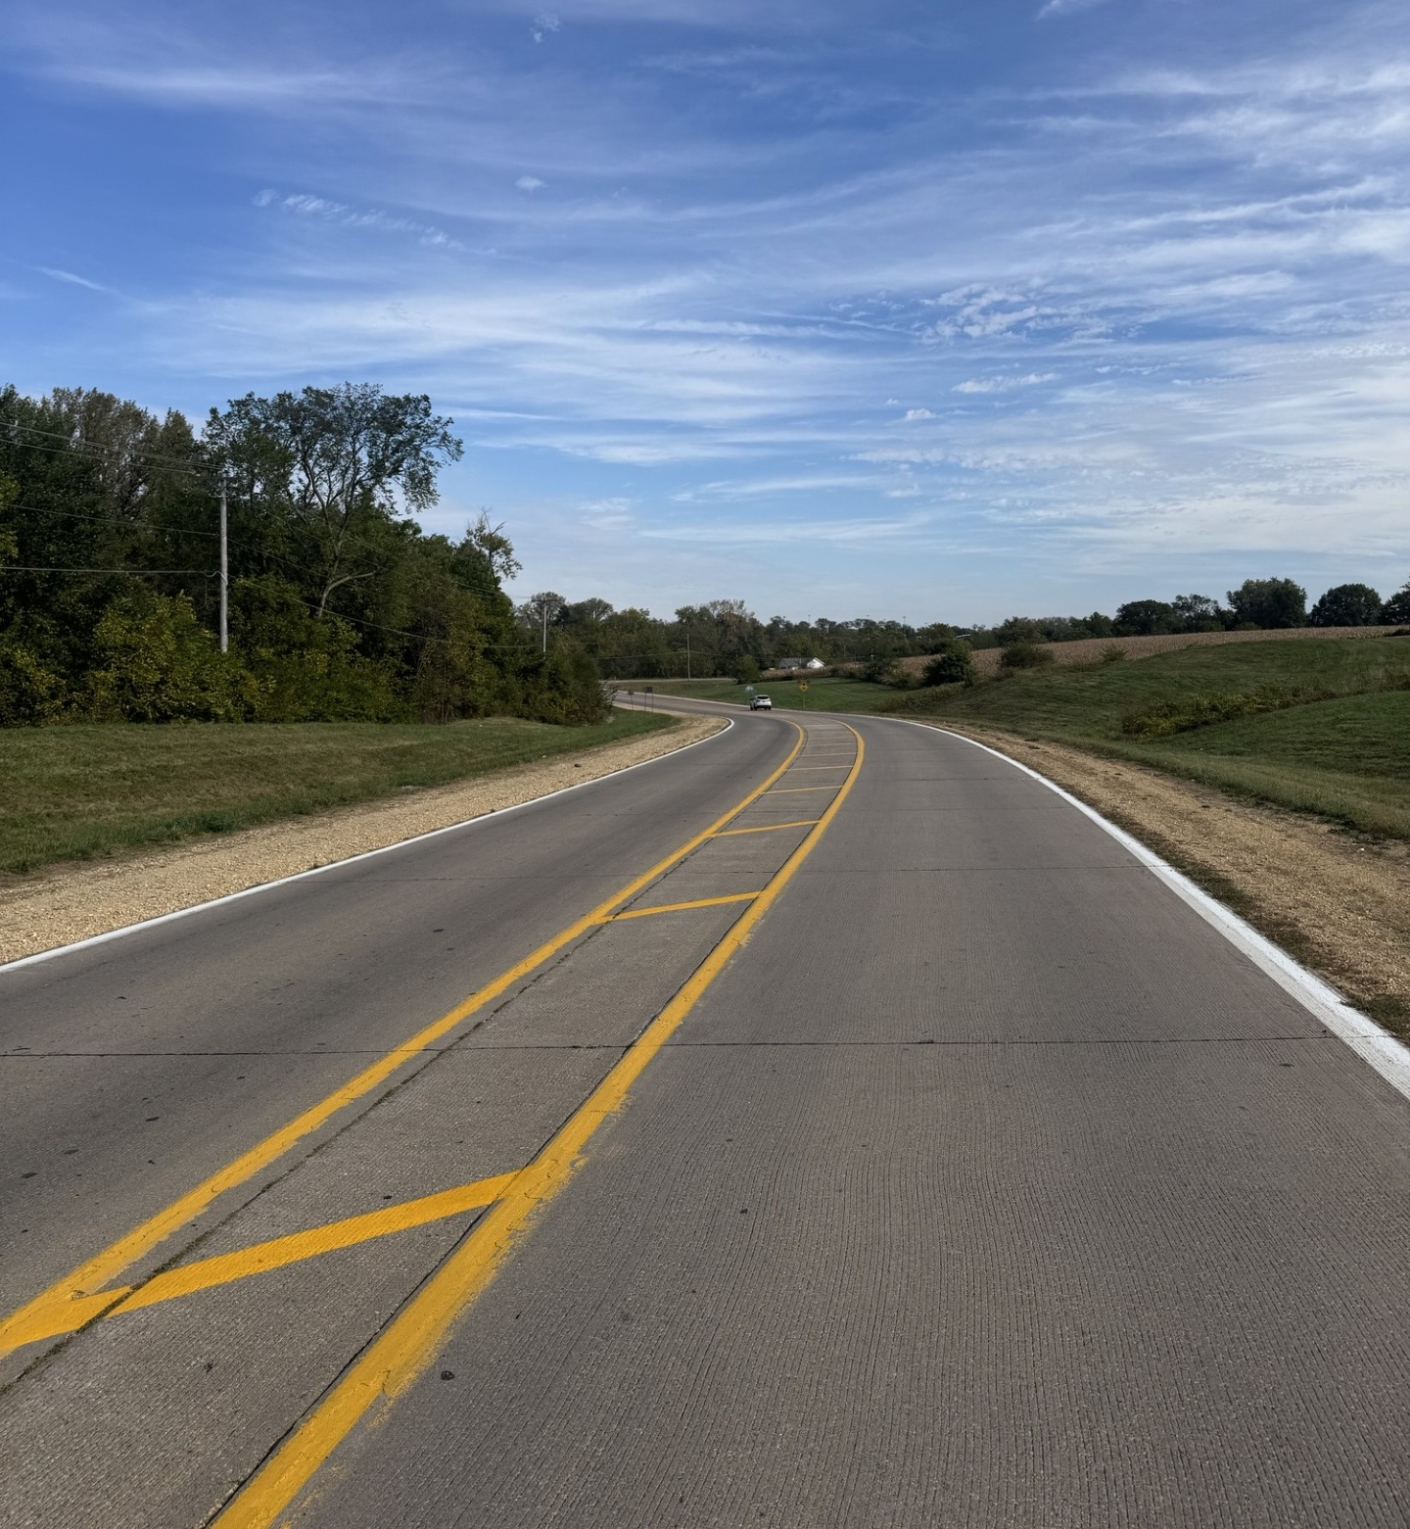
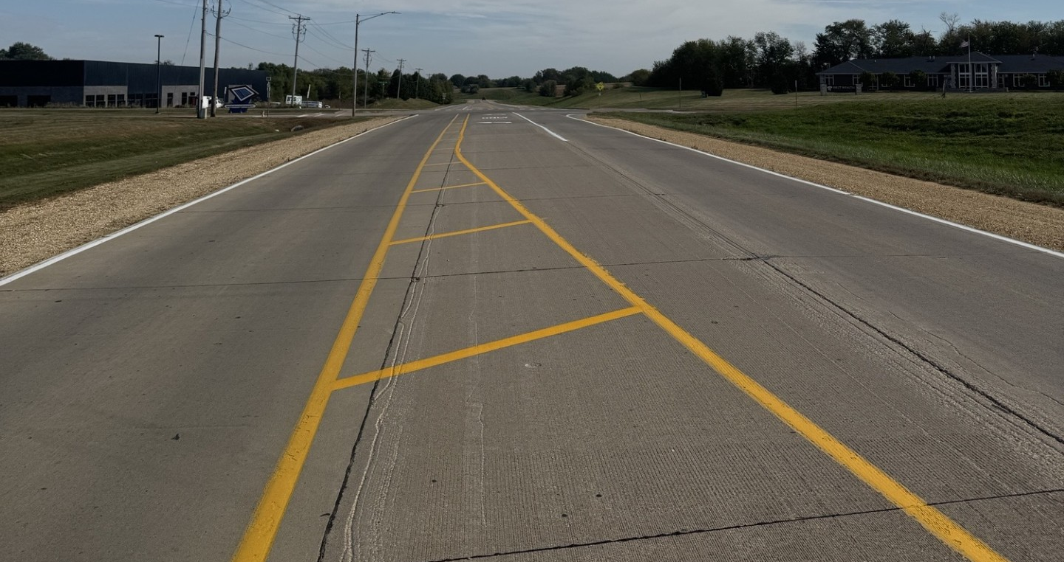
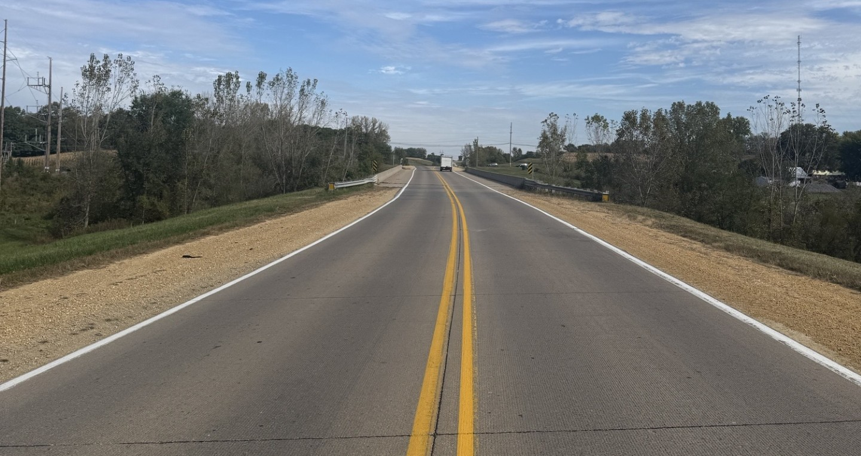
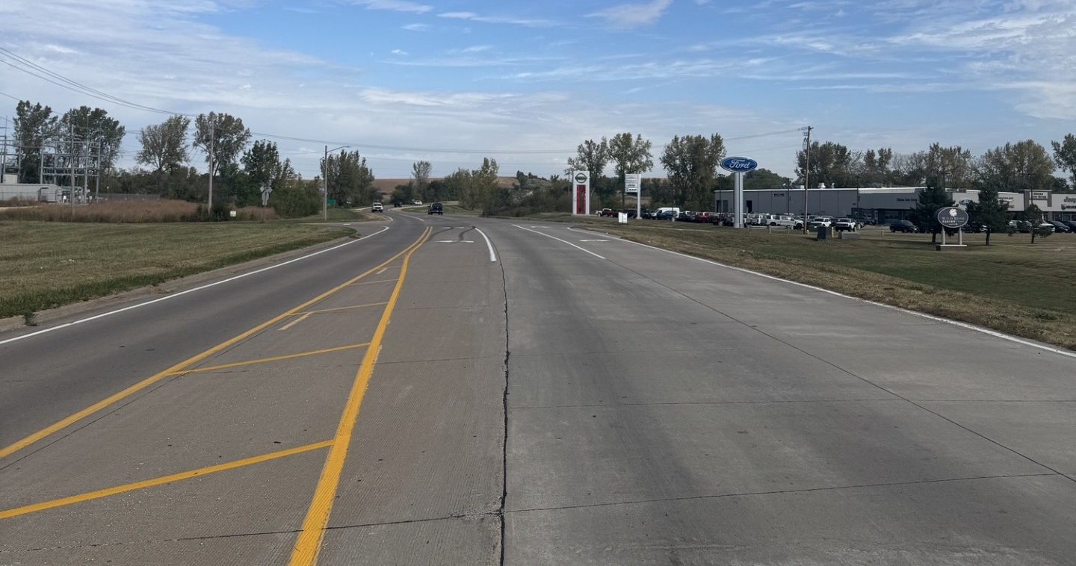
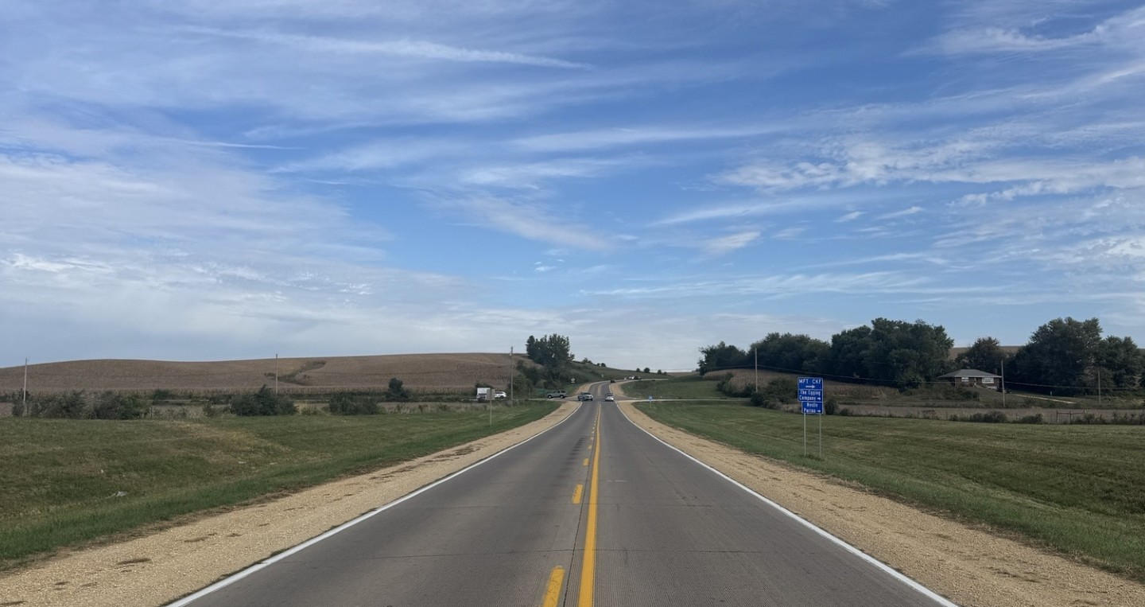
Mill Creek Parkway - Photos

Slide 9
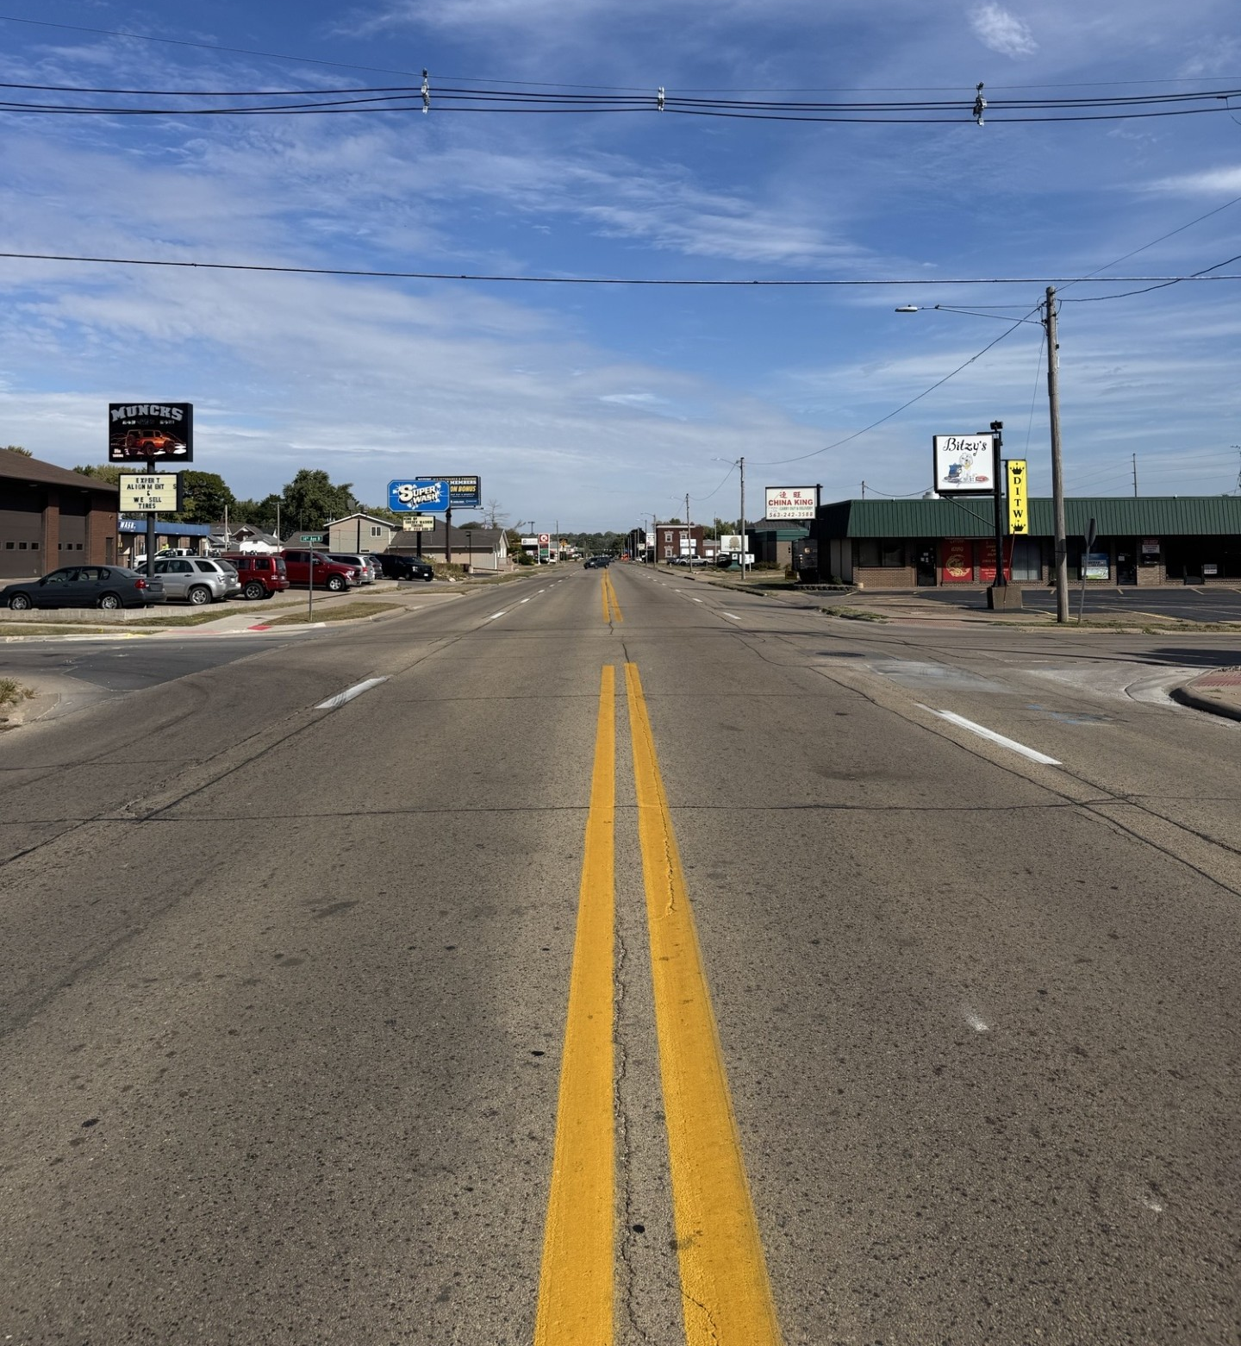
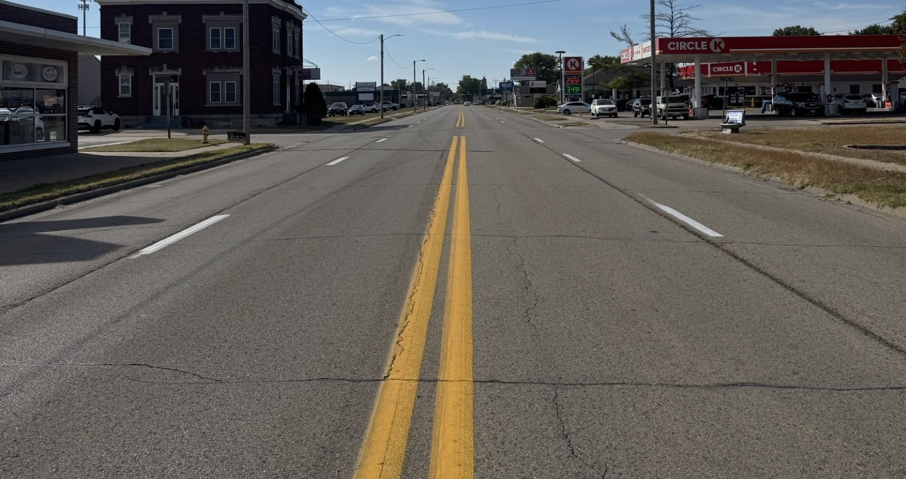
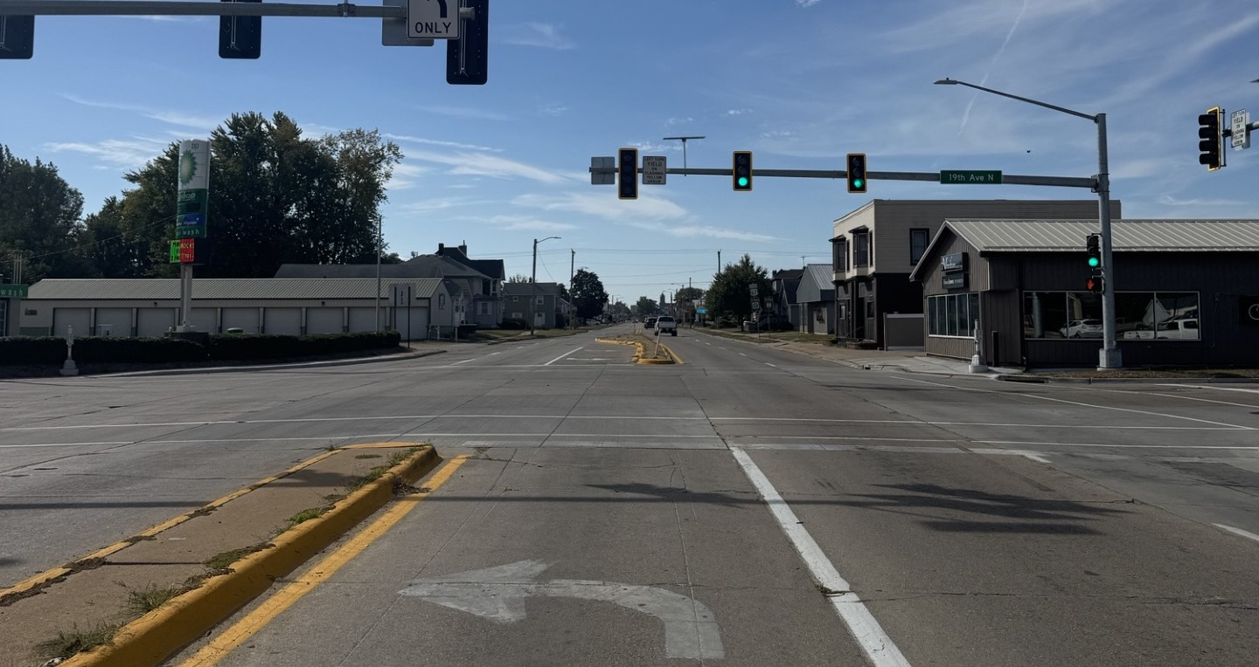
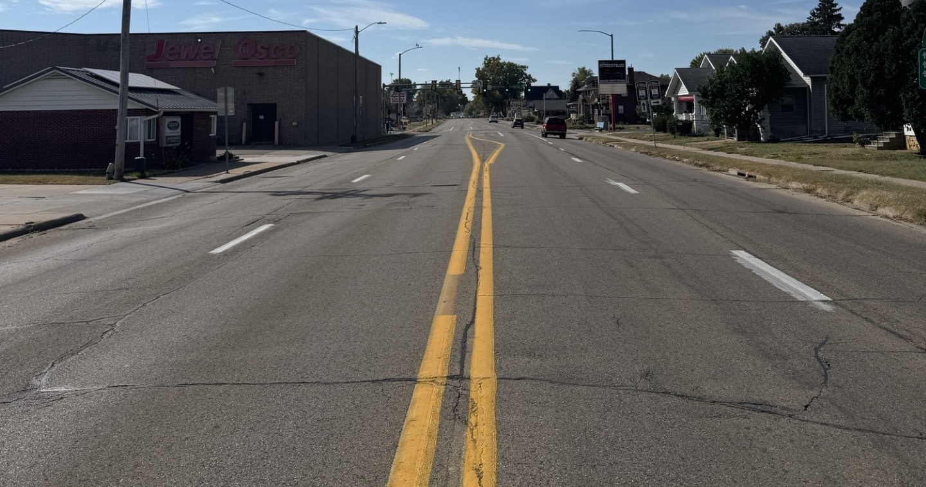
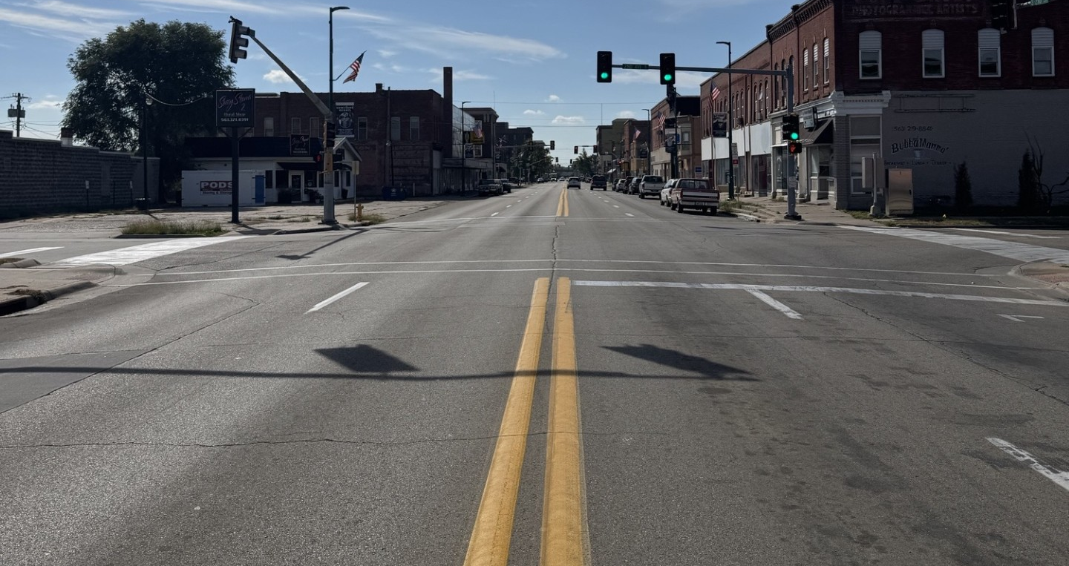
US Highway 67 - Photos

Slide 10
City of Clinton
Transportation Initiatives
October 14, 2025
QUESTIONS ??
Drive to Prosperity (RAISE Project)
  Manufacturing Drive
  Bluff Boulevard
Proposed Jurisdictional Transfer
  Highway 67 (between Highway 30 & 136)
  Mill Creek Parkway

