Slide 1

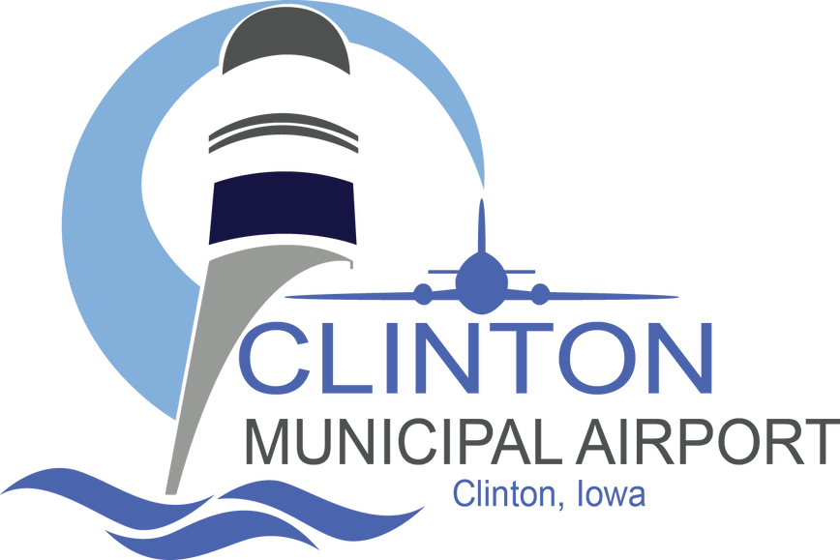
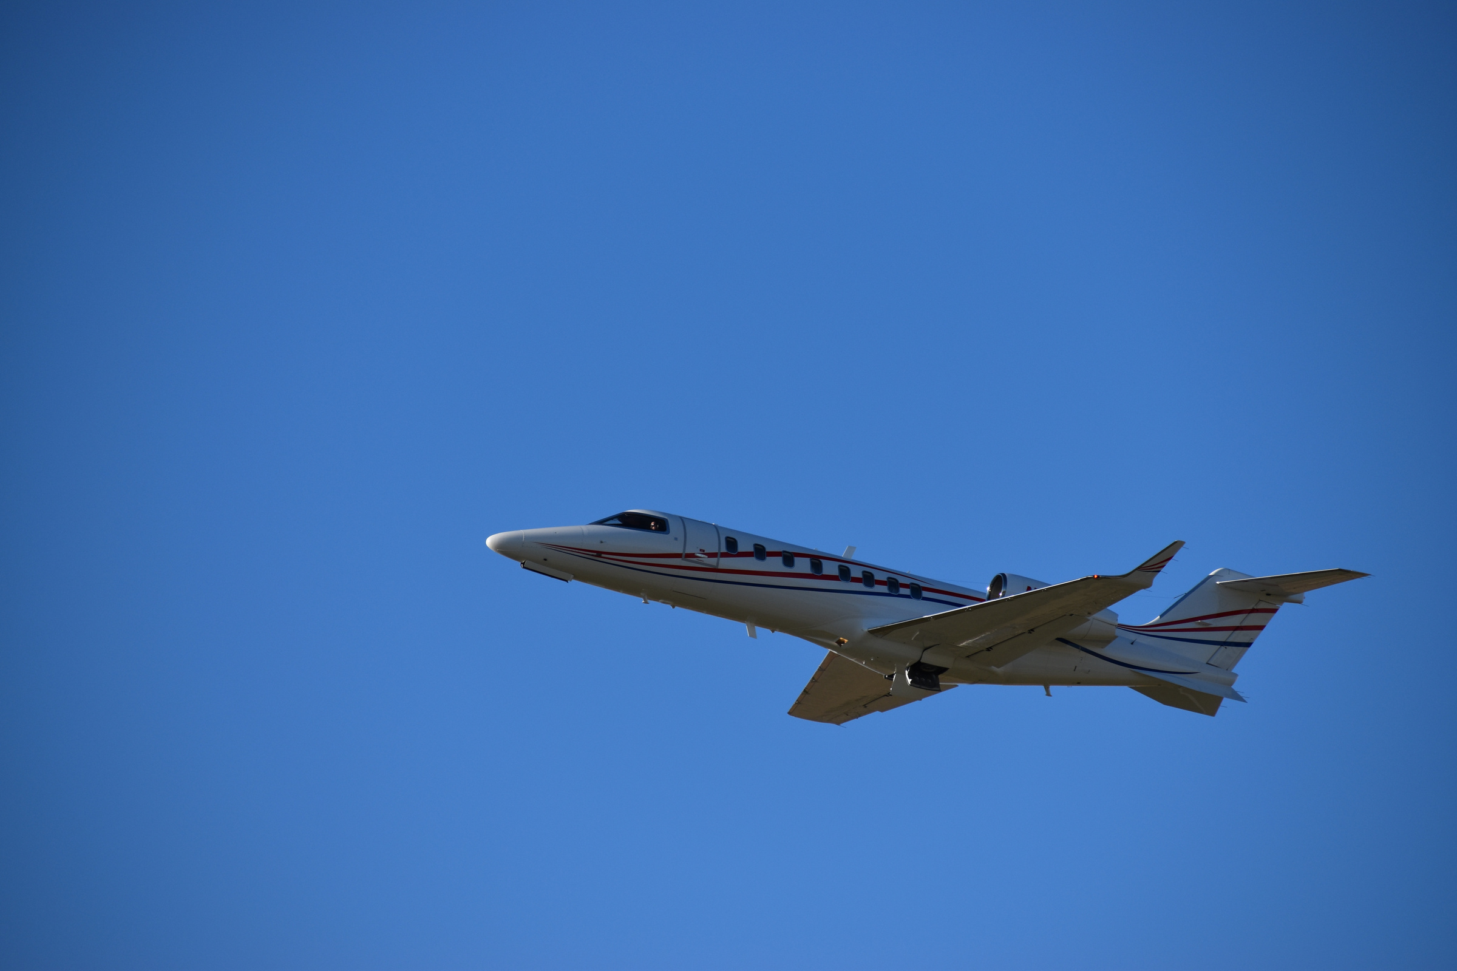


CLINTON MUNICIPAL AIRPORT

Slide 2
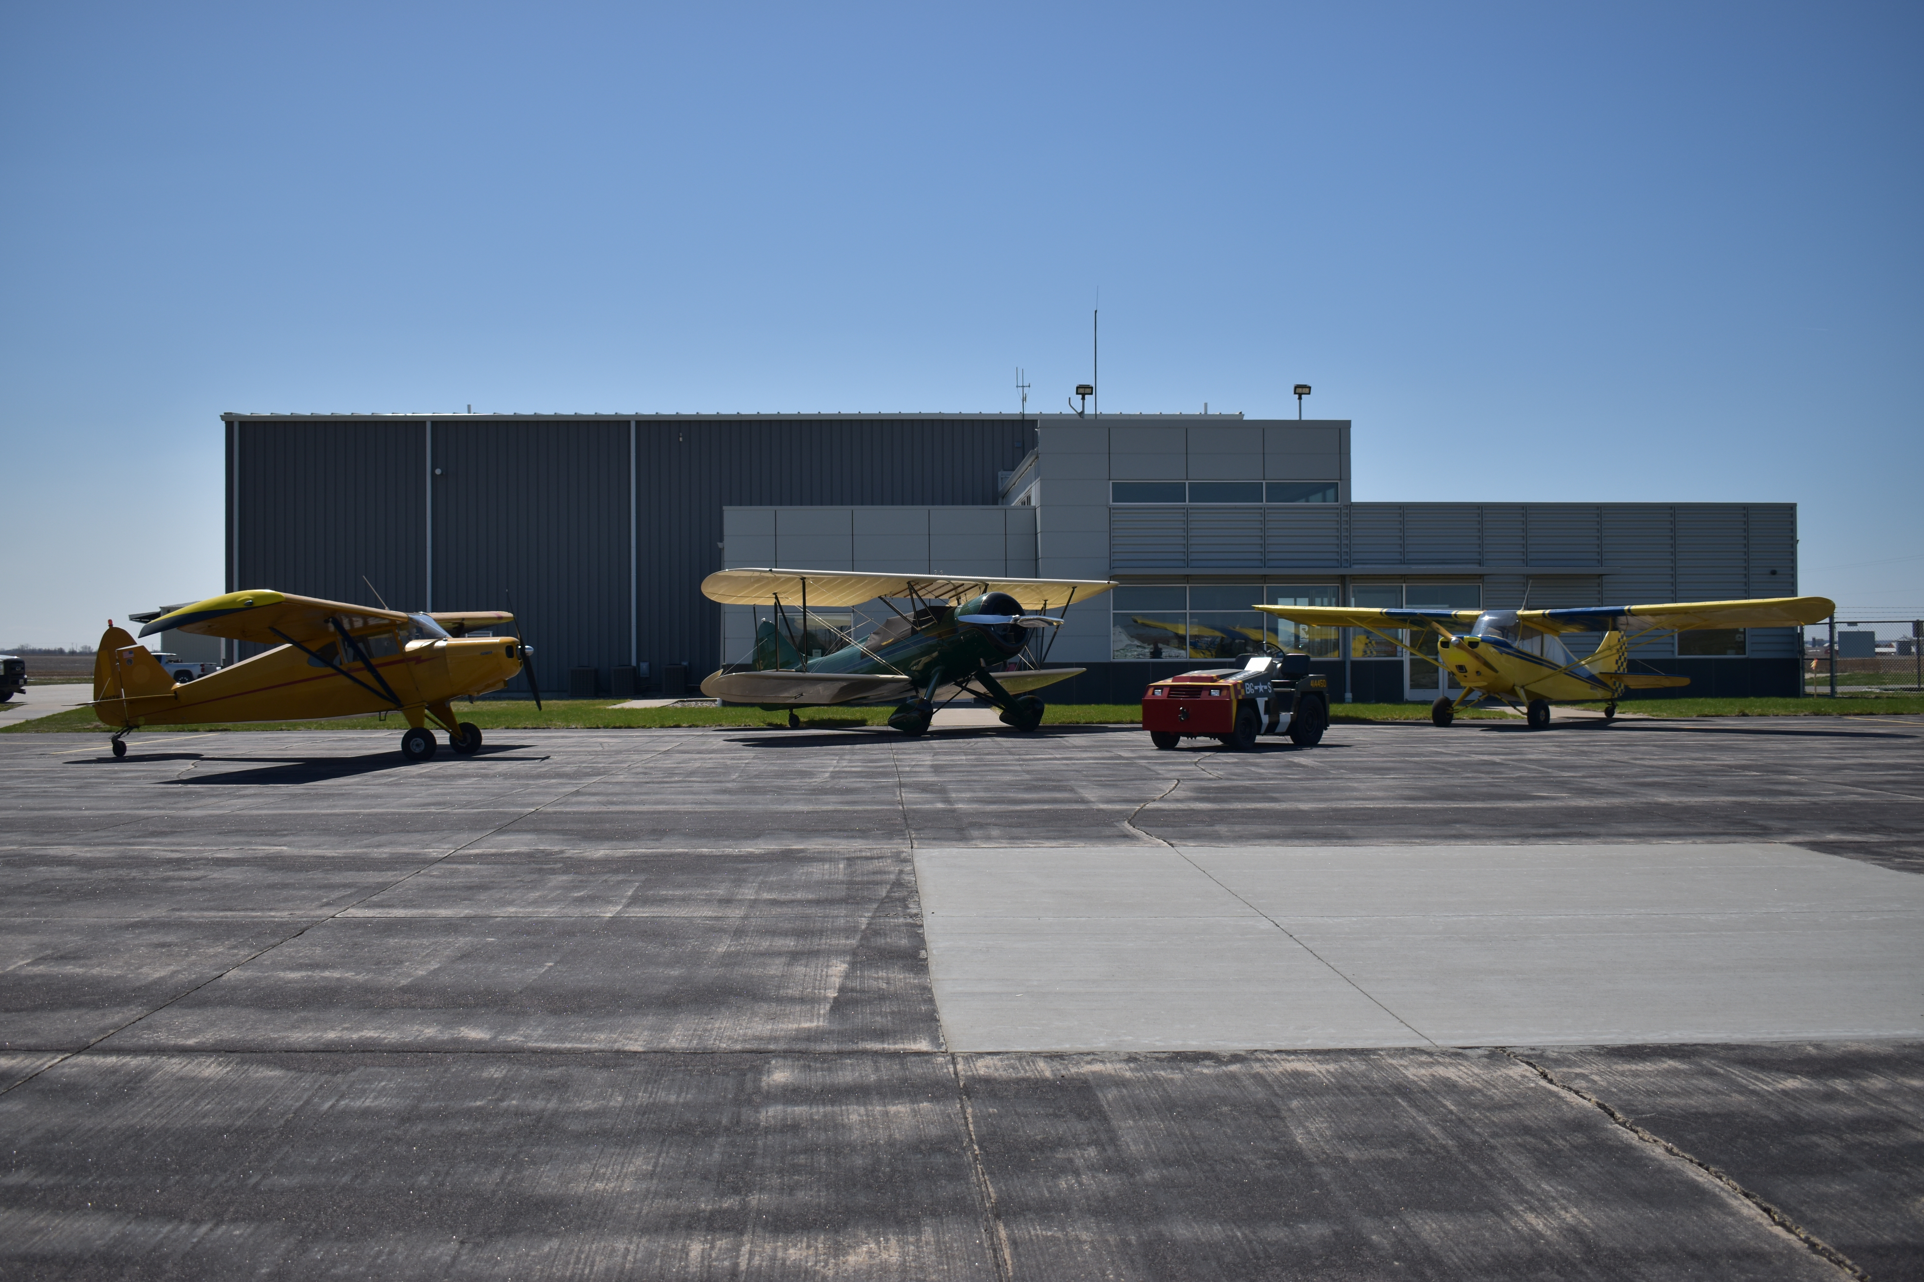
INTRODUCTION
Airport Commission Members:
  Cody Seeley, Chairman
  Kelly Goodsman-Smith, Vice-Chair
  Eddie Dunham, Secretary
  Rich Carlson
  Dan Mikesh
Airport Staff:
  Marlana Nass, Airport Manager
  Matt Reed, Assistant Airport Manager

Slide 3

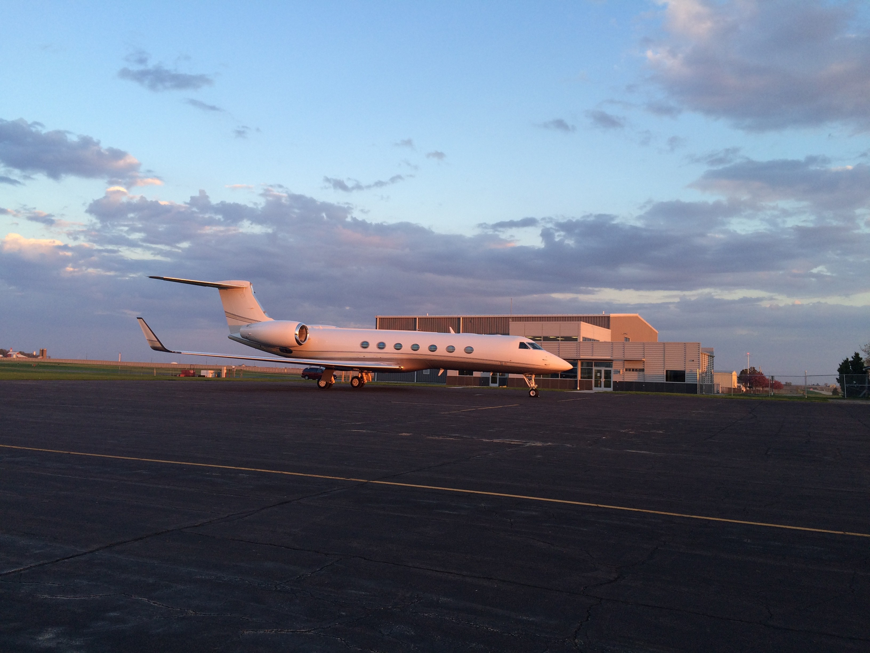
~556 Acres of land
OUR ASSETS
11 Buildings
~40 based aircraft
  Enhanced Service Airport
  City run, full service Fixed Base Operator (FBO)
  Based Flight School
  Modern and accessible terminal building with attached corporate hangar
  2 well maintained runways with instrument approaches
  Services provided to the Greater Clinton Region (including Illinois)
  Provides positive first impression on businesses and visitors to the area
~17,000 operations per year

Slide 4

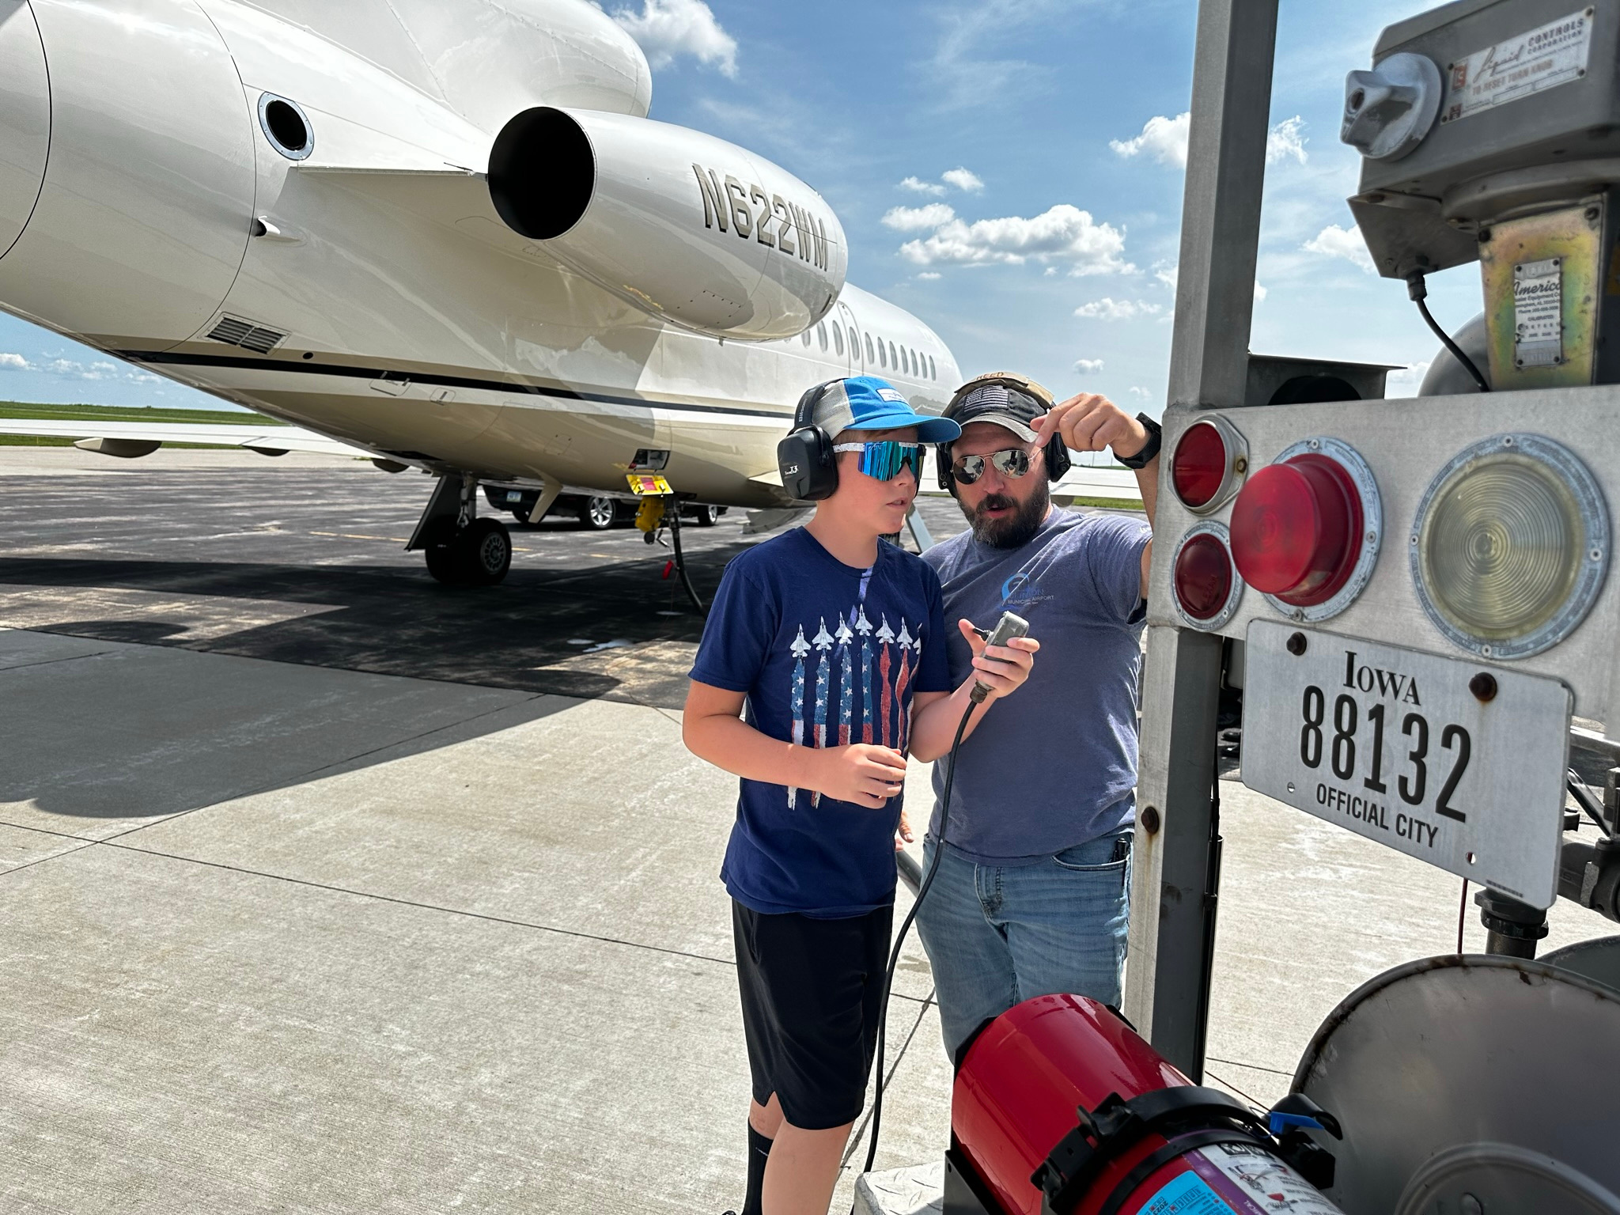
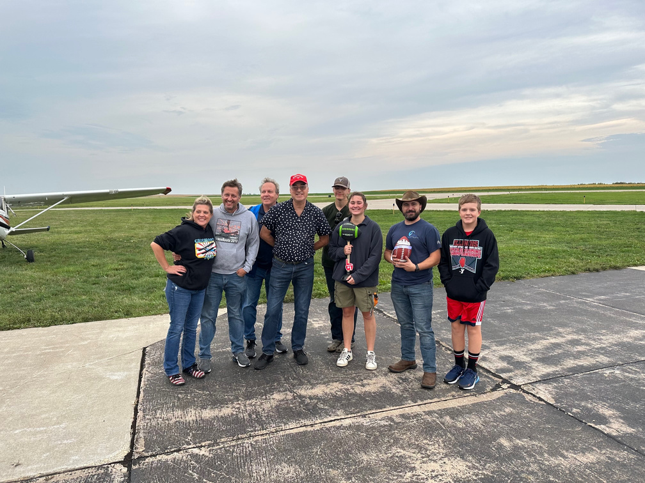
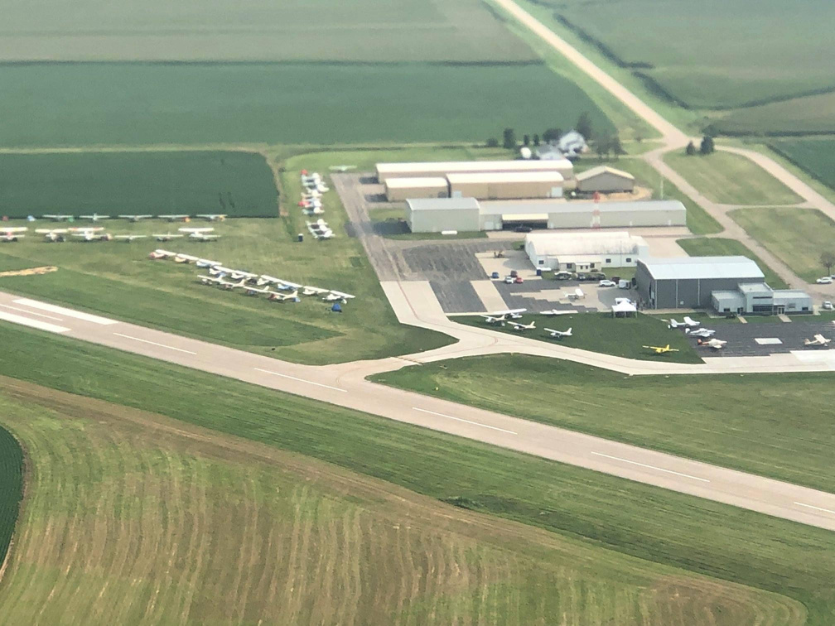
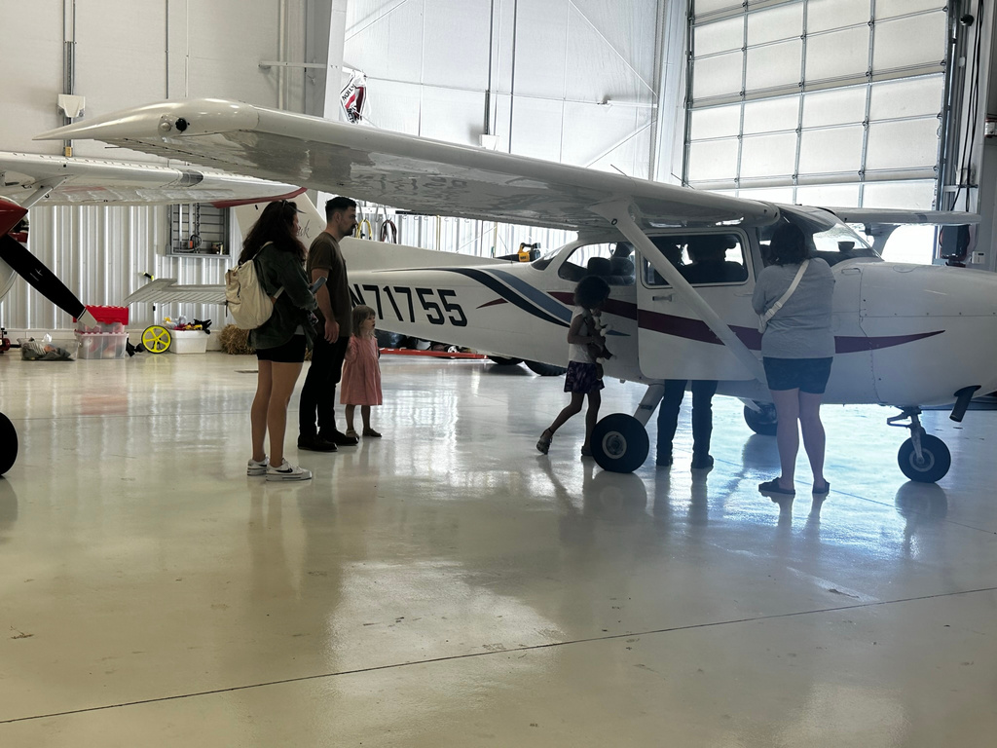
COMMUNITY
ENGAGEMENT

Slide 5
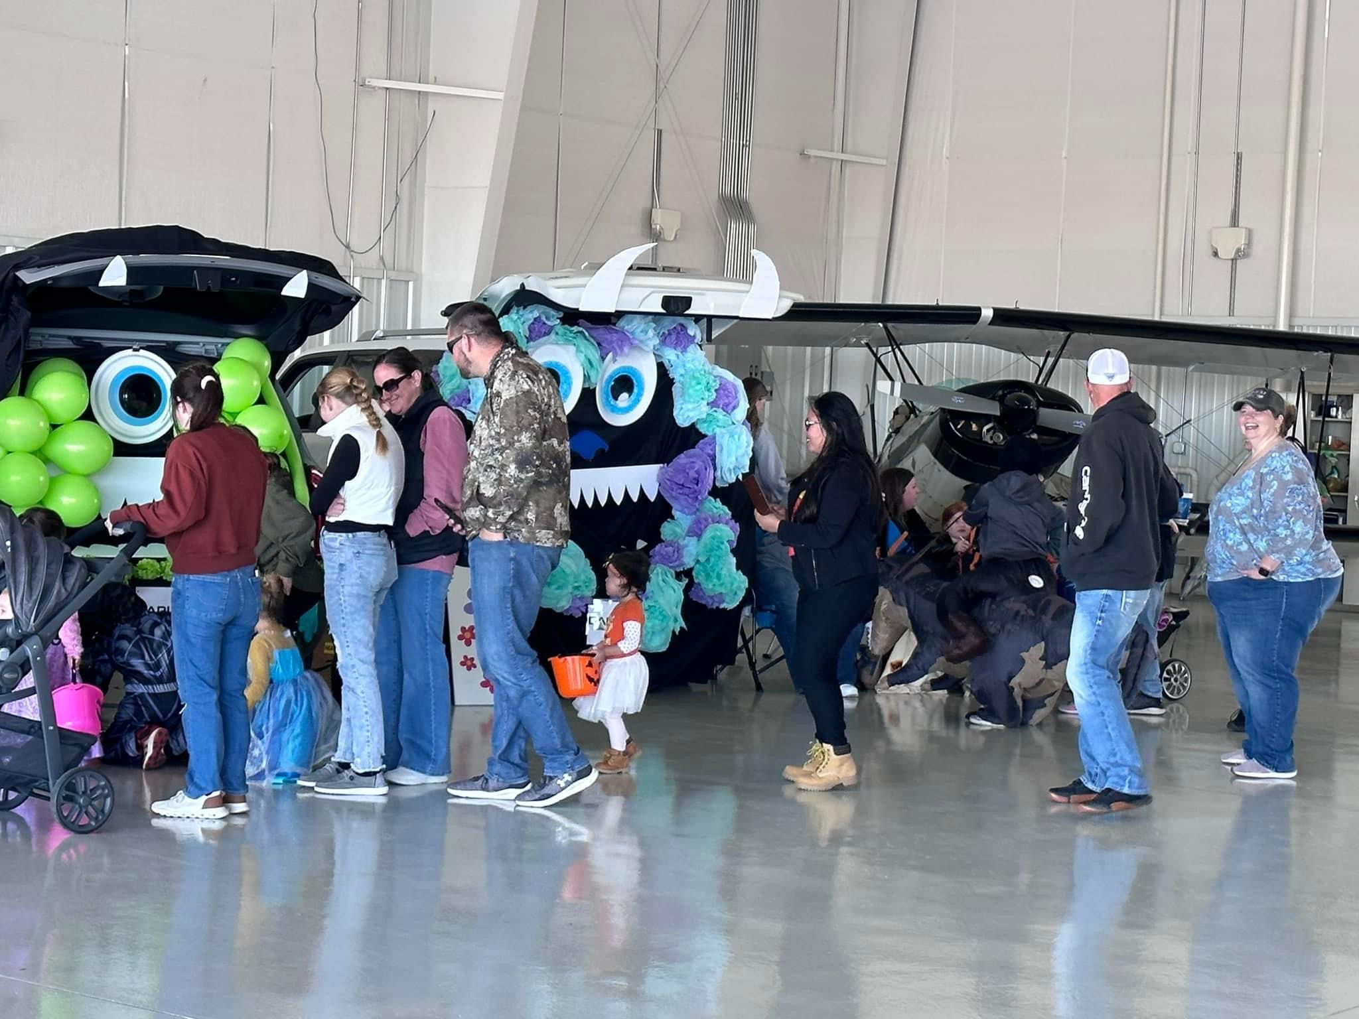

COMMUNITY
ENGAGEMENT
  Increase in Community events over the past 4 years
  Trunk - or - Treat brings 1500 visitors
  Cessna 150/152 Fly in celebrated it’s 25th year
  Active Social Media Presence
  Tours & walk throughs for local groups
  Hosting community events for local organizations
  Internship opportunities for local students
Monthly Flying Contests
Cessna 150/152 Fly-in
Trunk - or - Treat

Slide 6
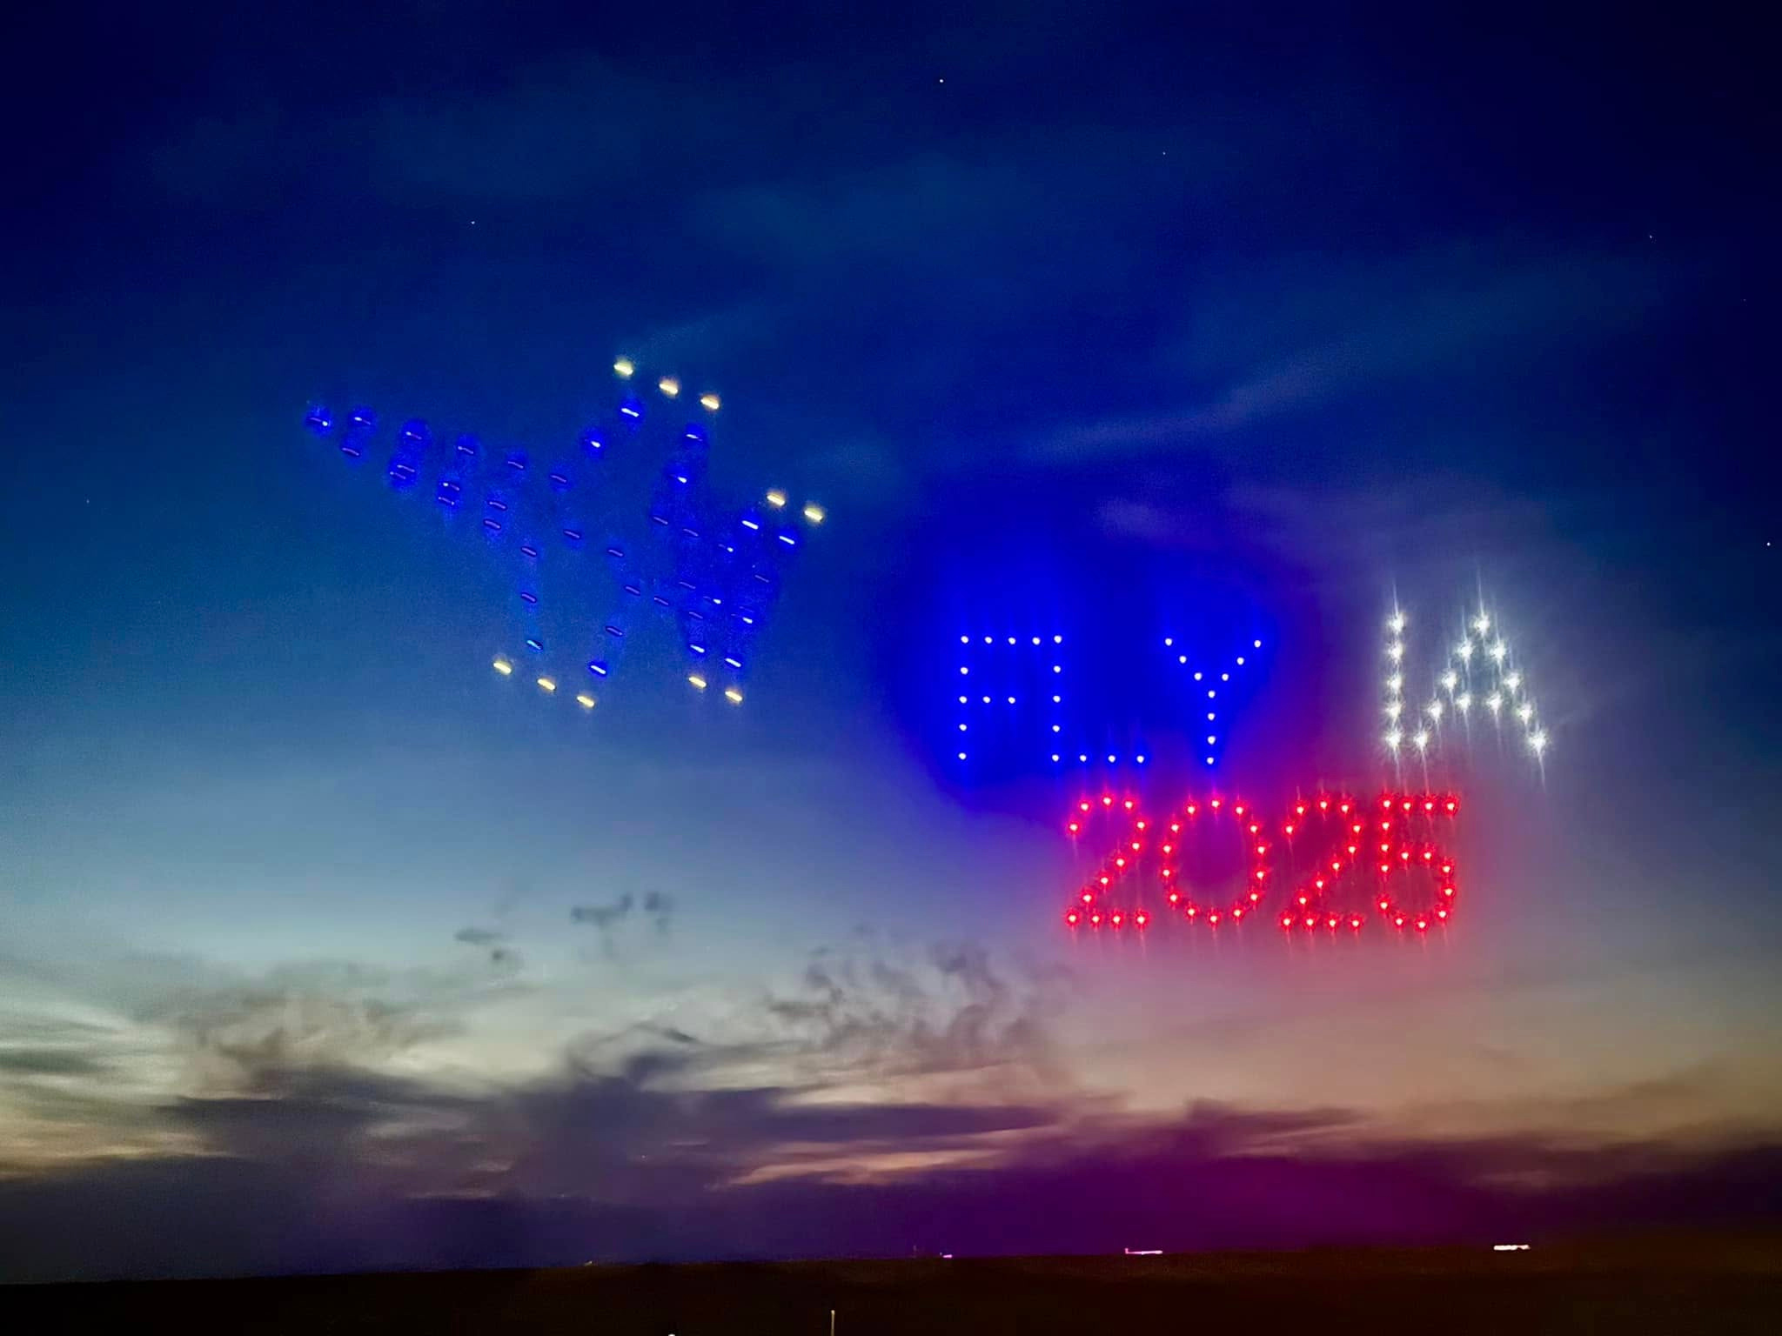
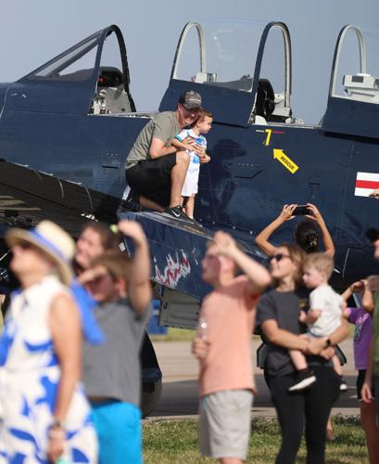
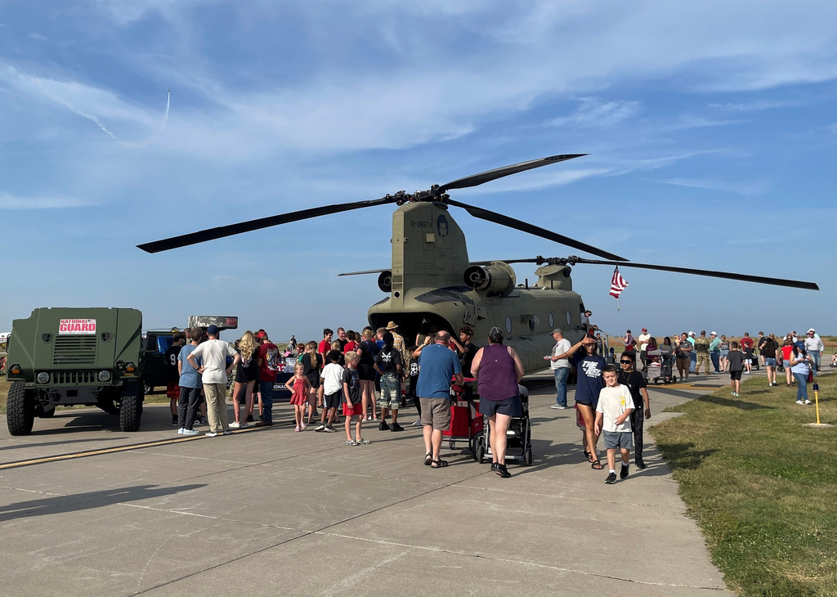
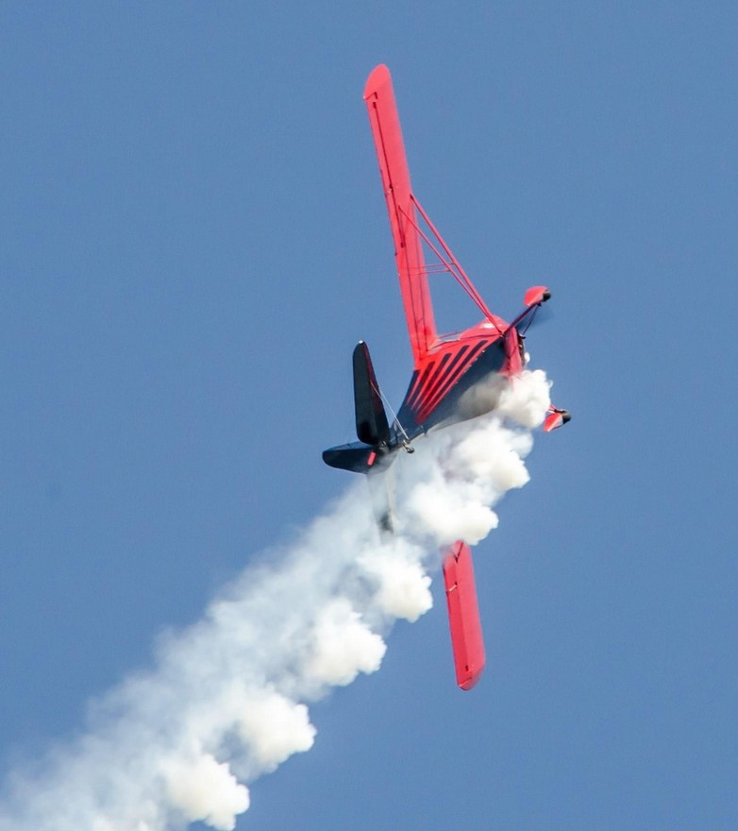
FLY IOWA
AIRSHOW

Slide 7
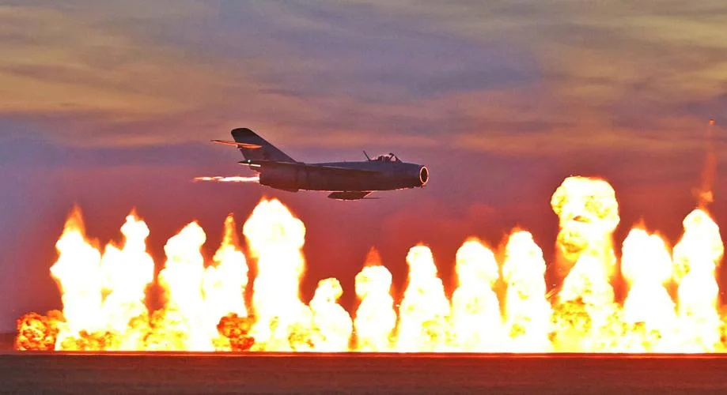
FLY IOWA AIRSHOW
  ~ 6000 people attended
  Free Air Show
  Celebrating 80 years in the community
  First ever custom Drone Light and fireworks show in the region
  Fully funded by local sponsors
  Excess funds will be awarded to local flight student

Slide 8
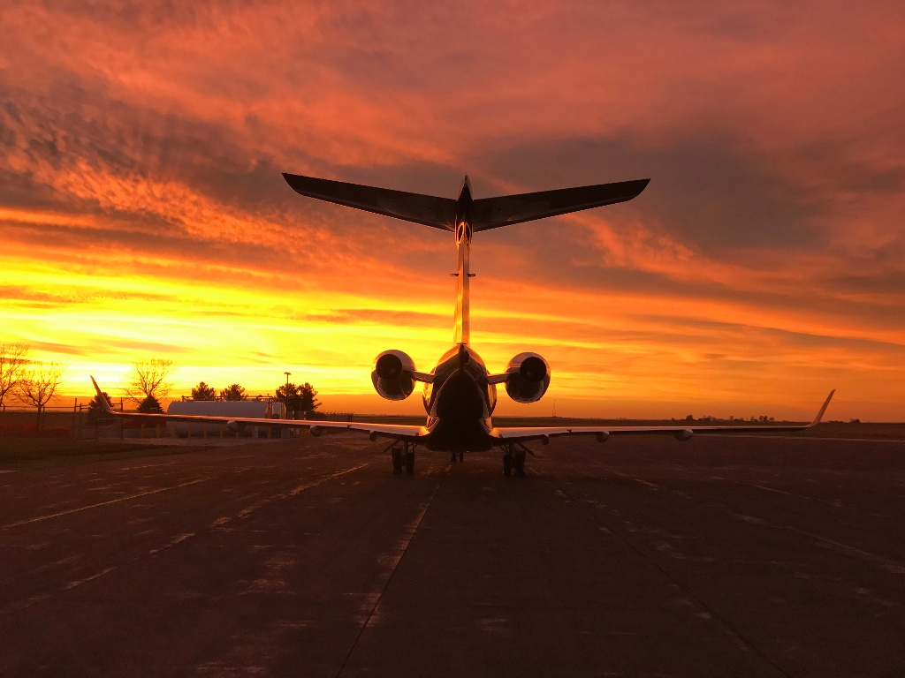
RECOGNITION & IMPACT
Distinguished
General Aviation Award
Partnerships with GROW Clinton
Economic
Driver
  First General Aviation Airport to be selected for the Distinguished General Aviation Award
  the “Air” Component of the Lincolnway Industrial Rail and Air Park
  Industries are known to target communities with healthy well maintained airport
  $3M direct economic Impact to Community*
*2020 study

Slide 9
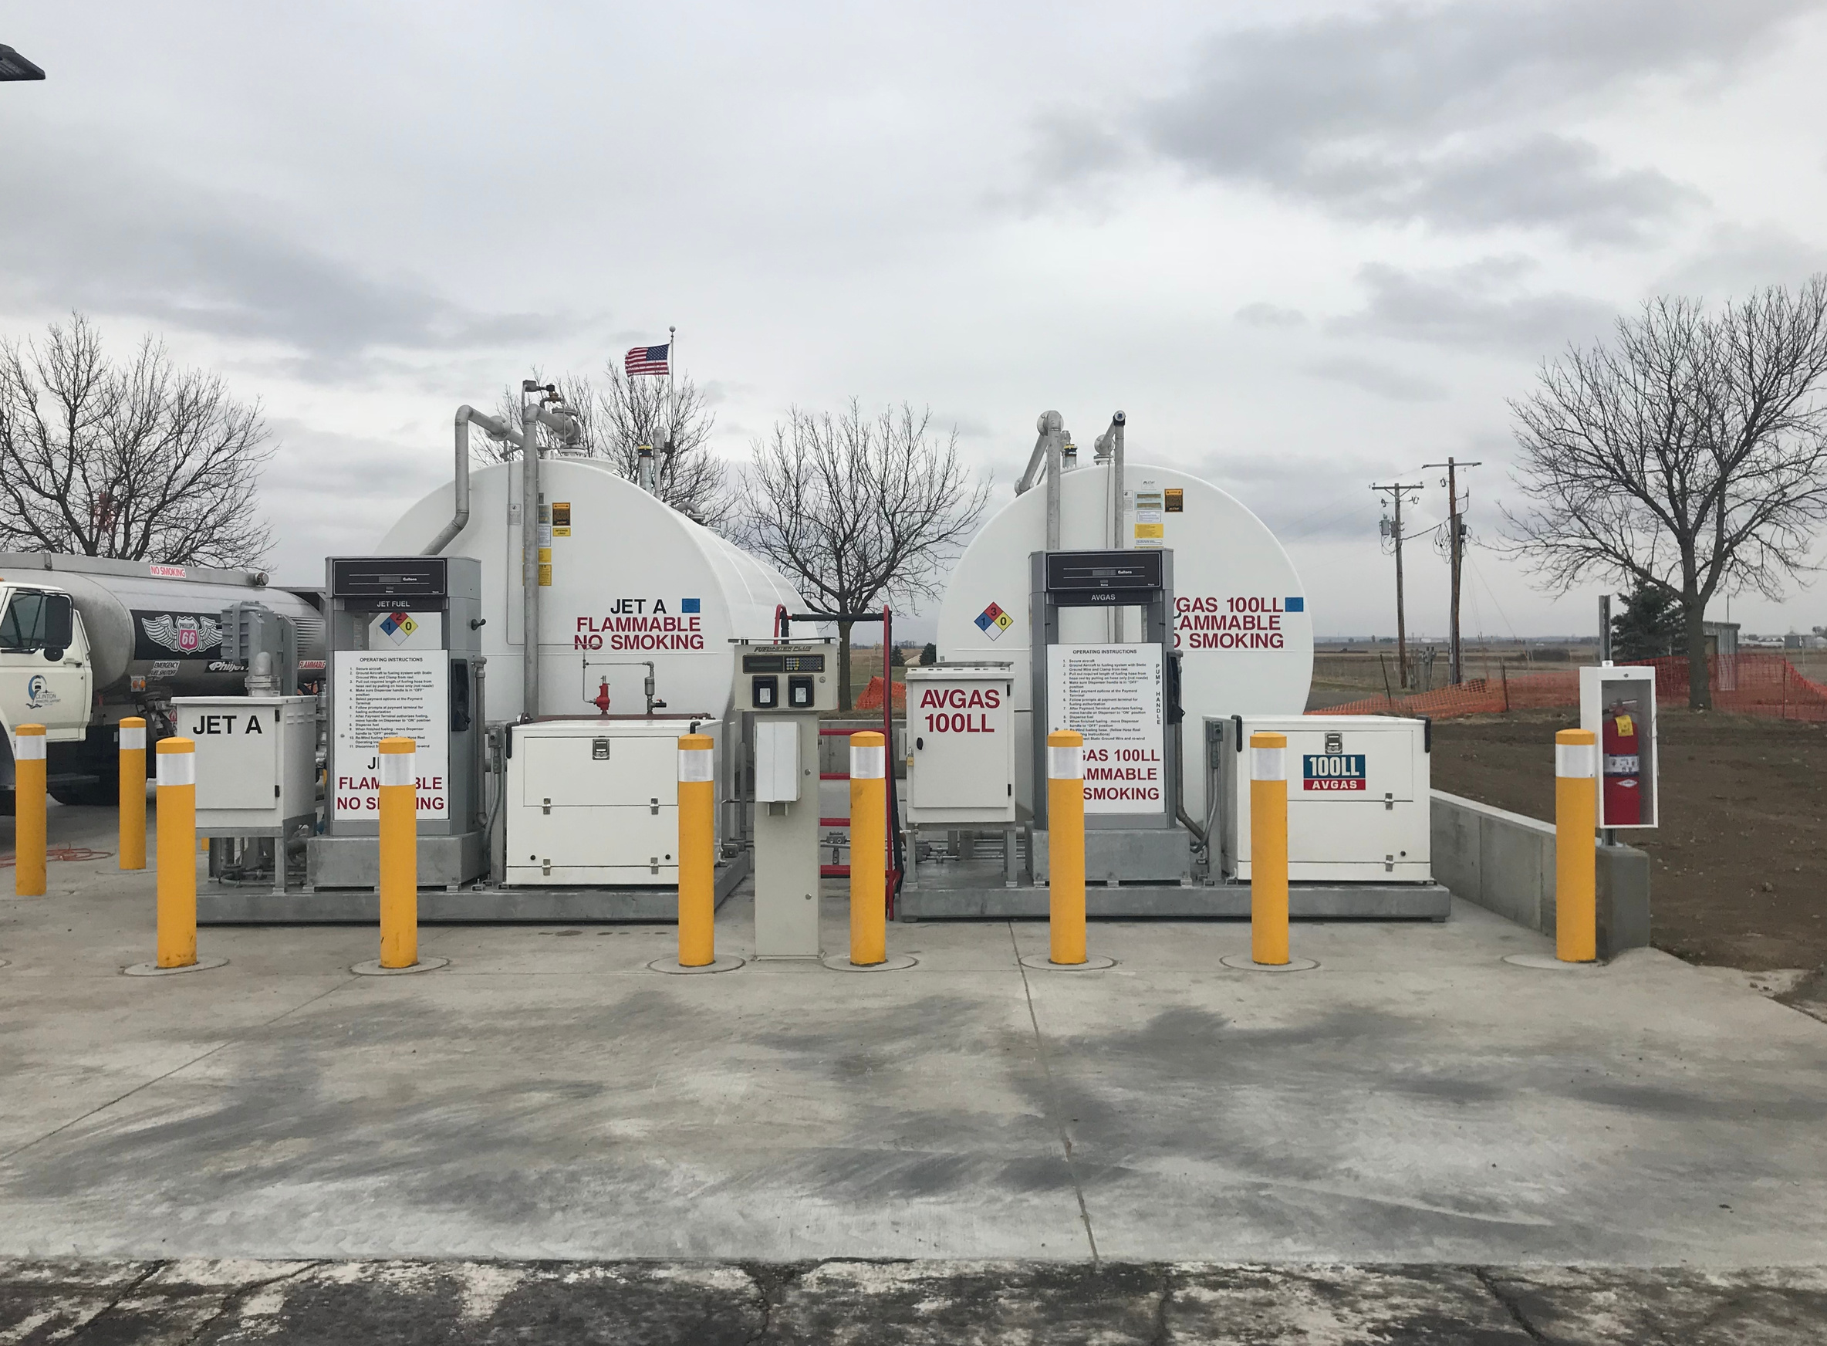
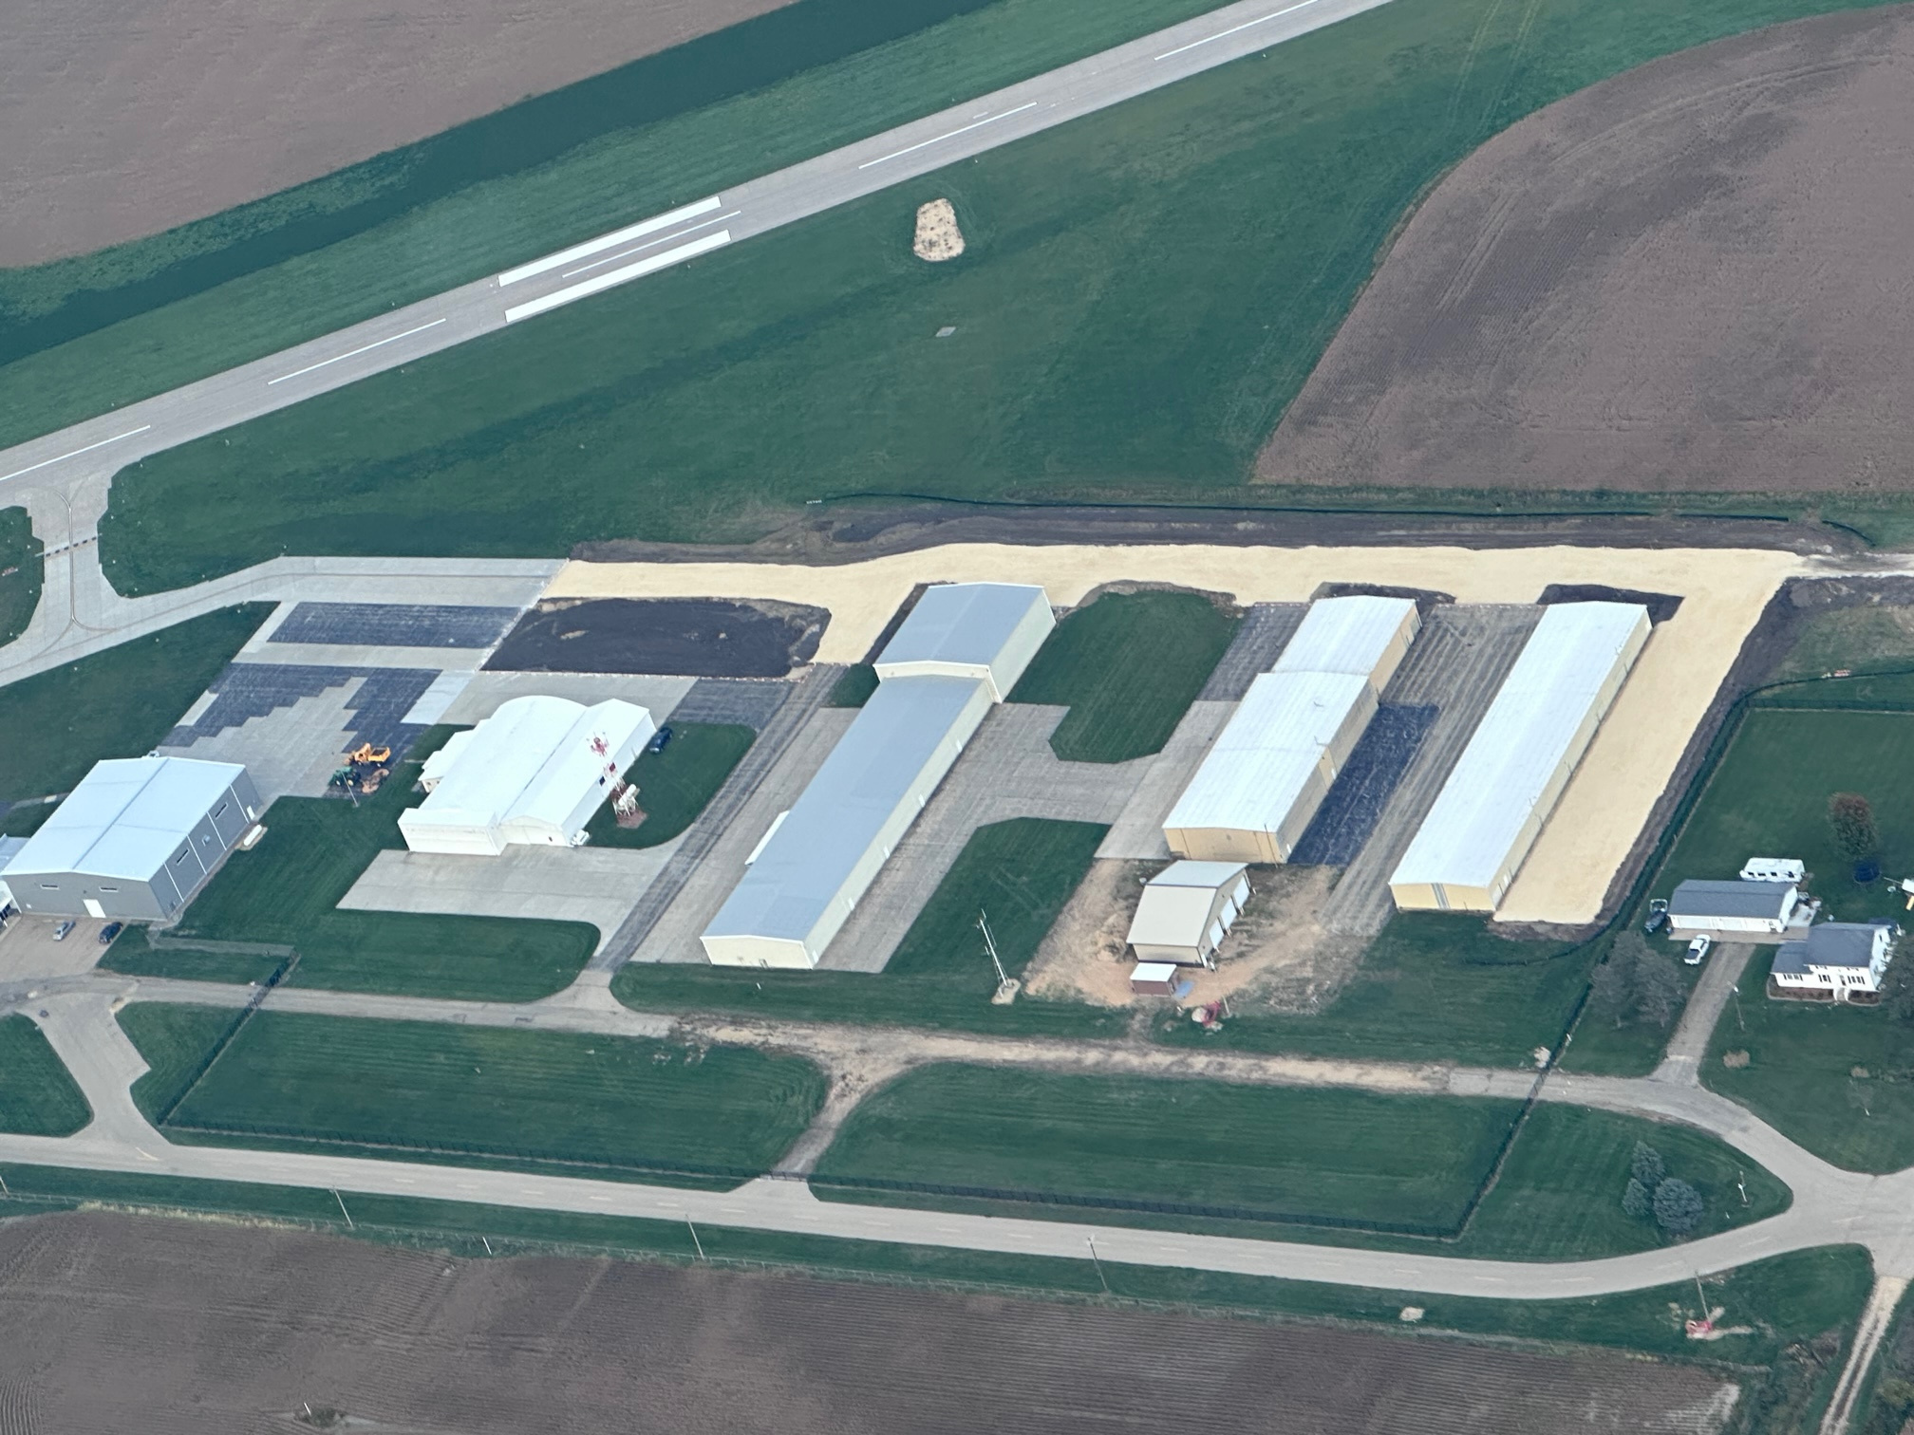
CAPITOL IMPROVEMENTS
  Terminal and Corporate Hangar (IDOT & FAA)
  Fuel Farm Replacement (FAA)
  Taxiway Charlie & Delta Reconfiguration (FAA)
  Main Ramp Rehabilitation Project (IDOT)
  Runway 14/32 Rehabilitation project (FAA)
  Security Fence (IDOT)
  T-Hangar Taxilane Rehabilitation (IDOT & FAA)
  Joint Sealing for Runway 14/32 (FAA)
  Main Ramp Rehab Phase 2 (IDOT)

Slide 10
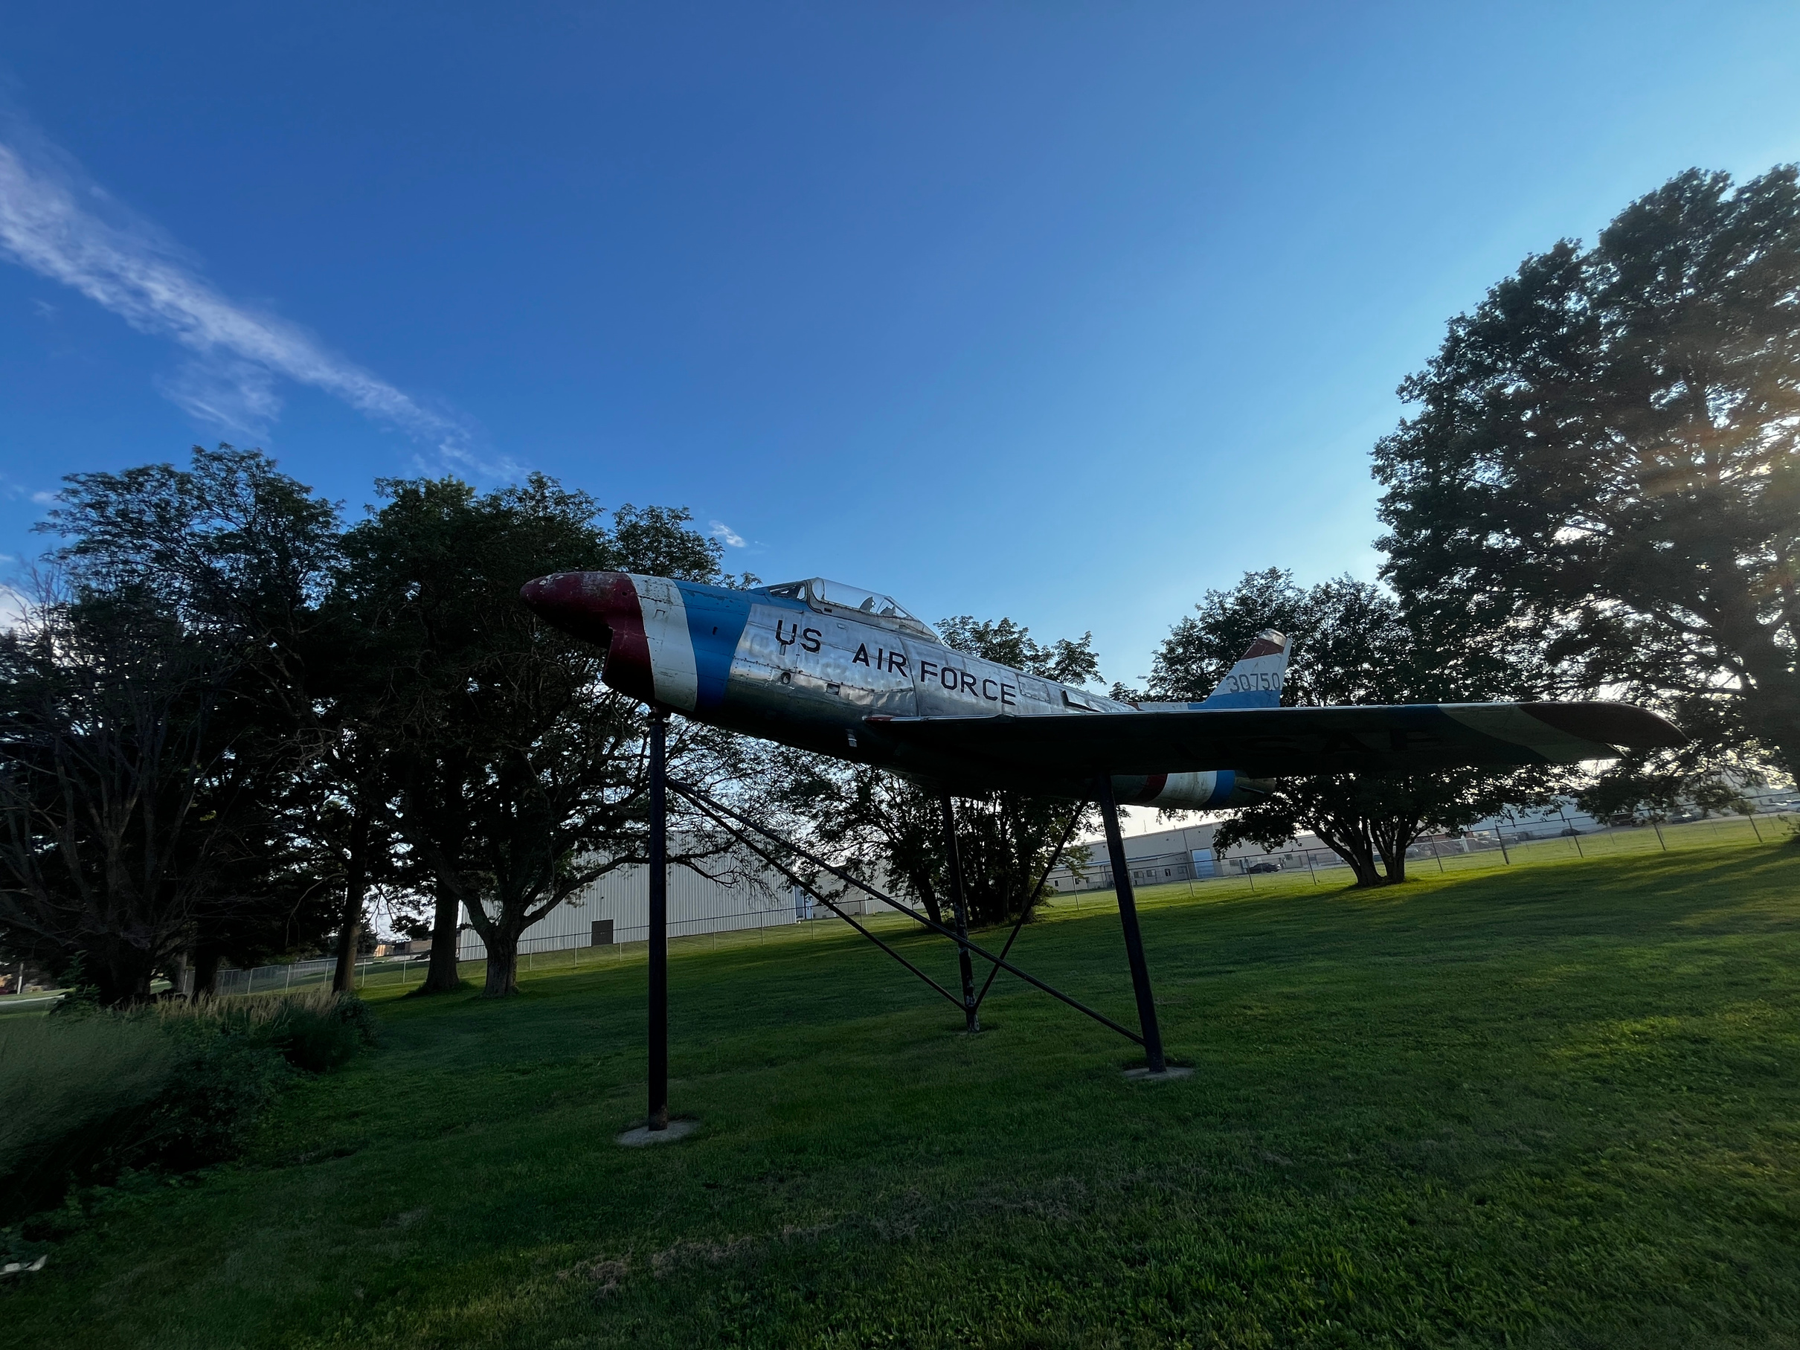
  Continued Pavement Maintenance
    Runway expansions to accommodate larger corporate aircraft
    T-Hangar improvements
  Improved Airport Signage
  Attract new businesses to the airport
  Expanding services
  Grow Pilot Population
  Continue to promote the Community
LOOKING AHEAD
Notes:
Pavement Maintenance continues to be a priority.
Runway expansion would allow the airport to support larger corporate aircraft
Attract new businesses to the airport
--Restaurant, maintenance facility, additional corporate hangars
Improve Airport Signage to bring increased visibility
Continue to grow the pilot population
Promote aviation and airport use to the public
I've had some conversations with folks in the community who have been “dreaming big” about our future. A few ideas that have floated around include static displays and plans for improvements near HWY 30. These are not official plans or priorities of the airport, but examples of the creative vision our community has when thinking about how we present ourselves to visitors, and a testament the support the airport receives. It’s a reminder that people here are excited about our growth and are constantly imagining ways to make Clinton stand out, and we are proud to be a part of that vision.

Slide 11
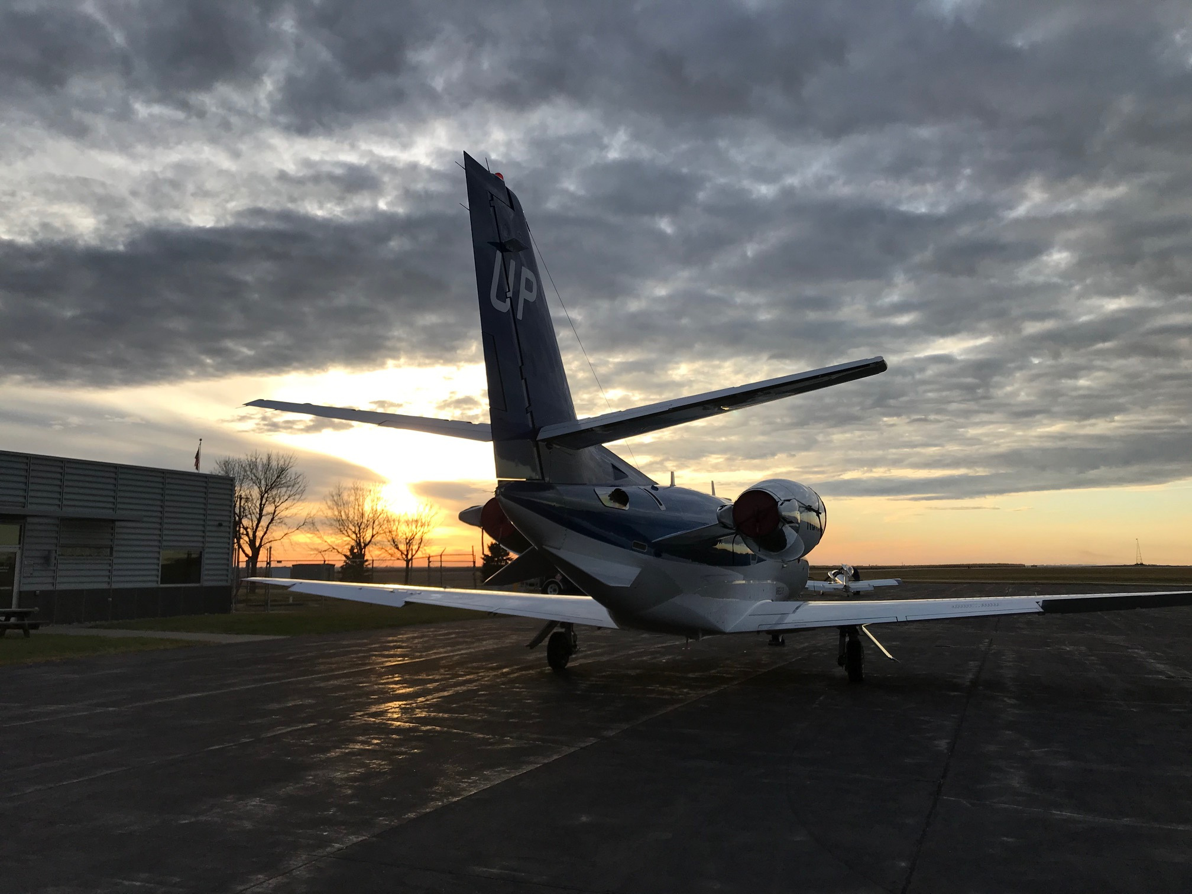
QUESTIONS?

