Slide 1
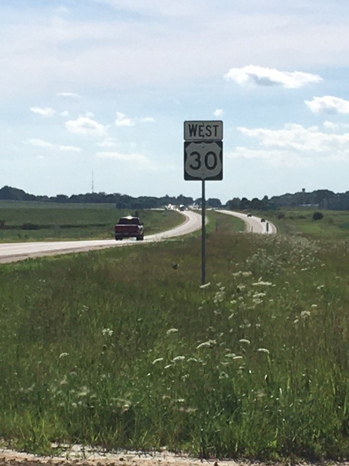
City of DeWitt and the DeWitt Chamber & Development Company
EAST INDUSTRIAL STREET AND OTHER LOCAL PROJECTS

Slide 2
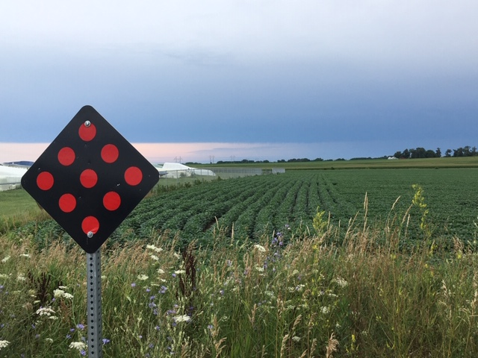
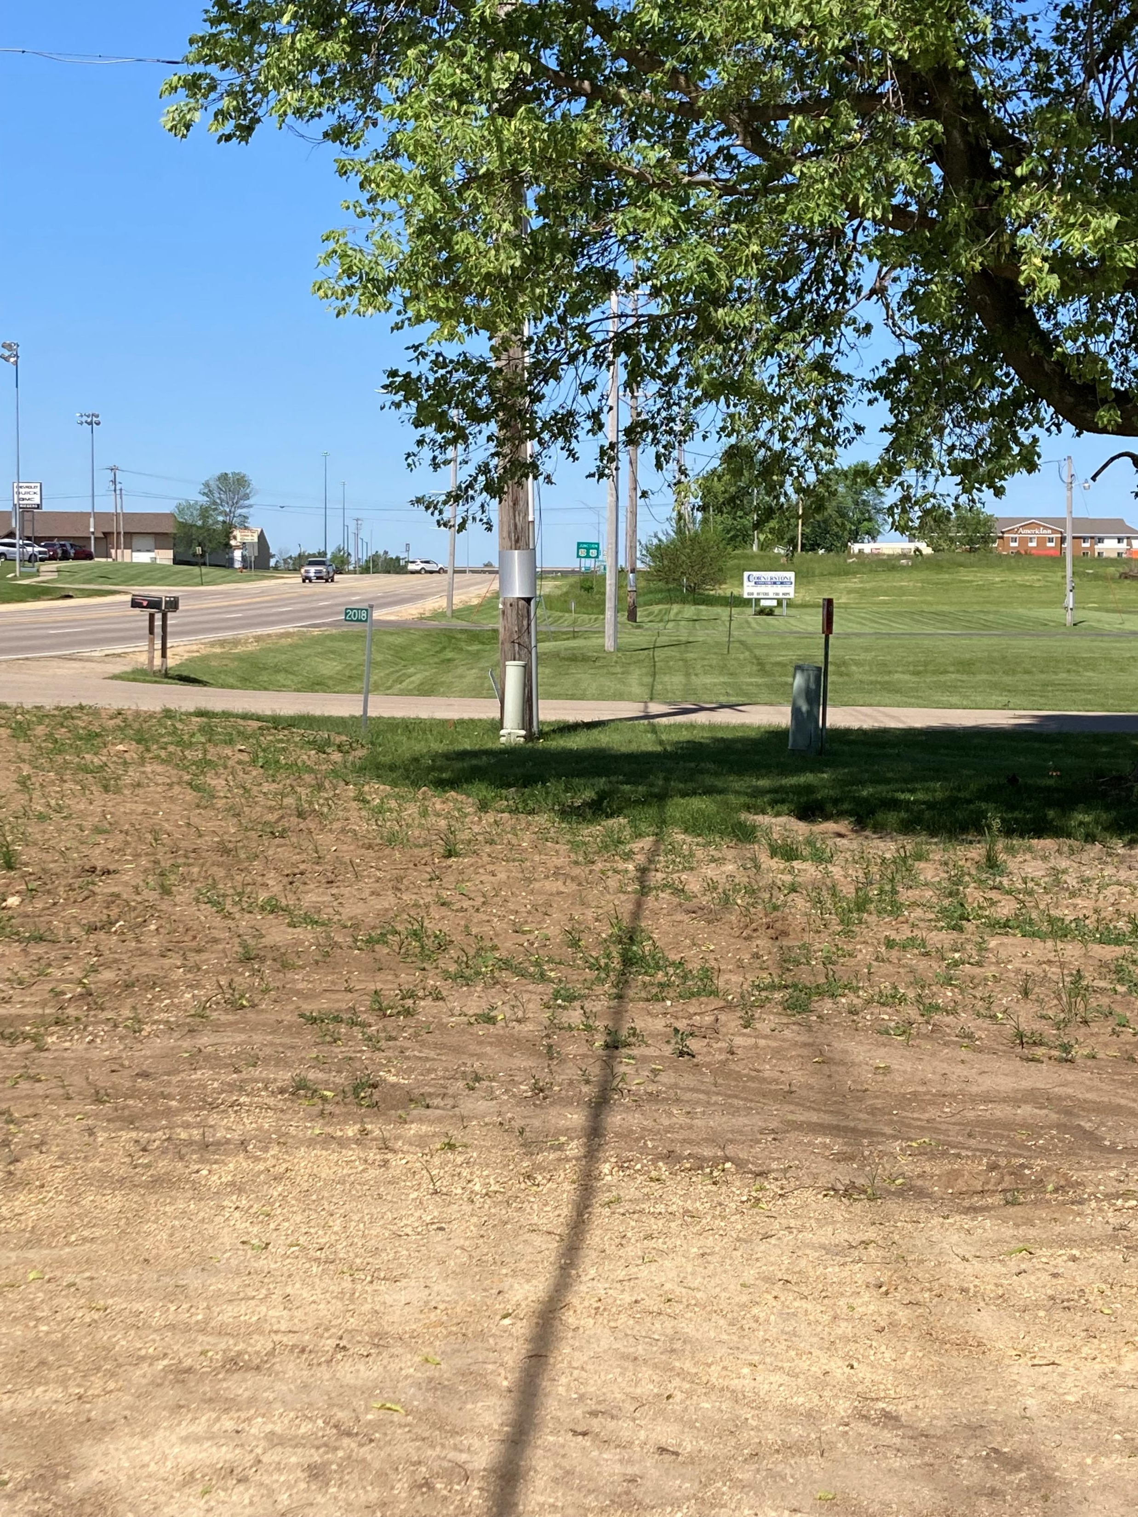
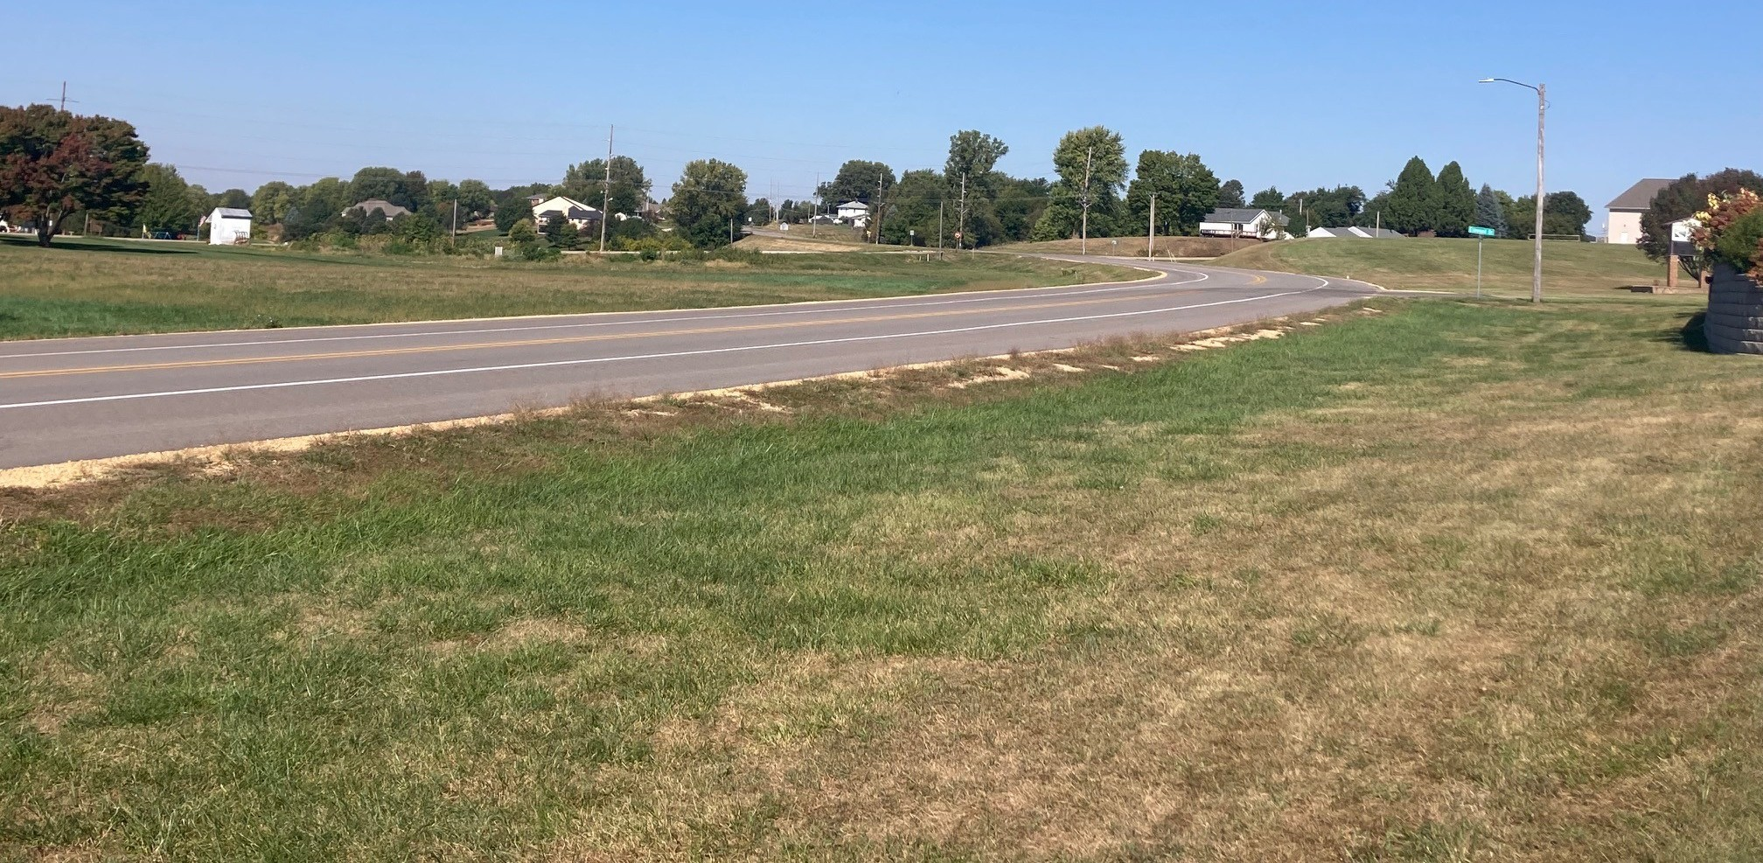
Agenda
A. 6th Avenue/North Ridge Road Project
B. Paul Skeffington Trail Extension
C. East Industrial Street Project
  1. RISE
  2. TSIP

Slide 3
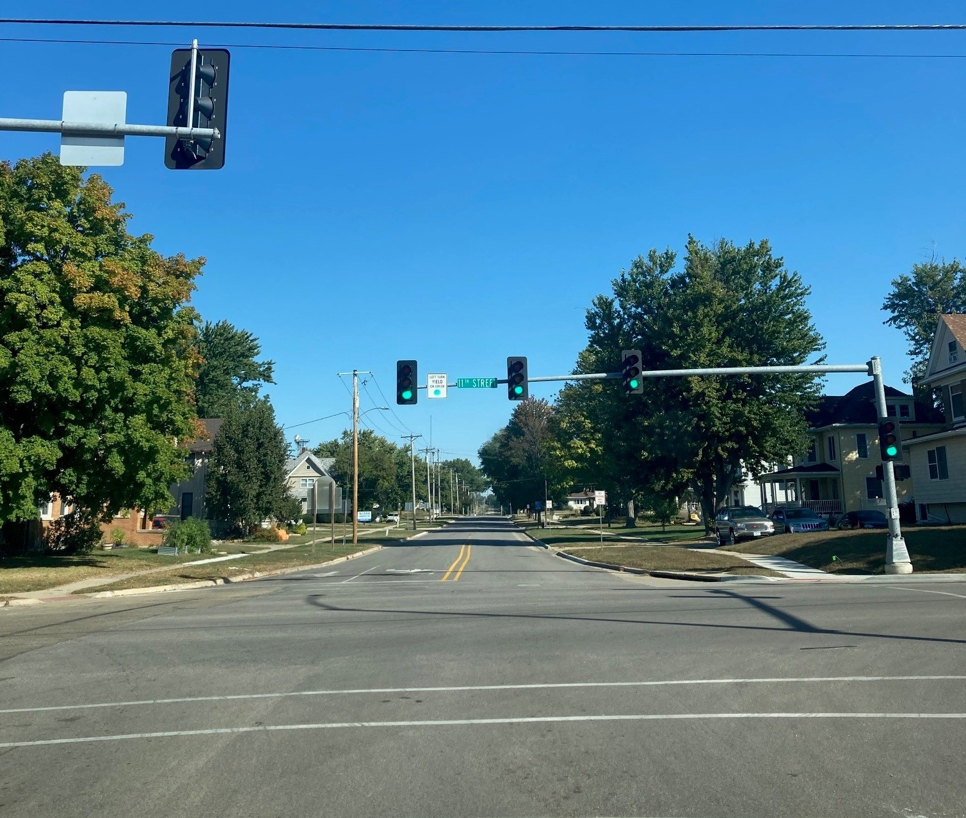
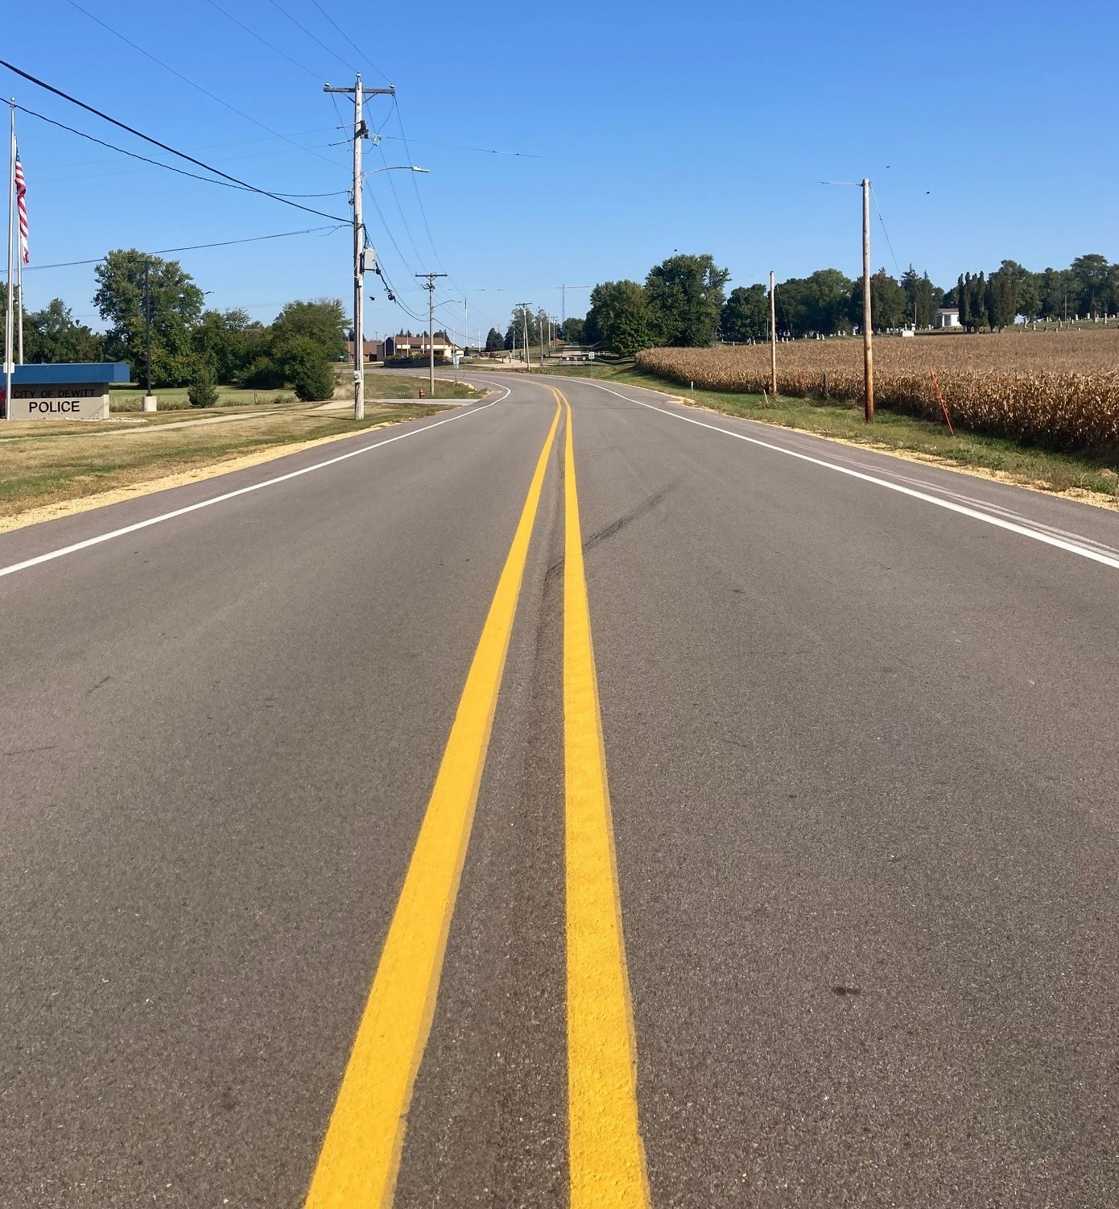
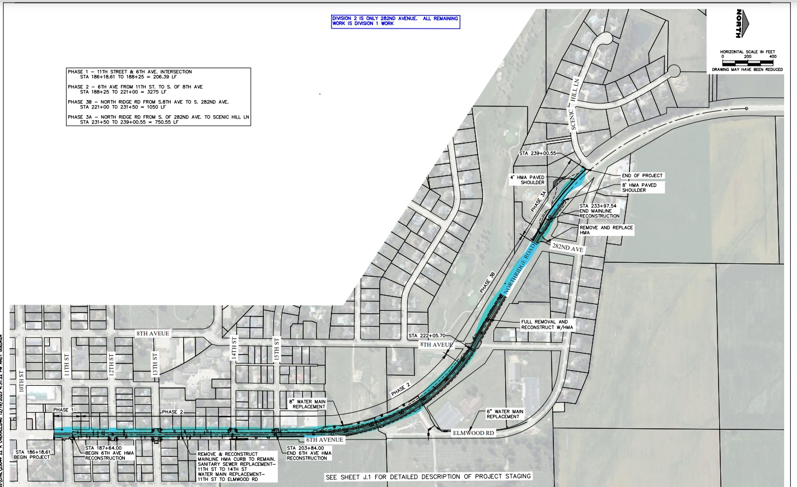
6th Avenue/Northridge Road 2024
$2.97 million project
$700,000.00 STBG SWAP Funds
1.3 miles of HMA pavement replacement
6 blocks of new utilities
Main north/south route
Entrance to Downtown
THANK YOU

Slide 4
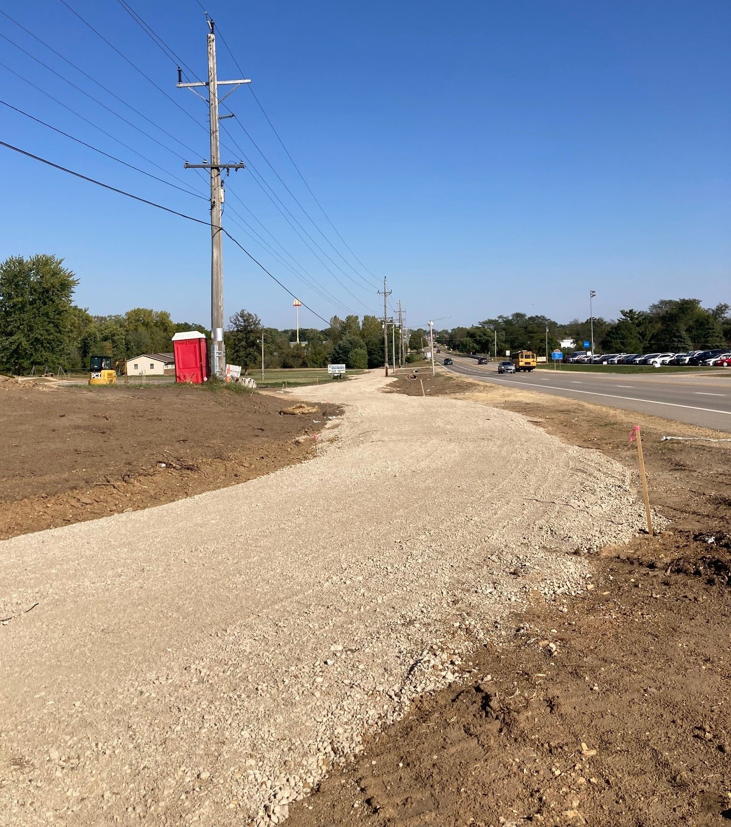
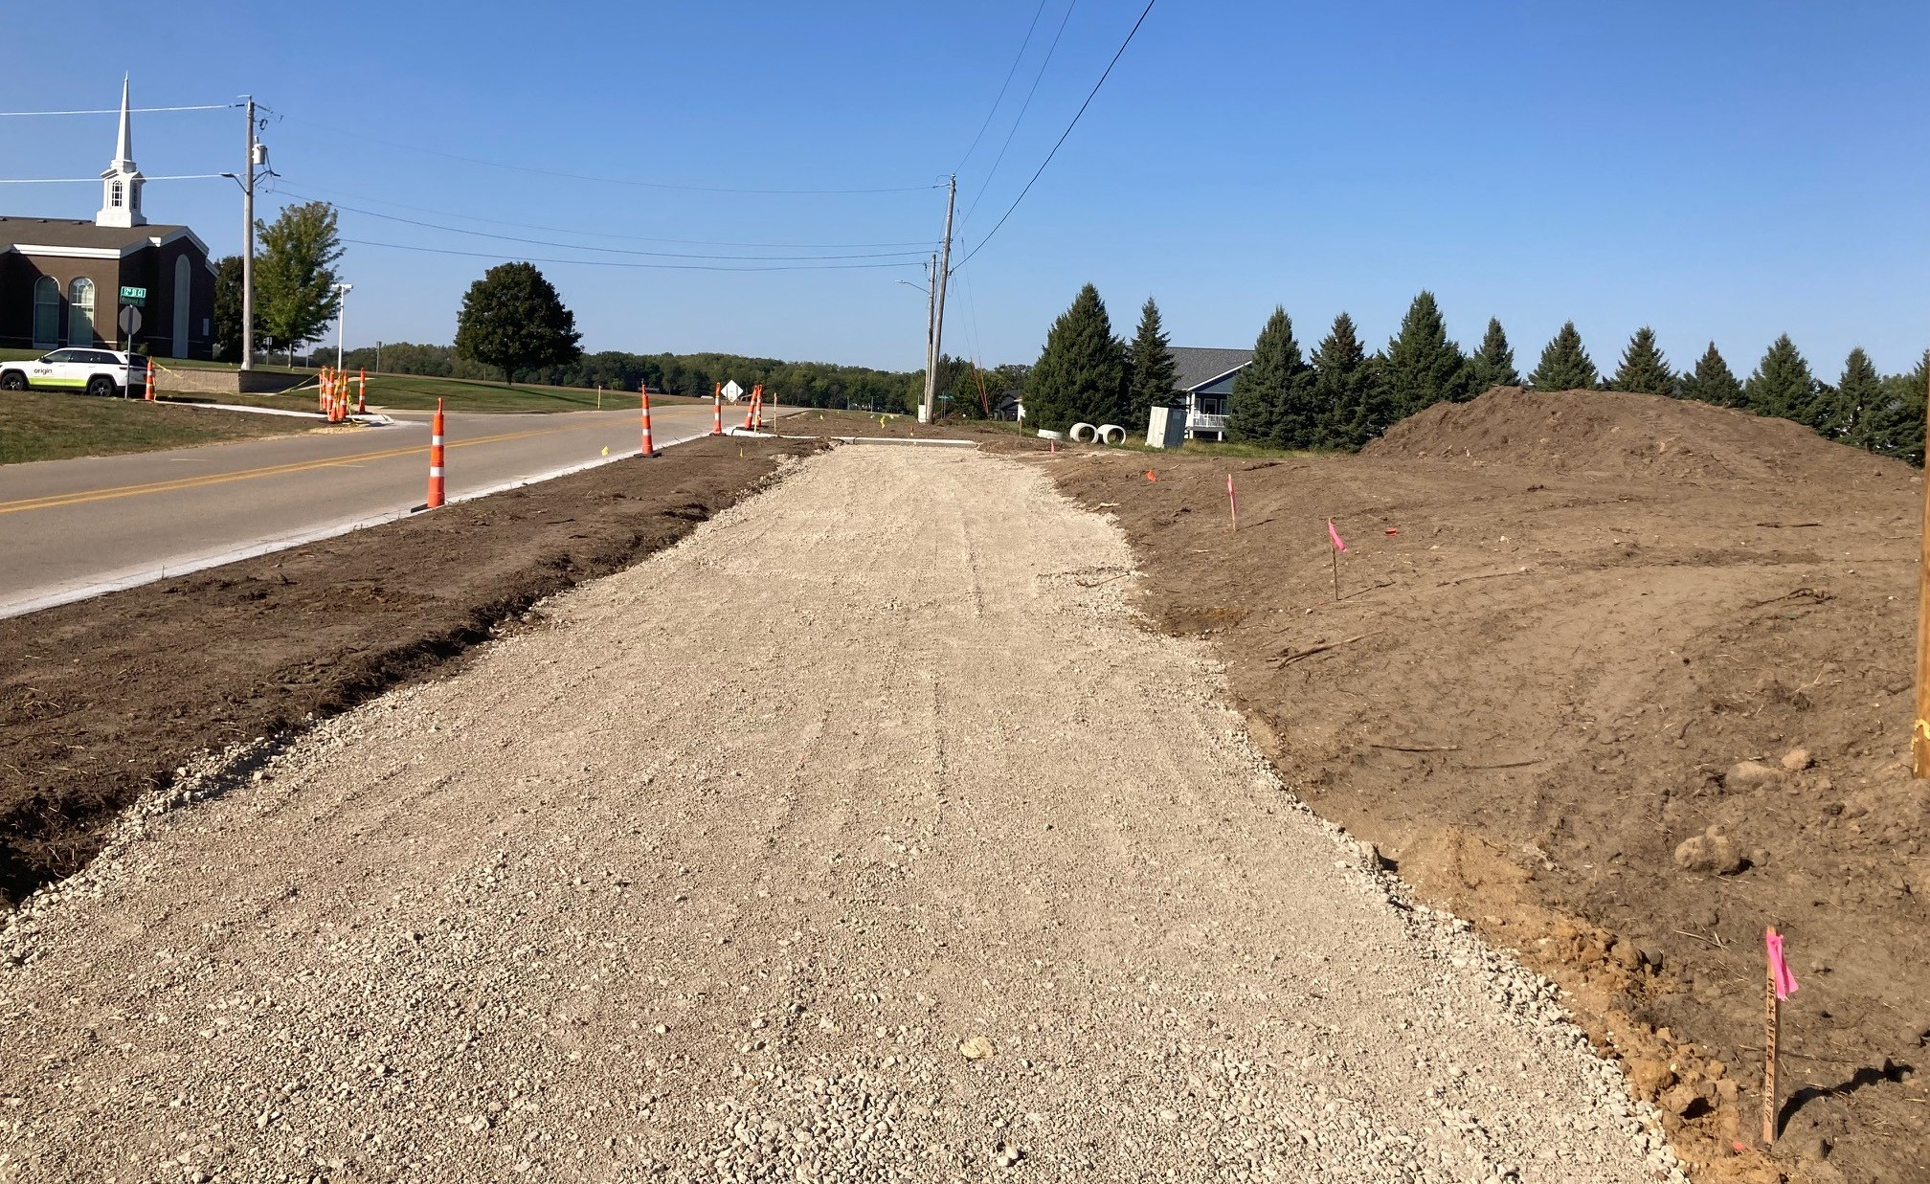
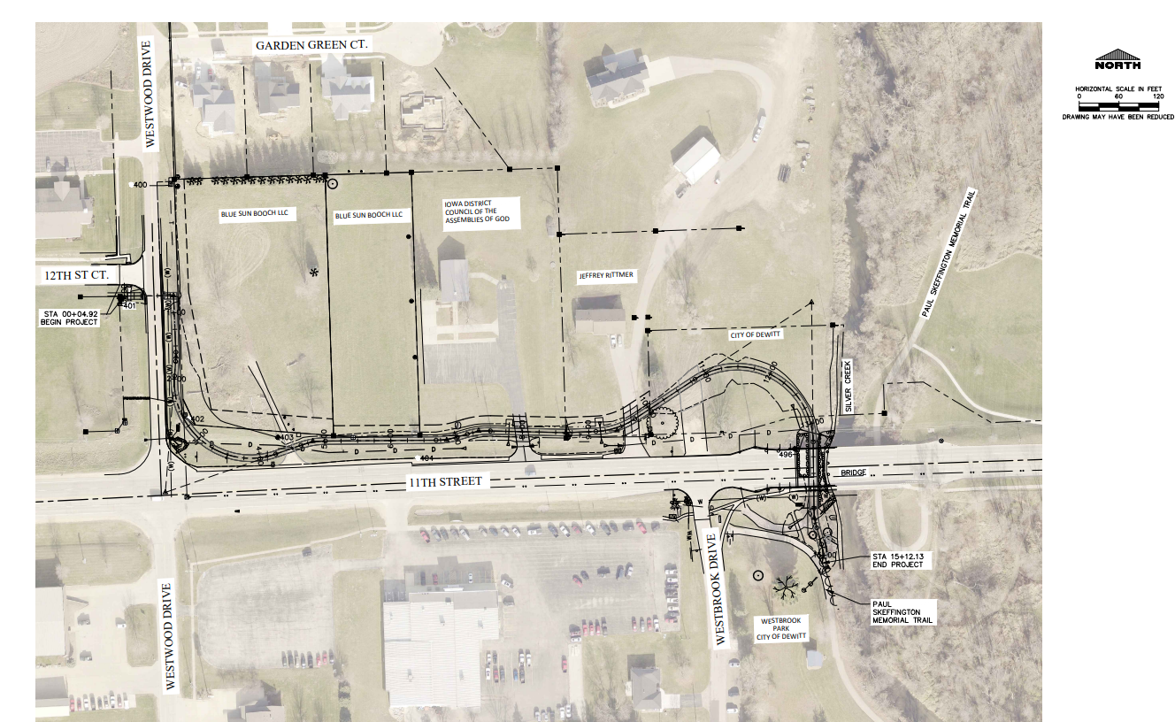
$725,000 project
$250,000 IDOT TAP Funds
New trail extension
Connects developing areas with Westbrook Park
Takes pedestrian traffic & bike traffic off the city’s busiest road
Safely connects new residential & business areas to rest of DeWitt
THANK YOU
Paul Skeffington Memorial Trail Extension 2025

Slide 5
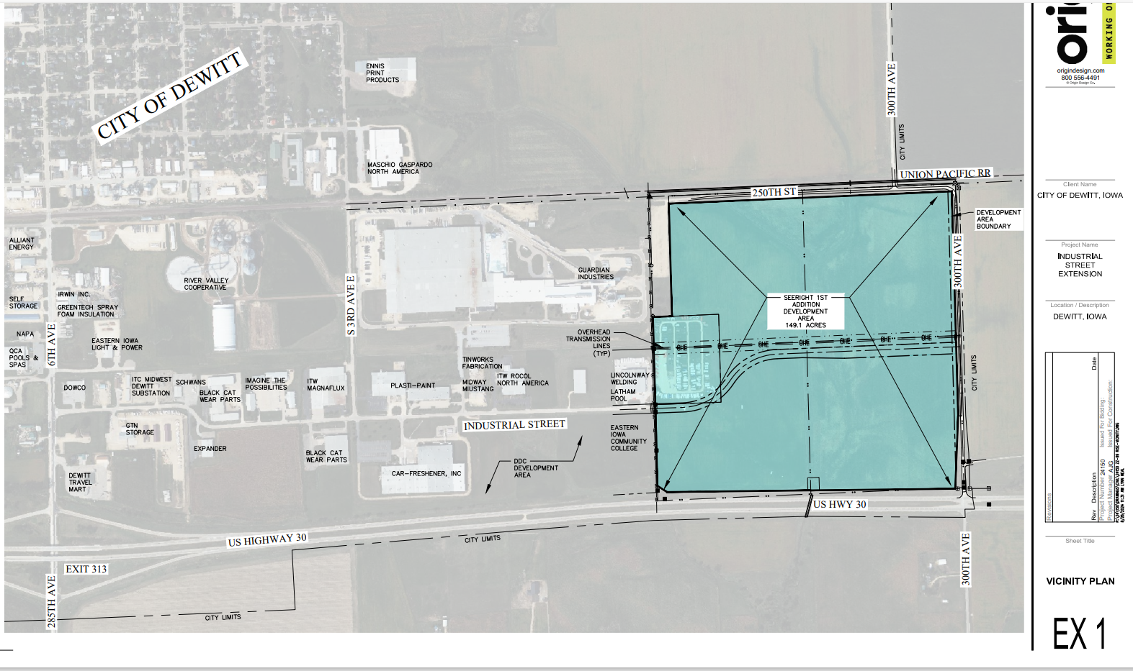
East Industrial Street Extension Project

Slide 6
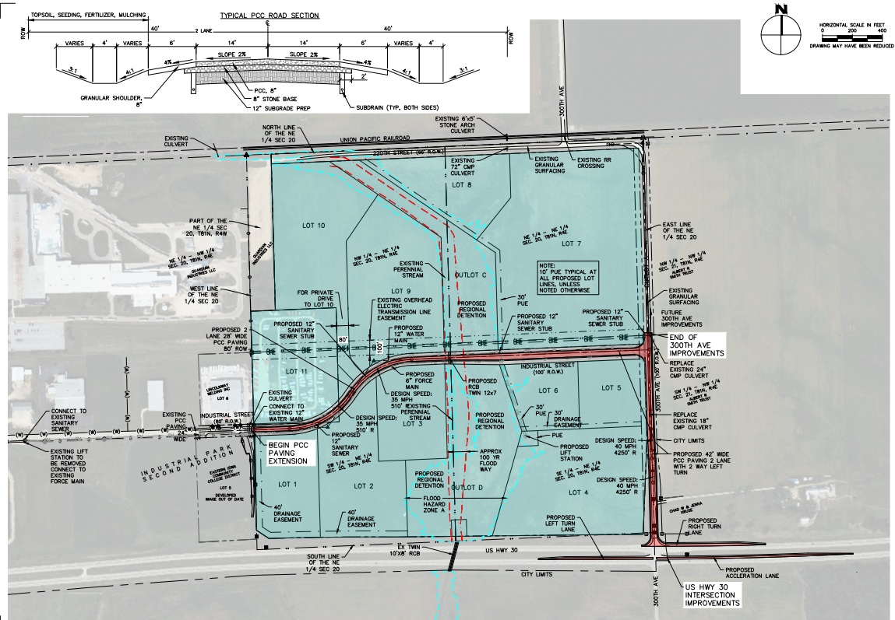
EAST INDUSTRIAL STREET EXTENSION PROJECT
Over ½ mile extension of Street and Utilities
Connects E. Industrial St. to US 30 via 300th Ave.
Extension of Industrial Park – 119 developable acres
RISE Grant Funded the last Industrial Street Extension, Constructed in 2004
DeWitt Development Company has sold every available acre in the existing Industrial Park
Around 1200 jobs in the existing Industrial Park
Goal to create an additional 1200 jobs in the next 15 years

Slide 7
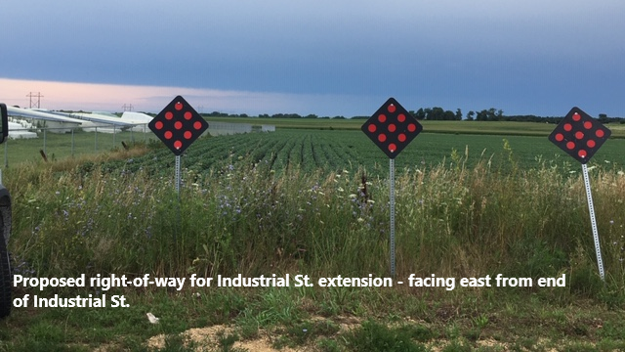
ESTIMATED TOTAL PROJECT COST: $9.5 million
RISE Request: $2.5 million
TSIP Request: $500,000
FEDERAL FUNDS ACQUIRED:
$3.4 million
LOCAL FUNDS COMMITTED:
$3.1 million

Slide 8
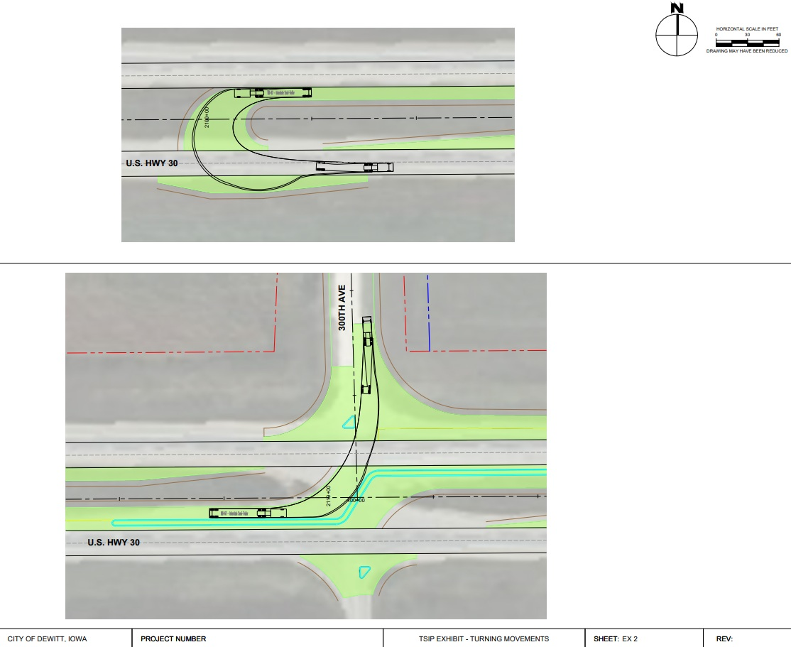
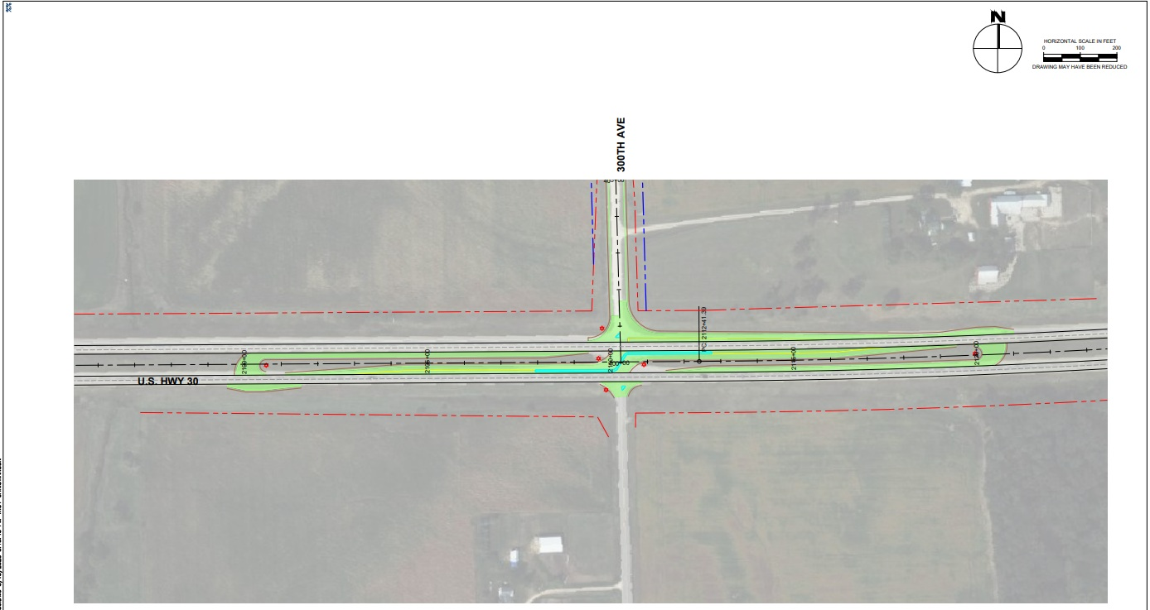
TSIP REQUEST:
R-Cut Solution proposed for US 30 & 300th Avenue Intersection
Maximizes access
Allows for redundant ingress/egress for Industrial Park
Provides safer turns for large trucks

Slide 9
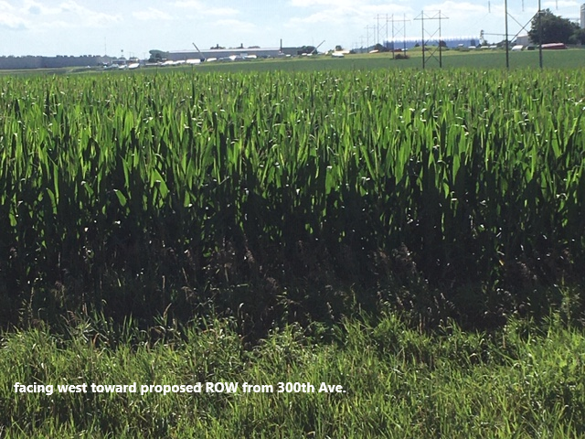
Thanks for your time!

