Slide 1
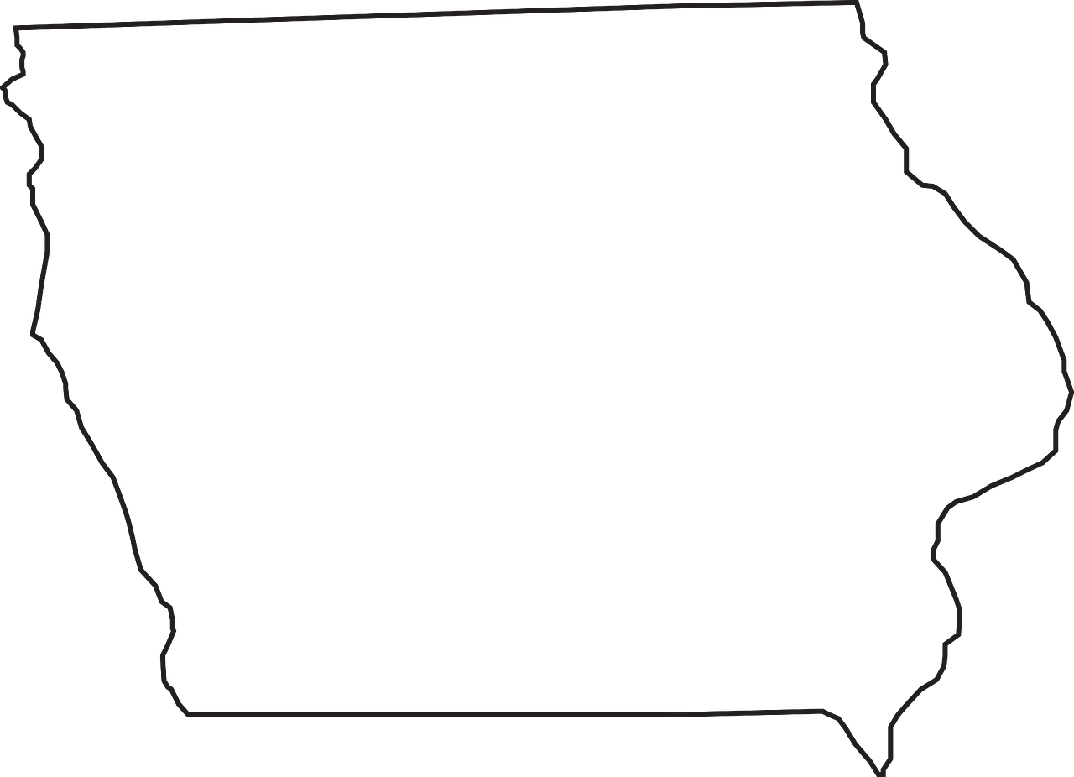





Iowa Transportation Commission
Public Input Meeting, Clinton, IA, 14 Oct 2025
IOWA PORTS
ASSOCIATION
Serving the Rural, Regional, Inland Ports on
Iowa’s East and West Coasts

Slide 2
Bottom Line
Request the Iowa Transportation Commission recognize the Iowa Ports Association similar to how the State Departments of Transportation recognize the ports associations in Illinois, Missouri, Wisconsin, and Minnesota.

Slide 3

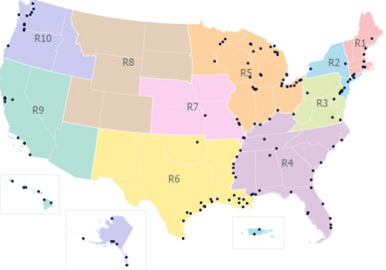
Inland Ports Black Hole
“U.S. Principal Ports” Map
A perceived
Rural injustice
Map Used By
Federal Agencies
Prior to 2020
Urban Exploitation
of Rural Areas?

Slide 4


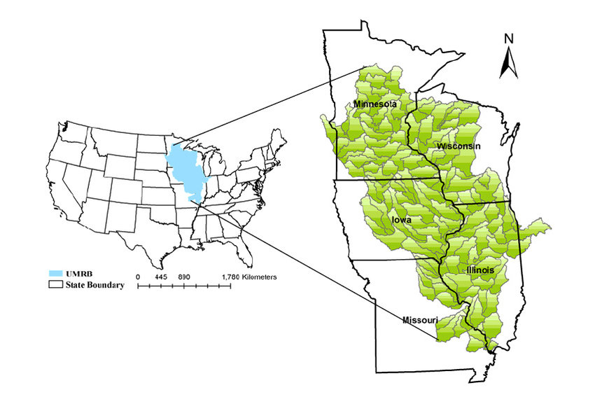



Upper Mississippi River Basin State Ports Associations
Iowa Was
Missing
X
Pre 2025

Slide 5
Upper Mississippi River Basin Ports Associations (2025)
Today

Slide 6

Iowa is the #2 Agriculture
Product Export State in the U.S.
Competing in the Current Export Market
Requires Modern Inland Ports
Iowa plays a crucial role in the U.S. export landscape, particularly in agriculture and manufacturing. The state's ability to adapt to changing global markets and maintain a diverse export portfolio is vital for its economic health and job creation. The continued growth in exports reflects Iowa's strategic importance in international trade.
https://www.worldstopexports.com/iowas-top-10-exports/#:~:text=Iowa%20generated%20an%20overall

Slide 7
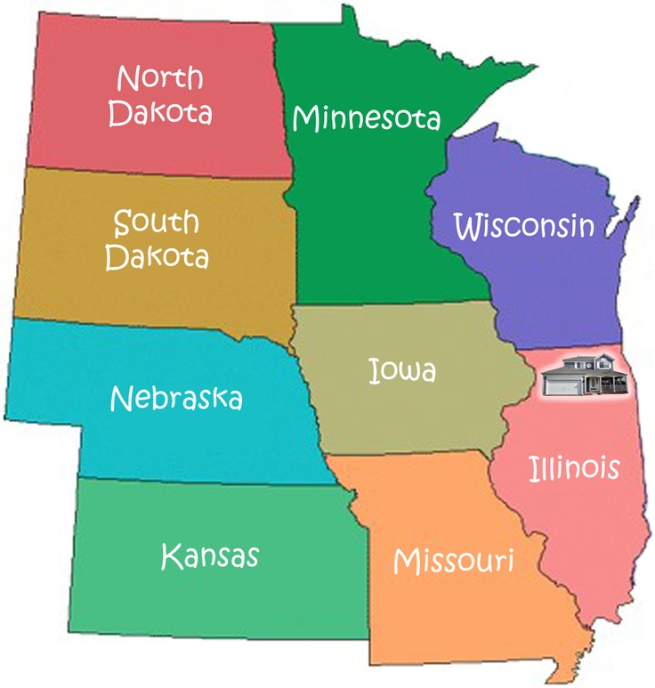
Top 10 U.S. Agriculture
Exporting States
#9
#4
#15
(2023)
#5
#2
#3
Iowa’s
Inland Ports
& Waterways
Serve 5 States
#10
#8
https://www.ers.usda.gov/data-products/state-agricultural-trade-data/annual-state-agricultural-exports

Slide 8
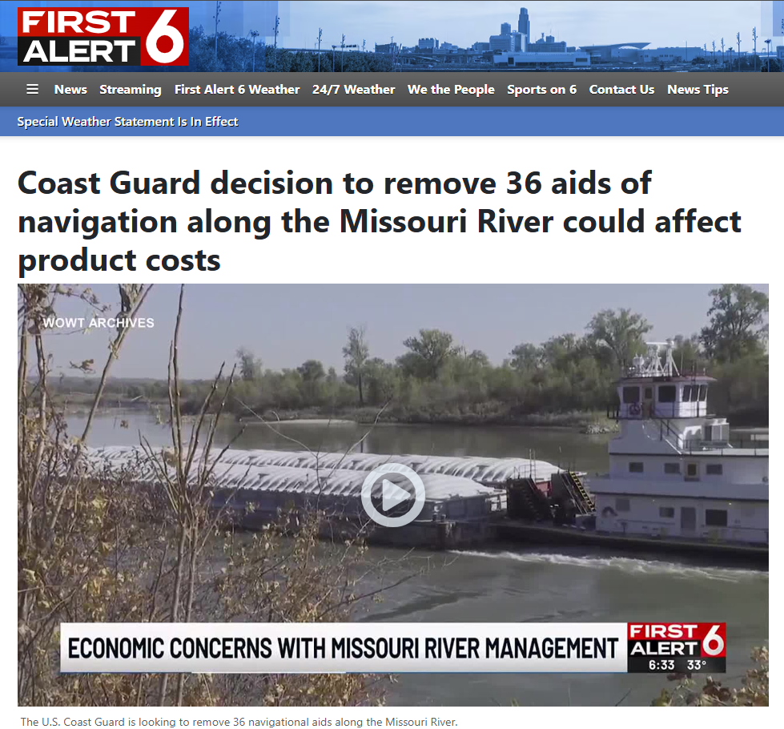
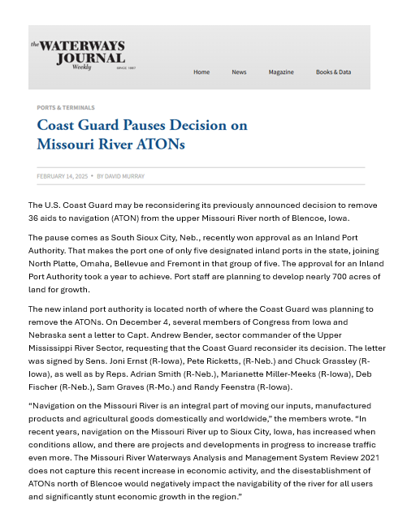
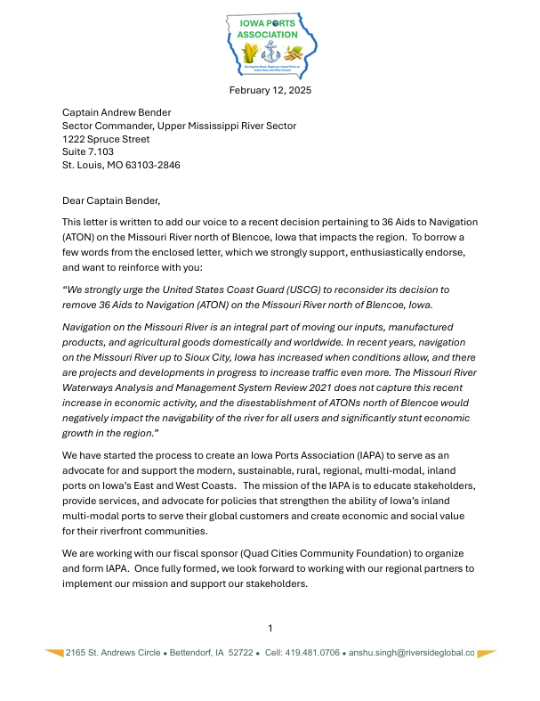
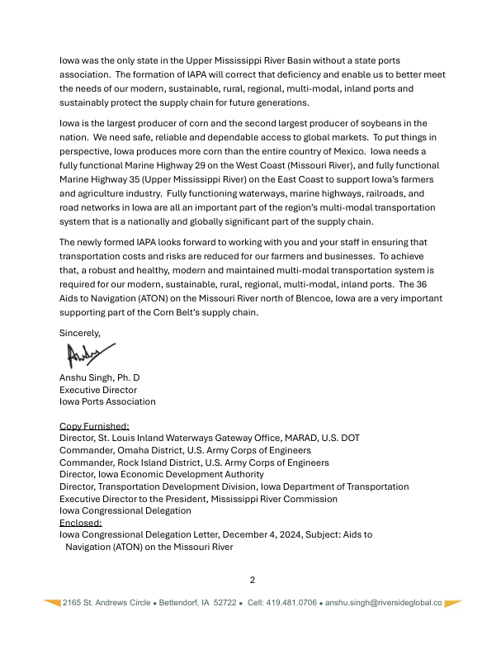

Slide 9
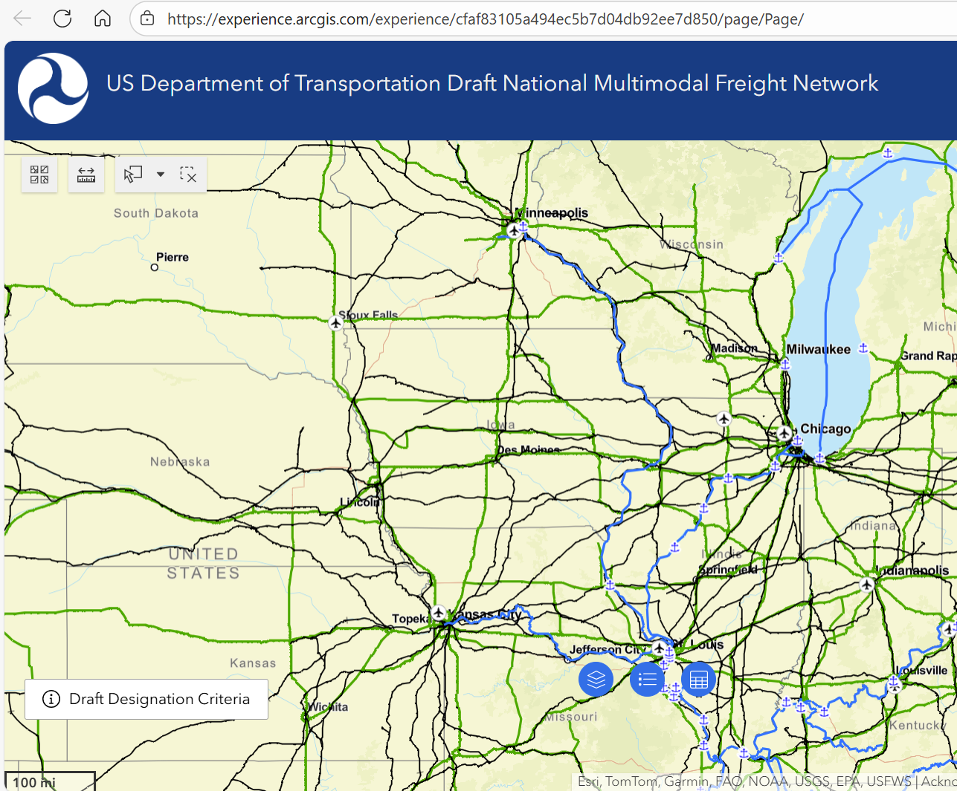
Feb 2025
Iowa Ports
Missing

Slide 10
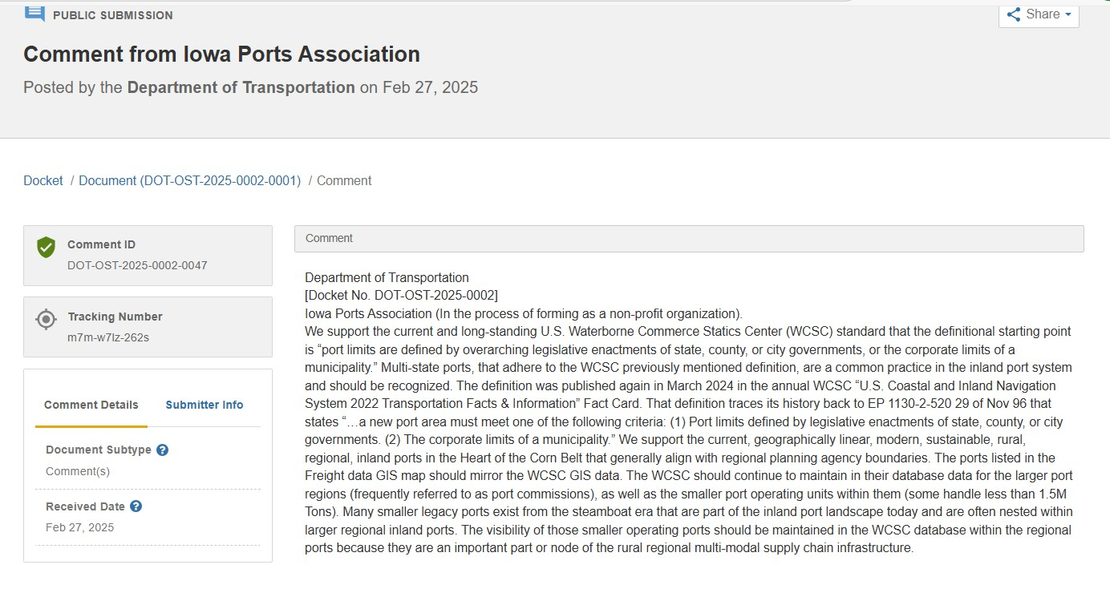

Slide 11
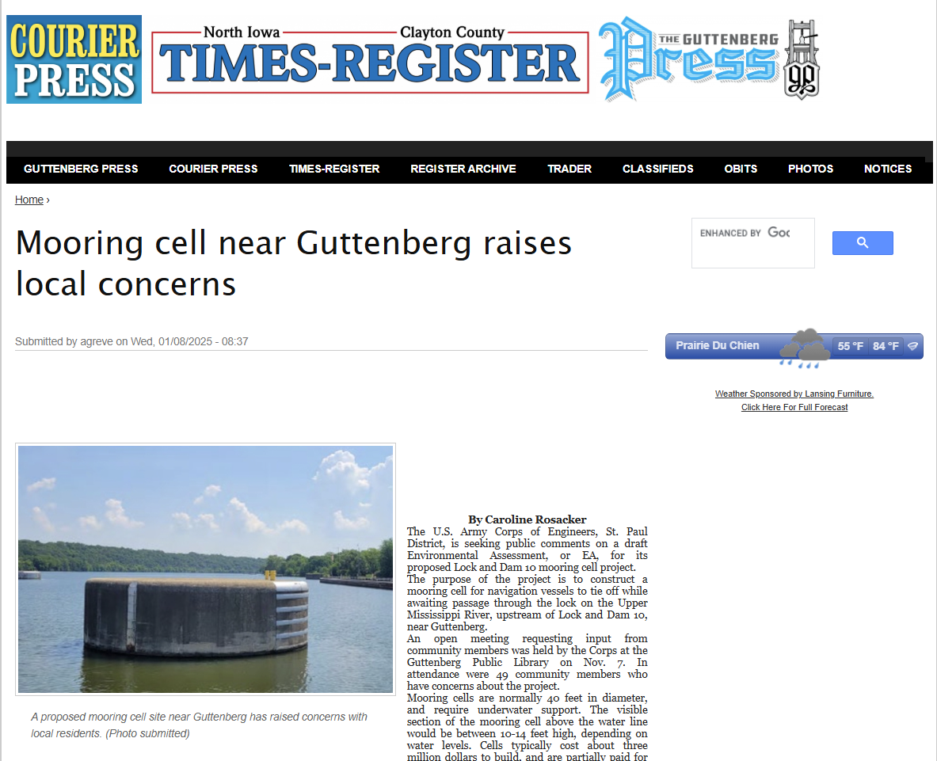

Slide 12
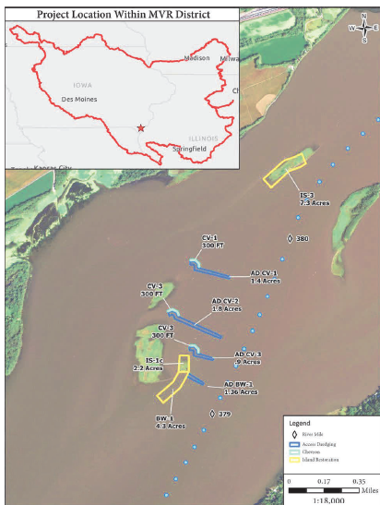
Aquatic Ecosystem Restoration in Lee County, IA Section 204 Project
Feasibility Report with Integrated Environmental Assessment- approved in Feb 2025
Project Partnership Agreement (PPA) between USACE, Rock Island District and Lee County Conservation Board and Iowa Ports Association (Non-Federal Sponsors)- in progress

Slide 13
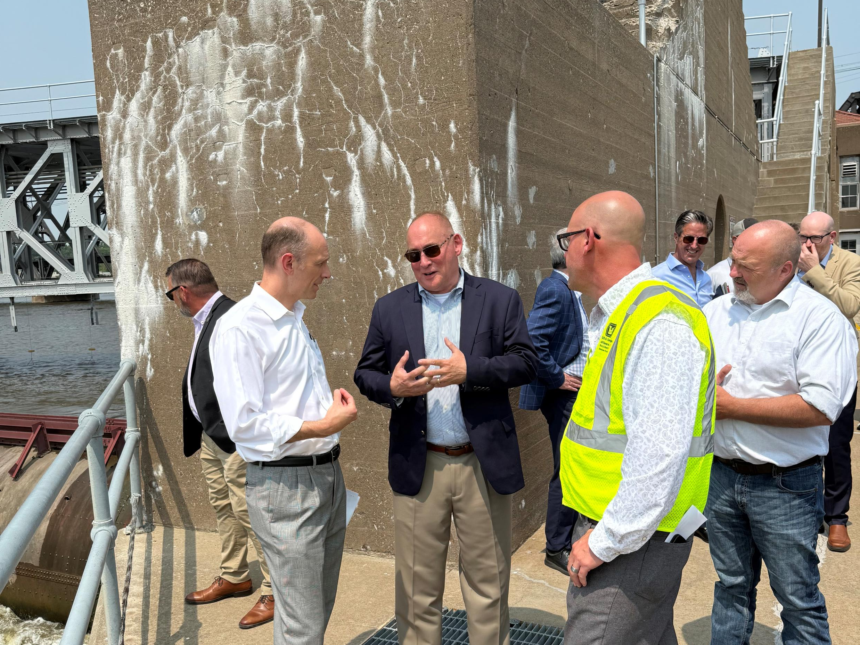

Locks and
Dam 15
June 2, 2025

Slide 14
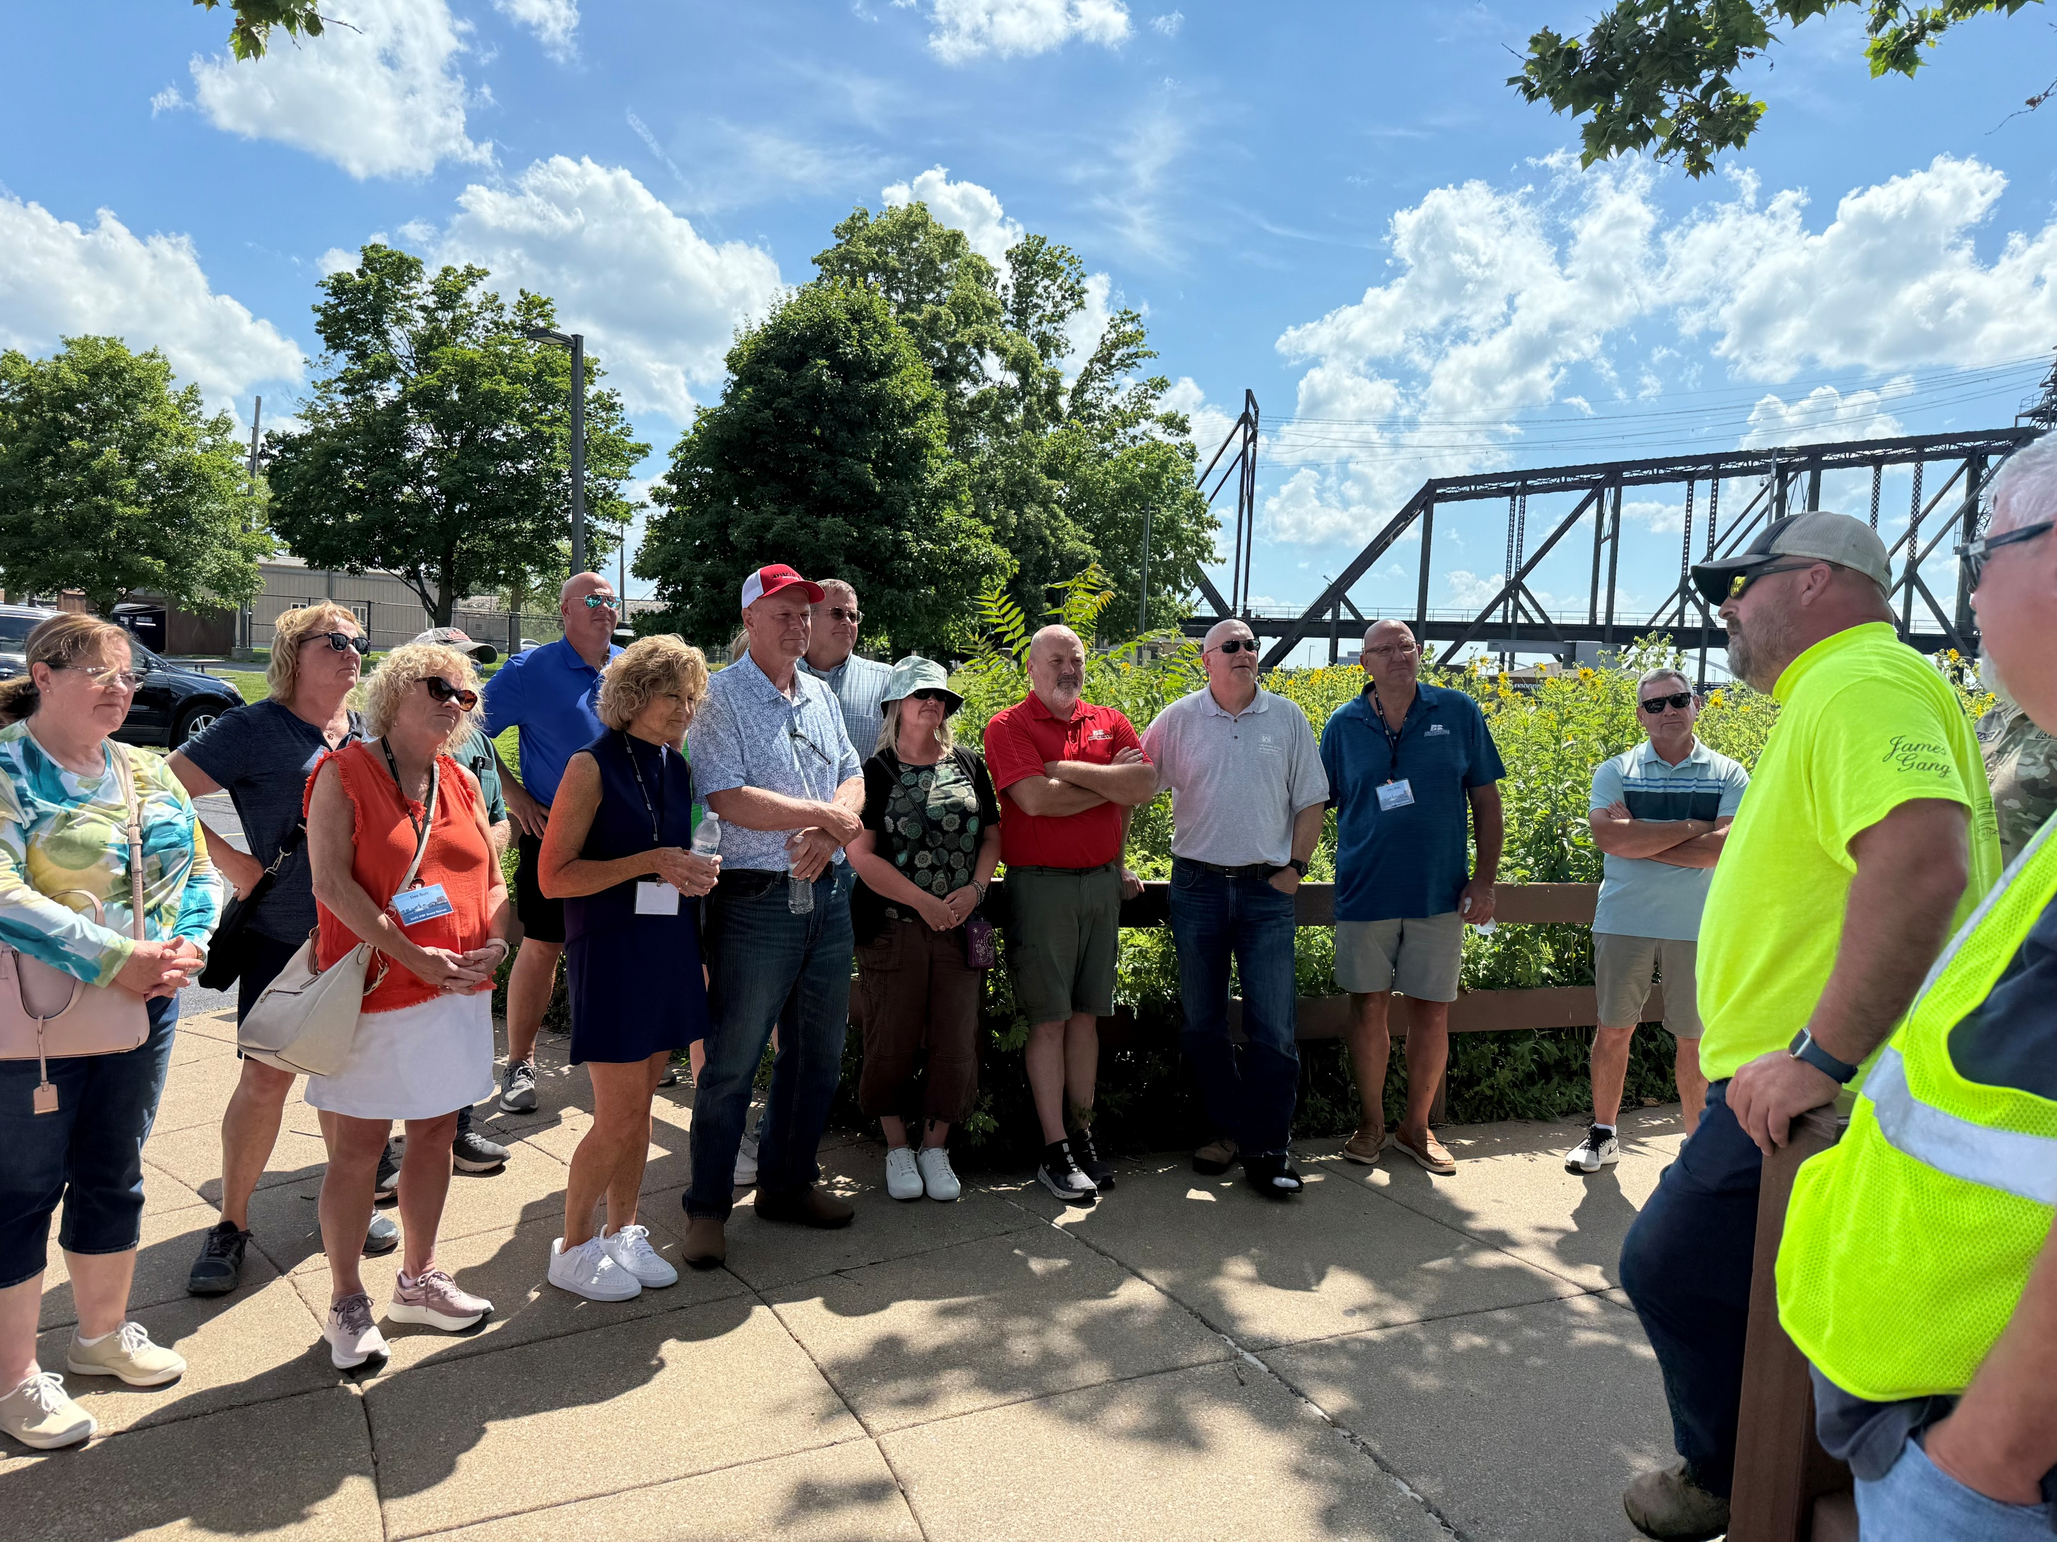

Locks and
Dam 15
Locks and
Dam 15
June 26, 2025

Slide 15
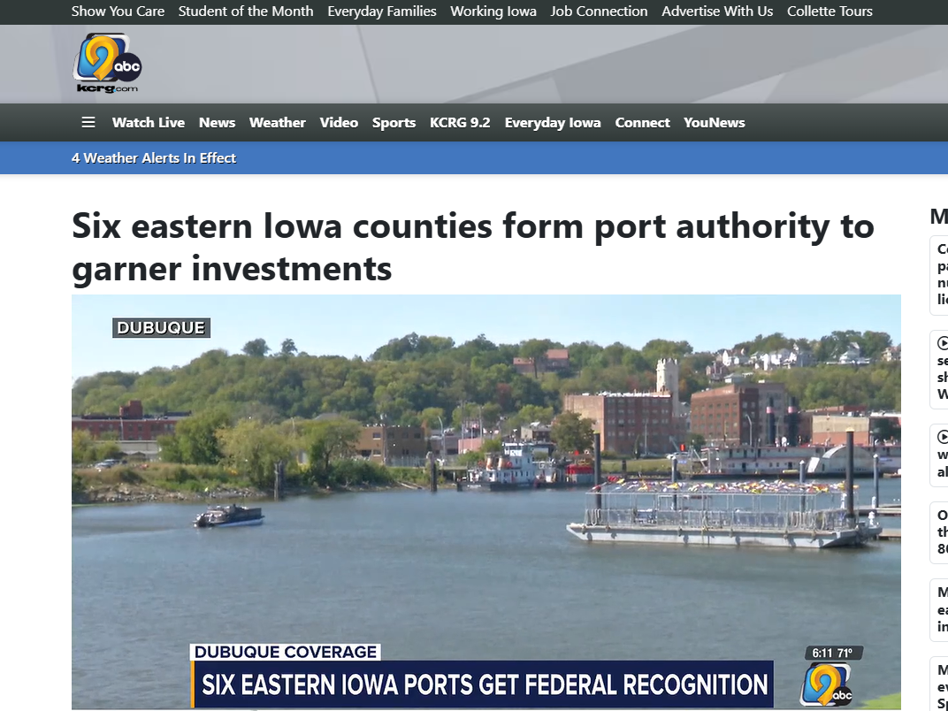


Slide 16


Dr. Anshu Singh
Executive Director
Iowa Ports Association
anshu.singh@cornbeltports.com

Slide 17

IOWA PORTS
ASSOCIATION
Serving the Rural, Regional, Inland Ports on
Iowa’s East and West Coasts

