Slide 1
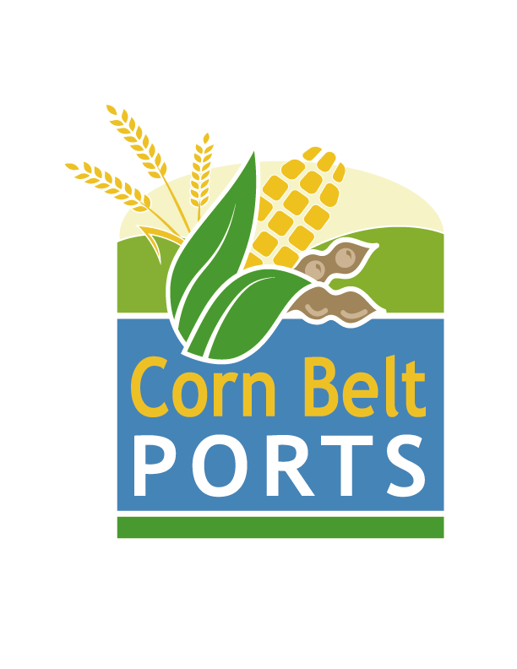
Corn Belt Ports
What is a Corn Belt Port Region?
Regional
Ports
Within the
Lock & Dam
System
Protecting the
Integrity of
Our Supply
Chain
A Major Navigation & Ecosystem Sustainability
Program (NESP) Enabler and Supporter…
17 Apr 2024

Slide 2
Bottom Line
Request the Iowa Transportation Commission recognize the Ports of Eastern Iowa within the Corn Belt Ports Framework.
Request the Iowa Transportation Commission Look at Supporting the Ports of Western Iowa.

Slide 3
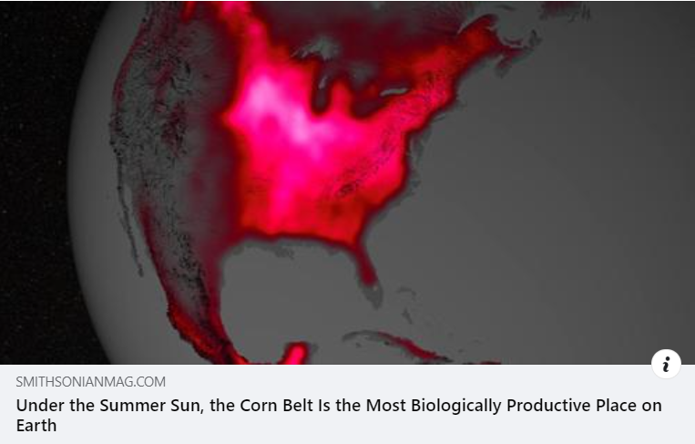
Corn Belt Ports
Protects
Our Supply
Chain for Future
Generations
https://www.smithsonianmag.com/smart-news/under-summer-sun-midwest-corn-belt-most-biologically-productive-place-earth-180950460/

Slide 4
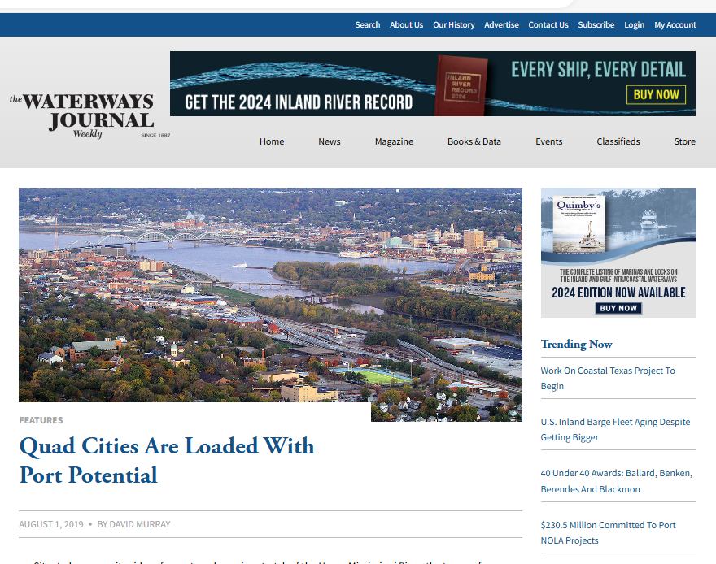
This Article Gave Birth to the Corn Belt Ports
https://www.waterwaysjournal.net/2019/08/01/quad-cities-are-loaded-with-port-potential/

Slide 5
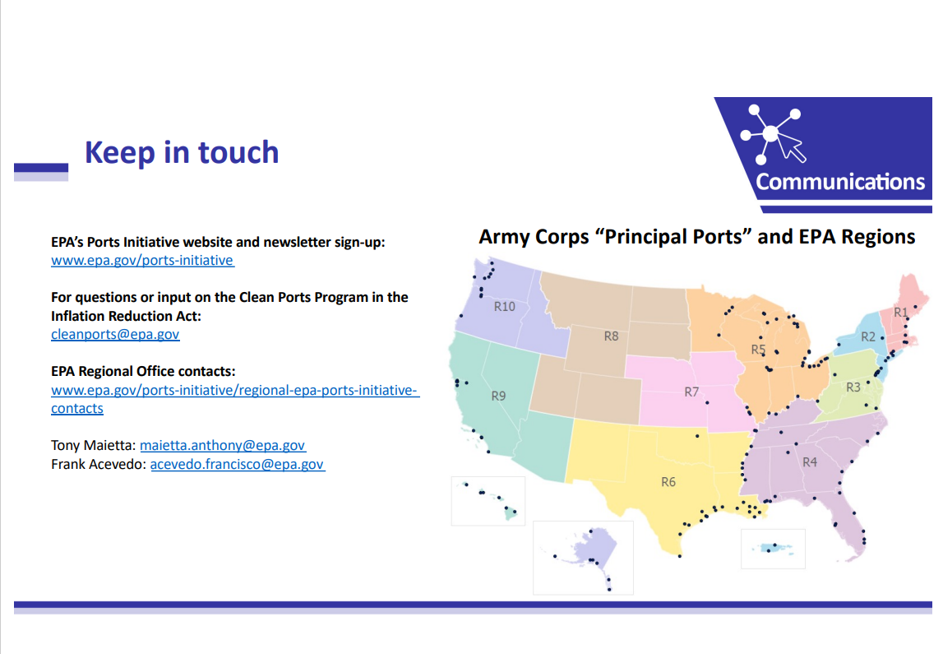
Inland Ports Black Hole
Corrected A
perceived
Rural injustice
Presented by EPA Region 5 on 28 July 2023

Slide 6
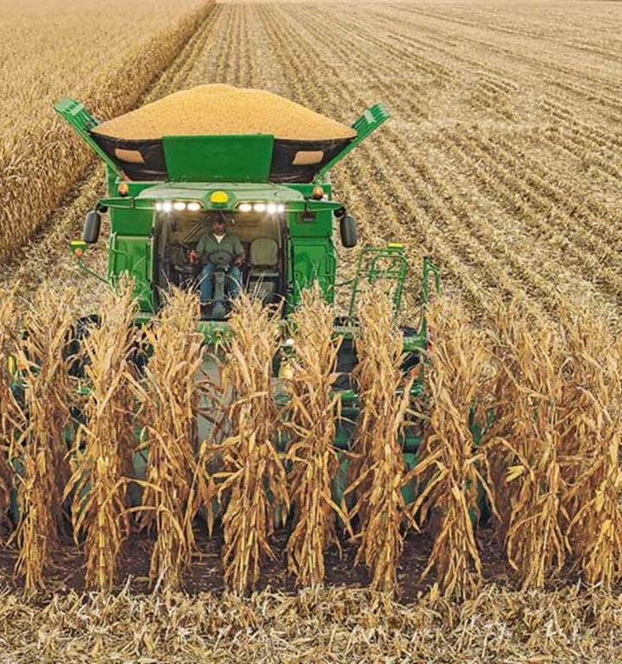
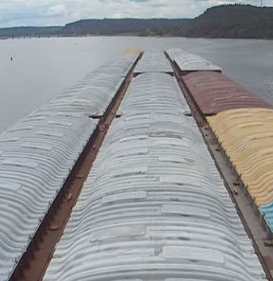
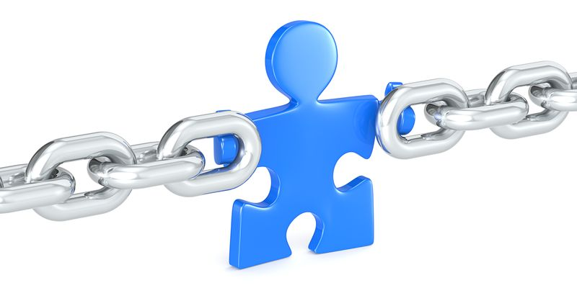
Rural, Regional, Multi-Modal, Linear, Inland Ports Have Been the Missing Link
Farmers Don’t Drive Their Combines to the River to Load Up the Barges

Slide 7
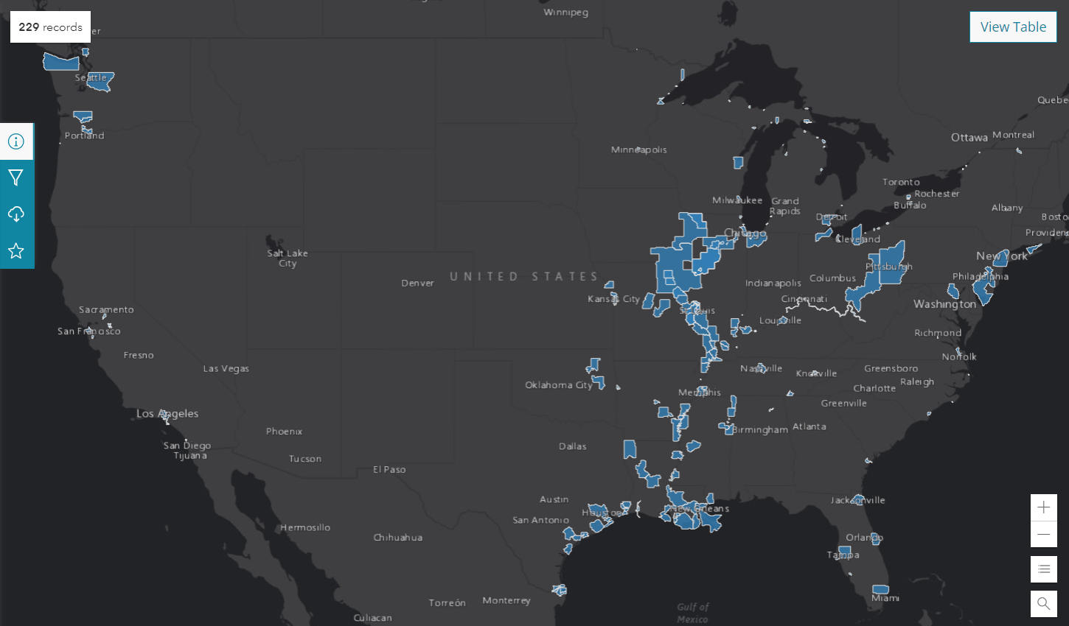
Conspicuously Absent 2019
National Ports GIS Database Map
The Inland Ports
“Black Hole”
(Port Shadow Zone)
+/- 100 Million
Tons of Freight
Ports Missing
Within the
Lock & Dam
System
Being in Flyover
Country is Bad Enough
You can’t Invest in a Port
that Doesn’t Exist
Locks & Dam 26
https://geospatial-usace.opendata.arcgis.com/datasets/b7fd6cec8d8c43e4a141d24170e6d82f_0/explore?location=36.975090%2C-98.856999%2C5.00
https://geospatial-usace.opendata.arcgis.com/datasets/b7fd6cec8d8c43e4a141d24170e6d82f_0/explore?location=36.975090%2C-98.856999%2C5.00

Slide 8
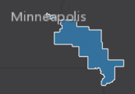
Corn Belt Ports Today
National Ports GIS Database Map
Ports
Within the
Lock & Dam
System
Applied for
and Approved
Locks & Dam 26
https://geospatial-usace.opendata.arcgis.com/datasets/b7fd6cec8d8c43e4a141d24170e6d82f_0/explore?location=36.975090%2C-98.856999%2C5.00

Slide 9
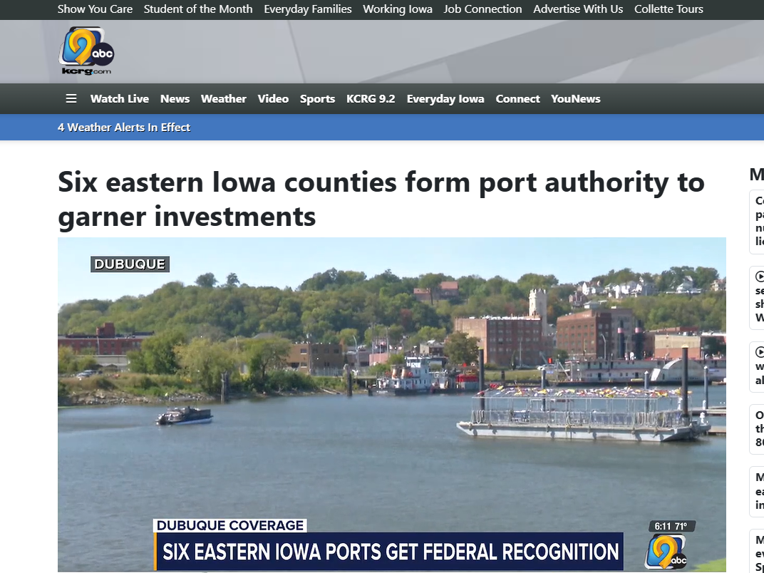


Slide 10


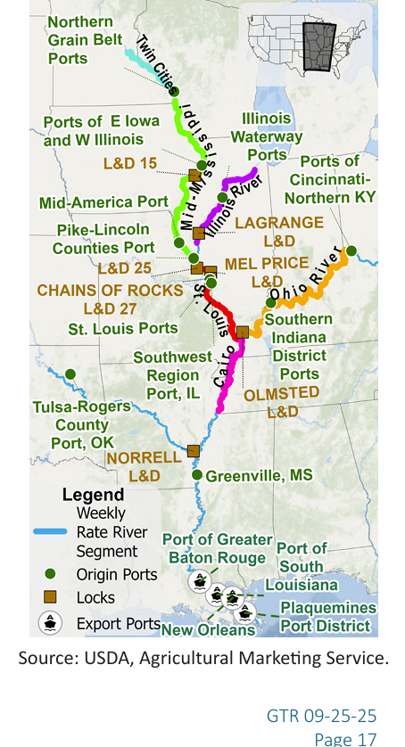
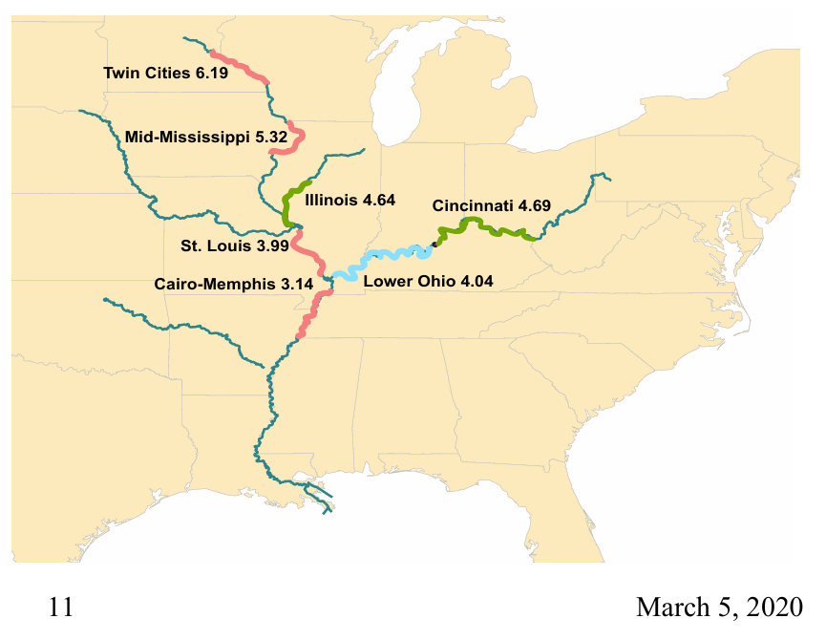
Map With Ports Now
Weekly Grain
Transportation Report
Map Without Ports Then

Slide 11
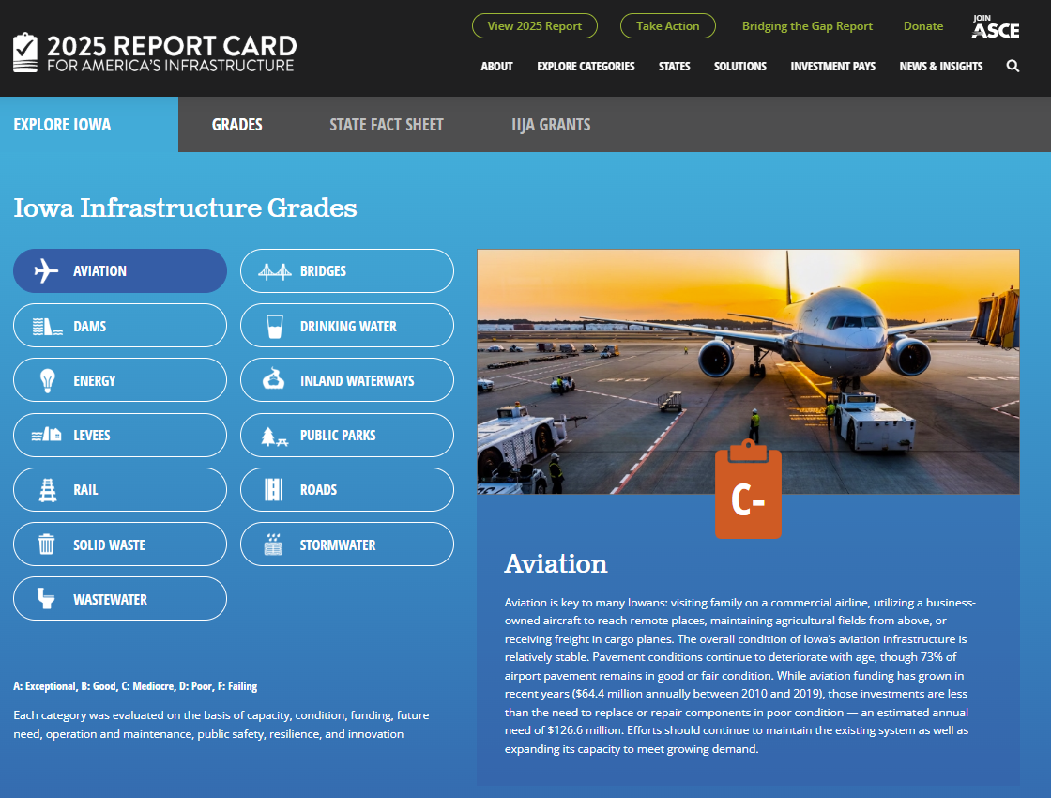
Ports ?

Slide 12
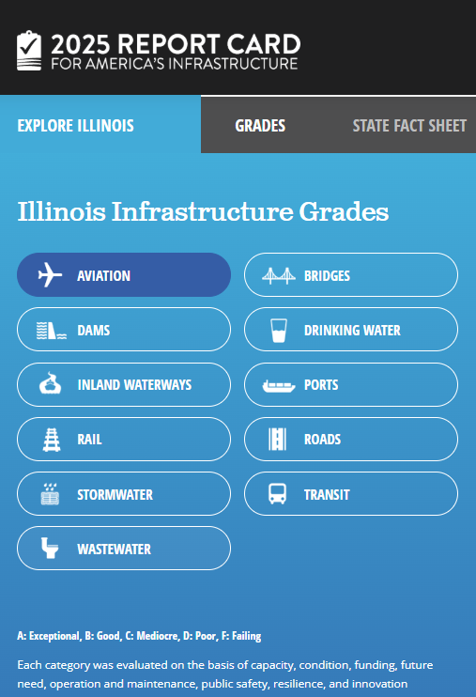
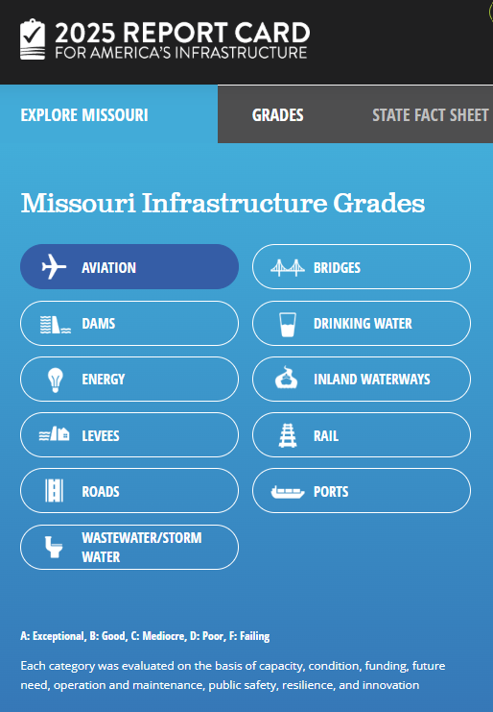
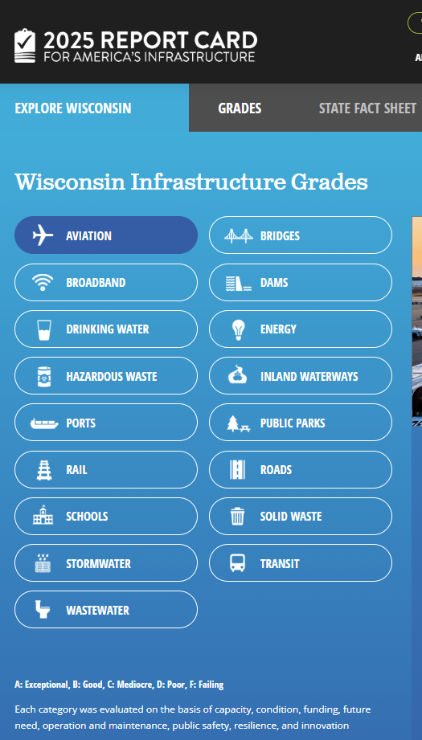
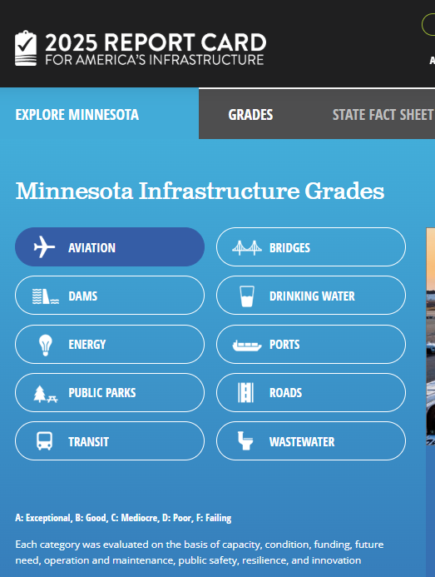



Slide 13
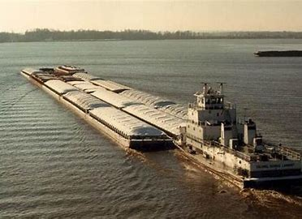
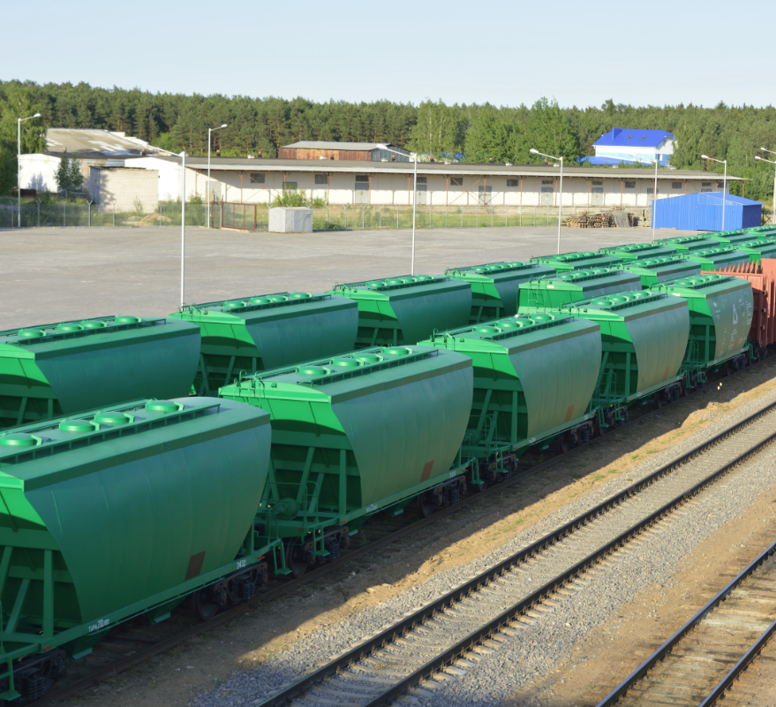

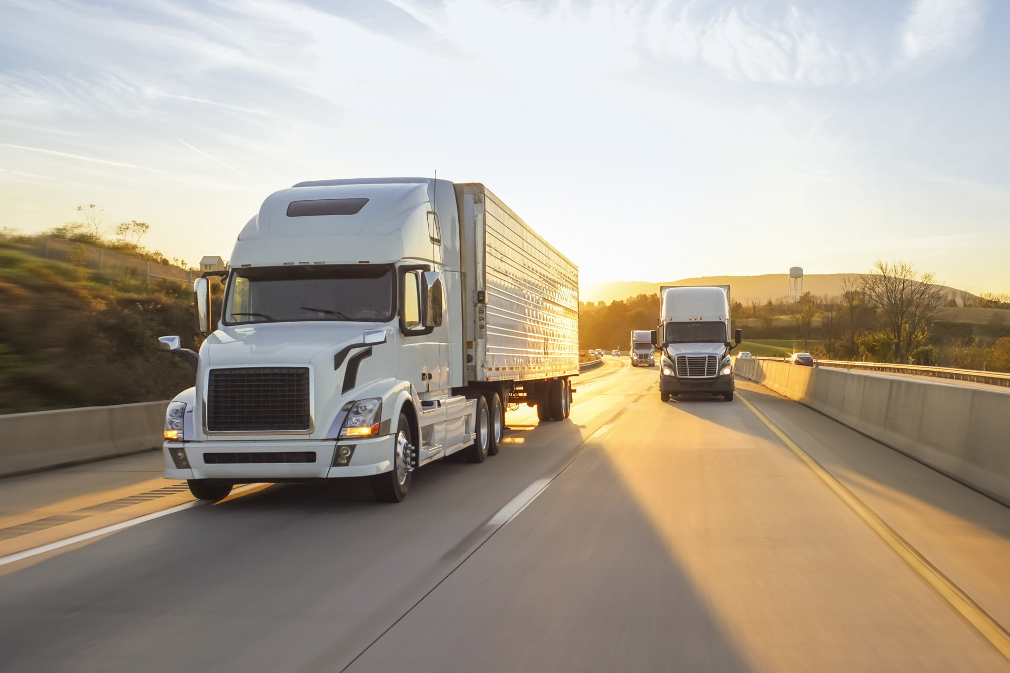


Slide 14
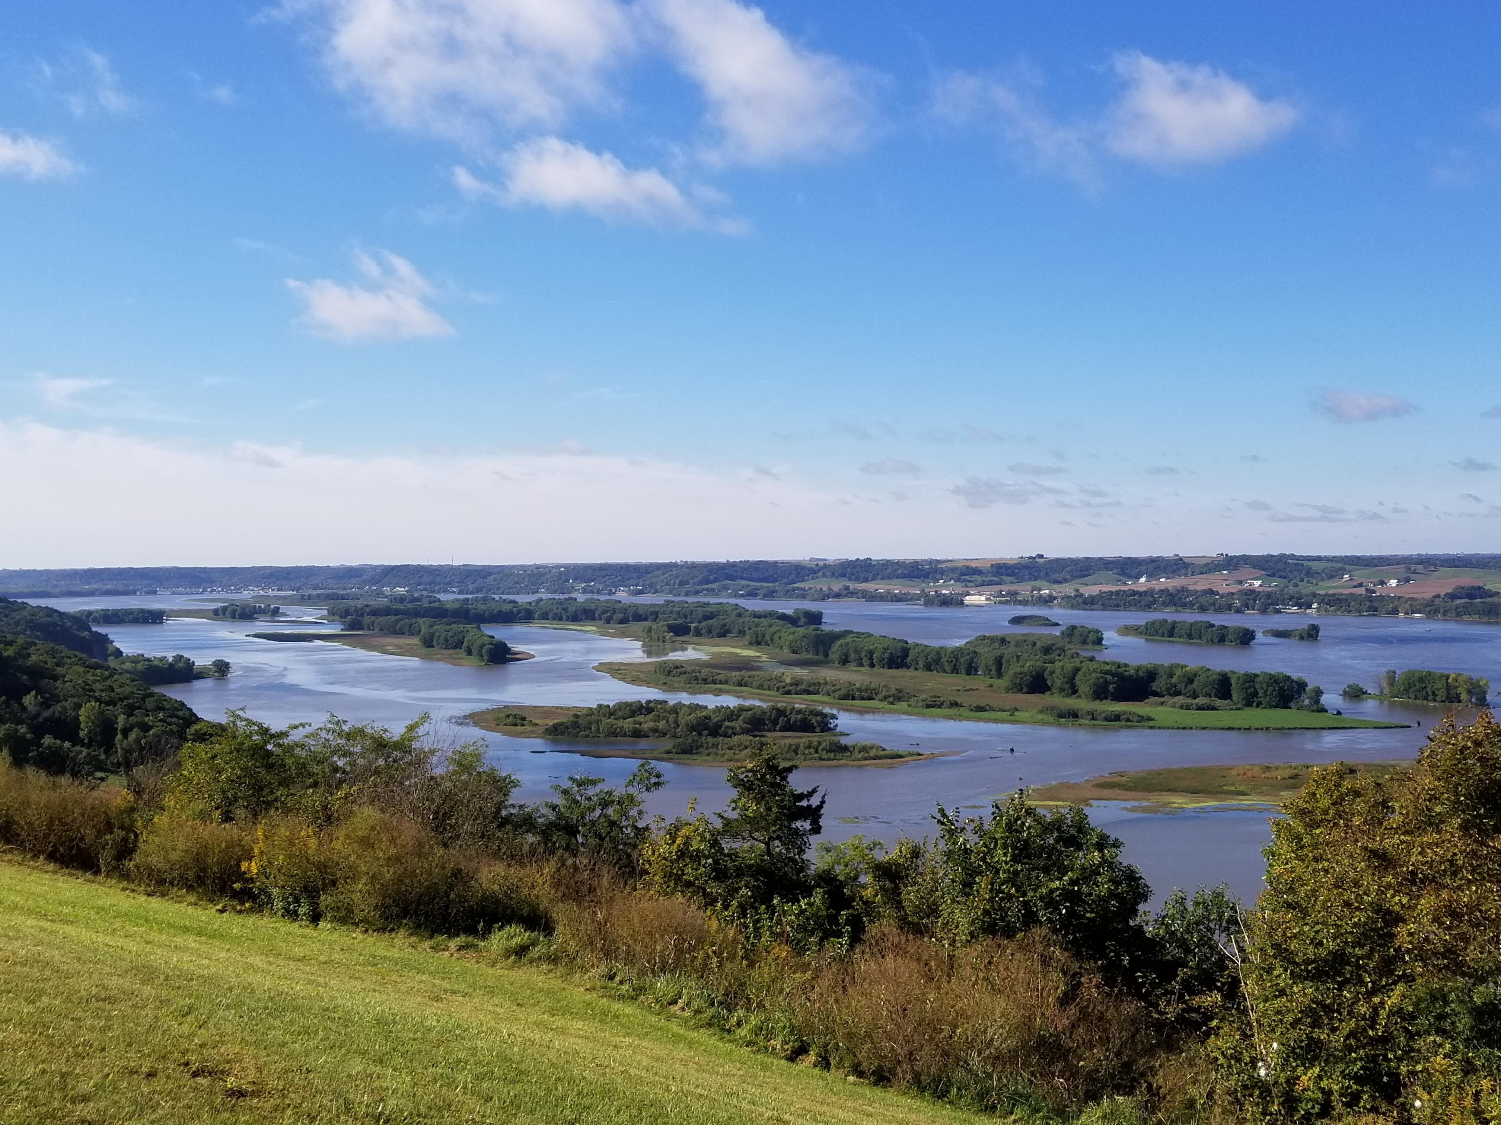
Plus Sustainability
Sustainability is the Foundation of the Corn Belt Ports

Slide 15
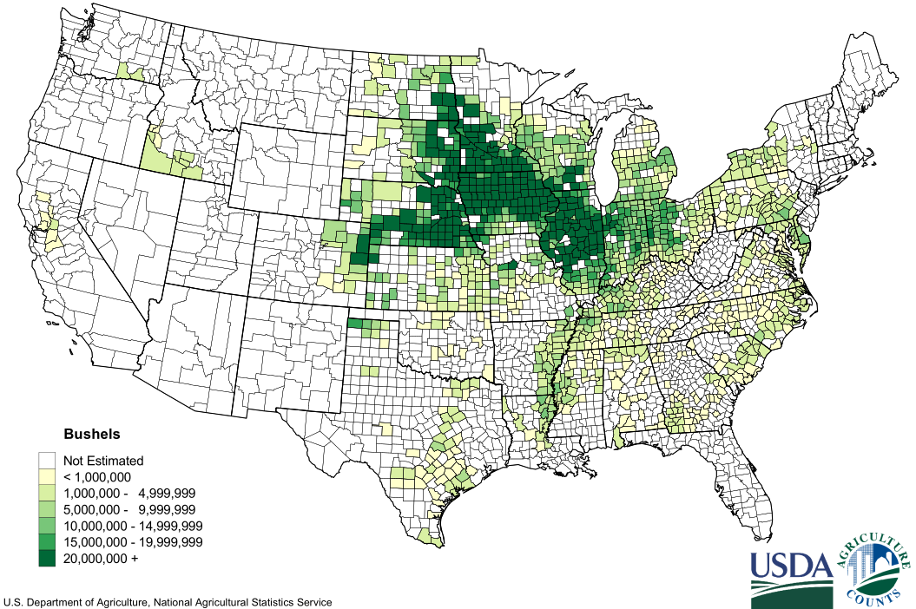
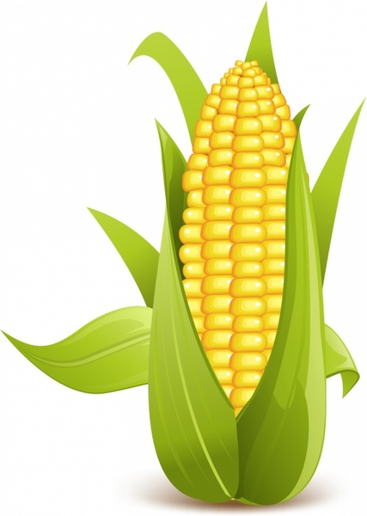
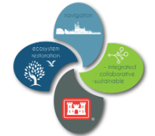
Corn Belt Ports
Ports
Within the
Lock & Dam
System
Modern, Rural, Regional, Multi-Modal, Inland Ports
Aligned with the
Heart of the Corn Belt
Formed
2020-2022
c
NESP
Enabler
Locks & Dam 26
(Melvin Price)
Corn for Grain 2018
Production by County
For Selected States
Corn Belt Ports Region
(A Top 50 US Port)
c
Coastal Port Access
to Global Markets

Slide 16
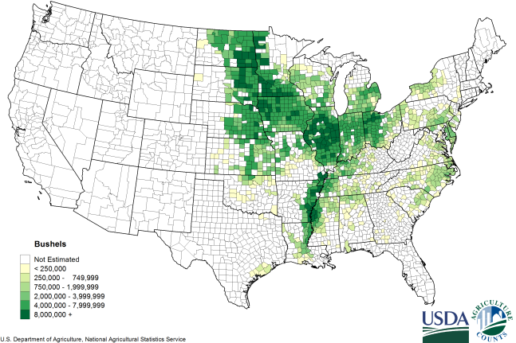

Corn Belt Ports
Modern, Sustainable, Rural, Regional,
Multi-Modal, Inland Ports
Aligned with
Soybean Production
Formed
2020-2022
NESP
Enabler
Locks & Dam 26
(Melvin Price)
Soybeans 2018
Production by County
For Selected States
Corn Belt Ports Region
(A Top 50 US Port)
Coastal Port Access
to Global Markets

Slide 17
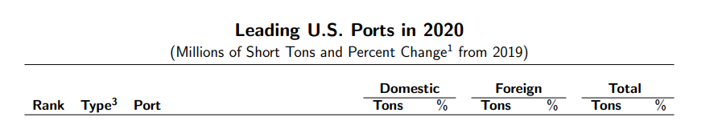
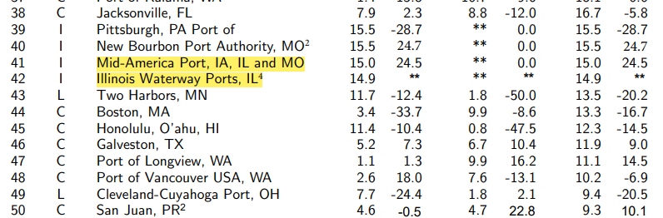
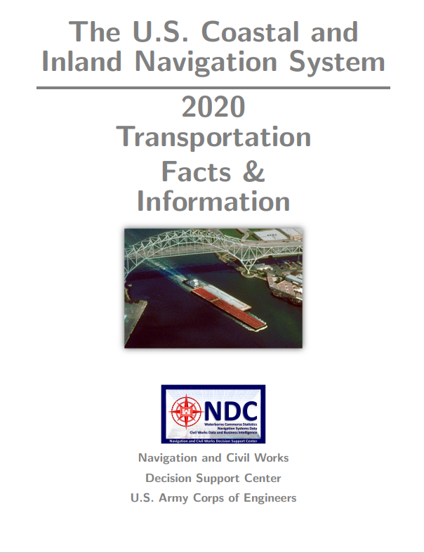
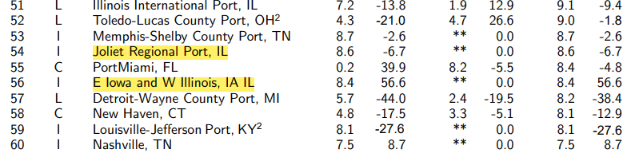
1st Time
In History
(Model)
Desired Ranking Range
NATIONALLY
RANKED
Desired Ranking Range
Goal
https://publibrary.planusace.us/#/series/Fact%20Cards
Joliet Regional Port, IL
https://publibrary.planusace.us/#/series/Fact%20Cards

Slide 18
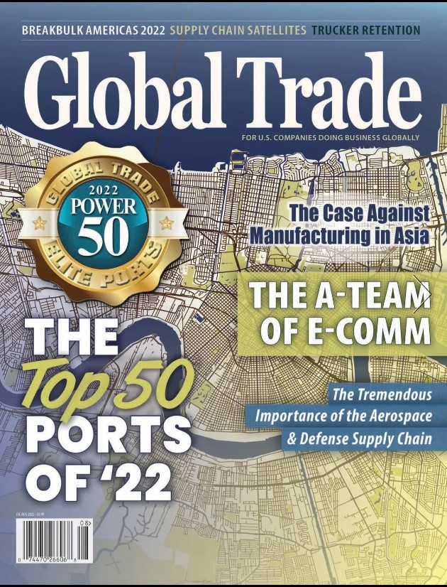

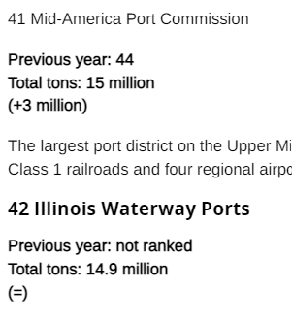
Top 50 Power Ports
41 Mid-America Port
Commission
Globally
Significant
2022 POWER PORTS Global Trade : July/August 2022 (mydigitalpublication.com)

Slide 19


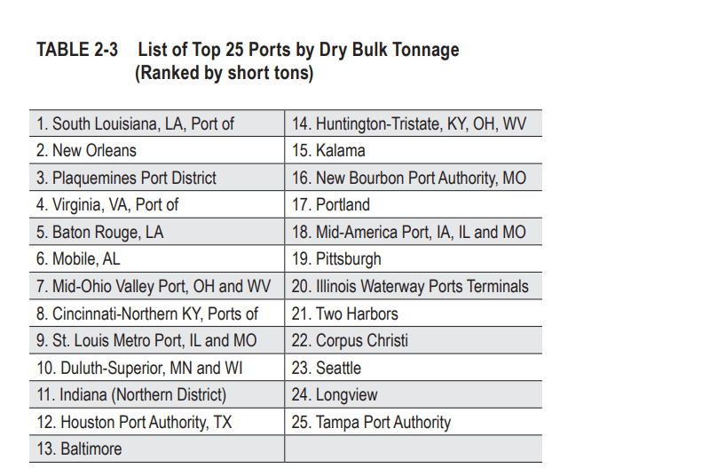
Critical Part
of the
Supply Chain
https://rosap.ntl.bts.gov/view/dot/65990/dot_65990_DS1.pdf?download-document-submit=Download

Slide 20


Slide 21
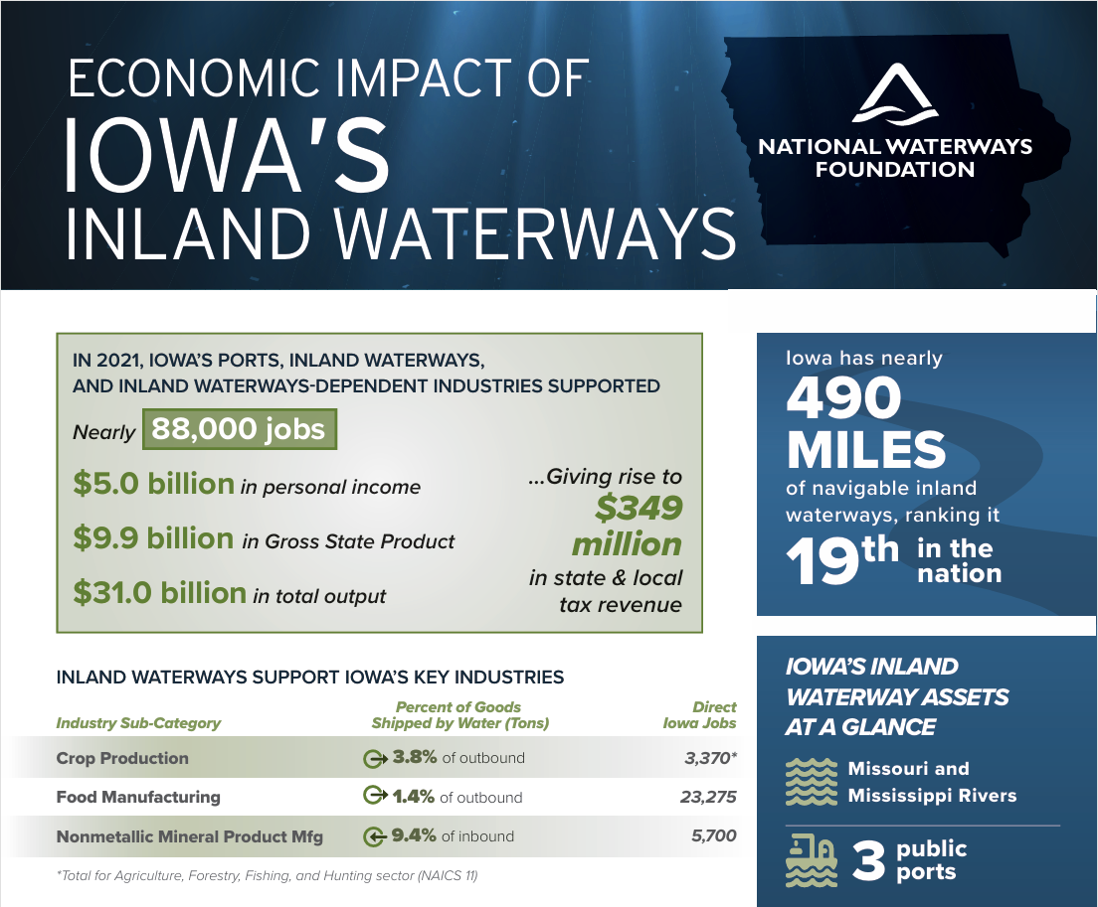

Slide 22
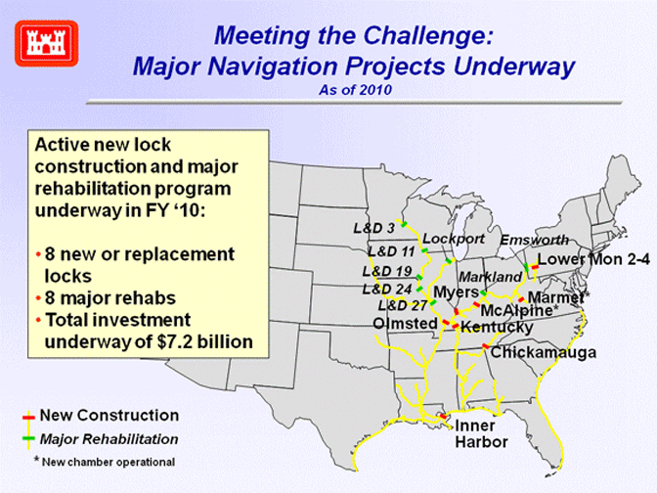
New Locks Only Went to
Where There Were Ports Inside
the Lock & Dam System
https://www.iwr.usace.army.mil/Missions/Navigation/Inland-Waterways-Users-Board/Trust-Fund-Projects/

Slide 23
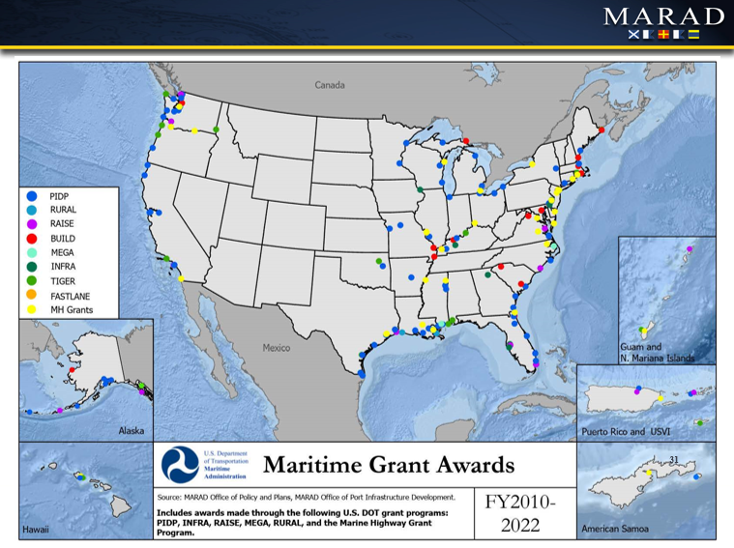
No Ports = No Grants
The one “INFRA” grant Dubuque
“received” was returned.

Slide 24
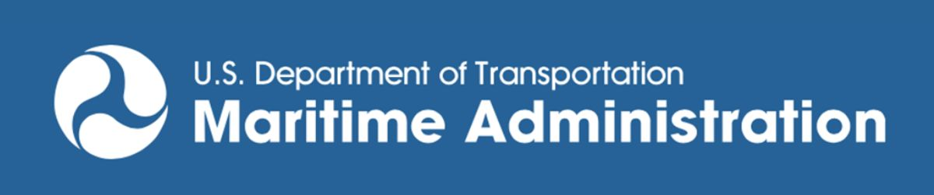
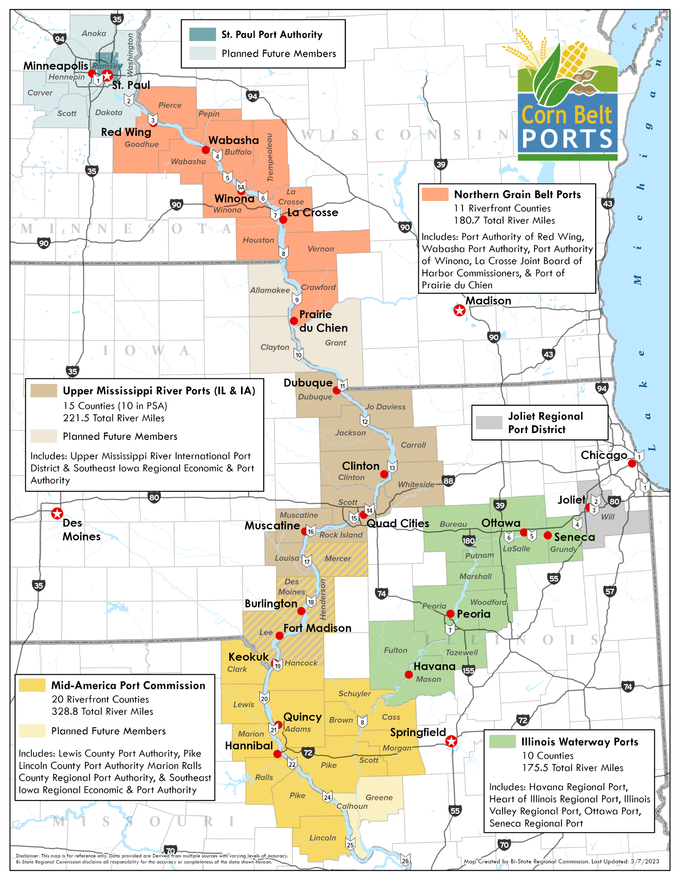
Urban Port
The County is the Building Block
2024 Port Infrastructure
Development Program Grants
A
B
15 November 2024
1
Hennepin, IL $38,582,711
Only Riverfront
Counties Depicted
2
Hardin, IL $9,000,000
$63.2M
2023 Port Infrastructure
Development Program Grants
Urban Port
7 November 2023
Special
Partnership
Area
1
A
Red Wing, MN $1,989,246
First Ever on
the Illinois
Waterway
B
Wabasha, MN $2,545,297
First Time
in U.S. History
C
C
LaGrange, MO $11,091,844
2022 and Prior
2
ZERO

Slide 25
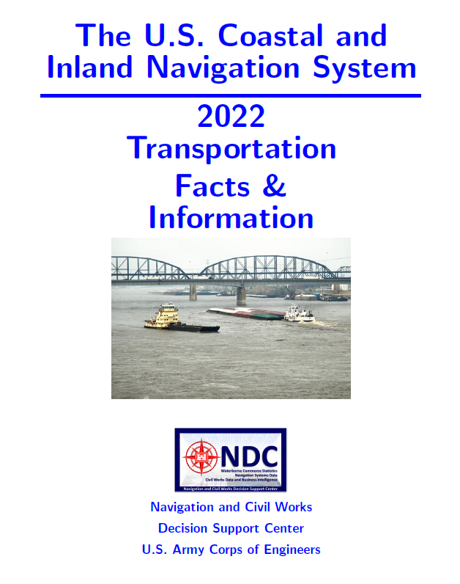
Basic U.S. Port Definition
“Port: Port limits are defined by overarching legislative enactments of state, county, or city governments or the corporate limits of a municipality.”

Slide 26
What is a Regional,
Inland U.S. Port?
Our
Definition
On a navigable Inland Waterway.
Has facilities and/or equipment (public and/or private) to load and/or unload barges, boats or ships.
Has a specific geographically defined area, usually based on city, county, and/or Regional Planning Agency (RPA) boundaries, or a combination of them.
Has a governing, coordinating, or management body or structure [independent or existing government entity (or entities), and could be collaborative].
Has authorizing legislation, government citation of authority, or a legal formation document/agreement.

Slide 27

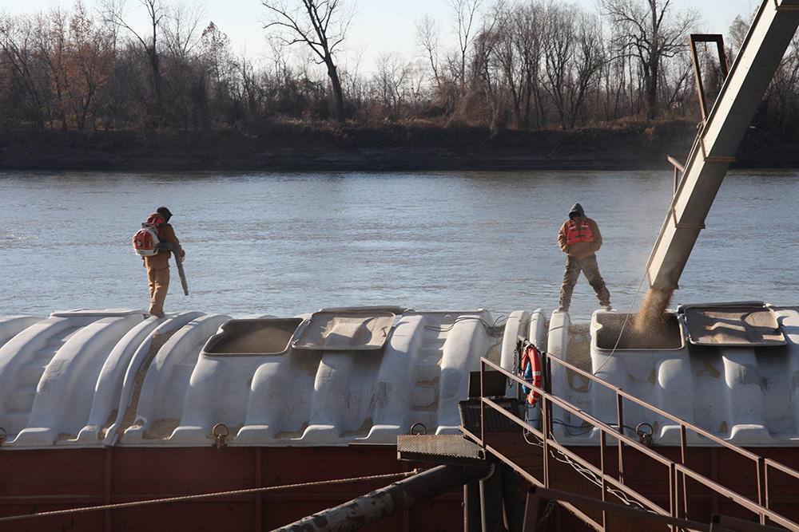
Urban Port
The County is the Building Block
Only Riverfront
Counties Depicted
Urban Port
Rural
maritime
Prosperity
Zones & Economic
Development
Engines
Special
Partnership
Area

Slide 28





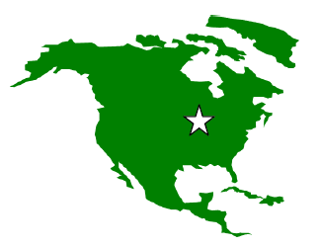


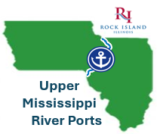
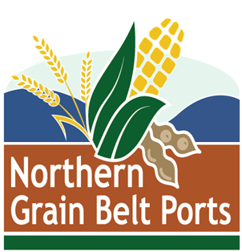
Corn Belt Ports Leadership
Ashley Harris
Chair,
Rock Island Regional
Port District
Jim Irwin
Chair,
Ports of Eastern Iowa
Authority
Travis McGlasson
Chair,
Illinois
Waterway Ports
Commission
Douglas Aeilts
Chair,
Mid-America Port Commission
Chad Ubl
Executive Secretary
Port of Winona, MN
Northern Grain
Belt Ports
Upper Mississippi River Ports (IA & IL)

Slide 29
Corn Belt Ports
Four distinct regional units of government (or, official government collaborations) that are county-based, modern, sustainable, long, linear, rural, multi-modal transportation features compatible with existing regional planning agency boundaries.

Slide 30
Corn Belt Ports
Geographically, the Corn Belt Ports are simply the state and federally recognized ports on the Upper Mississippi River (Marine Highway 35) and the Illinois Waterway (part of Marine Highway 55).
Or, more simply, the ports within Upper Mississippi River and Illinois Waterway Lock and Dam System above Locks and Dam 26.

Slide 31


Corn Belt Ports Model
Modern, Rural, Regional, Multi-Modal, Inland Port
A Regional Partnership Port
Multi-Modal Regional Port Commission
Lead Business/Industry Organization
Lead Economic Development Organization
Regional Planning Agencies (MPO Centered)
Sustainability & Environmental Working Group
Riverfront Cities and Towns Collaboration
Flood Infrastructure Working Group

Slide 32
Regional Inland Ports Benefits
Promote regional business/economic advancement and success tied to waterborne commerce.
Make us more competitive for man-made & natural infrastructure investment.
Serve as “catching mitts” for federal, state, and NGO investment from a variety of sources and programs.
Raise the visibility of our region regarding its rightful place in the national and global supply chains.
Provide a strong, official “U.S. Port” local voice for shaping decisions (federal and other) to advancing our riverfront communities and regional businesses.

Slide 33
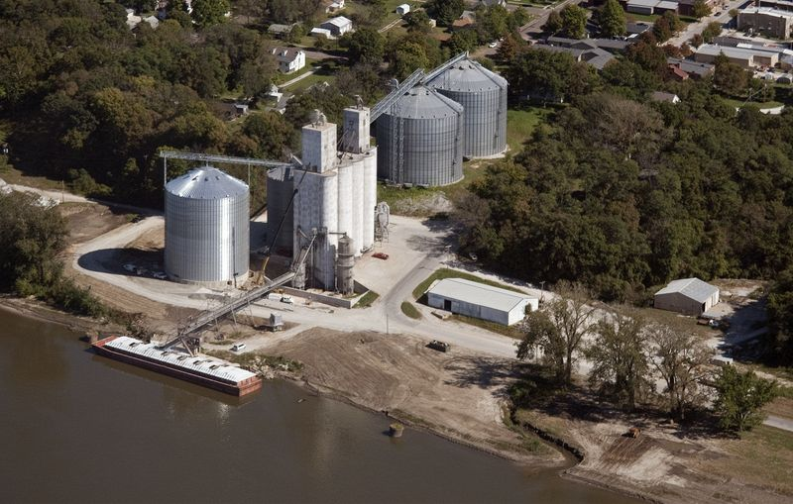
Why Did We Need Regional Inland Ports?
Assist Our Individual, Rural, Inland Ports that are:
Mostly private terminals
Mostly volunteer-led
Poor and under-resourced
May lack taxing authority
Often lack professional staff
Our rural inland regional ports need to be effective in competing nationally with large urban ports, and established coastal ports for federal resources.
RURAL PORTS CAN COMPETE
NATIONALLY & WIN

Slide 34

Freight Has
Value
Translate the freight tonnage handled in and by the regional Corn Belt Ports into long-overdue investment in our area.
Helped attract over $2B in IIJA and other
funding since 2022 and still growing!

Slide 35


A Formula that Delivers
for Our Private Terminals &
Our Riverfront Communities
Increased Manmade
& Natural Infrastructure
Investment
Regional &
Local
Ports
National
Waterways
(Local Public/Private
Partnerships)

Slide 36
Corn Belt Ports Model
Rural, Regional, Multi-Modal, Inland Port Regions
Port Regions Within the UMR & ILWW Locks & Dam Project
(Above Locks and Dam 26)
Port
Commission
A
Port
Commission
B
Port
Association
C
Port
Association?
D
Districts
Districts
Districts
Districts
1
2
3
4
5
1
2
3
4
5
1
2
3
4
5
1
2
3
4
5
Terminals
Terminals
Terminals
Terminals
Public = X
Private = Y
Public = X
Private = Y
Public = X
Private = Y
Public = X
Private = Y
50-100 Total
50-100 Total
50-100 Total
50-100 Total

Slide 37
National Waterways Conference 2025
8 minute video
https://youtu.be/c5S7s_jwkb4

