Slide 1
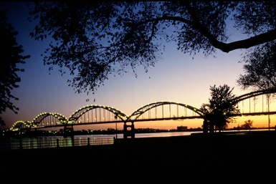
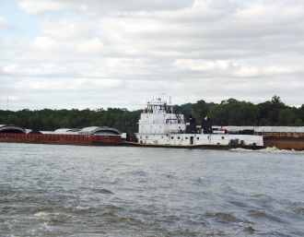
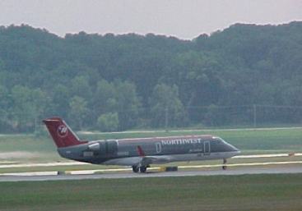
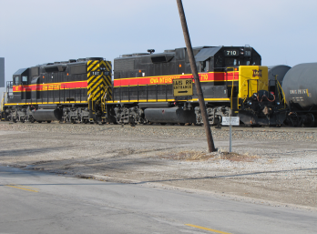
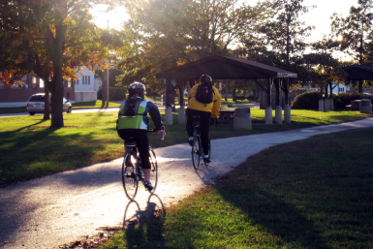
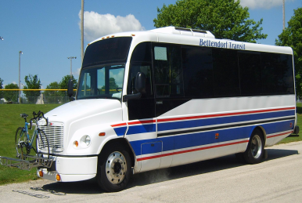
Iowa DOT Commission Presentation
October 14, 2025

Slide 2
Quad City Contingent
Nicole Gleason, Interim Davenport City Administrator
Brian Schadt, Davenport City Engineering
Decker Ploehn, Bettendorf City Administrator
Denise Bulat, Executive Director Bi-State Regional Commission

Slide 3
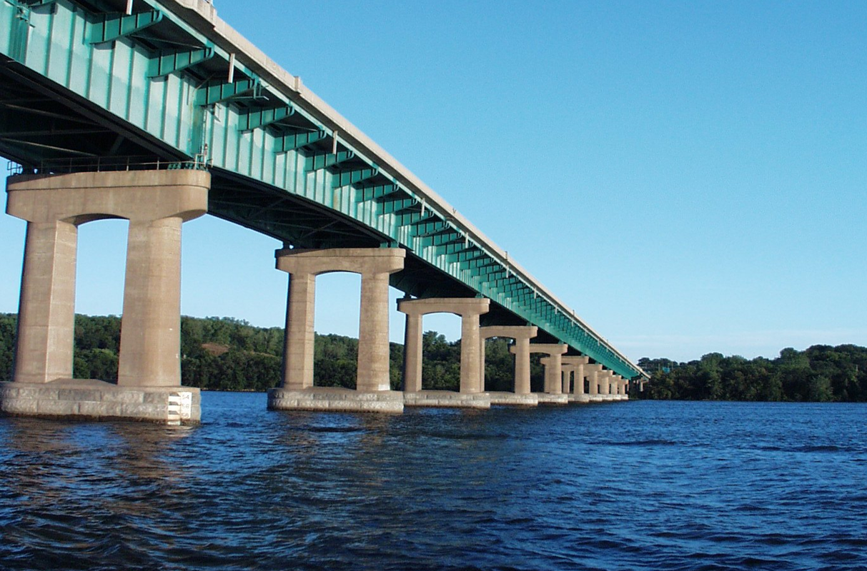
Interstate 80 Bridge
Included in Iowa and Illinois DOT TIP’s – Thank You!
Phase I Study Complete & Phase II Under Contract
Includes Multi-Purpose Trail
Construction Anticipated in 2028
Periodic Bridge Closures Required for Repairs
WB Ramps at US 67 Interchange Rated Poor for Crashes/Geometry
Notes:
Slightly updated.

Slide 4
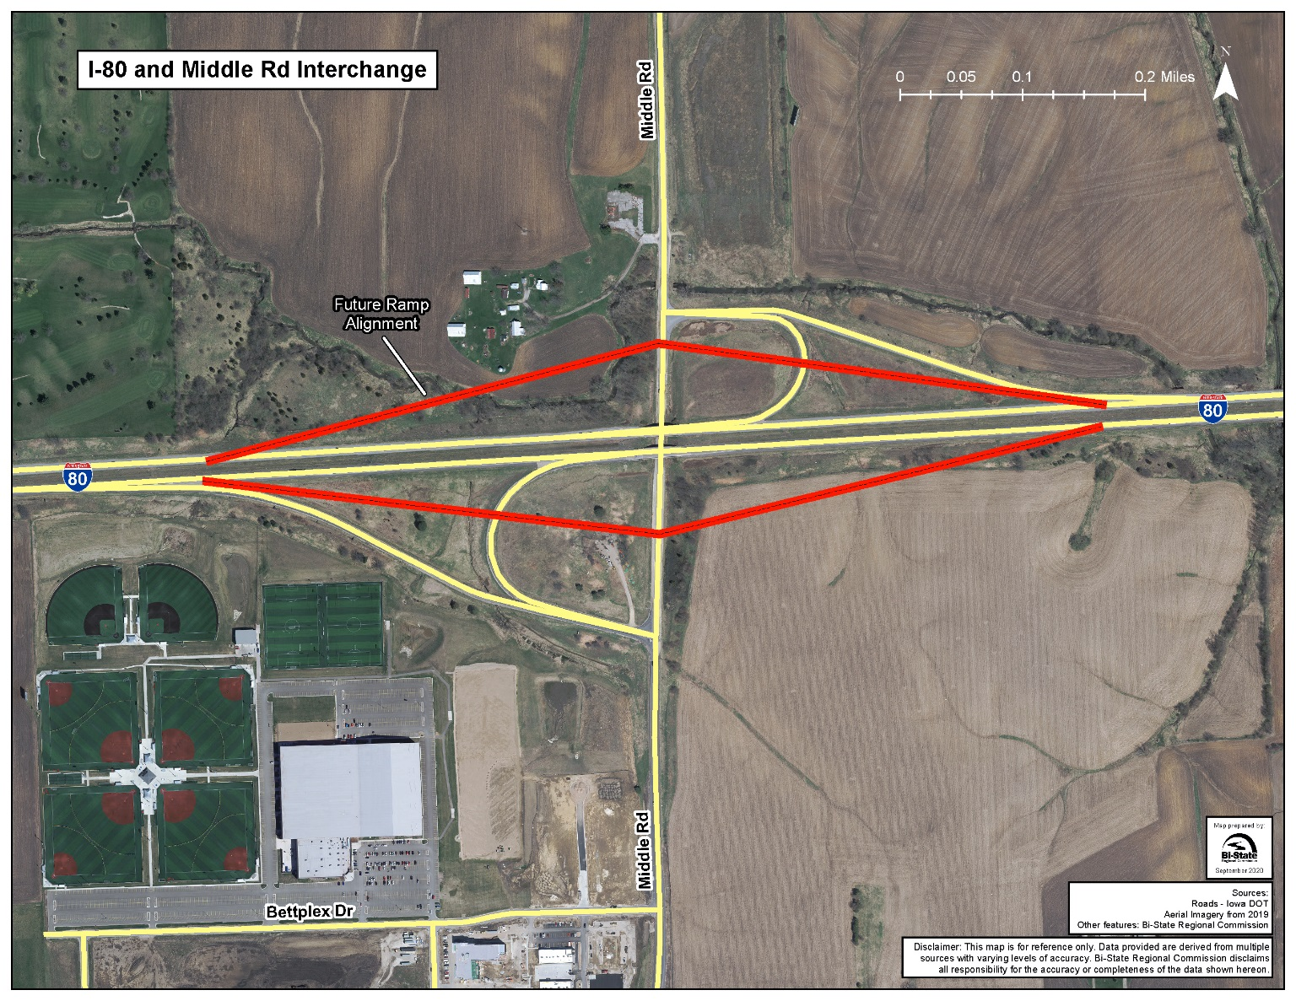
I-80 at Middle Road Interchange
Included in State TIP – Thank you!
34% Growth on I-80/100% on Middle Projected on Network Model
Roundabouts, W. Forest Grove Complete, Ped. Overpass has begun
Notes:
Not update but will update. If you have a different aerial get it to us.

Slide 5
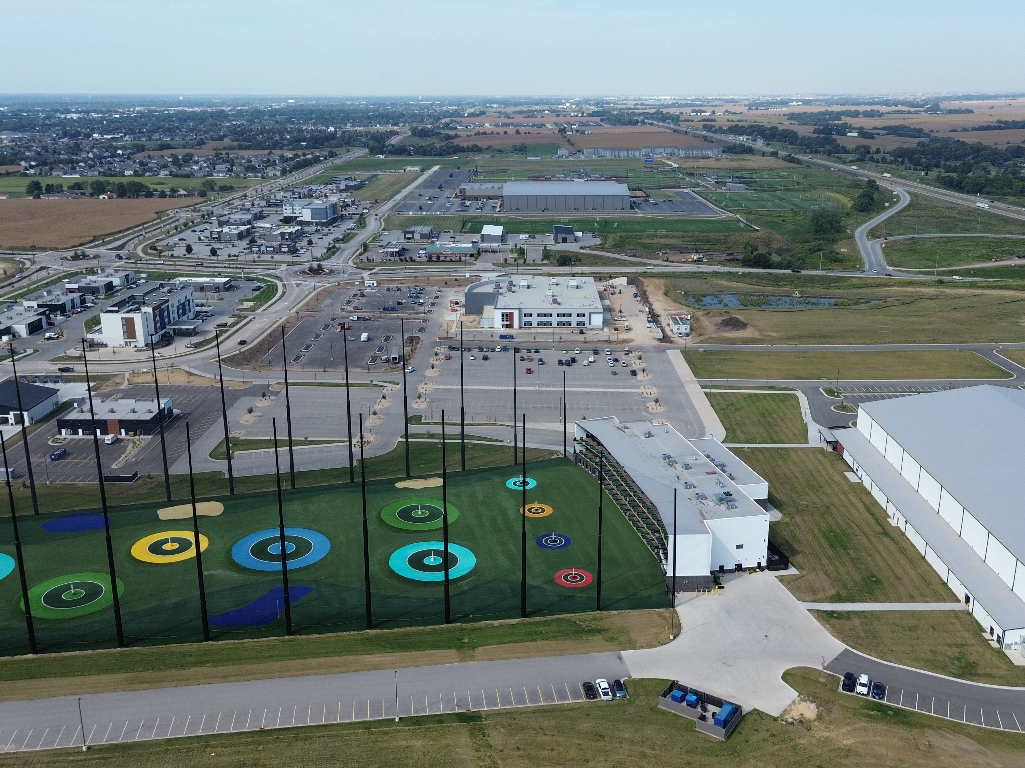
I-80 at Middle Development
Over $200 Million in Development Completed
TBK Sport Complex, Iron Tee, ORA Medical Complex, QC Bank H.Q.
Future Development Secured/Planned
Notes:
Need updates for this slide. Note the DOT Commission will have seen the complex the day before.

Slide 6
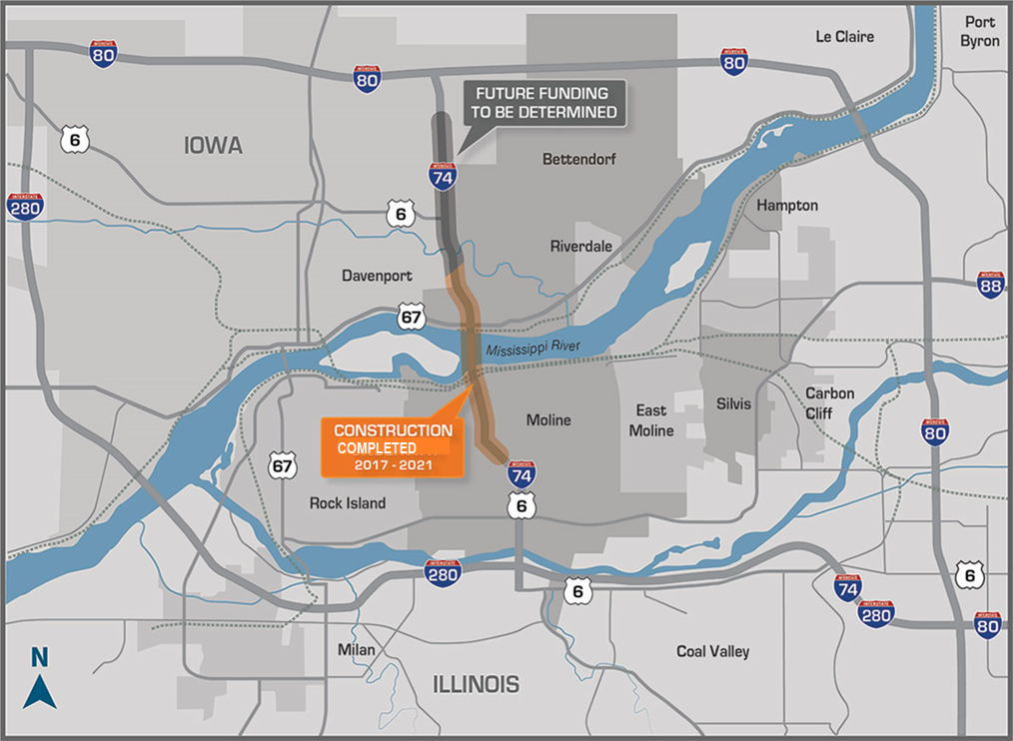
I-74 Bridge Corridor Project North Section
Long Range Need Removed to Expedite Bridge Construction
Crashes Occurring from Middle to Kimberly/Spruce Hills Dr.
No Pedestrian/Bike Access on Kimberly/Spruce Hills Dr.

Slide 7
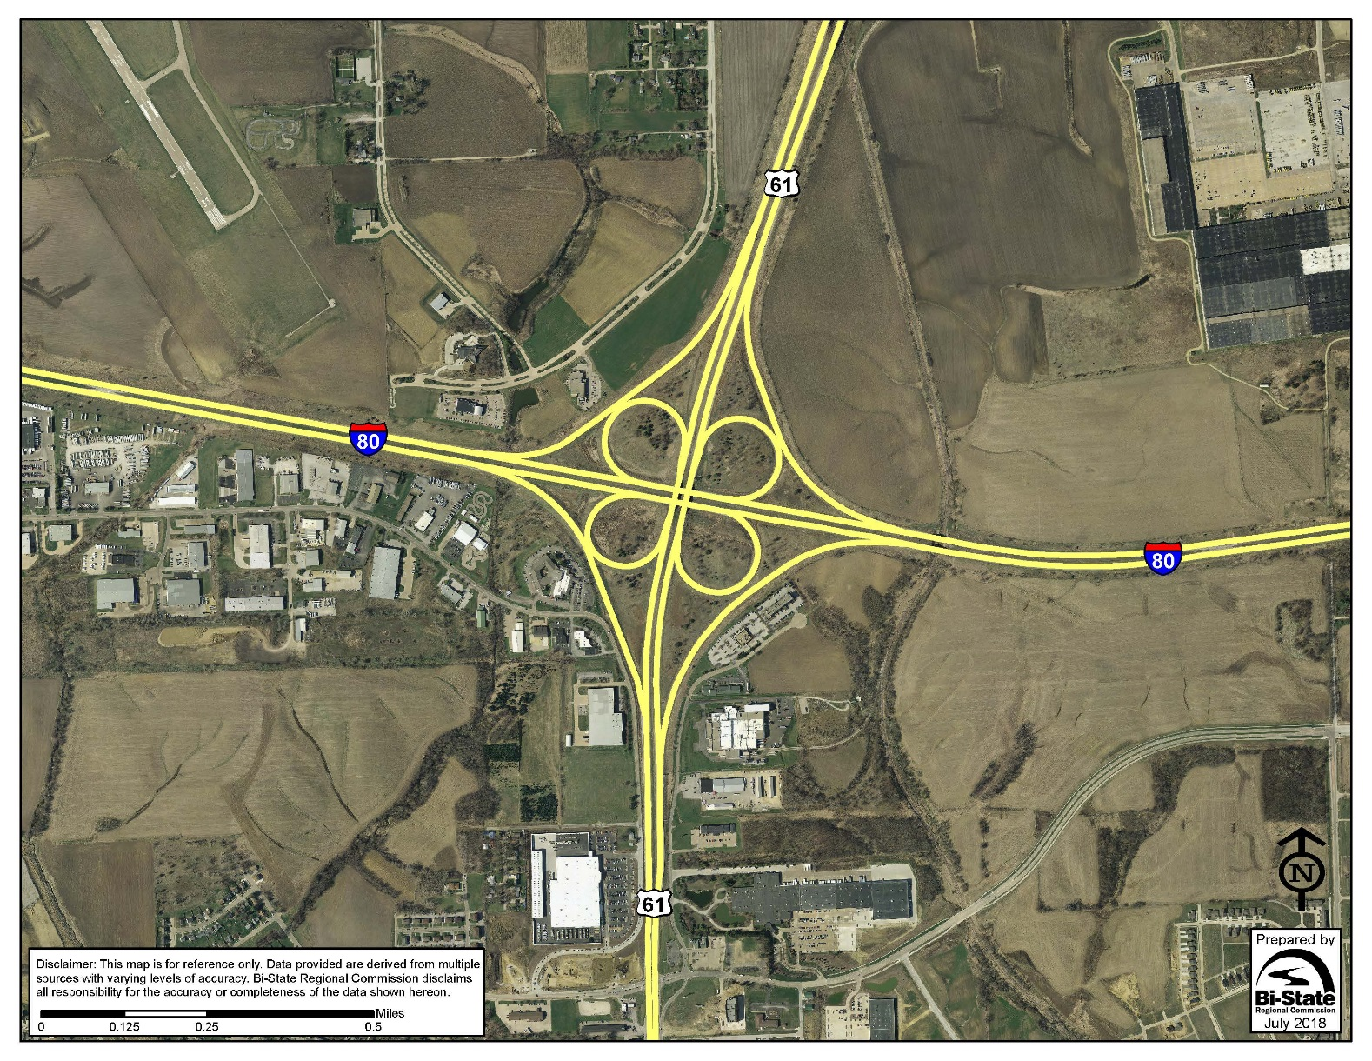
Interstate 80 at US 61 Interchange ~ 83,100 Intersecting AADT
Over 35% Growth on I-80 Forecasted +232/HMVMT Crashes
Exit/Entrance Ramps Don’t Meet Current Standards
Short Merge Zone at High Speeds = Dangerous Multi Vehicle Crashes
Notes:
Not updated but I am assuming this interchange remains a high priority and we should update?

Slide 8
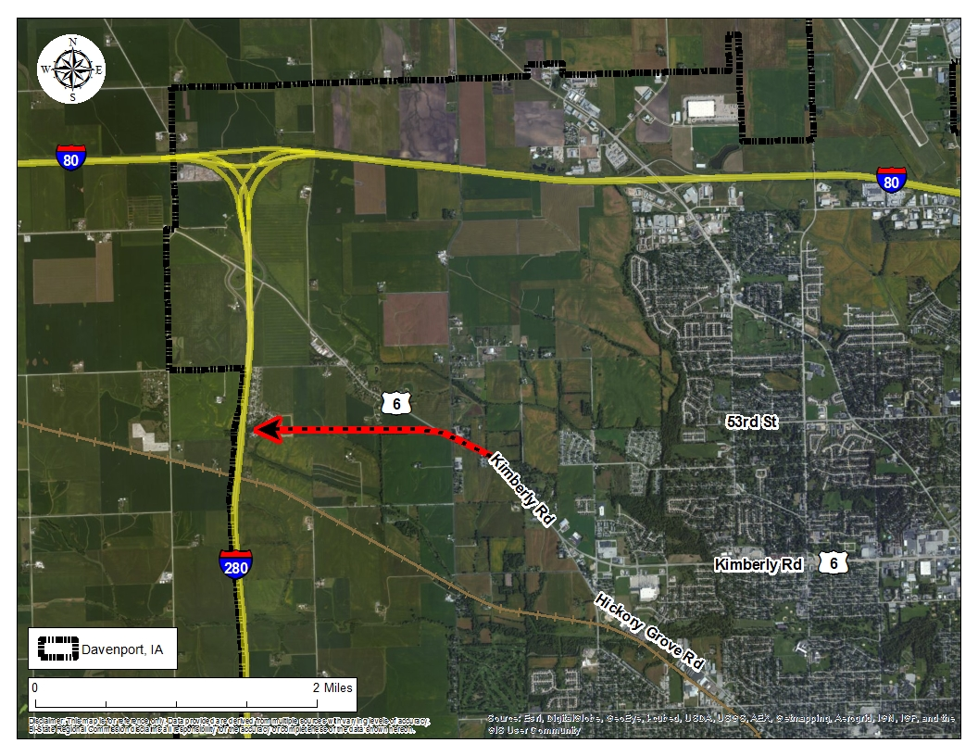
Interstate 280 at Kimberly Rd Interchange
IDOT 2008 Study of Relocation Options w/only 0.5 Miles Between Interch.
West Sewer Interceptor Project to I-280, $17.9 Million Underway
Access to 5K Acres for Industrial/Commercial Dev.
Notes:
Slightly updated. Do you want to use this slide or something different relative to expanding to the west?

Slide 9
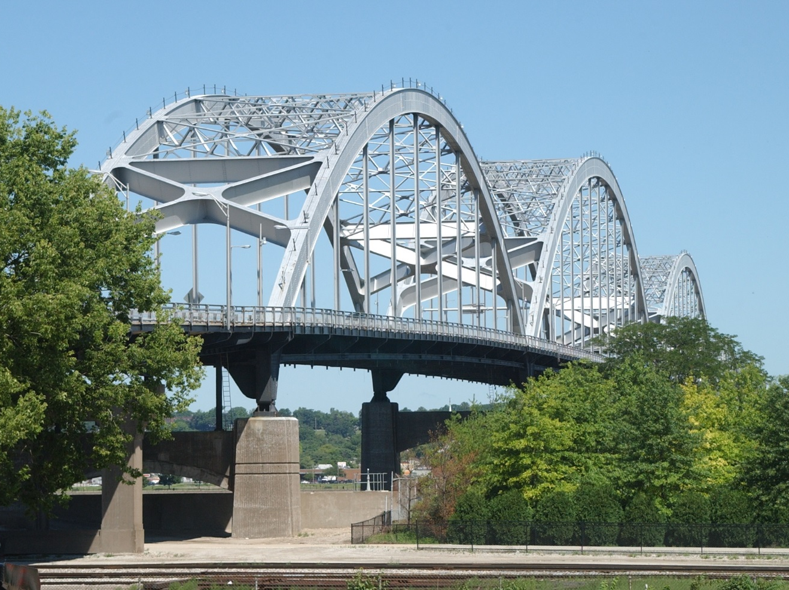
Centennial Bridge/US67 Corridor Project
Phase I Study has Begun
Phase II Anticipated in Two Years with Construction to Follow
Project Driven by Bridge Condition/Maintenance & Obsolete Design
Notes:
Anything else to add.

Slide 10
Iowa DOT Staff Appreciated
Consistent communication on various projects between engineers, PIO’s, District staff, & Public
Open to troubleshooting issues when they arise
Thank You! Questions?
Notes:
We could move this slide to the beginning or keep at the end.

