Slide 1
City of Marion
Michael D. Barkalow, P.E.
Public Works Director (City Engineer)
mbarkalow@cityofmarion.org
319.743.6340

Slide 2
East Post and IA 100
TEAP Study 2020
TSIP award of $500K
Total Cost of $1.7M
Punchlist items and retainage left on project
Added:
Turn Lanes
Que detection for westbound turn lane
New Signal

Slide 3
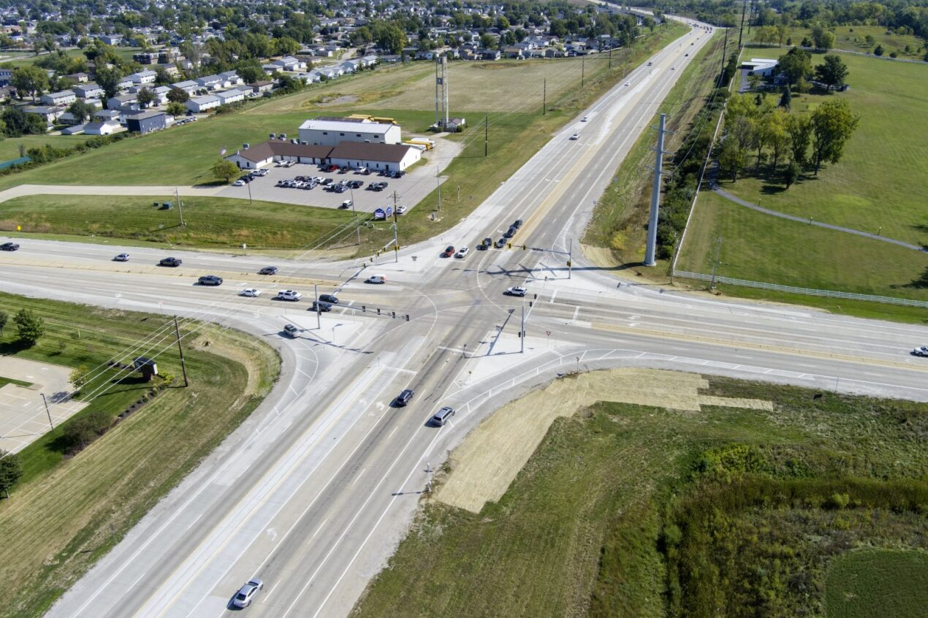
East Post and IA 100

Slide 4
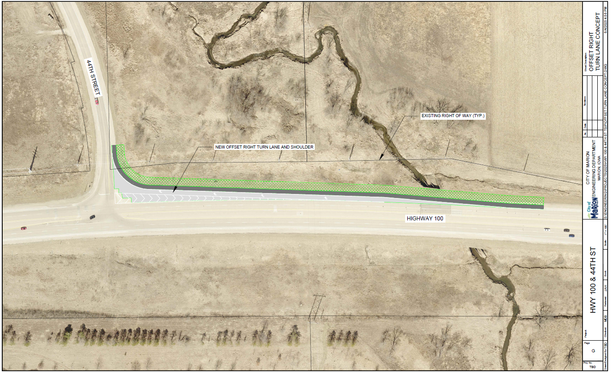
44th Street and IA 100
IDOT extending eastbound to northbound turn lane
City of Marion proposed to do an offset right
(westbound to northbound)
TSIP application has been submitted
One fatality last year

Slide 5
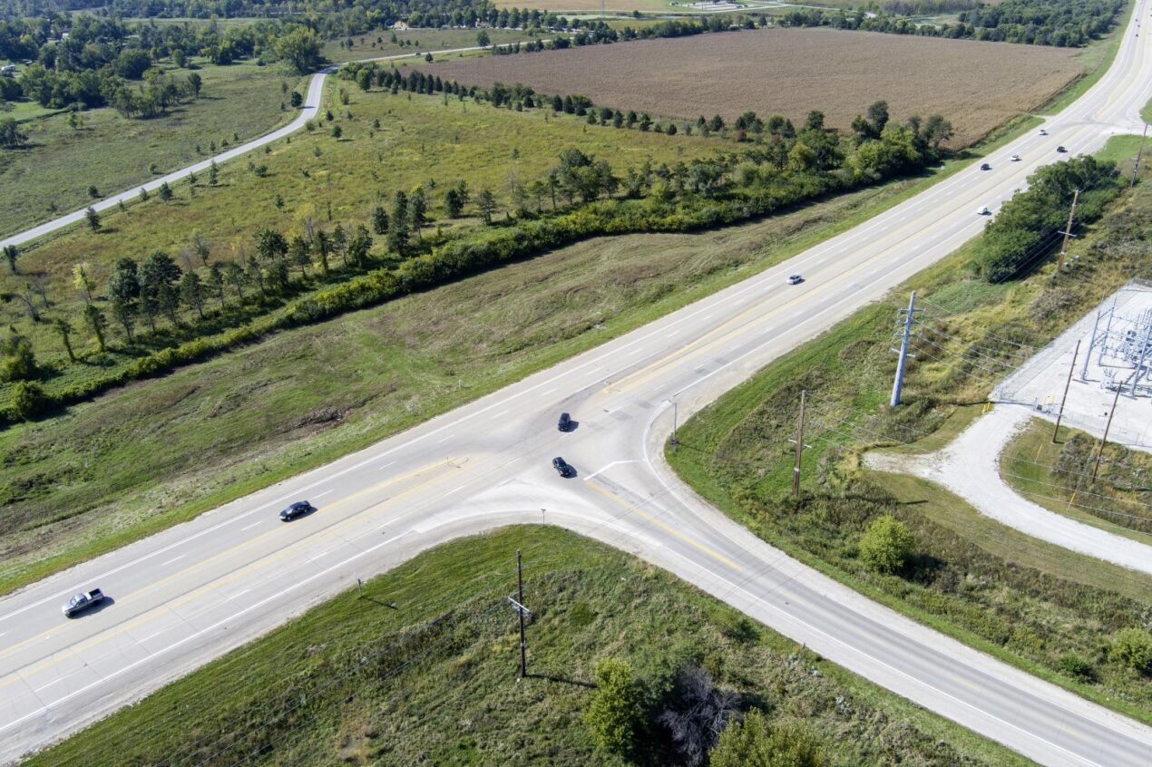
44th Street and IA 100

Slide 6
Iowa 13 Corridor TEAP
TEAP 2024
29th Avenue to IA 100
5 intersections
Used design of intersection for Tower Terrace
Continue to expand the study in Linn County
Used to help prioritize improvements

Slide 7
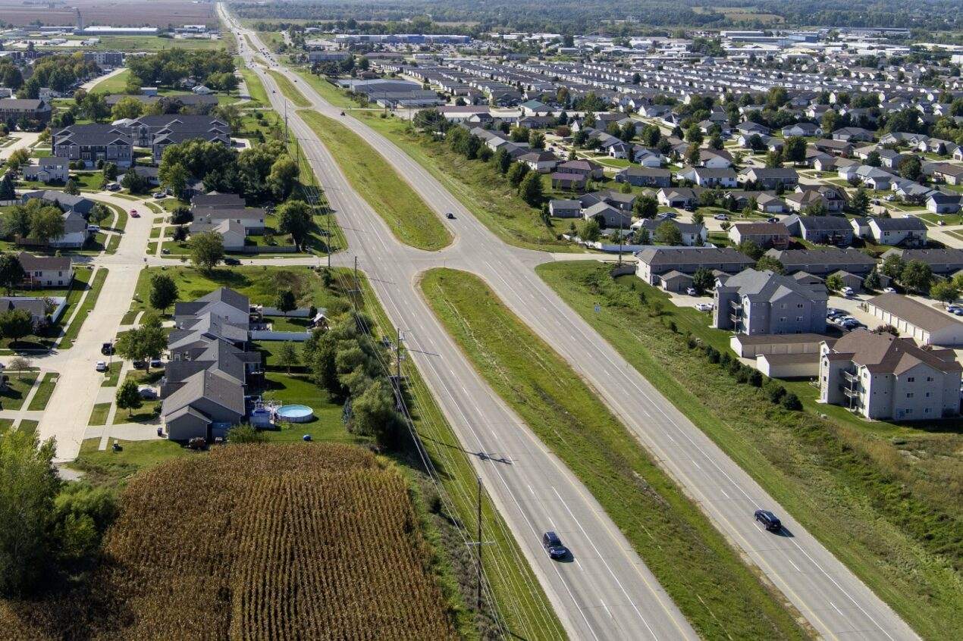
Iowa 13 TEAP

Slide 8
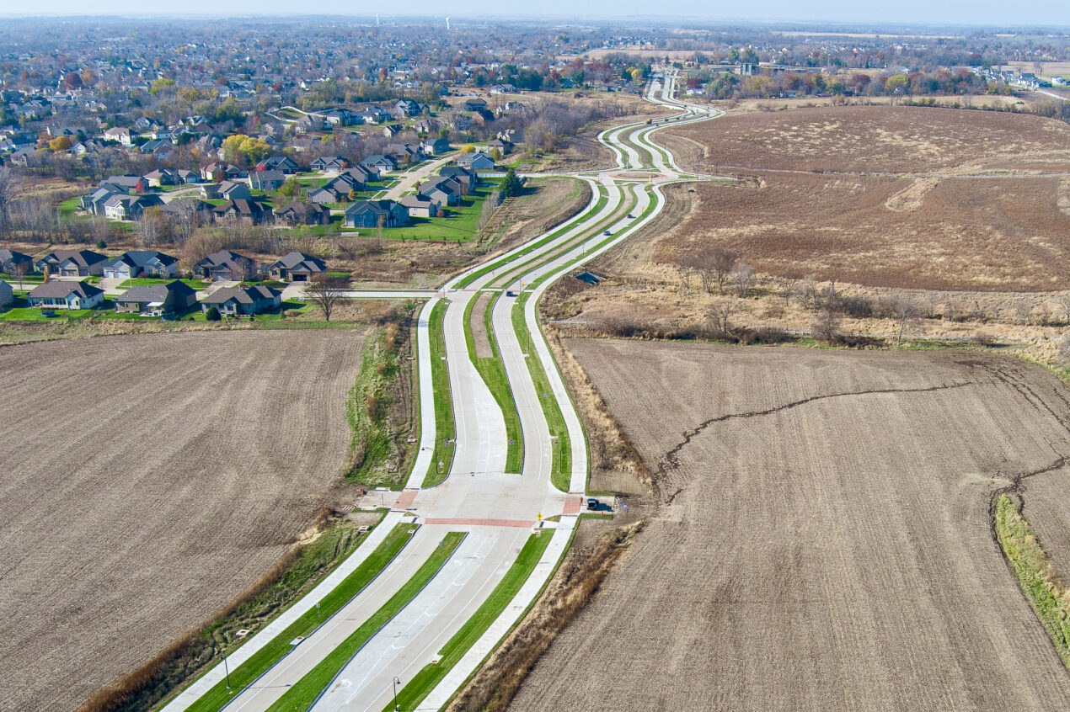
Tower Terrace C to Alburnett

Slide 9
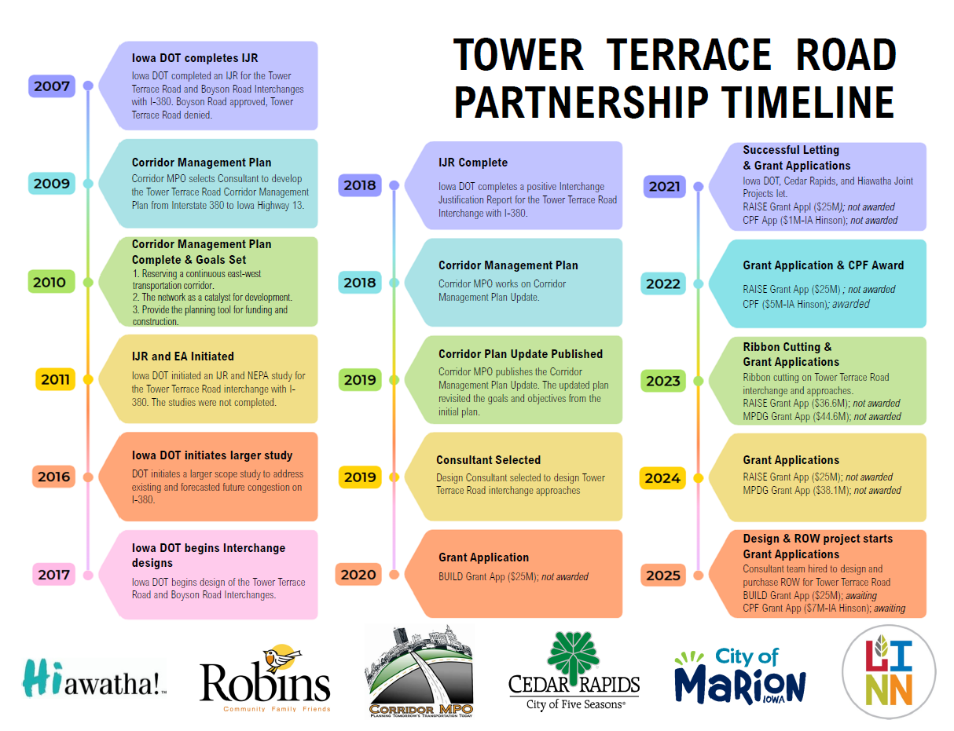
Tower Terrace

Slide 10
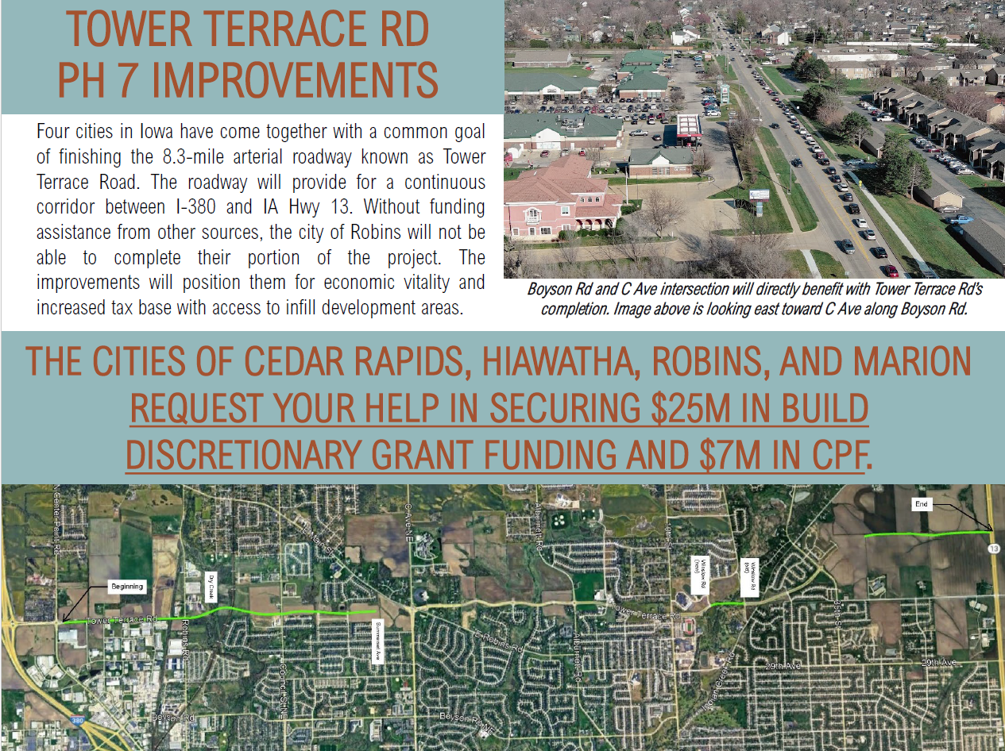
Tower Terrace

Slide 11
Others
CeMar Trail
Last segment has been bid
Connects Downtown Cedar Rapids with Uptown Marion
Lucore Road Sidepath
Currently going through acquisitions
Staff assistance
Helping with Alburnett CPF Funding
Biannual meeting with District 6

Slide 12
THANK YOU!
THANK YOU!

