Slide 1
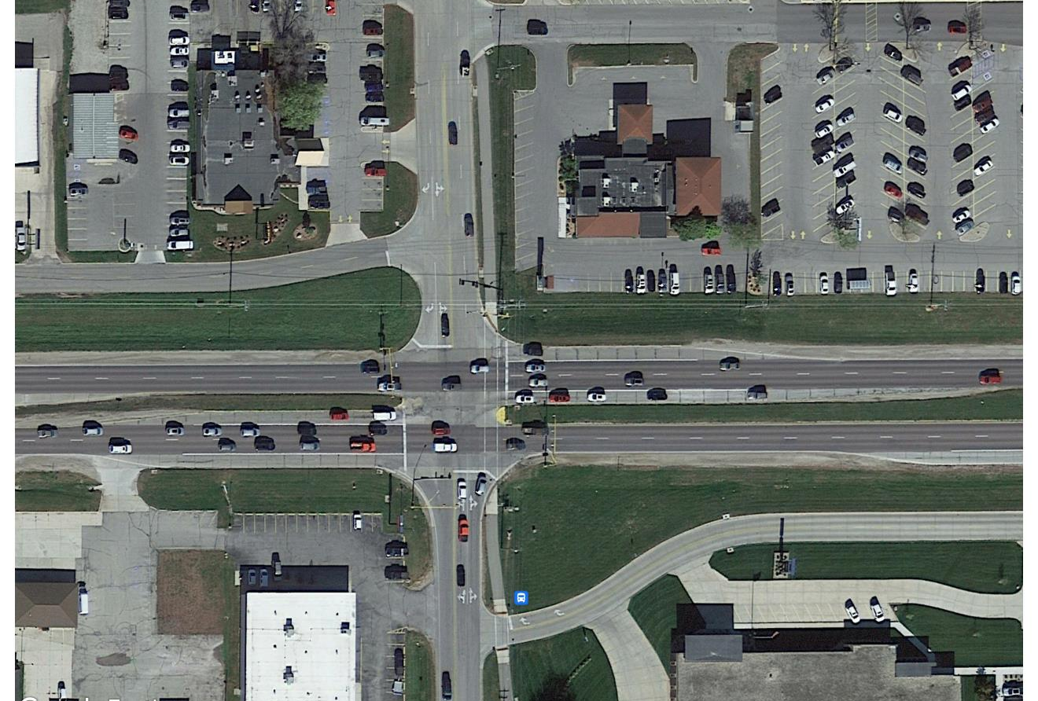



Iowa Highway 122 in Mason City
Iowa DOT Commission – October 14, 2025

Slide 2
What’s new in Mason City
Several exciting projects in Mason City
  Destination Iowa trail projects are wrapping up across the city
    Total of $18 million invested in recreational infrastructure
    Including the first world class bike park in Iowa
  Riverwalk along Willow Creek in the downtown area was recently completed
  Proposed Hotel in the Southbridge Mall parking Lot is set to begin construction
  Developed 93 multi-unit and upper story living spaces in the vibrant downtown, creating over 300 new housing units downtown over a 3-year period
    Will begin construction of additional 200 units in 2026
  50,000 sq ft Amazon Last Mile Distribution Facility was recently opened
  Reconstruction of about 1.5 miles of US 65 in South Portion of Mason City
  Reconstruction of nearly 1 mile of IA 122 in front of the MercyOne Hospital
  New $18 million Airport Terminal opened in 2024, driving a large increase in passenger traffic
  Site Certification is underway for over 250 acres
  A Comprehensive Plan was completed for Mason City, Clear Lake and Cerro Gordo Co.

Slide 3
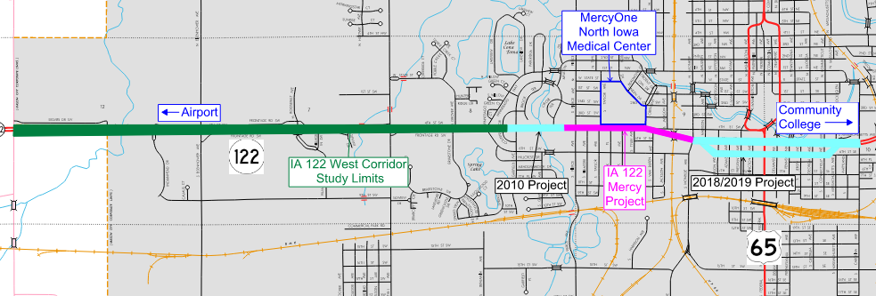
Recent History of IA 122 Projects
City of Mason City

Slide 4
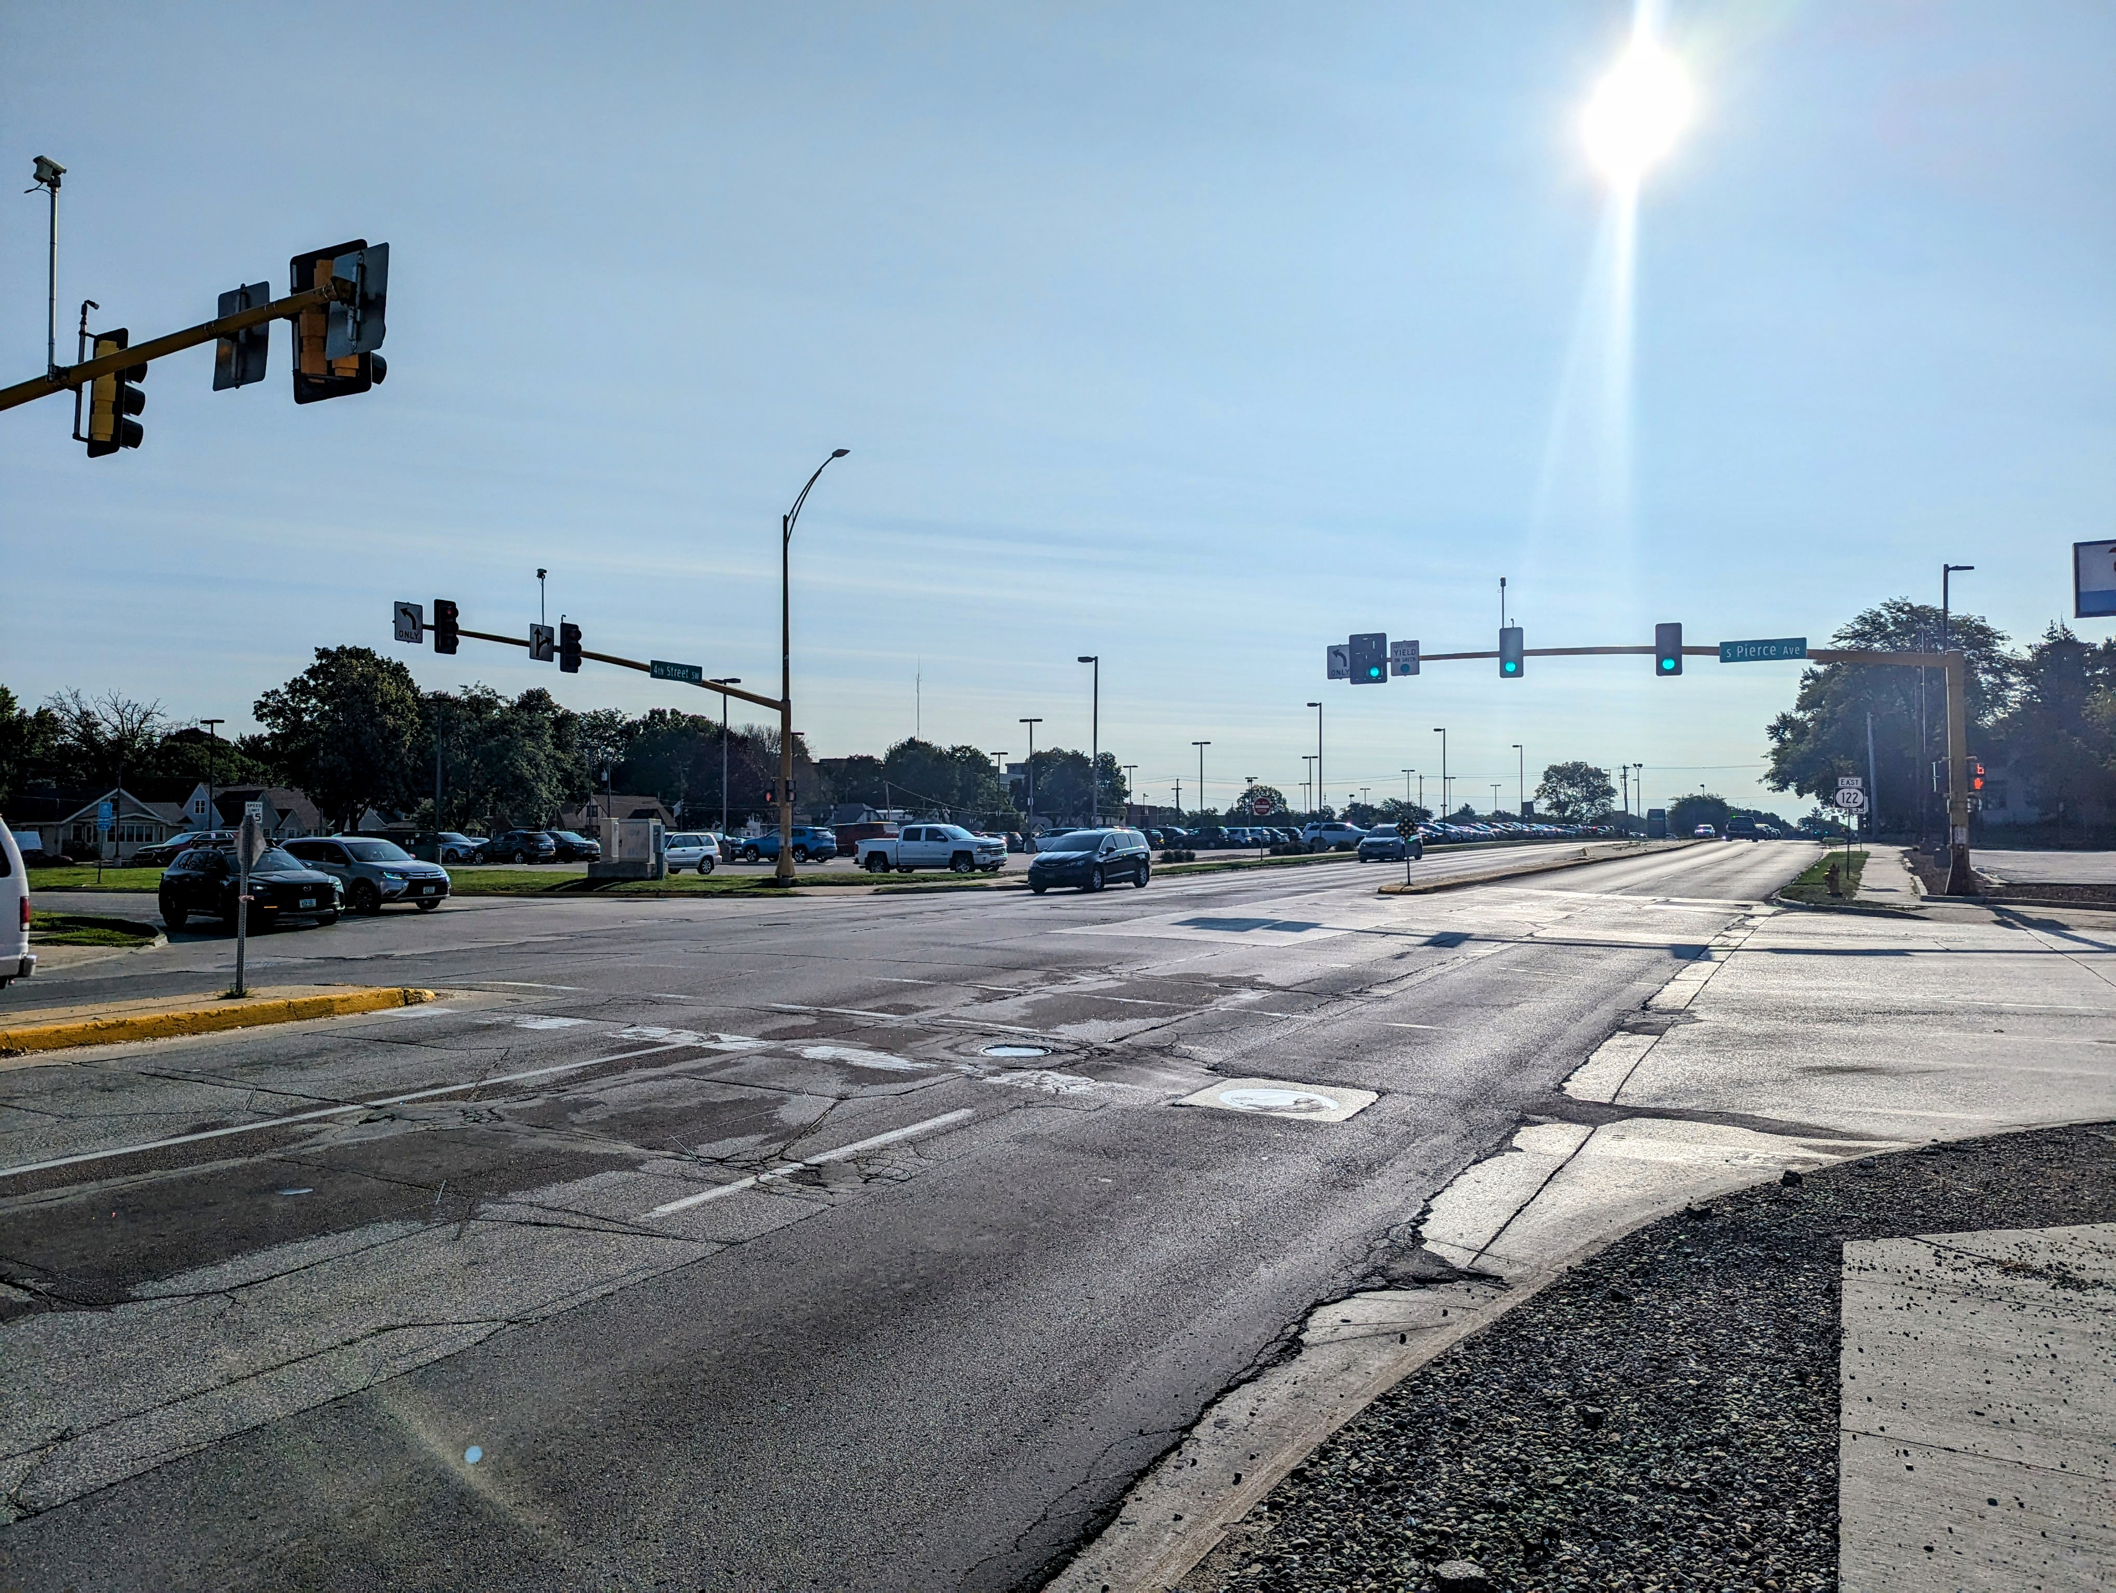
IA 122 Mercy Corridor Project Schedule
Previously presented to the Commissioners in the Fall of 2023 and the Fall of 2024
Letting – January 2025
Construction – 2025 to 2026
  The Contractor is wrapping up Year 1 Construction

Slide 5
IA 122 Mercy Corridor Iowa DOT and City of Mason City Partnership
Mason City lead the design of the Mercy Corridor project, with assistance from the DOT
  City funded the design fees
  City and DOT share in funding construction of the project
    DOT responsible for 60% of Participating Items
    City responsible for 40% of Participating Items and 100% of Non-Participating Item
Total Construction Bid was $12,450,000

Slide 6
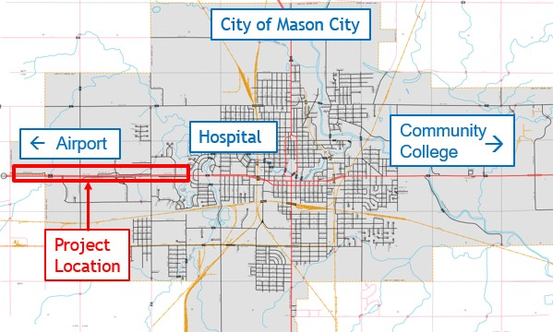
IA 122 West Section Project
Presented Corridor Feasibility Study to Commission on October 11, 2022
Reconstruction of the 4-lane Highway to urbanize the corridor with roundabouts
Started as approximately 2.6 miles
  The project scope has been revised to make it more manageable in construction and from a financial standpoint

Slide 7
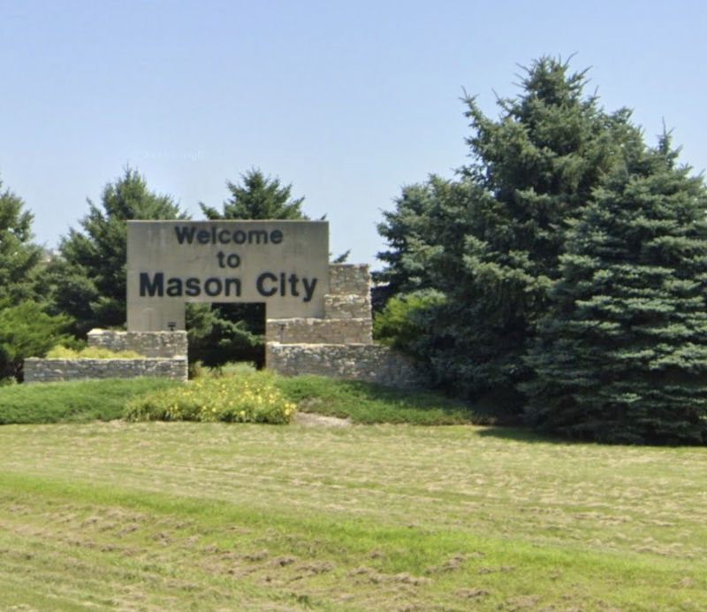
IA 122 West Section Study and Proposed Project
Project is the West entrance to the community
Many businesses along the corridor, including small retail, large commercial, hospitality, health and personal services
  Hospital is just east of the project limits on Iowa Highway 122
  Airport is west of the project limits on Iowa Highway 122
Expands upon the 2020 Traffic Engineering Assistance Program (TEAP) study
Continues Improvements to the Iowa Highway 122 Corridor through Mason City

Slide 8
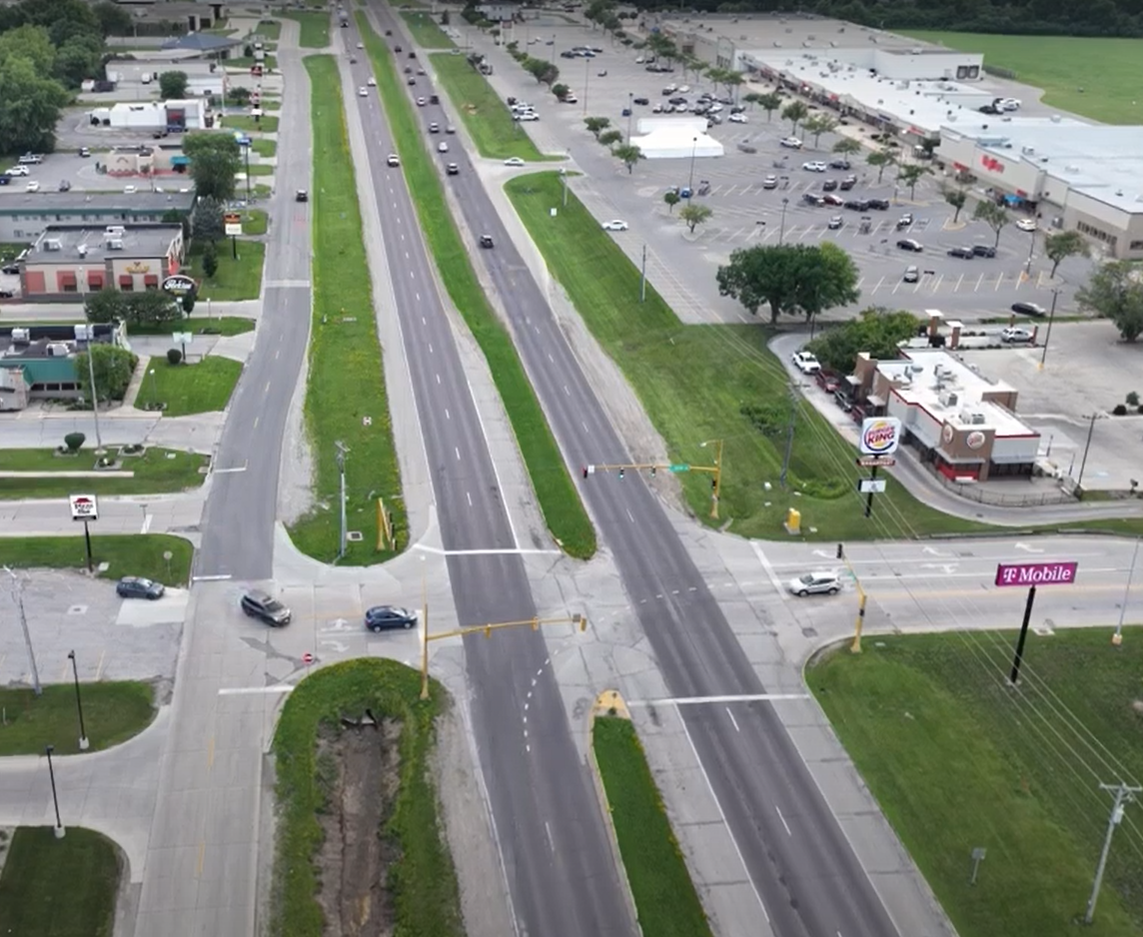
IA 122 West Section Existing Project Corridor Overview
Four-lane divided roadway, consistent with a rural corridor
6 major intersections with non-coordinated traffic signals
No longitudinal or crossing facilities for pedestrians or trails
Incomplete frontage road system
Inconsistent access points
Commercial, retail, health and service corridor serving North Iowa

Slide 9
IA 122 West Project Scope
Full reconstruction of the pavement
  Original pavement is more than 60 years old
Replace 5 signalized intersections with Roundabouts
  To improve safety, efficiency and operation of traffic through the Corridor
Provide shared use path and sidewalk to improve pedestrian and bike mobility
Grow Mason City’s ever expanding Pedestrian Transportation Network
  Continue the success of the Destination Iowa Trails projects
Maintain or improve access to surrounding properties to support vibrancy of businesses located adjacent to the corridor
Improve drainage along the corridor to provide a sustainable and resilient corridor
Estimated at $6.4 million for Engineering and Construction Engineering and $35.6 million for construction (in 2024 dollars)

Slide 10
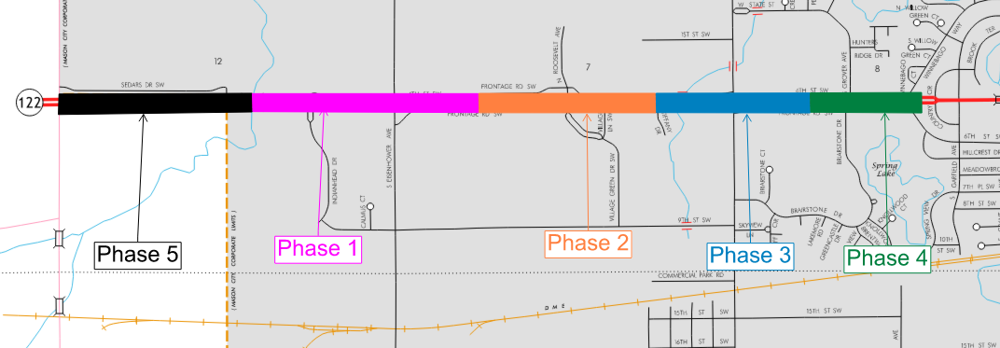
IA 122 West Section Study and Proposed Project
Mason City Staff and DOT District 2 Staff have been working together to revise the project scope, to make the project more manageable from financial and construction perspectives
  Includes changing the scope of work for the western most 0.55 miles of the project (Phase 5), and financing this Phase outside of the larger project
  The remaining project will be split into 4 sections, each roughly $9 million in construction costs

Slide 11

Grant and Funding Opportunities
The US Department of Transportation awarded Mason City an SS4A Grant in the fall of 2024
  Safe Streets and Roads for All (SS4A) Grants provide funds to prevent roadway deaths and serious injuries
  Mason City has been awarded $200,000 to develop a City-Wide Comprehensive Safety Plan
  Mason City will contribute $50,000 to the development of the Comprehensive Safety Plan
  Mason City has been working with FHWA to obtain the grant funds and begin work on the Action Plan

Slide 12
Grant and Funding Opportunities
The SS4A grant and subsequent Action Plan will evaluate Mason City’s streets and corridors across the entire jurisdiction
  Safety Impact – Which Mason City Streets can be improved?
  Equity – How to address transportation insecurity by increasing street safety for all users, motorized and non-motorized?
The IA 122 West corridor is identified as a priority improvement in the SS4A Application
  A dedicated portion of the Action Plan will focus on the IA 122 West Corridor
  If the grant money is available in time, Mason City plans to use the Action Plan to bolster the IA 122 West application for SS4A Implementation funds by June 2026

Slide 13

Next Steps
Complete the SS4A Safety Plan
  Mason City plans to use the Action Plan to bolster the IA 122 West application for SS4A Implementation funds by June 2026
Continue looking for funding opportunities
Begin Survey, NEPA and Design of the IA 122 West Corridor
Respectfully, we request to partner with the Iowa Department of Transportation to advance the project by including it in the Iowa DOT 5-year Program

Slide 14
Delegation:
Aaron Burnett, Mason City Administrator (Speaker)
10 First Street NW
Mason City, IA 50401
(641) 421-3600
aburnett@masoncity.net
Brent Hinson, Deputy City Administrator, Director of Finance
10 First Street NW
Mason City, IA 50401
(641) 421-3600
bhinson@masoncity.net
Fouad Daoud, President and CEO WHKS & Co. (Speaker)
1412 6th Street SW, PO Box 1467
Mason City, IA 504025
(641) 423-8271
fdaoud@whks.com
Scott Sweet, Vice President and Principal
1412 6th Street SW, PO Box 1467
Mason City, IA 504025
(641) 423-8271
ssweet@whks.com

