Slide 1
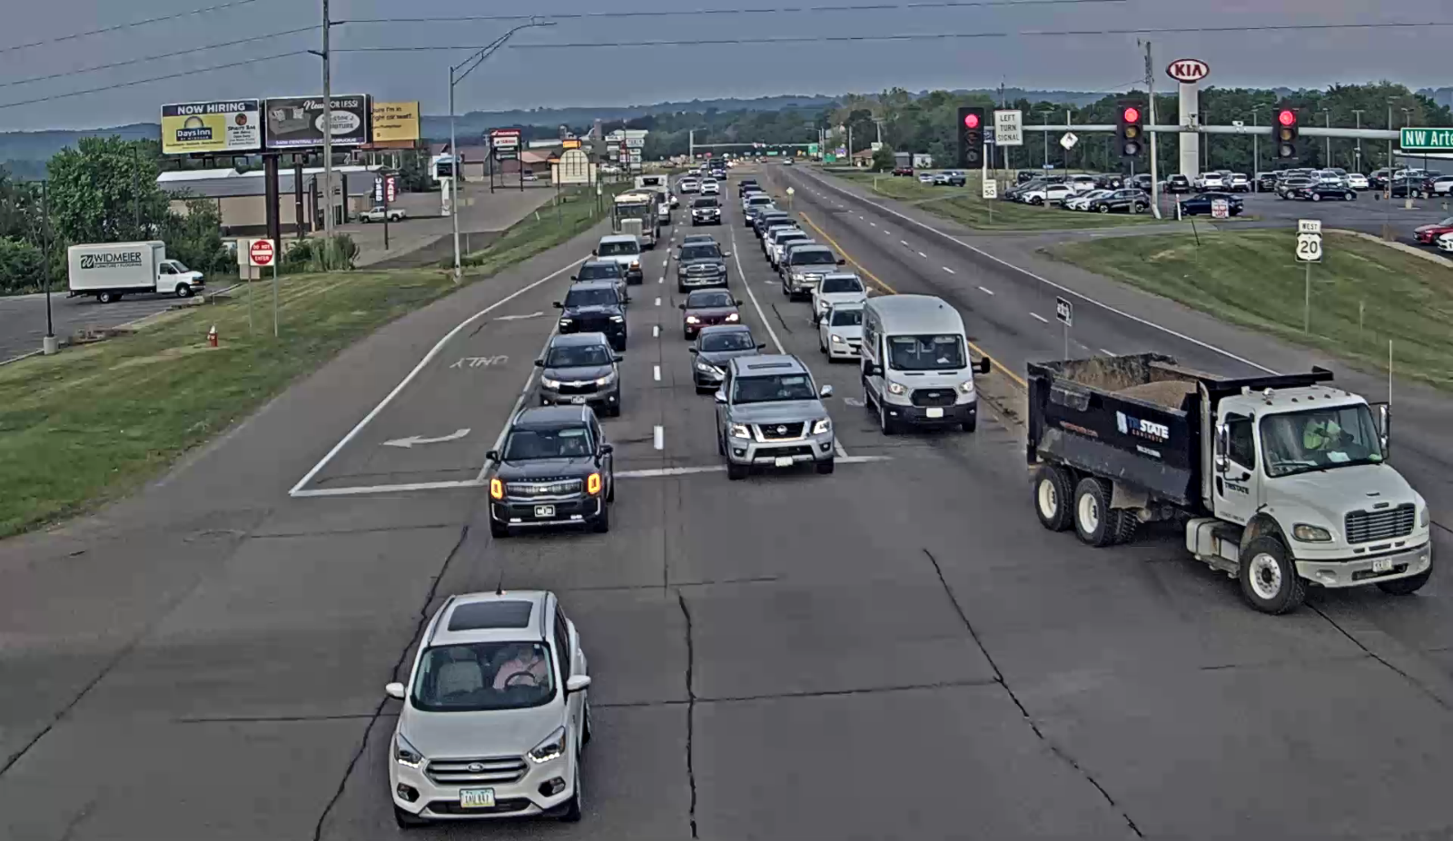





IOWA DOT COMMISSION PRESENTATION
Dubuque Metropolitan Area Transportation Study (DMATS)
US 20 / NORTHWEST ARTERIAL INTERSECTION
10/14/2025

Slide 2
THIS PRESENTATION WILL COVER
Partnerships
US 20 / NW Arterial Improvements
Impact of Merger of CP & KCS on DMATS
Building Bridges to Employment and Equity – RAISE Grant
Air Service
SMART Grant
2 | IOWA DOT Commission Meeting 10-14-2025
DMATS

Slide 3






PARTNERSHIPS
3 | IOWA DOT Commission Meeting 10-14-2025
DMATS

Slide 4
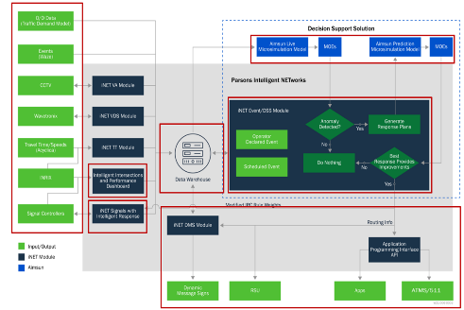
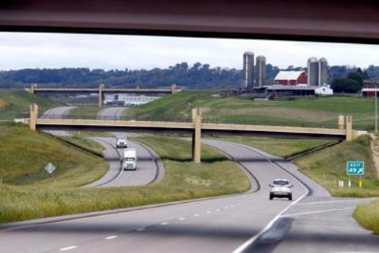
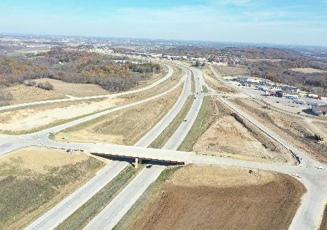
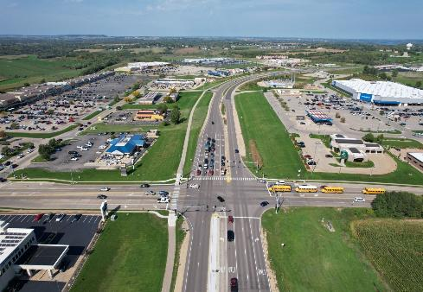
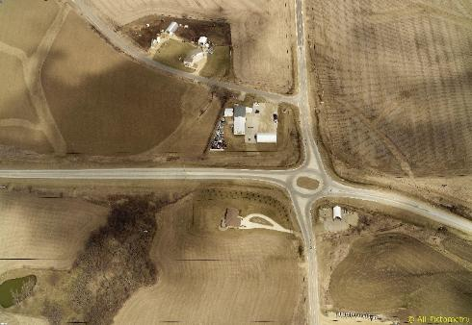
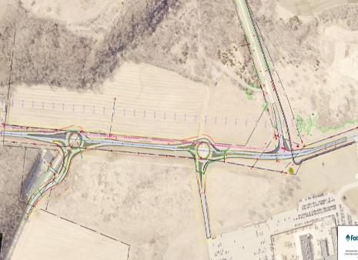
THANK YOU
STREETS
US 52 / SW ARTERIAL
SWISS VALLEY
NW Arterial
IA 3
JOHN DEERE
4 | IOWA DOT Commission Meeting 10-14-2025
DMATS

Slide 5
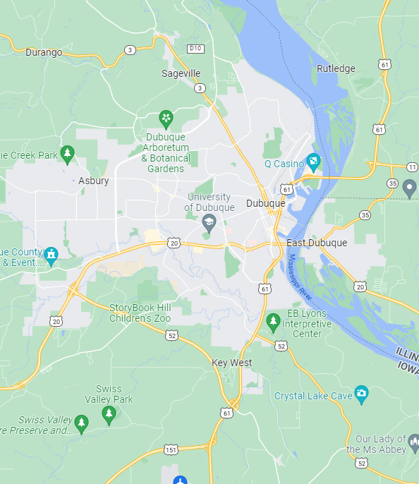
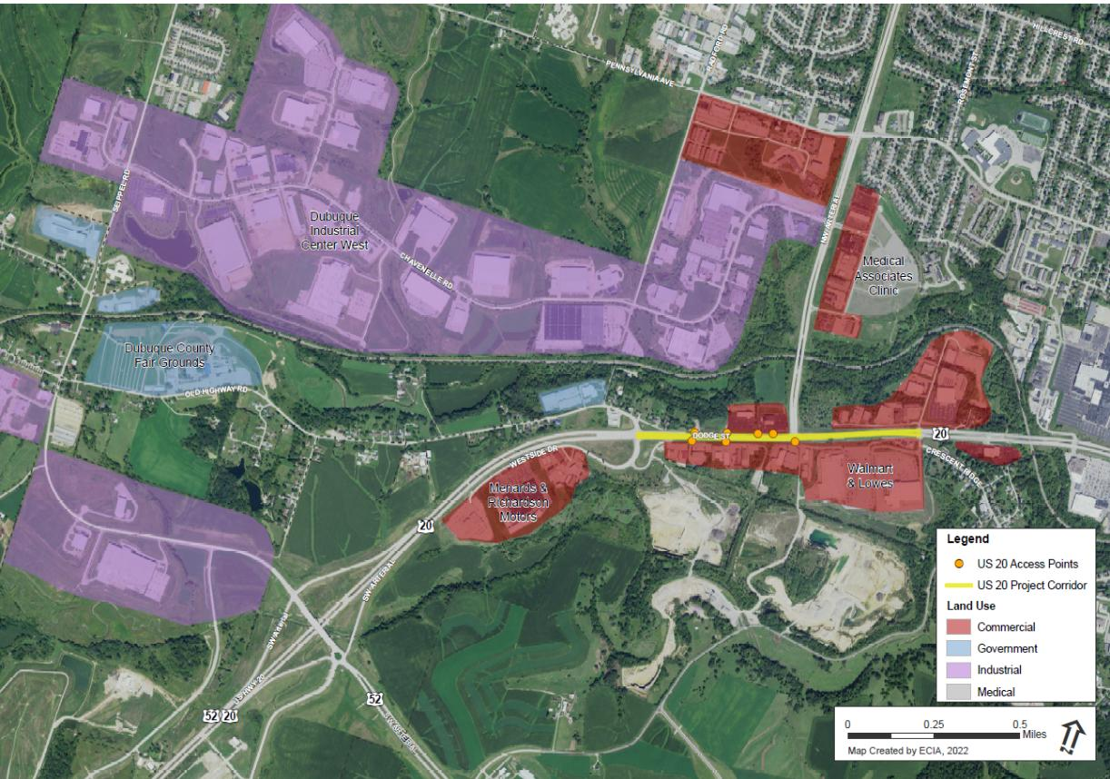

US 20 / NW ARTERIAL INTERSECTION
MAJOR Commercial
MAJOR
INDUSTRIAL
HIGH SCHOOL
COUNTY FAIRGROUNDS
MAJOR
MEDICAL
MAJOR COMMERCIAL
5 | IOWA DOT Commission Meeting 10-14-2025
DMATS

Slide 6
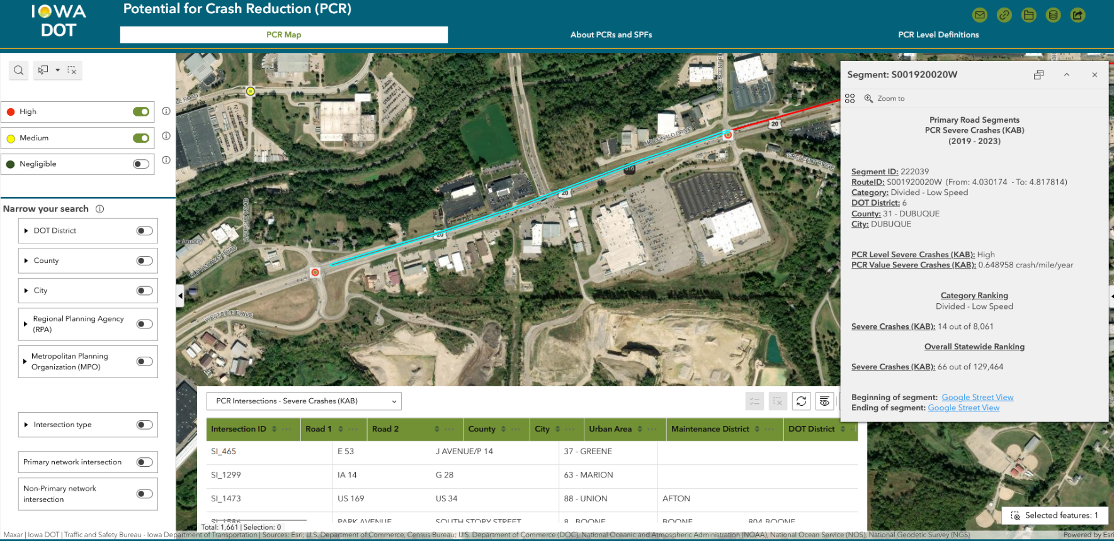
EXISTING CONDITION
44,000 VEHCILES PER DAY, INCLUDING 2,500 TRUCKS
194 Crashes from 2020 to 2025
6 | IOWA DOT Commission Meeting 10-14-2025
DMATS

Slide 7
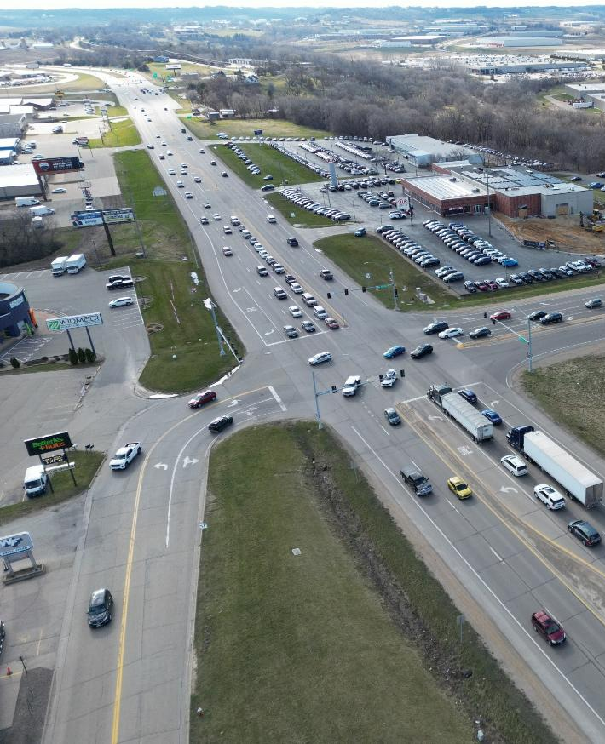
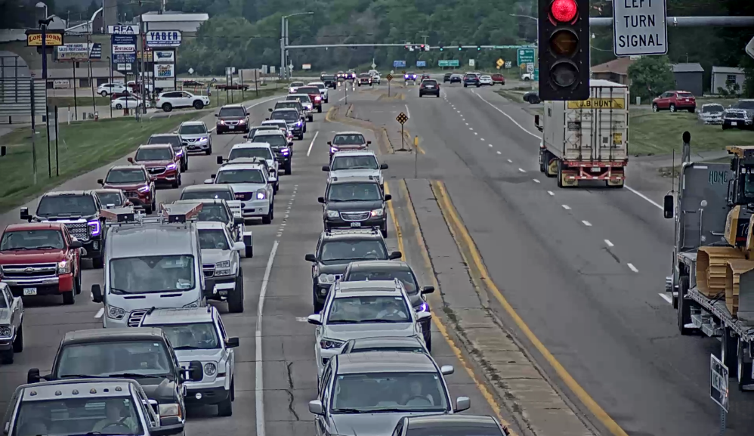
EXISTING CONDITION
Multiple Access Points
East Bound
Crashes are primarily related to:
  Poor access management near the intersection
7 | IOWA DOT Commission Meeting 10-14-2025
DMATS

Slide 8
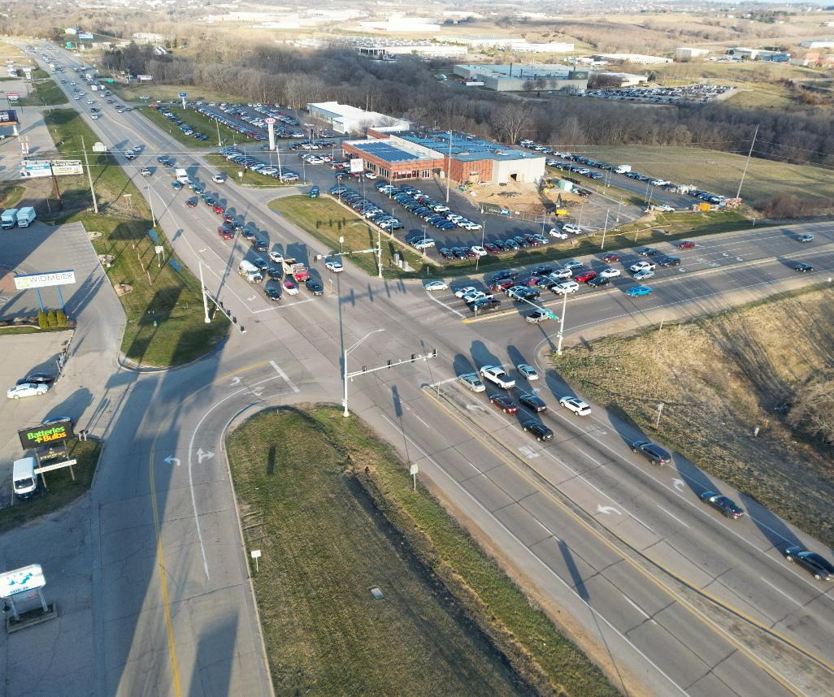
EXISTING CONDITION
East Bound
West Bound
Capacity Issues
Crashes are primarily related to lack of capacity at this intersection / congestion
8 | IOWA DOT Commission Meeting 10-14-2025
DMATS

Slide 9
PROJECT TIMELINE
🪧
Improvements at Old Highway
🏛️
City of Dubuque’s request
Part of the improvements suggested in the Six‐Lane Arterial Alternative were addressed during construction of US 52/SW Arterial construction
IADOT to improve US 20 / NW Arterial Intersection
2014
2018
2020
2021
2022
📑
🛣️
Opening of US 52/SW Arterial
📑
US 20 Location Study
Location Study
Free Flow Alternative
Partial Interchange Alternative
Eight‐Lane Arterial Alternative
Six‐Lane Arterial Alternative
Four-Lane Arterial Alternative
9 | IOWA DOT Commission Meeting 10-14-2025
DMATS

Slide 10
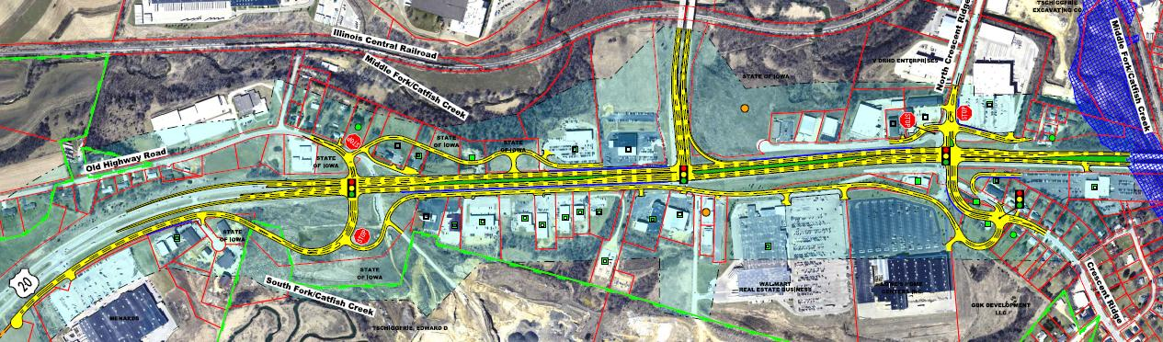
SIX LANE ARTERIAL ALTERNATIVE (Year 2014)
Two-way frontage roads serve existing mid-block access back to Old Highway Road
Three- leg intersection for US 20 and NW Arterial, eliminated south leg
Two-way frontage roads serve existing mid-block access back to Old Highway Road and Crescent Ridge
Design Features | Environmental Issues | Right-of-Way /Property Impacts ($ Million) | Order of Magnitude Cost ($Million) (Includes ROW)
6-Lane Signalized Arterial | 2 Recognized Environmental Conditions sites. Potential minor floodplain impact | 13.5 acres impacted 0 Full Residential 23 Partial Commercial 3 Full Commercial | $52 million in 2022 dollars
10 | IOWA DOT Commission Meeting 10-14-2025
DMATS

Slide 11
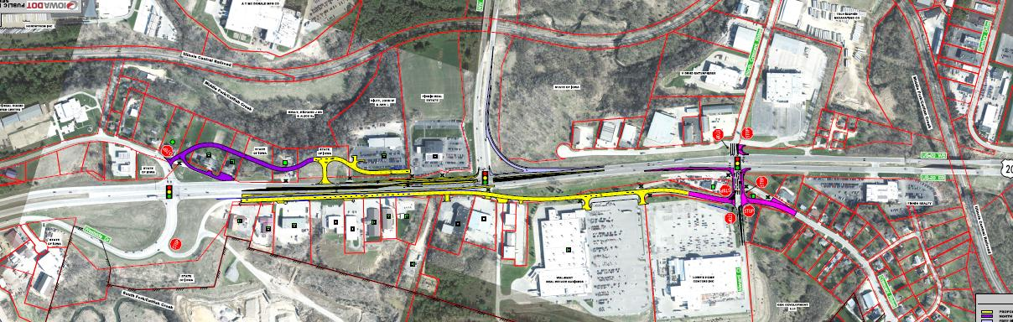
SIX LANE ARTERIAL ALTERNATIVE (Year 2022)
Two-way frontage roads serve existing mid-block access back to Old Highway Road
Three- leg intersection for US 20 and NW Arterial, eliminated south leg
Two-way frontage roads serve existing mid-block access back to Old Highway Road and Crescent Ridge
Design Features | Environmental Issues | Right-of-Way /Property Impacts ($ Million) | Order of Magnitude Cost ($Million) (Includes ROW)
4-Lane Signalized Arterial | 9 Potential regulated materials sites 5 Low risk sites 4 Moderate risk sites | 9 Potential regulated materials sites 5 Low risk sites 4 Moderate risk sites | $17.5 million in 2022 dollars
11 | IOWA DOT Commission Meeting 10-14-2025
DMATS

Slide 12
NEXT STEPS
Completed Public Input
Selected Preferred Alternative
Request Programming Project In IowaDOT Five Year Program
The Dubuque Metropolitan Area Transportation Study (DMATS) approved $6.0 million for the project.
12 | IOWA DOT Commission Meeting 10-14-2025
DMATS

Slide 13
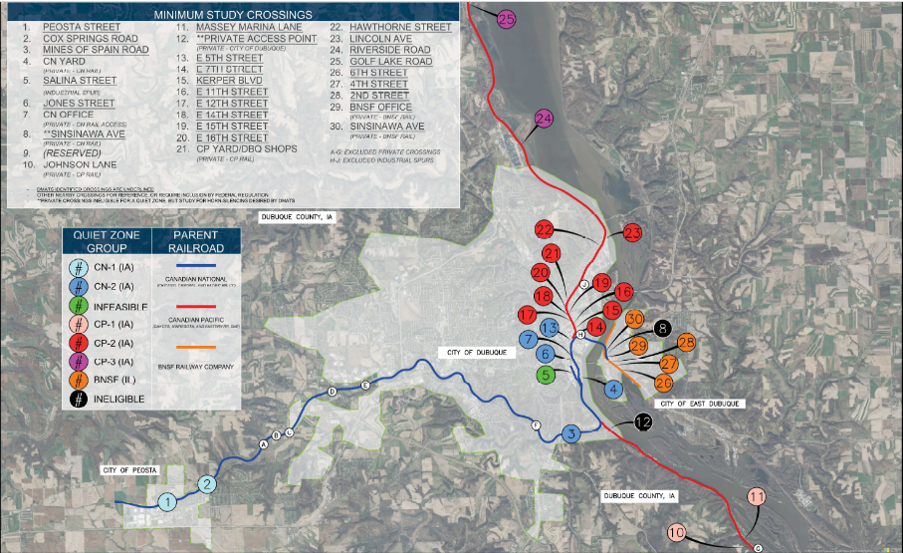
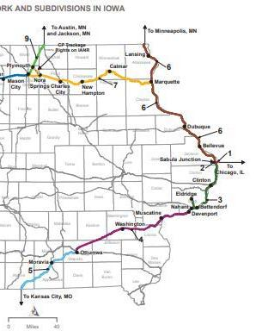

IMPACT OF CANADIAN PACIFIC AND KANSAS CITY SOUTHERN MERGER (KCS)
Route affected in Iowa
18 Intersections in the City of Dubuque
6
Intersections in the City of East Dubuque
2
Intersections in the City of Peosta
4
Intersections in Dubuque County
Intersections affected in DMATS
13 | IOWA DOT Commission Meeting 10-14-2025
DMATS

Slide 14
NEXT STEPS
Conducted a Quiet Zone study
Applied for Federal Rail Administration grants
    Highway-Railroad Crossing Safety Program
    Consolidated Rail Infrastructure Safety Improvements (CRISI) Program
14 | IOWA DOT Commission Meeting 10-14-2025
DMATS

Slide 15


BUILDING BRIDGES TO ELEVATE EMPLOYMENT (B2E2)
IMPROVEMENTS ON # 3
PROJECT AREA
15 | IOWA DOT Commission Meeting 10-14-2025

Slide 16
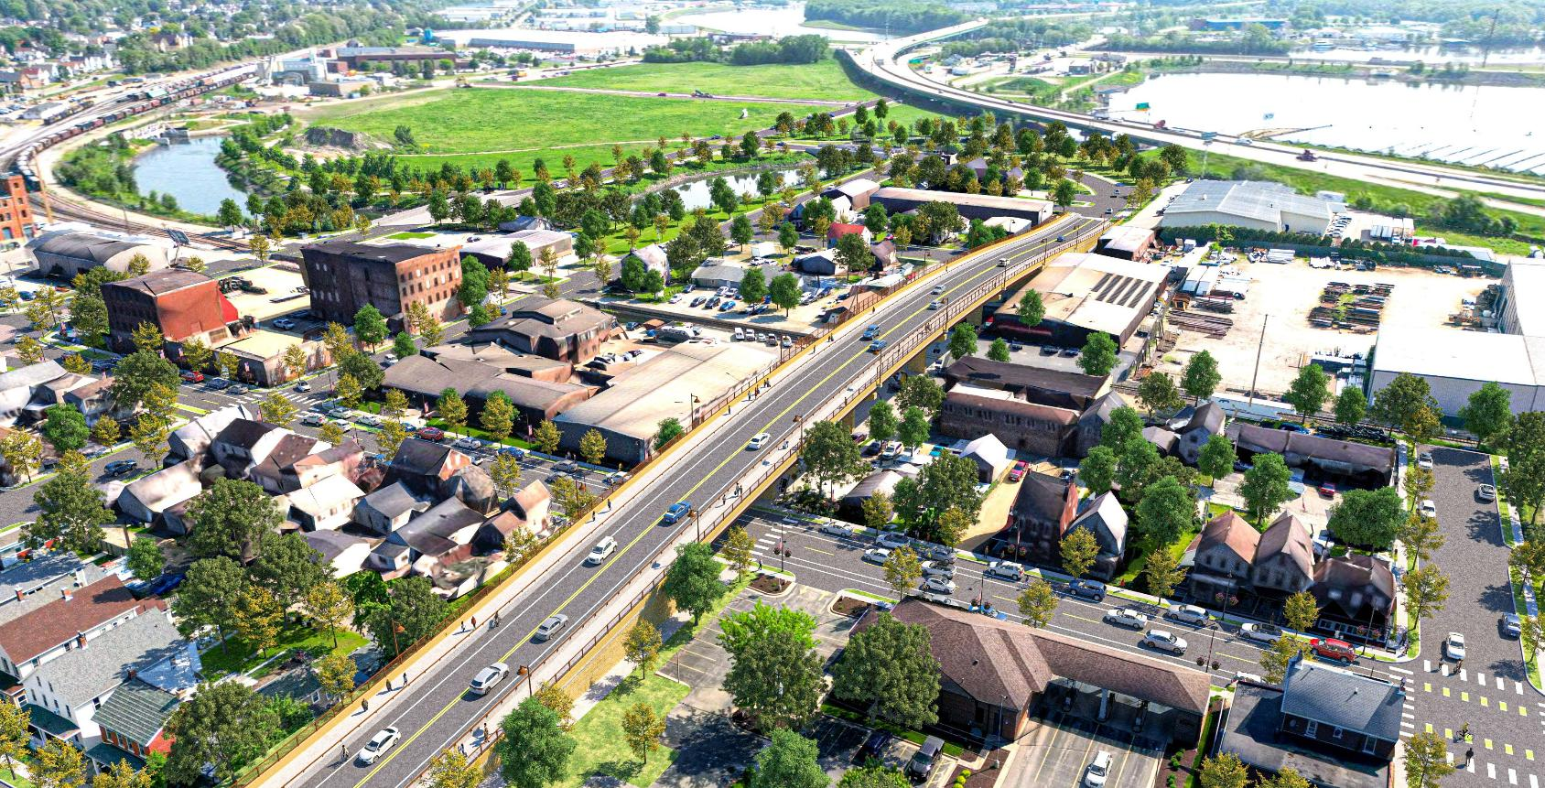
BUILDING BRIDGES TO ELEVATE EMPLOYMENT (B2E2)
LEGEND
Bee Branch Bicycle & Pedestrian Trail
Future Redevelopment
Bee Branch Creek
16th Street Complete Street
14th Street CPKC Railroad Overpass
Connectivity to Chaplain Schmitt Island & Kerper Boulevard
Washington Street Neighborhood Revitalization
Dubuque’s 2 lowest
income census tracts
Elm Street Complete Street
Connecting to Intermodal
Transportation Center.
To the Intermodal Transportation Center
Roundabouts
CPKC Railroad
10
6
1
2
10
1
4
3
11
10
11
5
7
8
9>
16 | IOWA DOT Commission Meeting 10-14-2025

Slide 17
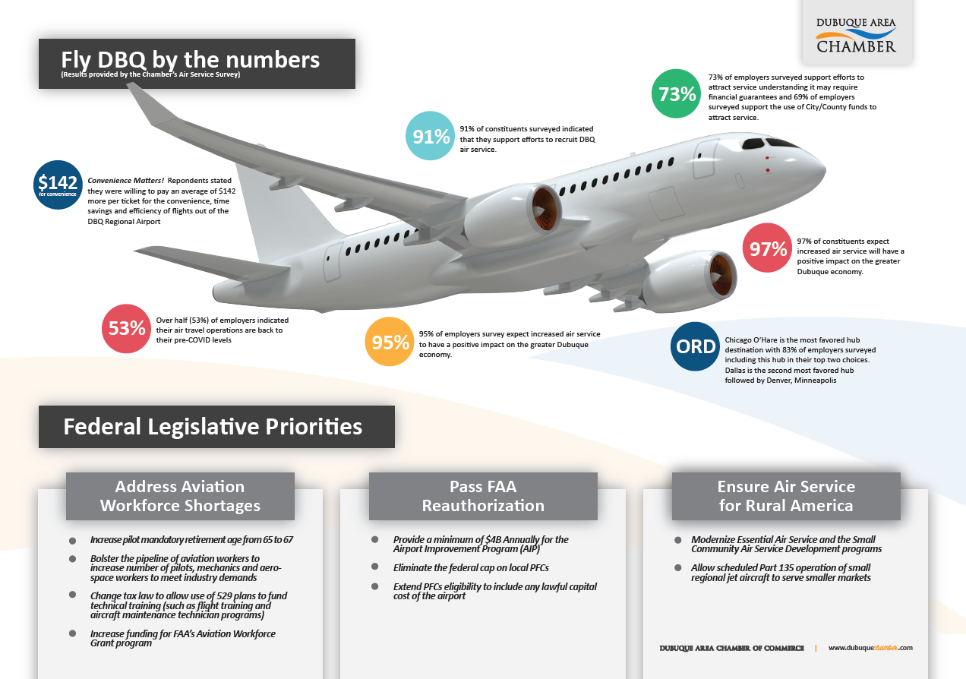
DBQ AIR: TAKING FLIGHT FOR ECONOMIC PROSPERITY
17 | IOWA DOT Commission Meeting 10-14-2025
DMATS

Slide 18
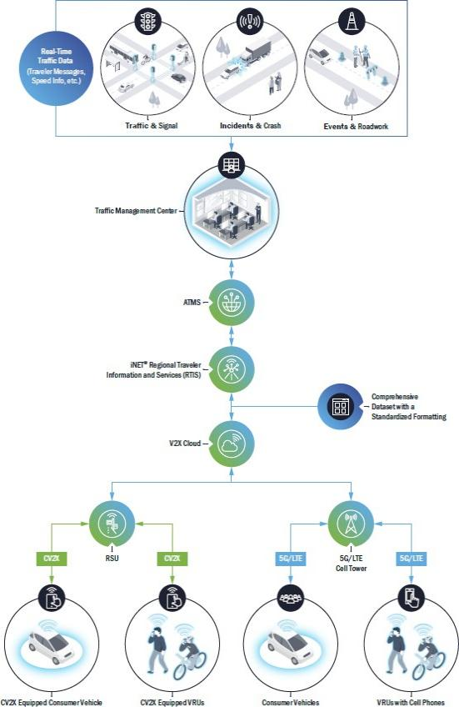
Metro Dubuque Traffic Data Aggregation for Connected Vehicles Project –SMART Project
SCOPE
The project aims to create a comprehensive data set for the entire Dubuque metropolitan area, covering aspects such as congestion, road closures, railroad crossing blockages, crashes, traffic signal timing, special events, parking, and weather conditions. During Phase I, the project has achieved the following:
  Integrated the data into a standardized format.
  Developed intelligence to define distribution limits for each data type.
  Created an open interface that provides this data in near real time through cellular connections to original equipment manufacturers (OEMs), infotainment system providers, and other third-party data stakeholders.
The project will revolutionize how transportation data is collected, shared, and utilized.
18 | IOWA DOT Commission Meeting 10-14-2025
DMATS

Slide 19
THANK YOU
19 | IOWA DOT Commission Meeting 10-14-2025
DMATS

