Slide 1
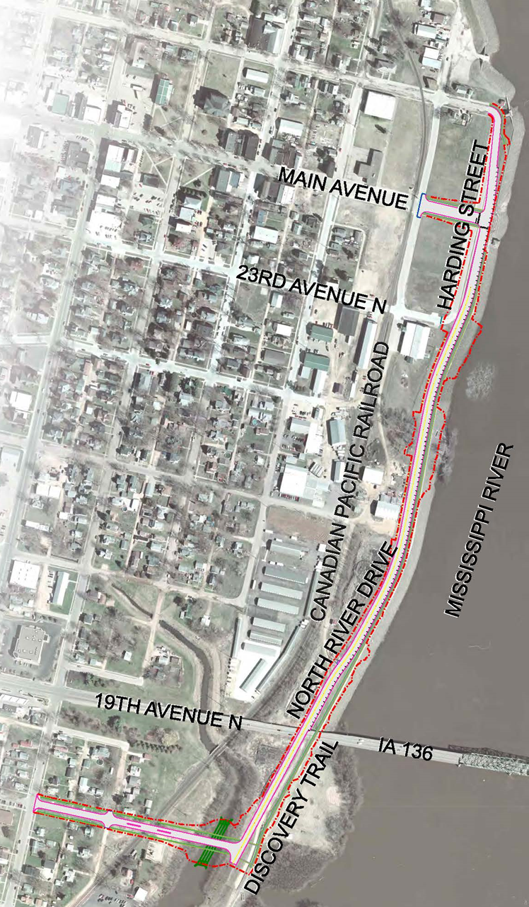

North river drive
Iowa dot commission
October 14, 2025
Project background and
funding status report

Slide 2
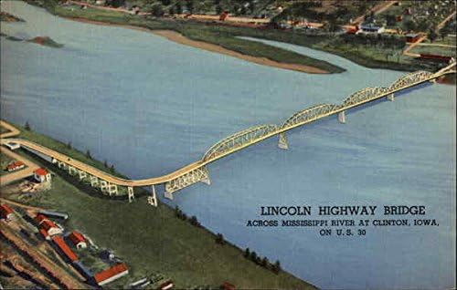
History of Lyons Business District
Lincoln Highway Bridge
  Opened July 4, 1891
  Replaced by the 19th Avenue N. (Hwy 136) Gateway Bridge in 1970s

Slide 3
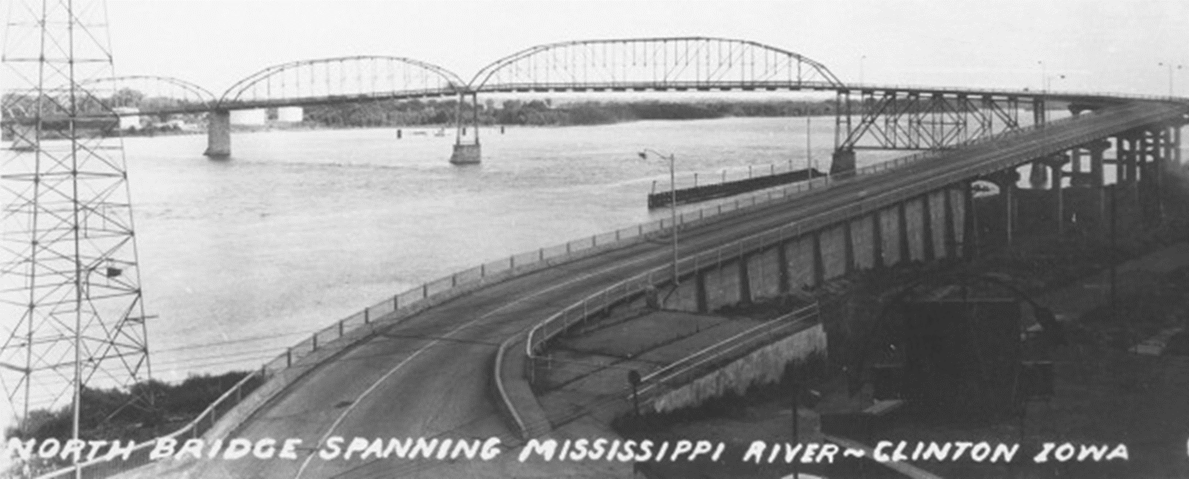
History of Lyons Business District
Lincoln Highway Bridge Connected Fulton, IL to Lyons, IA
  (currently known as Lyons Business District)

Slide 4
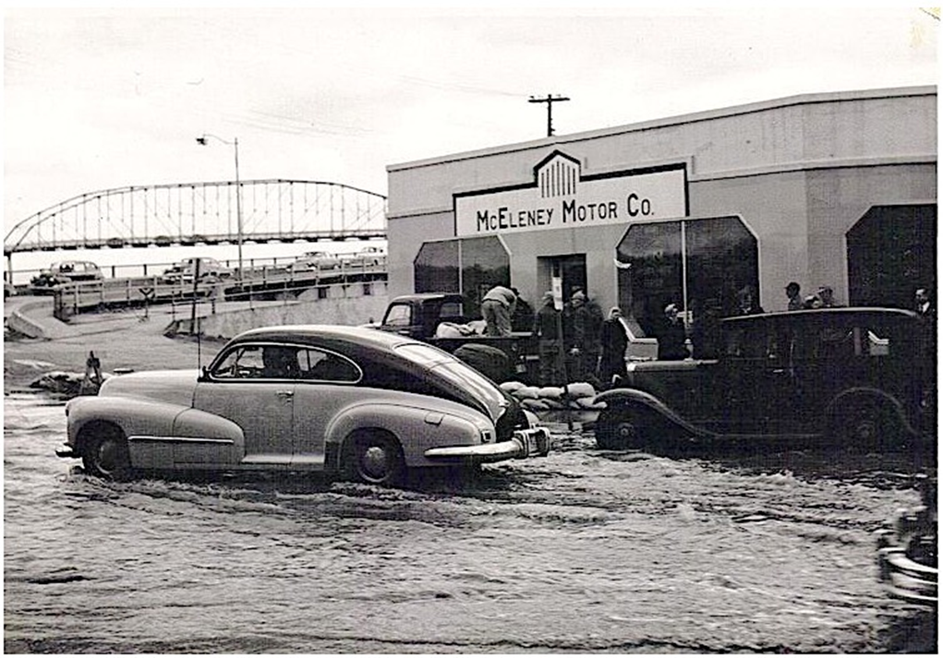
History of Lyons Business District
McEleney Motor Co. was the anchor business of Lyons
  Opened in 1914
  Relocated from Lyons in 2002
  Building razed shortly thereafter

Slide 5
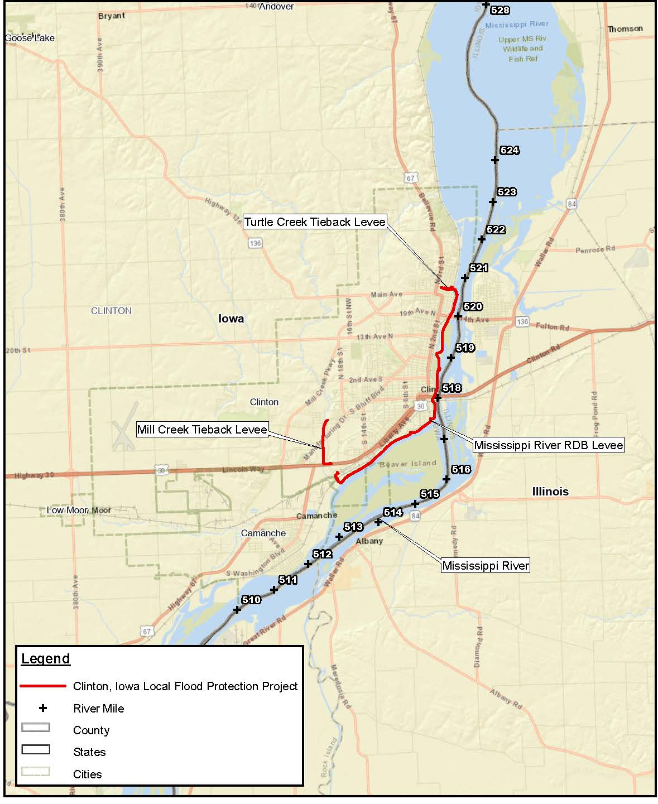
Clinton Levee History
Major flood of Mississippi River in 1965
USACE began building the levee in 1975
Nearly 8 miles of levee
  Mainline channel
  Mill Creek Tieback
  Turtle Creek Tieback
Riverview Drive on top of levee adjacent to downtown
Limited visibility and access to Mississippi River in northern Clinton/Lyons area

Slide 6
Public Involvement – North River Dr
Public meeting held June 21, 2023 with 20 people signed in as attendees
10 stakeholders have typically met every month on Friday mornings to discuss this project for many years
Primary Concerns
  Loss of traffic on Main Avenue
  Business closures
  Dilapidated buildings
  Underdeveloped/undeveloped properties
  Lack of access to the Mississippi River
  Underrealized taxable valuation in Lyons and surrounding neighborhoods
  Infrastructure condition
  Railroad crossings
  Lack of adequate roadway circulation
Accomplishments
  $650,000 Flood Resiliency Grant through former Iowa Senator Chris Cournoyer
  Quiet Zone establishment
  Roadway/permeable pavers improvements in Lyons
  Opportunities for growth and support Lyons Business and Technology Park
  Lyons Farmers Market development
  Sawmill Museum expansion
  Some business investment occurring

Slide 7
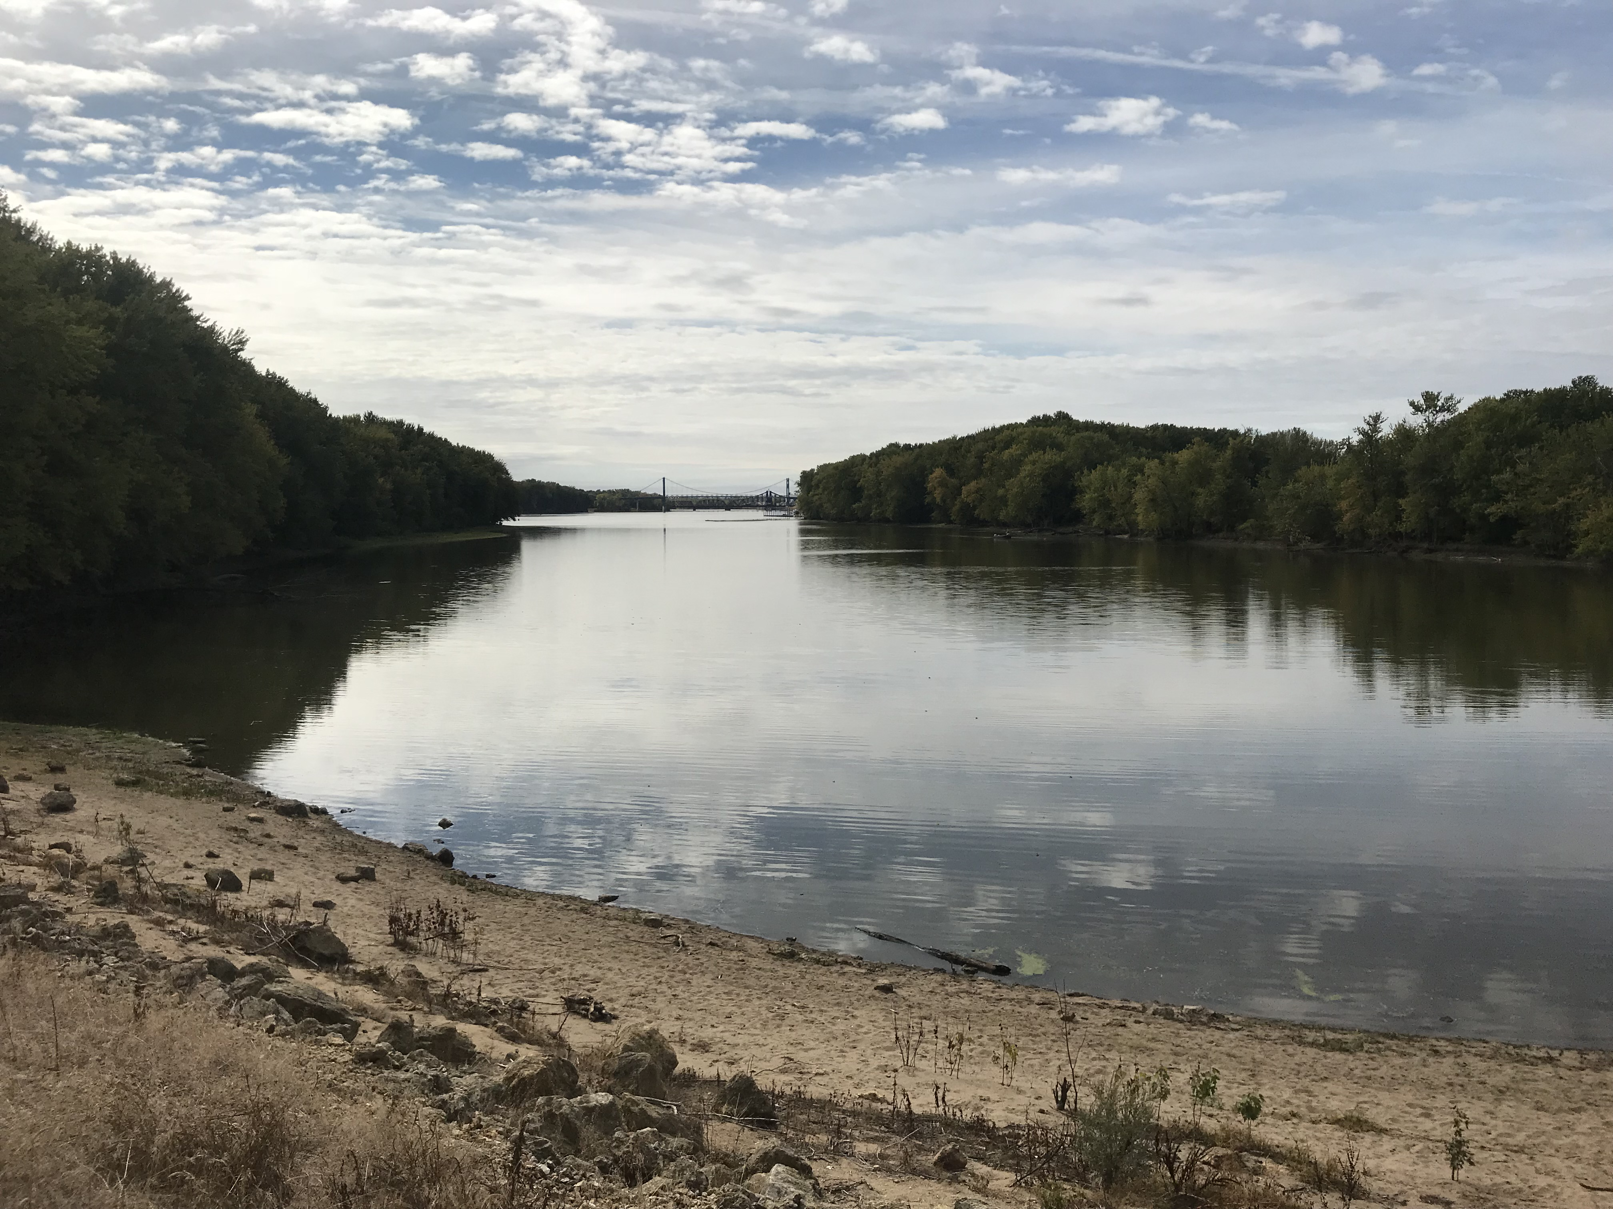
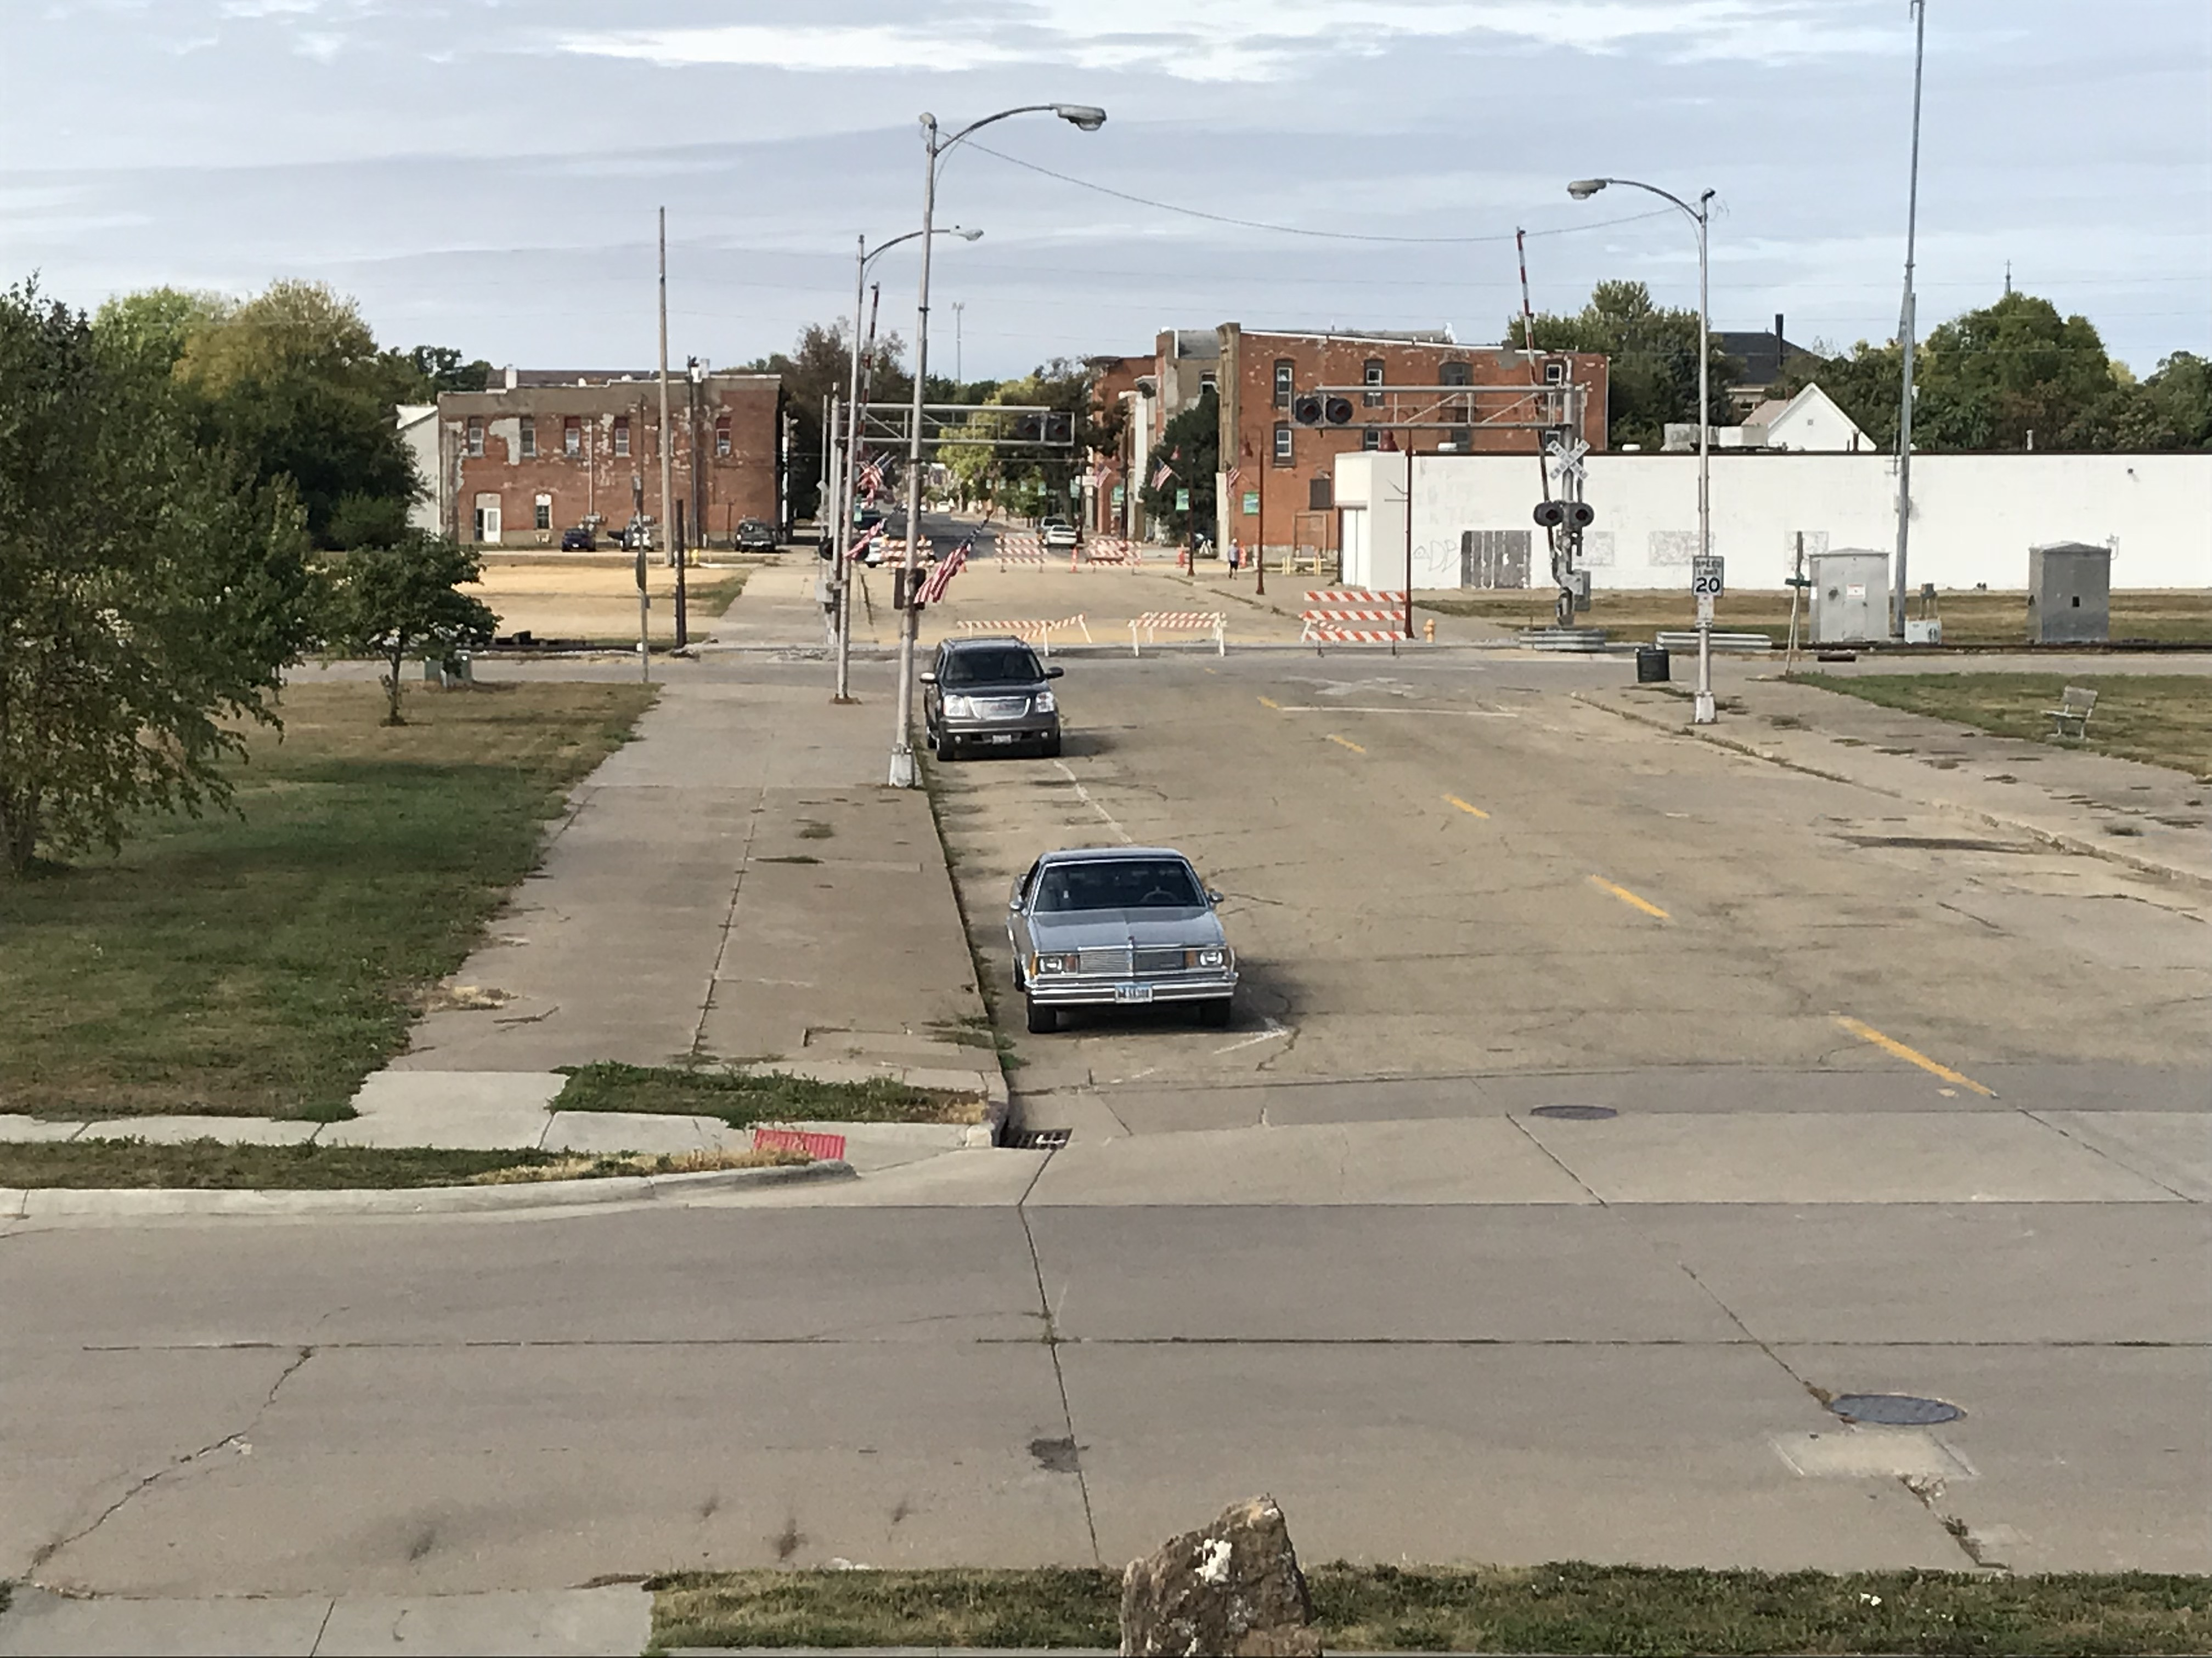
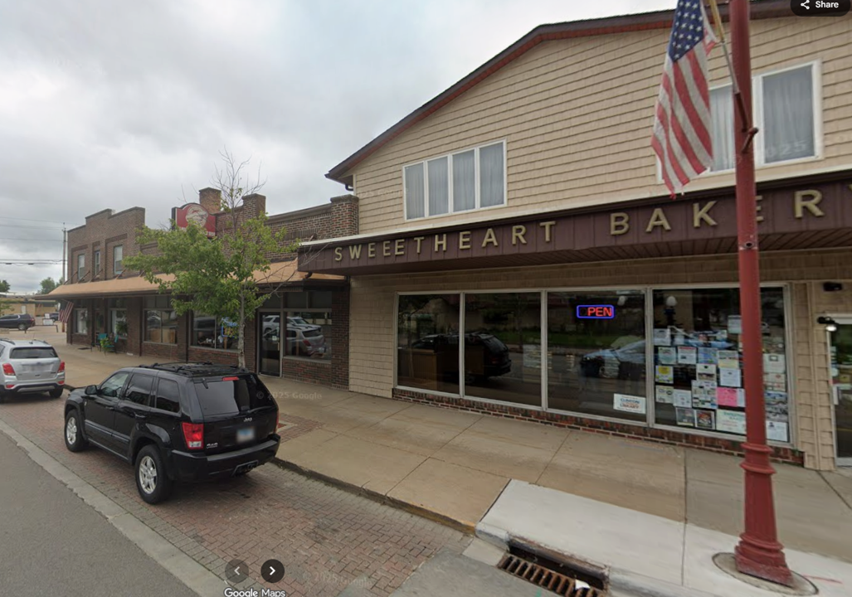
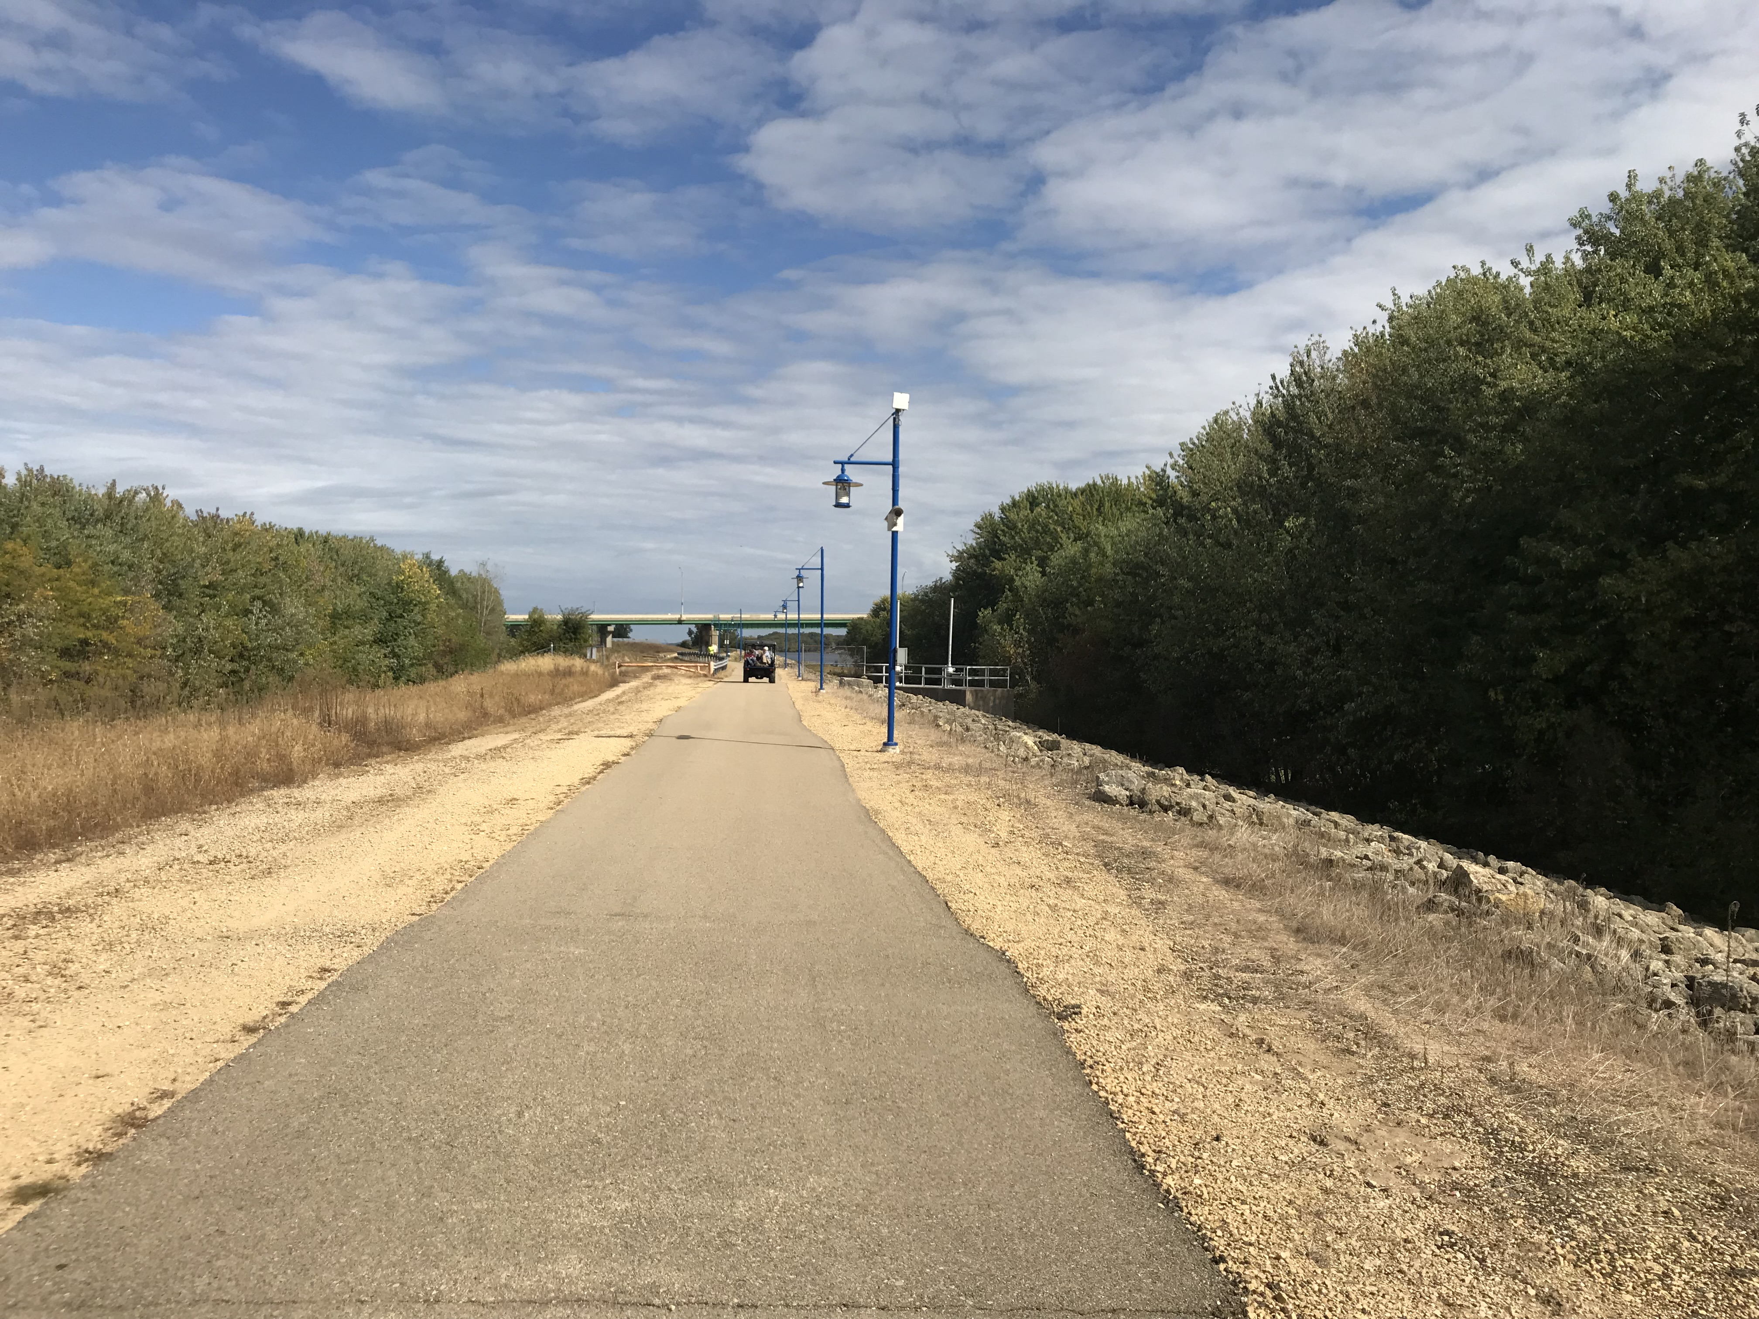
Project Goals
Improve Access to River
Support Economic Development and Increase Tax Base
Improve the Discovery Trail
Improve Access to Lyons Business District

Slide 8
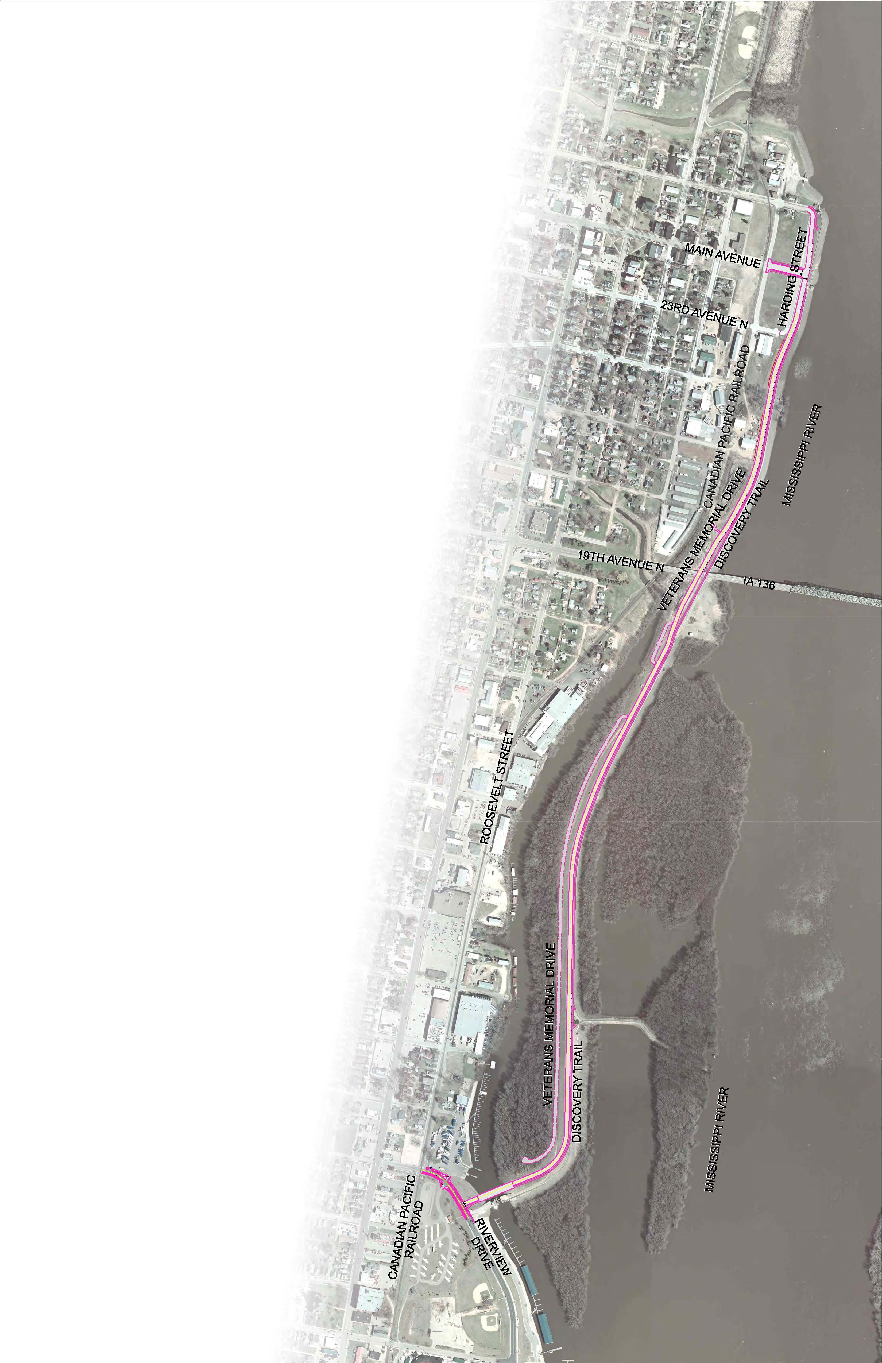
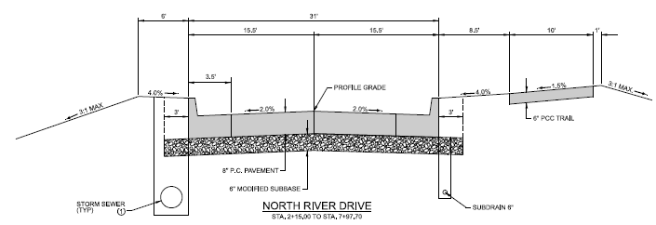
Initial Concept
2-lane urban road from Riverview Drive to 25th Avenue N.
  1.6 miles
New trail along top of levee (replace dilapidated trail)
Parallel parking along east side of road, adjacent to trail for most of project limits
Bridge over Joyce’s Slough Marina and Flood Control Gate
Project cost ~ $22M (2024 dollars)

Slide 9
Completed Items
Levee Flood Resiliency Plan Update for all of Clinton
Draft Environmental Assessment (EA) for Initial Concept (Riverview Dr to 25th Avenue N)
30% Design for Initial Concept
Action by Council – May 13, 2025
Shorten N. River Dr project to between 18th Ave N and 25th Ave N
Reapply for a $1M Community Project Funding (CPF) grant through Congresswoman Miller-Meeks

Slide 10

North River Dr. Elements
Current Project
2-lane urban road from 18th Avenue N. to 25th Avenue N.
  (0.9 miles)
New trail along top of levee
Parallel parking along east side of roadway
Improved safety crossing of CPKC Railway
Crossing of Car Barn Creek
Project cost is ~$16.9M (2024 dollars)

Slide 11
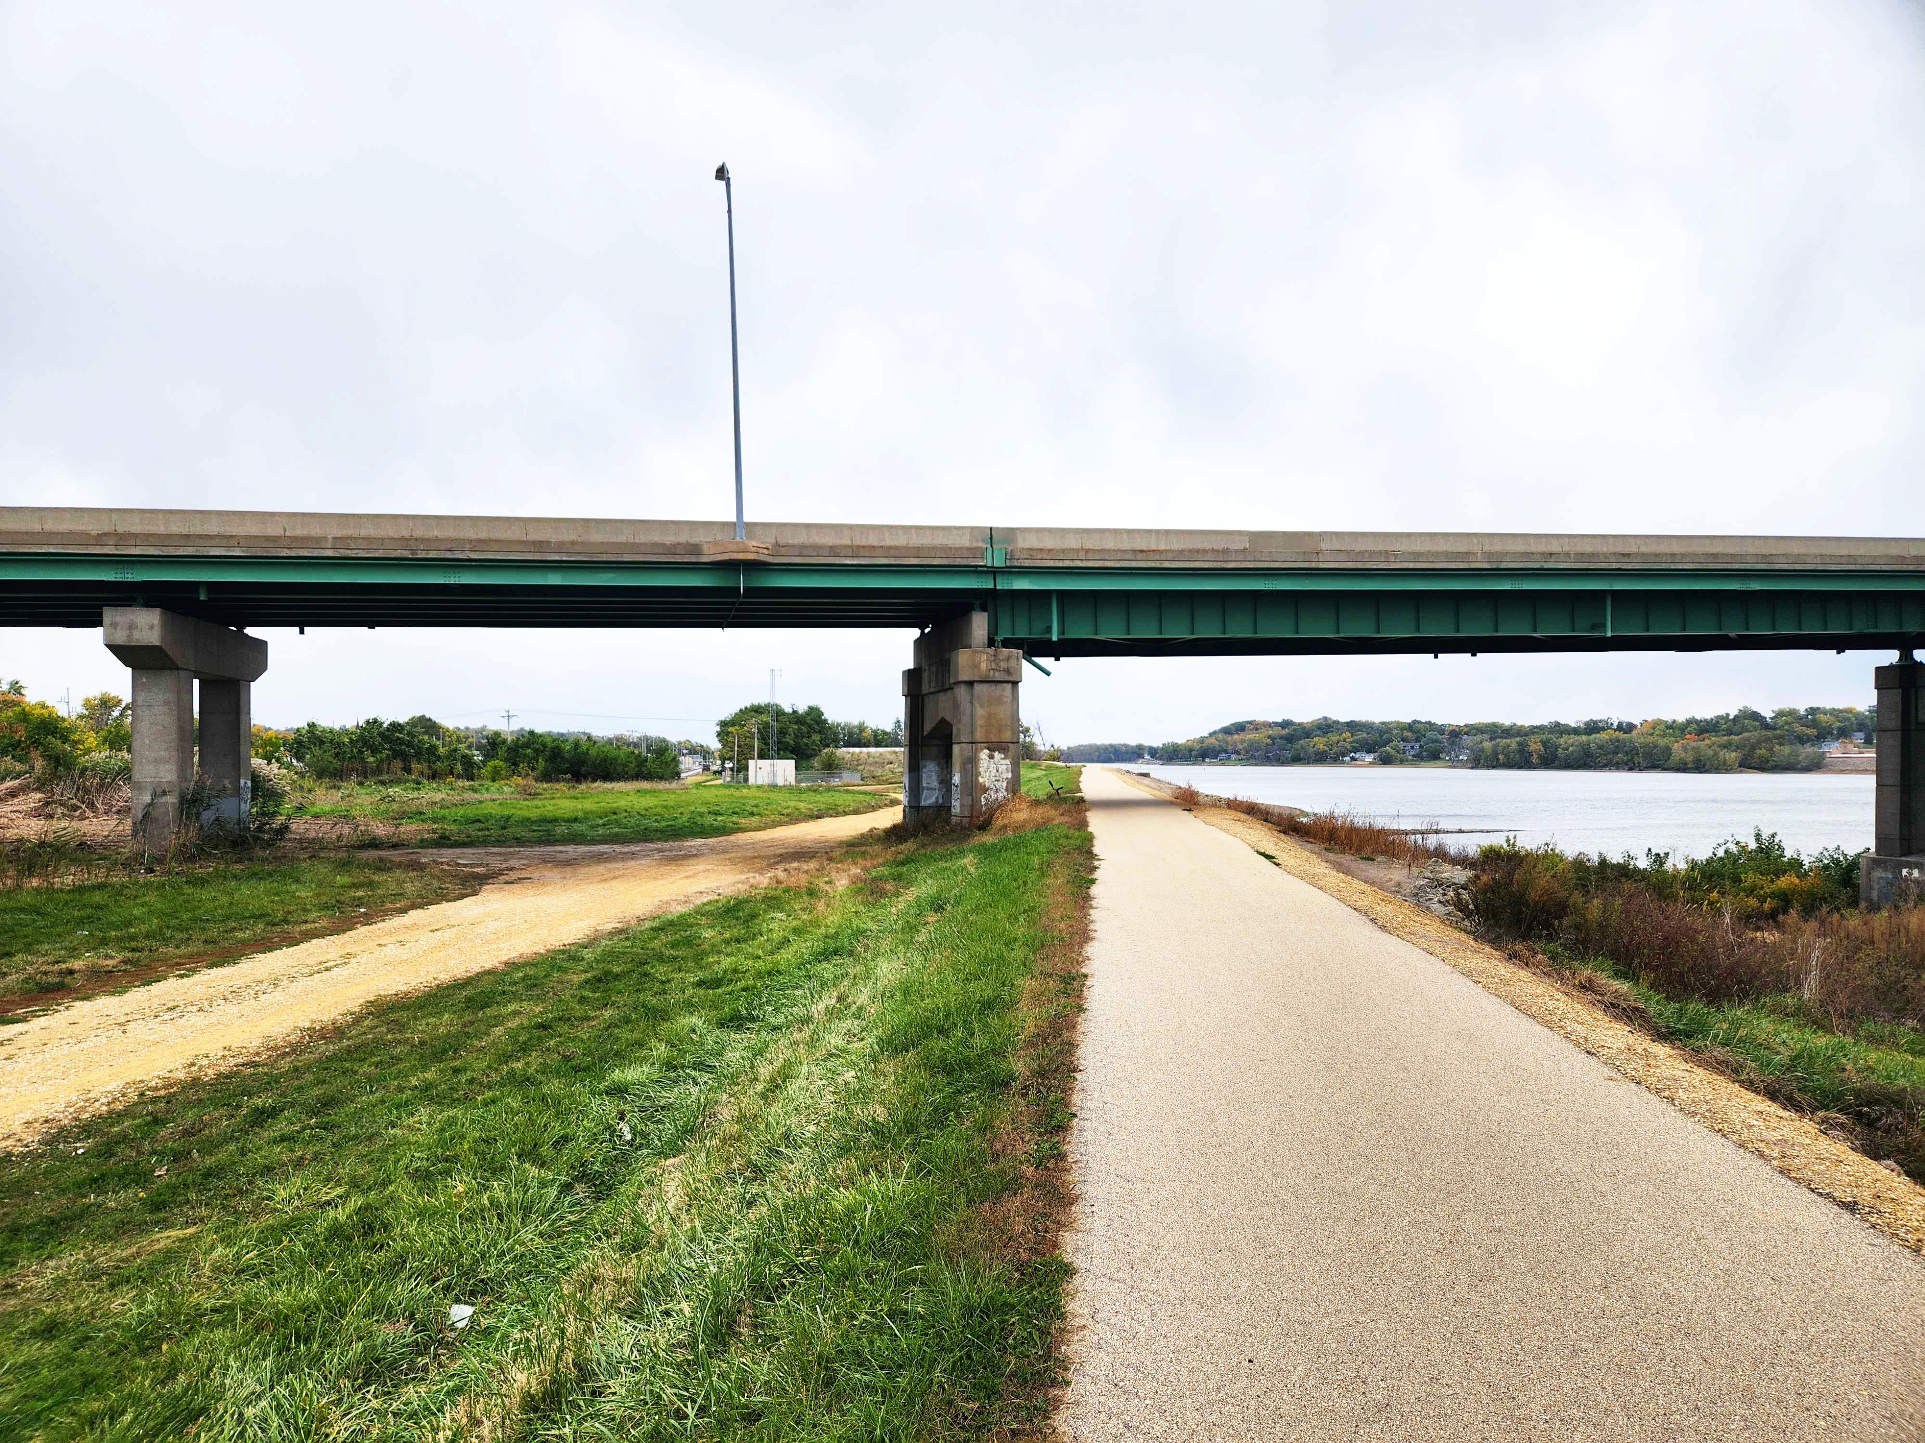

Slide 12
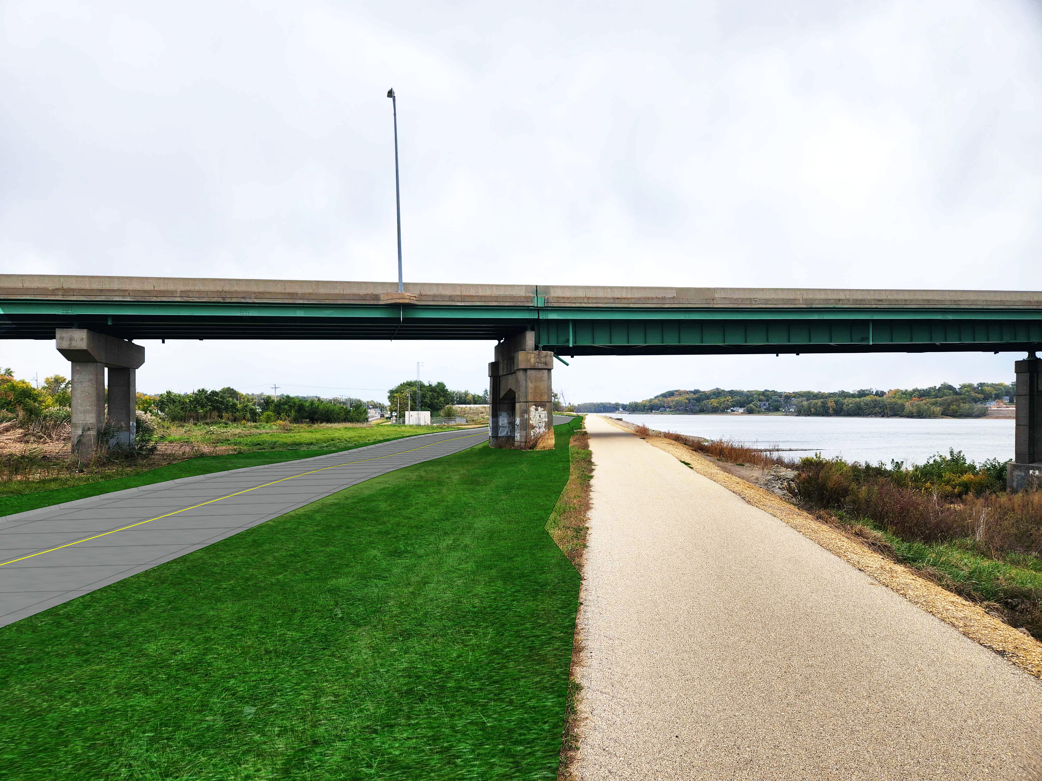

Slide 13
Next Steps
Await award of Community Project Funding grant (subsequent steps rely upon successful award)
Develop funding agreement with Iowa DOT’s assistance
Procure professional consultants to complete the following:
  NEPA study update for shorter project
  Land acquisition
  Section 408 permit with the Corps of Engineers
  Final Design
  Funding procurement for construction
Construction

Slide 14
Formal Request for Consideration
The relocation of the Lincoln Highway Bridge negatively impacted Lyons and surrounding neighborhoods.
Relocation of Highway 136 reduced traffic flow through commercial district.
Request for Iowa DOT’s financial support with the $750,000 match of the CPF grant, if awarded, to help revitalize the area impacted by the realignment.
  Tourism benefits with Mississippi River access via roadway, parking, trail upgrade, and potential infill development
  Economic need for the northern Clinton area
  Revitalization need for Lyons Business District
  Safe crossing of CPKC Railway

Slide 15
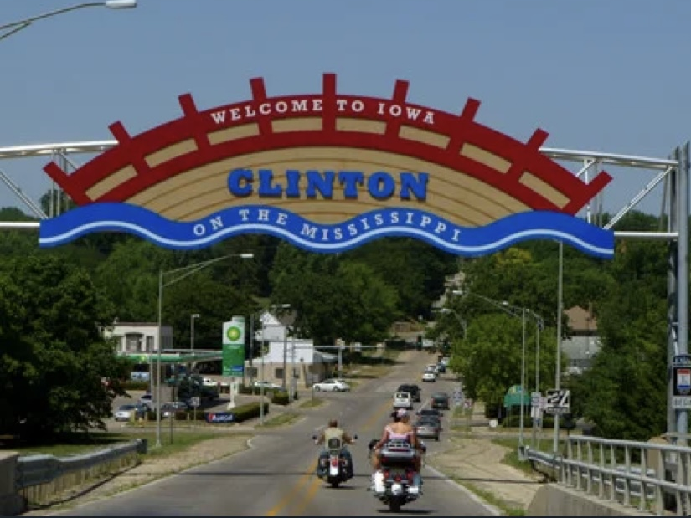
THANK YOU!

