Slide 1
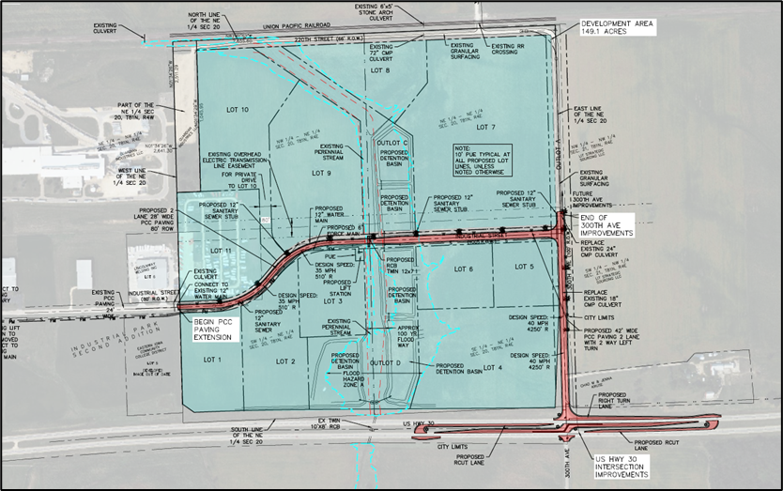
Local Development Recommendation
PROJECT NAME | SPONSOR | SCORE | TOTAL PROJECT COST | PERCENT PARTICIPATION | RECOMMENDED AMOUNT
Construction of approximately 2,810 feet of Industrial Street, paving of approximately 1,430 feet of 300th Avenue and intersection improvements including turn lanes and R-Cut at the intersection of U.S. 30 and 300th Avenue located on the southeast side of town | DeWitt | 46 | $5,826,391 | 50% | $2,913,196
1
1

