Slide 1


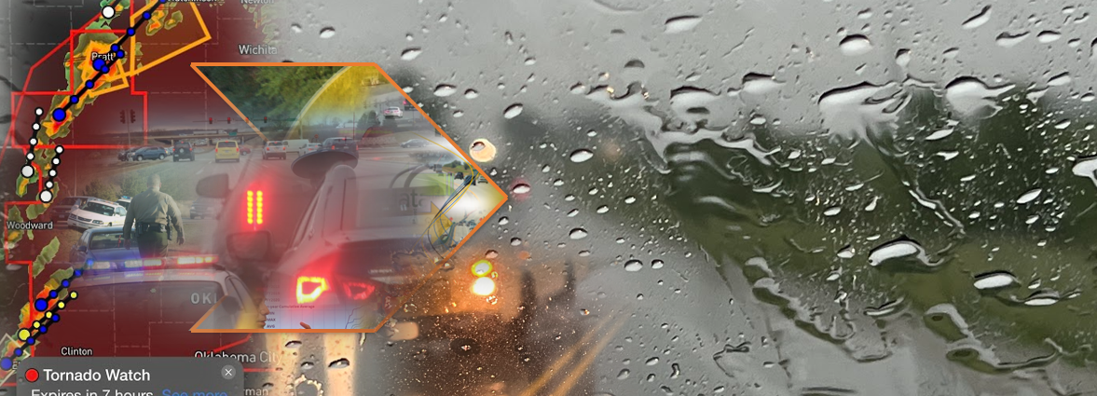
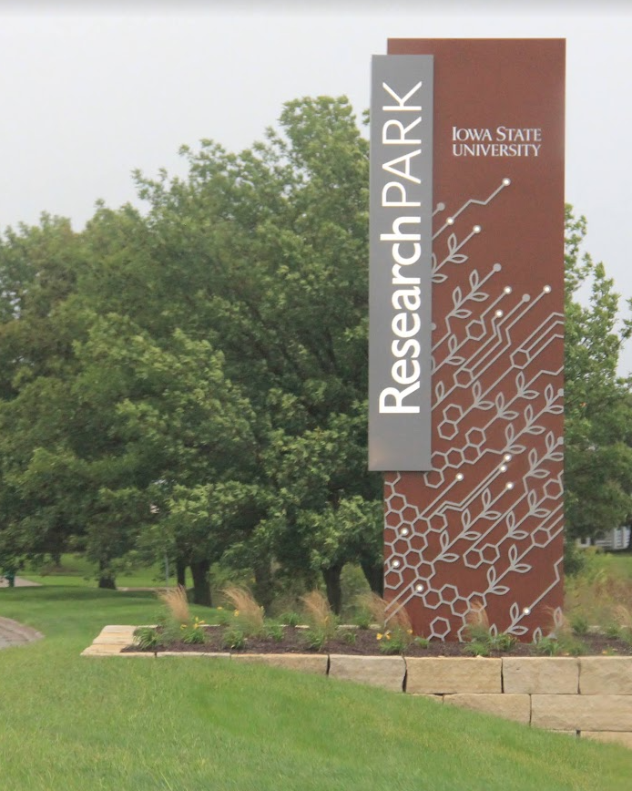
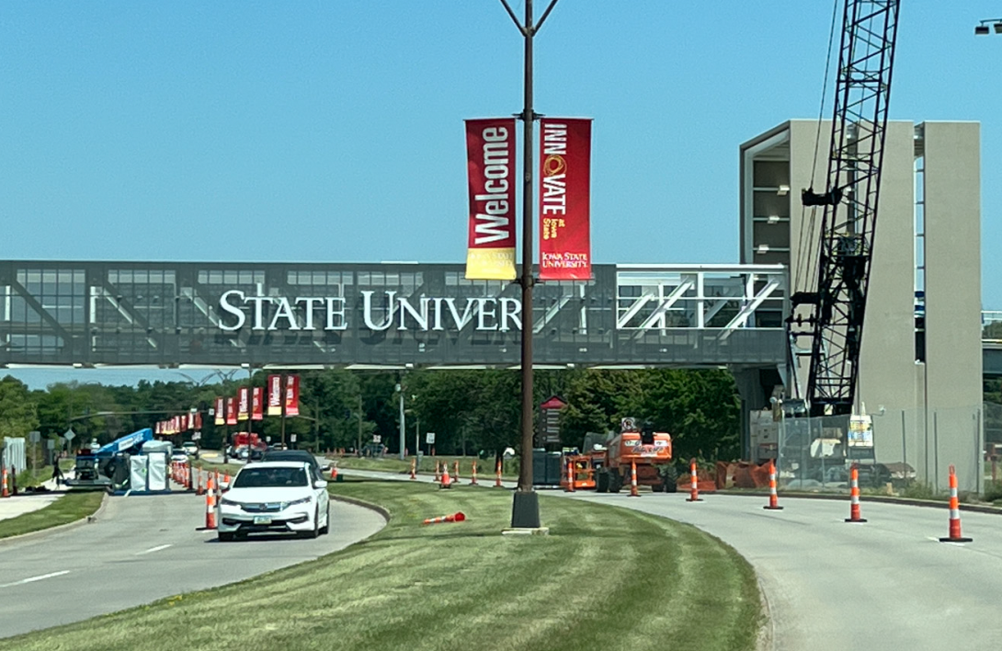


Overview of the Institute for Transportation
Iowa DOT Commission Meeting
November 12, 2025

Slide 2

Institute for Transportation (InTrans)
Founded in 1983 with a vision to transform Iowa’s transportation future
Now the largest research institute at Iowa State University
Powering active research projects that connect people, ideas, and technology
Driving innovation through research, education, and outreach
Located in the ISU Research Park — where ideas move Iowa forward
InTrans Mission
Saving lives and improving economic vitality through discovery, research, innovation, outreach, and implementing bold ideas.

Slide 3






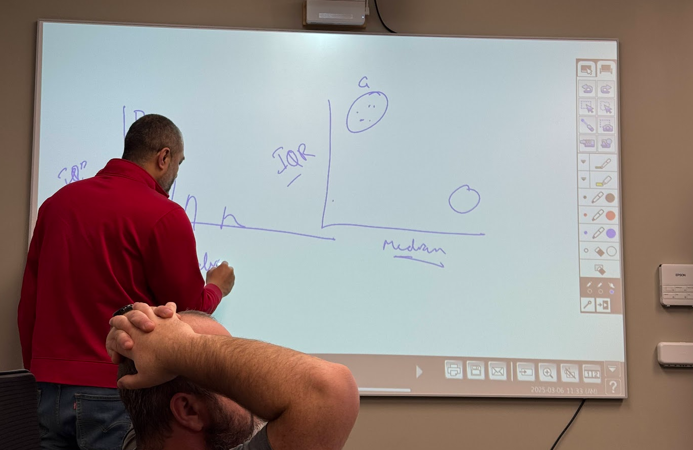



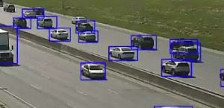

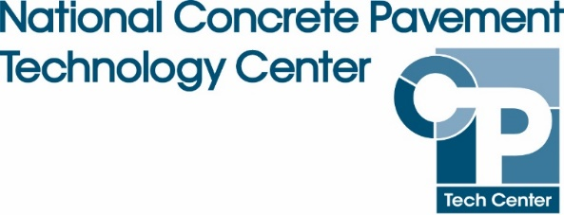
About InTrans
People
    24 affiliated faculty
    61 P&S
    11 postdocs
    84 graduate
    25 undergrad
13 active centers and programs

Slide 4
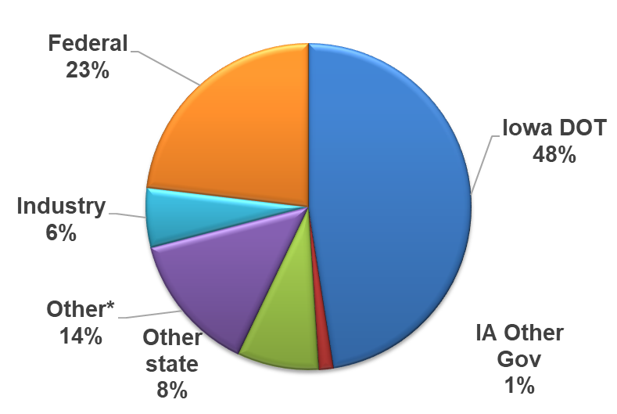
Partnerships and Stakeholders
Active master agreements
    Iowa Department of Transportation (DOT)
    Minnesota DOT
Federal Highway Administration (USDOT)
Federal Aviation Administration (USDOT)
National Academies (18 active projects)
10 pooled fund studies representing 45 states

Slide 5

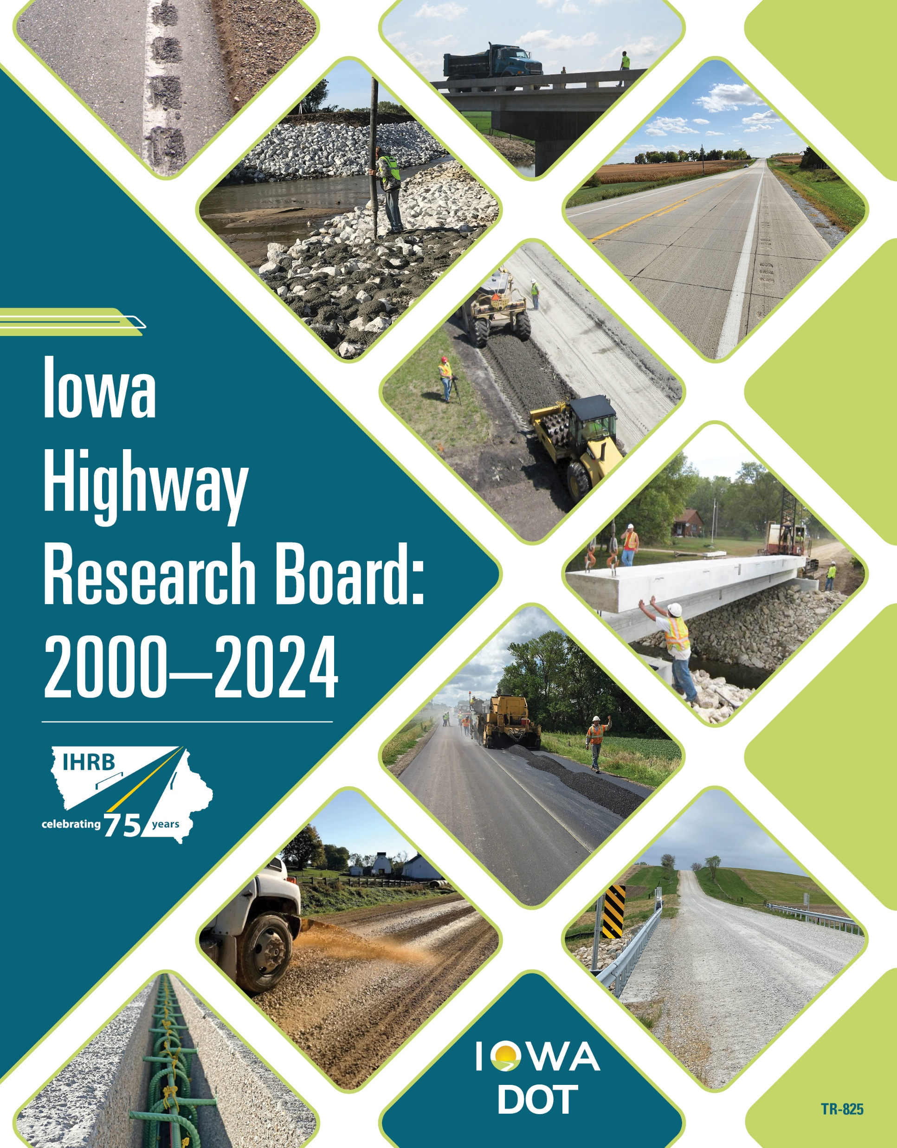
Long-term Partnership with Iowa DOT
Iowa DOT annual agreement
112 active awards
Partnership
    Leverages national research
    National model for State DOT/University partnerships
    Ensures Iowa is at the forefront of transportation research nationally
Promotes collaboration with U of Iowa and UNI

Slide 6
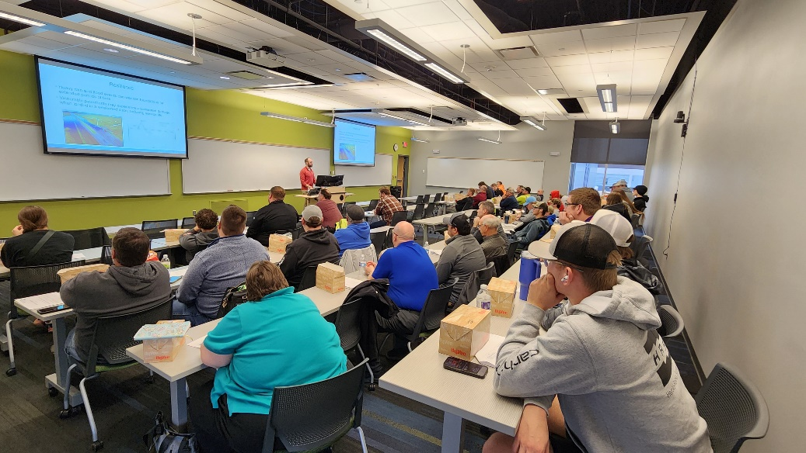
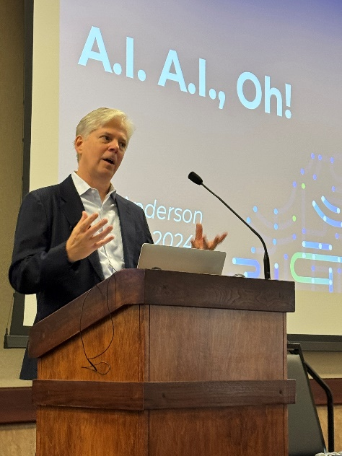
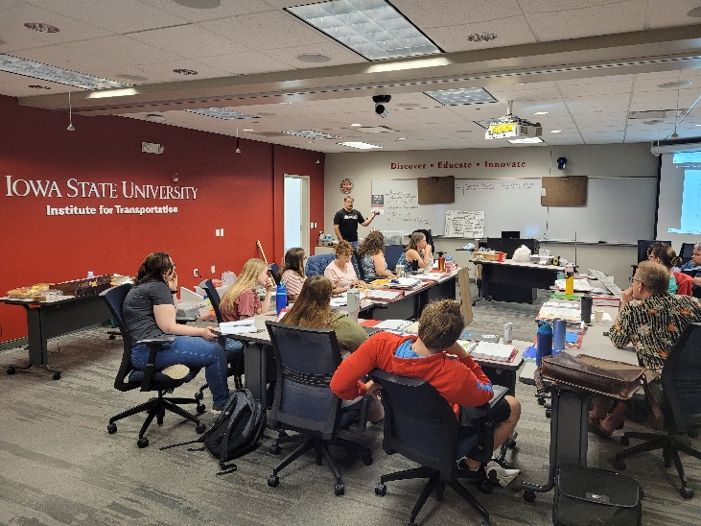
Outreach
  Local Technical Assistance Program (LTAP)
    Technical assistance and training for Iowa's local transportation agencies
    100+ training events annually
    5,500 attendees annually
  Professional Engagement
    199 roles across 60 different organizations
    TRB, ASCE, ITE, AASHTO

Slide 7
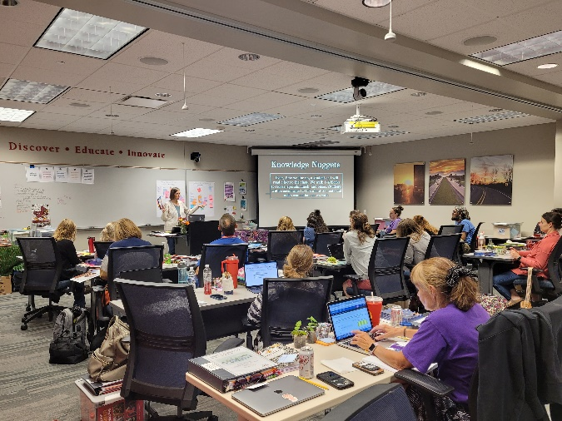
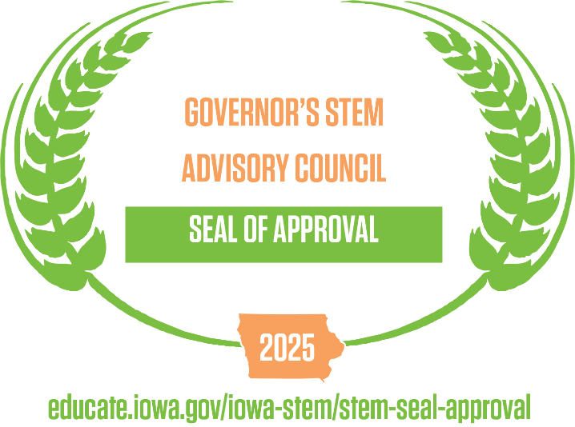
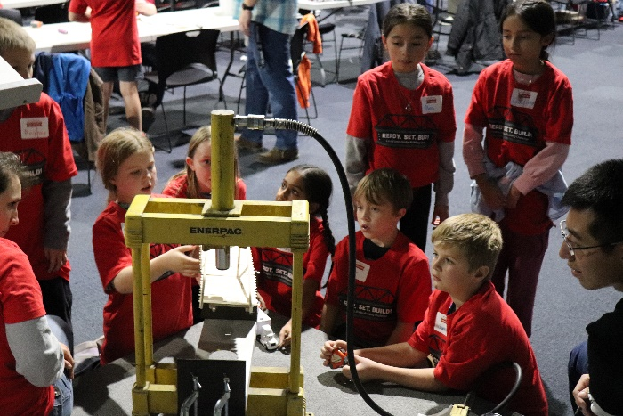
Education
  Teaching in the Fast Lane (funded by Iowa DOT)
    Professional development for elementary school teachers
    Teaches engineering concepts
  Transportation Institute for High School Educators (funded by Iowa DOT)
  Iowa STEM Seal of Approval from the Governor’s STEM Advisory Council
  Ready Set Build!
    Bridge building competition in conjunction with Iowa Science Center
    Developed in collaboration with Iowa DOT

Slide 8
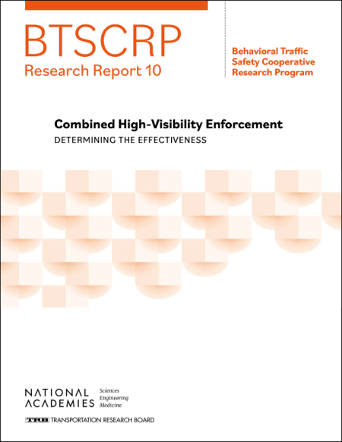
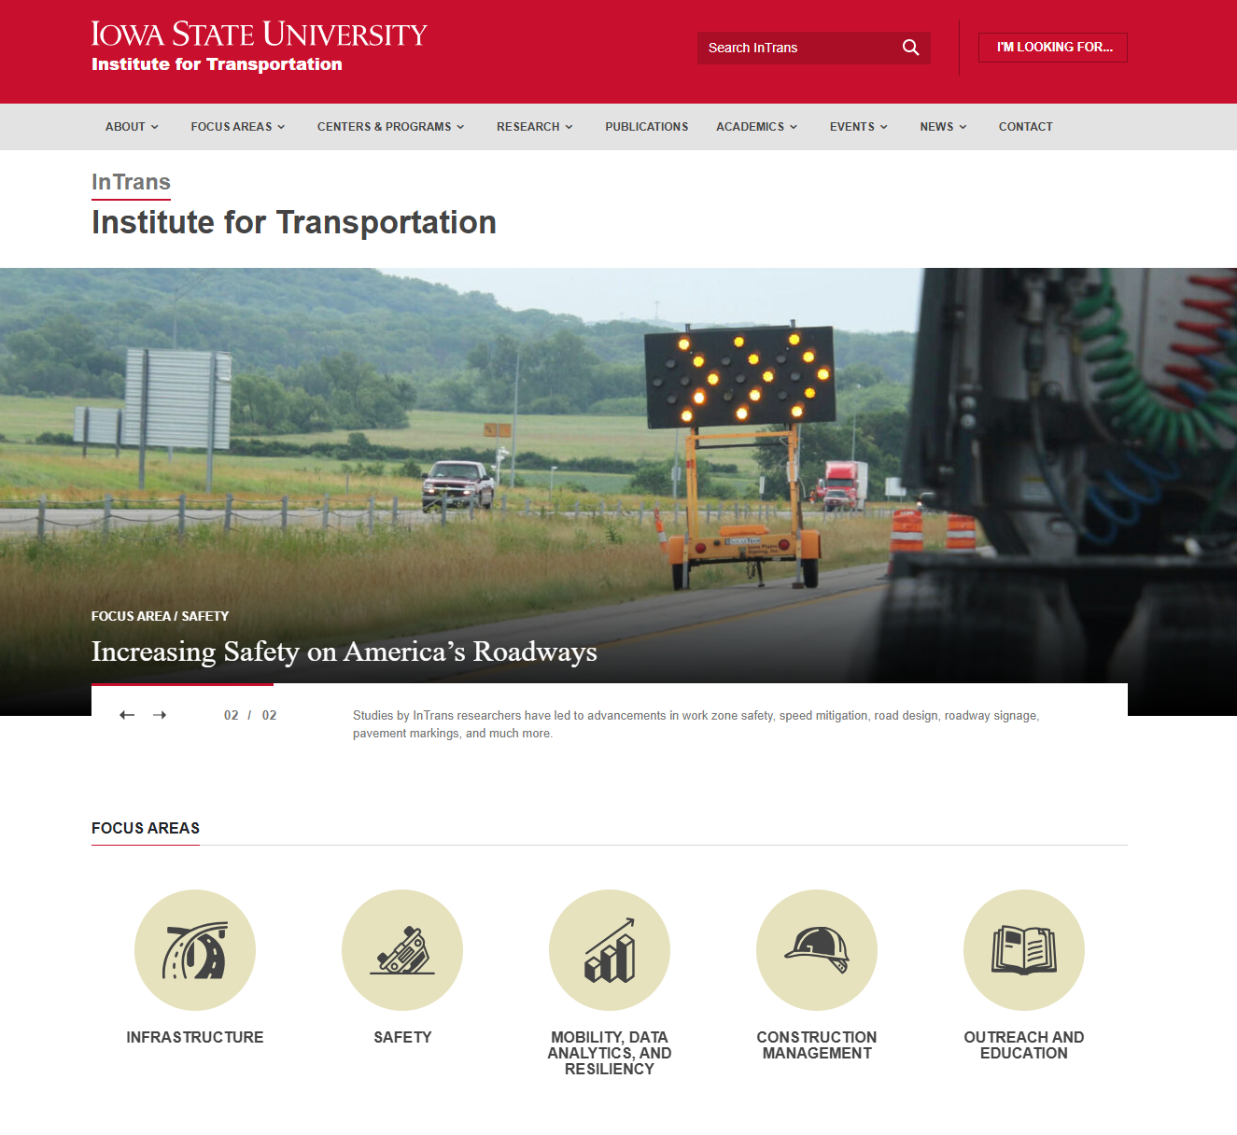
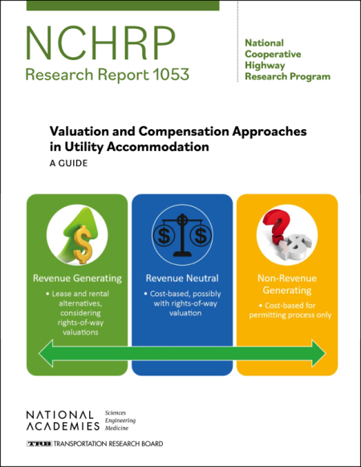
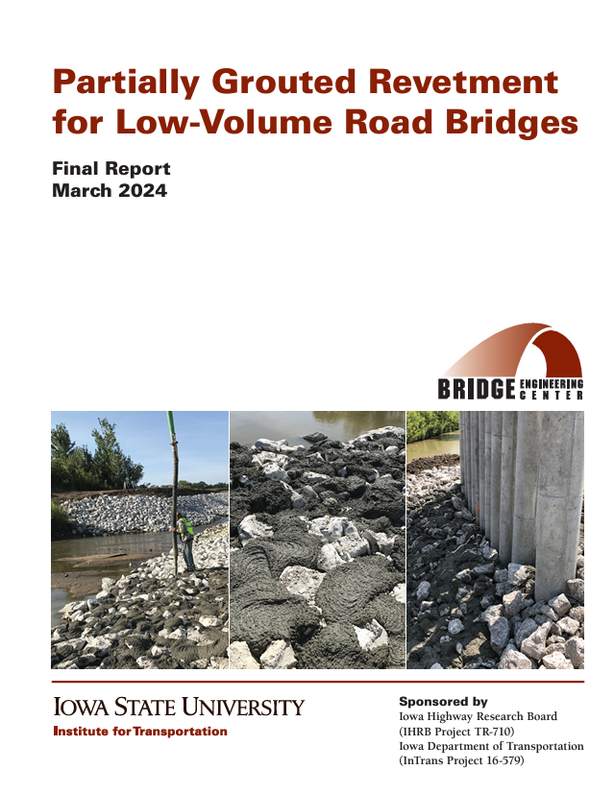
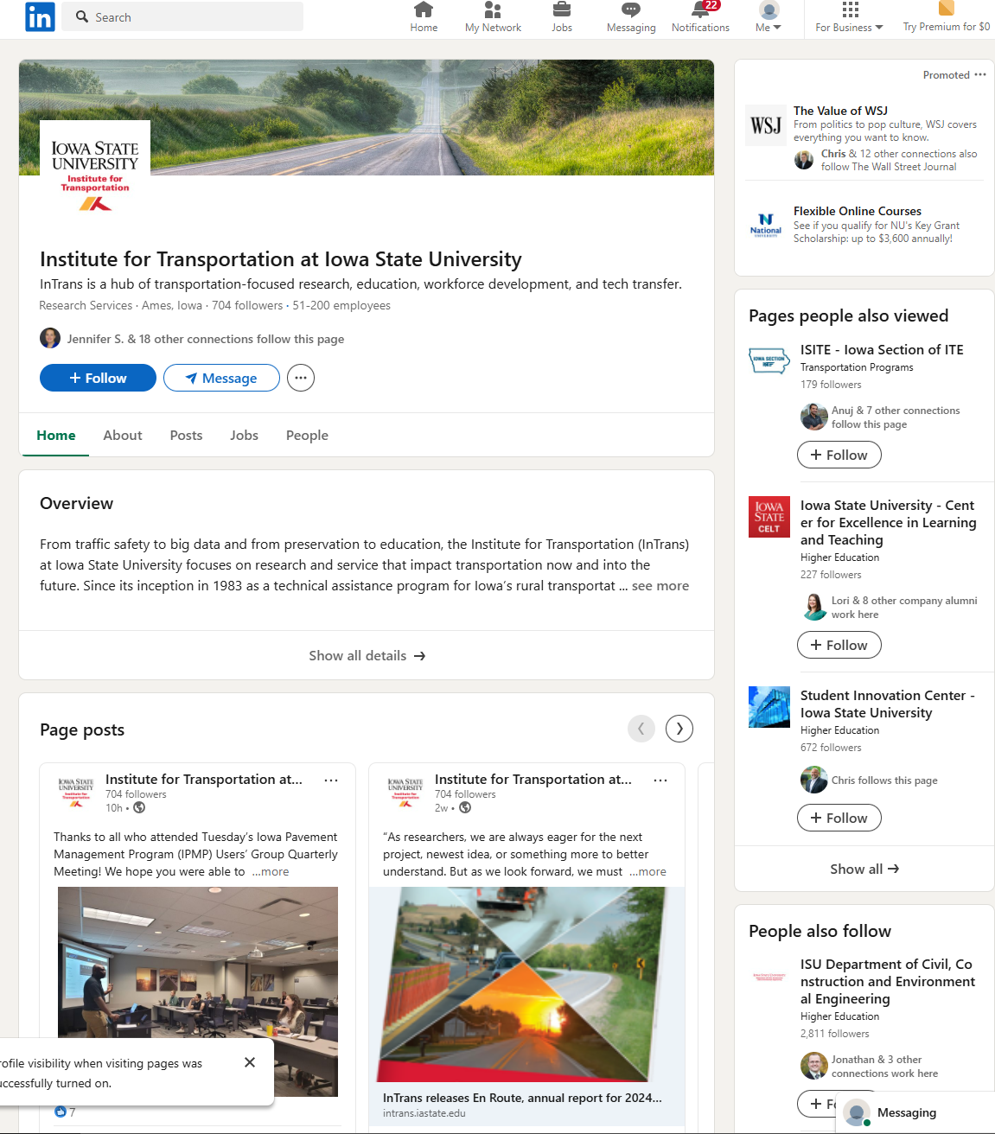
Impact
  33 Research Reports
  2 Technical Manuals
  38 Technical Briefs
  > 91 journal articles
  > 170 presentations
  > 580,000 web page visits last year
  704 followers on LinkedIn
  > 190,000 publication downloads last year
  Editorial board for 17 journals

Slide 9

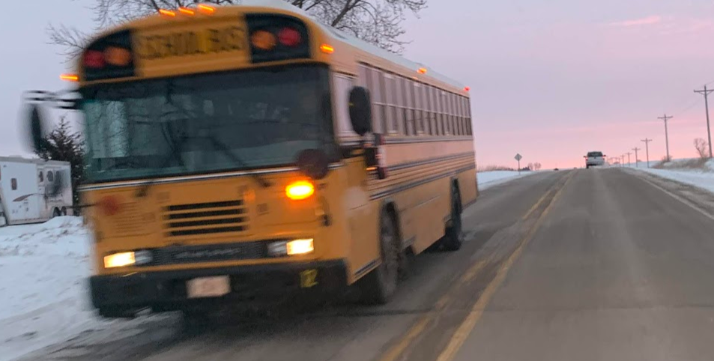
REACTOR LAB
Operations Research

Slide 10

REACTOR LAB

