Slide 1



Transportation Trends Update
November 12, 2025
3/2/2023

Slide 2
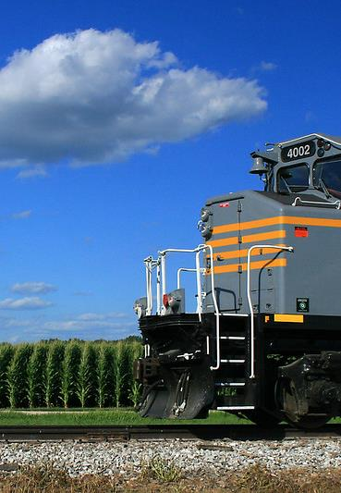

Agenda
Rail carloads
Commercial air service passenger counts
Vehicular traffic
Safety
Mississippi River

Slide 4
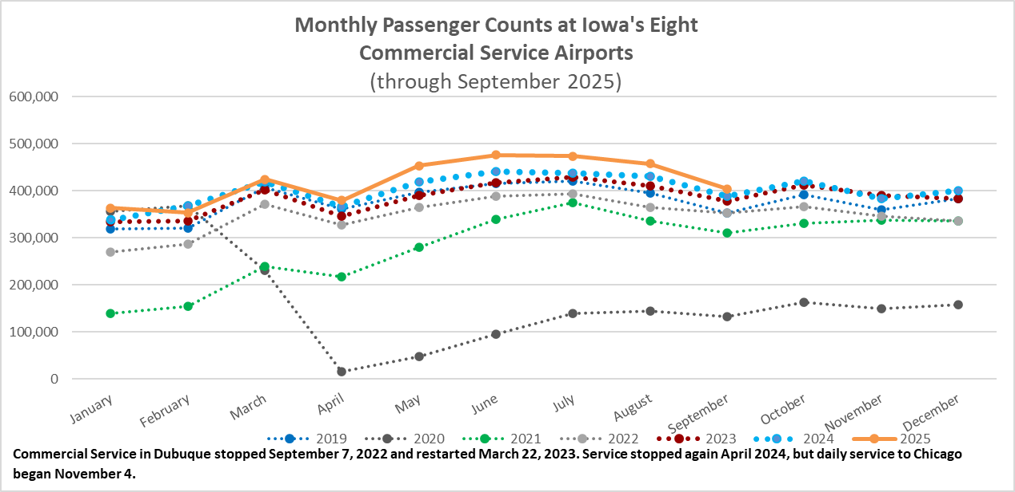

Slide 5
Monthly State Vehicle Miles of Travel
(through September 2025)
Vehicle Miles of Travel (in millions)

Slide 6
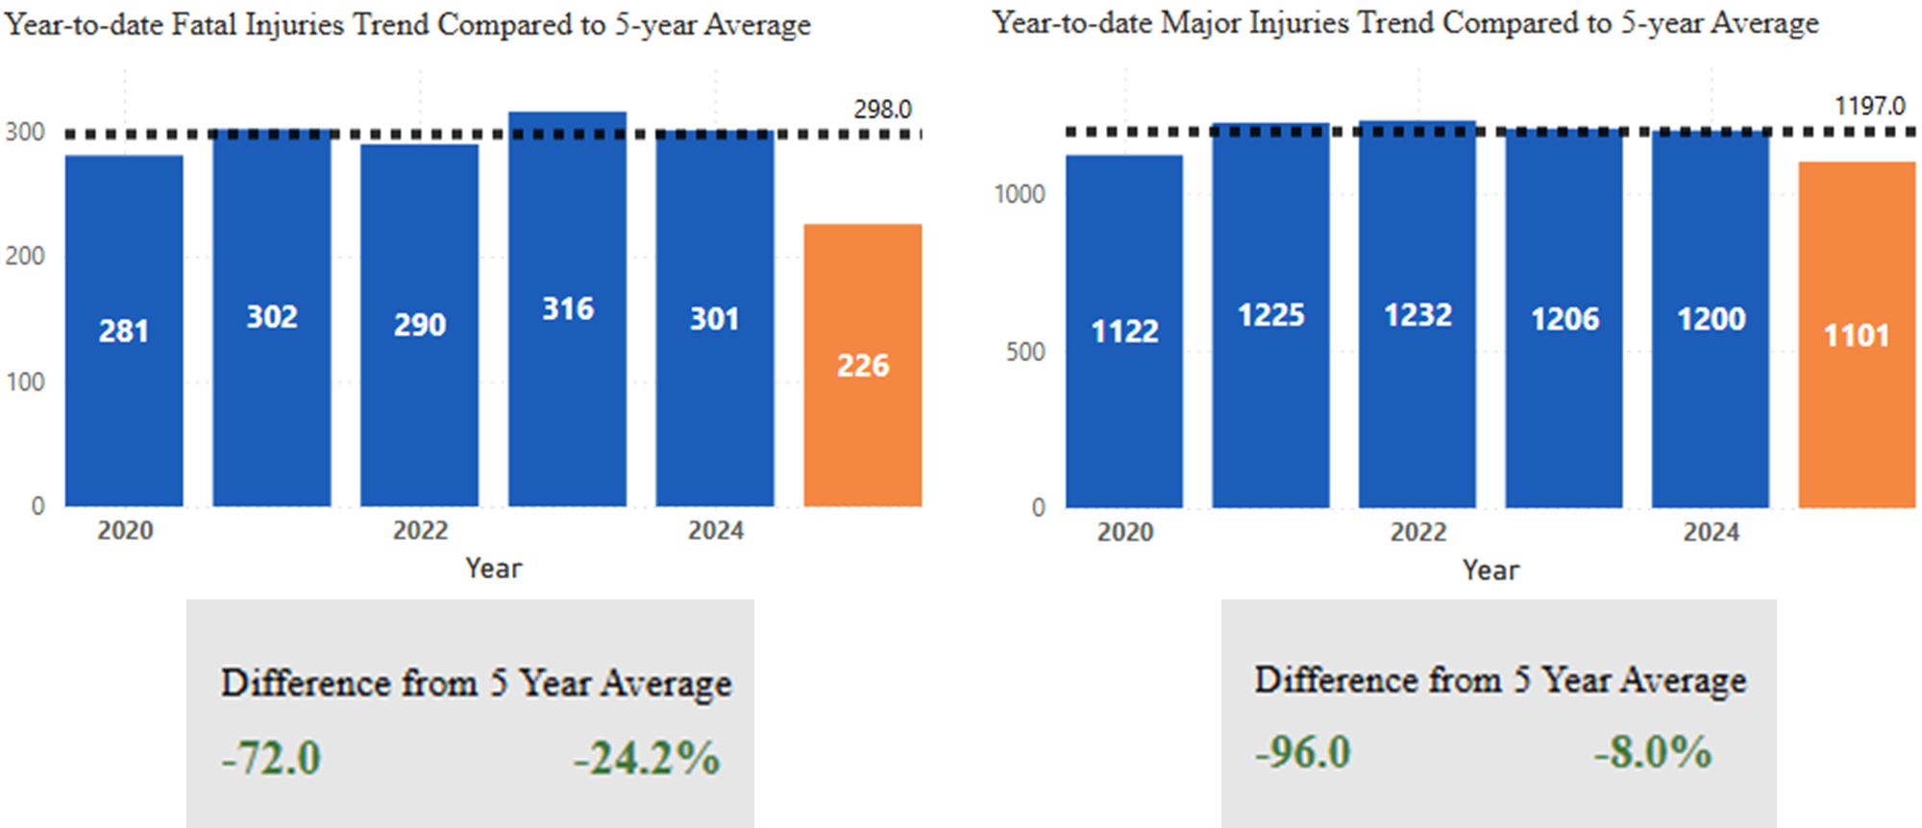
Statewide Fatalities & Major Injuries Year-to-Date
(As of November 4, 2025)

Slide 7
Mississippi River Water Levels
Near record low water levels have been reached in some locations on the Lower Mississippi River.
Since September 19, there have been restrictions on barges on both weight and number of barges in a tow.
Barge shipping costs have increased significantly - making exports more costly and increasing fertilizer costs

Slide 8
Questions?

