Slide 1
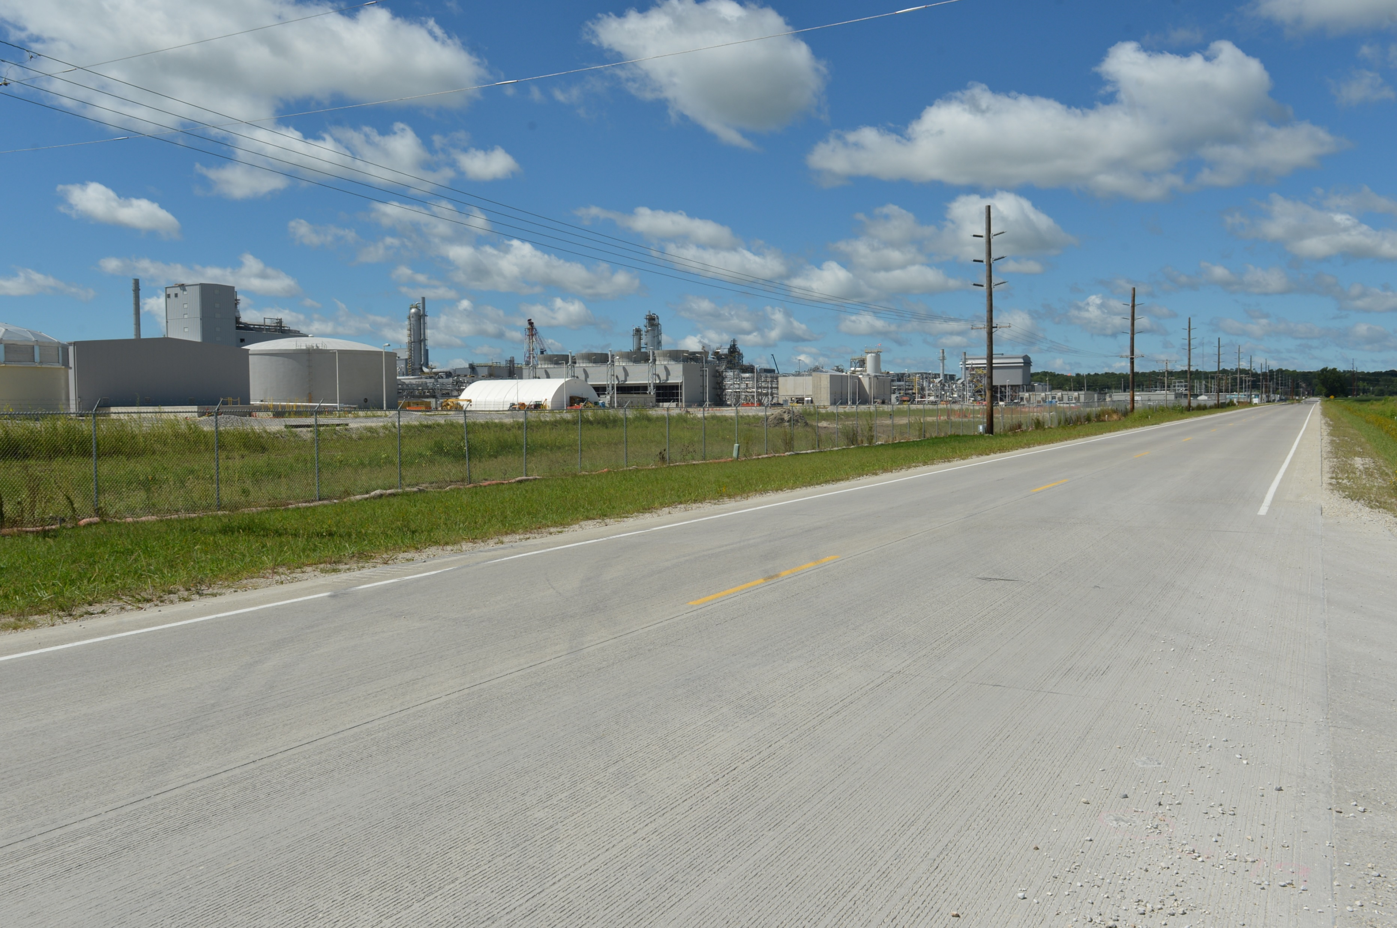

Revitalize Iowa’s Sound Economy Program
Funding Recommendation
Debra Arp
Local Systems Bureau, Grant Team Leader
11/12/2025

Slide 2
Revitalize Iowa’s Sound Economy Program
Created in 1985
Purpose: To promote economic development through roadway improvements
Eligible development shall have value-adding activities that feed new dollars into the economy
Available to cities and counties through an application program
2
2

Slide 3
Monthly Program Financial Report
Funded annually with dedicated state motor fuel and special fuel tax revenues
 | City RISE Fund | County RISE Fund
FY2026 Projected Total RISE Road Use Tax Fund (RUTF) Revenue ¹ | $12,017,805 | $6,008,902
Actual RISE Revenue Received as of 9/30/2025 ² (% of FY2026 Projected Revenue) | $3,170,533 (26.4%) | $1,557,235 (25.9%)
FY2026 RISE Funds Awarded as of 9/30/2025 (% of Projected Total RUTF committed) | $11,623,532 (96.7%) | $4,796,168 (79.8%)
Fund Balance as of 9/30/2025 | $60,598,185 | $16,067,836
Outstanding Commitments as of 9/30/2025³ | ($53,714,822) | ($19,306,768)
Uncommitted Balance as of 9/30/2025 | $6,883,364 | ($3,238,933)
¹ Calculation based on FY2025 average monthly RISE RUTF revenue of $1,001,484 to the city RISE fund and $500,742 to the county RISE fund. As of 9/30/2025, FY2026 is 25.0% complete.
² Actual RISE revenue includes RUTF revenue, loan repayments, and project settlements. These revenue sources are variable and are not included in projections.
3
3

Slide 4
Local Development Project Evaluation Criteria
Criteria | Points
Development Potential | 35
Economic Impact and Cost Effectiveness | 20
Local Commitment and Initiative | 33
Transportation Need and Justification | 4
Local Economic Need | 6
4
4

Slide 5
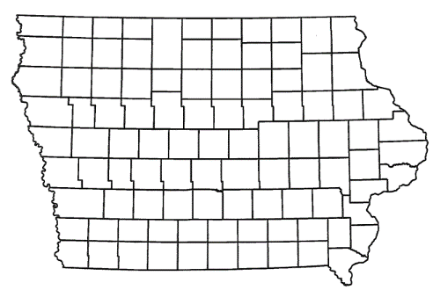
Local Development Recommendations
PROJECT NAME | SPONSOR | SCORE | TOTAL PROJECT COST | PERCENT PARTICIPATION | RECOMMENDED AMOUNT
Construction of approximately 2,810 feet of Industrial Street, paving of approximately 1,430 feet of 300th Avenue and intersection improvements including turn lanes and R-Cut at the intersection of U.S. 30 and 300th Avenue located on the southeast side of town | DeWitt | 46 | $5,826,391 | 50% | $2,913,196
5
5

Slide 6
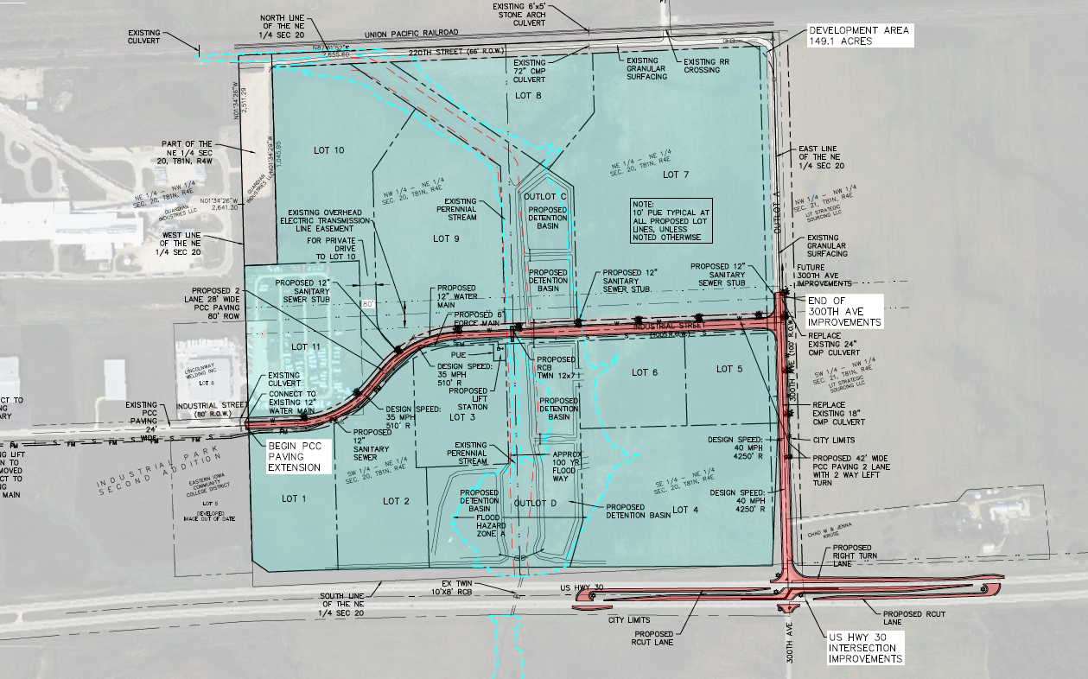
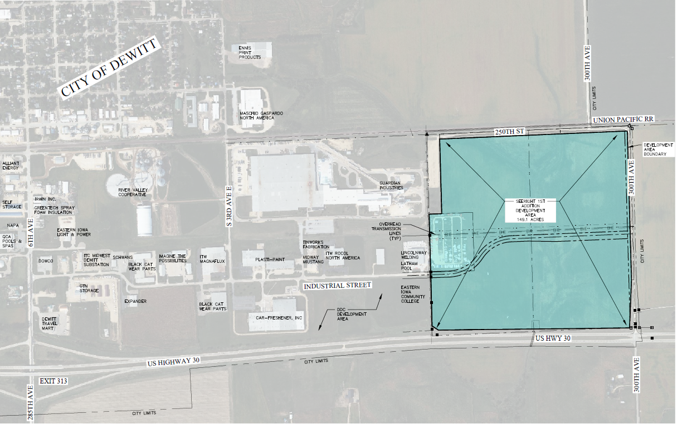
DeWitt
Local Development
Construction of approximately 2,810 feet of Industrial Street, paving of approximately 1,430 feet of 300th Avenue and intersection improvements including turn lanes and R-Cut at the intersection of U.S. 30 and 300th Avenue located on the southeast side of town.
Total Cost: $5,826,391
Requested: $2,913,196 (50%)
6

Slide 7



Questions?
jennifer.kolacia@iowadot.us
515-239-1738

