Slide 1
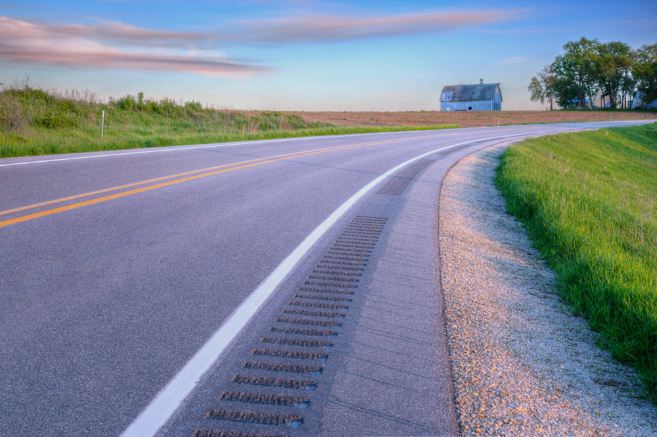

Traffic Safety Improvement Program
Funding Recommendation FY 2027
Jan Laaser-Webb
State Safety Engineer
11/12/2025
Notes:
Thank you for the time today to share the FY 2027 funding recommendations for the Traffic Safety Improvement Program. We often refer to the program as TSIP.

Slide 2
Background
Purpose: Implement traffic safety features in order to reduce fatalities and serious injuries
Available to all public entities responsible for public roads and streets
Iowa Code Section 312.2 ; Administrative Rule 761 Chapter 164
2
2
Notes:
The program’s purpose is funding projects specifically intended to reduce fatalities and major injuries on Iowa’s roadways.

Slide 3
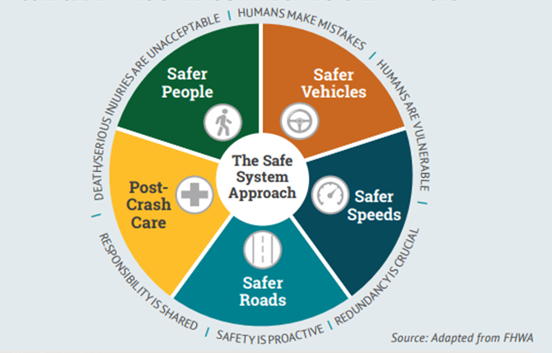
Notes:
The Safe System Approach to reducing traffic fatalities and serious, life-altering injuries considers inputs, outputs, and the quality of those .
A system designed with the expectation humans will behave perfectly is a system designed to fail.
Basis – Death & serious injury are not ok. We must work to eliminate and/or mitigate.
Humans make mistakes. Nobody is perfect.
Humans are vulnerable. Contrary to the many superhero and action movies, human bodies are fragile.
Responsibility is shared. We have frequently stressed individual responsibility AND we need to re-introduce communal responsibility.
Safety is proactive. Not an afterthought, a before-thought.
Redundancy is crucial. You don’t want there to be cracks for your friends or family to fall through.
The components – safer people, vehicles, speed, roads, and post-crash care. The slice of pie this program addresses is Safer Roads.

Slide 4
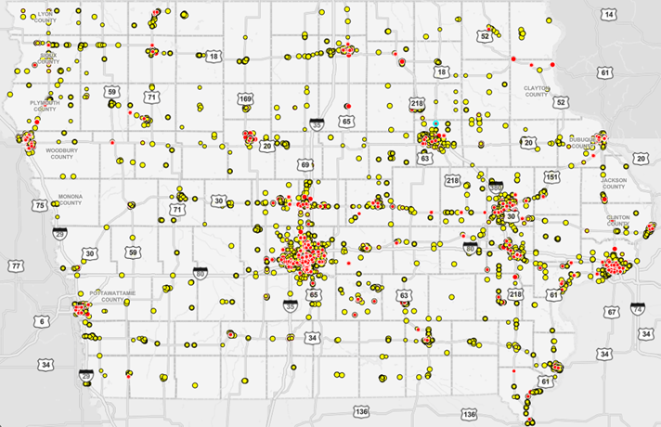
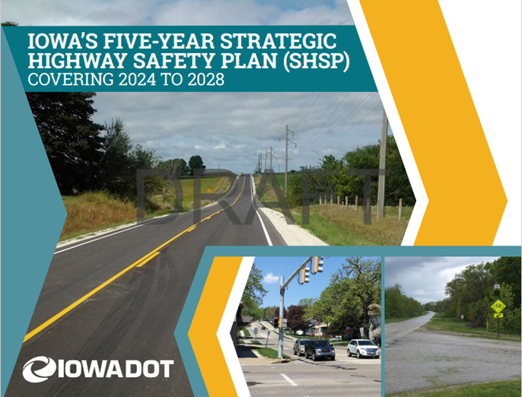
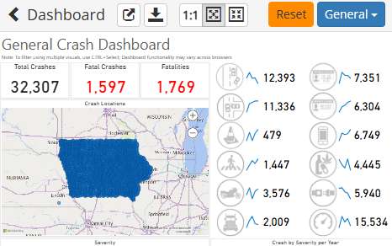
Resources
Notes:
Using the Safe System Approach, we work to
develop plans,
screen the system for locations needing the most attention,
and analyze crash data to determine what types of countermeasures would have the biggest impact

Slide 5
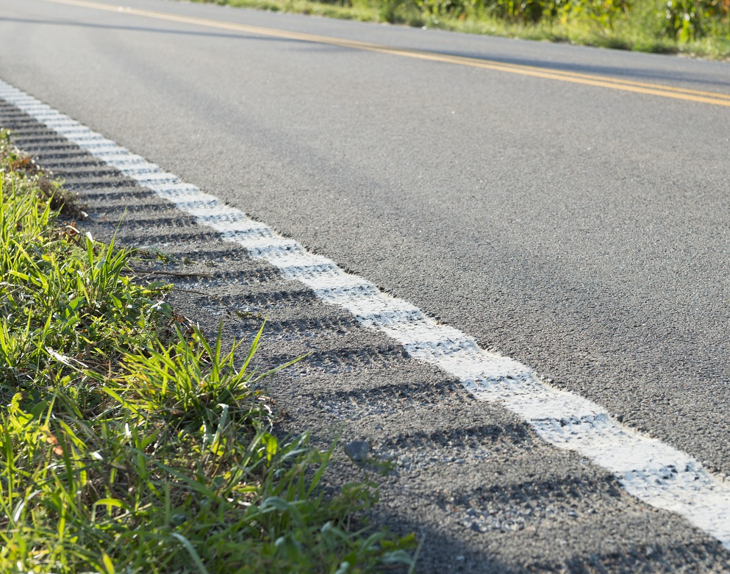
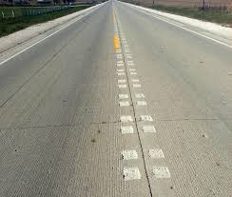
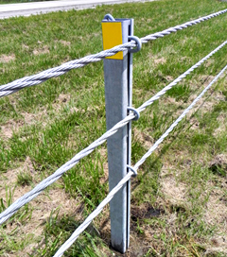
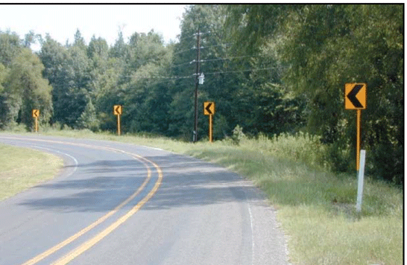
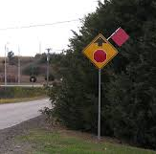
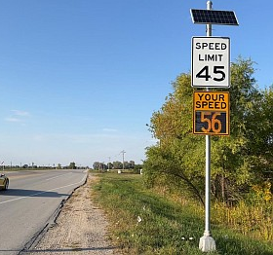
Notes:
Examples of traffic safety countermeasures include rumble strips, cable barrier, advanced warning signs, curve chevrons, and speed feedback signs.

Slide 6
Funding Categories
Site-Specific Improvements
Construction projects to improve traffic safety
Annual funding varies, generally $6-$7 million
Traffic Control Devices
Traffic control device materials
Annual funding = $500,000
Studies & Outreach
Traffic safety research and public information initiatives
Annual funding = $500,000
Full application list: https://iowadot.gov/consultants-contractors/traffic-safety/programs/traffic-safety-improvement-program-tsip
6
6
Notes:
There are 3 funding categories. Site specific are generally construction projects aimed at tweaking segments or intersections for safer travel, traffic control devices are generally signing or pavement marking for improved communication with the traveling public, and studies or outreach efforts are intended to prove or improve the effectiveness of all of the above.

Slide 7
Application Review/Scoring
Demonstrated relationship to traffic safety
Site’s potential for crash reduction
Type of countermeasure(s) proposed
Risk factor(s) addressed
Safety engineering analysis
Multi-agency committee input
Funding subject to agreement execution
Safety benefit expected vs. Project cost expected
Supported by transportation plan or engineering study
7
7
Notes:
When scoring applications, we look at the site’s potential for crash reduction (or PCR), anticipated safety benefit, the ratio of that benefit to the project cost, whether the countermeasure is proven or experimental, and whether or not the chosen countermeasure fits the type of crashes or risks experienced.
We’re fortunate to have a robust multi-agency committee made up of representatives from several bureaus within the DOT as well as county and city engineers.
As a sidenote, all funding is subject to finalizing an agreement

Slide 8
Available Funding and Application Summary
Available Funding: | Column 2
Annual estimated appropriation | $8,755,000
Total reversions | $1,010,000
Application Summary:
Applications received | 36
Total funds requested | $11,909,338
Total funding recommended | $9,752,043
8
8
Notes:
The FY2027 estimated appropriation is $8.755M. We received 36 applications this year totaling almost 12M in requests.

Slide 9
Site-specific Improvement
Recommended for Funding
PROJECT NAME | SPONSOR | SCORE | TOTAL PROJECT COST | REQUESTED AMOUNT (% of Total Project Cost) | RECOMMENDED AMOUNT (% of Total Project Cost)
16th NW & Mill Creek Pkwy – roundabout | City of Clinton | High | $1,400,980 | $500,000 (36%) | $500,000 (36%)
US 18 & US 71 – roundabout | City of Spencer | High | $5,200,683 | $500,000 (10%) | $500,000 (10%)
Division St & W Burlington Ave – roundabout | City of Burlington | Med Hi | $1,413,000 | $500,000 (35%) | $500,000 (35%)
Forest Ave – lane conversion | City of Des Moines | Med Hi | $3,700,000 | $500,000 (13.5%) | $500,000 (13.5%)
Main St & Burlington Ave – pedestrian improvements | City of Fairfield | Med Hi | $373,000 | $212,630 (57%) | $212,630 (57%)
9
9

Slide 10
Site-specific Improvement
Recommended for Funding
PROJECT NAME | SPONSOR | SCORE | TOTAL PROJECT COST | REQUESTED AMOUNT (% of Total Project Cost) | RECOMMENDED AMOUNT (% of Total Project Cost)
IA 100 & 44th St – offset right turn lane | City of Marion | Med Hi | $465,970 | $459,920 (99%) | $459,920 (99%)
9 intersections – destination lighting | Dubuque County | Med Hi | $236,000 | $236,000 (100%) | $236,000 (100%)
Canoe Rd – shoulders, edge rumbles, safety edge, 6” markings | Fayette County | Med Hi | $1,543,387 | $467,295 (25%) | $420,000 (23%)
F46 curve & intersection – realign, widen, center & edge rumbles, safety edge | Iowa County | Med Hi | $813,894 | $500,000 (61%) | $500,000 (61%)
F58 – shoulders, center & edge rumbles, safety edge, 6” markings | Cedar County | Med | $2,681,995 | $326,854 (12%) | $326,854 (12%)
10
10

Slide 11
Site-specific Improvement
Recommended for Funding
PROJECT NAME | SPONSOR | SCORE | TOTAL PROJECT COST | REQUESTED AMOUNT (% of Total Project Cost) | RECOMMENDED AMOUNT (% of Total Project Cost)
US 30 & 300th Ave – reduced conflict intersection | City of DeWitt | Med | $1,900,000 | $500,000 (26%) | $500,000 (26%)
29th Ave & 31st St – roundabout | City of Marion | Med | $605,100 | $500,000 (83%) | $500,000 (83%)
W38 – shoulders, center & edge rumbles, 6” markings | Washington County | Med | $4,022,751 | $500,000 (12.4%) | $470,000 (11.7%)
Hammond Ave & Ridgeway Ave – roundabout | City of Waterloo | Med | $1,200,000 | $500,000 (42%) | $470,000 (39%)
NE Alice’s Rd & Berkshire Pkwy – roundabout | City of Clive | Med Lo | $1,946,000 | $500,000 (26%) | $445,000 (23%)
11
11

Slide 12
Site-specific Improvement
Recommended for Funding
PROJECT NAME | SPONSOR | SCORE | TOTAL PROJECT COST | REQUESTED AMOUNT (% of Total Project Cost) | RECOMMENDED AMOUNT (% of Total Project Cost)
NE Beaverbrooke Blvd & NE Gateway Dr – roundabout | City of Grimes | Med Lo | $2,207,000 | $500,000 (23%) | $445,000 (20%)
Boyson Road – raised median & roundabout | City of Hiawatha | Med Lo | $1,270,143 | $500,000 (39%) | $445,000 (35%)
B45 – paved shoulders, shoulder rumbles, safety edge, 6” markings | Clayton County | Med Lo | $4,082,537 | $500,000 (12%) | $445,000 (11%)
395th Ave – paved shoulders, center & edge rumbles, 6” markings | Jackson County | Med Lo | $1,948,550 | $500,000 (26%) | $445,000 (23%)
K42 – paved shoulders, flatten foreslopes | Plymouth County | Med Lo | $587,790 | $500,000 (85%) | $445,000 (76%)
12
12

Slide 13
Traffic Control Device
Recommended for Funding
PROJECT NAME | SPONSOR | SCORE | TOTAL PROJECT COST | REQUESTED AMOUNT (% of Total Project Cost) | RECOMMENDED AMOUNT (% of Total Project Cost)
Canoe Rd & Apple Rd– speed feedback signs | City of Clermont | Med Hi | $7,254 | $7,254 (100%) | $7,254 (100%)
Portable temporary traffic signals | City of Waterloo | Med Hi | $61,075 | $61,075 (100%) | $50,000 (82%)
Portable temporary traffic signals | Palo Alto/Pocahontas Counties | Med Hi | $63,385 | $63,385 (100%) | $63,385 (100%)
Each of 2 intersections – Flashing yellow arrow, 12” lenses, camera detection | City of Algona | Med | $130,000 | $130,000 (100%) | $40,000 (31%)
US 6 & 8th St – Backplates, camera detection, pedestrian improvements | City of Newton | Med | $109,000 | $109,000 (100%) | $100,000 (92%)
13
13

Slide 14
Traffic Control Device
Recommended for Funding
PROJECT NAME | SPONSOR | SCORE | TOTAL PROJECT COST | REQUESTED AMOUNT (% of Total Project Cost) | RECOMMENDED AMOUNT (% of Total Project Cost)
8 stop & 10 chevron sites – solar flashing beacons | Humboldt County | Med | $26,000 | $26,000 (100%) | $26,000 (100%)
Sign Replacement Program | Local Systems Bureau | Med | $200,000 | $200,000 (100%) | $200,000 (100%)
14
14

Slide 15
Studies and Outreach
Recommended for Funding
PROJECT NAME | SPONSOR | SCORE | TOTAL PROJECT COST | REQUESTED AMOUNT (% of Total Project Cost) | RECOMMENDED AMOUNT (% of Total Project Cost)
Safety Studies Program | Traffic Operations & Safety Bureau | High | $500,000 | $500,000 (100%) | $500,000 (100%)
15
15

Slide 16
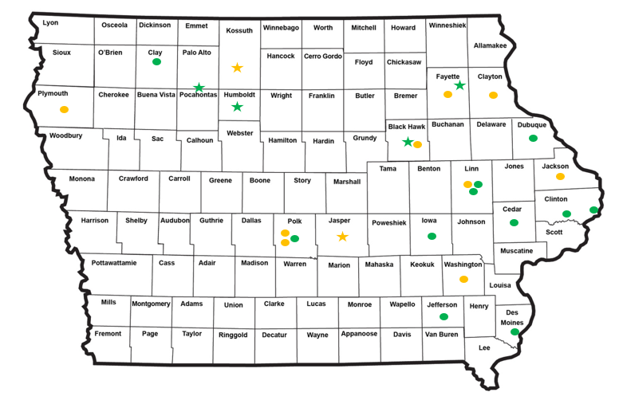
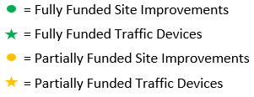
Map of Applications Received
16

Slide 17



Questions?
Jan.Laaser-webb@iowadot.us
515-239-1349

Slide 18
Site-specific Improvement
Not Recommended for Funding
PROJECT NAME | SPONSOR | SCORE | TOTAL PROJECT COST | REQUESTED AMOUNT (% of Total Project Cost) | RECOMMENDED AMOUNT (% of Total Project Cost)
IA 100 & IA 13 – traffic signal and turn lane | City of Marion | Low | $617,250 | $500,000 (81%) | $0 (0%)
1st St & Sycamore St – traffic signal | City of Waterloo | Low | $251,000 | $251,000 (100%) | $0 (0%)
90 locations – transverse rumble panels | Humboldt County | Low | $652,000 | $500,000 (77%) | $0 (0%)
Broadway & Burton Ave – traffic Signal & turn lane | City of Waterloo | Low | $37,000 | $37,000 (100%) | Withdrawn $0 (0%)
18
18

Slide 19
Traffic Control Device
Not Recommended for Funding
PROJECT NAME | SPONSOR | SCORE | TOTAL PROJECT COST | REQUESTED AMOUNT (% of Total Project Cost) | RECOMMENDED AMOUNT (% of Total Project Cost)
Trailer hitch PDMS | District 1 | Med Lo | $9,200 | $9,200 (100%) | $0 (0%)
Citywide – signal face protection | City of Waterloo | Low | $242,450 | $242,450 (100%) | $0 (0%)
Mobile St & Sumner St – traffic signal | City of Waterloo | Low | $120,000 | $120,000 (100%) | $0 (0%)
Portable dynamic message sign | Webster County | Low | $19,550 | $19,550 (100%) | $0 (0%)
19
19

