Slide 1
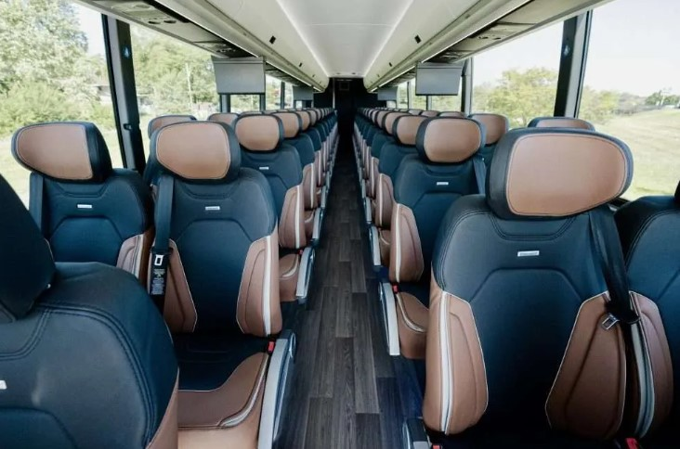


CY 2026 Intercity Bus Program
Transportation Commission Workshop
November 12, 2025
3/2/2023
2026

Slide 2
Intercity Bus vs. Public Transit
There are three main types of public transit services: fixed route , ADA complimentary paratransit, and demand response.
Fixed Route – services are provided by our 19 urban transit agencies. This type of transit is delivered with set routes, stops, and time points. No advanced reservations are necessary.
ADA Complementary Paratransit – services are provided by our 19 urban transit agencies. At a minimum, this type of transit is set 3/4–mile around a fixed route. Passengers must meet ADA requirements and reservations are required. Pick-up and drop-off are at desired locations.
Demand Response – services are provided by the 16 regional transit agencies. Reservations are required with pick-up and drop-off at desired locations.

Slide 3
Intercity Bus vs. Public Transit
Intercity Bus services are provided by 4 carriers in Iowa. This type of transportation is delivered with set routes, stops, and time points, including the ability to transfer passengers between providers. Advanced reservations/ ticketing are necessary.
Integrates connections between non-urbanized (rural) locations and urban areas.
Links intermodal facilities that provide the travelling public access to the network of local and regional transit systems, other intercity providers, airports, and passenger rail services.
Supports the connection between non-urbanized areas and the larger regional and national transportation systems.

Slide 4
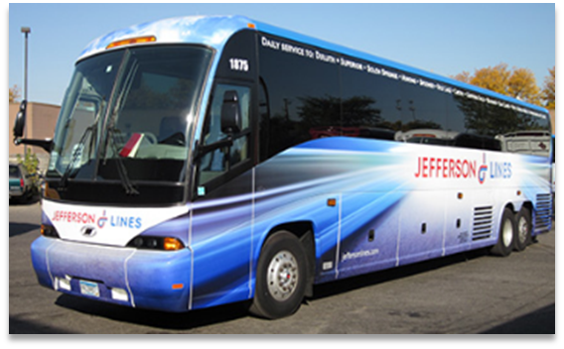
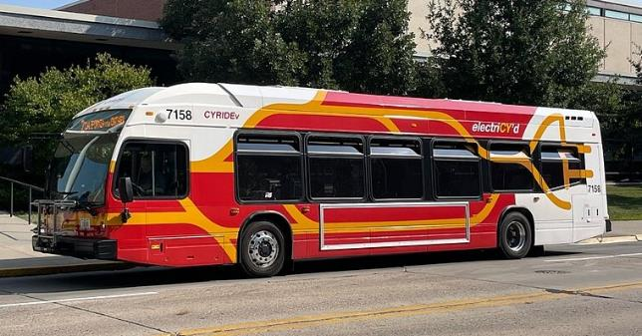
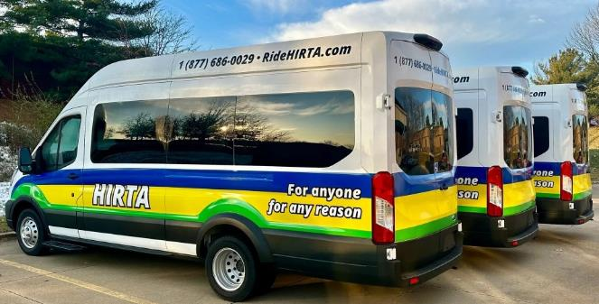
Intercity Bus vs. Public Transit
Jefferson Lines
CyRide
HIRTA

Slide 5
Intercity Bus Program
Purpose: Support intercity bus services that include stops at non-urbanized locations and makes meaningful connections to nationwide network
Available to private intercity bus companies, companies wishing to start bus service, public transit agencies either operating or proposing to operate bus service, and local communities wishing to support intercity connections to their community
Each state must spend at least 15-percent of its annual apportionment of FTA Formula Grants for Rural Areas money for the development and support of intercity bus transportation, unless it can certify, after consultation with intercity bus service providers, that the intercity bus needs of the state are being adequately met.

Slide 6
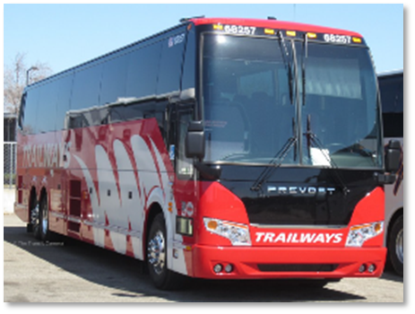
Burlington Trailways has ceased ICB Operations
Burlington Trailways last day operating Intercity Bus Service was September 27, 2025.
This affected ICB routes in 6 states (Colorado, Nebraska, Iowa, Missouri, Illinois, and Indiana.
Jefferson Lines and Greyhound have started operating a majority of these routes to continue service.
Burlington Trailways stated several reasons behind their closure including:
Higher operating costs
Lack of Federal funding
Insurance premium increases

Slide 7
Burlington Trailways has ceased ICB Operations
Burlington Trailways agreements and assets with the Iowa DOT:
All capital contracts have been cancelled. The remaining balances have been transferred back into the ICB Program.
ARPA Operating contract, after reimbursing Burlington Trailways’ operating deficits through end of service in September 2025, will be transferred to Jefferson Lines to operate these Iowa based routes.
AMOCO Loan repayment balance is $7,189. Iowa DOT is working with Burlington Trailways to ensure full repayment of this loan.
Burlington Trailways had 8 vehicles in their fleet that were acquired through the Iowa DOT. Jefferson Lines has purchased 7 of these vehicles to remain in service for intercity bus use. Iowa DOT is working with Burlington Trailways to ensure Federal share repayment is finalized on remaining vehicle.

Slide 8
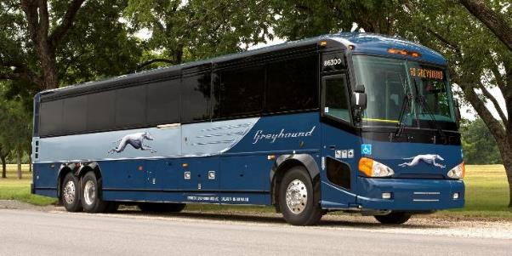
Funding Priorities
Iowa’s program has two components
In priority order:
Iowa based Operating Deficit (including marketing).
50% Federal with a 50% match.
Support for intercity bus capital improvements.
Over the road motorcoaches, vertical infrastructure, vehicle renovations/ improvements, ADA improvements to vehicles and facilities.
ADA vehicles require a 15% match.
All other capital projects require 20% match.

Slide 9
Available Funding and Application Summary - CY26
Available Funding
Total Intercity Bus Funds Available: $6,113,114
15% of federal non-urbanized (FTA Section 5311) transit funding:
FY25 5311(f) Funding: $2,683,362
FY24 5311(f) Funding – Unobligated: $1,327,394
Burlington Trailways – Closed Capital Contracts: $2,102,358
Application Summary
Total number of projects: 15
Total number of projects recommended: 13
Total project costs: $16,395,296
Total amount requested: $7,434,629
Total amount recommended: $6,032,129
Remaining Balance : $80,985

Slide 10
List of Recommended Projects – CY26
Greyhound Lines
GREYHOUND LINES | TOTAL PROJECT COST | REQUESTED AMOUNT | RECOMMENDED AMOUNT
Support Iowa Based Operating Deficits
Chicago to Denver | $1,405,980 | $319,860 | $319,860
Chicago to Des Moines – North Route | $907,920 | $304,153 | $304,153
Chicago to Des Moines – South Route | $788,400 | $284,481 | $284,481
Indianapolis to Des Moines | $722,700 | $186,095 | $186,095
St Louis to Des Moines | $1,029,300 | $363,686 | $363,686
Support for Capital Expenditures
Over-the Road Motorcoach | $832,591 | $707,702 | $707,702
Over-the Road Motorcoach | $832,591 | $707,702 | $707,702
Total | $6,519,482 | $2,873,679 | $2,873,679

Slide 11
List of Recommended Projects – CY26
Jefferson Lines
JEFFERSON LINES | TOTAL PROJECT COST | REQUESTED AMOUNT | RECOMMENDED AMOUNT
Support Iowa Based Operating Deficits
Continuation of Existing JL Iowa Routes | $2,830,134 | $375,851 | $375,851
Continuation of Existing BTW Iowa Routes | $2,905,680 | $671,349 | $671,349
Support for Capital Expenditures
Over-the Road Motorcoach | $825,000 | $701,250 | $701,250
Over-the Road Motorcoach | $825,000 | $701,250 | $701,250
Over-the Road Motorcoach | $825,000 | $701,250 | $701,250
Over-the Road Motorcoach | $825,000 | $701,250 | $0
Over-the Road Motorcoach | $825,000 | $701,250 | $0
Total | $9,860,814 | $4,553,450 | $3,150,950

Slide 12
List of Recommended Projects – CY26
City of Fort Dodge
CITY of FORT DODGE | TOTAL PROJECT COST | REQUESTED AMOUNT | RECOMMENDED AMOUNT
Support Iowa Based Operating Deficits
Marketing | $15,000 | $7,500 | $7,500
Total | $15,000 | $7,500 | $7,500

Slide 13
Summary of Recommended Funding - CY26
 | TOTAL PROJECT COST | REQUESTED AMOUNT | RECOMMENDED AMOUNT
Greyhound Lines | $6,519,482 | $2,873,679 | $2,873,679
Jefferson Lines | $9,860,814 | $4,553,450 | $3,150,950
City of Fort Dodge | $15,000 | $7,500 | $7,500
Total | $16,395,296 | $7,434,629 | $6,032,129

Slide 14
Intercity Bus Map

Slide 15
ICB Program Money From Older FTA Grants
Our team is currently evaluating open Intercity Bus grants from FTA to capture all unexpended money in the ICB Program
The potential for unexpended money would be:
Closed operating contracts that were not needed due to COVID era funding
Closed capital contracts for motorcoaches that did not require all available funds (cost underruns)
There is a possibility that the 2 motorcoaches requested by Jefferson Lines and not recommended in this cycle could be funded with these monies
We expect to have this exercise finalized within the next few months

Slide 16

Questions?
Jefferson Lines
For more information on Iowa’s public transit and intercity bus programs, visit
www.iowadot.gov/transit
Or contact the ICB Program Administrator
Matt Oetker
515-239-1765
matthew.oetker@iowadot.us

