Slide 1



Project Prioritization Update
Infrastructure Prioritization and Scoring System (IPASS)
3/2/2023
Charlie Purcell
TDD Deputy Division Director
November 12, 2025

Slide 2
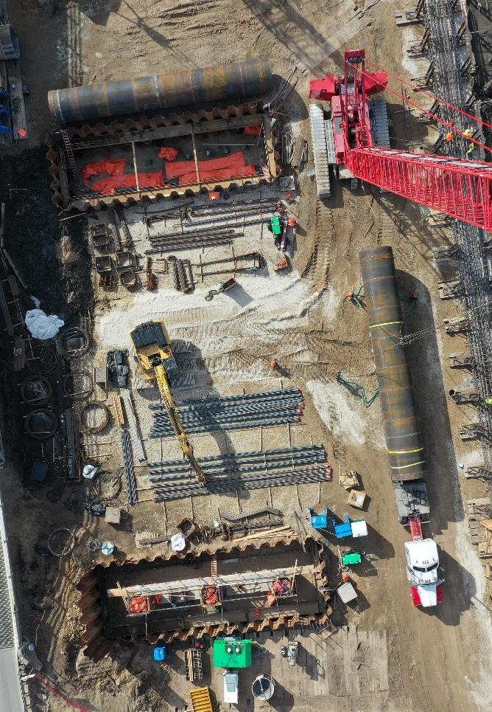

Agenda
Background
Refresher of approach to project Prioritization.
Tool structure
How projects will be evaluated and prioritized.
Progress so far
What steps have been taken since last year.
Next steps
Proposed next steps to implementation.
Notes:
The focus of today’s presentation will be to first refresh everyone on this effort. Some of you may not have been on the commission when we had this discussion a year ago, so we wanted to provide some background. We will then talk about the structure of the proposed approach and tool. I’ll provide an overview of the progress we’ve made since last year and finish up with where we plan to go over the next several months.

Slide 3

Background

Slide 4
November 2024 Commission Meeting
Described how use of the former prioritization tool evolved over time including for use in the business case process.
Explained the need to replace the existing prioritization tool.
Introduced concept of using outcome-based scoring for project prioritization that aligns better with our State Long-Range Transportation Plan (SLRTP).
Notes:
At last year’s November commission meeting we provided an overview of how our project prioritization processes have evolved over time and the desire to change directions on our approach. We also indicated that we wanted to more formally tie the prioritization process with the business case process which is our internal method of identifying projects to be added the highway candidate list. At the time, we had a tool to prioritize projects that scored projects based on existing condition. The tool was aging and required costly updates, so we decided to replace that tool and start new. Our new approach uses an outcome-based methodology that focused on the needs of the system instead of what is existing now.

Slide 5

Business Cases
Developed to help plan, program, and develop projects more efficiently.
Required to start certain types of projects or new studies.
Outlines why the project or study is needed and includes supporting data, including prioritization scores
Identifies potential solutions, and costs.
Used to identify projects that are brought to the Commission for consideration for programming
This Photo by Unknown Author is licensed under CC BY-SA
Notes:
In this presentation, I’ll make several references to business cases or the business case process. There were mentioned in the presentation I gave last year on this topic, but I wanted to provide a quick review of what these are and how we use them.
This is an internal process we developed several years ago to help us identify, plan, program, and develop projects more efficiently. To initiate certain types of projects or new studies, a business case must be submitted and approved.
The business case outlines why the project or study is needed along with supporting data, potential solutions, and costs. After a business case is approved, a project may be considered for programming and development. Only a small number of projects will require a business case; however, these are usually the high $ projects.
This year, we will be using the updated project prioritization scoring method to help review and evaluate the project business cases.

Slide 6
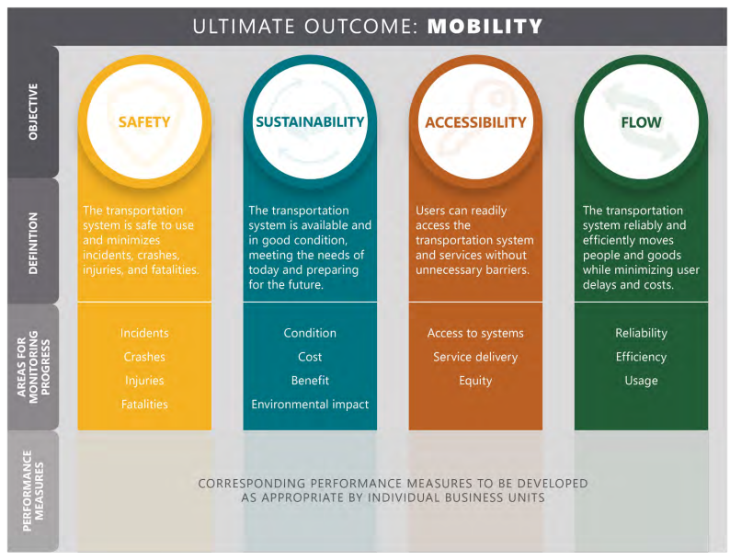
Outcome-based and Aligned
Notes:
These needs are derived from objectives outlined in the State Long-Range Transportation Plan (SLRTP) which you developed and approved. The current objectives include Safety, Sustainability, Accessibility, and Flow with the ultimate outcome being mobility. In developing our new approach, we wanted to evaluate projects to ensure that they are addressing the needs of the system in alignment with these core objectives.

Slide 7

Progress so
Far
Image Courtesy: Kenneth G. West Jr.

Slide 8
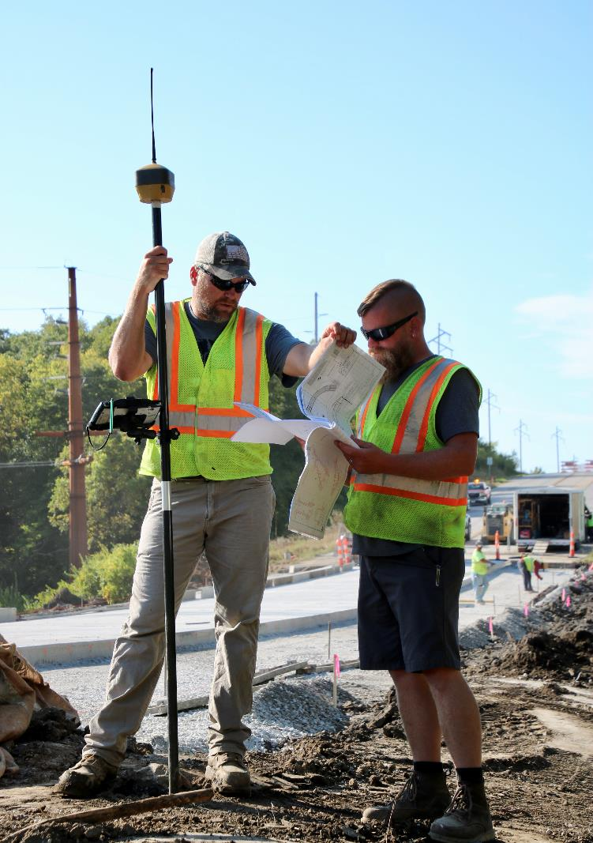
Our Progress
Internal workshop Jan 2025
Subject Matter Experts (SME) input on data sources
Follow up meeting with stakeholders June and October.
SME input on scoring evaluation
Initial buildout of prioritization tool.
Notes:
With the commission’s input from last year, we have been working to further develop our approach and build a tool that will help us implement this effort. At the start of this year, we held a workshop with internal staff from across the department to get input on the best approach and data to use for evaluating progress. From there we had smaller discussions with Subject Matter Experts (SMEs) to refine a limited list of datasets to use in our analysis. Since the end of June, we have followed up with that initial broader group and met with smaller groups to refine our scoring approach and begin building out a tool to support this effort.

Slide 9
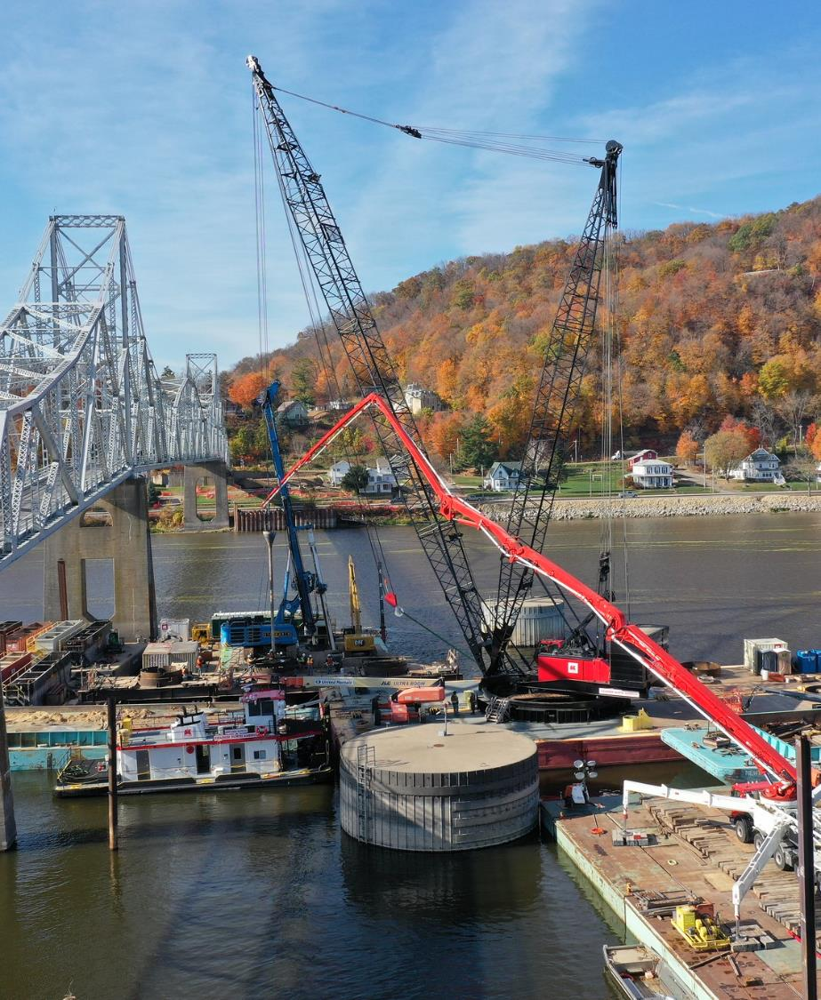
Structure &
Scoring

Slide 10

Infrastructure Prioritization and Scoring System
(IPASS)
Notes:
The new tool we are developing to prioritize and score projects is going to be called the Infrastructure Prioritization and Scoring System or IPASS for short. As mentioned earlier, this tool will focus on evaluating projects based on how well they are address the needs identified within the project location. Let’s now talk about how it will do that.

Slide 11
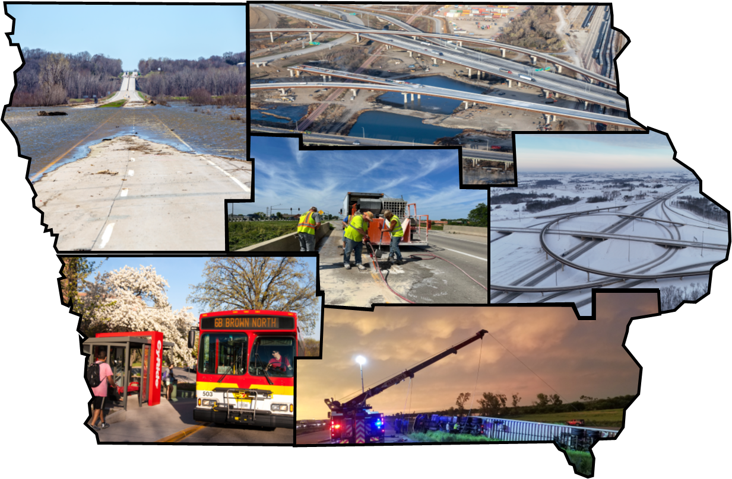
Identifying Iowa’s Transportation Needs
Notes:
Iowa’s transportation system has diverse and complex needs. The first thing that IPASS will help us do is identify the needs within a project location. Using data and analysis consistent with our State Long-Range Transportation System (SLRTP) we will determine which needs exist within the footprint of the proposed project. Again, the needs are measured based on the four objectives defined in the SLRTP. Data includes non-motorist accessibility, roadway and bridge condition, capacity, and of course safety. The intent is to ensure projects are addressing the critical issues of our transportation system and the improvements are targeted towards what is needed at a particular location.

Slide 12

Scoring Projects
Based on identified needs within the project area.
Based on how the needs are being addressed with the proposed project.
Cost will be incorporated into the score.
Notes:
When needs have been identified the next step is to evaluate the outcome. Projects will be scored based on a combination of the amount of need identified in the project location and how much of that need is going to addressed by the proposed project. Projects will only be evaluated/scored on the needs that exists. If a need doesn’t exist within a project’s footprint it will not be included in the scoring of the project. A simplified benefit cost metric will also be developed by dividing the IPASS score by the cost of the project. This will allow us to see how cost efficient a project is at addressing the needs within its area.

Slide 13
Structure & Project Scoring
Where will these scores be used?
Project scores will be used in tandem with other considerations to identify which projects should be added to the highway Candidate list.
IPASS scores will be used as one tool in the toolbox to evaluate projects submitted as business cases. Ensuring…
  More consistent use of data.
  Easier approach to reviewing projects, scores, and data at the same time.
Notes:
The purpose of all of this is to help us make more informed decisions when selecting projects to be presented for your consideration on the highway candidate list. IPASS and this approach will be just one tool in our toolbox for identifying which projects will be presented for your consideration. As always, there are many things to consider when deciding what projects should advance. What this process will do is ensure is that we have an efficient way of reviewing projects with consistent data. This will ensure that those reviewing business cases are able to do so more efficiently and effectively.

Slide 14
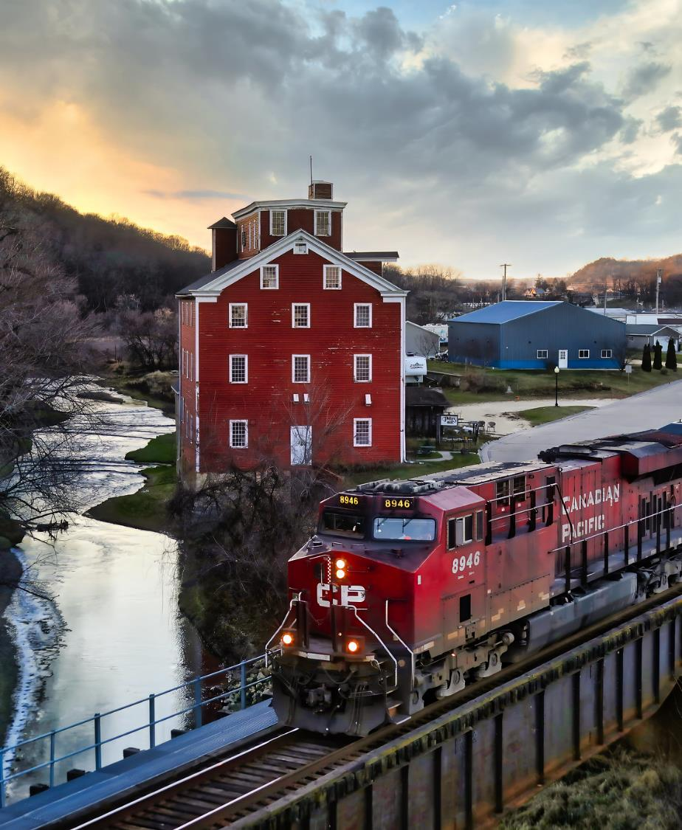
Next
Steps
Image Courtesy: Scott Hoag

Slide 15
Next Steps
Timeline of implementation
Fall 2025
  Initial scoring of business cases and highway candidate list projects.
  Refinement of new tool and outputs.
Winter 2025-2026
  Business case review by staff and management.
  Program team recommends projects to be added to candidate list.
Spring 2026
  Commission decision on highway candidate list and programming recommendations.
  Finalize business case decisions and notify staff of selected projects.
Notes:
So where do we go from here? This year we will be piloting the use of these scores with the projects that are submitted through the business case process. At the start of the year, the program team will recommend projects that will be added to the candidate list and in the spring those projects will be presented to you for your consideration. At that time, we will share the scores that were derived using this process.

Slide 16
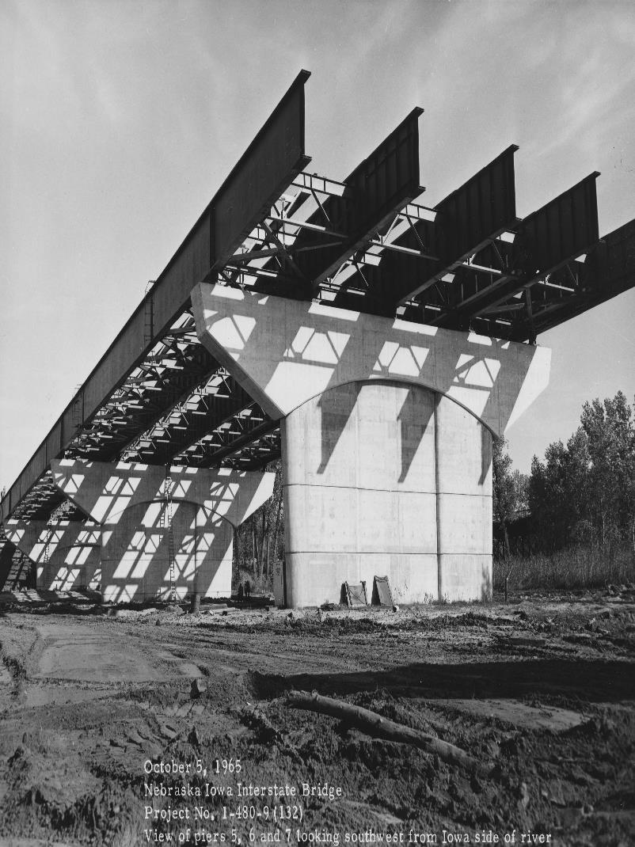
In summary we are:
Aligning project prioritization with department objectives with a renewed focus on needs and outcomes.
Integrating with the business case process.
Using the scores to evaluate projects that will be presented on the highway candidate list for your consideration.

Slide 17
Questions?
Charlie Purcell
charlie.purcell@iowadot.us​
iowadot.gov

