Slide 1
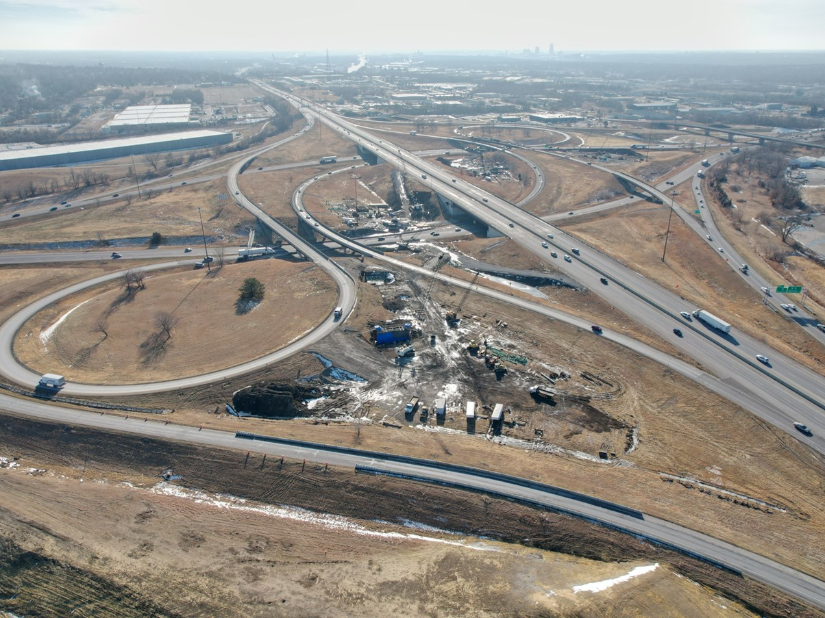


Potential 2026-2030 Highway Program Amendment
November 12, 2025
3/2/2023

Slide 2
Highway Program Amendment - Background
August Redistribution process resulted in an additional $102.8m in federal funds to the department in SFY 2026 of which $60m has already been programmed
State Fiscal Year 2025 resulted in a budget reversion of $13.5m to the Primary Road Fund
State Fiscal Year 2027 Budget request anticipated to be $19m lower than previous forecast
Missouri Valley Bypass project is expected to be delayed one year, leaving a significant balance of funds in SFY 2027
Favorable letting results in SFY 26 have resulted in a current Highway Program Balance of -$6.8 m.

Slide 3
Highway Program Amendment - Background
(Continued)
I-35 section from N of 315th St. to 0.5 mi N of E-57 is not currently programmed but development is at the stage where it could be let in SFY 27
Segment is next highest priority in the Interstate Plan
Securing ROW in SFY 26 would allow the construction of this project to be considered in the next programming cycle if needed for balancing program
It is recommended to add $5.1m in ROW to the 2026 Program for the N of 315th St. to 0.5 mi N of E-57 project

Slide 4
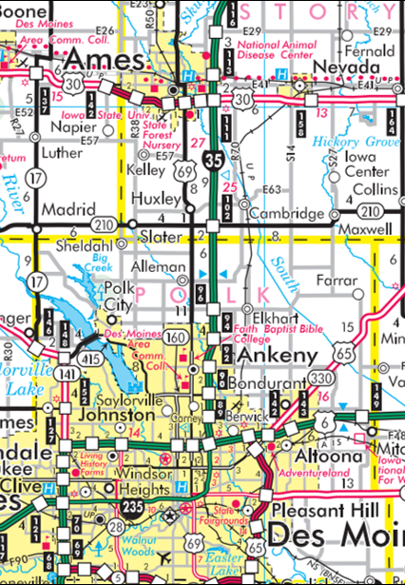
I-35 Corridor
I-35 Ankeny to Ames Capacity Improvements
0.5 mi N of E-57 to N of US 30
2028 ROW
$5.9 Million (Programmed)
2029 Grade/Pave/Signs
$ 13.5 Million (Programmed)
2030 Grade/Pave/Bridge
$22.6 Million (Programmed)
N of 315th St to 0.5 mi N of E-57 (Unprogrammed)
Ankeny to N of 315th St
2026 Grade/Pave/Lighting/Signs
$51.4 Million (Programmed)
2027 Erosion Control
$1.2 Million (Programmed)

Slide 5
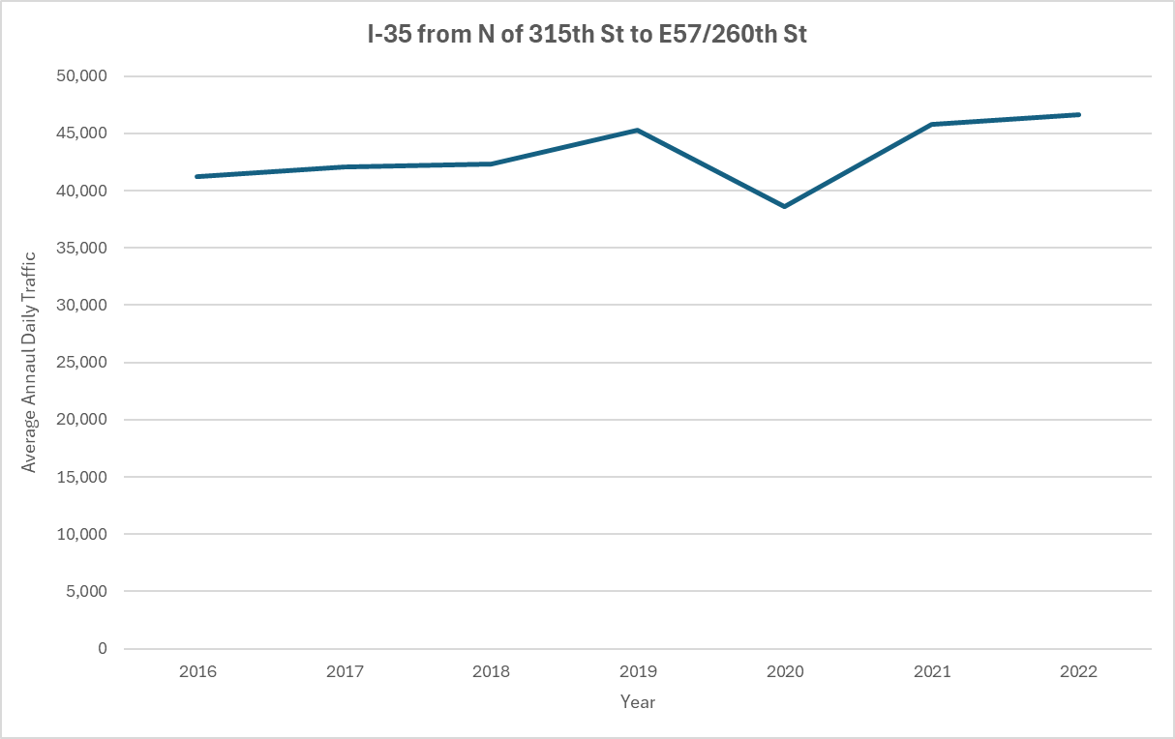
2016-2022 Average Annual Daily Traffic Growth

Slide 6
2026-2035 Highway Program Analysis
($ in millions)
(For Highway Planning Purposes Only)

Slide 7
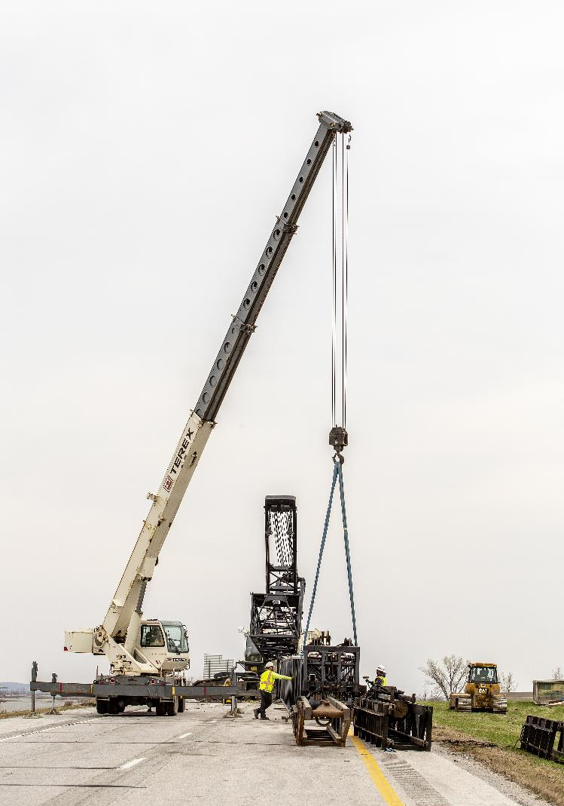
Next Steps
Action Item for December Commission Meeting: Approve the 2026-2030 Iowa Transportation Improvement Program Amendment.

Slide 8
Questions?

