Slide 1
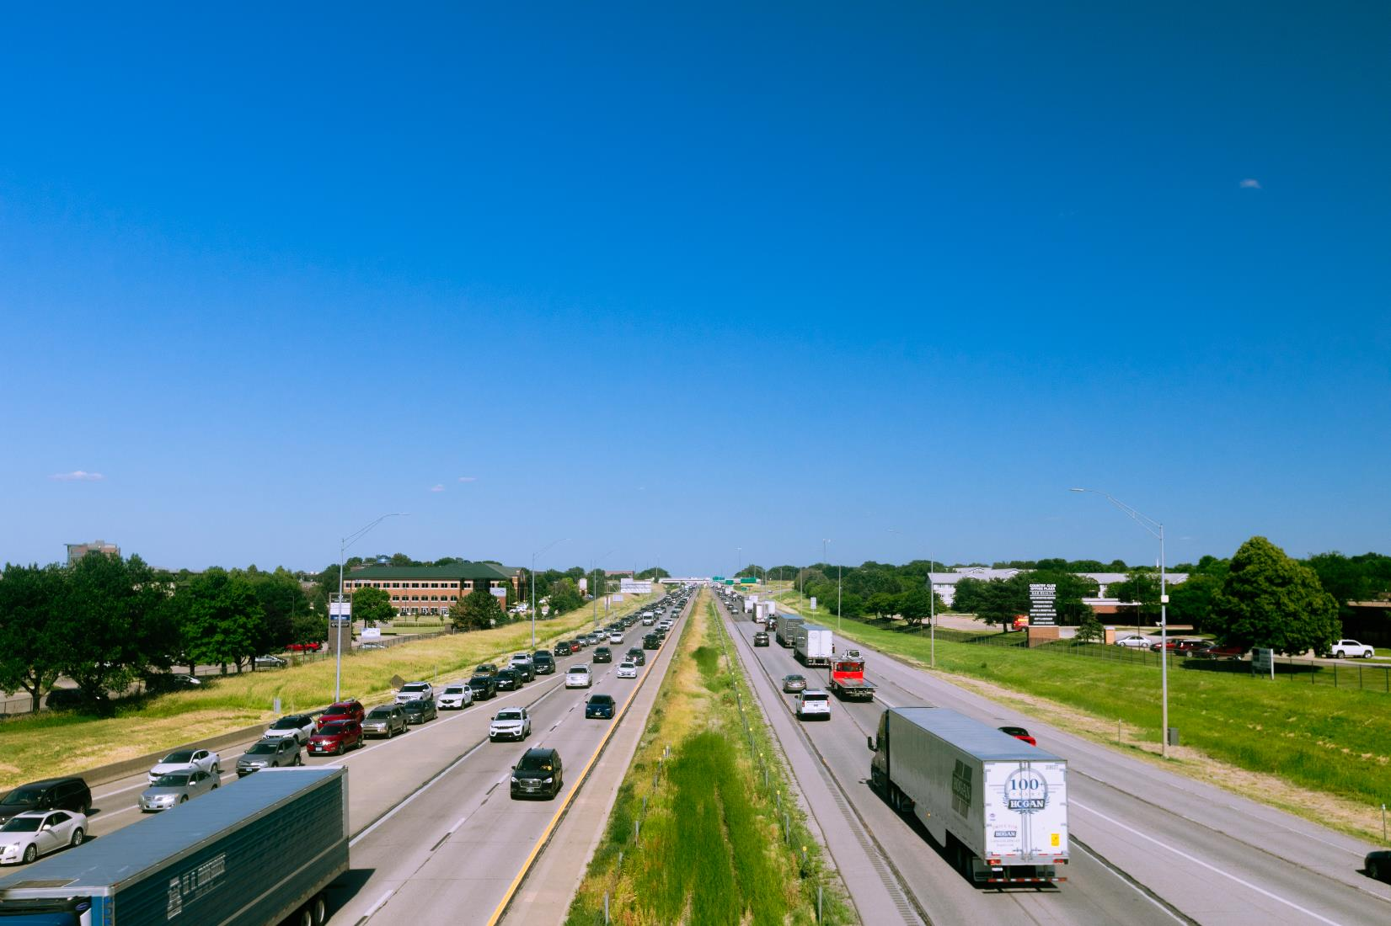


FY 2026 Highway Program Balance Report
December 9, 2025
3/2/2023

Slide 2
Receipts / Costs
Revenue
Forecast PRF Receipts (October) $328.3m
Actual PRF Receipts (October) $331.8m
Lettings
Programmed Amounts (November) $365.7m
Project Costs (November) $325.4m

Slide 3
Balance
FY 2026 Program Balance (June 2025) ($32.3m)
October PRF Receipts Difference $3.5m
November Project Letting Difference $40.3m
Program Balance (November 2025) $11.5m
Previous Balance Reported: ($6.8m)
FY 2026 Highway Program Balance Overview

Slide 4






Fiscal Year 2026 Overview
Revenue: Expect monthly revenue fluctuations.
Lettings:
Forty-one percent of the FY 2026 Program has been awarded.
The November letting was approximately $43 million.
Next letting scheduled for December 16, 2025.

Slide 5
Questions?

